Slide 1
Text Categorization

Slide 2
Text Categorization
Assigning documents to a fixed set of categories.
Applications:
Web pages
Recommending
Yahoo-like classification
Newsgroup Messages
Recommending
spam filtering
News articles
Personalized newspaper
Email messages
Routing
Prioritizing
Folderizing
spam filtering

Slide 3
Learning for Text Categorization
Manual development of text categorization functions is difficult.
Learning Algorithms:
Bayesian (naïve)
Neural network
Relevance Feedback (Rocchio)
Rule based (Ripper)
Nearest Neighbor (case based)
Support Vector Machines (SVM)

Slide 4
The Vector-Space Model
Assume t distinct terms remain after preprocessing; call them index terms or the vocabulary.
These “orthogonal” terms form a vector space.
Dimension = t = |vocabulary|
Each term, i, in a document or query, j, is given a real-valued weight, w_{ij.}
Both documents and queries are expressed as t-dimensional vectors:
d_{j} = (w_{1j}, w_{2j}, …, w_{tj})

Slide 5
Graphic Representation
Example:
D₁ = 2T₁ + 3T₂ + 5T₃
D₂ = 3T₁ + 7T₂ + T₃
Q = 0T₁ + 0T₂ + 2T₃
T₃
5
D₁ = 2T₁+ 3T₂ + 5T₃
Q = 0T₁ + 0T₂ + 2T₃
2
3
T₁
D₂ = 3T₁ + 7T₂ + T₃
Is D₁ or D₂ more similar to Q?
How to measure the degree of similarity? Distance? Angle? Projection?
7
T₂

Slide 6
Term Weights: Term Frequency
More frequent terms in a document are more important, i.e. more indicative of the topic.
f_{ij} = frequency of term i in document j
May want to normalize term frequency (tf) by dividing by the frequency of the most common term in the document:
tf_{ij} = f_{ij} / max_{i}{f_{ij}}

Slide 7
Term Weights: Inverse Document Frequency
Terms that appear in many different documents are less indicative of overall topic.
df _{i} = document frequency of term i
= number of documents containing term i
idf_{i} = inverse document frequency of term i,
= log₂ (N/ df _{i})
(N: total number of documents)
An indication of a term’s discrimination power.
Log used to dampen the effect relative to tf.

Slide 8
TF-IDF Weighting
A typical combined term importance indicator is tf-idf weighting:
w_{ij} = tf_{ij} idf_{i} = tf_{ij} log₂ (N/ df_{i})
A term occurring frequently in the document but rarely in the rest of the collection is given high weight.
Many other ways of determining term weights have been proposed.
Experimentally, tf-idf has been found to work well.

Slide 9
Similarity Measure
A similarity measure is a function that computes the degree of similarity between two vectors.
Using a similarity measure between the query and each document:
It is possible to rank the retrieved documents in the order of presumed relevance.
It is possible to enforce a certain threshold so that the size of the retrieved set can be controlled.

Slide 10
Cosine Similarity Measure
Cosine similarity measures the cosine of the angle between two vectors.
Inner product normalized by the vector lengths.
t₃
θ₁
D₁
Q
CosSim(d_{j}, q) =
θ₂
t₁
t₂
D₂
D₁ = 2T₁ + 3T₂ + 5T₃ CosSim(D₁ , Q) = 10 / √(4+9+25)(0+0+4) = 0.81
D₂ = 3T₁ + 7T₂ + 1T₃ CosSim(D₂ , Q) = 2 / √(9+49+1)(0+0+4) = 0.13
Q = 0T₁ + 0T₂ + 2T₃
D₁ is 6 times better than D₂ using cosine similarity but only 5 times better using inner product.

Slide 11
Using Relevance Feedback (Rocchio)
Relevance feedback methods can be adapted for text categorization.
Use standard TF/IDF weighted vectors to represent text documents (normalized by maximum term frequency).
For each category, compute a prototype vector by summing the vectors of the training documents in the category.
Assign test documents to the category with the closest prototype vector based on cosine similarity.

Slide 12
Illustration of Rocchio Text Categorization

Slide 13
Rocchio Text Categorization Algorithm (Training)
Assume the set of categories is {c₁, c₂,…c_{n}}
For i from 1 to n let p_{i} = <0, 0,…,0> (init. prototype vectors)
For each training example <x, c(x)> ∈ D
Let d be the frequency normalized TF/IDF term vector for doc x
Let i = j: (c_{j} = c(x))
(sum all the document vectors in c_{i} to get p_{i})
Let p_{i} = p_{i} + d

Slide 14
Rocchio Text Categorization Algorithm (Test)
Given test document x
Let d be the TF/IDF weighted term vector for x
Let m = –2 (init. maximum cosSim)
For i from 1 to n:
(compute similarity to prototype vector)
Let s = cosSim(d, p_{i})
if s > m
let m = s
let r = c_{i} (update most similar class prototype)
Return class r

Slide 15
Rocchio Properties
Does not guarantee a consistent hypothesis.
Forms a simple generalization of the examples in each class (a prototype).
Prototype vector does not need to be averaged or otherwise normalized for length since cosine similarity is insensitive to vector length.
Classification is based on similarity to class prototypes.

Slide 16
Nearest-Neighbor Learning Algorithm
Learning is just storing the representations of the training examples in D.
Testing instance x:
Compute similarity between x and all examples in D.
Assign x the category of the most similar example in D.
Does not explicitly compute a generalization or category prototypes.
Also called:
Case-based
Memory-based
Lazy learning

Slide 17
K Nearest-Neighbor
Using only the closest example to determine categorization is subject to errors due to:
A single atypical example.
Noise (i.e. error) in the category label of a single training example.
More robust alternative is to find the k most-similar examples and return the majority category of these k examples.
Value of k is typically odd to avoid ties, 3 and 5 are most common.

Slide 18
Illustration of 3 Nearest Neighbor for Text

Slide 19
Rocchio Anomoly
Prototype models have problems with polymorphic (disjunctive) categories.

Slide 20
3 Nearest Neighbor Comparison
Nearest Neighbor tends to handle polymorphic categories better.

Slide 21
K Nearest Neighbor for Text
Training:
For each each training example <x, c(x)> ∈ D
Compute the corresponding TF-IDF vector, d_{x}, for document x
Test instance y:
Compute TF-IDF vector d for document y
For each <x, c(x)> ∈ D
Let s_{x} = cosSim(d, d_{x})
Sort examples, x, in D by decreasing value of s_{x}
Let N be the first k examples in D. (get most similar neighbors)
Return the majority class of examples in N

Slide 22
Naïve Bayes for Text
Modeled as generating a bag of words for a document in a given category by repeatedly sampling with replacement from a vocabulary V = {w₁, w₂,…w_{m}} based on the probabilities P(w_{j} | c_{i}).
Smooth probability estimates with Laplace m-estimates assuming a uniform distribution over all words (p = 1/|V|) and m = |V|
Equivalent to a virtual sample of seeing each word in each category exactly once.

Slide 23
Naïve Bayes Generative Model for Text
spam
legit
spam
spam
legit
legit
spam
spam
legit
Category
Viagra
science
win
PM
!!
hot
!!
hot
!
computer
Friday
Nigeria
deal
deal
test
homework
lottery
nude
March
score
Viagra
!
Viagra
May
$
exam
spam
legit

Slide 24
Naïve Bayes Classification
Win lotttery $ !
?? ??
spam
legit
spam
spam
legit
legit
spam
spam
legit
Viagra
science
Category
win
PM
hot
!!
computer
Friday
Nigeria
!
deal
test
homework
lottery
nude
March
score
!
Viagra
May
$
exam
spam
legit

Slide 25
Text Naïve Bayes Algorithm (Train)
Let V be the vocabulary of all words in the documents in D
For each category c_{i} ∈ C
Let D_{i} be the subset of documents in D in category c_{i}
P(c_{i}) = |D_{i}| / |D|
Let T_{i} be the concatenation of all the documents in D_{i}
Let n_{i} be the total number of word occurrences in T_{i}
For each word w_{j} ∈ V
Let n_{ij} be the number of occurrences of w_{j} in T_{i}
Let P(w_{j} | c_{i}) = (n_{ij} + 1) / (n_{i} + |V|)

Slide 26
Text Naïve Bayes Algorithm (Test)
Given a test document X
Let n be the number of word occurrences in X
Return the category:
where a_{i} is the word occurring the ith position in X

Slide 27
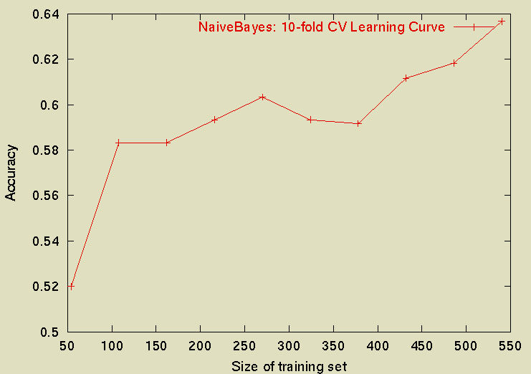
Sample Learning Curve (Yahoo Science Data)

