Slide 1
Lecture 9: Semantic Parsing
Kai-Wei Chang
CS @ UCLA
kw@kwchang.net
Couse webpage: https://uclanlp.github.io/CS269-17/

Slide 2
Paper summary
Individual project, due: Sunday 11/18
1~2 pages: ~1,000 words
Submit your summary at CCLE (pdf format, webpage, etc.)
(optional) provide the link to your summary: https://goo.gl/m2GQ6S
(optional) pull request at https://github.com/uclanlp/CS269-17/tree/master/summary

Slide 3
Computational Semantics
Many high-level applications
Question answering
Information extraction
Internet bots
Siri/Cortana/Alexa/Google Now
Translation
Shallow vs. deep semantics
Cheap, fast, low-level techniques v.s. computational expensive, high-level techniques

Slide 4
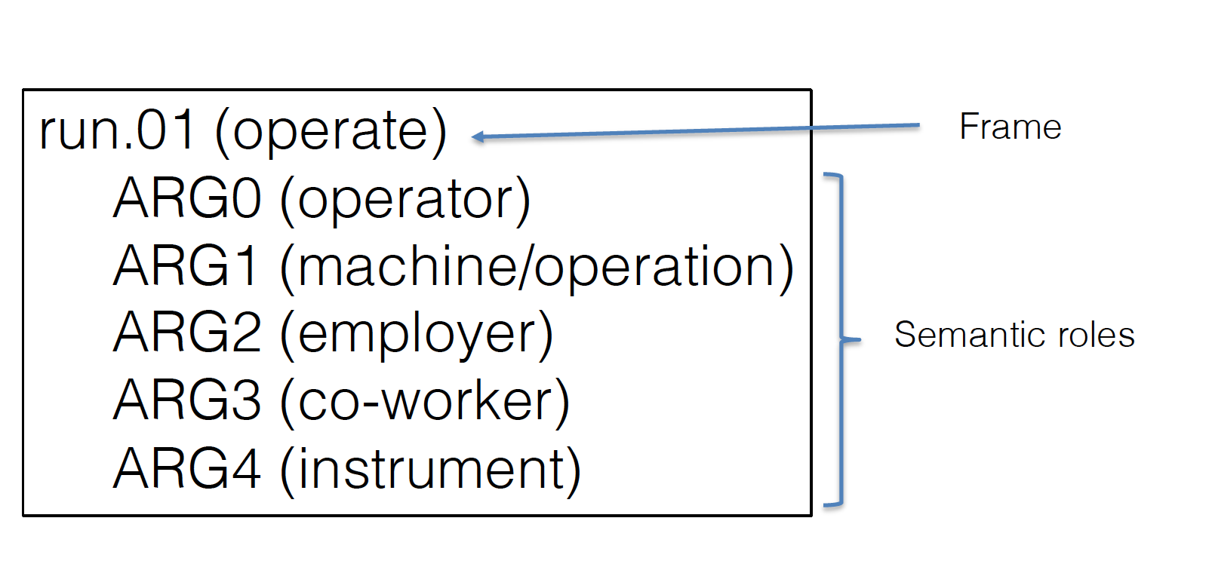
Semantic Roles
Predicates: some words represent events
Arguments: specific roles that involves in the event
PropBank
Several other alternative role lexicons

Slide 5
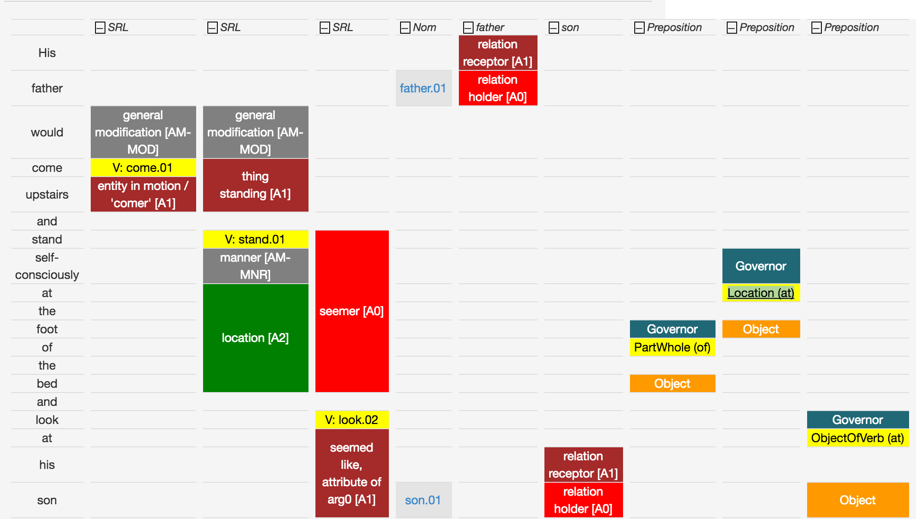
Semantic Roles
http://cogcomp.cs.illinois.edu/page/demo_view/srl
His father would come upstairs and stand self-consciously
At the foot of the bed and look at his son.

Slide 6
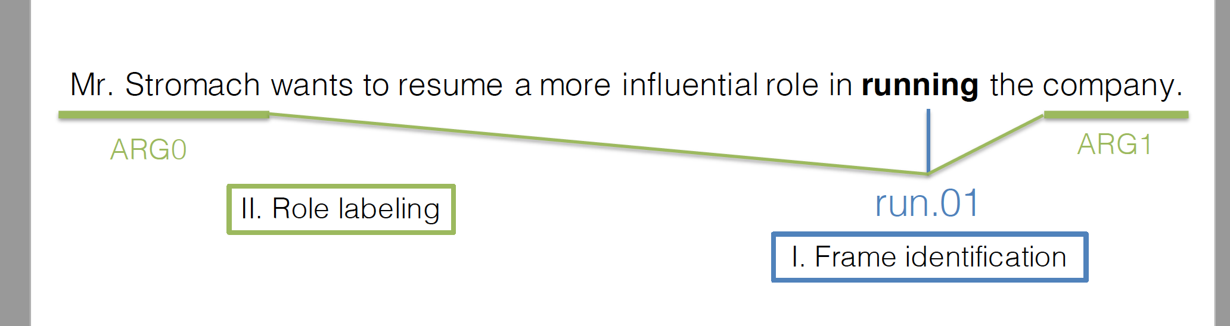
Semantic Role Labelling
Give a sentence, identify predicate frames and annotate semantic roles

Slide 7
Role Identification
We can model it as multi-class classification

Slide 8
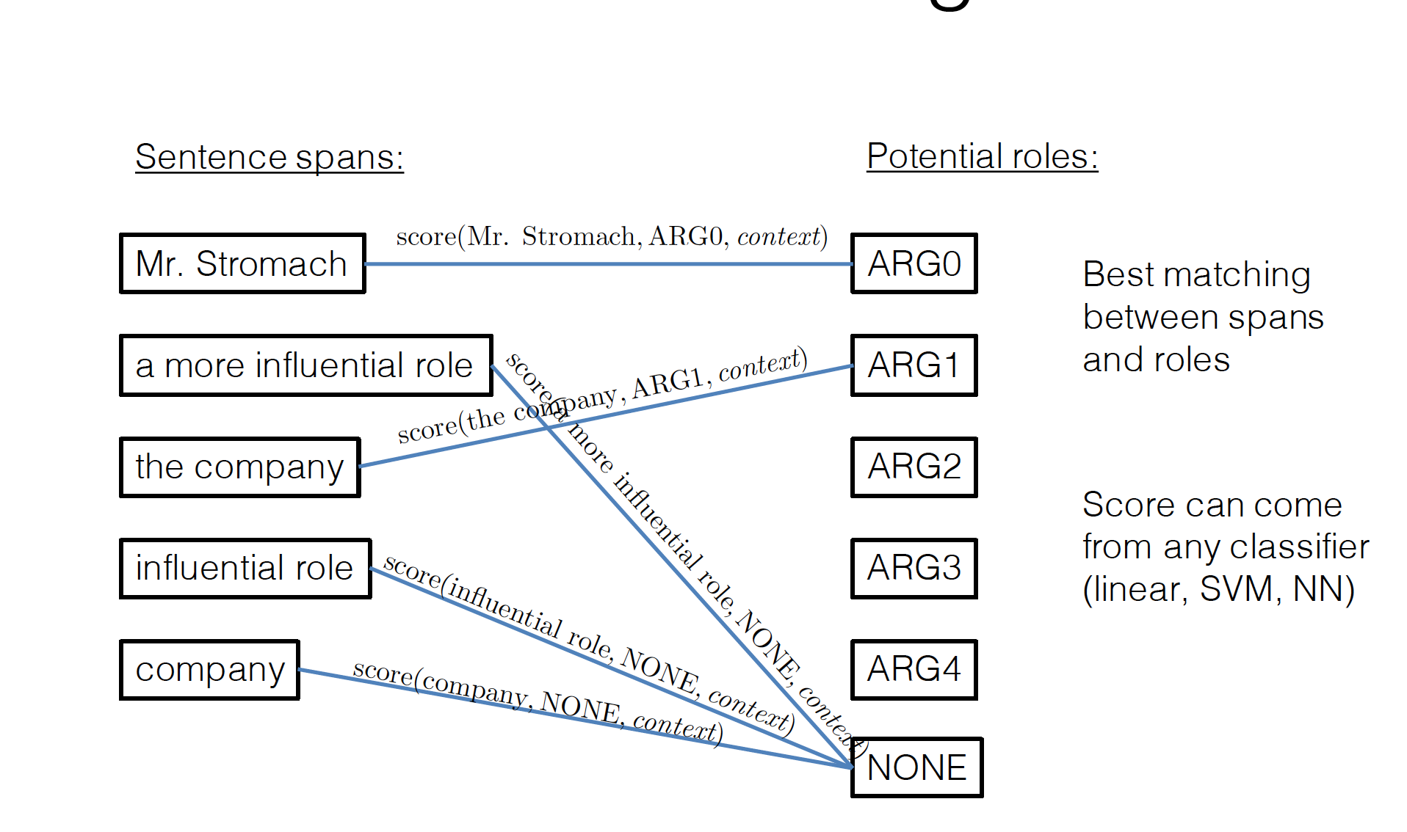
Role labeling
Conduct constrained inference

Slide 9
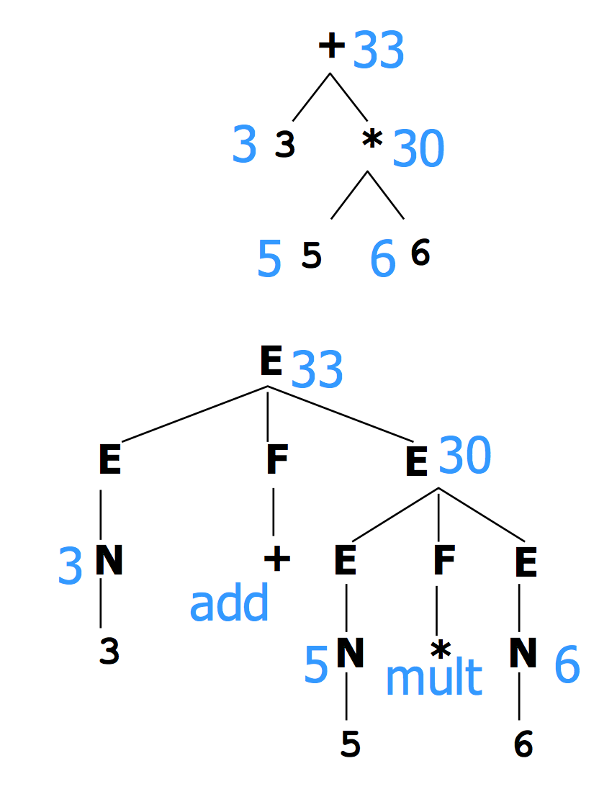
Semantic parsing
Motivation: programming language
What is the meaning of 3+5*6
Examples from Chris Manning’s NLP course

Slide 10
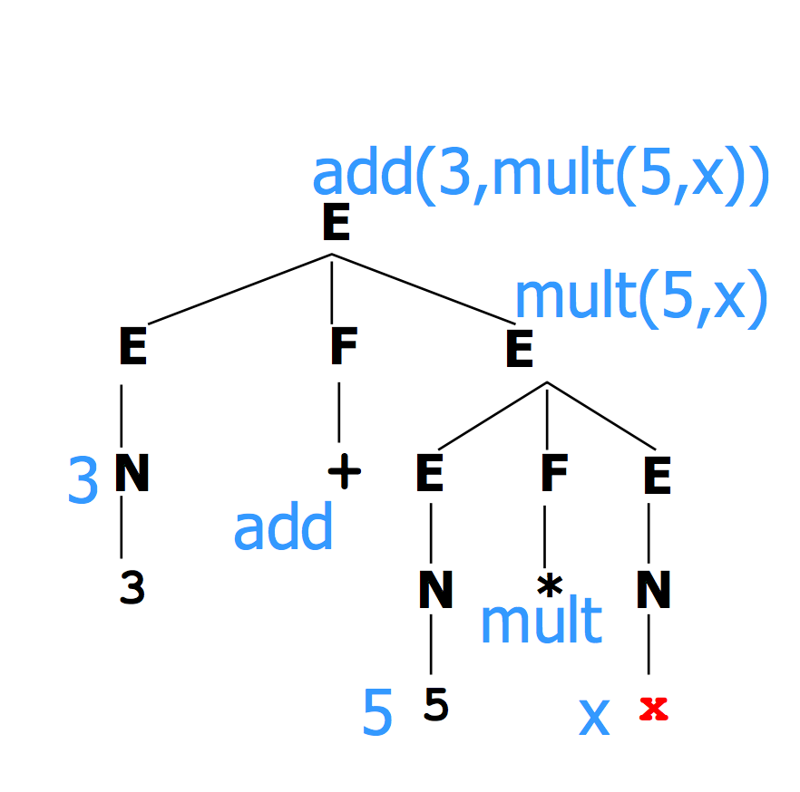
Semantic parsing
More complex meaning
3+5*x: we don’t know x at the compile time
“Meaning” at a node is a piece of code
Form is “rule-to-rule” translation
We provide a way to form the semantics from bottom-up

Slide 11
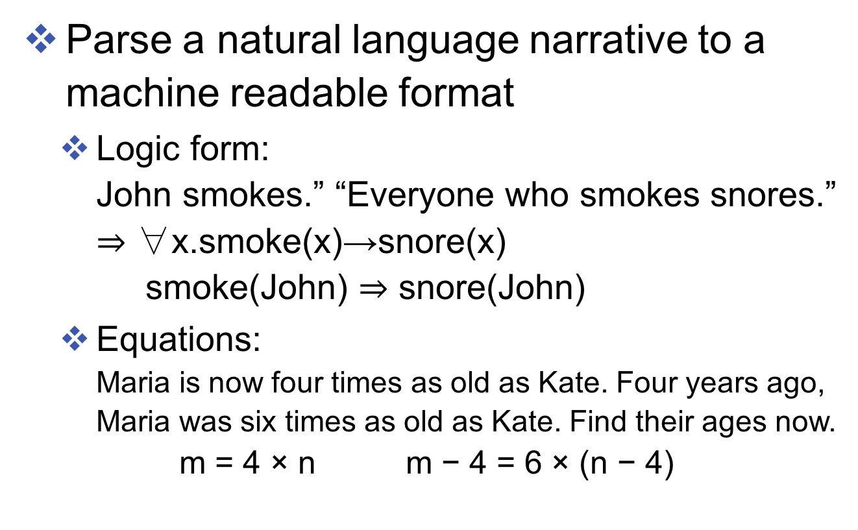
Semantic Parsing
Parse a natural language narrative to a machine readable format
Logic form: John smokes.” “Everyone who smokes snores.” $⇒$ ∀x.smoke(x)→snore(x) smoke(John) $⇒$ snore(John)
Equations: Maria is now four times as old as Kate. Four years ago, Maria was six times as old as Kate. Find their ages now. m = 4 × n m − 4 = 6 × (n − 4)

Slide 12
Logic
Boolean: semantic values of sentences
Entities: e.g., objects, times, etc.
Function of various types A function returning a boolean called “predicate” e.g., green (x) Function can return other functions or take functions as arguments

Slide 13

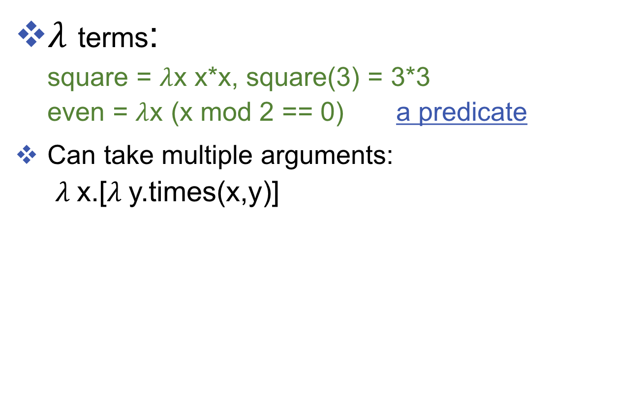
Logic: $λ$ terms
$λ$ terms: square = $λ$x x*x, square(3) = 3*3 even = $λ$x (x mod 2 == 0) a predicate
Can take multiple arguments: $λ$x.[$λ$y.times(x,y)]

Slide 14
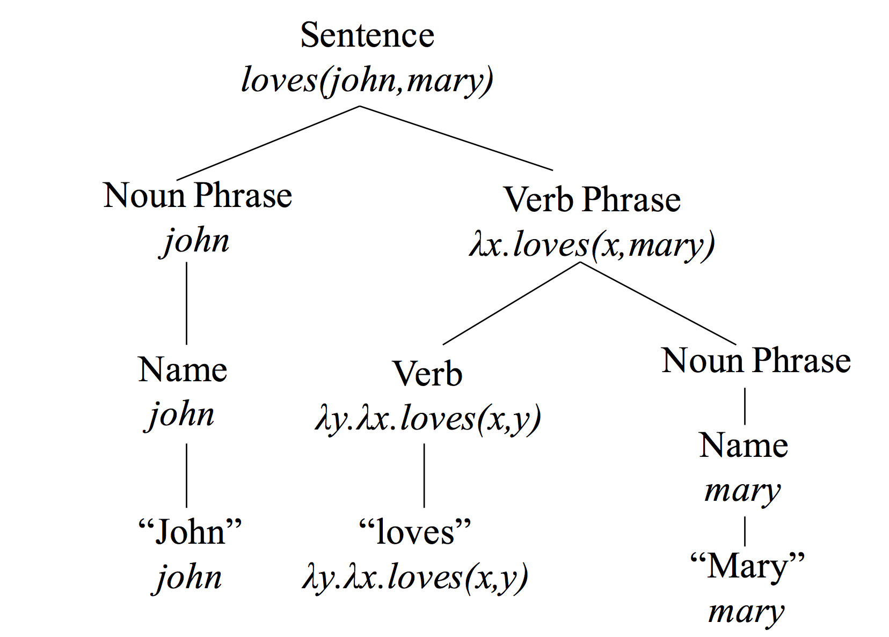
Parse tree with associated semantics

Slide 15
