Slide 1
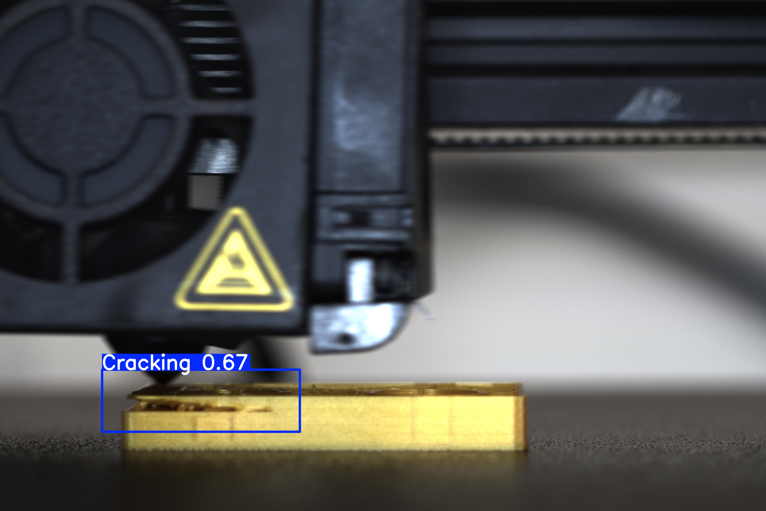
Original YOLOv8n baseline
Five FDM defect classes with official COCO initialization
Frozen dataset
1371 train / 171 validation / 171 test
Revised JSON annotations
48 conflicting or related images excluded
100 epochs, 640-pixel inputs, SGD
Batch 16, AMP, seed 42, workers 0
Saved validation prediction, confidence threshold 0.25
Completed 100 epochs in 31.6 minutes on RTX 3080 Laptop GPU
Notes:
Member 04, Tianyao Zhang. Data and settings sources: D:\Desktop\7215\project\baseline\runs\yolov8n_newjson_from_official_20261105_213549/protocol.json and D:/Desktop/7215/project/reports/new_json_20261105/current_data_audit.json. Every original JSON is preserved. The frozen test set is withheld. This image is a real dataset photograph, not a generated illustration. Framework sources: https://github.com/ultralytics/ultralytics/tree/v8.2.103 and https://docs.ultralytics.com/models/yolov8/. The original YOLOv8n architecture is unchanged except for its class output. Training wrappers, JSON conversion, audit and delivery used AI assistance. About 40 seconds: describe the revised JSON, fixed split and exact baseline configuration.

Slide 2
Independent reload validation
Precision 93.22% Recall 94.05%
mAP50 95.47% mAP50–95 60.03%
171 validation images. Off platform has 9 validation objects.
Test remains withheld. Verified print-process IDs are still unavailable.
Notes:
Source: D:\Desktop\7215\project\baseline\runs\yolov8n_newjson_from_official_20261105_213549/independent_validation/validation_metrics.json. The final slide uses a saved best.pt reloaded from disk on 171 validation images. Validation also selected the best checkpoint, so the numbers are not untouched test performance. P/R use the Ultralytics F1-curve operating point, while AP integrates confidence. Default AP collection conf=0.001, NMS IoU=0.7, imgsz=640, batch=16, device=0, FP32 validation. Per-class chart data use validation_metrics.json, rounded to eight decimal places for Excel workbook compatibility, and remain editable. The original JSON retains full precision. Off_platform has nine validation objects. Filename family grouping is inferred, and adjacent real-process frames can remain dependent. About 45 seconds: state the measured metrics, discuss the sparse class and withhold claims of independent-print generalization or unified FPS.

