Slide 1
Convolutional Neural Network
SC-yjtian
2019.09.10

Slide 2
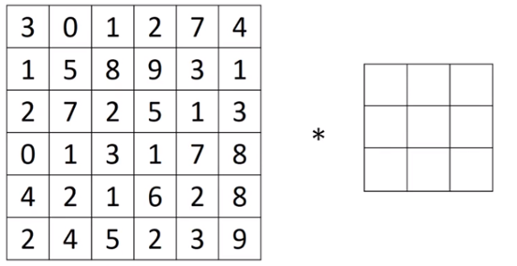
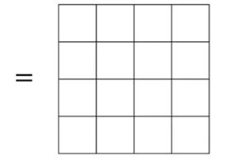
Convolution
n x n image
f x f filter
n-f+1 x n-f+1

Slide 3

Padding
Valid: no padding
n-f+1
Same: output size = input size
n+2p-f+1 = n
$$p= \frac{f-1}{2}$$

Slide 4
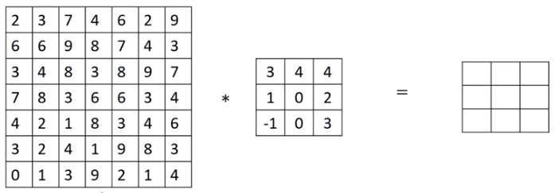

Stride

Slide 5
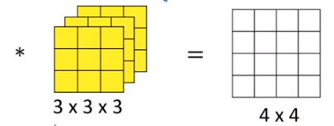
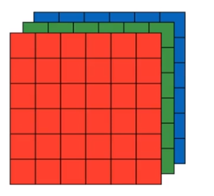
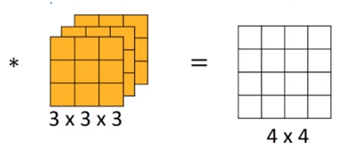
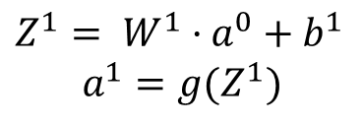
Conv layer
$Z^{1}= W^{1}·$ $a^{0}+b^{1}$
$$a^{1}=g(Z^{1})$$

Slide 6
Test
One conv layer:
5x5x3 input size, 10 filters that are 3x3x3, padding 1, stride 2
how many parameters? output size?

Slide 7
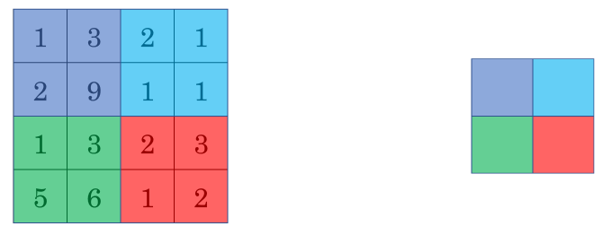
Pooling layer
Max Pooling
9
2
f = 2
s = 2
p = 0
6
3
Average Pooling

Slide 8
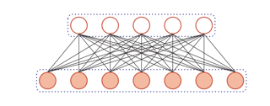
Fully Connected layer

Slide 9



CNN Example
Conv 1
Pool 1
Conv 2
f=5
s=1
nf= 6
f=5
s=1
nf= 16
Max pooling
f=2
s=2
32x32x3
28x28x6
14x14x6
10x10x16
Pool 2
FC 3
FC 4
400x120
120x84
Softmax
10 output
Max pooling
f=2
s=2
5x5x16
120
84

Slide 10

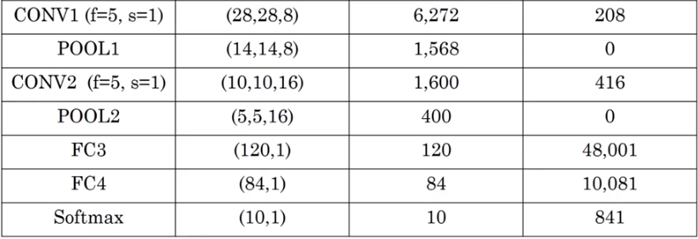
CNN Example

Slide 11
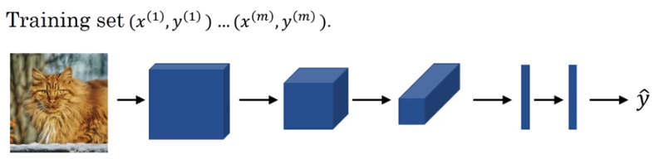

CNN Train

Slide 12
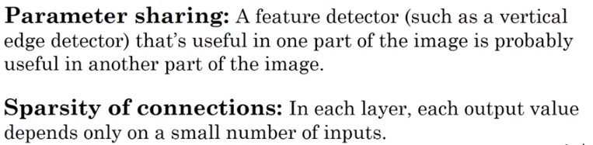
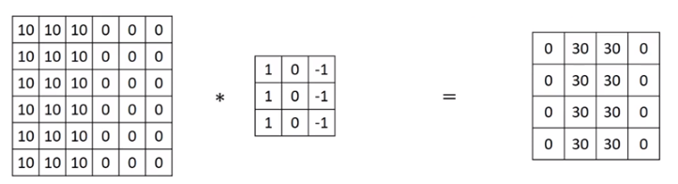
CNN

Slide 13
Exercise
Code: https://github.com/Tianyijian/nndl-exercise

Slide 14
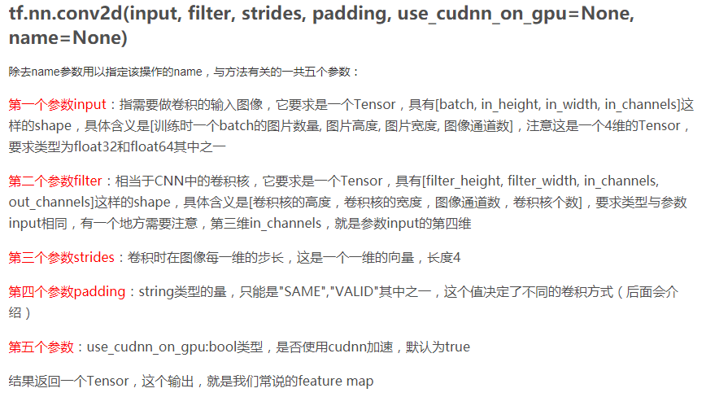
tf.nn.conv2d

Slide 15
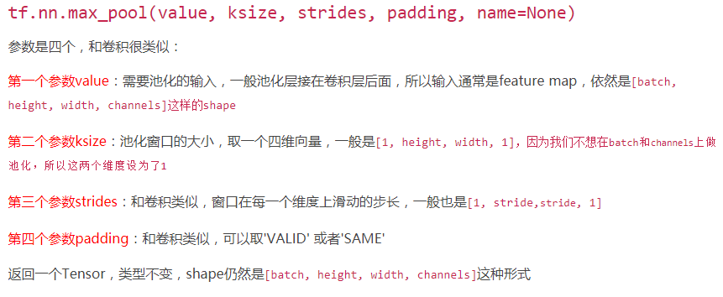
tf.nn.max_pool

Slide 16
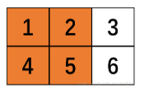

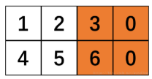

Padding
X: 2x3 filter: 2x2 S: 2
Valid: no padding, remove
Same: padding, add
Ref: https://blog.csdn.net/wuzqChom/article/details/74785643

Slide 17
tutorial
[Tensorflow 官方中文教程-MNIST 进阶]
http://www.tensorfly.cn/tfdoc/tutorials/mnist_pros.html
[Tensorflow 搭建自己的神经网络 (莫烦 Python 教程)]
https://www.bilibili.com/video/av16001891/?p=28

Slide 18
Thank You

