Slide 1
Group Work vol.1
Tianyu Dai, xiaoqing li
xuejian ma, Yuheng liao

Slide 2
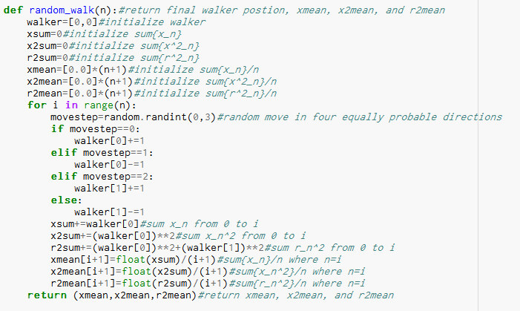

Slide 3
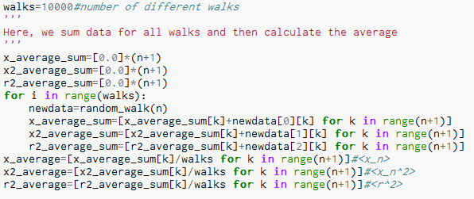

${10}^{4}$ different walks

Slide 4
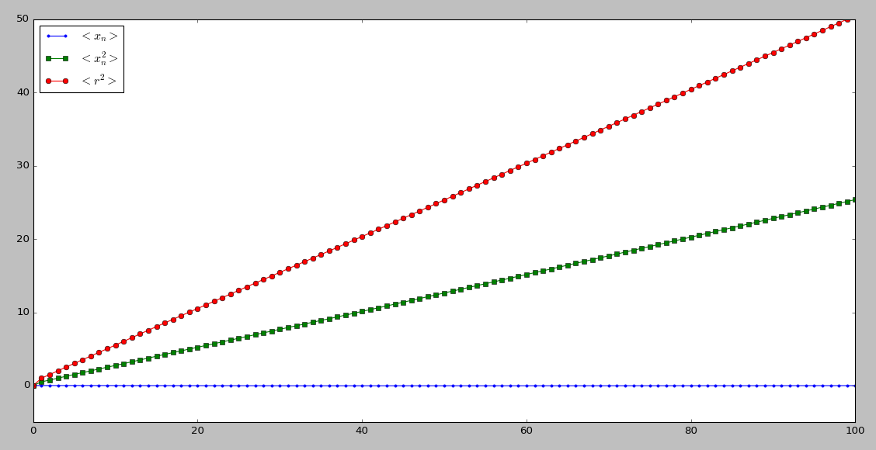

Slide 5
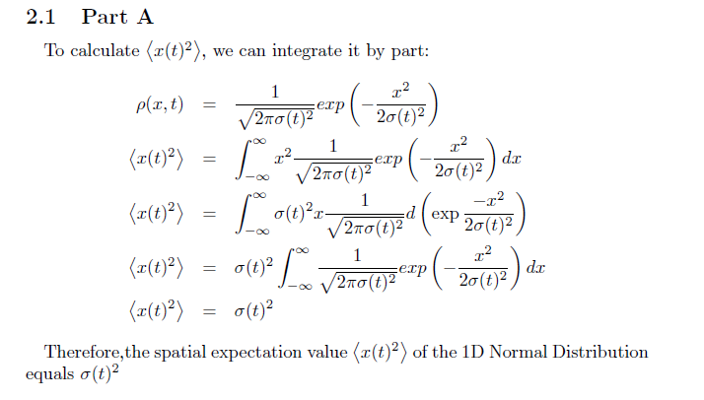
Gaussian distribution

Slide 6
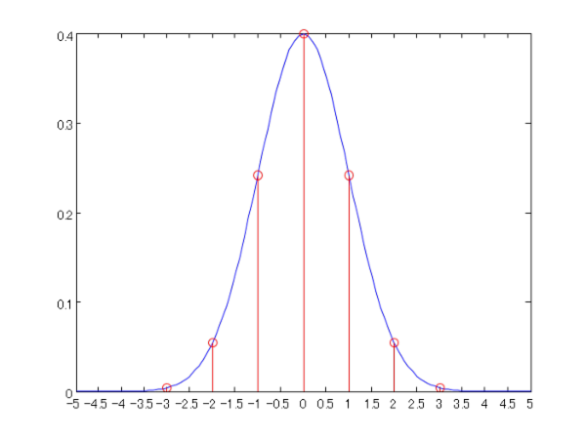

Gaussian distribution

Slide 7
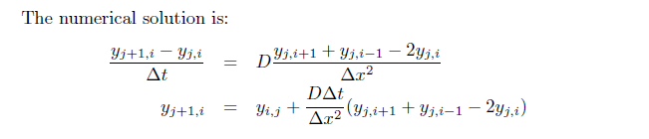
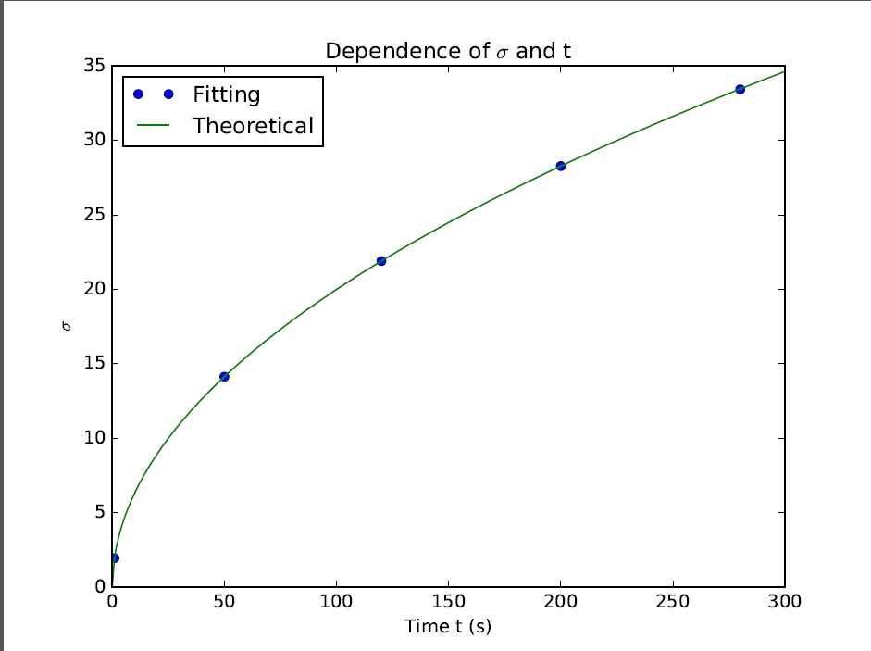
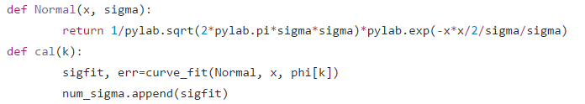
Fitting
Fitting function:
Core code:

Slide 10
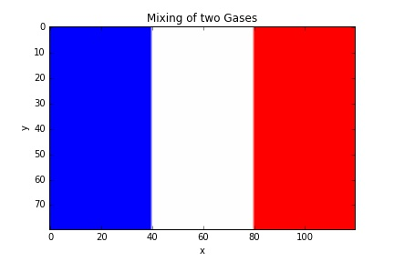
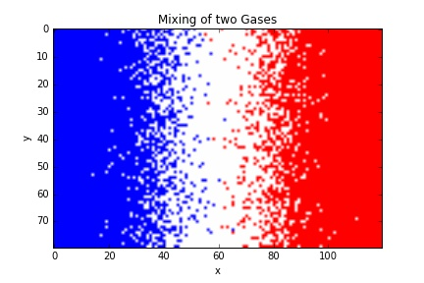
Mixing of Two gases
Set up a matrix, sites, with dimensions [80, 120]
Let the elements in its left 40 columns be -1 which means these sites are occupied by A-particles, and the elements in the right 40 columns be 1 which are occupied by B-particles.
Use another matrix, mol, to record every particle’s coordinate.
Pick a particle randomly, and extract its coordinate (x, y), then move it randomly

Slide 11
Mixing of Two gases
Check Boundary Condition
Check whether the neighboring site is empty,
sites[y+1, x]=0
If yes, move the molecule and update its coordinates.
sites[y+1, x]=sites[y, x], sites[y, x]=0
Add 1 to its y-coordinate
If no, reject this move and pick another molecule
Count the total number of -1 on each column of the grid, then divide it by the length of the width of the grid
Count the total number of 1 on each column of the grid, then divide it by the length of the width of the grid

Slide 12
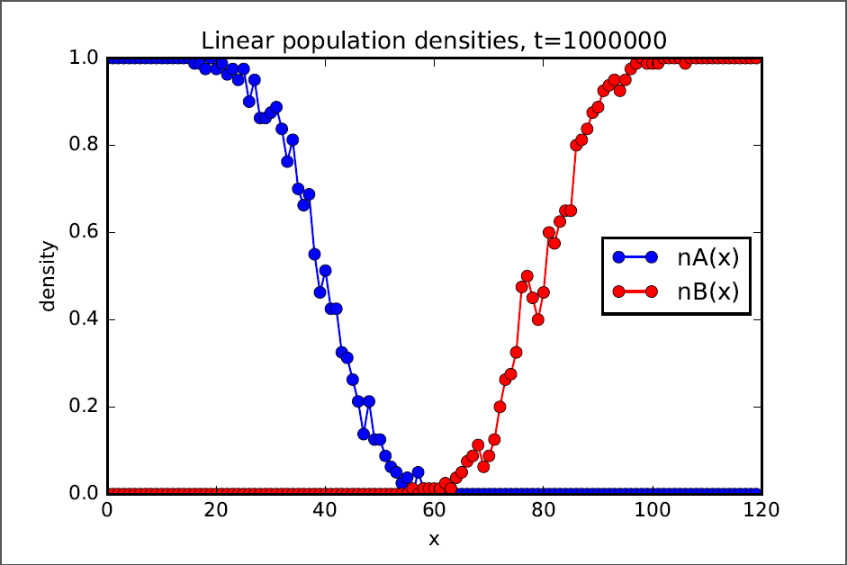
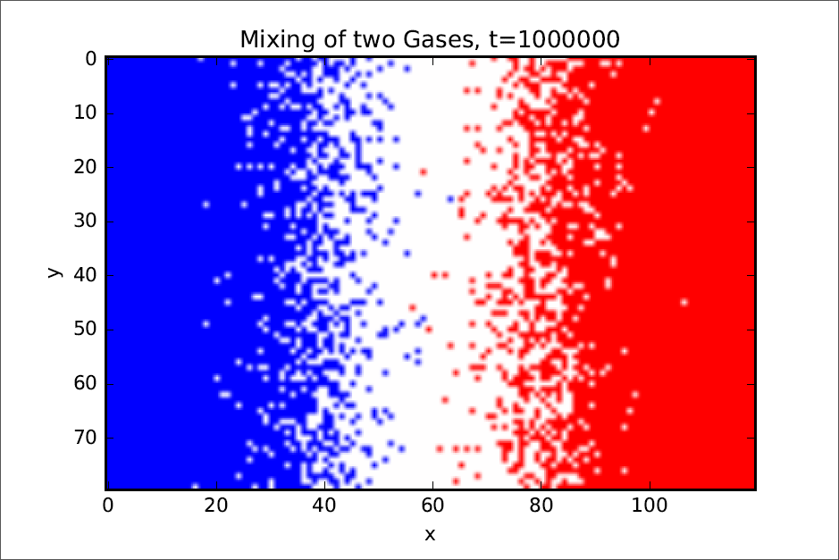
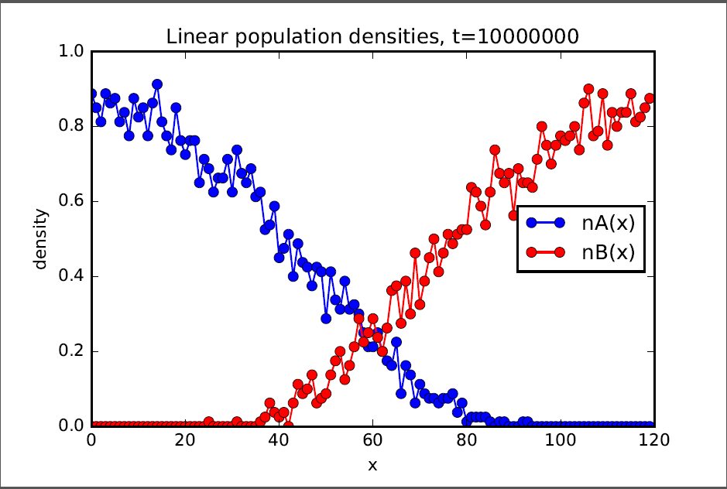
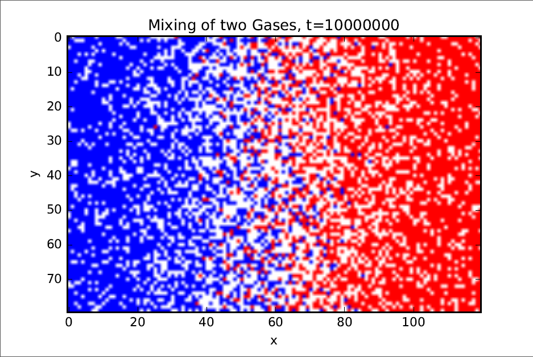

Slide 13
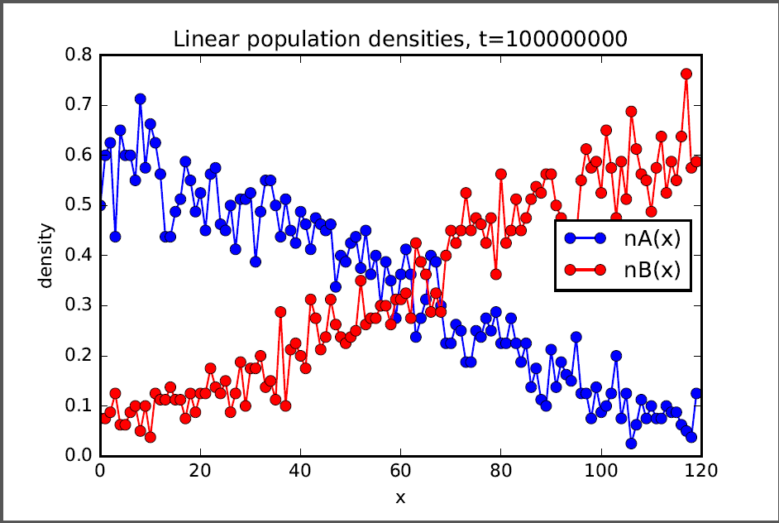
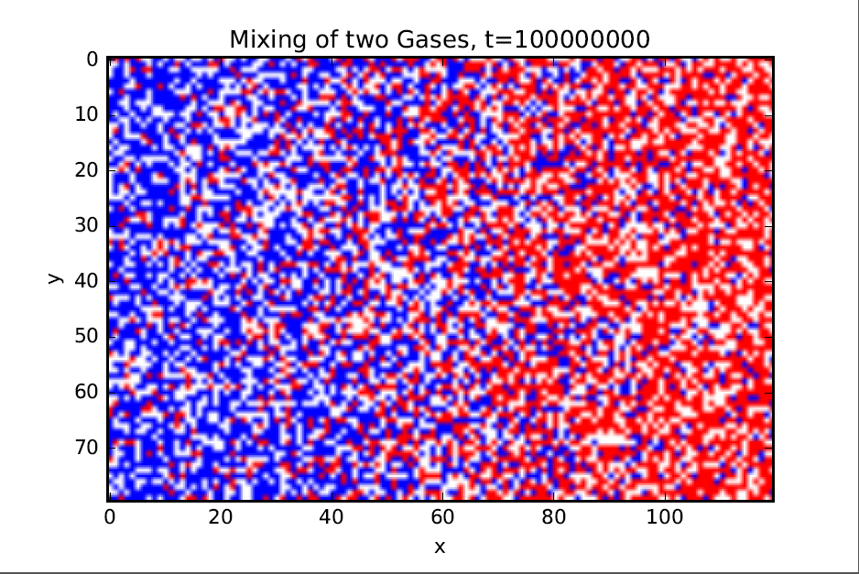
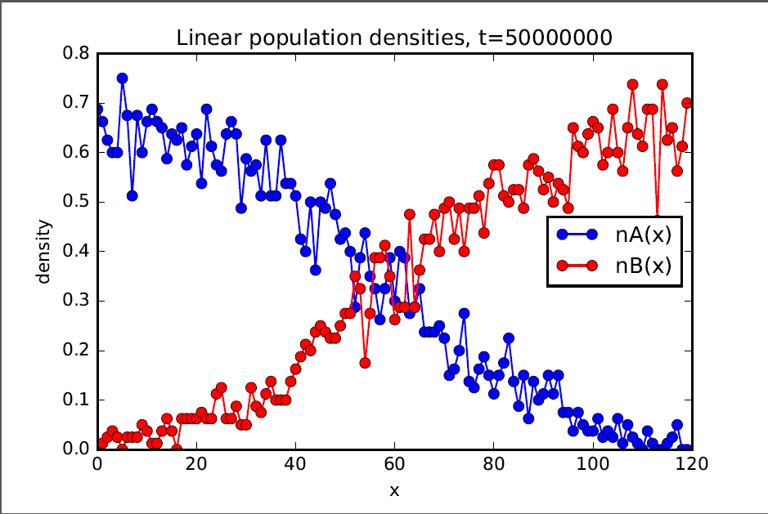
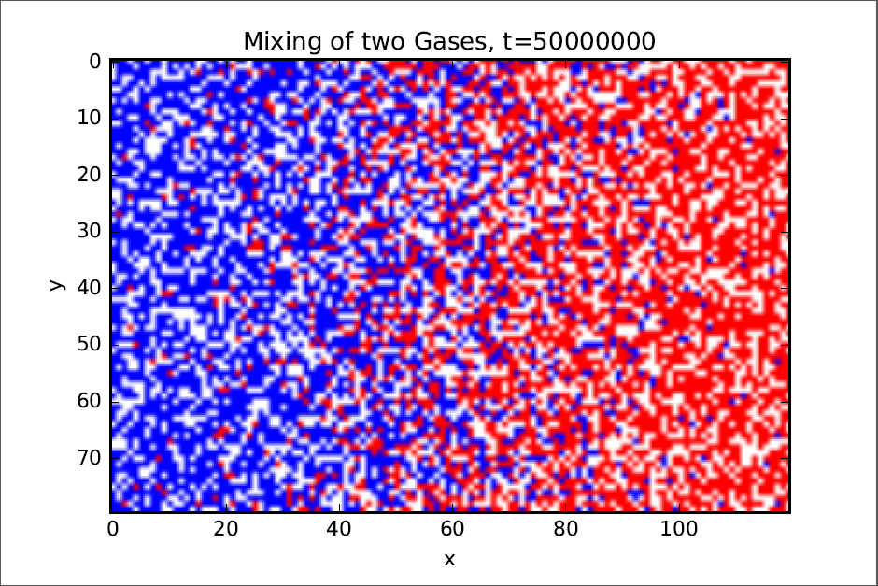

Slide 14
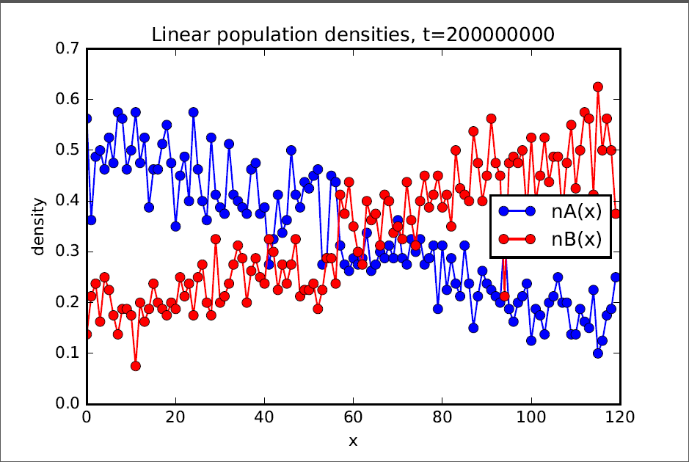
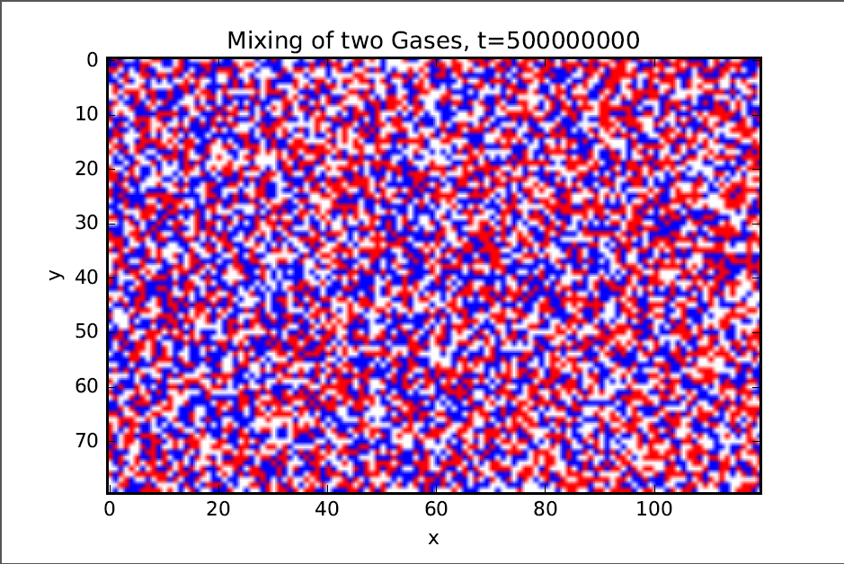
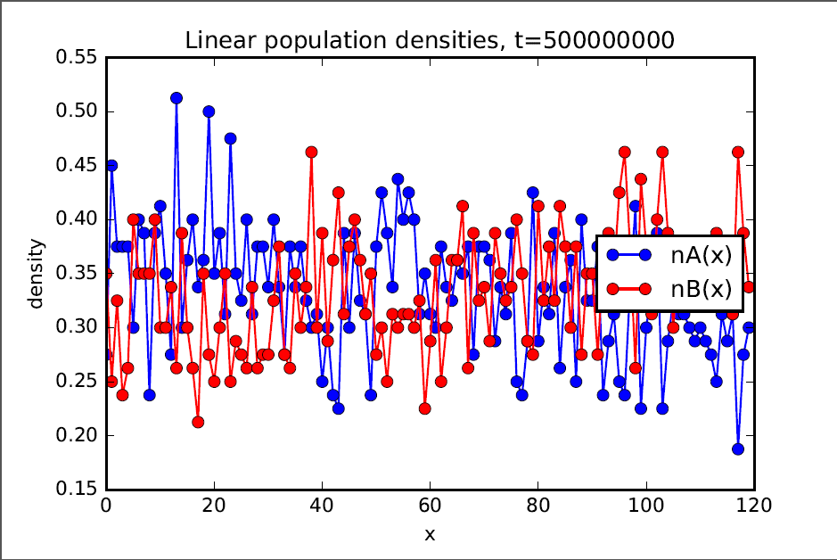
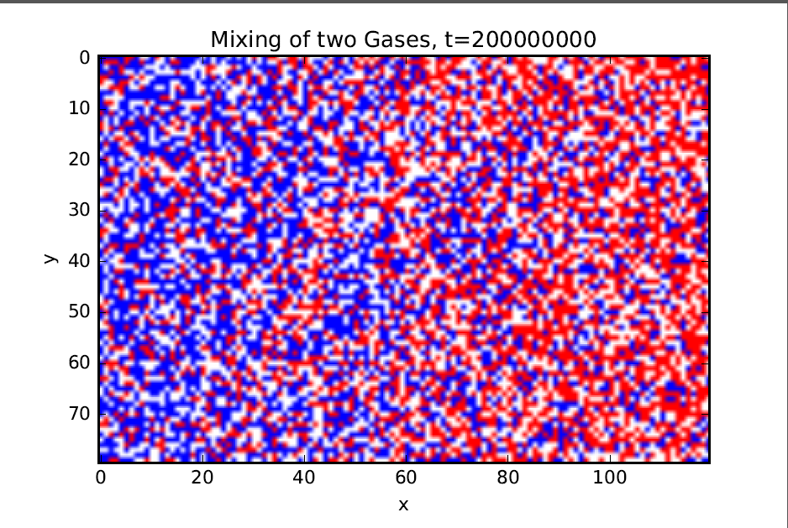

Slide 15
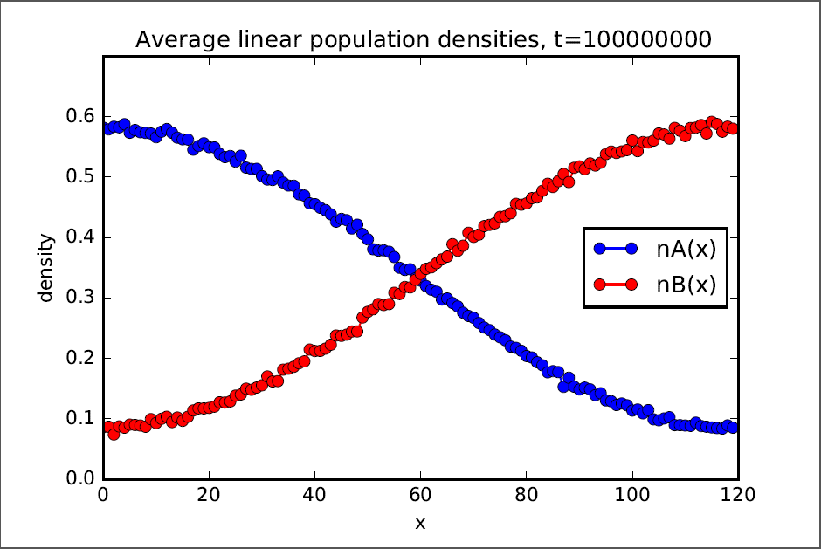

Slide 16
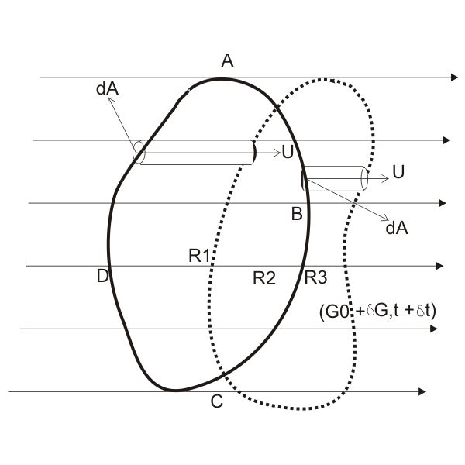
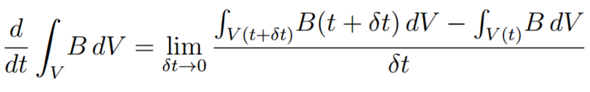
Reynolds Transport Theorem

Slide 17
Thank you!

