Slide 1
Group Work vol.1
Tianyu Dai, xiaoqing li
xuejian ma, Yuheng liao

Slide 2
2D Random Walk
walker=[0,0]
movestep=random.randint(0,3)
walker[1]+=1
movestep=2
walker[0]-=1
walker[0]+=1
movestep=1
movestep=0
movestep=3
walker[1]-=1

Slide 3
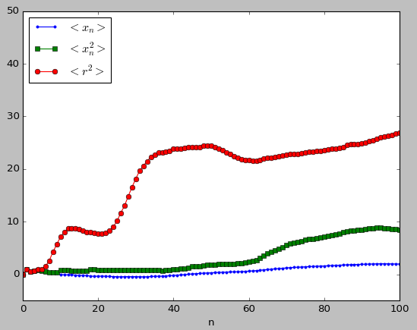
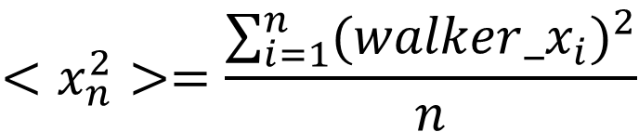
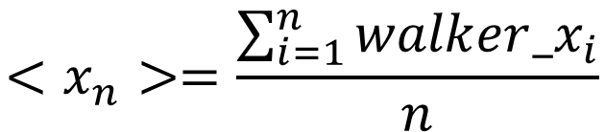
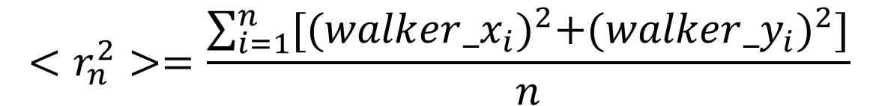
$$<x_{n}>=\frac{\sum_{i=1}^{n}{{walker_x}_{i}}}{n}$$
$$<x_{n}^{2}>=\frac{\sum_{i=1}^{n}{{{(walker_x}_{i})}^{2}}}{n}$$
$$<r_{n}^{2}>=\frac{\sum_{i=1}^{n}{{[{(walker_x}_{i})}^{2}+{{(walker_y}_{i})}^{2}]}}{n}$$

Slide 4
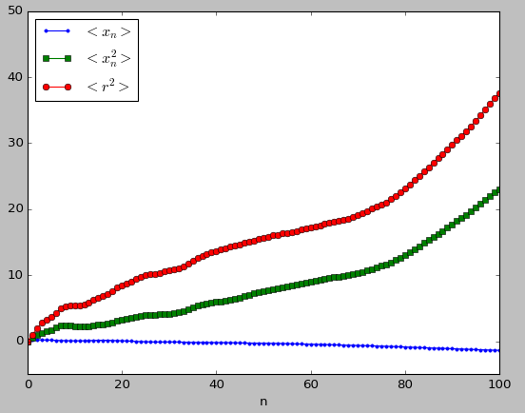
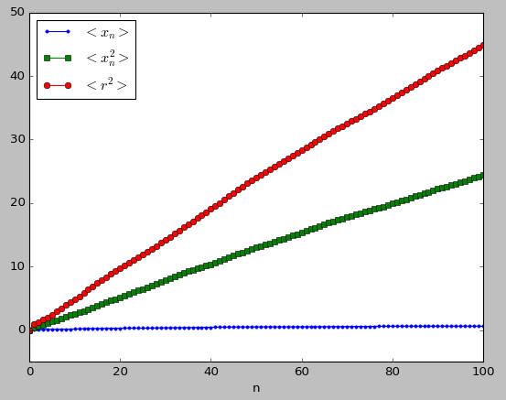
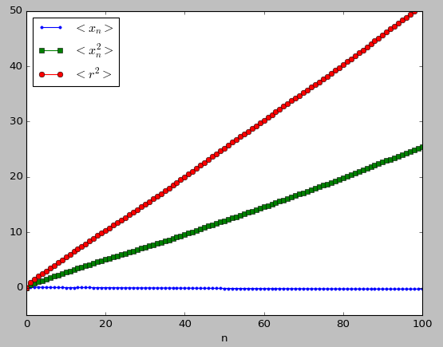
1 walk
10 walks
100 walks
1000 walks

Slide 5
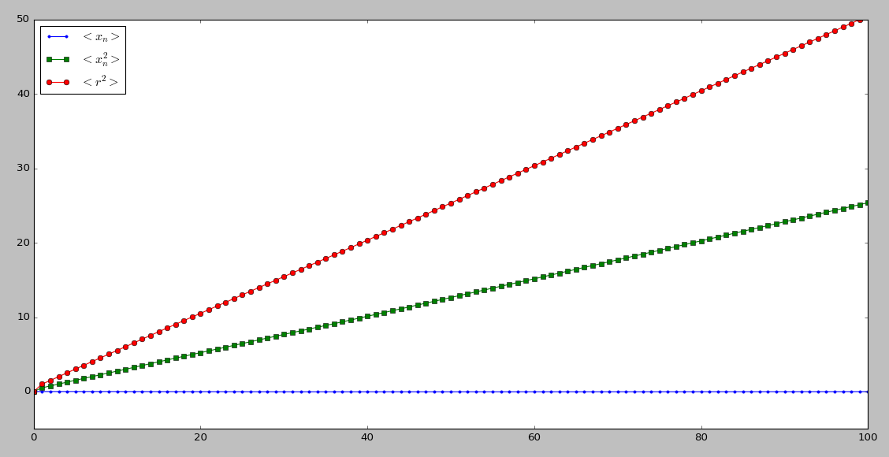






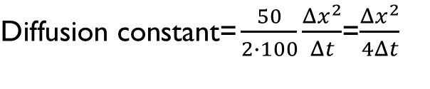
$$<r^{2}> ∝n$$
$$n∝t$$
$$<r^{2}> ∝t$$
$$<r_{n}^{2}>$$
$\text{D}\text{iffusion} \text{constant}\text{=}\frac{50}{2∙100}\frac{Δx^{2}}{Δt}$=$\frac{Δx^{2}}{4Δt}$
$$<x_{n}^{2}>$$
$$<x_{n}>$$
10000 walks

Slide 6
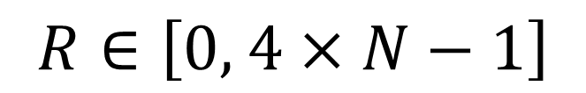
Modification
Generate only one random number in each step
$$R∈\left[0, 4×N−1\right]$$
Direction: int (R/N) Chosen molecule: R mod N

Slide 7
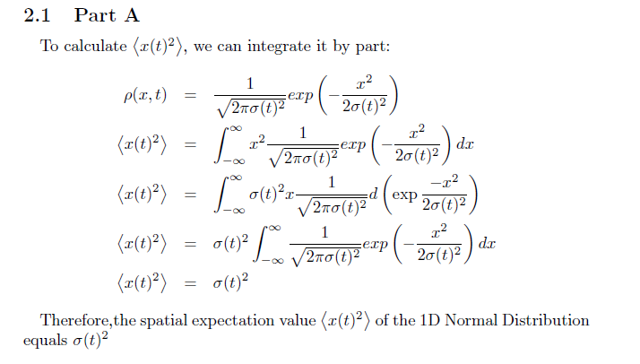
Gaussian distribution

Slide 8
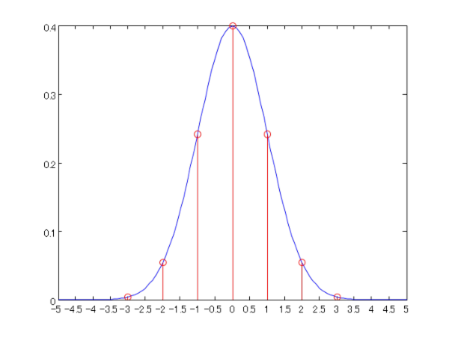

Gaussian distribution

Slide 9
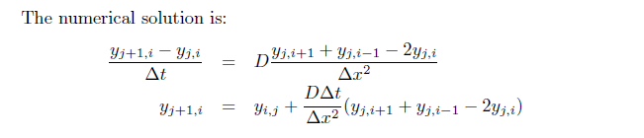
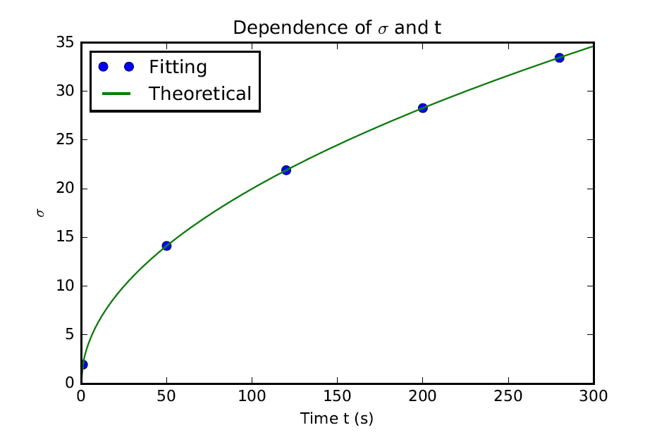
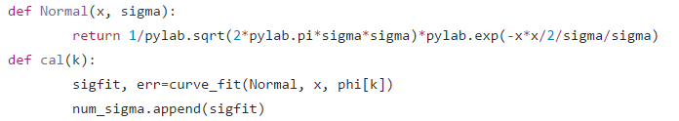
Fitting
Fitting function:
Core code:

Slide 10
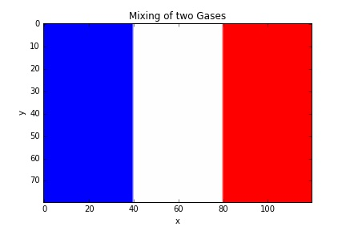
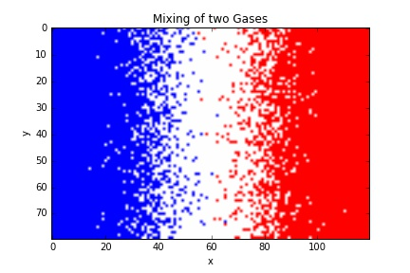
Mixing of Two gases
Set up a matrix, sites, with dimensions [80, 120]
Let the elements in its left 40 columns be -1 which means these sites are occupied by A-particles, and the elements in the right 40 columns be 1 which are occupied by B-particles.
Use another matrix, mol, to record every particle’s coordinate.
Pick a particle randomly, and extract its coordinate (x, y), then move it randomly

Slide 11
Mixing of Two gases
Check Boundary Condition
Check whether the neighboring site is empty,
sites[y+1, x]=0
If yes, move the molecule and update its coordinates.
sites[y+1, x]=sites[y, x], sites[y, x]=0
Add 1 to its y-coordinate
If no, reject this move and pick another molecule
Count the total number of -1 on each column of the grid, then divide it by the length of the width of the grid
Count the total number of 1 on each column of the grid, then divide it by the length of the width of the grid

Slide 12
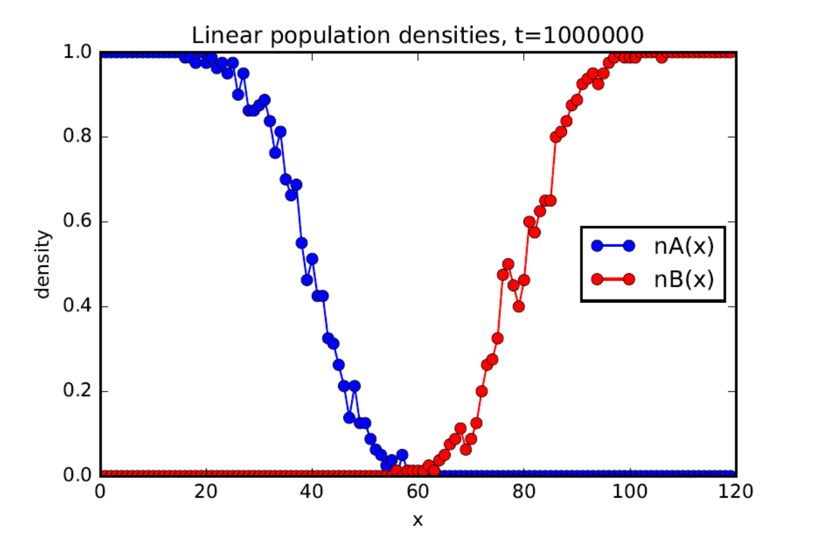
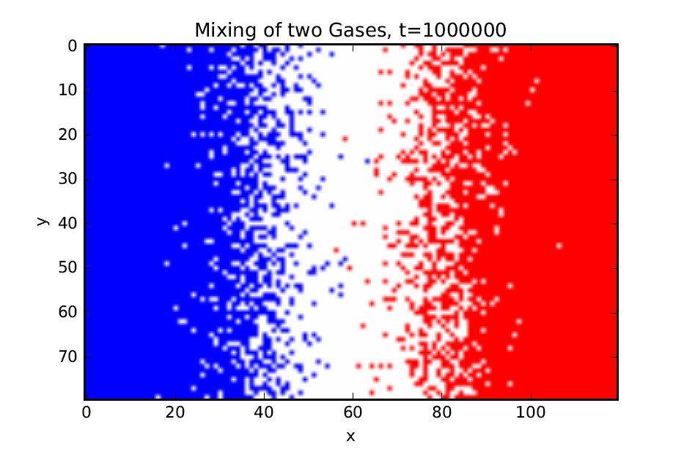
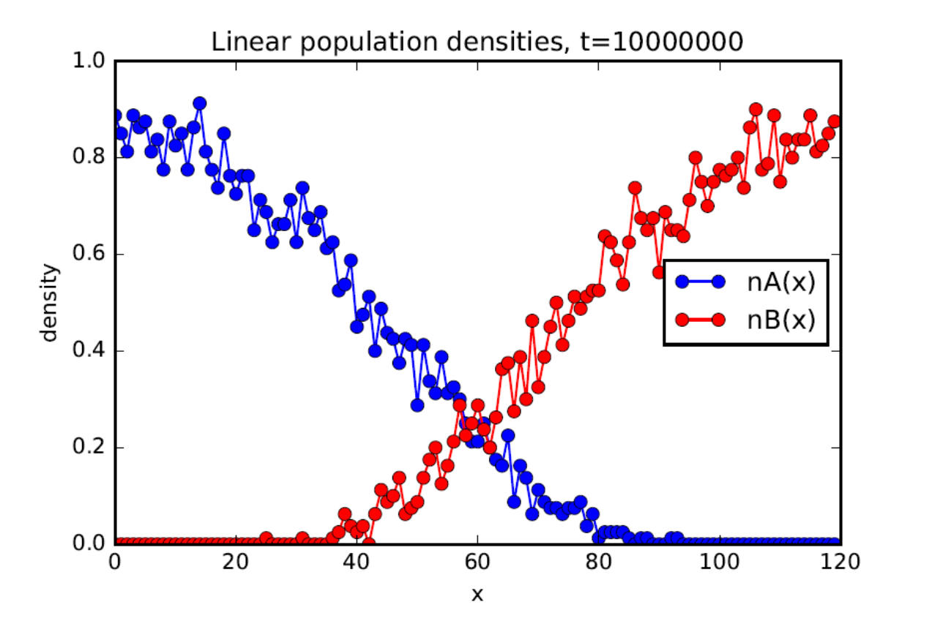
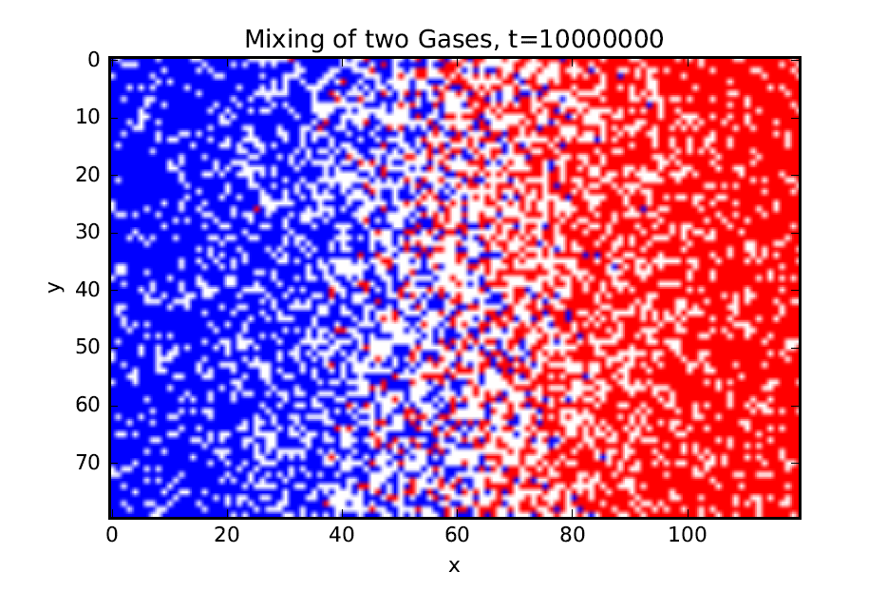

Slide 13
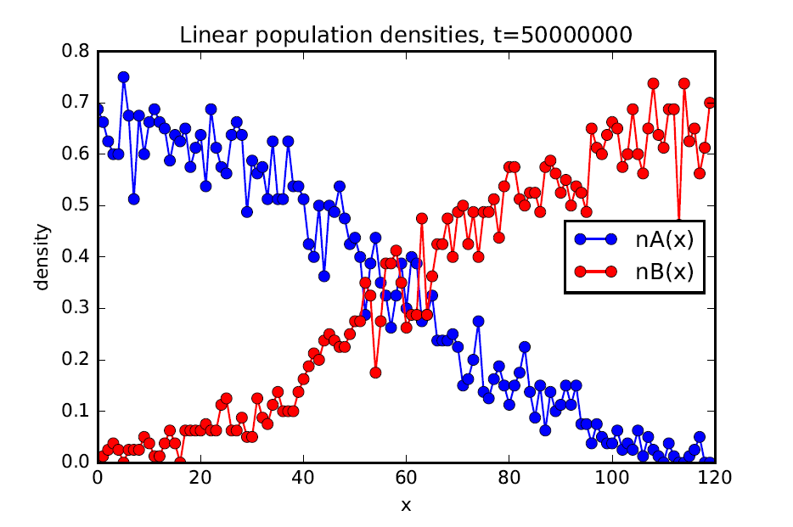
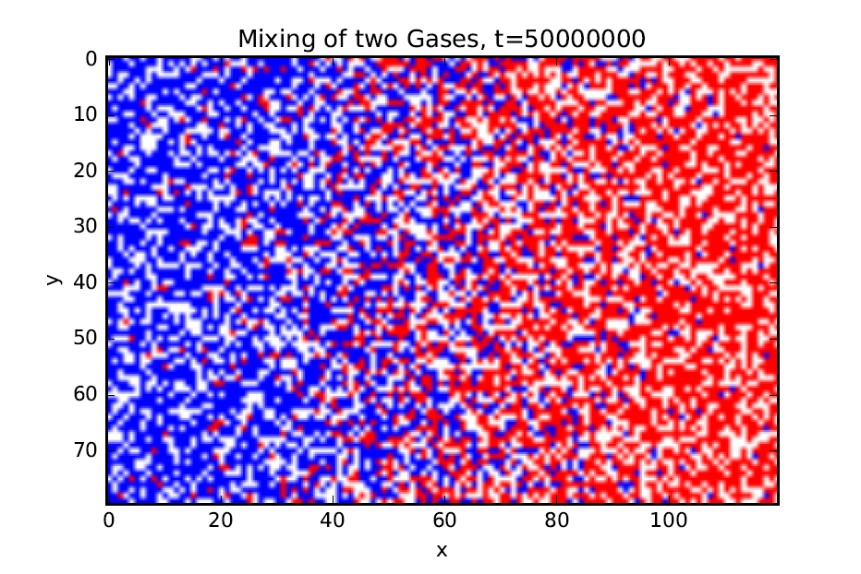
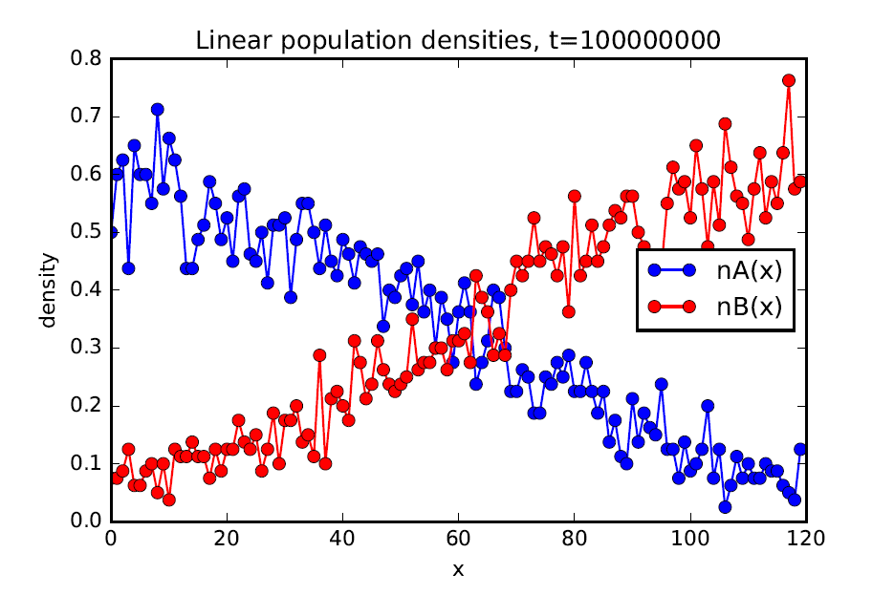
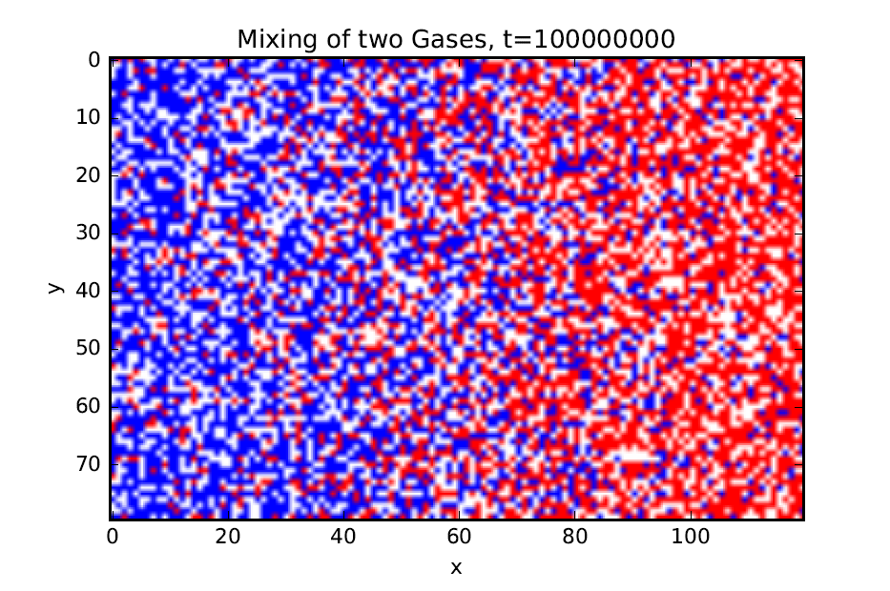

Slide 14
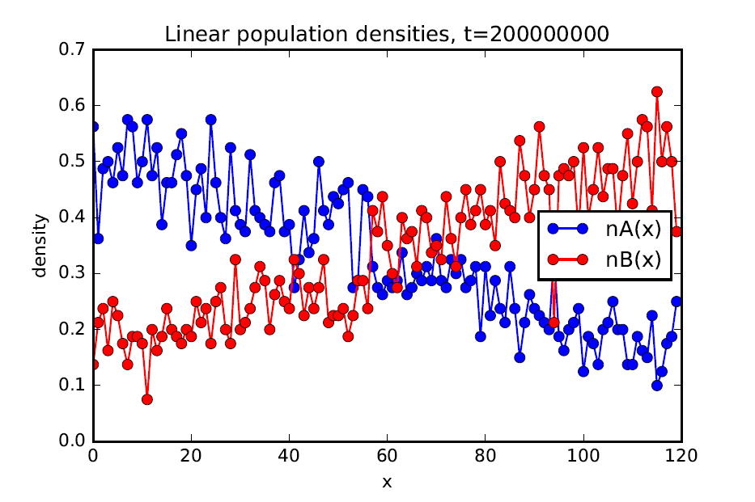
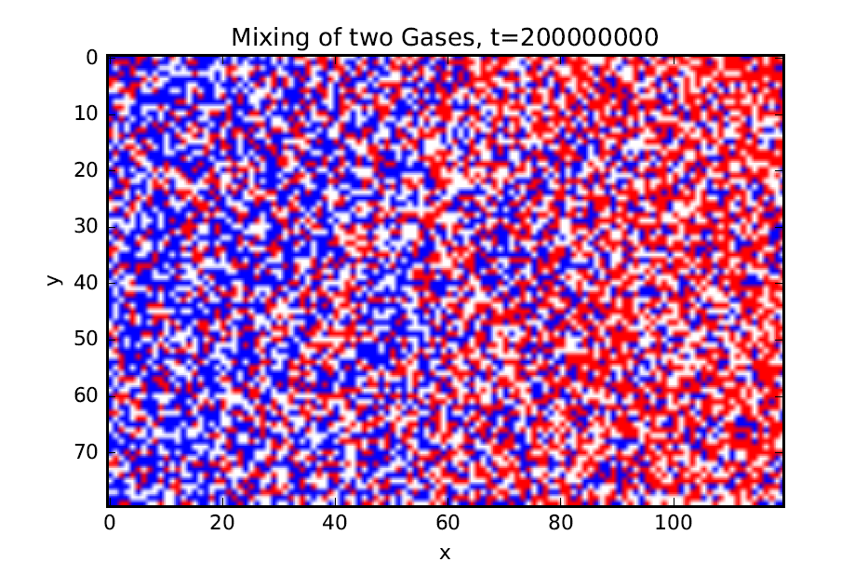
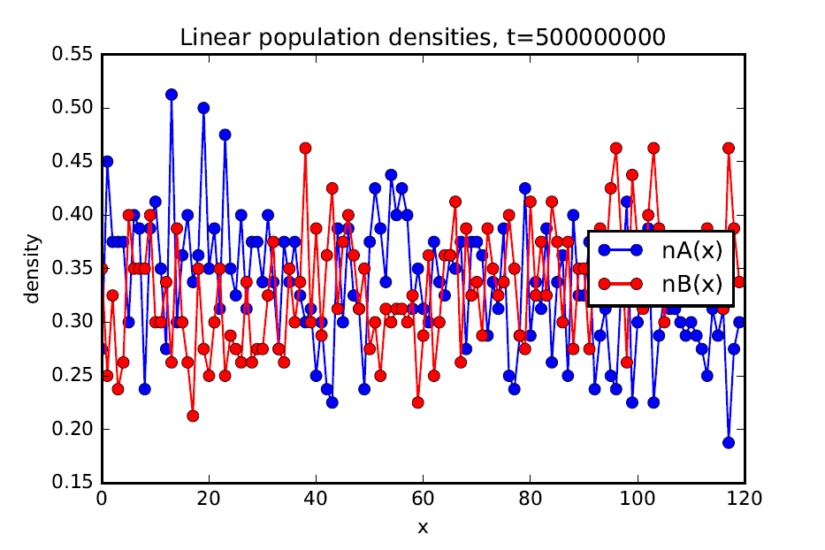
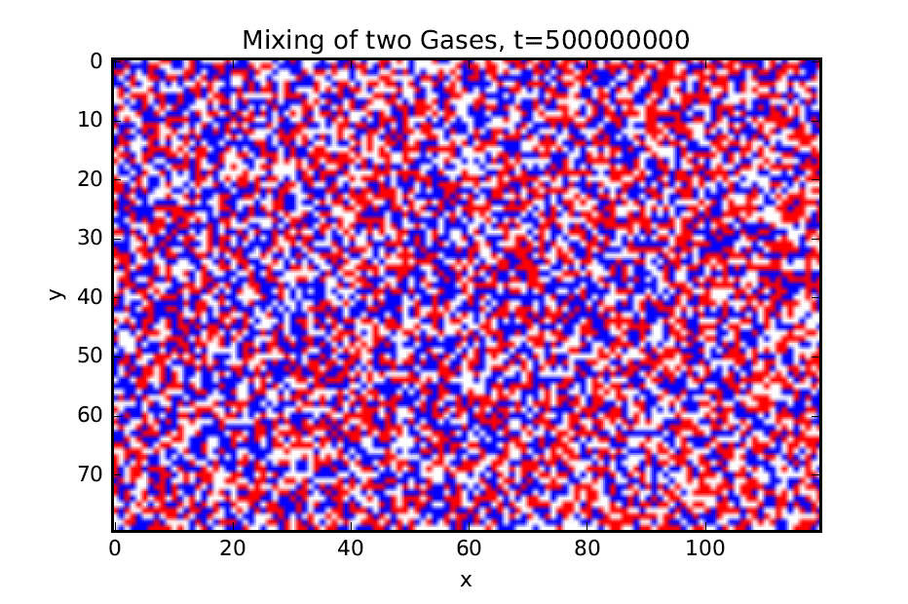

Slide 15
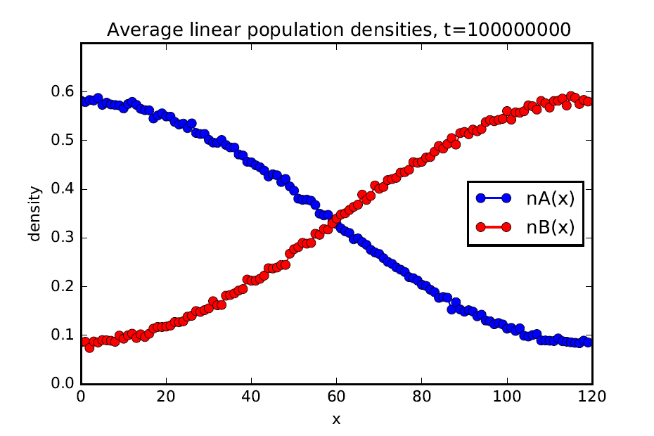
100 - Times Averaged
One - Time

Slide 16
Thank you!

