Slide 1
Group Work vol.1
Tianyu Dai, xiaoqing li
xuejian ma, Yuheng liao

Slide 2
2D Random Walk
walker=[0,0]
movestep=random.randint(0,3)
walker[1]+=1
movestep=2
walker[0]-=1
walker[0]+=1
movestep=1
movestep=0
movestep=3
walker[1]-=1

Slide 3
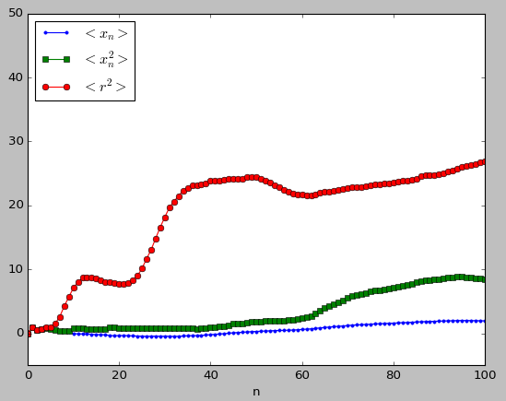
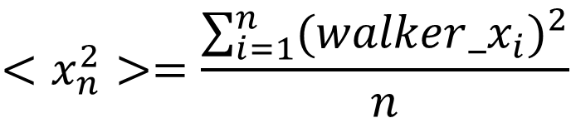
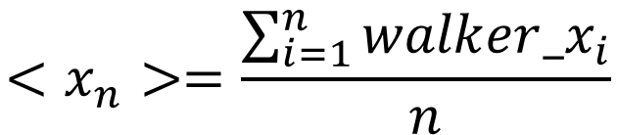
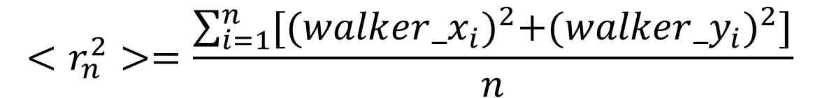
$$<x_{n}>=\frac{\sum_{i=1}^{n}{{walker_x}_{i}}}{n}$$
$$<x_{n}^{2}>=\frac{\sum_{i=1}^{n}{{{(walker_x}_{i})}^{2}}}{n}$$
$$<r_{n}^{2}>=\frac{\sum_{i=1}^{n}{{[{(walker_x}_{i})}^{2}+{{(walker_y}_{i})}^{2}]}}{n}$$

Slide 4
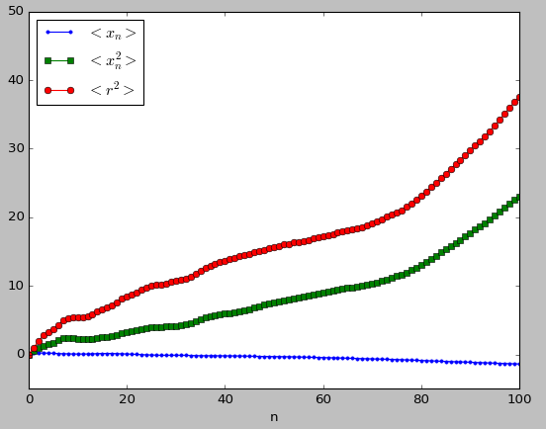
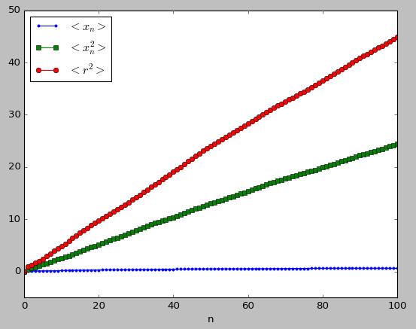
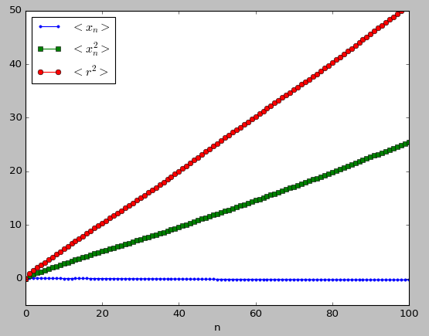
1 walk
10 walks
100 walks
1000 walks

Slide 5
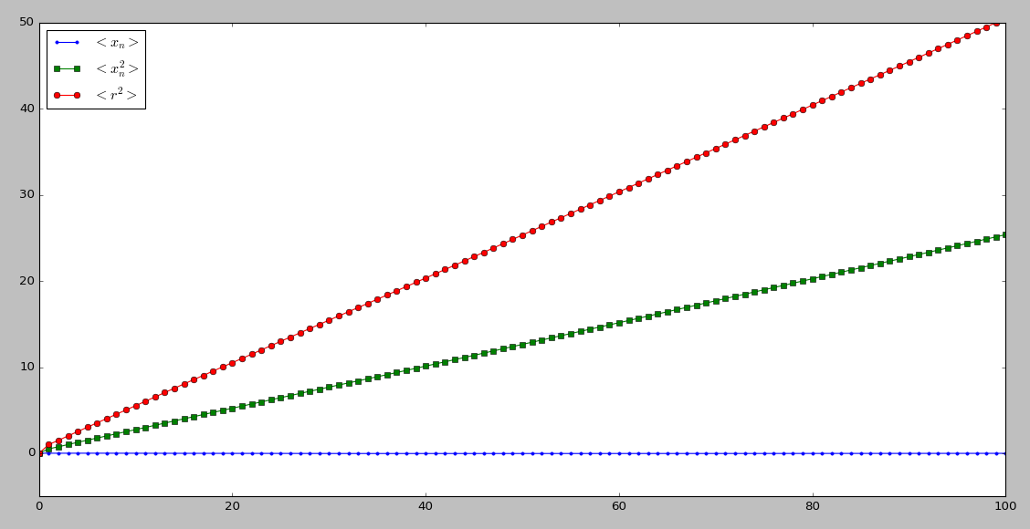






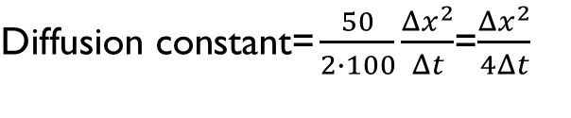
$$<r^{2}> ∝n$$
$$n∝t$$
$$<r^{2}> ∝t$$
$$<r_{n}^{2}>$$
$\text{D}\text{iffusion} \text{constant}\text{=}\frac{50}{2∙100}\frac{Δx^{2}}{Δt}$=$\frac{Δx^{2}}{4Δt}$
$$<x_{n}^{2}>$$
$$<x_{n}>$$
10000 walks

Slide 6
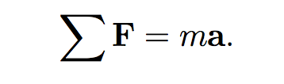
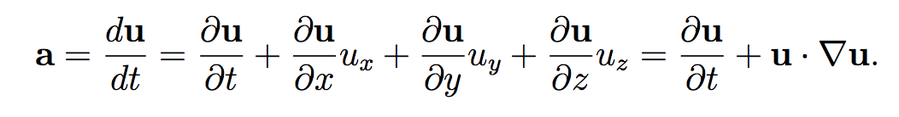
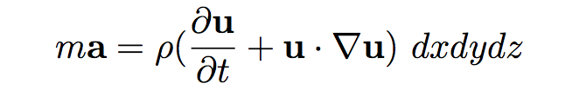

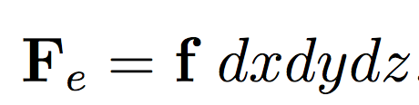
NAVIER-STOKES EQUATION
RHS
LHS

Slide 7
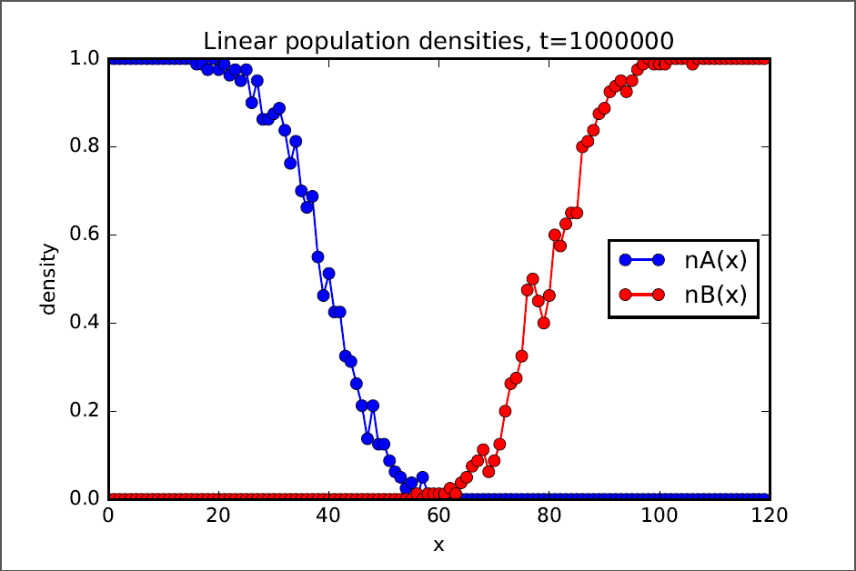
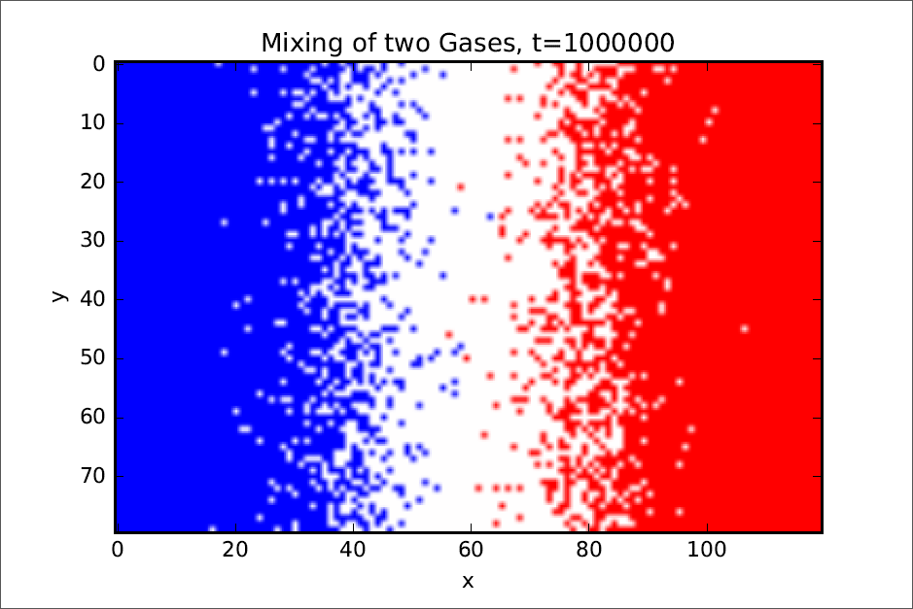
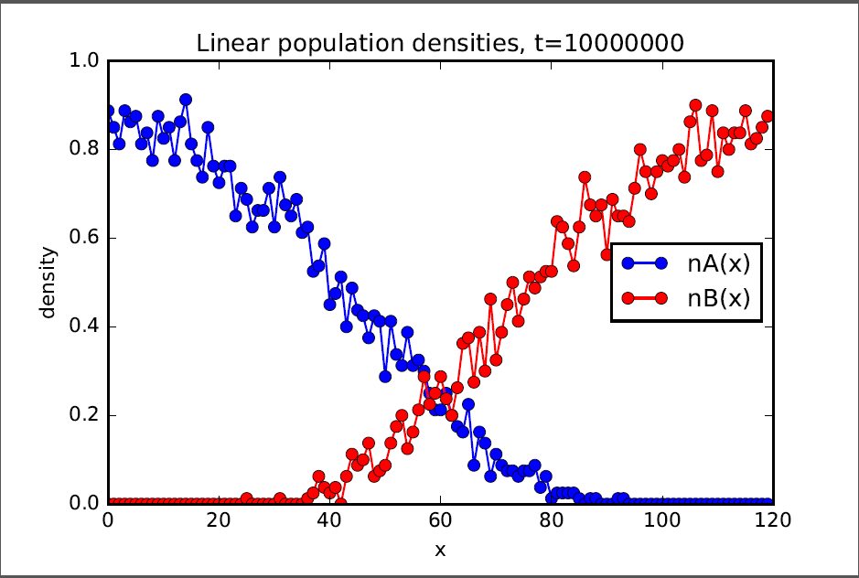
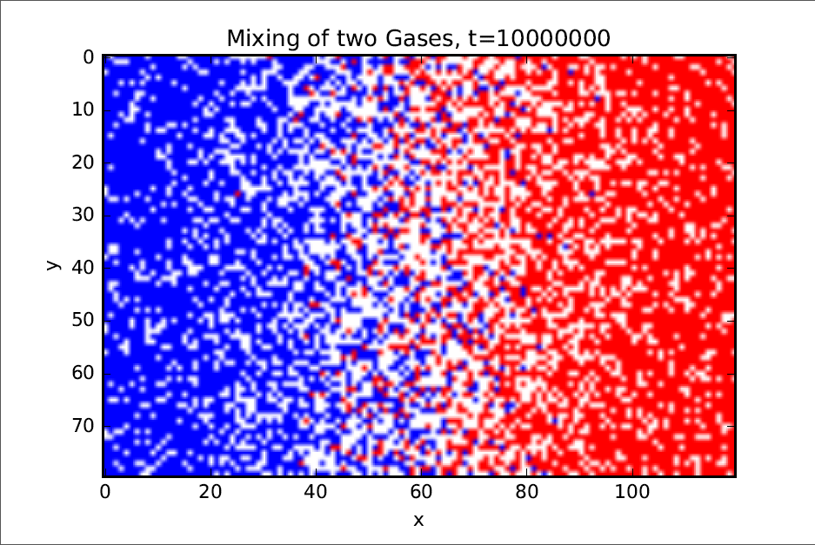

Slide 8
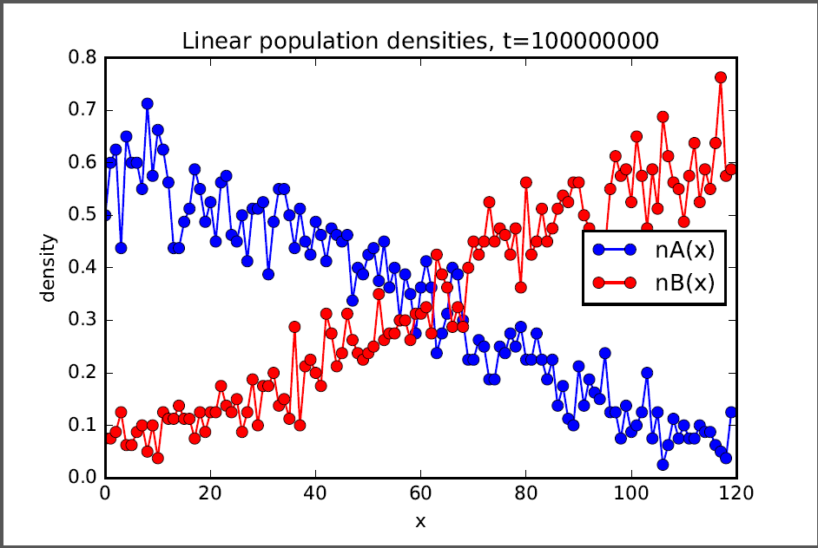
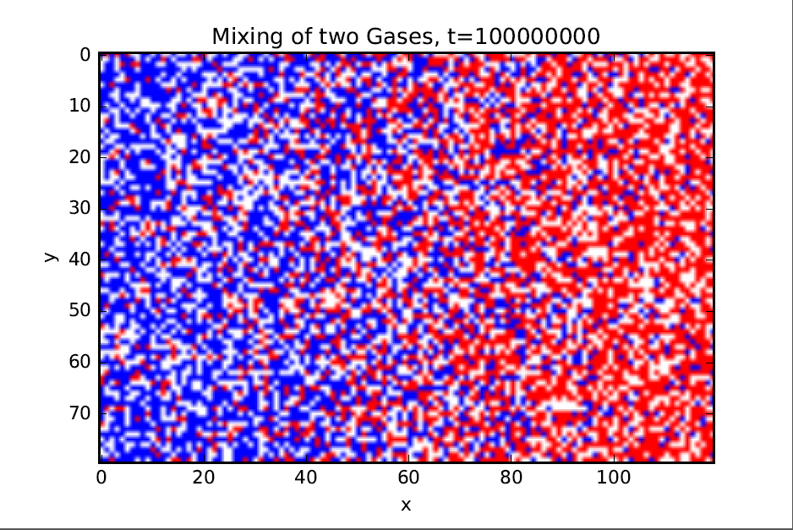
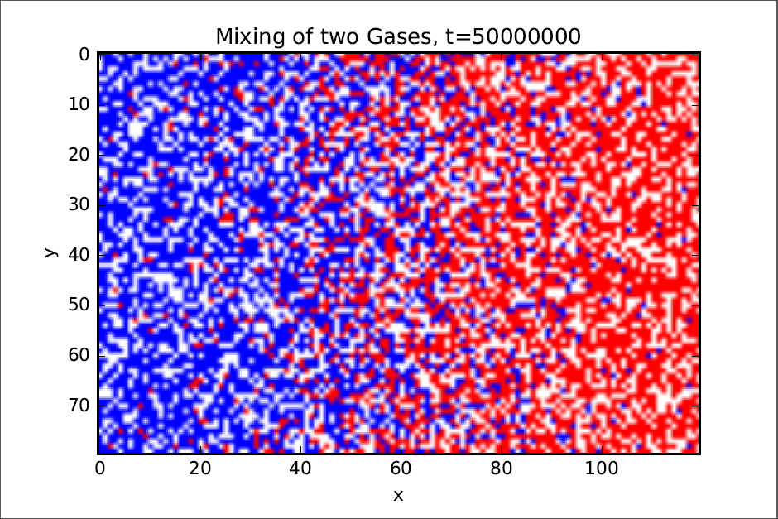
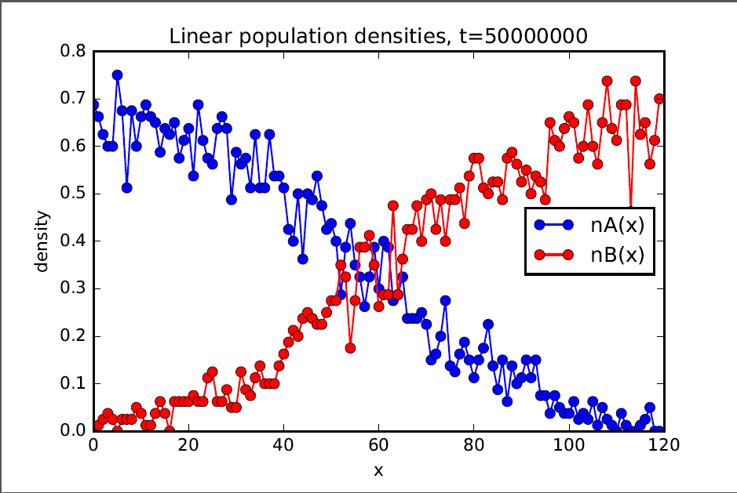

Slide 9
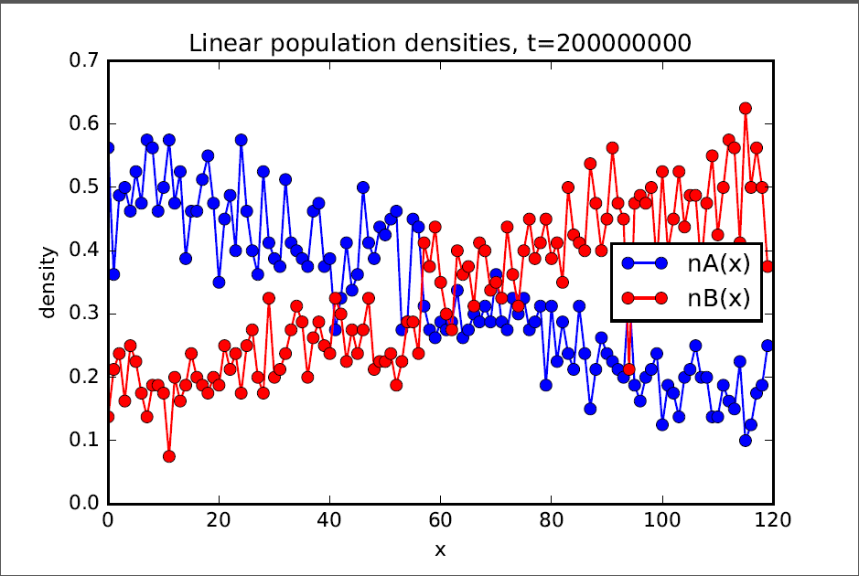
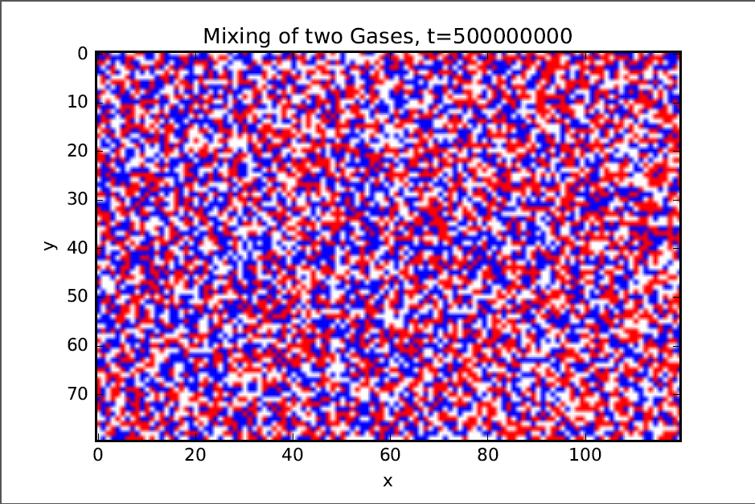
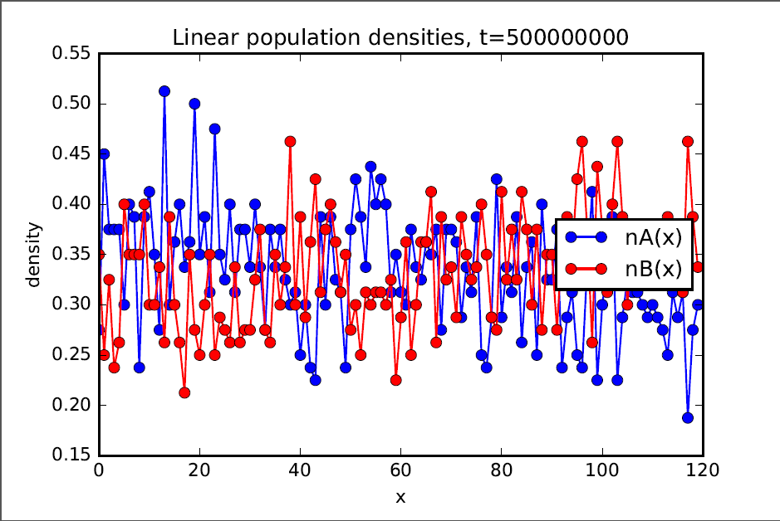
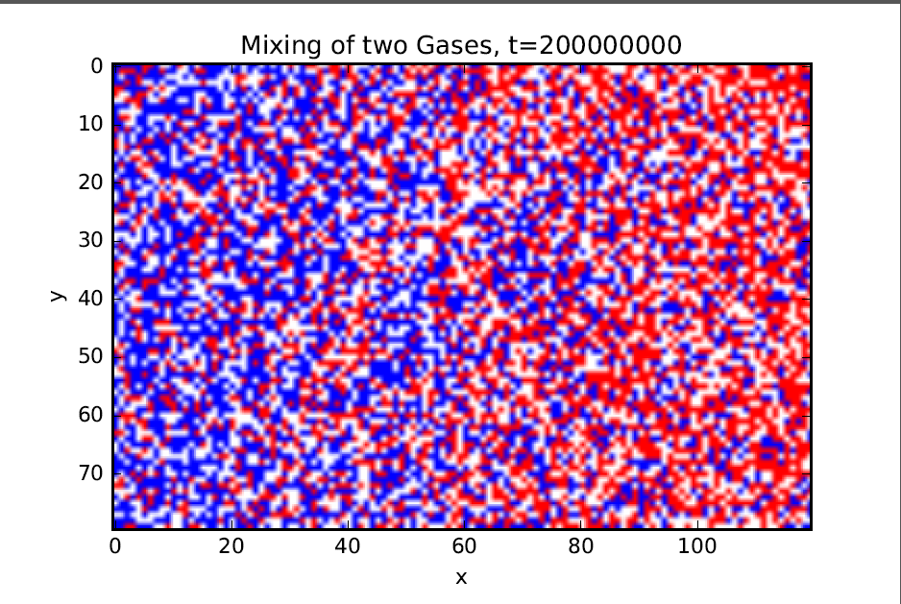

Slide 10
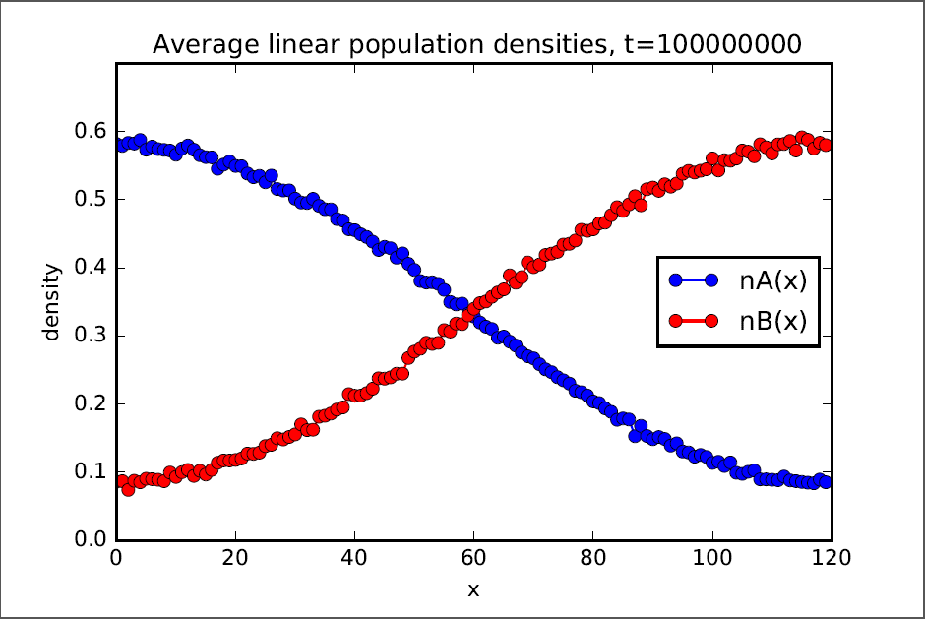

Slide 11
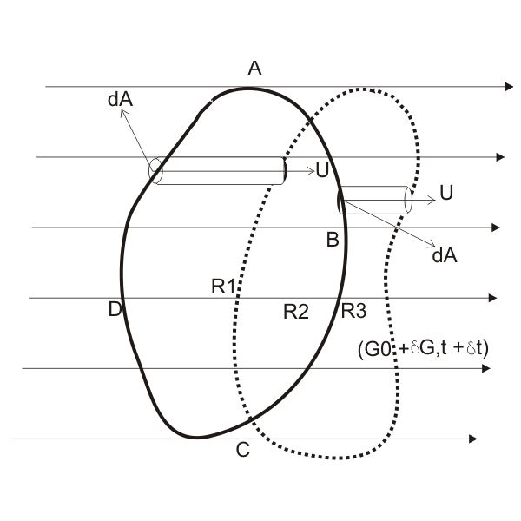
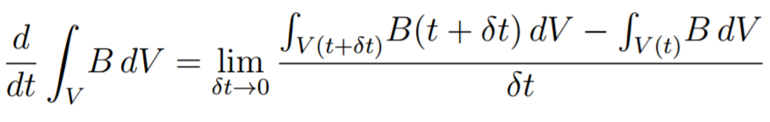
Reynolds Transport Theorem

Slide 12
Thank you!

