Slide 1
Random Walk

Slide 2
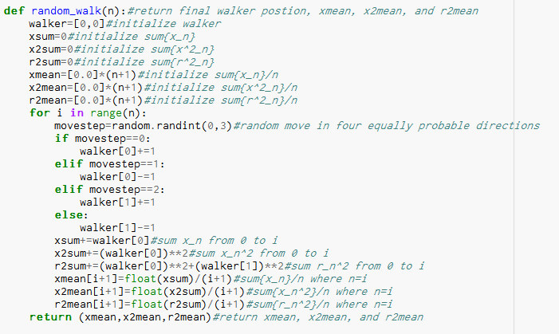
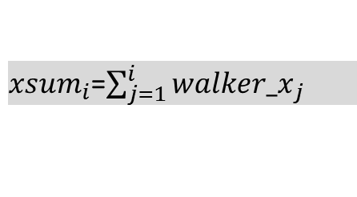
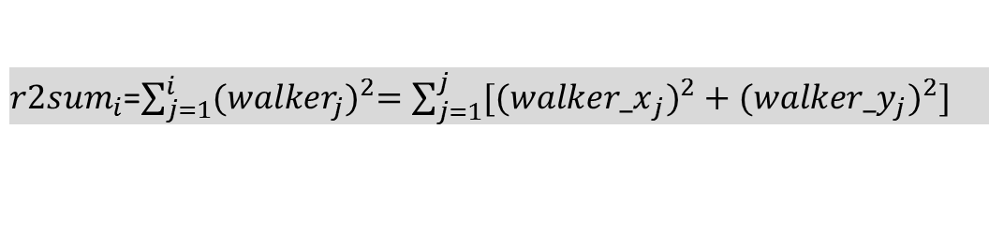
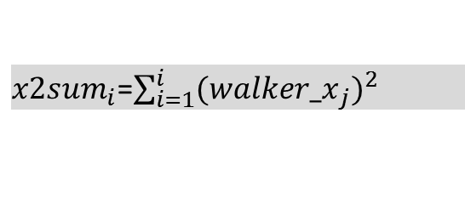
${xsum}_{i}$=$\sum_{j=1}^{i}{{walker_x}_{j}}$
${x2sum}_{i}$=$\sum_{i=1}^{i}{{{(walker_x}_{j})}^{2}}$
${r2sum}_{i}$=$\sum_{j=1}^{i}{{(walker_{j})}^{2}=\sum_{j=1}^{j}{{{[(walker_x}_{j})}^{2}+{{(walker_y}_{j})}^{2}]}}$

Slide 3
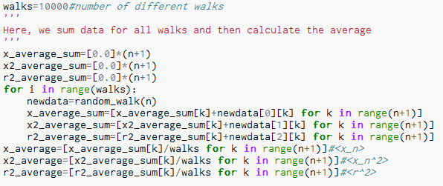

${10}^{4}$ different walks

Slide 4
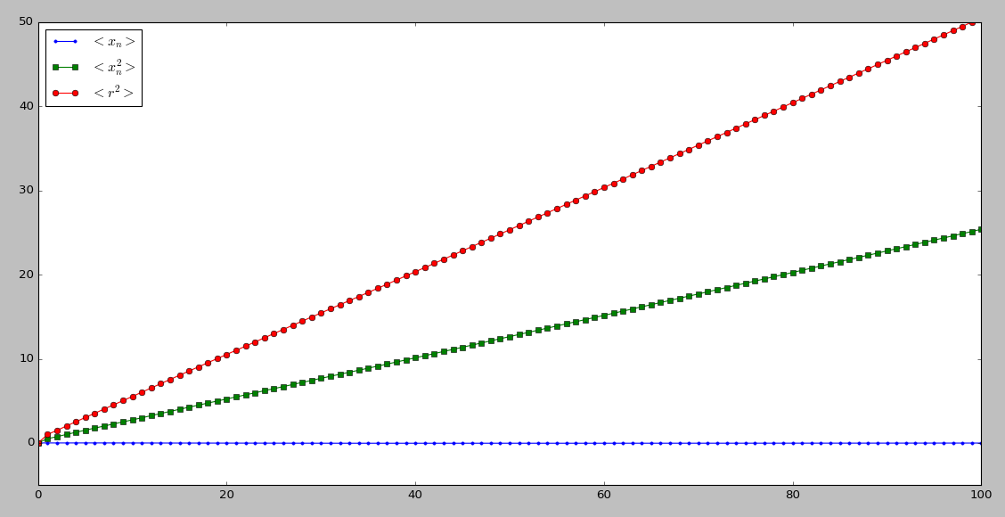
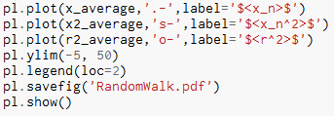




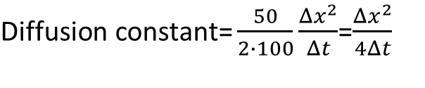


$$<r^{2}> ∝n$$
$$n∝t$$
$$<r^{2}> ∝t$$
$$<r_{n}^{2}>$$
$\text{D}\text{iffusion} \text{constant}\text{=}\frac{50}{2∙100}\frac{Δx^{2}}{Δt}$=$\frac{Δx^{2}}{4Δt}$
$$<x_{n}^{2}>$$
$$<x_{n}>$$

