Slide 1
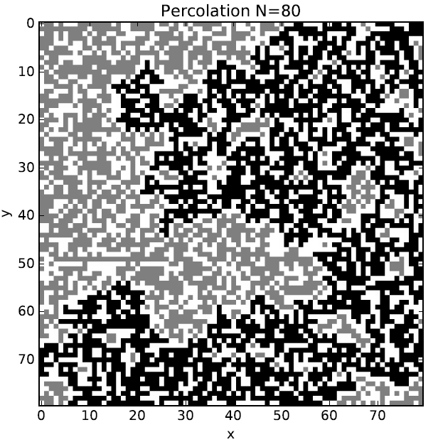
Percolation
Xuejian Ma
Tianyu Dai
Yuheng Liao
Xiaoqing Li

Slide 2
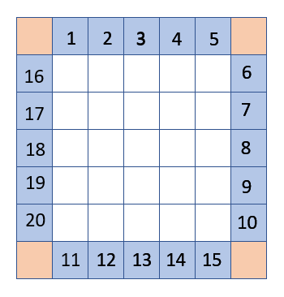
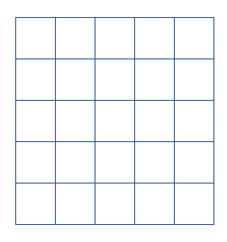
N×N lattice
(N+2)×(N+2) lattice
Notes:
Begin with an empty lattice and initialize all sites to zero.
A way to deal with boundary condition: enlarge a N×N lattice to a (N+2)×(N+2) one
Thus, every site equally has 4 neighbors
Then we label the blue boxes with numbers 1 to 4N
Since the four orange boxes have nothing to do with the grid which we are interested, we just ignore them

Slide 3
27
27
21
26
22
25
26
24
26
26
23
24
26
24
Notes:
Select and occupy a random site, labeling it with number 4N+1, since it is the first cluster. Select another site at random and check neighboring sites to see if any belong to a cluster.
If no, this new site is labeled with next cluster
If yes, we give this mark number to all the neighboring clusters to make them a new bigger cluster.

Slide 4
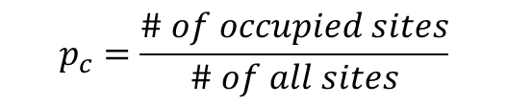
33
33
33
33
33
33
33
33
33
33
33
33
33
33
33
33
33
33
33
33
33
33
33
33
33
33
33
33
33
33
33
33
33
33
33
33
27
27
33
33
27
33
33
27
33
26
33
$$p_{c}=\frac{\# of occupied sites}{\# of all sites}$$
Notes:
Keep doing this, until the maximums of four blue lists are equal, which means a spanning cluster arises.
From the value of the spanning cluster, we can directly know how many sites (the Value-4N)are occupied.
Sweep the lattice we are interested (the small one), if its value equals to the value of the spanning cluster, we give 1 to it; if it is empty, we give -1 to it; otherwise, 0.

Slide 5
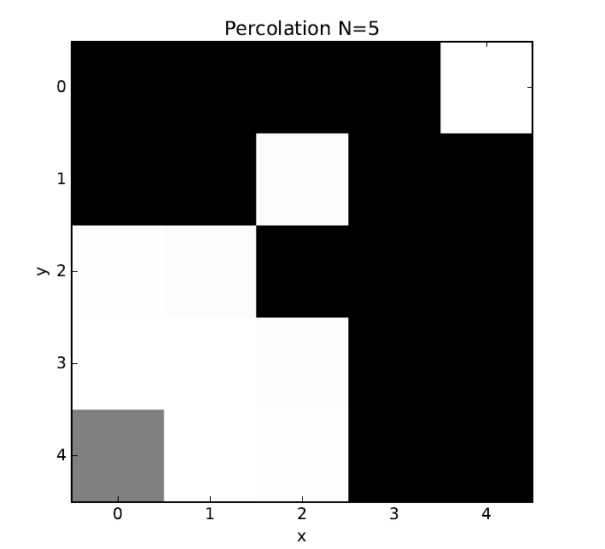
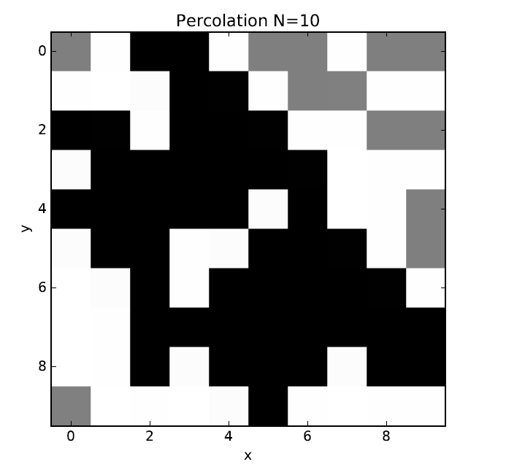
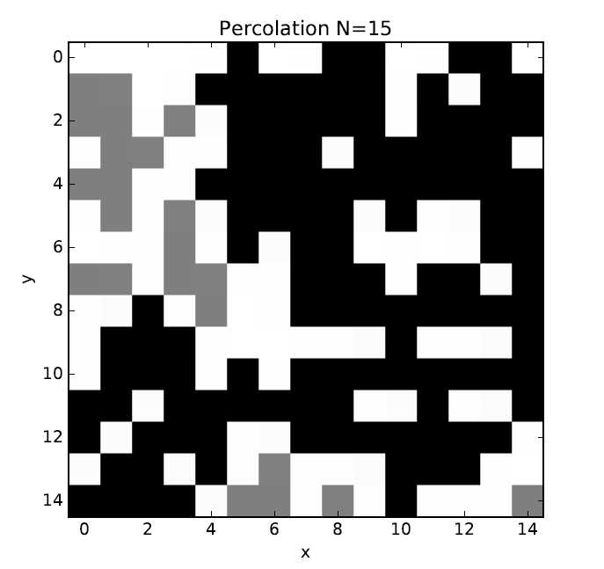
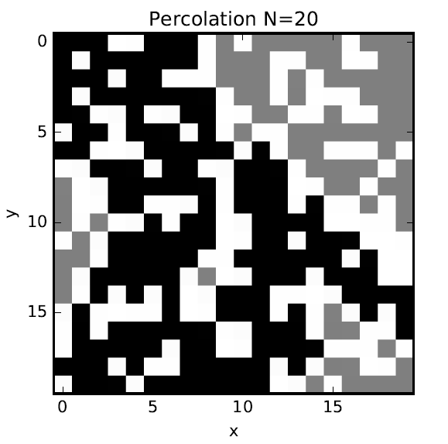

Slide 6
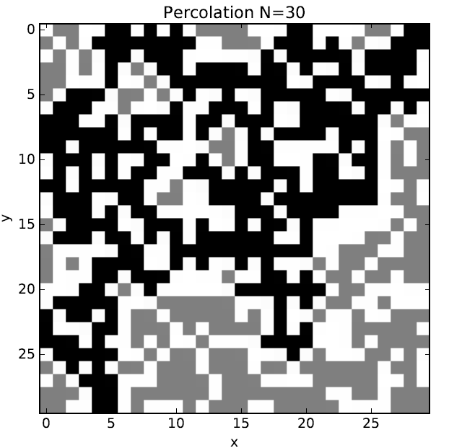
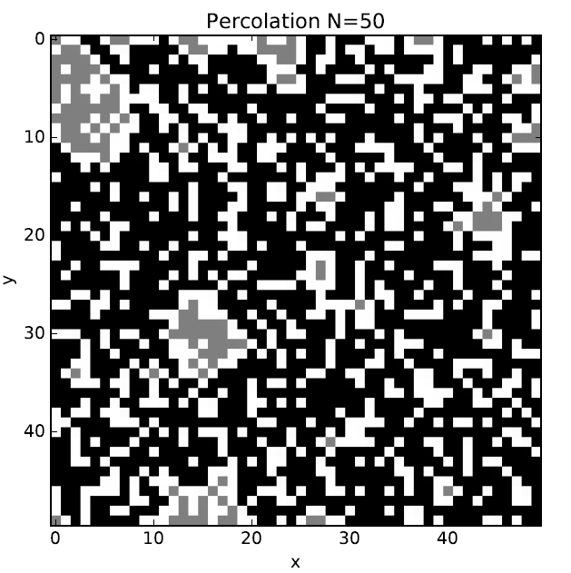

Slide 7
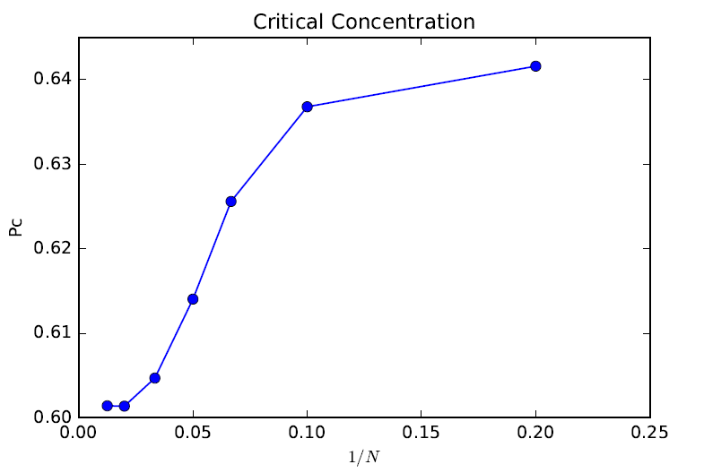

$$p_{c}(0)≈0.602$$

