Slide 1
Nash Pursuit Strategy for Nonzero-Sum MPC Game via Inverse Optimal Control
Tianyu Qiu¹, Han Zhang¹, Jingchuan Wang¹
¹ Autonomous Robot Lab, Shanghai Jiao Tong University

Slide 2
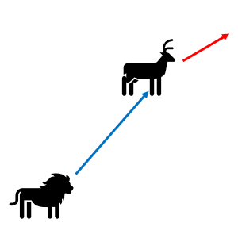
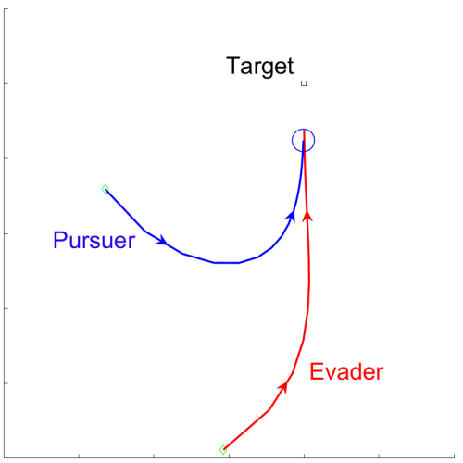
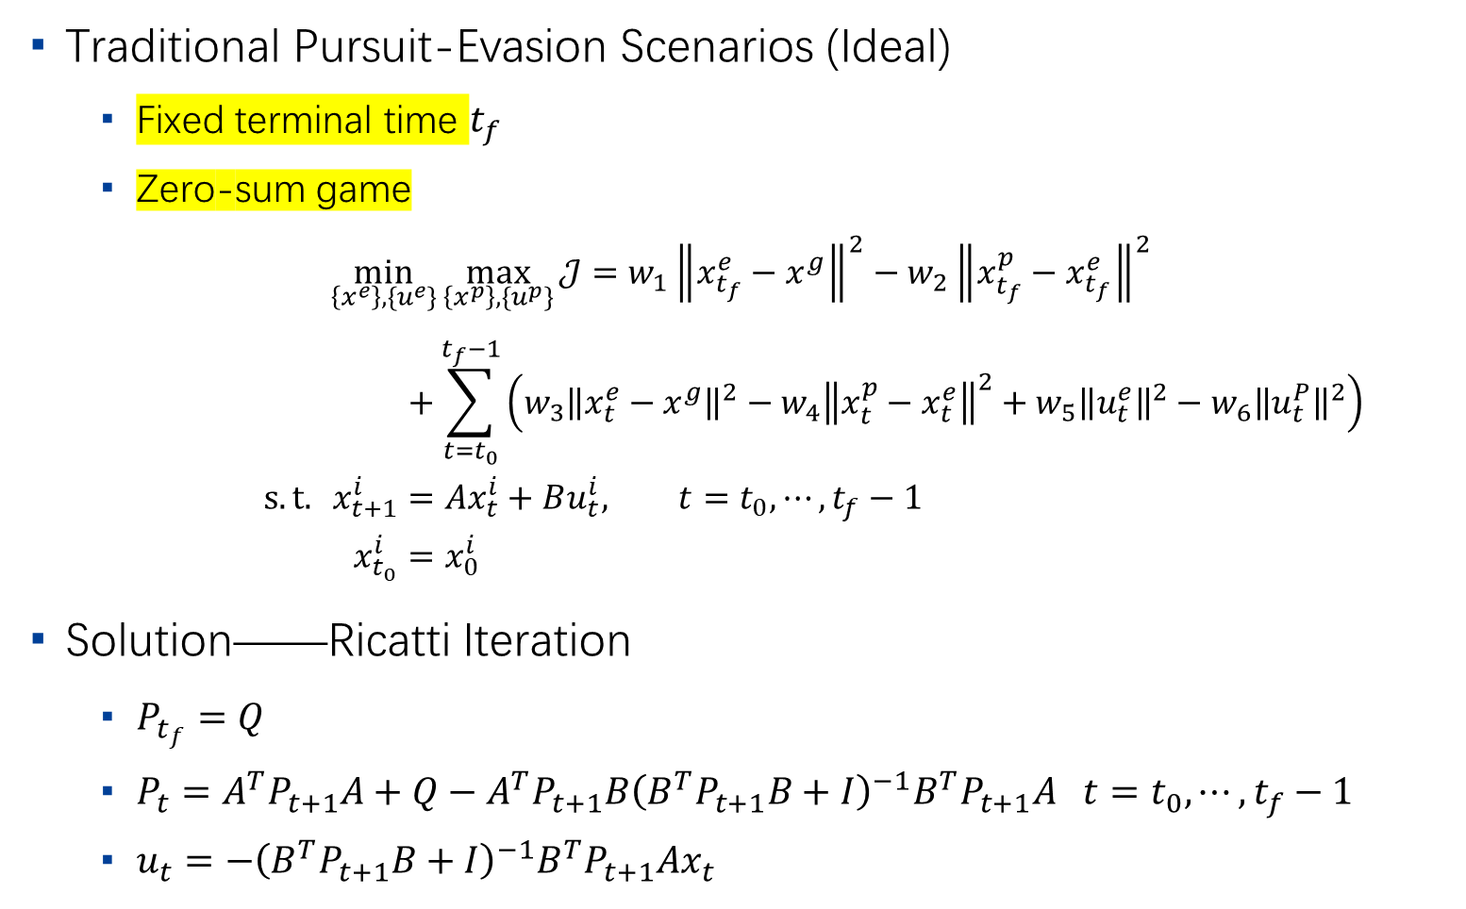
Motivation
2
Traditional Pursuit-Evasion Scenarios (Ideal)
Fixed terminal time $t_{f}$
Zero-sum game
$$\min_{\left\{x^{e}\right\},\{u^{e}\}}{\max_{\left\{x^{p}\right\},\{u^{p}\}}{𝒥}}=w_{1}{\left\|x_{t_{f}}^{e}−x^{g}\right\|}^{2}−w_{2}{\left\|x_{t_{f}}^{p}−x_{t_{f}}^{e}\right\|}^{2}$$
$$+\sum_{t=t_{0}}^{t_{f}−1}{\left(w_{3}{\left\|x_{t}^{e}−x^{g}\right\|}^{2}−w_{4}{\left\|x_{t}^{p}−x_{t}^{e}\right\|}^{2}+w_{5}{\left\|u_{t}^{e}\right\|}^{2}−w_{6}{\left\|u_{t}^{P}\right\|}^{2}\right)} \\ s.t. x_{t+1}^{i}=Ax_{t}^{i}+Bu_{t}^{i}, t=t_{0},⋯,t_{f}−1 \\ x_{t_{0}}^{i}=x_{0}^{i}$$
Solution——Ricatti Iteration
$P_{t_{f}}=Q$
$P_{t}=A^{T}P_{t+1}A+Q−A^{T}P_{t+1}B{\left(B^{T}P_{t+1}B+I\right)}^{−1}B^{T}P_{t+1}A t=t_{0},⋯,t_{f}−1$
$u_{t}=−{\left(B^{T}P_{t+1}B+I\right)}^{−1}B^{T}P_{t+1}Ax_{t}$
Animal Hunting
Target Defending

Slide 3
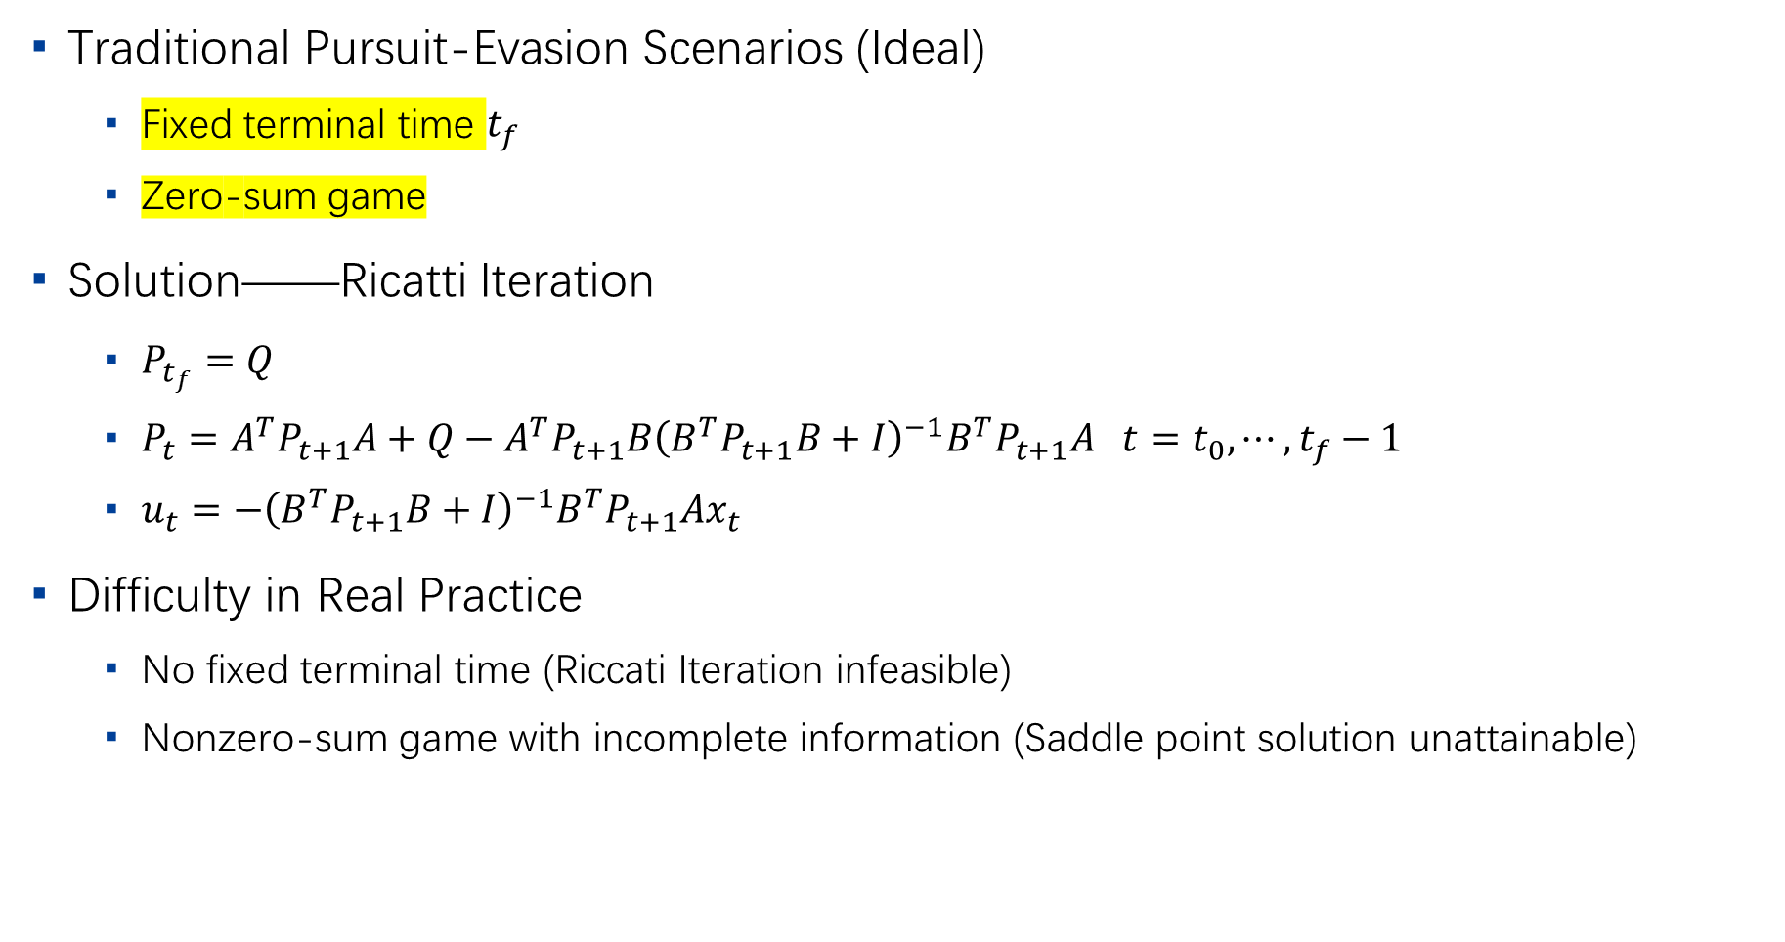
Motivation
3
Traditional Pursuit-Evasion Scenarios (Ideal)
Fixed terminal time $t_{f}$
Zero-sum game
Solution——Ricatti Iteration
$P_{t_{f}}=Q$
$P_{t}=A^{T}P_{t+1}A+Q−A^{T}P_{t+1}B{\left(B^{T}P_{t+1}B+I\right)}^{−1}B^{T}P_{t+1}A t=t_{0},⋯,t_{f}−1$
$u_{t}=−{\left(B^{T}P_{t+1}B+I\right)}^{−1}B^{T}P_{t+1}Ax_{t}$
Difficulty in Real Practice
No fixed terminal time (Riccati Iteration infeasible)
Nonzero-sum game with incomplete information (Saddle point solution unattainable)

Slide 4
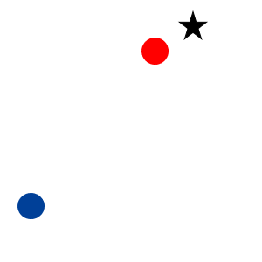
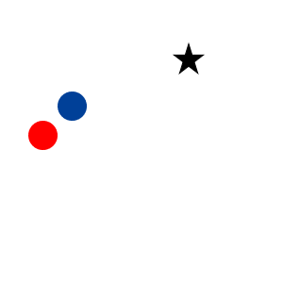
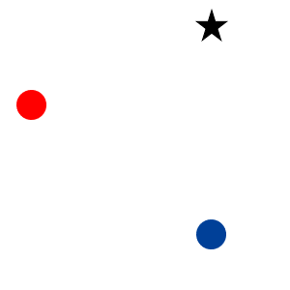




Problem Formulation
4
Terminal indicator function
: Evader
: Pursuer
: Goal
Evader win
$σ_{t}^{e}=0$
$σ_{t}^{p}=+∞$
$$σ_{t}^{e}\left(x_{t}^{e},x_{t}^{p},x^{g}\right)=\left\{\begin{aligned}&1, &if \left\|x_{t}^{e}−x^{g}\right\|>r^{e}∧\left\|x_{t}^{e}−x_{t}^{p}\right\|>r^{p} \\ &0, &if \left\|x_{t}^{e}−x^{g}\right\|≤r^{e}∧\left\|x_{t}^{e}−x_{t}^{p}\right\|>r^{p} \\ &+∞, &if \left\|x_{t}^{e}−x^{g}\right\|>r^{e}∧\left\|x_{t}^{e}−x_{t}^{p}\right\|≤r^{p}\end{aligned}\right., σ_{t}^{p}\left(x_{t}^{e},x_{t}^{p},x^{g}\right)=\left\{\begin{aligned}&1, &if \left\|x_{t}^{p}−x_{t}^{e}\right\|>r^{p}∧\left\|x_{t}^{e}−x^{g}\right\|>r^{e} \\ &0, &if \left\|x_{t}^{p}−x_{t}^{e}\right\|≤r^{p}∧\left\|x_{t}^{e}−x^{g}\right\|>r^{e} \\ &+∞, &if \left\|x_{t}^{p}−x_{t}^{e}\right\|>r^{p}∧\left\|x_{t}^{e}−x^{g}\right\|≤r^{e}\end{aligned}\right.$$
$r^{e},r^{p}$: Reaching / Capture radius of the evader and the pursuer
Pursuer win
$σ_{t}^{e}=+∞$
$σ_{t}^{p}=0$
Game Continue
$σ_{t}^{e}=σ_{t}^{p}=1$

Slide 5
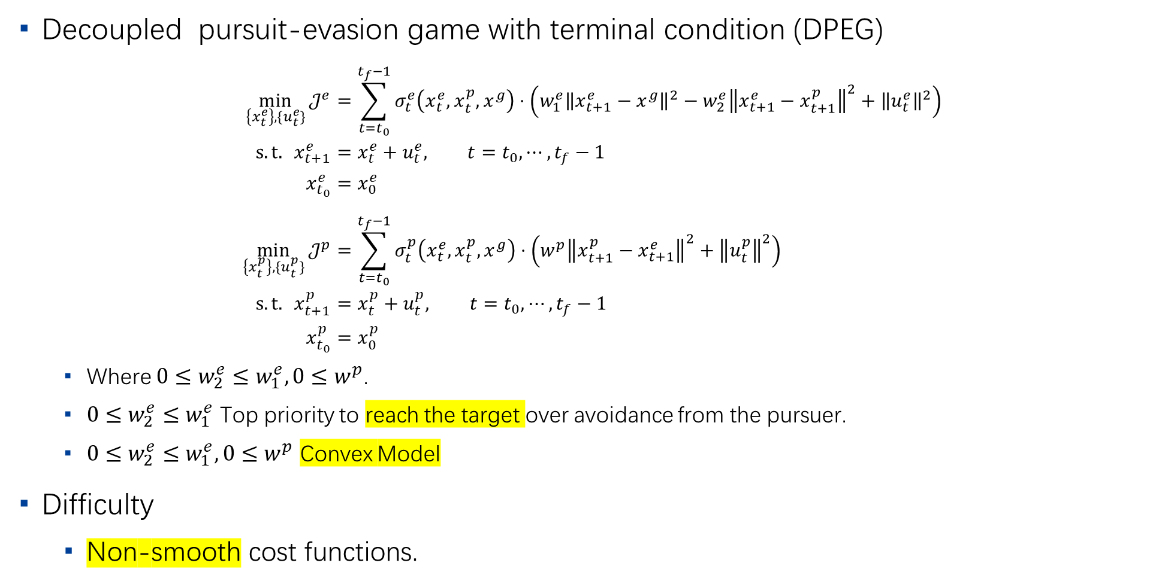
Problem Formulation
5
Decoupled pursuit-evasion game with terminal condition (DPEG)
$$\min_{\left\{x_{t}^{e}\right\},\{u_{t}^{e}\}}{𝒥^{e}}=\sum_{t=t_{0}}^{t_{f}−1}{σ_{t}^{e}\left(x_{t}^{e},x_{t}^{p},x^{g}\right)⋅\left(w_{1}^{e}{\left\|x_{t+1}^{e}−x^{g}\right\|}^{2}−w_{2}^{e}{\left\|x_{t+1}^{e}−x_{t+1}^{p}\right\|}^{2}+{\left\|u_{t}^{e}\right\|}^{2}\right)} \\ s.t. x_{t+1}^{e}=x_{t}^{e}+u_{t}^{e}, t=t_{0},⋯,t_{f}−1 \\ x_{t_{0}}^{e}=x_{0}^{e} \\ \min_{\left\{x_{t}^{p}\right\},\{u_{t}^{p}\}}{𝒥^{p}}=\sum_{t=t_{0}}^{t_{f}−1}{σ_{t}^{p}\left(x_{t}^{e},x_{t}^{p},x^{g}\right)⋅\left(w^{p}{\left\|x_{t+1}^{p}−x_{t+1}^{e}\right\|}^{2}+{\left\|u_{t}^{p}\right\|}^{2}\right)} \\ s.t. x_{t+1}^{p}=x_{t}^{p}+u_{t}^{p}, t=t_{0},⋯,t_{f}−1 \\ x_{t_{0}}^{p}=x_{0}^{p}$$
Where $0≤w_{2}^{e}≤w_{1}^{e}, 0≤w^{p}$.
$0≤w_{2}^{e}≤w_{1}^{e}$ Top priority to reach the target over avoidance from the pursuer.
$0≤w_{2}^{e}≤w_{1}^{e}, 0≤w^{p}$ Convex Model
Difficulty
Non-smooth cost functions.

Slide 6
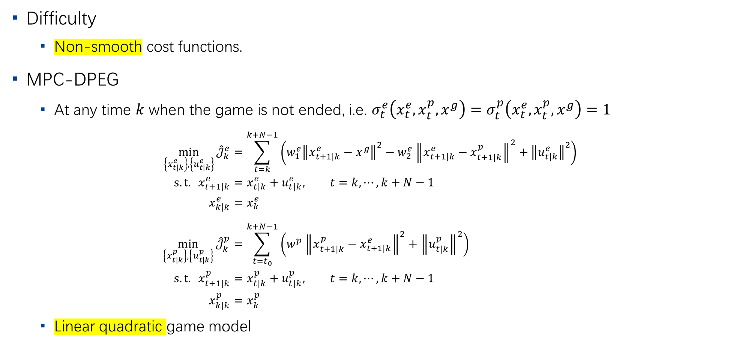
Problem Formulation
6
Difficulty
Non-smooth cost functions.
MPC-DPEG
At any time $k$ when the game is not ended, i.e. $σ_{t}^{e}\left(x_{t}^{e},x_{t}^{p},x^{g}\right)=σ_{t}^{p}\left(x_{t}^{e},x_{t}^{p},x^{g}\right)=1$
$$\min_{\left\{x_{t|k}^{e}\right\},\left\{u_{t|k}^{e}\right\}}{{\hat{𝒥}}_{k}^{e}}=\sum_{t=k}^{k+N−1}{\left(w_{1}^{e}{\left\|x_{t+1|k}^{e}−x^{g}\right\|}^{2}−w_{2}^{e}{\left\|x_{t+1|k}^{e}−x_{t+1|k}^{p}\right\|}^{2}+{\left\|u_{t|k}^{e}\right\|}^{2}\right)} \\ s.t. x_{t+1|k}^{e}=x_{t|k}^{e}+u_{t|k}^{e}, t=k,⋯,k+N−1 \\ x_{k|k}^{e}=x_{k}^{e} \\ \min_{\left\{x_{t|k}^{p}\right\},\left\{u_{t|k}^{p}\right\}}{{\hat{𝒥}}_{k}^{p}}=\sum_{t=t_{0}}^{k+N−1}{\left(w^{p}{\left\|x_{t+1|k}^{p}−x_{t+1|k}^{e}\right\|}^{2}+{\left\|u_{t|k}^{p}\right\|}^{2}\right)} \\ s.t. x_{t+1|k}^{p}=x_{t|k}^{p}+u_{t|k}^{p}, t=k,⋯,k+N−1 \\ x_{k|k}^{p}=x_{k}^{p}$$
Linear quadratic game model

Slide 7
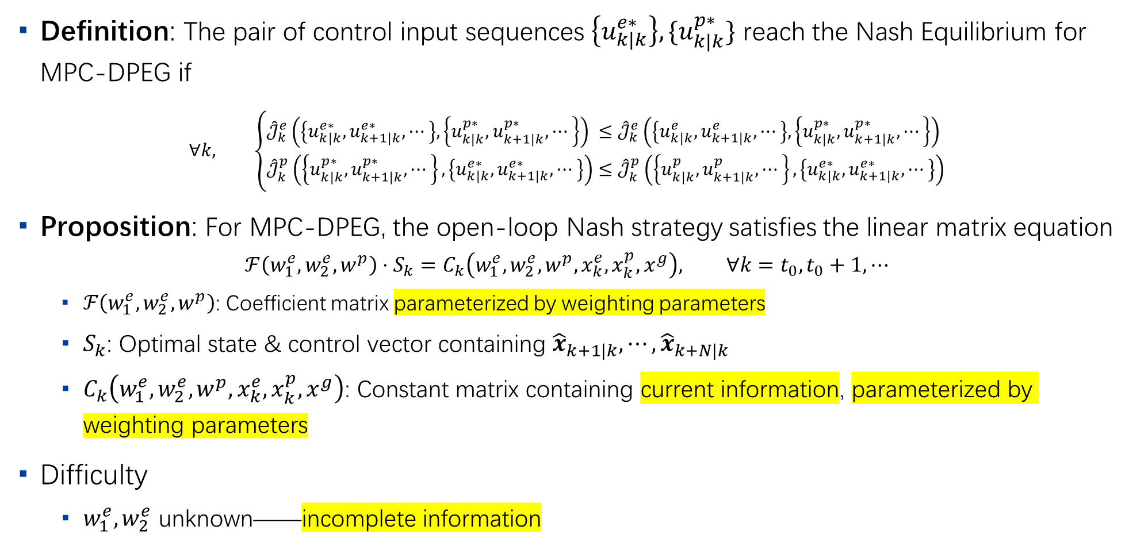
Nash Strategy for MPC-DPEG
7
Definition: The pair of control input sequences $\left\{u_{k|k}^{e∗}\right\},\{u_{k|k}^{p∗}\}$ reach the Nash Equilibrium for MPC-DPEG if
$$∀k, \left\{\begin{aligned}&{\hat{𝒥}}_{k}^{e}\left(\left\{u_{k|k}^{e∗},u_{k+1|k}^{e∗},⋯\right\},\left\{u_{k|k}^{p∗},u_{k+1|k}^{p∗},⋯\right\}\right)&≤&{\hat{𝒥}}_{k}^{e}\left(\left\{u_{k|k}^{e},u_{k+1|k}^{e},⋯\right\},\left\{u_{k|k}^{p∗},u_{k+1|k}^{p∗},⋯\right\}\right) \\ &{\hat{𝒥}}_{k}^{p}\left(\left\{u_{k|k}^{p∗},u_{k+1|k}^{p∗},⋯\right\},\left\{u_{k|k}^{e∗},u_{k+1|k}^{e∗},⋯\right\}\right)&≤&{\hat{𝒥}}_{k}^{p}\left(\left\{u_{k|k}^{p},u_{k+1|k}^{p},⋯\right\},\left\{u_{k|k}^{e∗},u_{k+1|k}^{e∗},⋯\right\}\right)\end{aligned}\right.$$
Proposition: For MPC-DPEG, the open-loop Nash strategy satisfies the linear matrix equation
$$ℱ\left(w_{1}^{e},w_{2}^{e},w^{p}\right)⋅S_{k}=C_{k}\left(w_{1}^{e},w_{2}^{e},w^{p},x_{k}^{e}, x_{k}^{p},x^{g}\right), ∀k=t_{0},t_{0}+1,⋯$$
$ℱ\left(w_{1}^{e},w_{2}^{e},w^{p}\right)$: Coefficient matrix parameterized by weighting parameters
$S_{k}$: Optimal state & control vector containing ${\hat{x}}_{k+1|k},⋯,{\hat{x}}_{k+N|k}$
$C_{k}\left(w_{1}^{e},w_{2}^{e},w^{p},x_{k}^{e}, x_{k}^{p},x^{g}\right)$: Constant matrix containing current information, parameterized by weighting parameters
Difficulty
$w_{1}^{e}, w_{2}^{e}$ unknown——incomplete information

Slide 8
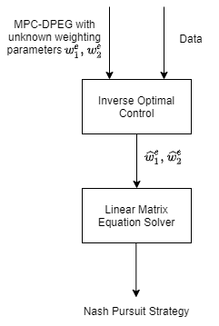
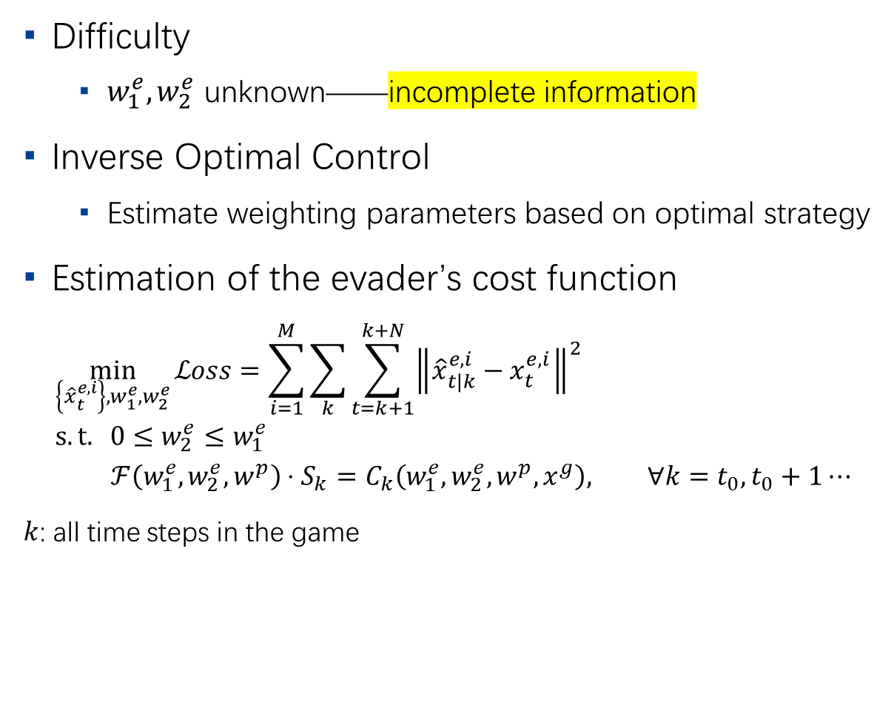
IOC Technique
8
Difficulty
$w_{1}^{e}, w_{2}^{e}$ unknown——incomplete information
Inverse Optimal Control
Estimate weighting parameters based on optimal strategy
Estimation of the evader’s cost function
$$\min_{\left\{{\hat{x}}_{t}^{e,i}\right\},w_{1}^{e},w_{2}^{e}}{ℒoss}=\sum_{i=1}^{M}{\sum_{k}{\sum_{t=k+1}^{k+N}{{\left\|{\hat{x}}_{t|k}^{e,i}−x_{t}^{e,i}\right\|}^{2}}}} \\ s.t. 0≤w_{2}^{e}≤w_{1}^{e} \\ ℱ\left(w_{1}^{e},w_{2}^{e},w^{p}\right)⋅S_{k}=C_{k}\left(w_{1}^{e},w_{2}^{e},w^{p},x^{g}\right), ∀k=t_{0},t_{0}+1⋯$$
$k$: all time steps in the game

Slide 9
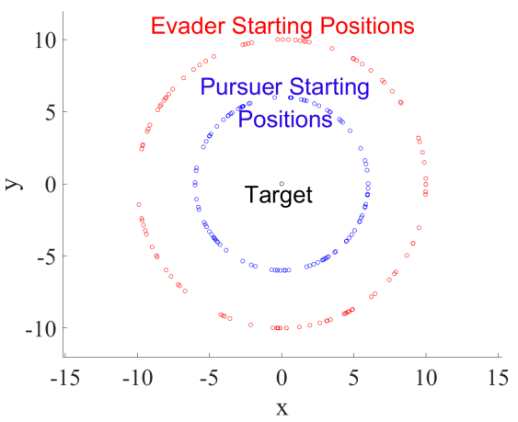
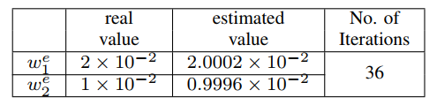
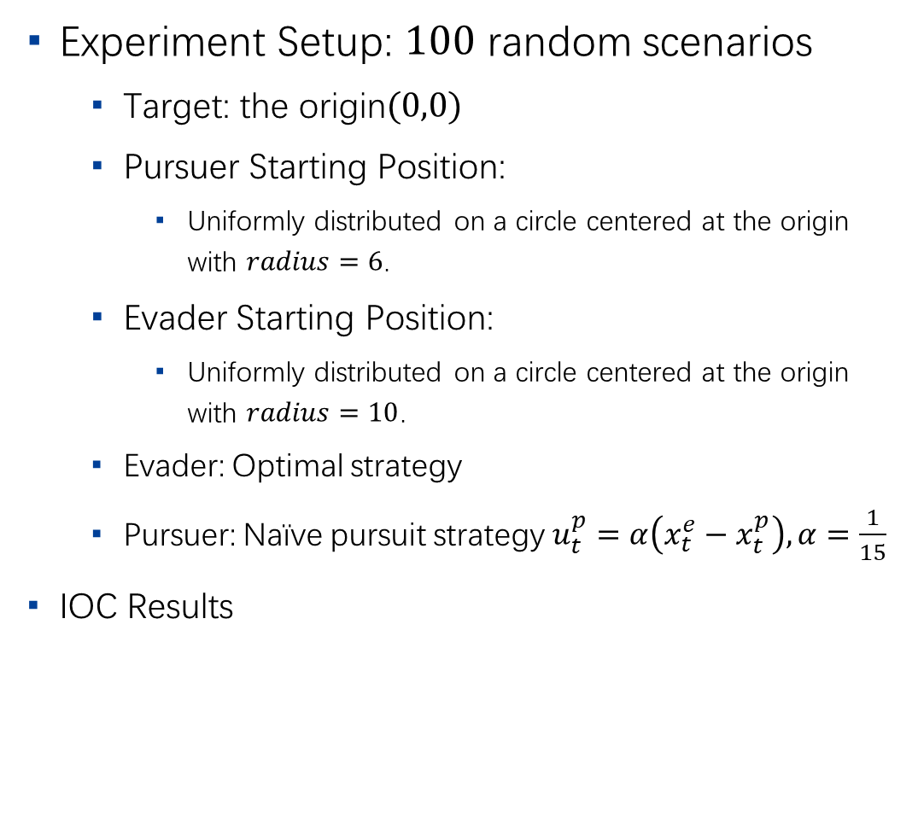
Numerical Examples
9
Experiment Setup: $100$ random scenarios
Target: the origin$(0,0)$
Pursuer Starting Position:
Uniformly distributed on a circle centered at the origin with $radius=6$.
Evader Starting Position:
Uniformly distributed on a circle centered at the origin with $radius=10$.
Evader: Optimal strategy
Pursuer: Naïve pursuit strategy $u_{t}^{p}=α\left(x_{t}^{e}−x_{t}^{p}\right), α=\frac{1}{15}$
IOC Results

Slide 10
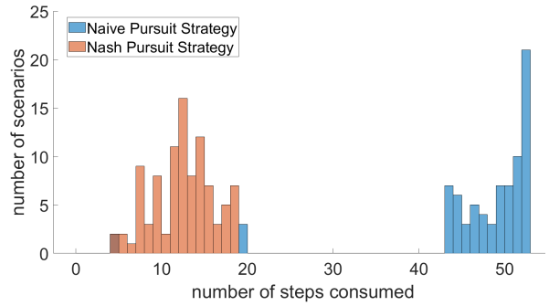
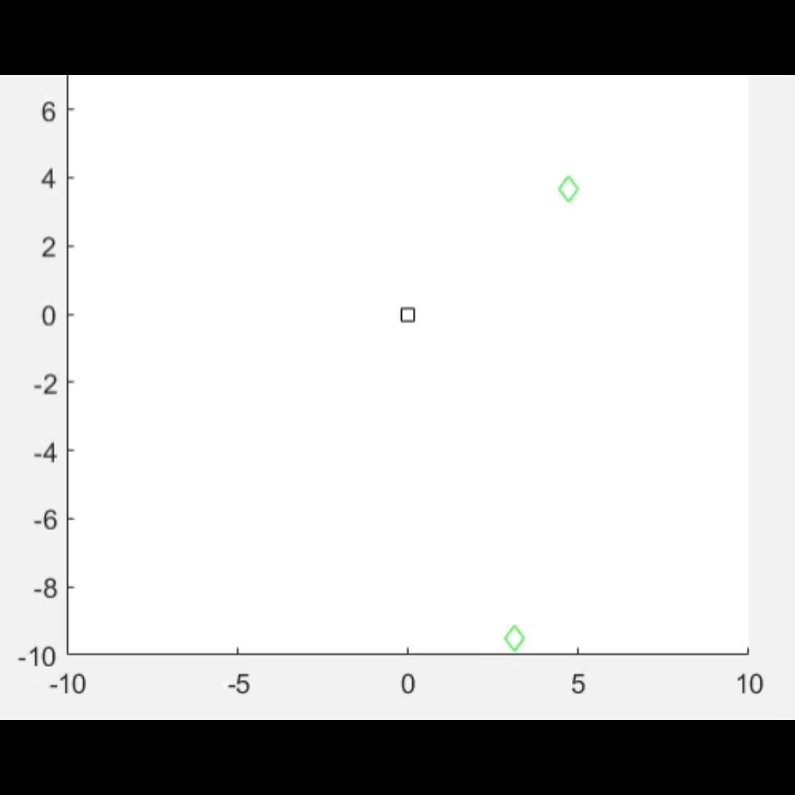

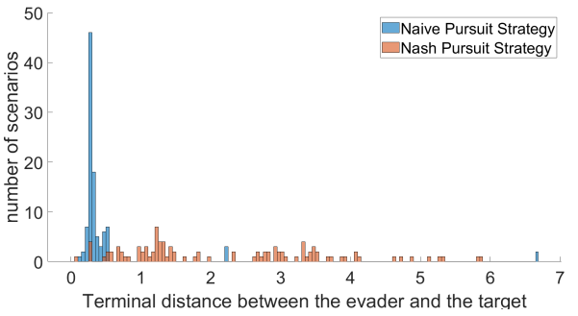
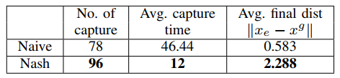
Naïve Strategy v.s. Nash Strategy
10
Stats for 100 scenarios
Nash Strategy
Naïve Strategy

Slide 11
Conclusions
11
Motivation
Ideal model not able to depict the real practice
Contribution
Formulate a DPEG model with terminal condition & incomplete information
Apply MPC to address the non-smooth cost function.
Apply IOC to estimate the unknown weighting parameters.
Future work
Generalization to more complicated scenarios
Constrained environment
Team of pursuers v.s. Team of evaders
Changing number of players

Slide 12
Thank you！

