Slide 1
CS548 17F Project-3 Presentation
Tes shizume
Shaoju wu
Tianyu Wu
Yang zheng

Slide 2
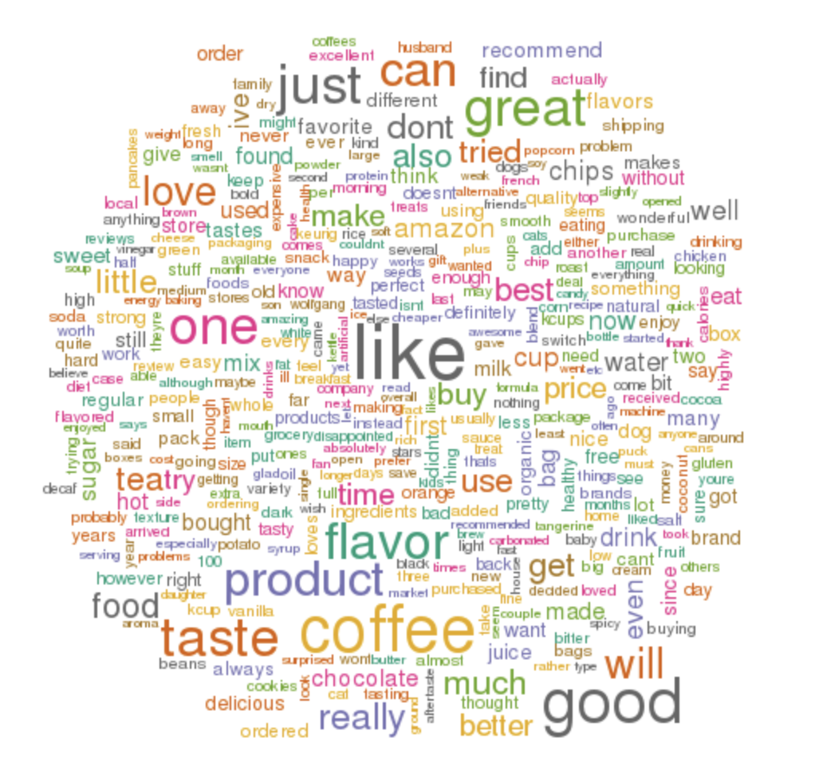
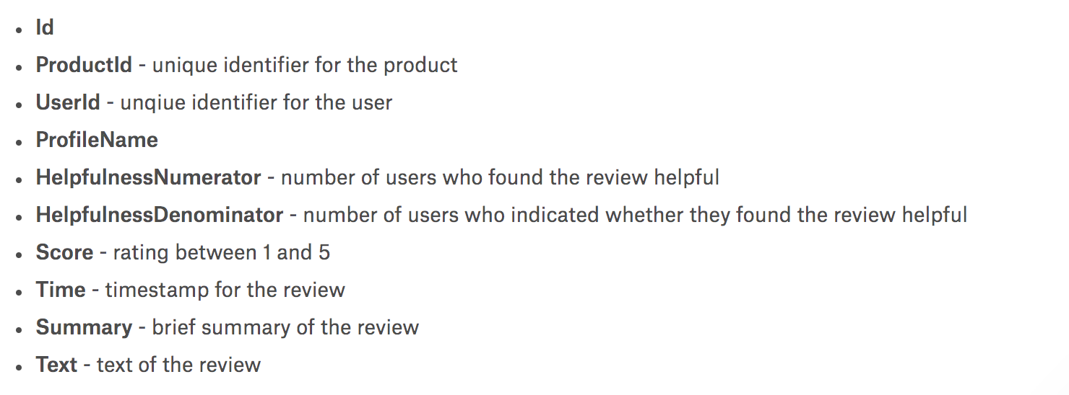
Dataset Description
The Amazon Fine Food Reviews dataset consists of 568,454 food reviews instances and 10 attributes from Amazon users left up to October 2012.

Slide 3
Initial Preprocessing
Tailored 568,454 instances to 19,875 instances which has 100 – 110 review words
7,471 unique products
9,553 unique reviewer IDs and 8,897 profile names
Product scores from 1 to 5, mean is 4.075, mode is 5, SD is 1.33
Used nltk.corpus.stopwords.words(“english”) packages get rid of STOP words
Used String package get rid of punctuation in the text
Used nltk.stem.SnowballStemmer() to perform stemming
Used wordnet to construct food vocabulary for mining food words in text

Slide 4
Experiment
1. What associations are there about the presence of food in the review text?
2. What are the differences in the association rules got from reviews with high scores(>3) and that with low scores(<=3)?
3. Would one product be purchased after a another one? What’s the association rule?

Slide 5
What associations are there about the presence of food in the review text?

Slide 6
What are the differences in the association rules got from reviews with high scores(>3) and that with low scores(<=3)?

Slide 7
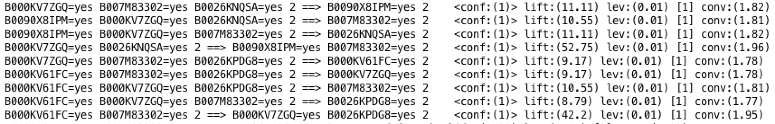
Would one product be purchased with a another one? What’s the association rule?
Dimension reduction to popular-products, only use instances which purchased hot-product. Convert ‘no’ to missing value ‘?’
Parameter: delta:0.05, minMetric:0.01, minSupport:0.03
Large amount of instances and product varieties requires small confidence and support, otherwise, no rules would be found. We could use this result to make recommend list of each product.

Slide 8
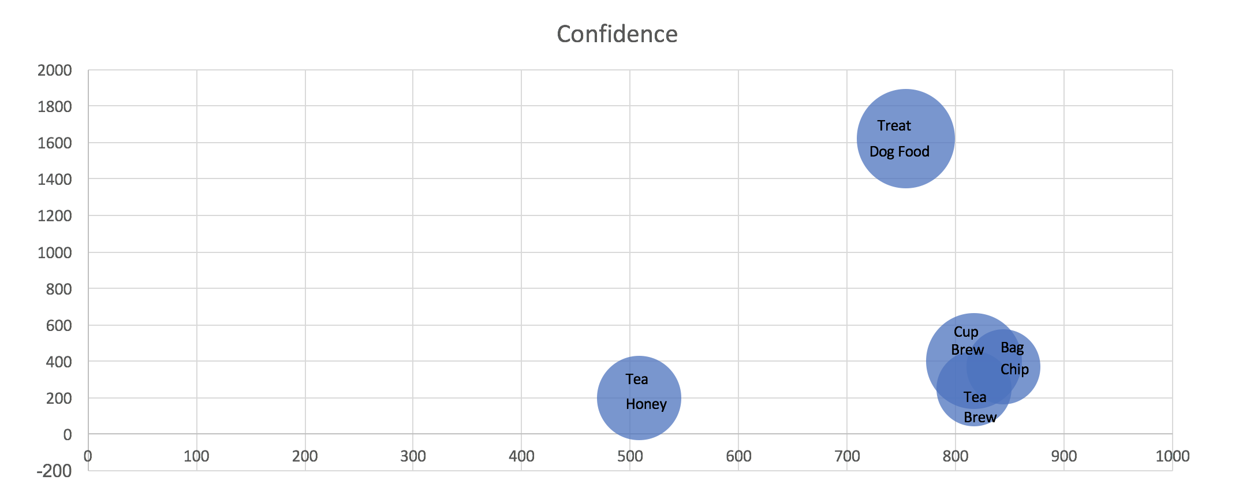
Summary

