Slide 1
CS548 17F PROJECT-Text mining PRESENTATION
TIANYU WU

Slide 2
Data Description
From https://www.kaggle.com/zynicide/wine-reviews.
CSV file with country, description, designation, points, price, province, region_1, region_2, variety, and winery of Wines.
150,930 instances in original dataset, 10 attributes
The data was scraped from WineEnthusiast during the week of June 15th, 2017.

Slide 3
Initial Preprocessing
97,156 instances and 9 attributes after removing missing and duplicated values.
Transform NON-ASCII data into ASCII data, including many foreign language characters and marks.
Stemmed and removed stop words and punctuation by nltk.stem, nltk.corpus and string.punctuation.
LabelEncoder() and inverse_transform() from nltk.preprocessing was used in step Classification.

Slide 4
Python Packages
Pandas | nltk | sklearn | sklearn
Numpy | word_tokenize | Feature_extraction.text | tree
Seaborn | corpus, stem | CountVectorizer, TfidfVetorizer | metrics
matplotlib | preprocessing | Model_selection | Linear_model

Slide 5
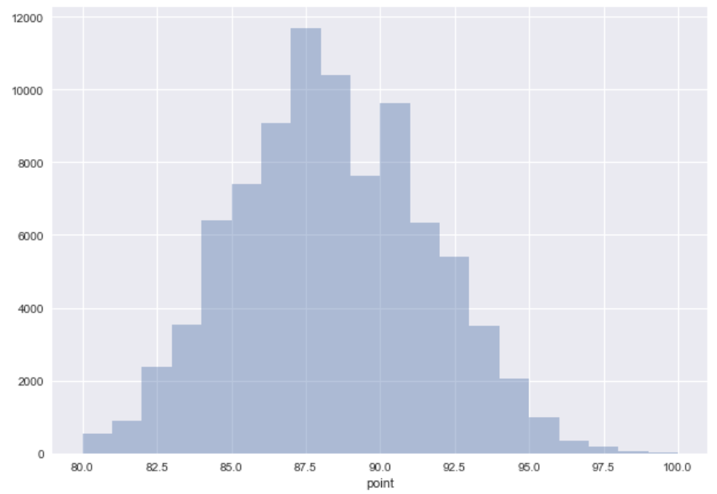
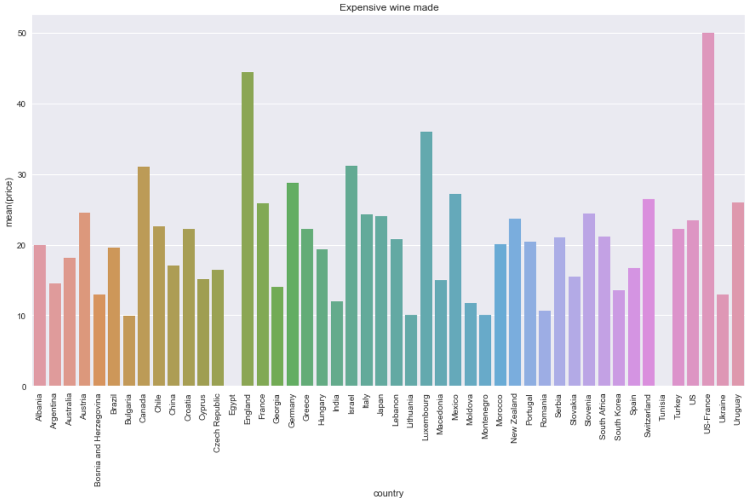
Data Exploration

Slide 6
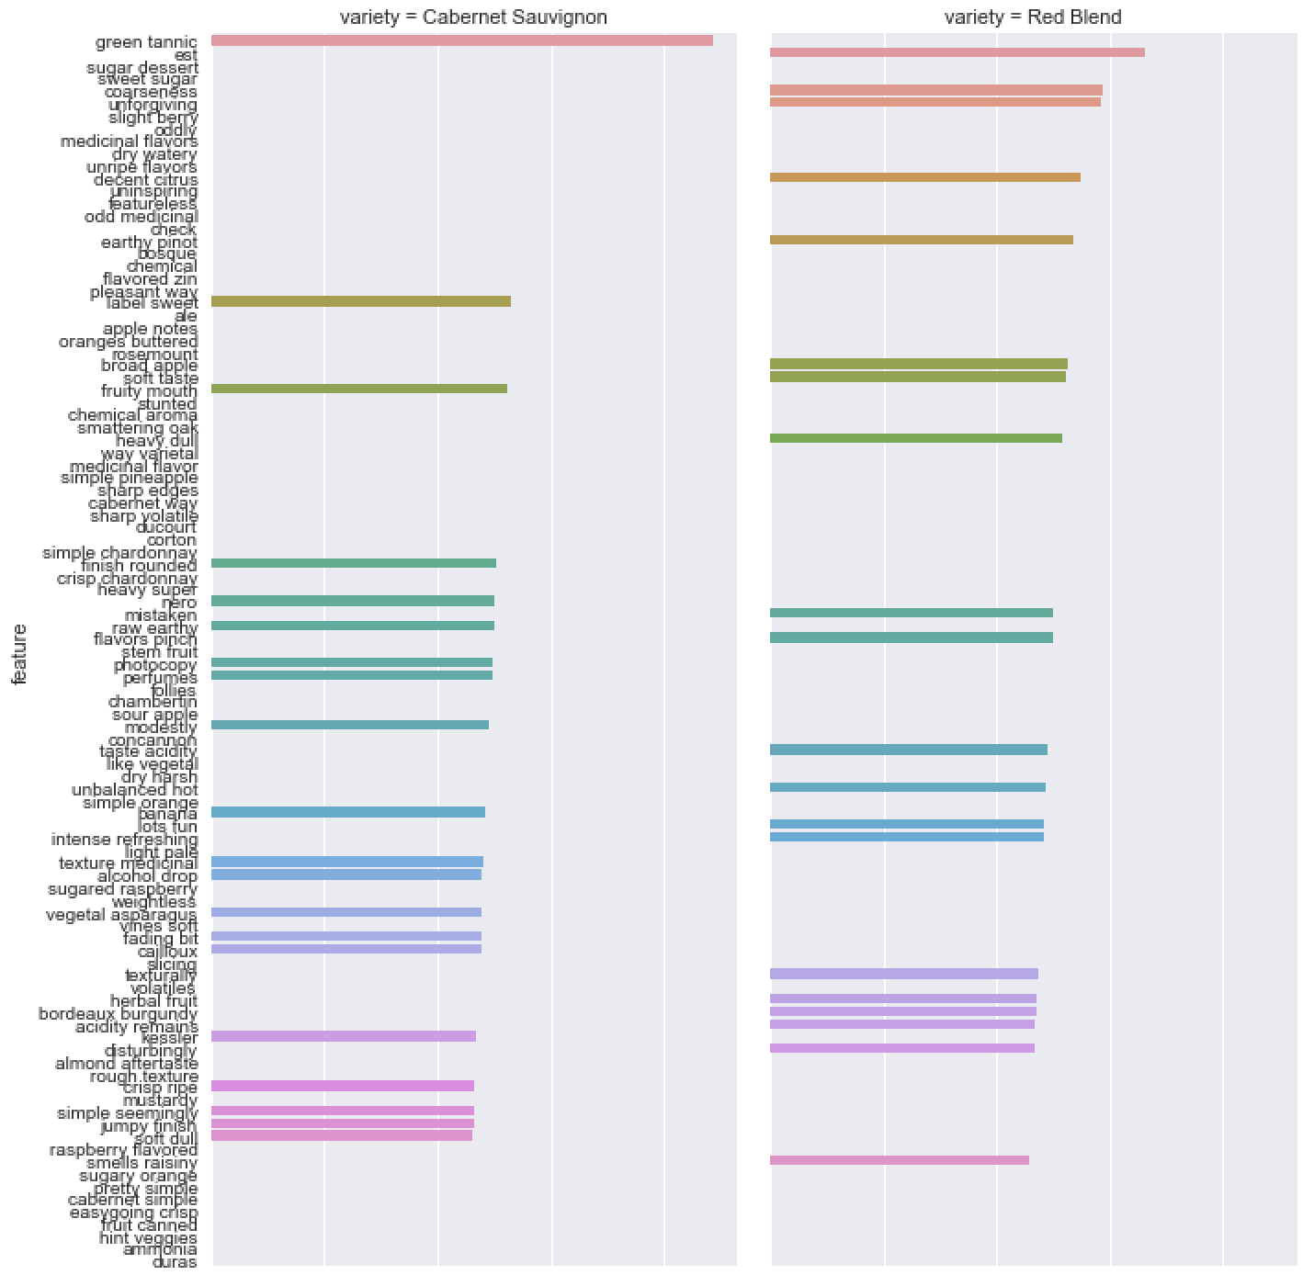
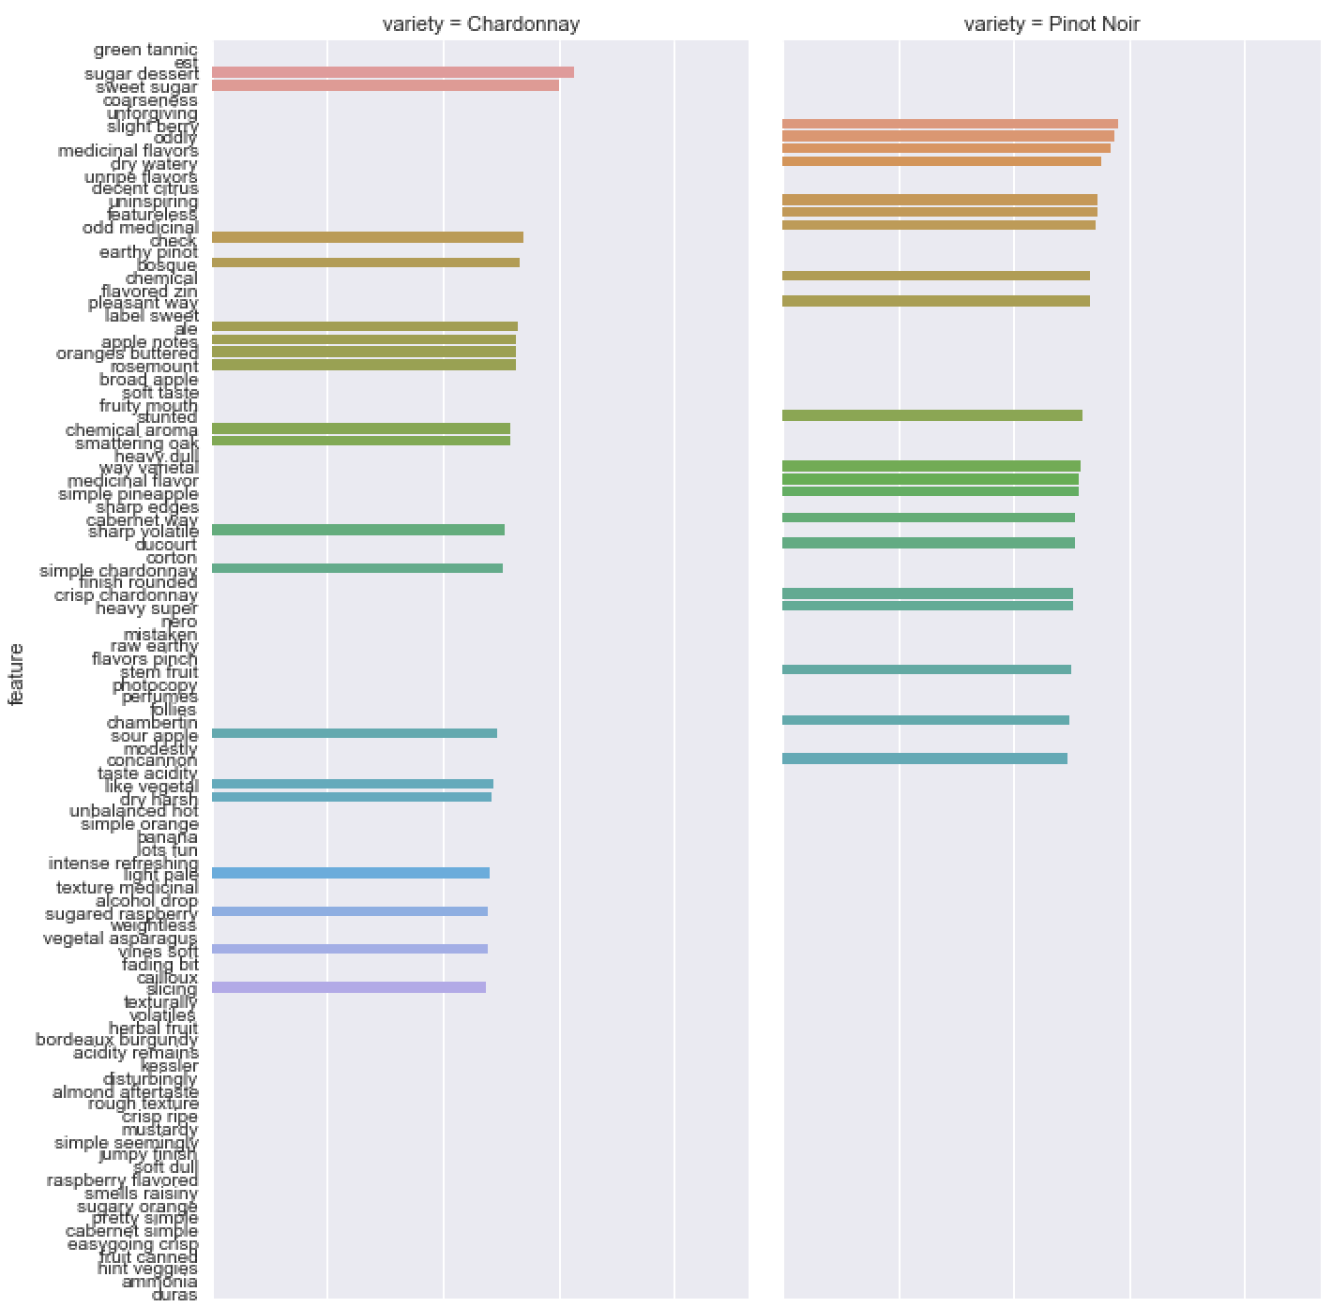
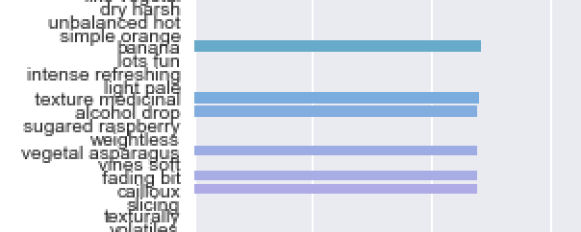
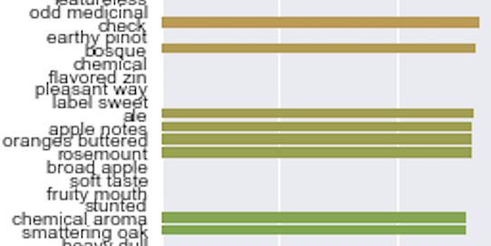
TF-IDF Results from Variety

Slide 7
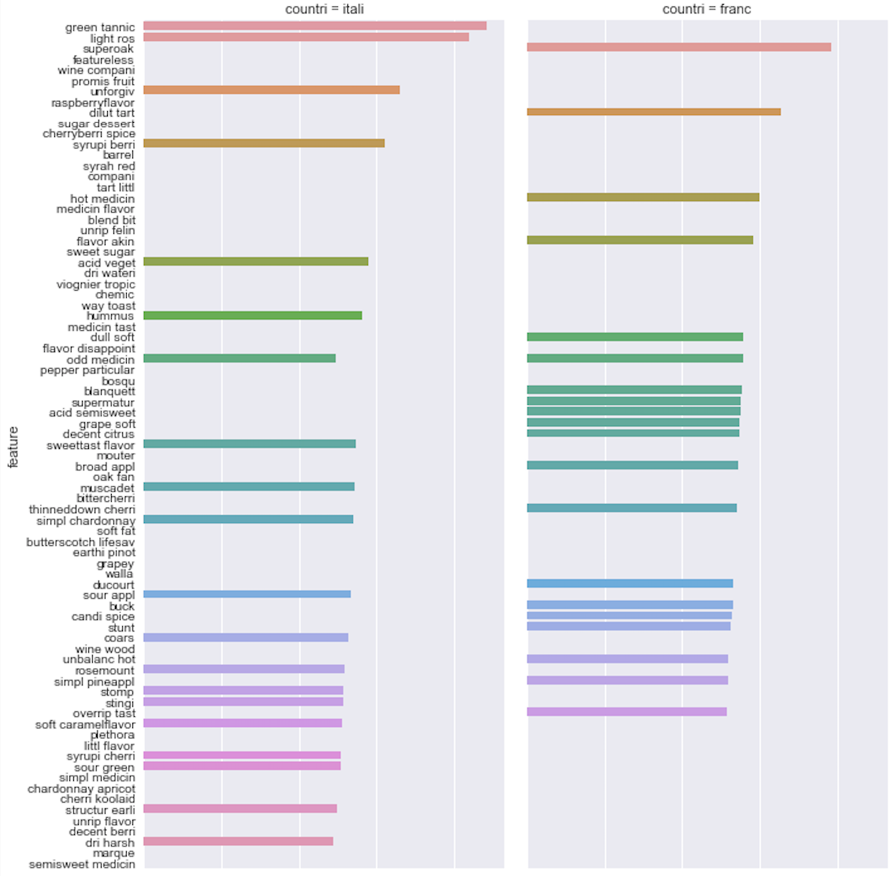
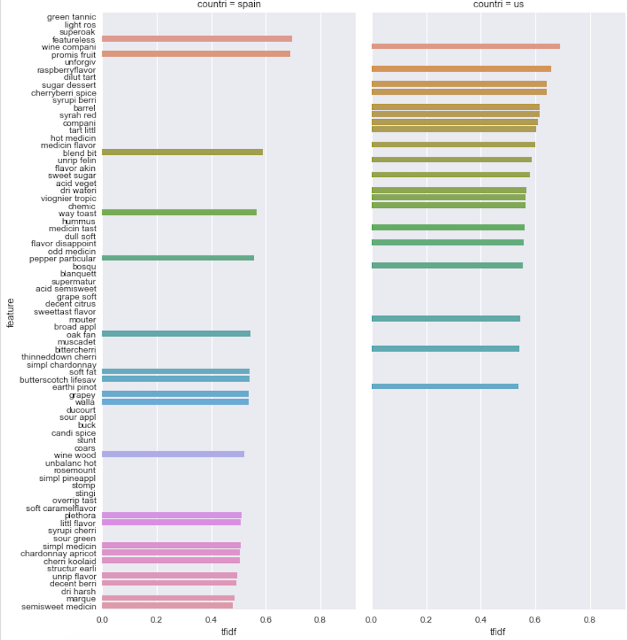


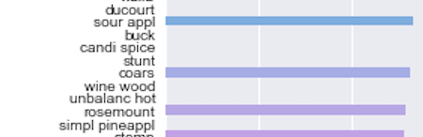
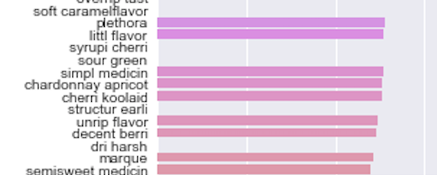
TF-IDF Results from Country

Slide 8
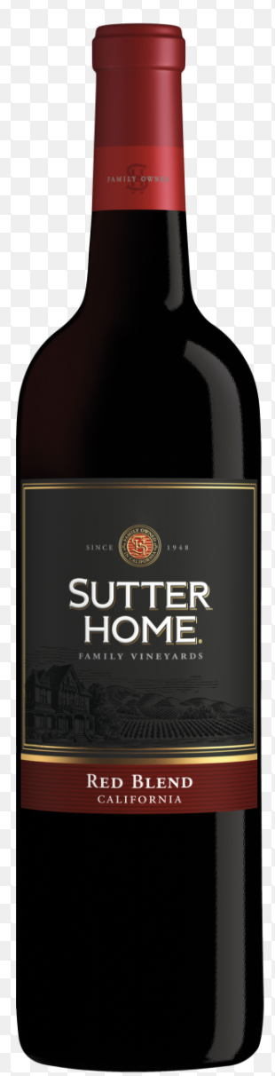
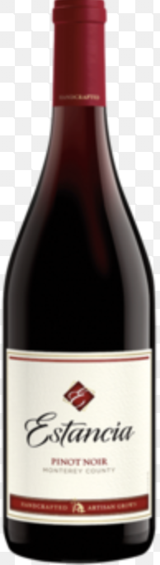
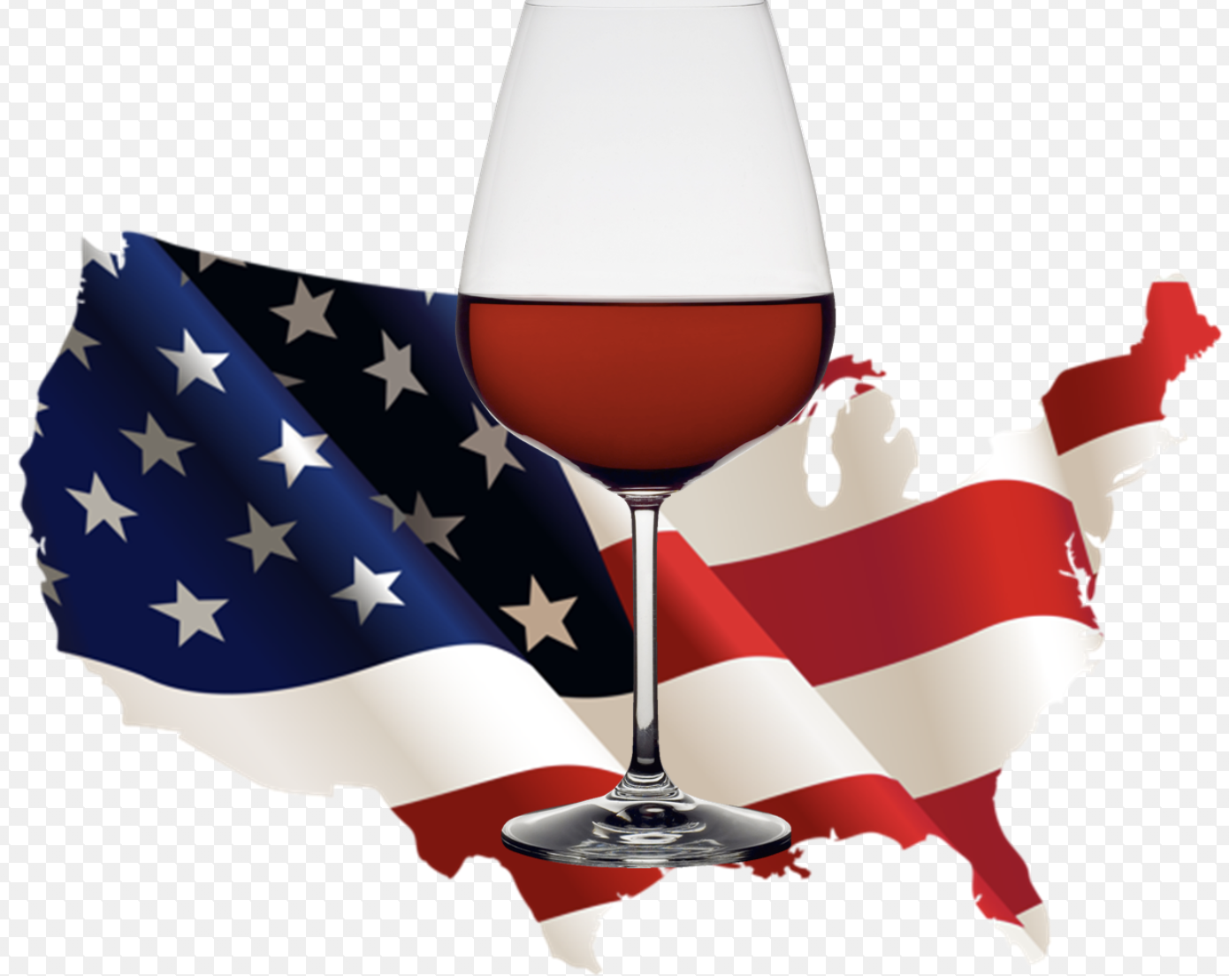
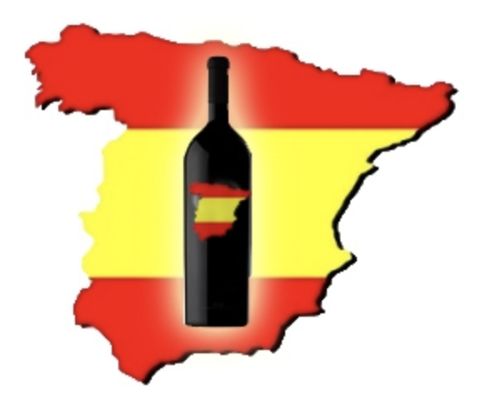
Guiding Questions
1. What are the best description features of different varieties of wine?
Red Blend wine was coarseness and suitable by dessert.
Pinot Noir wine tasted like slight berry, oddly, and medicinal flavors.
2. What are the best description features of different country’s wine?
US liked to make berry and sweet flavor wine while Italy liked to make tart wine.
Spain wine were always criticized as featureless and way toasted.
3. Can we predict wine price range based on description features?
The answer is yes!
Pictures are belong to http://www.artofthetable.com/

Slide 9
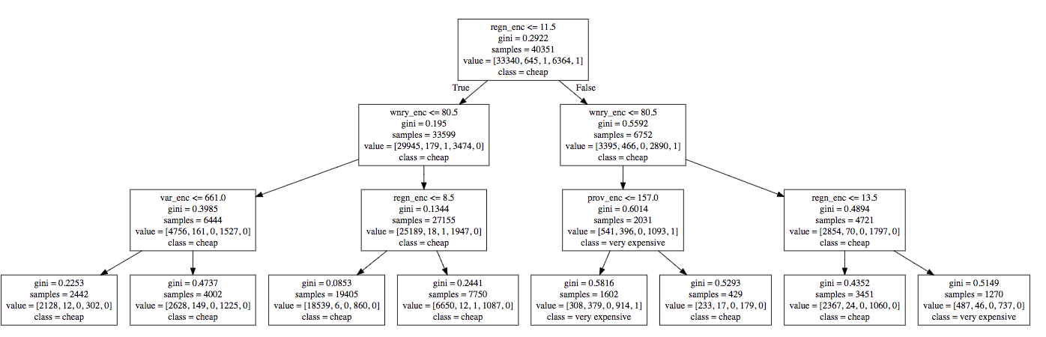
DECISION TREE
cross_val_score: 0.847

Slide 10
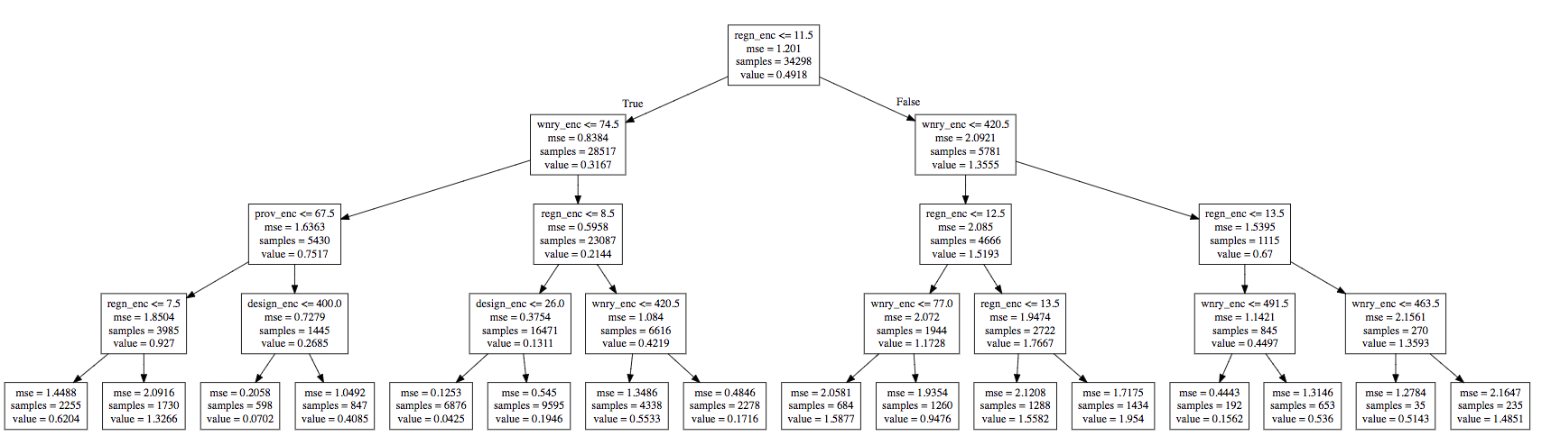
REGRESSION TREE

Slide 11
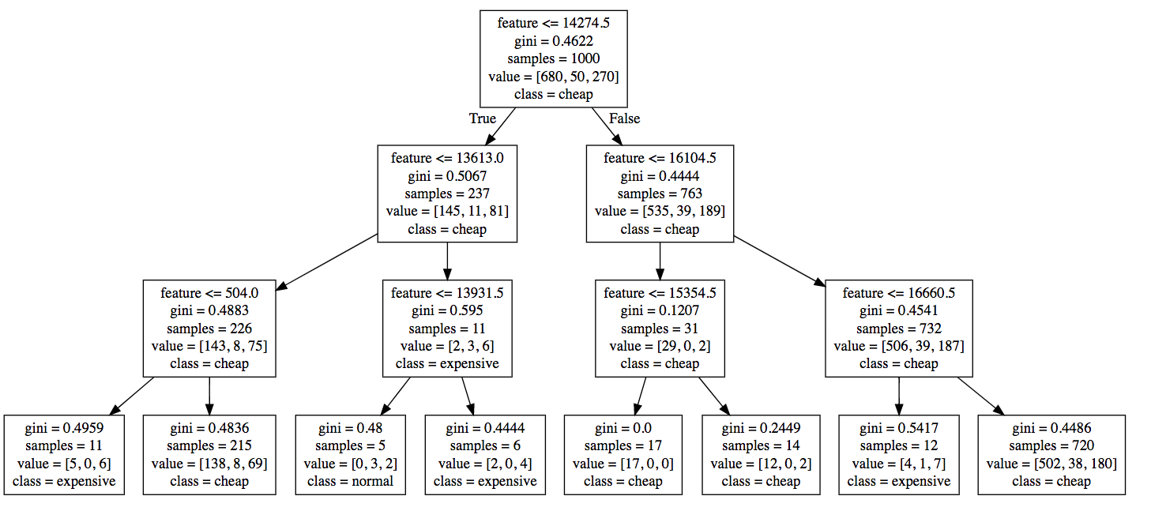
Decision Tree with Description Features
cross_val_score: 0.826

Slide 12
Thank you
Questions?

