Slide 1


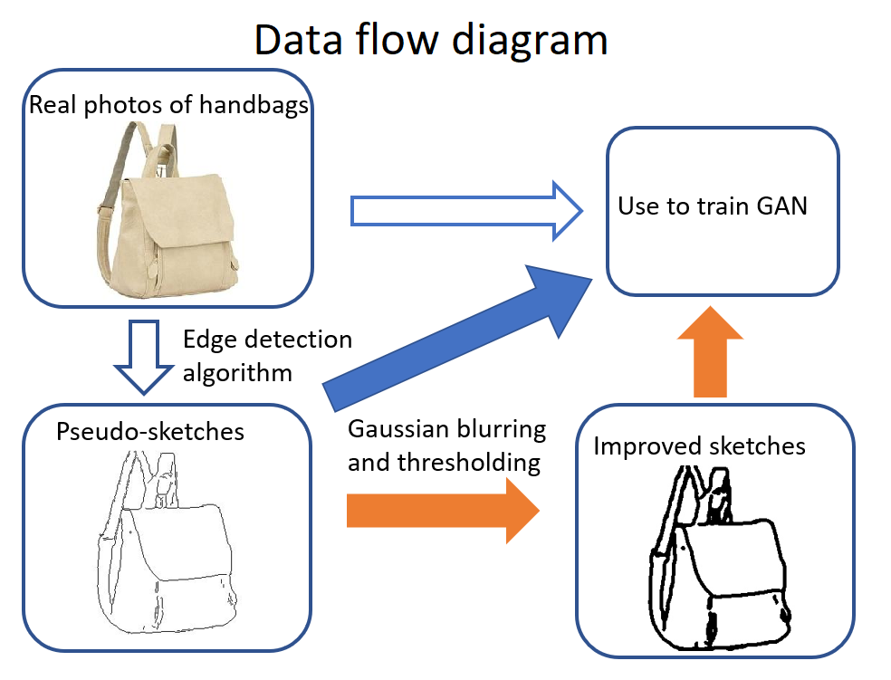
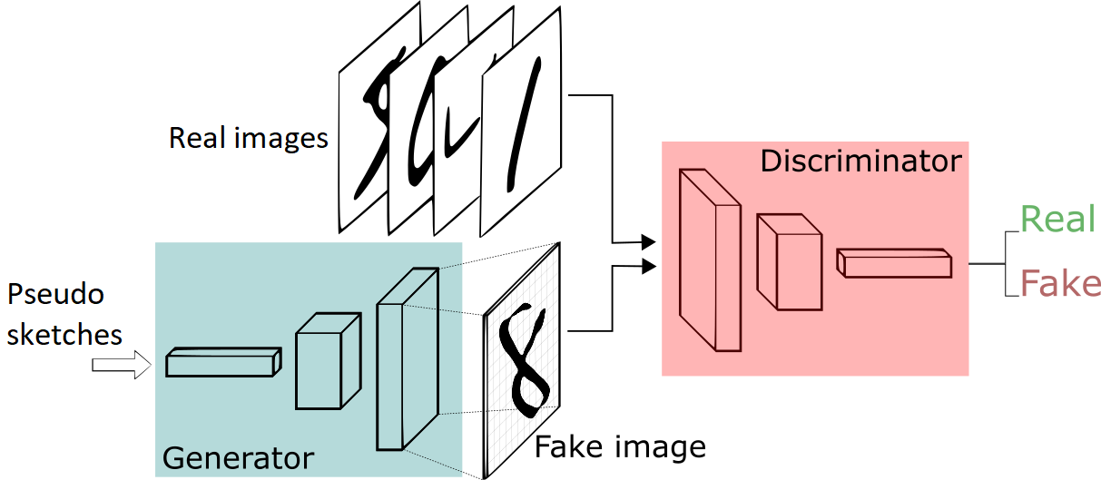
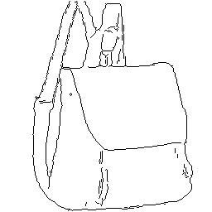
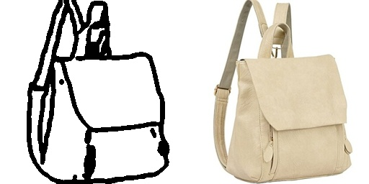
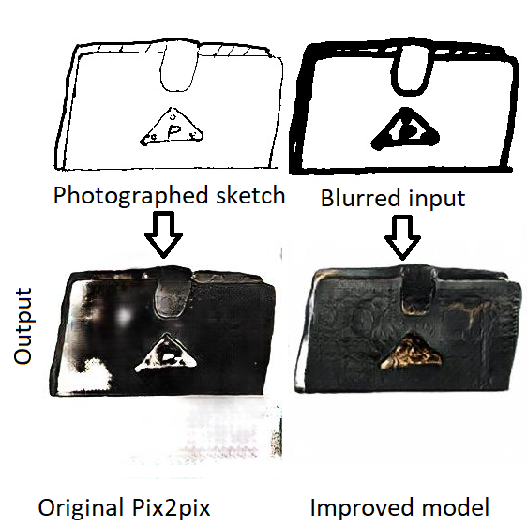
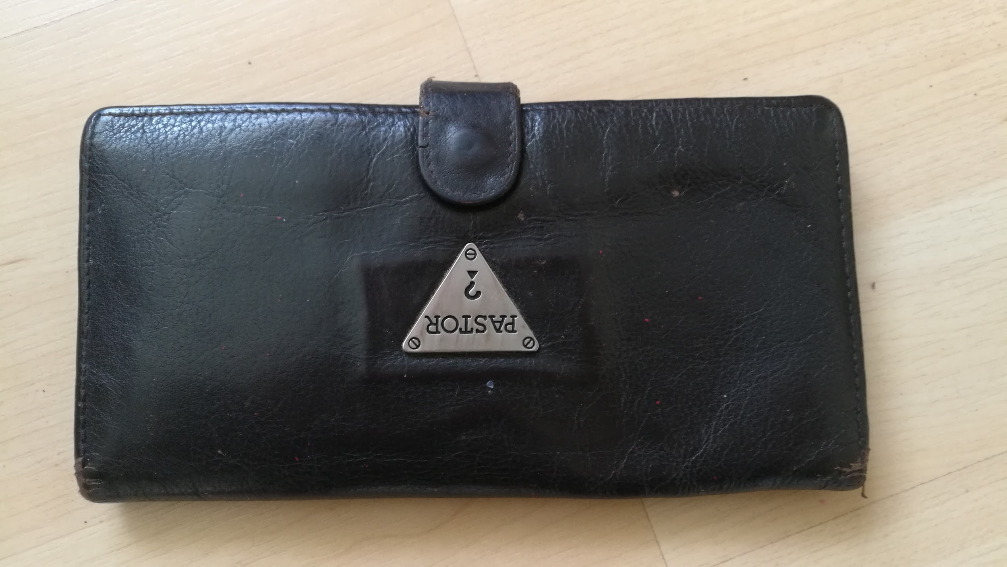
Generating Realistic Sketch-based Images via GANs
Tianyue Zhao, Andrew Zhao, and David Shen
¹Gunn High School, ²Launch Capital
Sketch-Based Image Synthesis (SBIS) using Generative adversarial networks (GANs) has enormous potential. (Sangkloy, et al., Liu, et al.) Composing an image, especially a photorealistic one, currently requires hours of highly repetitive work. Meanwhile, SBIS allows users to draw a rough sketch of the desired image and immediately receive a photorealistic image generated by the computer, potentially saving millions of dollars and hours for the image composing, comics, and animation industries. (Isola, et al.) The structure of a GAN is illustrated in Figure 1.
However, current SBIS software, with pix2pix by Isola, et al. being a representative example, can not yet generate images realistic enough for real-world use. Also, the real-world performance of these programs is considerably worse than their performance on training data. We determined that
INTRODUCTION
RESEARCH METHODOLOGIES
We use a GAN hosted on a GPU server to create our sketch-based image synthesis program. Our main focus is to improve the program by feeding higher-quality test data that the GAN can use.
We apply Gaussian blurring with a kernel size of 9X9 pixels, followed by thresholding. These two steps merge the lines that are close together but originally separate, eliminating unnecessary and unnatural details. The GAN is then trained on these images with batch size 1 and 40 epochs of 10000 training examples each.
Our goal is to collect both quantitative and qualitative data: quantitative data in the form of image statistics for every trial and qualitative data in the from of the images themselves.
this is largely because the pseudo-sketches used for training are not realistic enough, which aligns with the principle of “garbage in, garbage out”. We therefore set out to investigate: can augmenting SBIS GANs with conventional image-processing algorithms result in better performance?
Fig 1. GAN diagram
Fig 2. Research Methodology Visualized
We have proved that augmenting SBIS GANs with conventional image processing algorithms can result in substantially more realistic generated images. However, some issues more dependent on the nature of the neural network still remain. For example, computation of the mean power spectrum for computer-generated images fail to match distributions of ones generated using natural images.
Future work:
1. Generalized SBIS program
Right now, our program mainly focuses on handbags. We can see if our results hold if we replicate our experiment using different ‘themes’ of test data, such as if we used animal pictures.
2. Color-hints
The author can currently only control the shape, not the color, of the generated image. We can work towards enabling color-control by placing blots of the desired color in parts of the sketch.
3.Additional augmentation
We have shown that augmenting advanced neural networks with conventional image processing algorithms can result in great improvements. More methods of augmentation should be explored to reveal more of the potential of this strategy.
The output of the SBIS (short for Sketch Based Image Synthesis) Neural Network on human-drawn sketches is substantially naturalized.
Before, there were significant problems with the generated images. There are still some differences, but the biggest discrepancies have vanished.
We have vastly improved the resilience of SBIS algorithms to variations in the quality of input sketches.
For example, the performance of the model does not differ much between sketches drawn with thicker lines and thinner lines. The original model only accepted thin lines.
As a result, real life application of SBIS is now much more viable.
We also proved that augmenting Neural Networks with conventional image processing methods can be highly successful.
CONCLUSIONS, IMPLICATIONS, AND NEXT STEPS
DATA AND FINDINGS
DISCUSSION, ANALYSIS, AND EVALUATION
Fig 3. Original pseudo-sketch Improved sketch Actual bag
The improved sketch does not contain as many unnatural details, and resembles an actual human-drawn sketch much more closely. Training the model on these improved sketches made the model perform better on human-drawn sketches.
ACKNOWLEDGEMENTS / REFERENCES
Special thanks to Dave Shen for giving helpful feedback on our milestones.
***Works Cited:
Goodfellow, I. J., Pouget-Abadie, J., Mirza, M., Xu, B., Warde-Farley, D., Ozair, S., … Bengio, Y. (2014). Generative adversarial nets.
Liu, Y., Qin, Z., Luo, Z., & Wang, H. (2017). Auto-painter: Cartoon image generation from sketch by using generative adversarial networks. Retrieved from https://arxiv.org/abs/1705.01908
Sangkloy, P., Lu, J., Fang, C., Yu, F., & Hays, J. (2016). Scribbler: Controlling deep image synthesis with sketch and color. Retrieved from https://arxiv.org/abs/1612.00835
Isola, P., Zhu, J., Zhou, T., & Efros, A. A. (2017). Image-to-image translation with conditional adversarial networks.
Güçlütürk, Y., Güçlü, U., Van Lier, R., & Van Gerven, M. A. (2016). Convolutional sketch inversion.
Jin, Y., Zhang, J., Li, M., Tian, Y., Zhu, H., & Fang, Z. (2017). Towards the automatic anime characters creation with generative adversarial networks.
Karpathy, A. (n.d.). Generative adversarial networks.
Ledig, C., Theis, L., Huszar, F., Caballero, J., Cunningham, A., Acosta, A., … Shi, W. (2017). Photo-realistic single image super-resolution using a generative adversarial network.
Liu, Y., Qin, Z., Luo, Z., & Wang, H. (2017). Auto-painter: Cartoon image generation from sketch by using generative adversarial networks. Osokin, A., Chessel, A., Carazo Salas, R. E., & Vaggi, F. (2017). GANs for biological image synthesis.
Reed, S., Akata, Z., Yan, X., Logeswaran, L., Schiele, B., & Lee, H. (2016). Generative adversarial text to image synthesis.
s
Original wallet
Fig 4. The improved model has substantially improved performance
The improved model generated an image with less white space and realistic use of colors, whereas the original model left the lower left portion and the triangle blank. However, the texture on the generated image leaves room for improvement.
Notes:
1

