Slide 1
Housing crisis in Ireland
National College of Ireland
PGDDA_SEP24 project
Ana Pusic, Tibor Toth
X24163392, x24142239

Slide 2
Project content
The housing crisis is a frequent topic in public life - we are interested in its data-based characteristics, as data-based crisis management can be effective.
It is a complex issue with economic, geographic, demographic, international, labor market, social, and many other dimensions.
Our two main research directions:
What is its size, how many new dwellings can solve it?
What sort of data can describe its geographic and demographic structure?
Our toolkit consists of Python, MongoDB, PgSQL, Word, and Power BI, using SQL, py, csv, txt, xlsx, pbix, png, and docx files during the data management and reporting process.

Slide 3
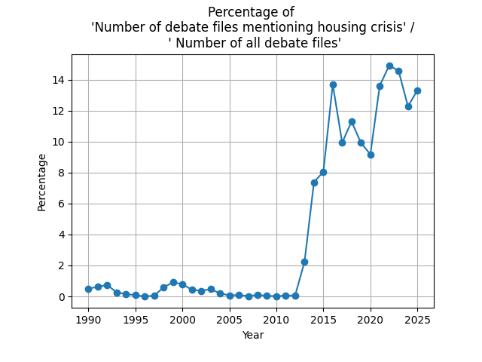
Crisis: compared to what? What is the last ‘non-housing-crisis’ year?
Politics is able to compress all relevant significant aspects.
Data resource: Oireachtas: API -- > XML files -- > debate / speech texts.
XML : if the ‘housing crisis’ is subject of the of debate / speech: text analysis.
Python: number of the debate files and files that contain ‘housing crisis’, and visualisation.
Indicator: the percentage of ‘housing crisis’ files out of all files in each year.

Slide 4
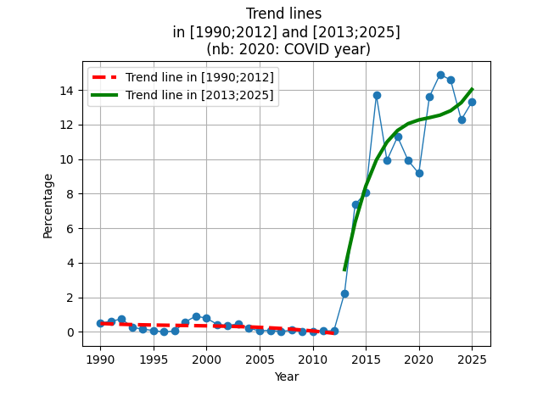
The base year is: 2012.
Trend has an elbow point in the year 2012.
Linear, quadratic and cubic trends are similar.
The cubic trend lines are indicated on the chart.
The break in the trend is obvious: change after 2012.
NB: events, like Brexit or Covid related debates, may have impact.
Year result: 2012 was the last non-crisis year -- > 2012 is the state to which we should return.

Slide 5
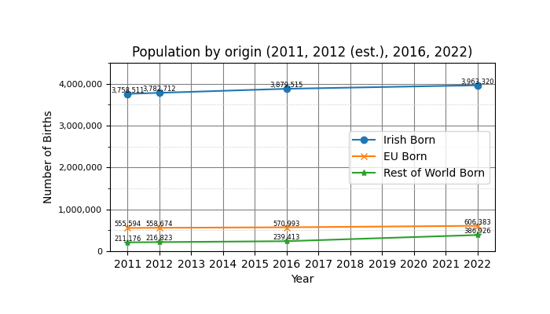
2012 census data set -as the base year- is needed: estimation
CSO census data: 2011, 2016, 2022.
2012 data set must be produced.
Base year for 2012 estimate: linear between 2011 and 2016.
Many possible indicators in housing subject, e.g.: population, place of birth, geographic data, genaral housing data, split of house/ bungalow / flat / apartment data, etc. Population by place of birth is indicated on the chart.
Our main indicator on national level: number of people / dwelling (next slide).

Slide 6
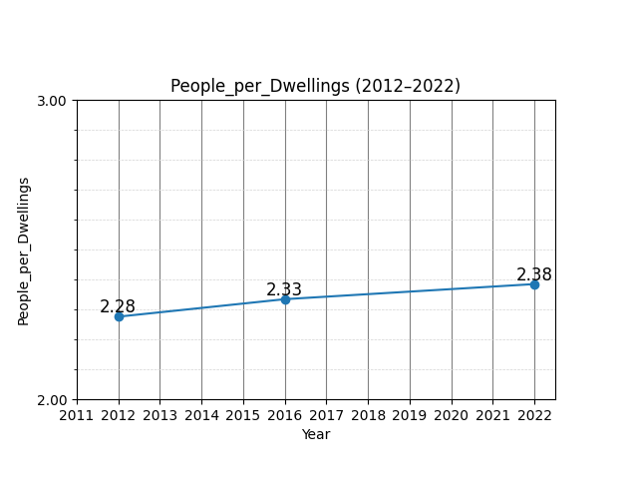
The scale of the crisis on national level: 294K dwellings in 2030
2012: 2.28 people / dwelling; 2022: 2.38 (I.e. 100 dwellings served 228 people in 2012 and 238 in 2022)
2012-2022 shortage is143K. (= Population/ 2.28 – available dwellings in 2022).
2022-2030 shortage= 151K. (=Population growth (2022 to 2030 est.) / 2.28).
Total shortage in 2030: 294K dwellings. (=143K + 151K above)
Government’s text in 2025: 300K.
Our other possible indicators showed 250K and 285K. We accepted 294K as the estimate.
NB: Government’s model is obviously
more complex and
applies more detailed assumptions.

Slide 7
Our project’s data flow in CRISP-DM approach
Business understanding, Data understanding
CSO census datasets with metadata: 2011, 2016, 2022: csv
Data preparation
Python for API / XML scraping: py, html, xml, txt
Filtered data for modelling: SQL, csv
Modelling, Evaluation and Deployment
Python data processing for national level numbers: csv/ txt, py. Reports in png, pibx, docx, pptx, mp4.
SQL analysis for detailed reports: sql. Reports in png, pibx, docx, pptx, mp4.
Research papers, Media articles: html, pdf
Other inputs.
Oireachtas API structure; Debate and speech text: html, xml
PostgreSQL DB for structured data: csv / PgSQL
Mongo DB for semi-structured data: Mongo DB

