Slide 1
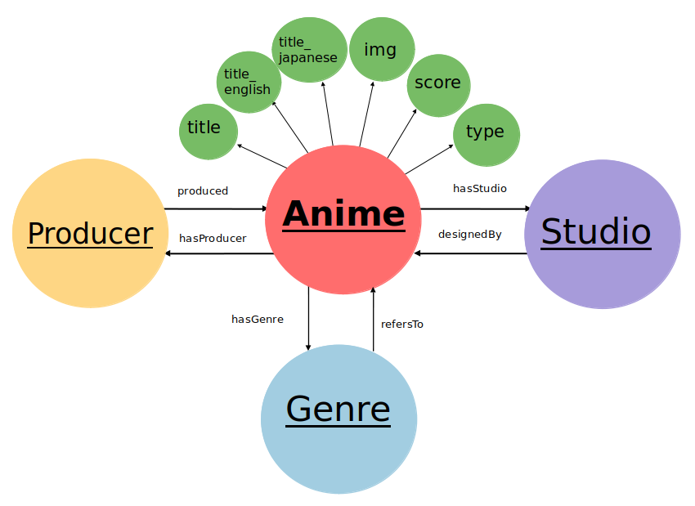
Ontologia

Slide 2
title_
japanese
img
title_
english
score
title
type
produced
Anime
hasStudio
Producer
Studio
hasProducer
designedBy
hasGenre
refersTo
Genre

