Slide 1
SafeStreets
Tiberio Galbiati – Saeid Rezaei

Slide 2
Requirement Analysis
and Specification Document
(RASD)

Slide 3
Goals & use-cases of the system
Reporting
Picture
Location
Kind of violation
Mining information
Heatmap
Statistics
Tickets
Automatic generation
Approval by policemen

Slide 4
Requirements
Requirements
Form: User must be able to choose the kind of violation from a list
Date, time and position should be automatically added to the violation reported
The user must be able to select the vehicle to report in case there are other vehicles in picture
Heatmap: an interactive map with a colored overlay to show how many violations happened in each street
Application must be able to automatically generate a ticket and let policemen approve them

Slide 5
Assumptions
Device
HD camera
GPS location with at least 5m accuracy
Plate Recognition
Accuracy > 95%
No manual insertion
Authority integration
Verified accounts
Access to vehicle registration databases
Notes:
Key decision not letting user to manually write the plate to have only consistent data

Slide 6
Alloy

Slide 7
Signatures
abstract sig User { name: one Name, surname: one Surname, email: one Email, password: one Password, accessLevel: one Bool, minedInfo: some MiningModule, }
sig Violation { location: one Location, addr: some GPSconvertor, reporter: one Costumer, photo: one Photo, licensePlate: one ALPR, date: one Date }
sig Customer extends User { costumerLocation: one Location, accessLevel = False
}
abstract sig MiningModule { violations: some Violation,
}
sig AverageViolations extends MiningModule {}
sig OffenderFinder extends MiningModule {}
sig ThirdParty extends User { tickets: some Ticket, #tickets >= 0 accessLevel = True }

Slide 8
Facts
// Each Ticket Issued by one Authority
fact
EachTicketOneAuthority { all t: Ticket | one au: Authority | au.tickets = t
// location of an EndUser should be equal to the reverse geocoding address
fact EqualLocationForEndUserAndGeo {
one revGeo : ReverseGeoCoding|
one u : EndUser |
revGeo.loc = u.userLocation
}
// Each violation has only one corresponding ticket
fact EachViolatioContainsOneTicket {
one t : Ticket , v : Violation |
t.violations = v
{

Slide 9
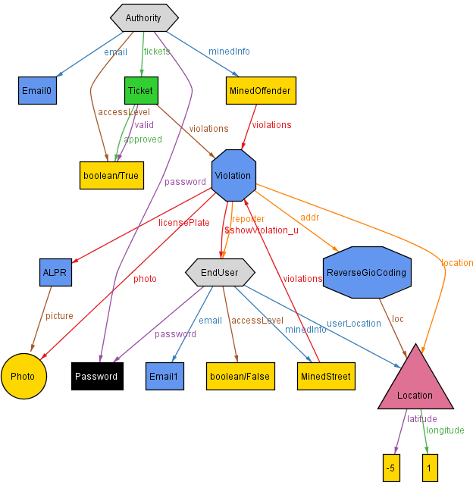

Slide 10
Design Document
(DD)

Slide 11
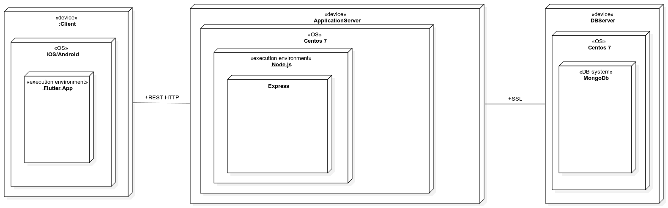




Deployment architecture
Deployment
--API--
--SSL--
Notes:
3 tier architecture
Mobile app for both platforms mainly just for presentation
Our App server for main logic
External database to increase and scalability

Slide 12
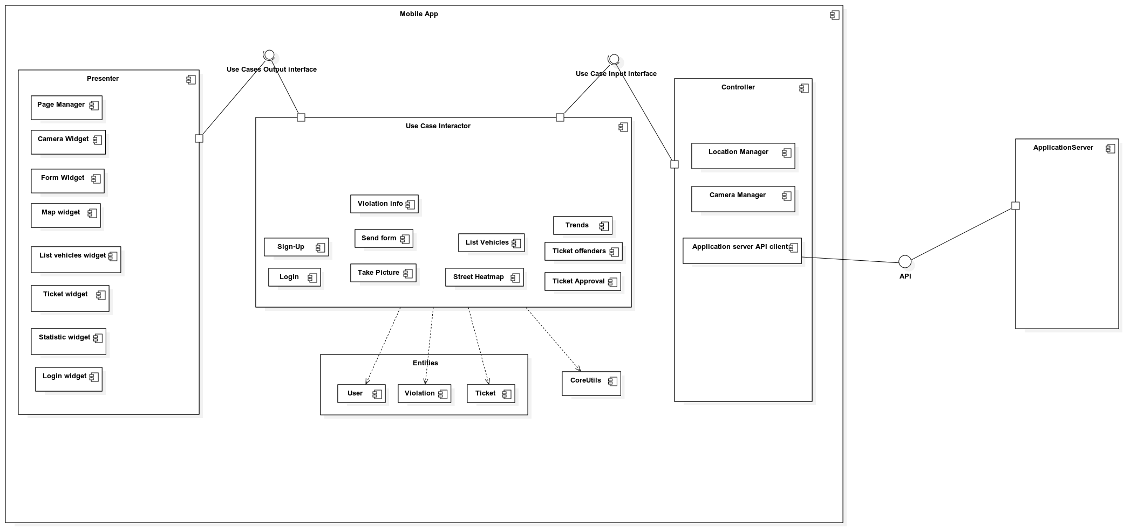
Components & clean architecture
Mobile App components architecture
Notes:
The core are use cases: clean architecture means having one component for each use case. Two interfaces . In and out

Slide 13
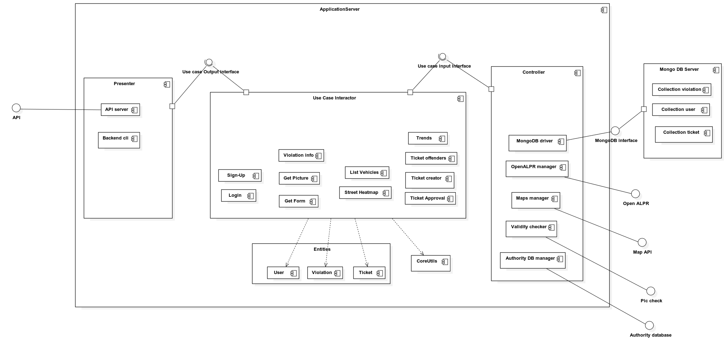
Components & clean architecture
Server Components architecture

Slide 14
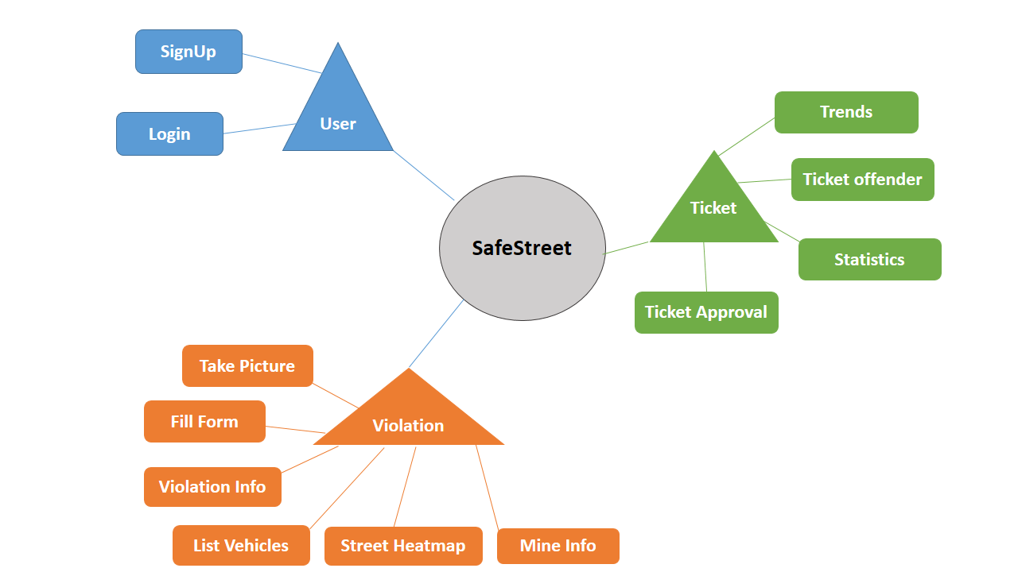
Implementation and testing
Implementation & Testing

