Slide 1

A Study on Convolutional Neural Networks Variant for Face Mask Classification
Team ID:39 Presenter: Zihong Sun
Team Members: Siriporn Pattamaset, Muhammad Rifki Kurniawan,
Casarico Massimo, Qixiu Yang, Galbiati Tiberio, Lu Xu

Slide 2
Introduction
Proposed method
CONTENTS
Experiment and Result
Conclusion

Slide 3
01
Introduction

Slide 4
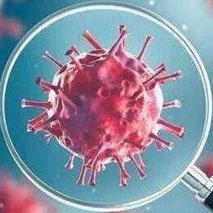
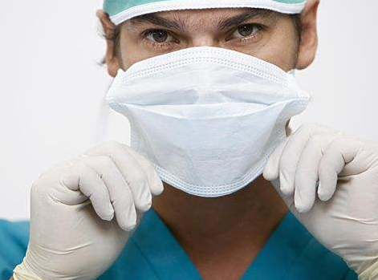
Introduction
The COVID-19 pandemic has become global pandemic
Testing whether people wear masks has become a new demand
Creating an algorithm that can directly detect is a person is wearing a face mask or not.

Slide 5
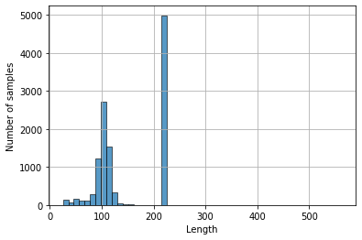
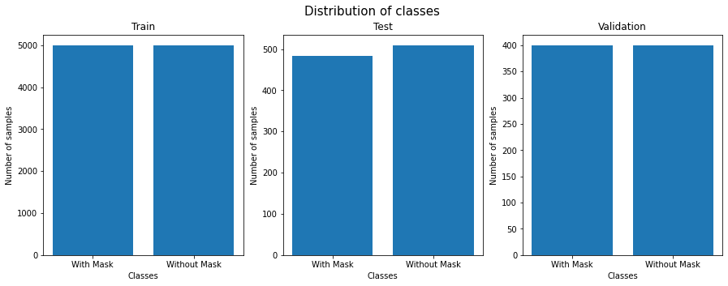
Introduction
Introduction to The Face Mask Data Set
Training Set
10,000 samples
Test Set
992 samples
Validation Set
800 samples
The number of the positive images and
negative images is balanced in each class
Data Set
12000 images, 328.92MB in size
minimum size: pixels
maximum size: 563 pixels

Slide 6
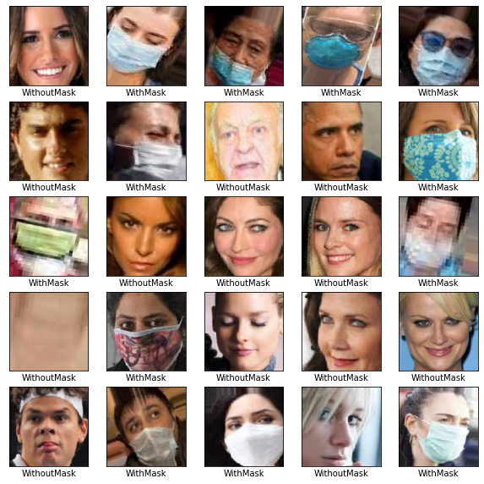
Introduction
The Face Mask Data examples

Slide 7
Introduction
Deep Learning Frameworks
TensorFlow
Keras
PyTorch
Binary Classification and Image Classification
Classification task is two categories
Distinguish different types of images according to the semantic information of the image
Transfer learning
The transfer of learned and trained model parameters to a new model to help new model training

Slide 8
02
Proposed method

Slide 9
Proposed method
Transfer Learning
Formalize transfer learning in term of backbone/headclassifier
Define loss function (crossentropy/binary-cross-entropy)
Problem Formulation
2 classes classification problem formulation
CNN
feedforward neural network
including convolution calculations and a deep structure
Pre-trained ImageNet models
To solve the problem that the network converges more slowly and the accuracy rate becomes worse.

Slide 10

Proposed method
Colaboratory: A Jupyter notebook environment that requires no setup and runs entirely in the cloud
Creating different models based on the same dataset
Using different architectures and hyperparameters

Slide 11
03
Experiment and Result

Slide 12
Experiment and Result
THE SUMMARY OF PARAMETERS SETUP IN EACH EXPERIMENTS
Model | Image shape | Batch size | Learning rate
Hand-craft CNN1 | (224x224x3) | 32 | 0.0003
Hand-craft CNN2 | (256x256x3) | 64 | 0.0004
EfficientNetB0 | (224x224x3) | 16 | 0.0003
ResNet18 | (224x224x3) | 32 | 0.001
Xception | (256x256x3) | 64 | 0.001
Hand-craft CNN1
Hand-craft CNN2
Hand-craft CNN models
EfficientNetB0
ResNet18
Xception
Pre-trained models

Slide 13
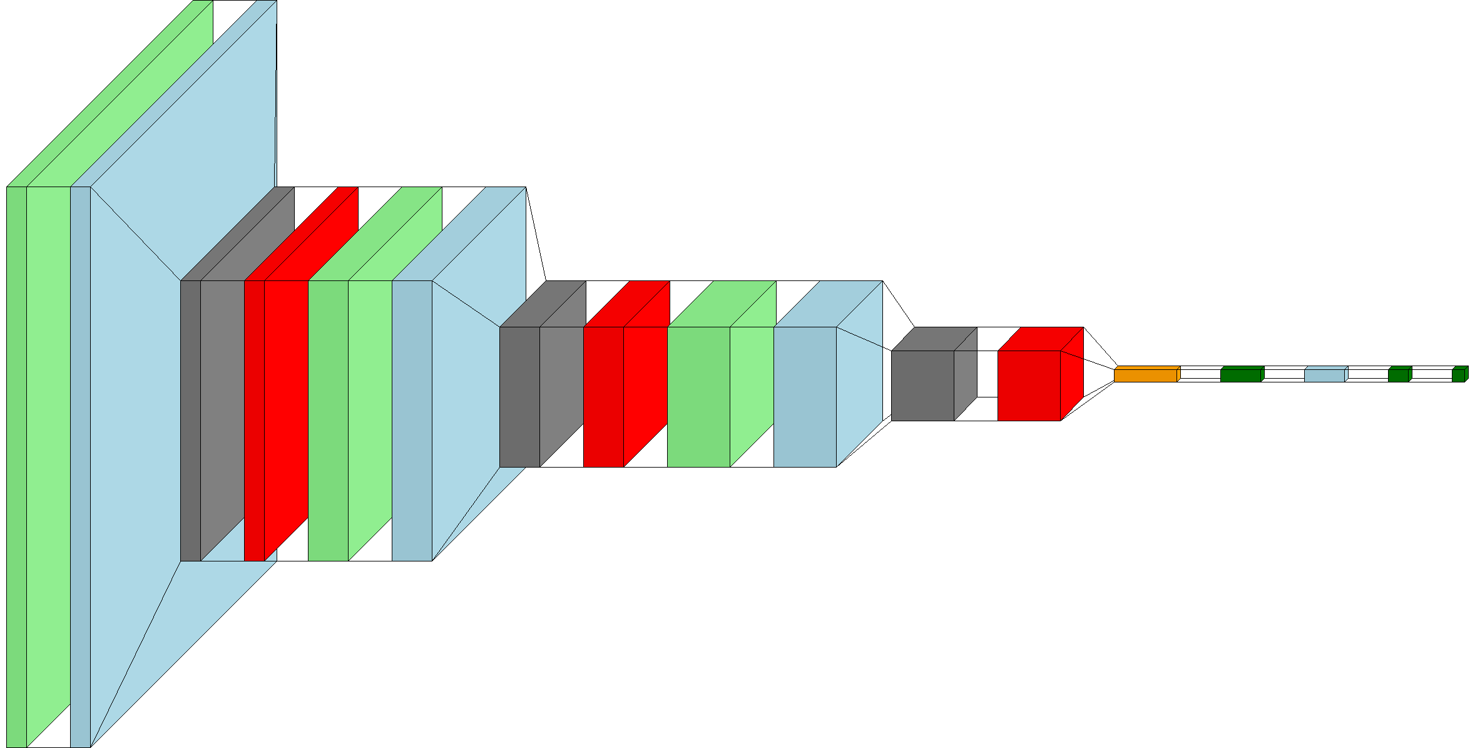
Experiment and Result
Convolutional layers
Batch normalization
Max pooling layers
Dropout
Flatten
Dense
Model 1 : Hand-craft CNN1
224x224x32
3 convolutional layers(light green)
4 batch normalization(light blue)
3 max pooling layers (gray)
1 flatten(orange)
3 dense(green)
112x112x64
56x56x128
28x28x128
32
64
2
Optimized with Adam optimizer
Learning rate = 0.0003
Early stop setting patient = 5

Slide 14
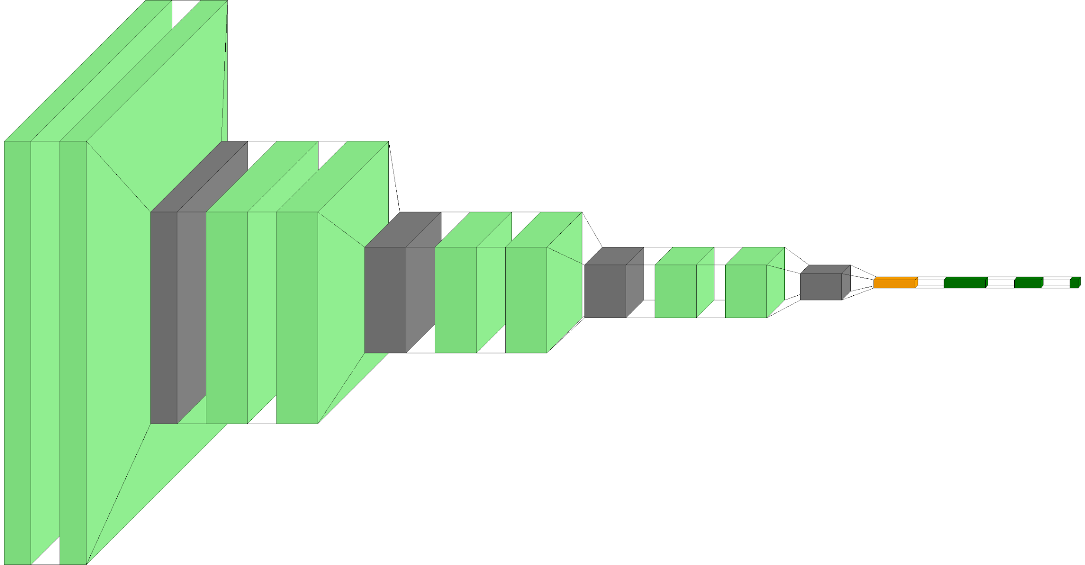
Experiment and Result
Model 2 : Hand-craft CNN2
Convolutional layers
Max pooling layers
Flatten
Dense
256x256x64
3 convolutional layers(light green)
4 batch normalization(light blue)
3 max pooling layers (gray)
1 flatten(orange)
3 dense(green)
128x128x128
64x64x256
32x32x512
128
64
2
Optimized with Adam optimizer
Learning rate = 0.0004
Early stop setting patient = 5

Slide 15
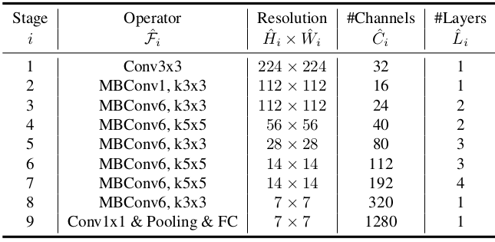
Experiment and Result
Model 3 : Pre-trained model with EfficientNetB0
To apply this pre-trained model to our purpose, we modified classifier from 1,000 classes to 2 classes by attaching fully connected layer
Optimized with Adam optimizer
weight = pretrained weight
Learning rate = 0.00001
Early stop setting patient = 5
EfficientNet-B0 baseline network (Tan, Mingxing, and Quoc Le. "Efficientnet: Rethinking model scaling for convolutional neural networks." In International Conference on Machine Learning, pp. 6105-6114. PMLR, 2019.)
23

Slide 16
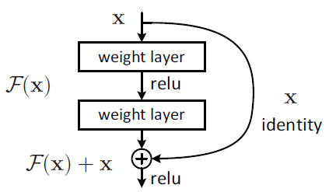
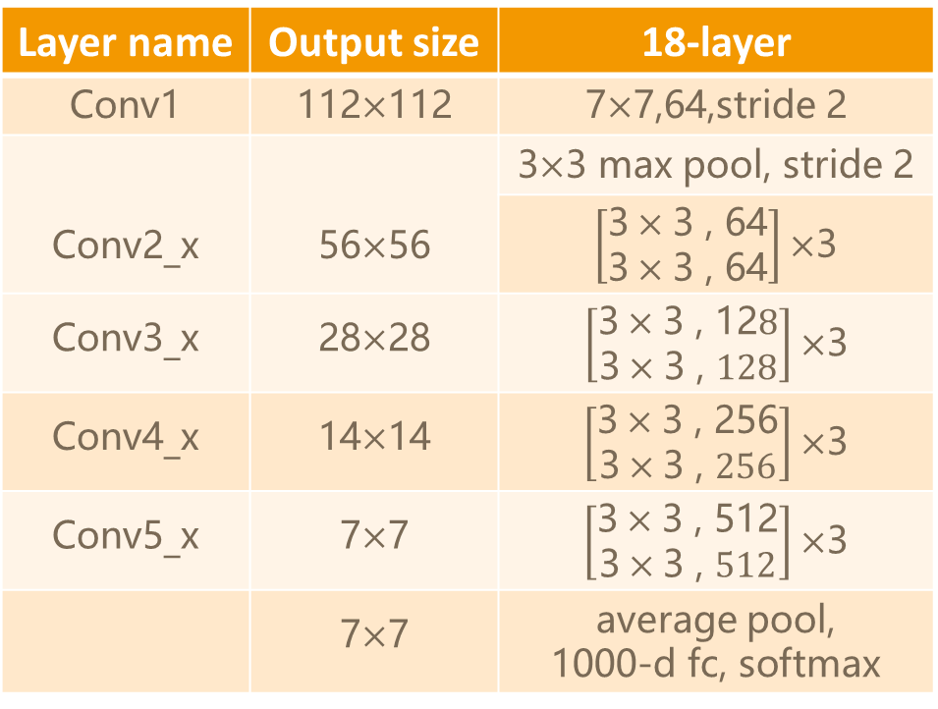
Experiment and Result
Model 4 : Pre-trained model with ResNet18
Layer name | Output size | 18-layer
Conv1 | 112$×$112 | 7$×$7,64,stride 2
Conv2_x | 56$×$56 | 3$×$3 max pool, stride 2
 |  | $\left[\begin{matrix}\text{3}×\text{3 , 64} \\ \text{3}×\text{3 , 64}\end{matrix}\right]×$3
Conv3_x | 28$×$28 | $\left[\begin{matrix}\text{3}×\text{3 , 12}8 \\ \text{3}×\text{3 , }128\end{matrix}\right]×$3
Conv4_x | 14$×$14 | $\left[\begin{matrix}\text{3}×\text{3 , 256} \\ \text{3}×\text{3 , }256\end{matrix}\right]×$3
Conv5_x | 7$×$7 | $\left[\begin{matrix}\text{3}×\text{3 , 512} \\ \text{3}×\text{3 , }512\end{matrix}\right]×$3
 | 7$×$7 | average pool, 1000-d fc, softmax
Kaiming He, Xiangyu Zhang, Shaoqing Ren, Jian Sun" Deep Residual Learning for Image Recognition[C] " IEEE Conference on Computer Vision & Pattern Recognition. IEEE Computer Society, 2016.

Slide 17
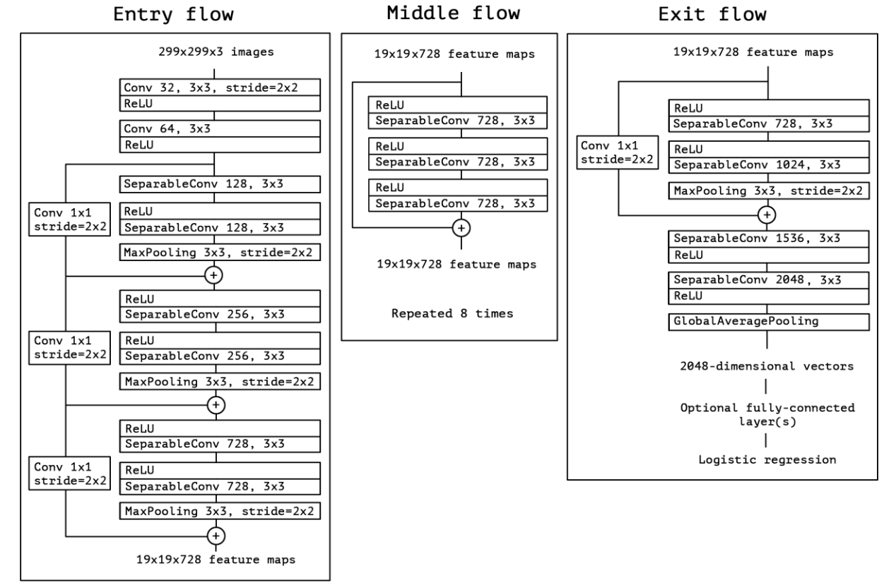
Experiment and Result
Model 5 : Pre-trained model with Xception
Chollet, F. . "Xception: Deep Learning with Depthwise Separable Convolutions." 2017 IEEE Conference on Computer Vision and Pattern Recognition (CVPR) (2017).
Tested different version
• Cross validation
• Using two consecutive trainings
• Callback to control the variation of learning rate

Slide 18
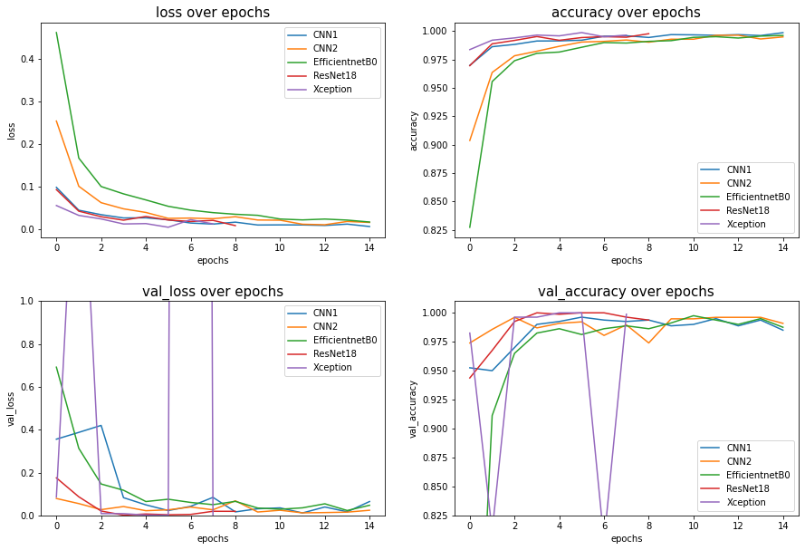
Experiment and Result
Comparing the accuracies in training and validation over epochs
Training loss
Validation loss

Slide 19
Experiment and Result
Comparing the losses in training and validation over epochs
Training accuracy
Validation accuracy

Slide 20
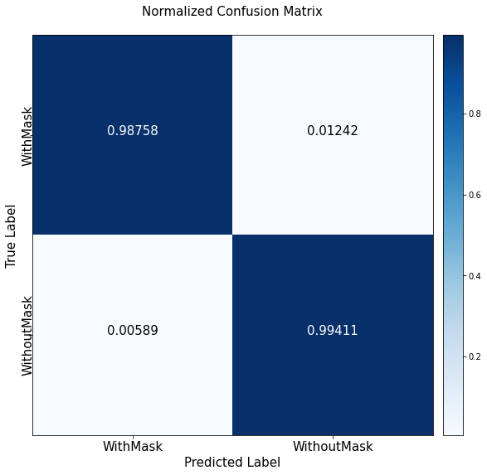
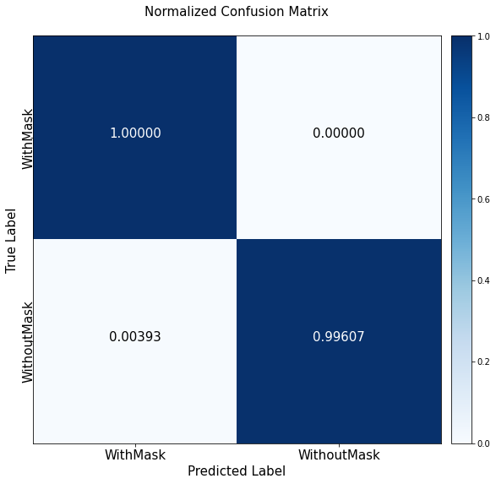

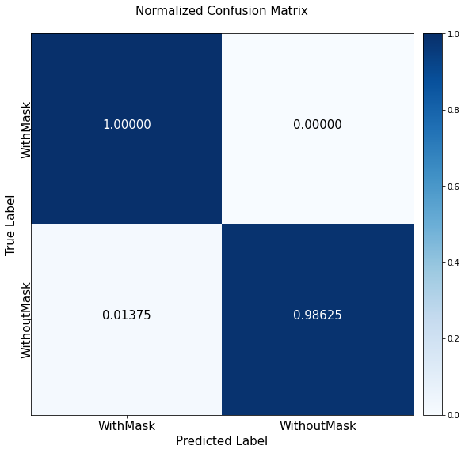
Experiment and Result
Confusion matrix of the test dataset
CNN1
EfficientNet0
CNN2
ResNet18

Slide 21
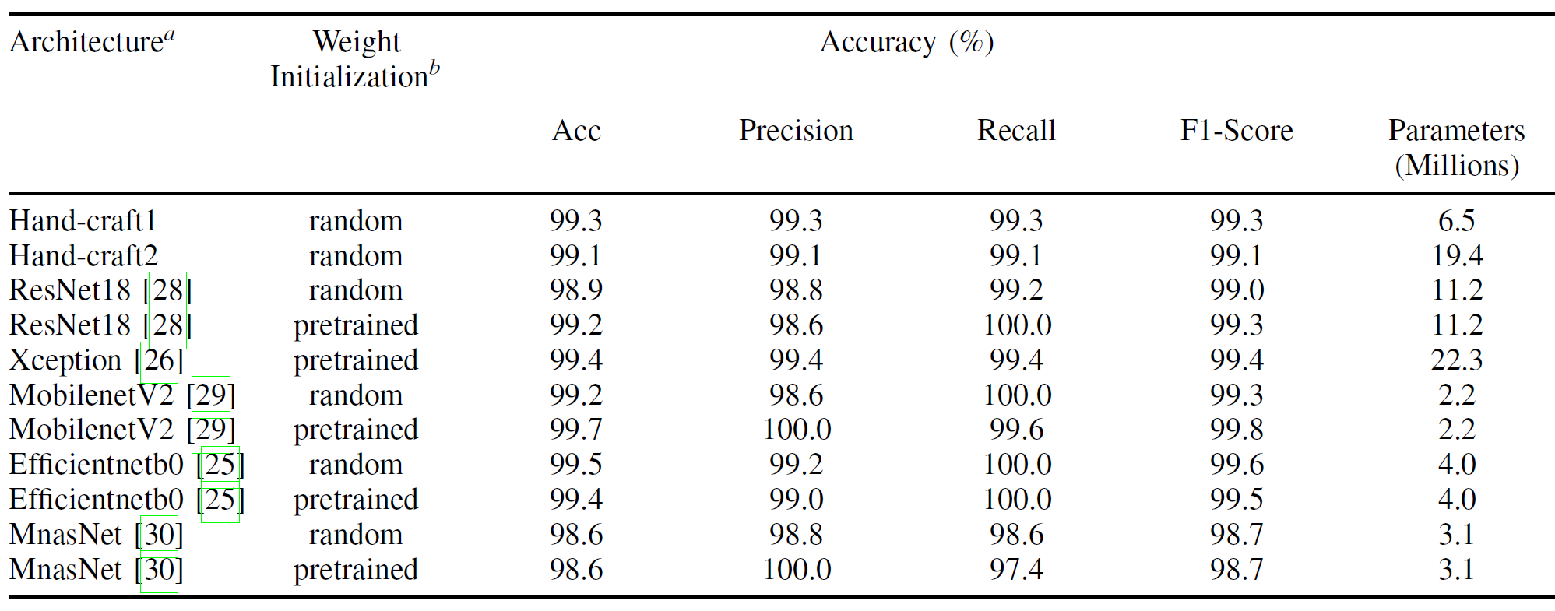
Experiment and Result
ACCURACY AND PERFORMANCE BENCHMARK ON VARIOUS NETWORKS ARCHITECTURES

Slide 22
04
Conclusion

Slide 23
Experiment and Result
ACCURACY AND PERFORMANCE BENCHMARK ON VARIOUS NETWORKS ARCHITECTURES

Slide 24
Conclusion
All the experimental models can achieve the accuracy over 99%.
The dataset seems well prepared, so all the models performed accurately and achieve over 99\% accuracy.
MobilenotV2 can give the best performance over the other models.
Models with Transfer learning
Simple CNNs models
Training the model with pre-trained weights initialization can yield better than random weights initialization.
Compared to other pre-trained models achieving similar accuracy, MobilenetV2 is much smaller than MnasNet, EfficientNetB0, and others.
the simple model of CNNs, such as hand-craft CNN1, provides simple architecture, less complexity with high accuracy as well.

Slide 25
THANK YOU

