Slide 1
URL Shortener
Tiberiu Gabriel Suditu

Slide 2
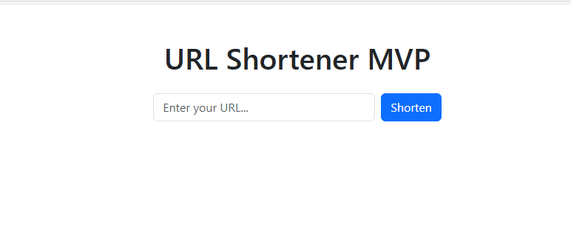
Project Overview
The URL Shortener is a full-stack web application that allows users to convert long URLs into short, shareable links.
Built with a Django backend and a React frontend, the project provides a simple interface for creating and managing short links, ensuring fast redirection and a user-friendly experience.

Slide 3
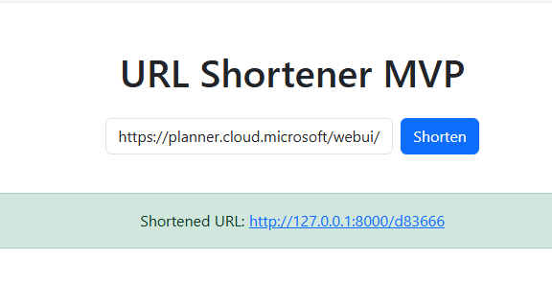
Functional Requirements
Users can submit a long URL and receive a unique, shortened link.
Accessing a short link redirects the user to the original long URL.
The application provides a simple web interface for URL input and result display.
A REST API endpoint is available for programmatic URL shortening.
The system validates URLs and handles invalid input gracefully.

Slide 4
Non-Functional Requirements
The application must provide fast redirection, with minimal latency for users.
Error handling should be robust, ensuring clear feedback for invalid or broken links.
Code quality must follow best practices and PEP8 standards.
Automated tests and continuous integration should be in place to maintain reliability.
The user interface should be intuitive and responsive across devices.

Slide 5
Technology Stack
Backend: Django (Python) for API development and URL management
Frontend: React (JavaScript) for a dynamic and responsive user interface
Package Managers: Pip with requirements.txt for backend, npm with package.json and package-lock.json for frontend
Database: SQLite for lightweight data storage
Testing: Pytest for backend, Jest for frontend
CI/CD: GitHub Actions for automated testing and deployment

Slide 6
Live Demo

Slide 7
Project Structure & Key Directories
The project is organized for clear separation of backend, frontend, and documentation.
backend/: Django project and app for API, URL logic, and database models.
manage.py: Django management script
backend/settings.py: Project configuration
shortener/: URL shortening logic and views
frontend/: React application for the user interface.
src/: Main React source code and components
public/: Static files and HTML template
docs/: Project documentation and requirements.
.github/workflows/: CI/CD pipeline configuration (GitHub Actions)
requirements.txt: Python dependencies
README.md: Project overview and setup instructions

Slide 8
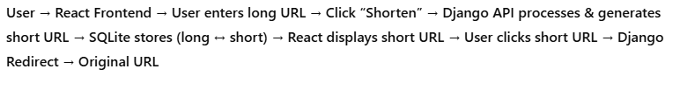
Architecture Diagram
The user interacts with the React frontend, which provides a simple interface for submitting and receiving URLs.
The frontend communicates with the Django backend via REST API calls.
The backend processes requests, generates short links, and stores data in the SQLite database.
When a short link is accessed, the backend retrieves the original URL and redirects the user accordingly.

Slide 9
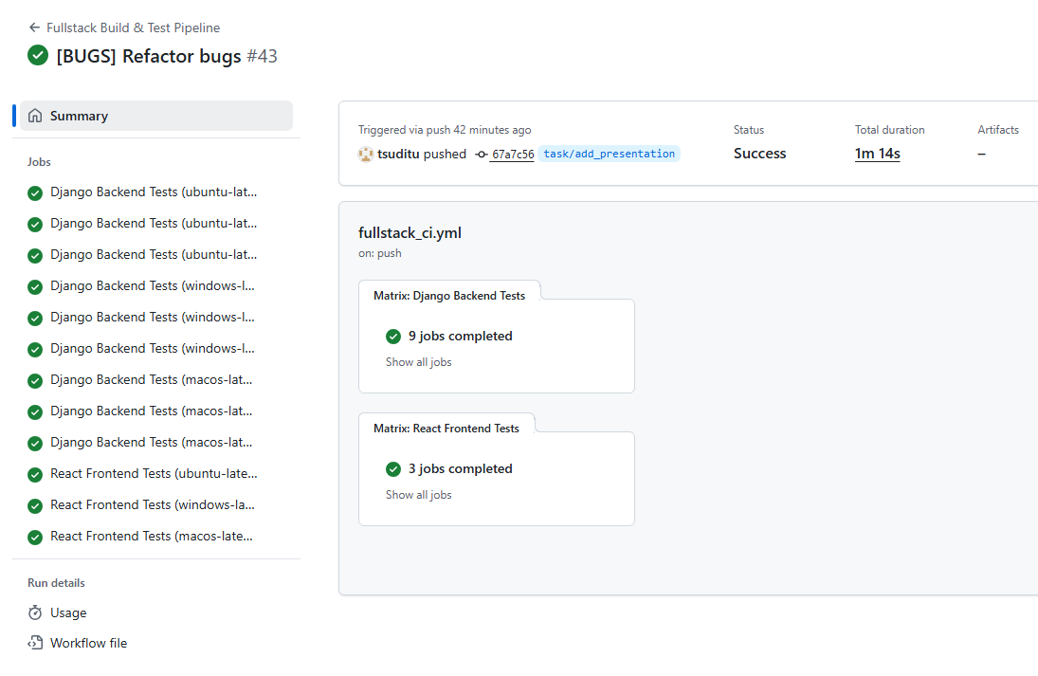
Continuous Integration & Deployment (CI/CD) with GitHub Actions
Automated workflows run on every push and pull request to the repository.
The pipeline installs dependencies, runs backend and frontend tests, and checks code quality.
Ensures that only passing, well-tested code is merged into the main branch.
Provides fast feedback to developers and maintains project reliability.
Easily extensible for deployment or additional quality checks.

Slide 10
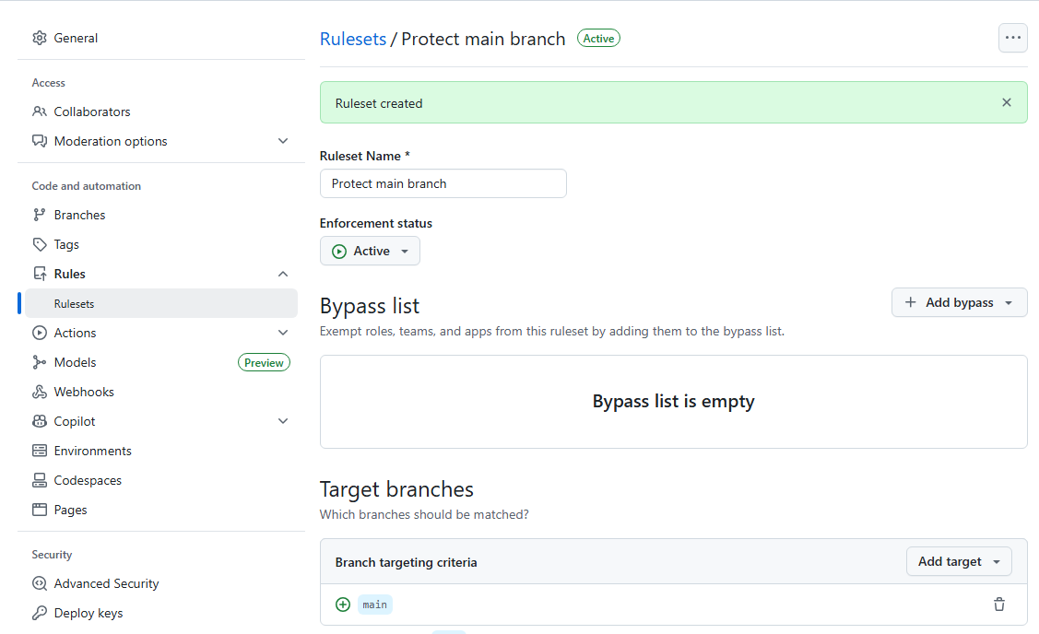
Protecting the main Branch (GitHub Ruleset)
The main branch is protected to ensure safe, stable, and professional development.
Why protect main?
Prevents accidental pushes and force-pushes
Avoids history rewriting and branch deletion
Forces all changes to go through Pull Requests (PRs)
Maintains project stability and code quality
Applied Rules:
No direct pushes to main (restrict updates)
Main branch cannot be deleted (restrict deletions)
Force pushes are blocked (no history rewriting)
Pull request required before merging (enables code review)
(Optional) Require linear history for clean commit structure
Result:
All changes are reviewed and tested before merging
CI/CD can enforce tests and checks
The codebase remains secure, clean, and stable
Accidental mistakes are avoided, following industry best practices

Slide 11
Q&A

Slide 12
Thank you!

