Slide 1
AN IN-DEPTH ANALYSIS OF MISSING MARKS ISSUES IN THE UNIVERSITY OF ELDORET
PRESENTERS
S/N | NAME | REG.NO
1. | TIBERIUS ONCHIRI | AST/057/20
2. | LORENA ATIENO | AST/059/20
3. | KIPROTICH KELVIN KOSKEI | AST/060/20
4. | MARY WANJIKU NJUGUNA | AST/062/20
5. | EMMANUEL LISECHE | AST/063/20
6. | ALICE CHONI NGOMBO | AST/061/20

Slide 2
1. INTRODUCTION
1.1 Background of the study
The University of Eldoret, like many institutions of higher learning, operates within a complex ecosystem of academic administration, where the accurate recording and maintenance of students' academic records are paramount. In recent years, the university has faced challenges regarding missing marks in student records, which has raised concerns among stakeholders.
According to Smith et al. (2019), the accurate documentation of academic performance is fundamental to ensuring transparency, fairness, and credibility within the academic system. However, discrepancies in the recording of marks can have far-reaching implications, including incorrect grade calculations, delays

Slide 3
1.2 Significance of the Research
Improving Academic Integrity: By identifying the extent of missing marks within the University of Eldoret system, this presentation will shed light on the integrity of the academic assessment process. Addressing missing marks is crucial for upholding the university's reputation for fairness and transparency in grading
Enhancing Educational Equity: Investigating specific schools experiencing higher instances of missing marks will help pinpoint areas where students may be disproportionately affected. This information can inform targeted interventions to ensure equitable educational opportunities for all students, regardless of their academic program or department.
Enhancing Institutional Effectiveness: Identifying patterns related to the type of assessment affected, such as Continuous Assessment Tests (CAT), final exams, or both, will enable the university to pinpoint areas where improvements are needed in assessment practices. Developing strategies and interventions to mitigate the occurrence of missing marks will enhance the overall effectiveness and reliability of the university's academic assessment processes, ultimately benefiting students, faculty, and the institution as a whole.
Promoting Gender Equity: By investigating which gender has a higher incidence of missing marks, this study can uncover potential gender disparities in academic assessment. Addressing any gender-based discrepancies in missing marks is essential for promoting gender equity and ensuring that all students have equal opportunities for academic

Slide 4
1.3 Statement of the problem
The persistent occurrence of missing marks within the University of Eldoret System poses a significant challenge to the integrity and reliability of academic records. Despite efforts to mitigate this issue, it continues to persist, raising concerns among students, faculty, administrators, and other stakeholders. As Thompson and Brown (2021) highlight, "Missing marks not only create confusion and frustration among students but also erode trust in the academic assessment process, ultimately compromising the credibility of the institution." Furthermore, Gomez and Patel (2022) note, "The lack of a systematic approach to addressing missing marks perpetuates inefficiencies in academic administration and undermines the institution's ability to fulfill its educational mandate
Despite these challenges, there is a dearth of comprehensive research examining the root causes and implications of missing marks within the University of Eldoret System. As such, there is an urgent need for an in-depth analysis to identify the underlying factors contributing to missing marks, assess their impact on students and the institution, and propose targeted interventions to address this critical issue. By addressing these gaps in knowledge, this study aims to provide actionable insights that will inform evidence-based strategies to enhance the integrity and reliability of academic assessment processes within the University of Eldora System.

Slide 5
2. Research Question
What are the primary factors contributing to the occurrence of missing marks in the University of Eldoret?
Which schools have higher incidences of missing marks?
Which Gender has higher cases of missing marks across the university?
Which assessment area is mostly affected that is, CAT or Exam.
Objectives
Identify the extent of missing marks within the University of Eldoret.
Investigate the specific schools experiencing higher instances of missing marks.
Investigate upon which gender has high missing mark problem.
Identify patterns related to the type of assessment affected (Continuous Assessment Tests - CAT, final exams, or both).
Identify the association between assessment area affected and school.

Slide 6
3. Research Methodology
Surveys: Online surveys were distributed to students using a Convenience sampling approach. The surveys will be designed to gather quantitative data on the frequency of missing marks incidents, perceived causes, and their impact on academic records and student progression
Qualitative Research, such as interview with the target population to gather comprehensive insights about missing mark.
Quantitative Research: Quantitative research, such as statistical analysis that involves the collection and analysis of data to test hypotheses and generalize findings to the whole University.
Target population: Fourth year students and fifth year students(Engineering students).
Sample size: n = 5500/ 1+ 5500*0.05^2 = 373
Softwares used
Rstudio
SPSS
MS Excel

Slide 7
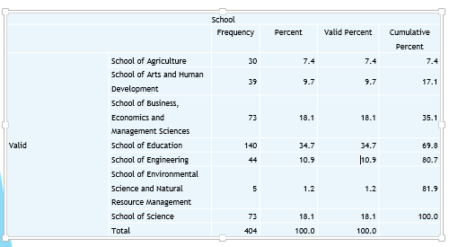
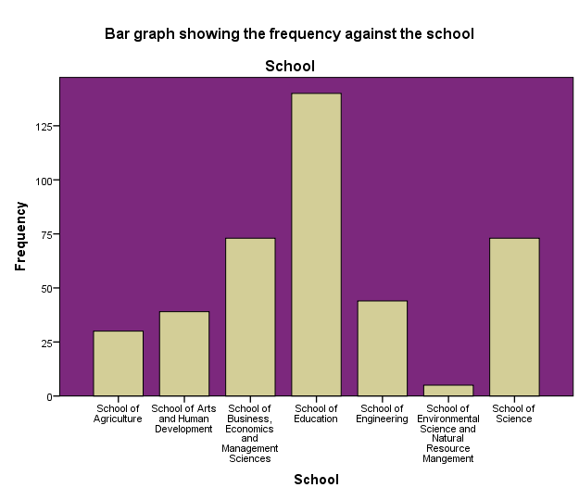
4. RESEARCH FINDINGS AND DISCUSSION
This chapter presents the findings and analysis of the research on missing marks within the University of Eldoret System. It synthesizes quantitative and qualitative data to uncover patterns, trends, and insights regarding the prevalence, causes, consequences, and potential solutions to missing marks incidents. By providing actionable insights, this chapter contributes to enhancing academic administration and quality assurance within the institution.
SCHOOL RATE

Slide 8
Interpretation
The output indicates the distribution of respondents across different schools within the institution. The School of Education has the highest representation, comprising 34.7% of respondents, followed by the School of Business, Economics and Management Sciences at 18.1%, and the School of Science also at 18.1%. The School of Engineering accounts for 10.9%, while the School of Arts and Human Development and the School of Agriculture constitute 9.7% and 7.4% respectively. Additionally, smaller percentages are attributed to the School of Environmental Science and Natural Resource Management at 1.2%.

Slide 9
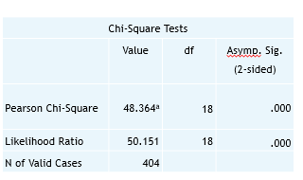
Missingmark_Area * School Crosstabulation
From the above the Pearson Chi-Square value is 48.364, with 18 degrees of freedom. The associated p-value is less than 0.01 indicating that there is a statistically significant association between the variables based on the Pearson Chi-Square test. On theLikelihood Ratio Chi-Square the value is 50.151, with 18 degrees of freedom, and a p-value of less than .01 indicating a statistically significant association between the variables based on the Likelihood Ratio Chi-Square test.

Slide 10
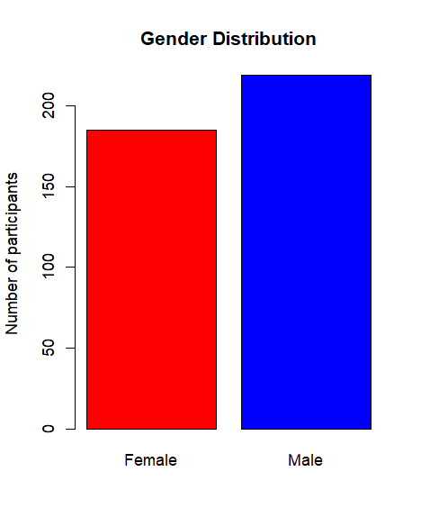

Gender Rate
From the bar plots, it can be seen that there were fewer females as compared to males who participated in the missing marks survey.
Thus from this result, we find the proportions of males and females who participated in the study as follows. Thus there were about 46% female participants and 54% male participants. “(185/404)*100=46% female ”,(219/404)*100=54% male.
The exact counts were as follows:

Slide 11
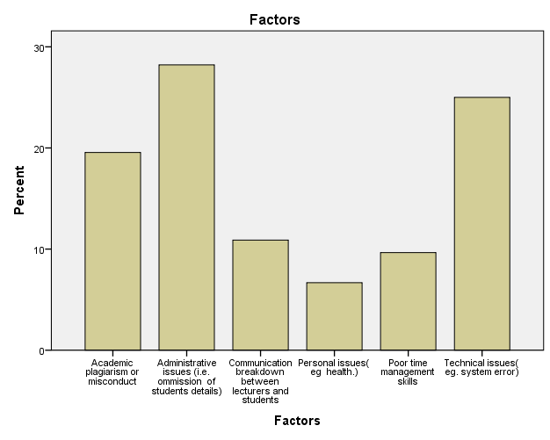
Bar plot showing the percentage of responded factors causing missing marks
A total of 114 out of 404 respondents perceived the administrative issues (omission of student’s details) as the main cause of students geeing missing marks. 101 respondents perceived that technical issue as the main cause, 79 respondents perceived that academic plagiarism as the main, 44 thought communication breakdown as the case, 39 perceived poor time management skills as the cause and 27 sugggested the personal issues as the main cause.

Slide 12
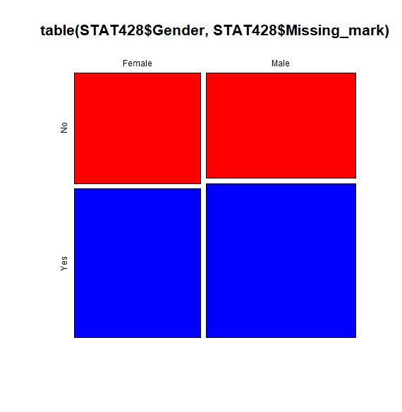
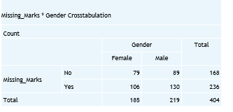
CROSSTABULATION MISSING MARKS VS GENDER
The "Missing_Marks * Gender Crosstabulation" table provides a breakdown of the count of individuals based on their gender and whether they have missing marks. It reveals that among females, 79 individuals do not have missing marks, while 106 do. Similarly, among males, 89 individuals do not have missing marks, while 130 do. Overall, out of 185 females and 219 males included in the analysis, 168 and 236 individuals respectively have been categorized regarding missing marks. This breakdown allows for a comparison of missing marks between genders within the dataset.

Slide 13
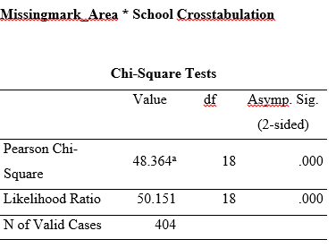
Cross-tabulation between missing mark and Schools
Ho: There is no association between missing mark and Schools.
Vs H1: There is a association between missing mark and schools
From the above the Pearson Chi-Square value is 48.364, with 18 degrees of freedom. The associated p-value is less than .0001 indicating that there is a statistically significant association between the variables based on the Pearson Chi-Square test. On theLikelihood Ratio Chi-Square the value is 50.151, with 18 degrees of freedom, and a p-value of less than .0001, indicating a statistically significant association between the variables based on the Likelihood Ratio Chi-Square test.

Slide 14
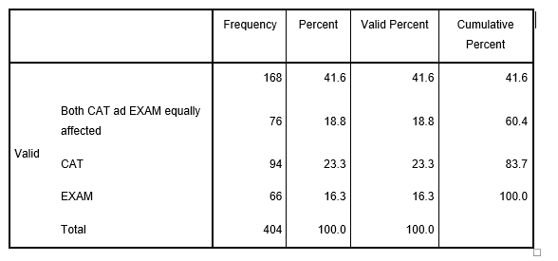
Frequency of Missing marks areas affected

Slide 15
5. SUMMARY OF FINDINGS, CONCLUSIONS AND RECOMMENDATIONS
This chapter provides recommendations based on the findings of the study on missing marks within the University of Eldoret System. Drawing upon the insights assembled from the research. This section offers actionable suggestions to address the identified issues and enhance academic administration and quality assurance within the institution. Additionally, future directions for research and interventions are proposed to further mitigate the occurrence of missing marks and improve the overall effectiveness of academic assessment processes.
CONCLUSION
In conclusion, addressing missing marks issues requires a multifaceted approach that encompasses technological innovation, policy reform, capacity building, and stakeholder collaboration. By implementing the recommendations outlined in this chapter and embracing future research directions, the University of Eldoret can enhance the integrity and reliability of its academic assessment processes, ultimately fostering a conducive learning environment for student success and institutional excellence

Slide 16
Recommendations
(a) Strengthening Data Management Systems
Given the prevalence of missing marks incidents reported by respondents, it is imperative for the University of Eldoret to invest in robust data management systems. Implementing automated systems for recording and managing academic data can significantly reduce the occurrence of errors and discrepancies, thereby minimizing the risk of missing marks incidents. These systems should be user-friendly, accessible to all stakeholders, and regularly updated to ensure accuracy and reliability.
(b) Enhancing Training and Capacity Building
To address the underlying causes of missing marks, such as human error and administrative inefficiencies, comprehensive training programs should be implemented for faculty and staff involved in academic administration. Training sessions should cover best practices for data entry, grade submission, and record-keeping, as well as provide guidance on the use of technology tools and platforms. Additionally, ongoing capacity-building initiatives can help staff stay abreast of emerging trends and developments in academic assessment processes.
(c) Improving Communication and Collaboration
Effective communication and collaboration among stakeholders are essential for preventing and addressing missing marks incidents. The University of Eldoret should establish clear channels of communication between faculty, administrators, and students to facilitate timely exchange of information and feedback. Regular meetings, forums, and workshops can foster a culture of transparency and accountability, enabling proactive interventions to resolve issues related to missing marks.
(d) Reviewing and Updating Policies
It is crucial for the university to review and update its policies and procedures related to academic assessment and quality assurance. Clear guidelines should be established for grade submission, verification, and appeals processes, ensuring consistency and fairness across departments and programs. Moreover, mechanisms for monitoring and evaluating the effectiveness of these policies should be put in place to identify areas for improvement and adaptation.
(e) Longitudinal Studies
Future research should consider conducting longitudinal studies to track the prevalence and trends of missing marks over time. Longitudinal data can provide insights into the effectiveness of interventions and policy changes implemented by the university, allowing for continuous improvement and refinement of academic assessment processes.

Slide 17
THANK YOU

