Slide 1

Electric Eye
A portable, cost effective, surveillance system
Elijah Lopez
Supervisor: Fitra Khan
Fall 2018

Slide 2
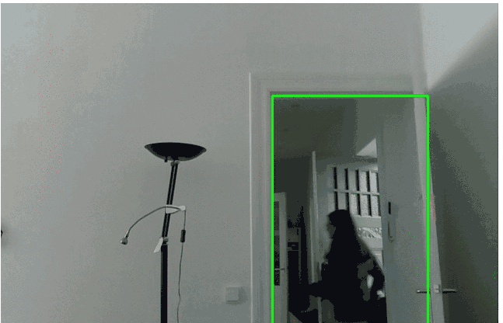
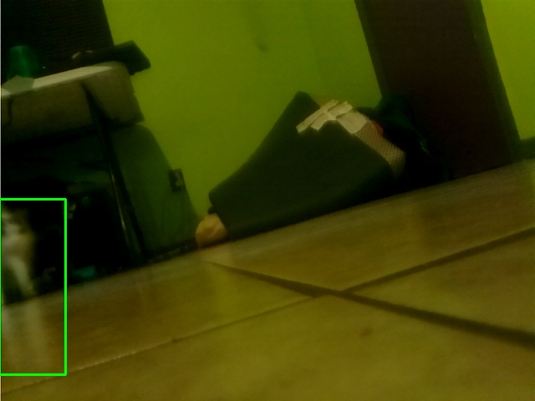
Project Overview
Portable surveillance
Mobile Control, configurable
“Electric fence” of coverage
Low cost

Slide 3
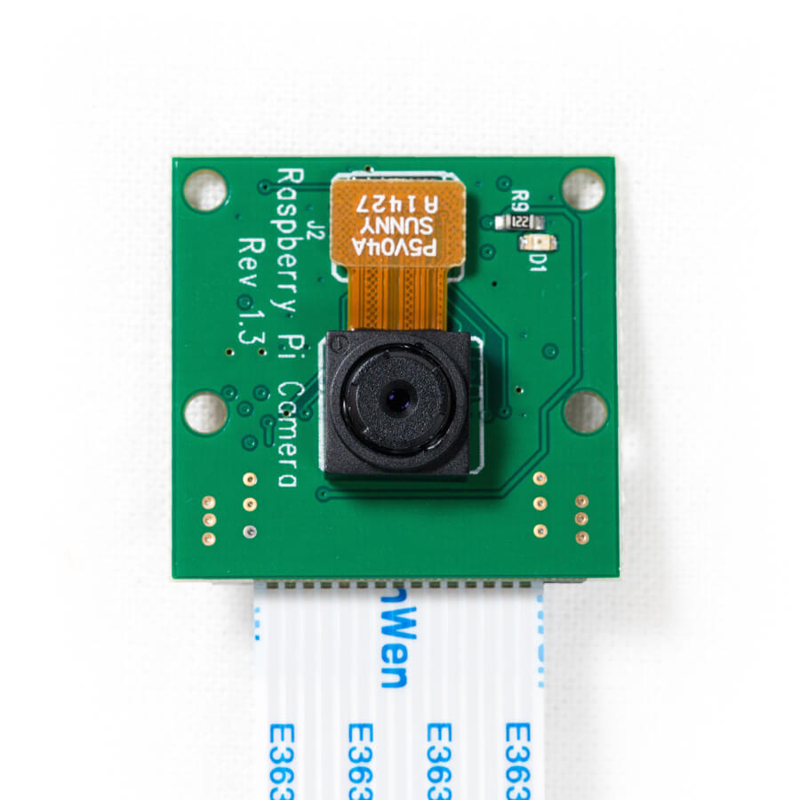
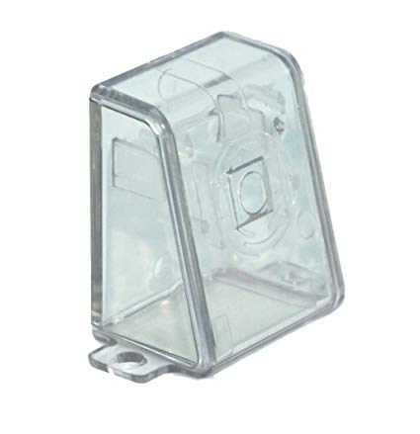
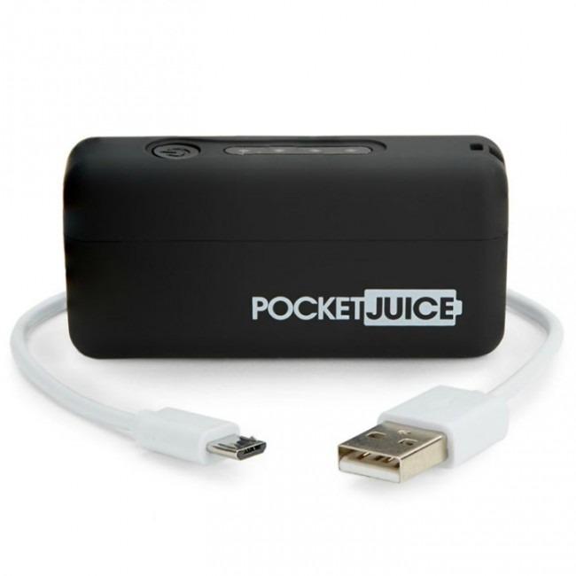
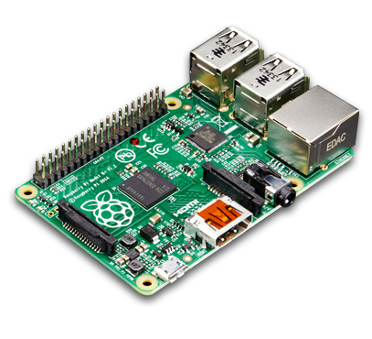
Hardware
Raspberry Pi 3 $32
PiCamera $13
Portable Battery $12
Picase $6
__________________________
$63
*Average prices as found on Amazon.com

Slide 4
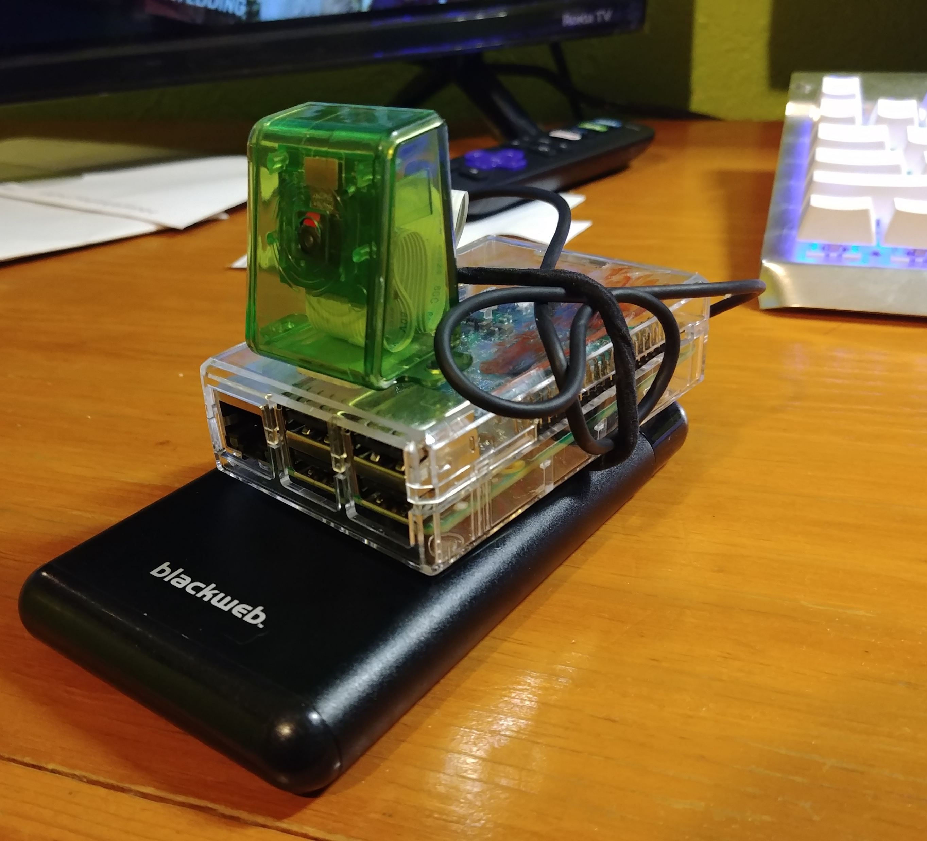
Hardware Assembled

Slide 5
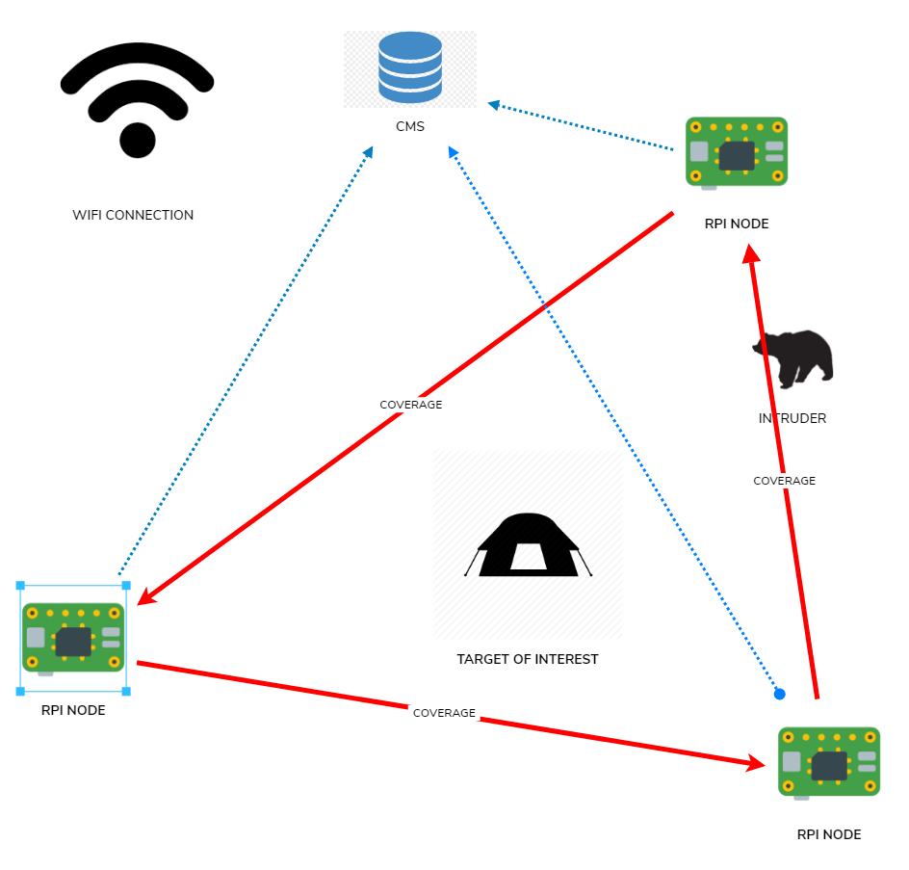
Implementation
Joystick

Slide 6
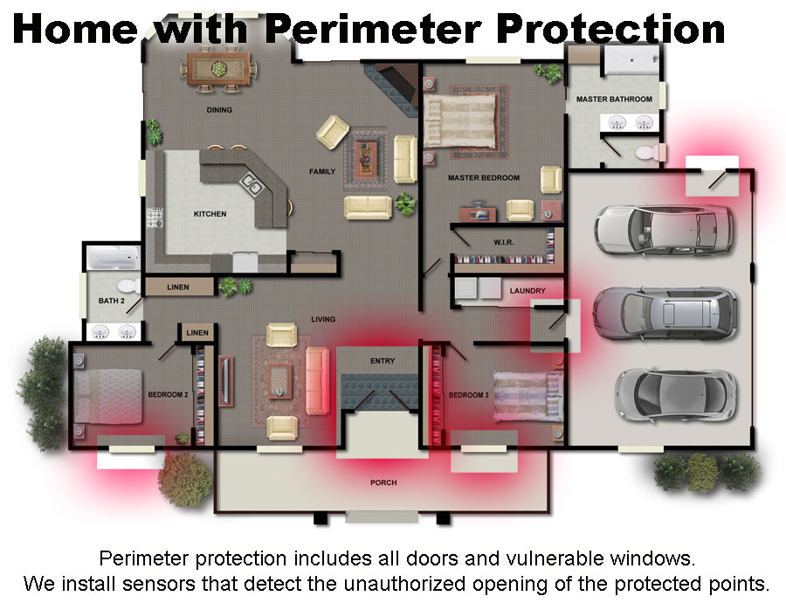
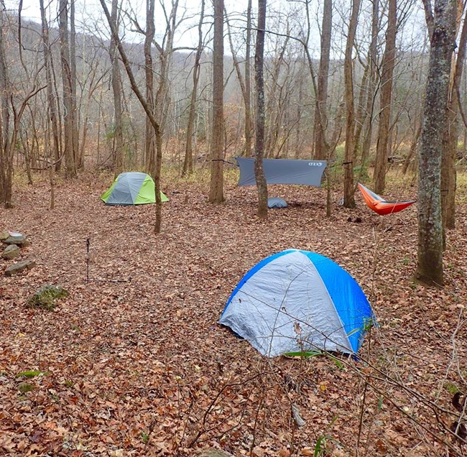
Applications
Portable
Low cost

Slide 7
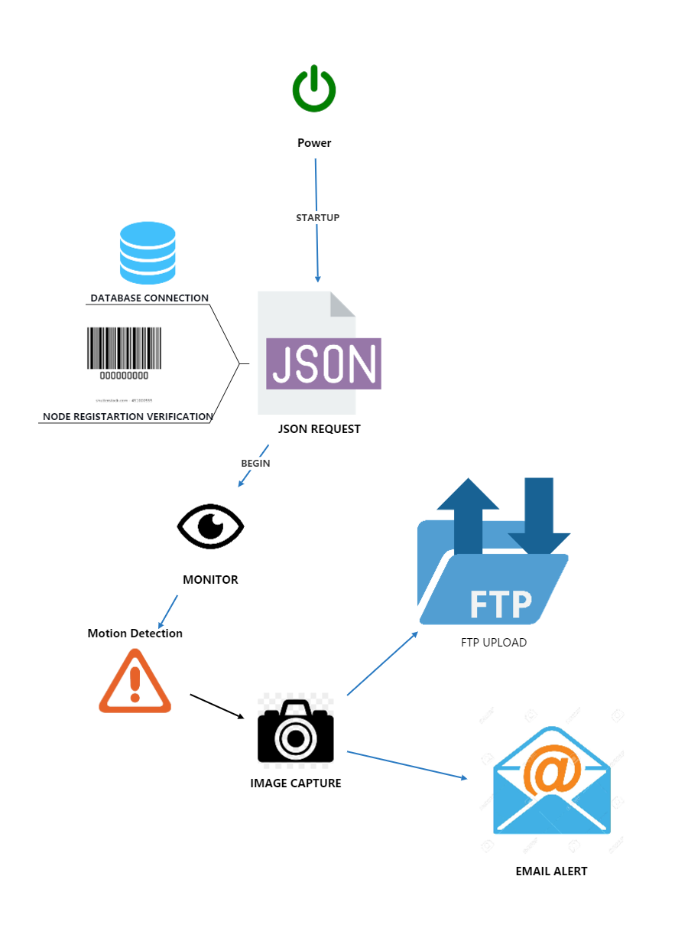
HOW DOES IT WORK(RPI NODE)

Slide 8
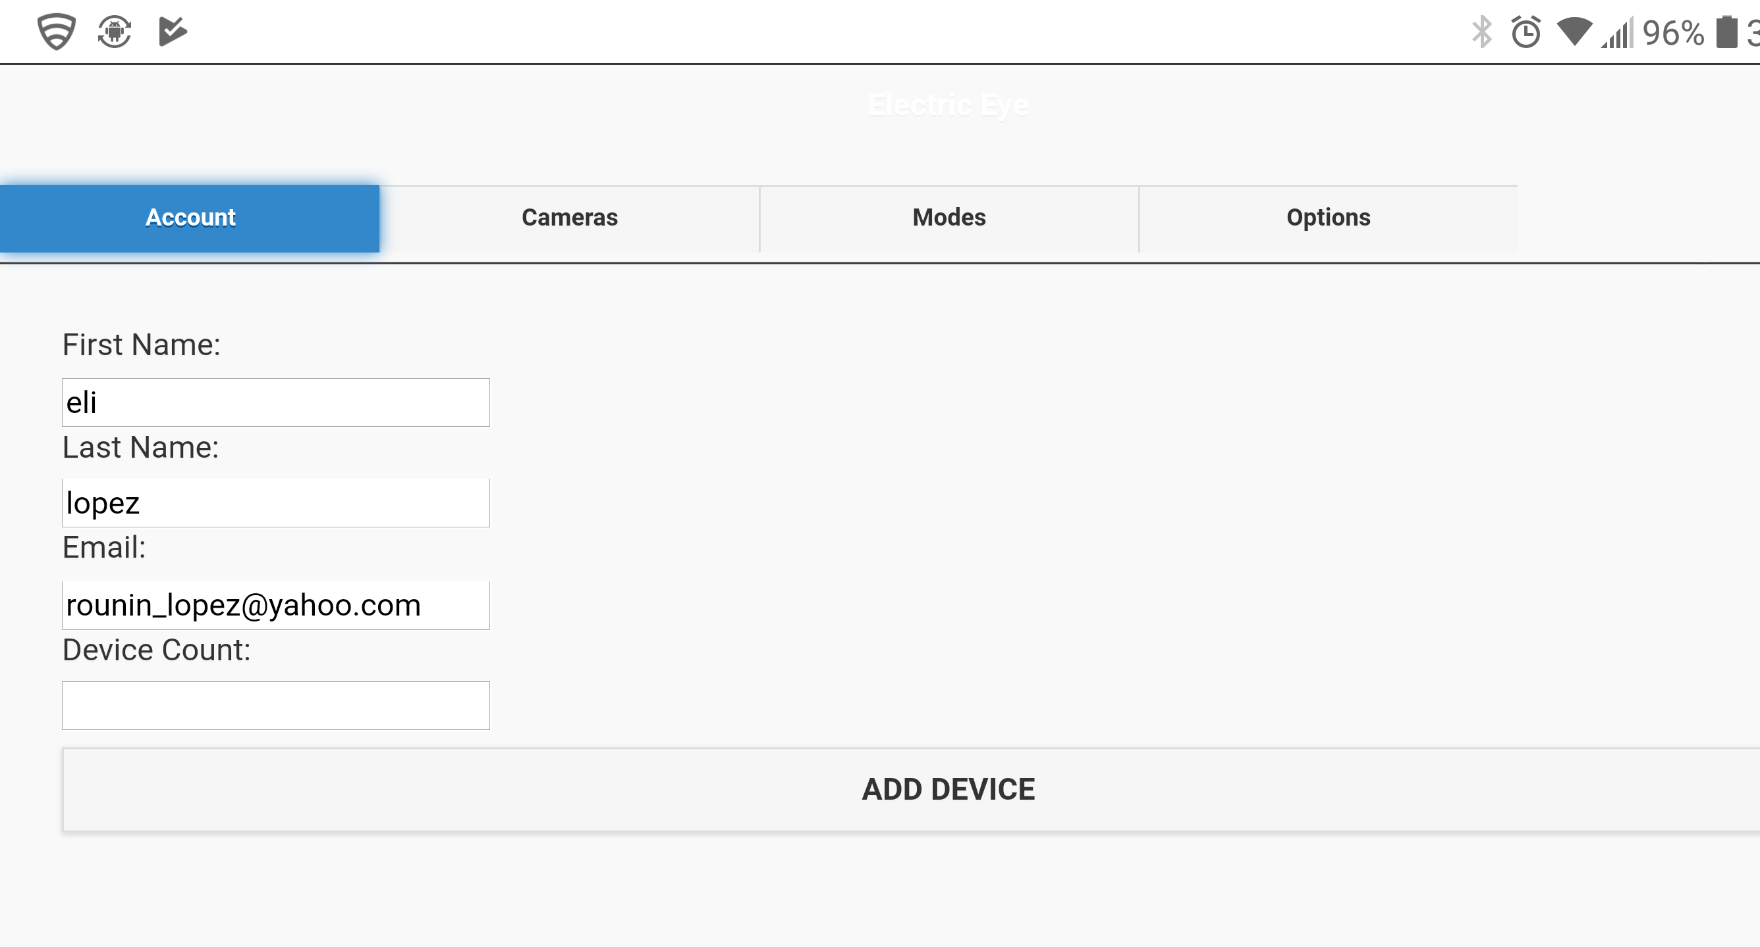
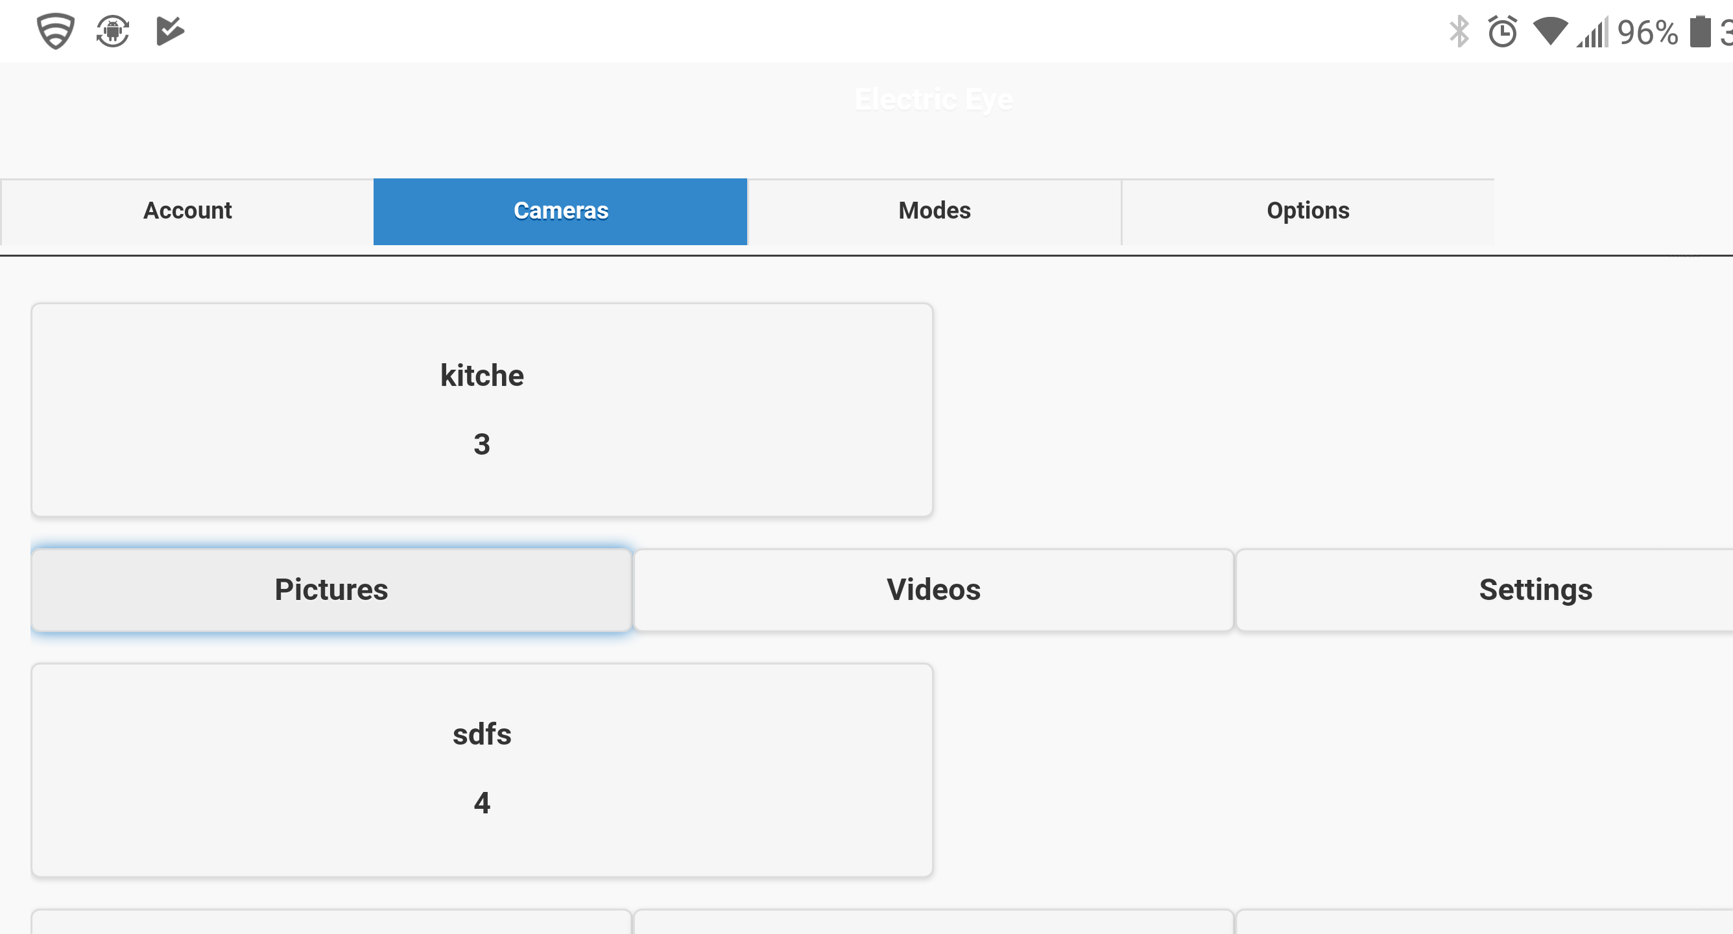
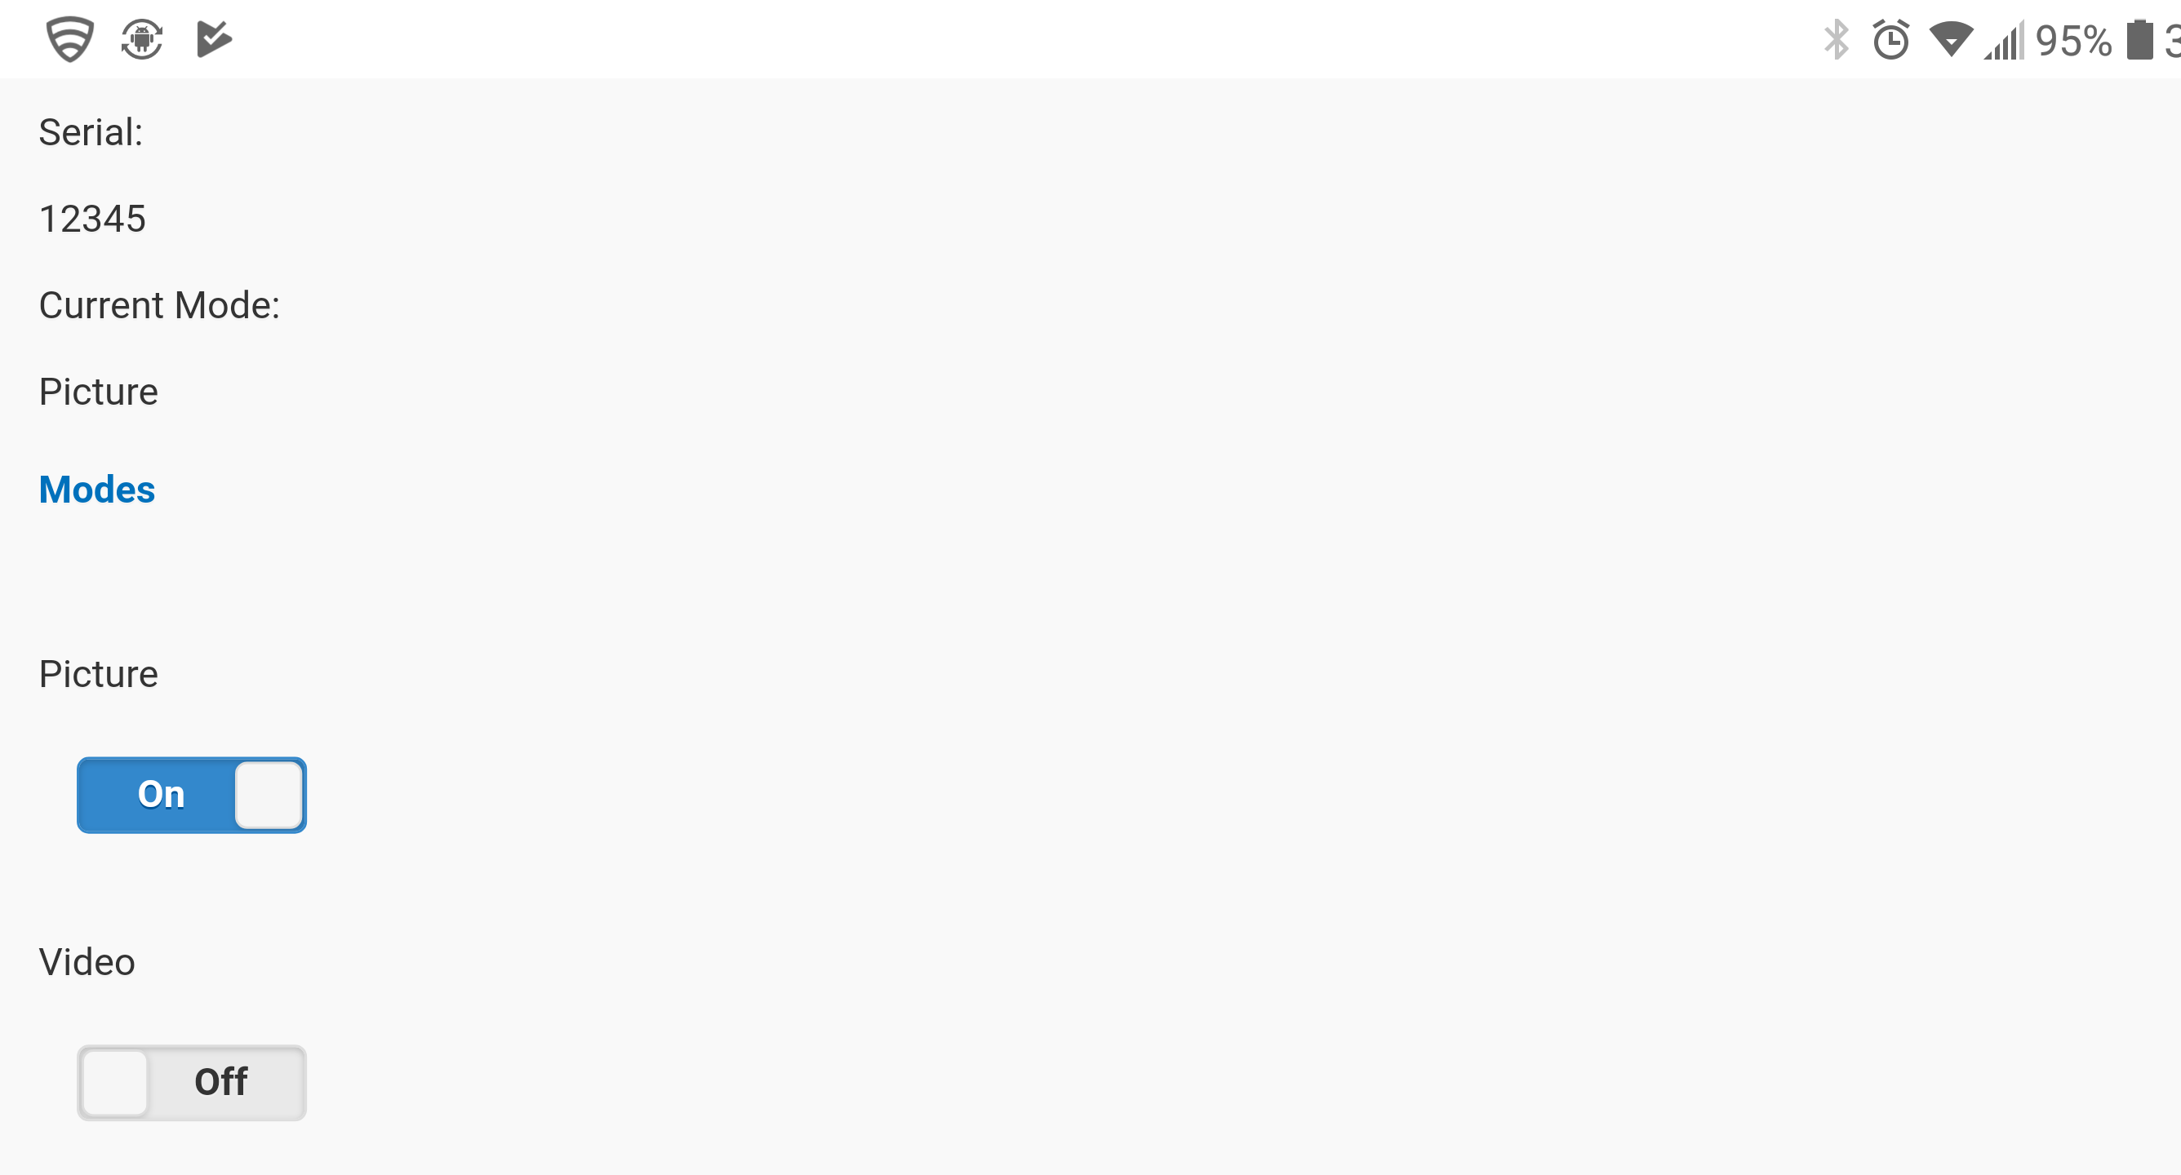
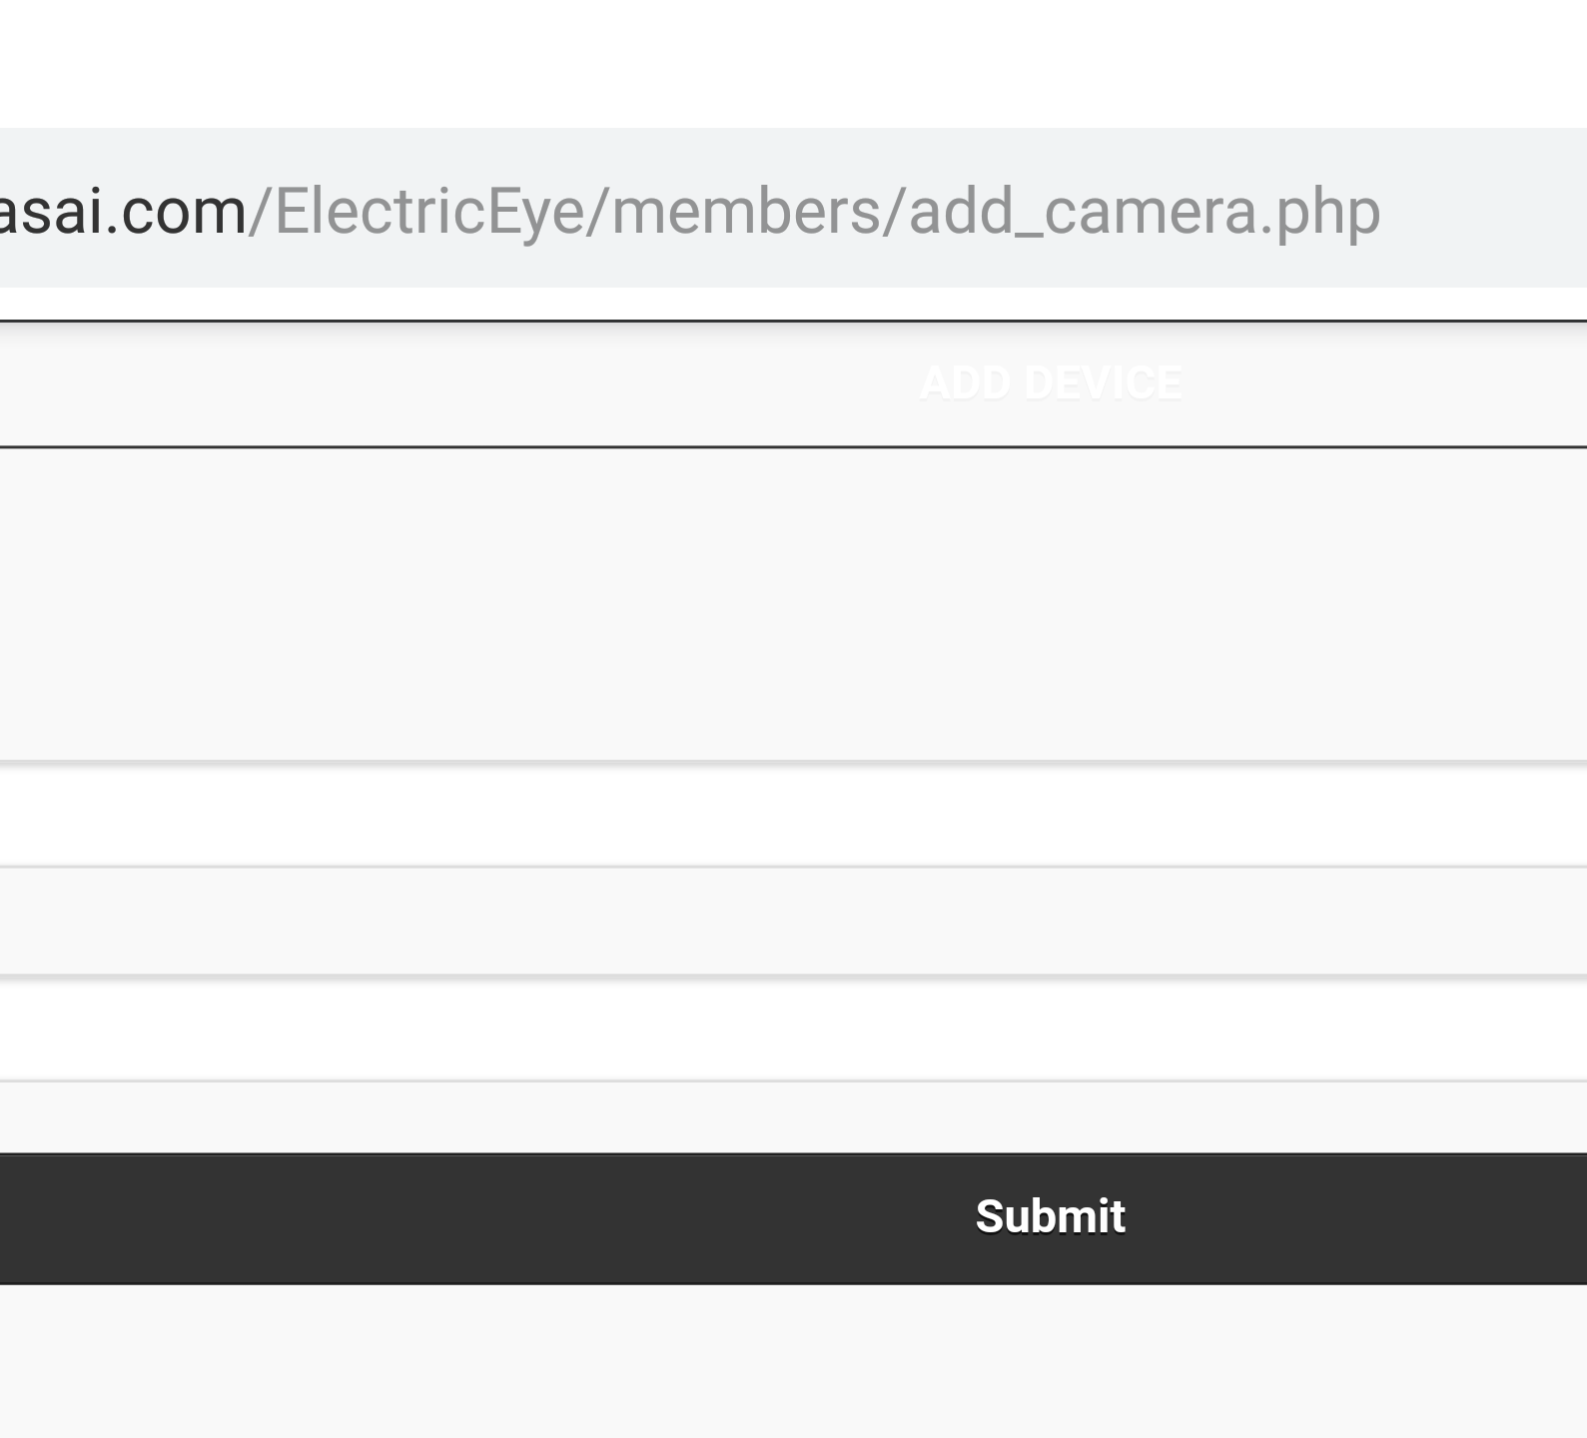
How Does it Work (User)

Slide 9
How Does it Work (WIFI)

Slide 10

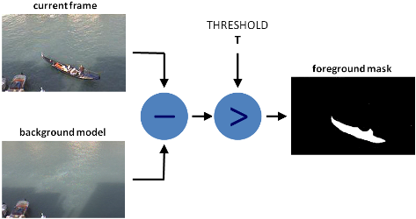
How Does it Work (Image Processing)

Slide 11
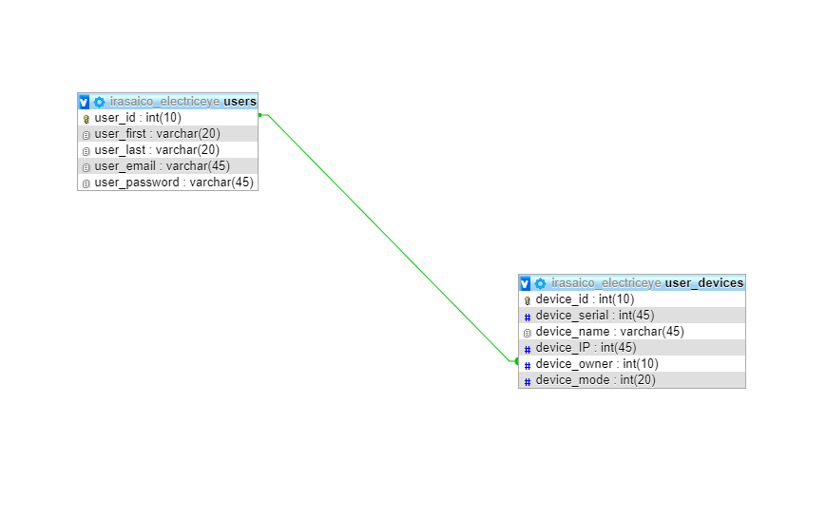
DATABASE

Slide 12
Demo

Slide 13
Areas of research
Better organized display of images on website (by date, hour…)
More precise movement frames sent
Reduce unit cost (raspberry pi 1, cheaper online sources)

Slide 14
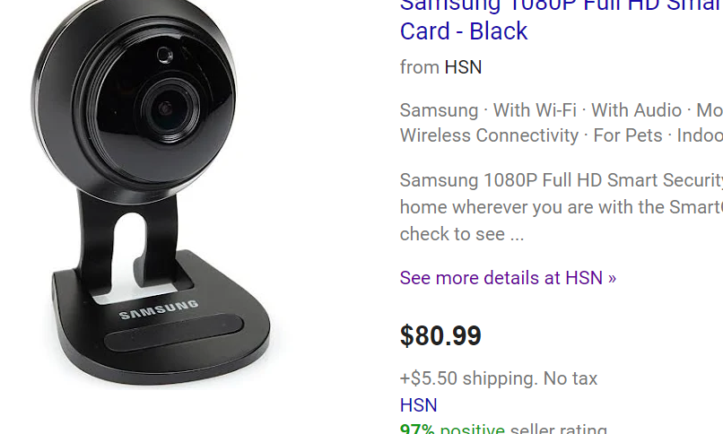
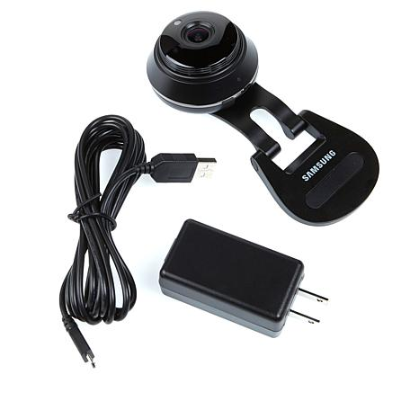
Conclusion
Objective was meet
Always room for improvement

