Slide 1

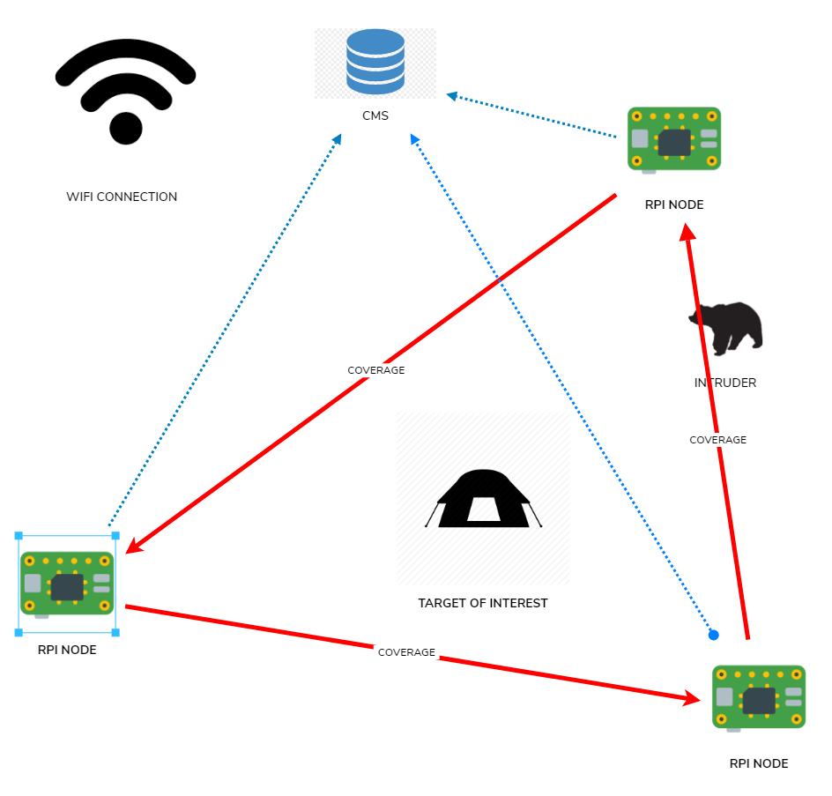
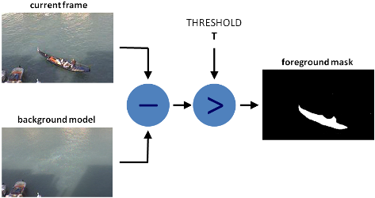

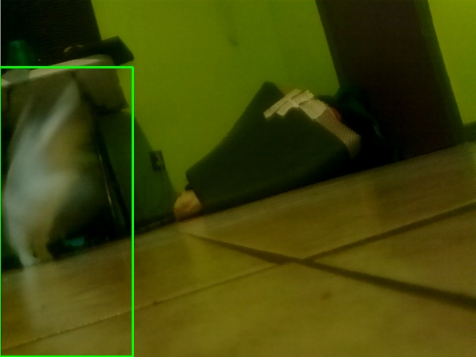
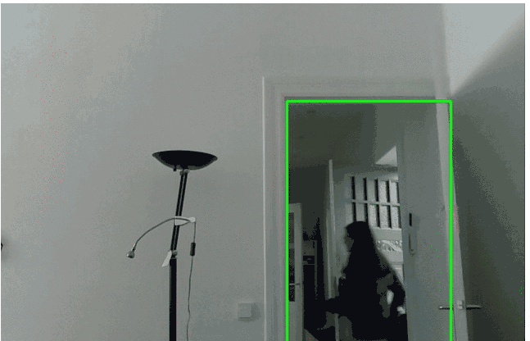
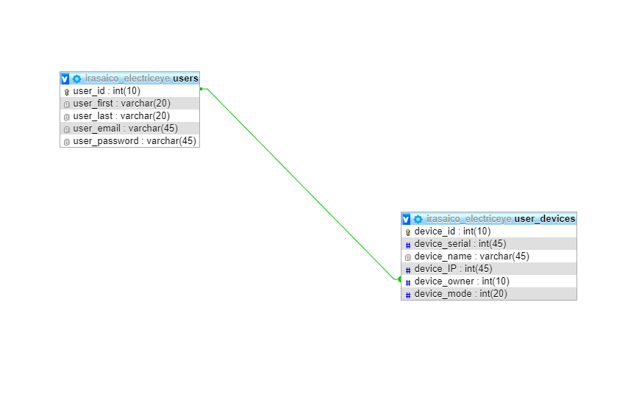
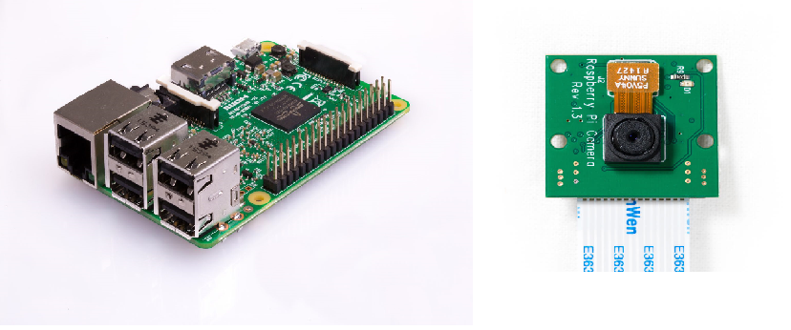
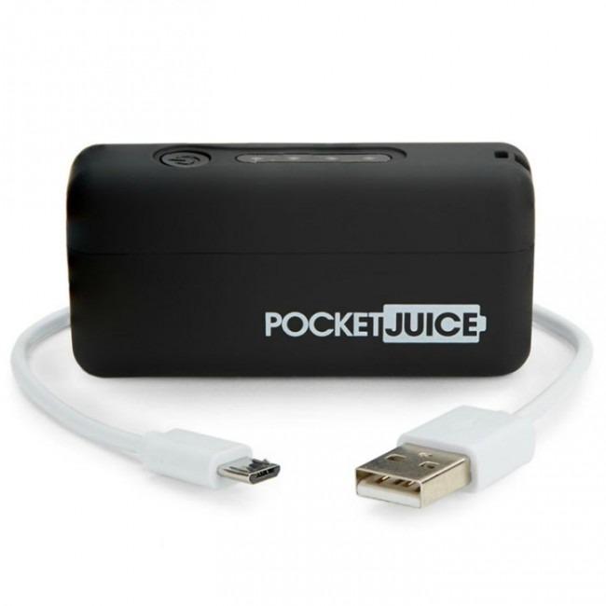
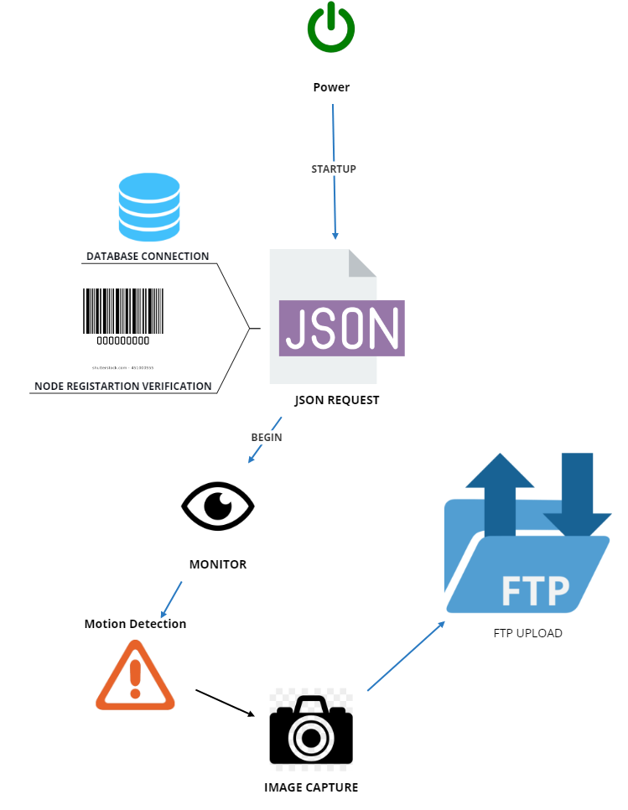
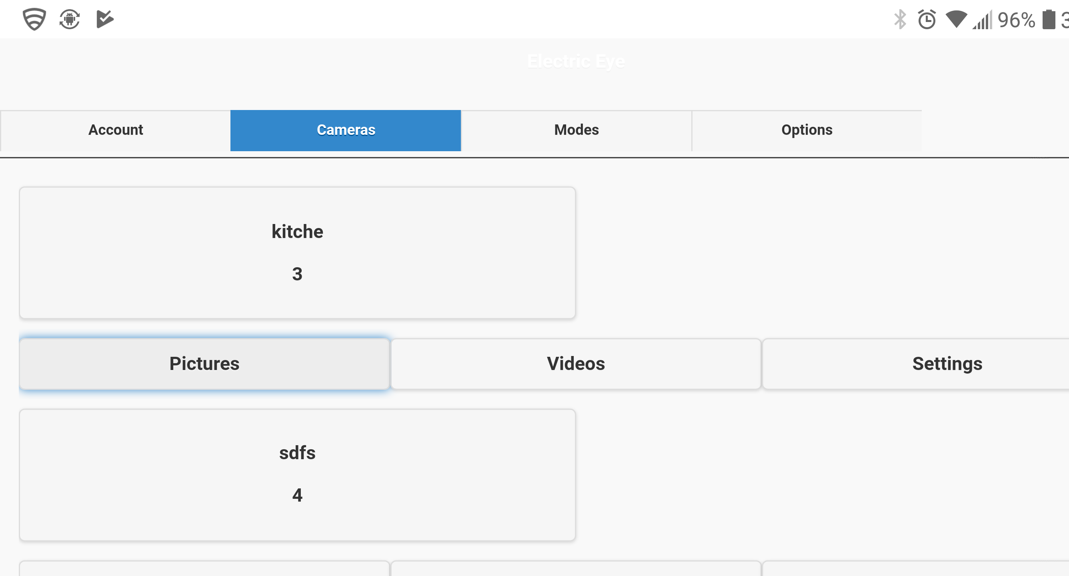
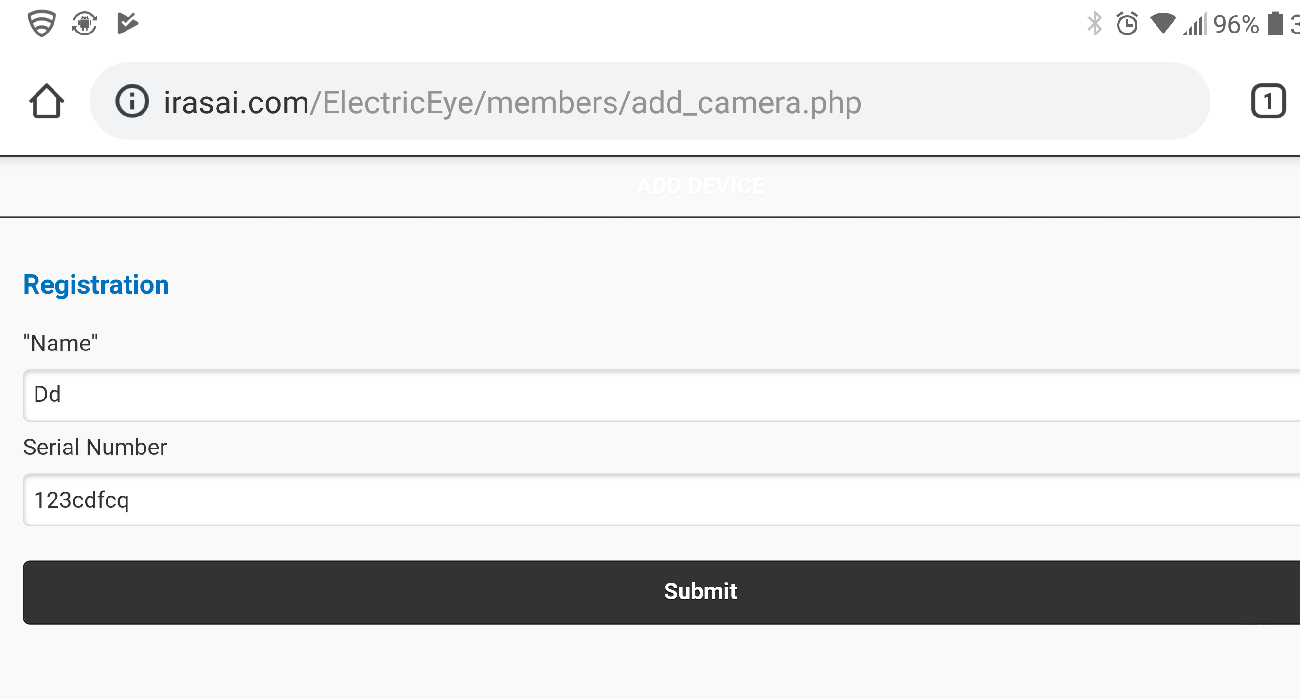




Electric Eye: A Cost Efficient and Portable Surveillance System
Project Overview
Implementation
Computer Vision
Analysis and Review
This project’s purpose is to create a portable and cost effective surveillance system. This project will realize this goal via a network of raspberry pi “nodes” that will each serve as an “Electronic Eye” and together will all remote to a server based Central management system. A mobile friendly website will serve as a portal to the collected data from the nodes and will also serve as a GUI for controlling each individual node.
Database
Hardware
Results and Conclusion
Cost Effective
Raspberry Pi 3: $35 USD
Raspberry PI Camera: $10 USD
Battery: $8.00 USD
----------------------------------------------------
Total: 53 $ USD
Method of Operation
Website
Future Research
Easier method of connecting to nodes to new WIFI network
“Dead Data” Protection/Node replacement
Phone alerts
College of Engineering
and Computer Science
Senior Project by Elijah Lopez| Supervisor: Fitratullah Khan | Fall 2018

