Slide 1

“You are in good company”
www.fewgoodpeople.com
“ Core JAVA”
by Girish M

Slide 2
Core JAVA Training
Session I
What is Java?
Where Java is used?
Java Foundation
Java Versions
Types of Java Applications
Features of Java
Java System Setting
Session II
Program Structure
Variable
Types of variables
Variable declaration
Data type
Data type memory allocation
Session III
Java Operators
Arithmetic Operators
Relational Operators
Bitwise Operators
Logical Operators
Assignment Operators
Misc Operators
Session IV
OOPs
Object
Class
Inheritance
Polymorphism
Overloading
Overriding
Abstraction
Encapsulation
Session V
Java Keywords
Programming Conditional Controls
Comments in Java
Access Specifiers /Modifiers
Session VI
Java Naming Conventions
Java Constructor
Static Keyword
“this” Keyword
“super” Keyword
Array (1D & 2D)
2

Slide 3
What is Java?
Java is a programming language and a platform.
Java is a high level, robust, secured and object-oriented programming language.
Platform:
Any hardware or software environment in which a program runs, is known as a platform. Since Java has its own runtime environment (JRE) and API, it is called platform.
Where Java is used?
According to Sun, 3 billion devices run java. There are many devices where java is currently used. Some of them are as follows:
Desktop Applications such as acrobat reader, media player, antivirus etc.
Web Applications such as irctc.co.in, ticket booking sites and etc.
Enterprise Applications such as banking applications.
Mobile, Embedded System, Smart Card, Robotics, Games etc.
3

Slide 4
Java Foundation
The history of java starts from Green Team. Initially Java is used to develop a language for digital devices such as set-top boxes, televisions etc.
Later they get entered into internet programming.
First it was called "Greentalk“ with file extension as .gt
After that, it was called Oak
In 1995, Oak was renamed as "Java" because it was already a trademark by Oak Technologies.
Java was developed by James Gosling and their team at Sun Microsystems (which is now a subsidiary of Oracle Corporation) and released in 1995.
There are many java versions that has been released. Current stable release of Java is Java SE 8.
JDK Alpha and Beta (1995)
JDK 1.0 (23rd Jan, 1996)
JDK 1.1 (19th Feb, 1997)
J2SE 1.2 (8th Dec, 1998)
J2SE 1.3 (8th May, 2000)
J2SE 1.4 (6th Feb, 2002)
J2SE 5.0 (30th Sep, 2004)
Java SE 6 (11th Dec, 2006)
Java SE 7 (28th July, 2011)
Java SE 8 (18th March, 2014)
Java Versions
4

Slide 5
Types of Java Applications
There are mainly 4 type of applications that can be created using java programming:
Standalone Application
It is also known as desktop application or window-based application.
An application that we need to install on every machine such as media player, antivirus etc.
AWT and Swing are used in java for creating standalone applications.
Web Application
An application that runs on the server side and creates dynamic page, is called web application. Currently, servlet, jsp, struts, jsf etc. technologies are used for creating web applications in java.
Enterprise Application
An application that is distributed in nature, such as banking applications etc.
It has the advantage of high level security, load balancing and clustering. In java, EJB is used for creating enterprise applications.
Mobile Application
An application that is created for mobile devices. Currently Android and Java ME are used for creating mobile applications.
5

Slide 6
Features of Java
Some of the major features of JAVA are
Simple
Object-Oriented
Platform independent
Secured & Robust
Dynamic
High Performance
Multithreaded
Distributed
JDK, JRE, JVM
JAVA_HOME
CLASSPATH
PATH
Compile
Run Java
Java System Settings
6

Slide 7
Java Program Structure
Package declaration
Import references
Class declaration
Variables and methods declaration
package com.tibil;
import java.lang.*;
public class HelloFriendsProgram {
public static void main(String[] args) {
System.out.println("Hello Friends..");
}
}
7

Slide 8
Variable
Variable are reserved area in memory location.
There are three types of variables: local, instance and static.
There are two types of datatypes in java, primitive and non-primitive.
Local variable
Instance variable
Static variable
Local Variable :
A variable that is declared inside the method is called local variable.
Instance Variable :
A variable that is declared inside the class but outside the method is called instance variable . It is not declared as static.
Static Variable :
A variable that is declared as static is called static variable. It cannot be local.
Types of variables
8

Slide 9
Variable declaration
class A{
int data=50;//instance variable
static int m=100;//static variable
void method(){
int n=90;//local variable
}
}//end of class
The Identifier can contain
Alphabets, digits, _, $
First character must be an alphabet
Keywords should not be used as Identifiers
User Defined Identifiers
9

Slide 10
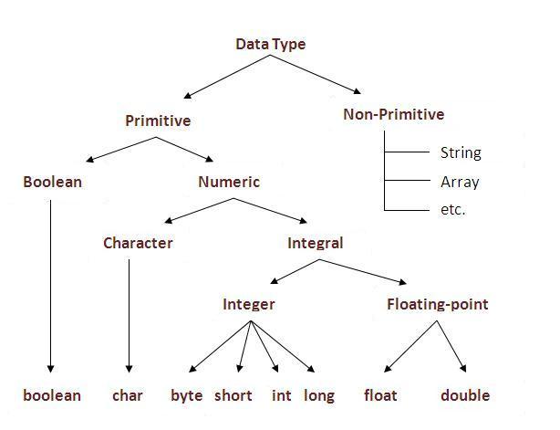
Data type
The data type of a variable is an attribute that tells what kind of data that value can have.
Data type ‘s Types :
Primitive
Non Primitive
10

Slide 11
Data type memory allocation
Data Type | Default Value | Default size
boolean | False | 1 bit
char | '' | 2 byte
byte | 0 | 1 byte
short | 0 | 2 byte
int | 0 | 4 byte
long | 0L | 8 byte
float | 0.0f | 4 byte
double | 0.0d | 8 byte
11

Slide 12
Java Operators
Java provides a rich set of operators to manipulate variables.
Arithmetic Operators
Relational Operators
Bitwise Operators
Logical Operators
Assignment Operators
Misc Operators
Arithmetic operators are used in mathematical expressions in the same way that they are used in algebra.
Eg : a=10, b=5 c=a+b => c=(10+5)
Arithmetic Operators
Operator | Description
+ | Addition - Adds values on either side of the operator
- | Subtraction - Subtracts right hand operand from left hand operand
* | Multiplication - Multiplies values on either side of the operator
/ | Division - Divides left hand operand by right hand operand
% | Modulus - Divides left hand operand by right hand operand and returns remainder
++ | Increment - Increases the value of operand by 1
-- | Decrement - Decreases the value of operand by 1
12

Slide 13
Relational Operators
Operator | Description
== | Checks if the values of two operands are equal or not, if yes then condition becomes true.
!= | Checks if the values of two operands are equal or not, if values are not equal then condition becomes true.
> | Checks if the value of left operand is greater than the value of right operand, if yes then condition becomes true.
< | Checks if the value of left operand is less than the value of right operand, if yes then condition becomes true.
>= | Checks if the value of left operand is greater than or equal to the value of right operand, if yes then condition becomes true.
<= | Checks if the value of left operand is less than or equal to the value of right operand, if yes then condition becomes true.
13

Slide 14
Bitwise Operators
Java defines several bitwise operators, which can be applied to the integer types, long, int, short, char, and byte.
Bitwise operator works on bits and performs bit-by-bit operation. Assume if a = 60; and b = 13; now in binary format they will be as follows:
a = 0011 1100
b = 0000 1101
-----------------
a&b = 0000 1100
a|b = 0011 1101
a^b = 0011 0001
~a = 1100 0011
Operator | Description
& | Binary AND Operator copies a bit to the result if it exists in both operands.
| | Binary OR Operator copies a bit if it exists in either operand.
^ | Binary XOR Operator copies the bit if it is set in one operand but not both.
~ | Binary Ones Complement Operator is unary and has the effect of 'flipping' bits.
14

Slide 15
Logical Operators
Operator | Description
&& | Called Logical AND operator. If both the operands are non-zero, then the condition becomes true.
|| | Called Logical OR Operator. If any of the two operands are non-zero, then the condition becomes true.
! | Called Logical NOT Operator. Use to reverses the logical state of its operand. If a condition is true then Logical NOT operator will make false.
15

Slide 16
Assignment Operators
Operator | Description
= | Simple assignment operator, Assigns values from right side operands to left side operand
+= | Add AND assignment operator, It adds right operand to the left operand and assign the result to left operand
-= | Subtract AND assignment operator, It subtracts right operand from the left operand and assign the result to left operand
*= | Multiply AND assignment operator, It multiplies right operand with the left operand and assign the result to left operand
/= | Divide AND assignment operator, It divides left operand with the right operand and assign the result to left operand
%= | Modulus AND assignment operator, It takes modulus using two operands and assign the result to left operand
&= | Bitwise AND assignment operator
^= | bitwise exclusive OR and assignment operator
|= | bitwise inclusive OR and assignment operator
16

Slide 17
Misc Operators
Conditional Operator ( ? : )
Conditional operator is also known as the ternary operator.
This operator consists of three operands and is used to evaluate Boolean expressions. The goal of the operator is to decide which value should be assigned to the variable. The operator is written as:
variable x = (expression) ? value if true : value if false
Example :
int a , b;
a = 10;
b = (a == 1) ? 20: 30;
17

Slide 18
OOPs
OOPs (Object Oriented Programming System)
Object-Oriented Programming is a methodology or paradigm to design a program using classes and objects. It simplifies the software development and maintenance by providing some concepts:
Object
Class
Inheritance
Polymorphism
Overloading
Overriding
Abstraction
Encapsulation
Object means a real word entity that has its own state and behavior.
For example: chair, pen, table, keyboard, bike etc. It can be physical and logical.
Java class is a template / blueprint based on which we will be creating an object.
A class is a set of specifications that describes the characteristics (state) and behavior of an entity.
Object and Class
18

Slide 19
Inheritance:
The feature by which one class acquires the properties and functionalities of another class. This is important because it supports the concept of reusability.
Polymorphism (from the Greek meaning "having multiple forms") is the ability of different objects to respond, each in its own way, to identical messages.
The process of extracting the essential information and hiding the irrelevant details.
The process of binding code and data together in the form of a capsule. The insulation of the data from the direct access by the program is called data hiding.
Polymorphism:
Abstraction:
Encapsulation:
19

Slide 20
Java Keywords
Data types
byte, short, int, long, char, float, double, and boolean
Control Statements
If, else, switch, for, while, do, case, break, default, continue
Class & Objects
class, interface, extends, implements, new, return, super, this
Access Specifier / Modifier
default, private, protected, public, abstract, final, static, transient, synchronized
Packages
package, import
Exception Handling
try, catch, finally, throw, throws
Miscellaneous
instanceof, void
20

Slide 21
Programming Conditional Controls
if statement, if else statement
Nested if statement
if else if else ladder
switch case statements
Ternary operator
for
while
do-while
for each loop
Iterative Controls( Loops)
21

Slide 22
Comments in Java
A single line comment in Java will start with //
// This is a single line comment in Java
A multi line comment starts with a /* and ends with a */
/* This is a multi line
comment
in Java */
A multi-line comment that can be documented by javadoc tool.
/** This is documented
comment */
22

Slide 23
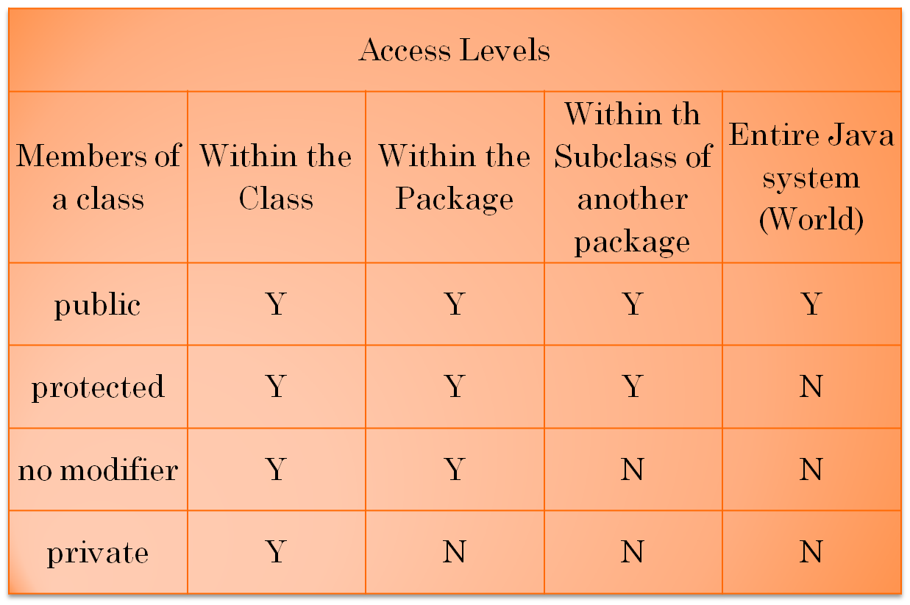
Access Specifiers /Modifiers
Java provides access protection at 2 levels:
Class level
Member level
Four Access Control Modifiers in Java
public
private
protected
default
23

Slide 24
Java Naming Conventions
Interface
Abstract Class
Name | Convention
class name | should start with uppercase letter and be a noun e.g. String, Color, Button, System, Thread etc.
interface name | should start with uppercase letter and be an adjective e.g. Runnable, Remote, ActionListener etc.
method name | should start with lowercase letter and be a verb e.g. actionPerformed(), main(), print(), println() etc.
variable name | should start with lowercase letter e.g. firstName, orderNumber etc.
package name | should be in lowercase letter e.g. java, lang, sql, util etc.
constants name | should be in uppercase letter. e.g. RED, YELLOW, MAX_PRIORITY etc.
24

Slide 25
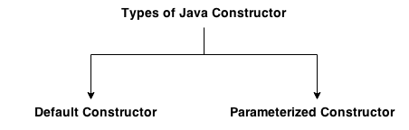
Java Constructor
Constructor in java is a special type of method that is used to initialize the object.
Java constructor is invoked at the time of object creation. It constructs the values i.e. provides data for the object that is why it is known as constructor.
There are basically two rules defined for the constructor.
1. Constructor name must be same as its class name
2. Constructor must have no explicit return type
There are two types of constructors:
1. Default constructor (no-arg constructor)
2. Parameterized constructor
Rules for creating java constructor
Types of java constructors
25

Slide 26
“static” Keyword
The static keyword in java is used for memory management mainly.
We can apply java static keyword with variables, methods and blocks. The static keyword belongs to the class than instance of the class.
The static can be used for:
1. variable (also known as class variable)
2. method (also known as class method)
3. block
26

Slide 27
“this” Keyword
"this" is a reference variable that refers to the current object.
class Student{
int id;
String name;
Student(int id,String name){
id = id;
name = name;
}
void display(){System.out.println(id+" "+name);}
public static void main(String args[]){
Student s1 = new Student(111,"AAAA");
Student s2 = new Student(112,"BBBB");
s1.display();
s2.display();
}
}
27

Slide 28
“super” keyword
The super keyword in java is a reference variable that is used to refer immediate parent class object.
class Vehicle{
int speed=50;
}
class Bike extends Vehicle{
int speed=100;
void display(){
System.out.println(speed);
}
public static void main(String args[]){
Bike b=new Bike();
b.display();
}
}
28

Slide 29
Array
Arrays are used to store a group of related elements.
1D Arrays:
I. Declaring array name:
datatype [ ] arrayName ; or datatype arrayName[]
Ex. int [ ] list; or int list[ ];
II. Allocating memory for holding data values
arrayName = new datatype[NE];
Ex. int [ ] list = new int[10]; or int list[ ] = new int[10];
III. Combine I and II
datatype arrayName [ ] = new datatype[NE];
Ex. String names[] = new String[10];
Where NE indicates Number of Elements( Can be constant or variable)
Note : data type can be primitive type or reference type.
Initialization :
int marks[]= { 85,68,90,56 };
29

Slide 30
Array
Arrays are used to store a group of related elements.
2D Arrays
datatype [ ][ ] arrayName ;
arrayName = new datatype[NR][NC];
OR
datatype arrayName [ ] [ ] = new datatype[NR][NC];
Note : data type can be primitive type or reference type.
Ex. int m[][] = new int[4][3];
Ex. int [][] list = new int[4][ ];
list[0] = new int[3]; // First row has 3 columns
list[1] = new int[4]; // Second row has 4 columns
Note: rows are allowed to vary in length, called jagged arrays
30

