Slide 1
Lab6: Logistic Regression and Metrics
Hao-Lun Sun & DataLab
2021.10.14

Slide 2
Outline
Brief Review: Logistic Regression
Maximum likelihood in Logistic Regression
Implement
Common Evaluation Metrics for Binary Classification
Confusion Matrix
Soft Classifiers – ROC Curve

Slide 3
Outline
Brief Review: Logistic Regression
Maximum likelihood in Logistic Regression
Implement
Common Evaluation Metrics for Binary Classification
Confusion Matrix
Soft Classifiers – ROC Curve

Slide 4
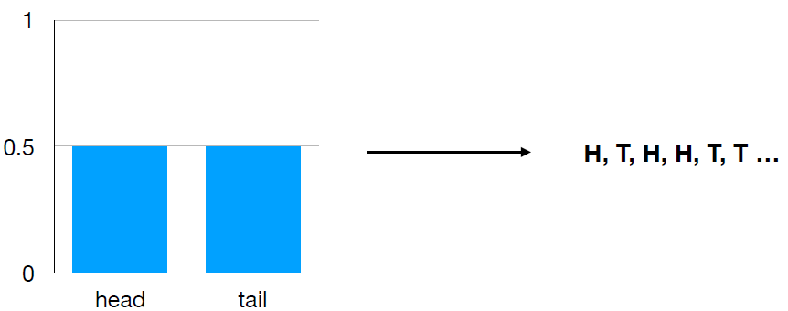

Maximum Likelihood
Flipping coin: We have already known ground truth distribution. For example, $P\left(x=head\right)=\frac{1}{2}$ and $P\left(x=tail\right)=$ $\frac{1}{2}$ .

Slide 5
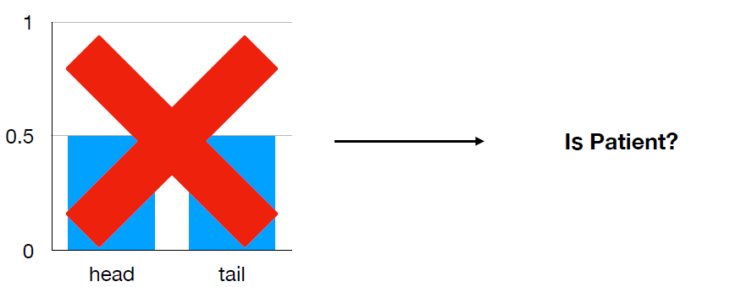
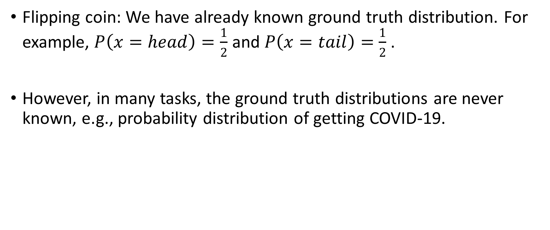
Maximum Likelihood
Flipping coin: We have already known ground truth distribution. For example, $P\left(x=head\right)=\frac{1}{2}$ and $P\left(x=tail\right)=$ $\frac{1}{2}$ .
However, in many tasks, the ground truth distributions are never known, e.g., probability distribution of getting COVID-19.

Slide 6

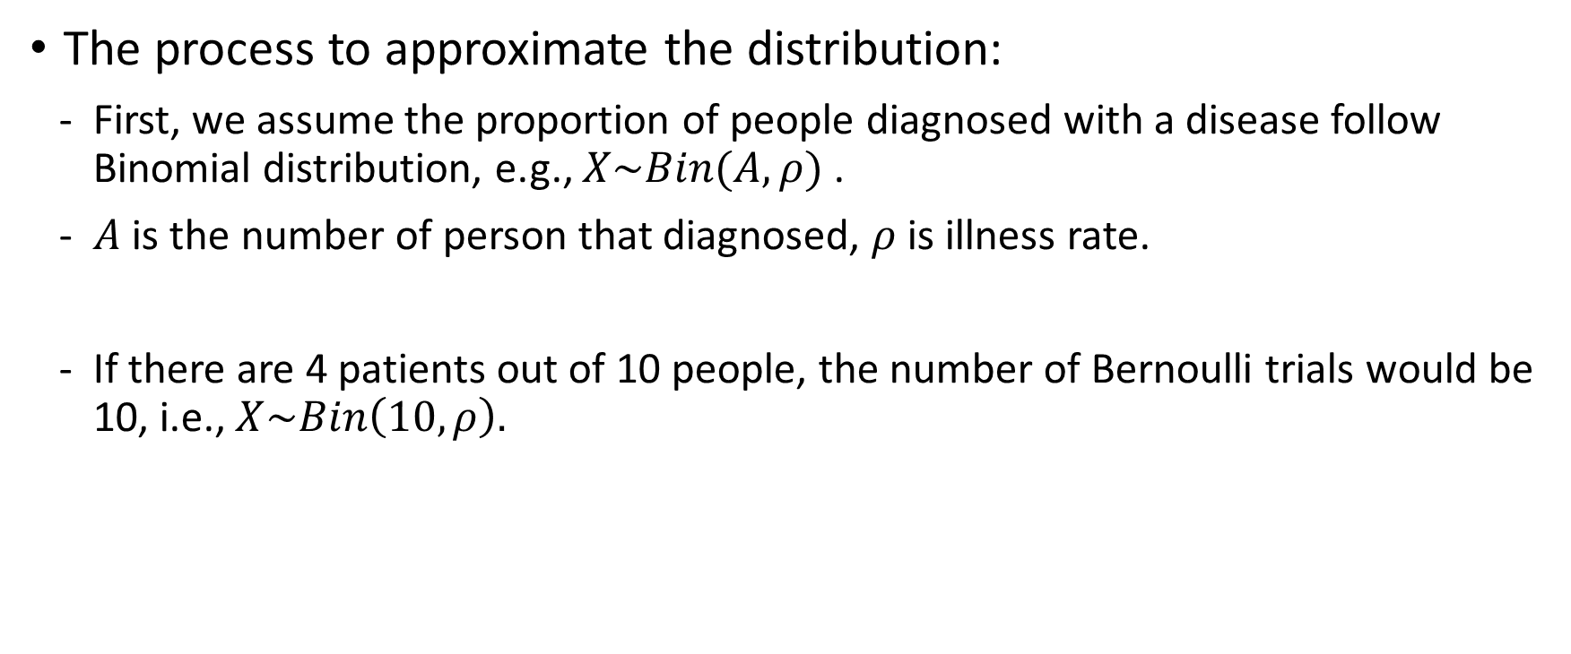
Maximum Likelihood
The process to approximate the distribution:
First, we assume the proportion of people diagnosed with a disease follow Binomial distribution, e.g., $X\sim Bin(A,ρ)$ .
$A$ is the number of person that diagnosed, $ρ$ is illness rate.
If there are 4 patients out of 10 people, the number of Bernoulli trials would be 10, i.e., $X\sim Bin\left(10,ρ\right).$

Slide 7
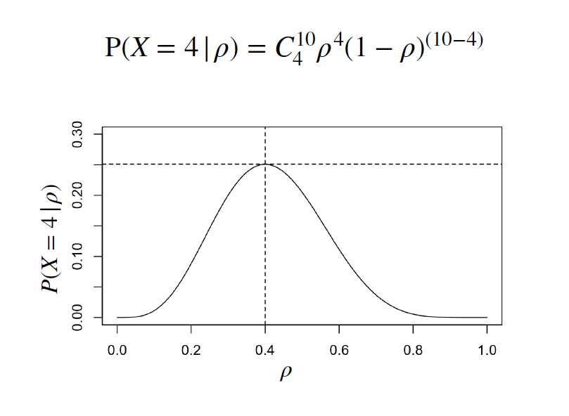
Maximum Likelihood

Slide 8
Outline
Brief Review: Logistic Regression
Maximum likelihood in Logistic Regression
Implement
Common Evaluation Metrics for Binary Classification
Confusion Matrix
Soft Classifiers – ROC Curve

Slide 9


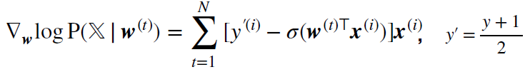
Logistic Regression
In logistic regression, we solve maximum log-likelihood instead .
Update with gradient decent:
Where:

Slide 10
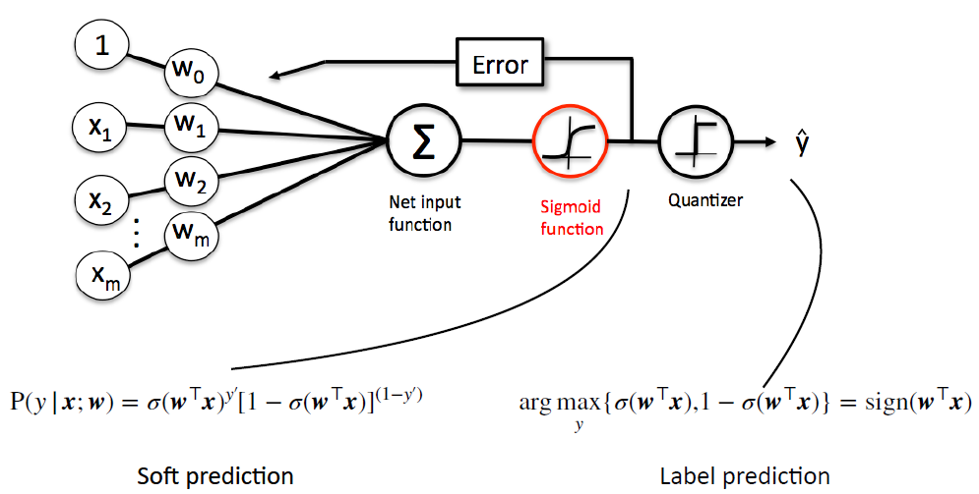
Logistic Regression

Slide 11
Outline
Brief Review: Logistic Regression
Maximum likelihood in Logistic Regression
Implement
Common Evaluation Metrics for Binary Classification
Confusion Matrix
Soft Classifiers – ROC Curve

Slide 12
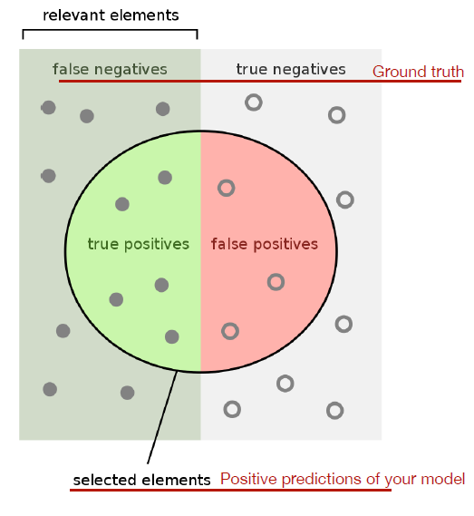
Confusion Matrix
It is important to know how the model make wrong prediction.
In binary classification, confusion matrix is a common tool to analyze the predictions.

Slide 13
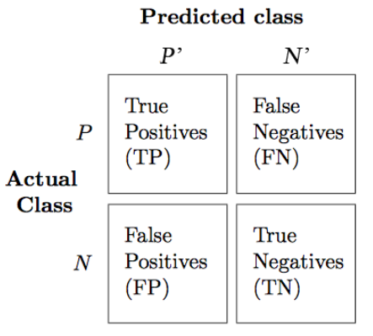

Confusion Matrix
It is important to know how the model make wrong prediction.
In binary classification, confusion matrix is a common tool to analyze the predictions.
Other metrics we can use:

Slide 14
Outline
Brief Review: Logistic Regression
Maximum likelihood in Logistic Regression
Implement
Common Evaluation Metrics for Binary Classification
Confusion Matrix
Soft Classifiers – ROC Curve

Slide 15
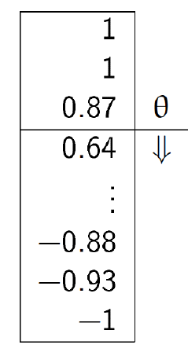


ROC Curve
ROC curve analyze the performance for every threshold in soft classifiers.
In X-axis: FPR
In Y-axis: TPR

Slide 16
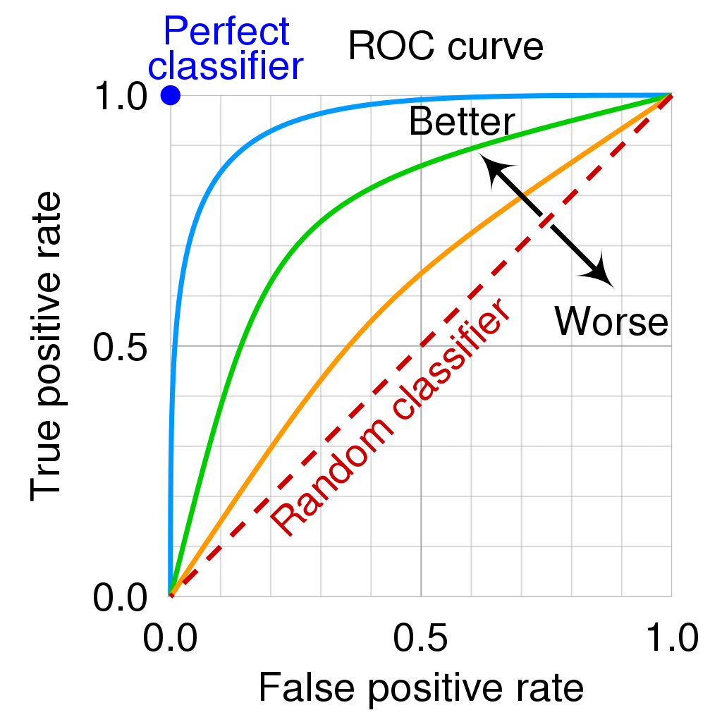
ROC Curve
ROC curve analyze the performance for every threshold in soft classifiers.
In X-axis: FPR
In Y-axis: TPR
By cmglee, MartinThoma - Roc-draft-xkcd-style.svg, CC BY-SA 4.0, https://commons.wikimedia.org/w/index.php?curid=109730045

Slide 17
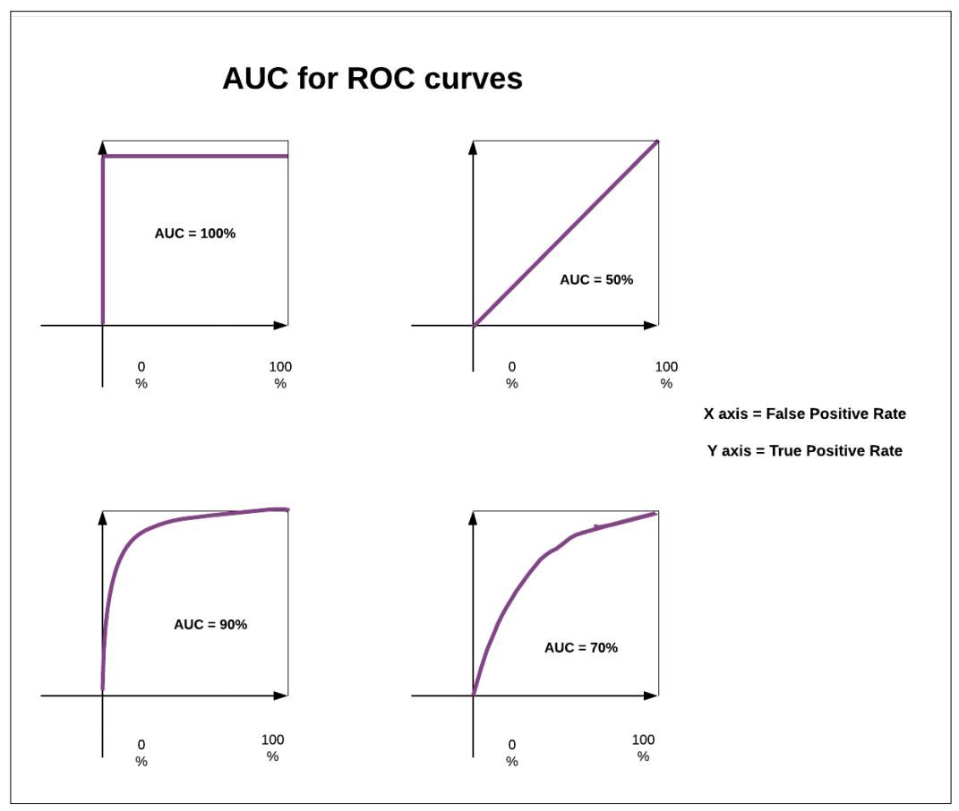
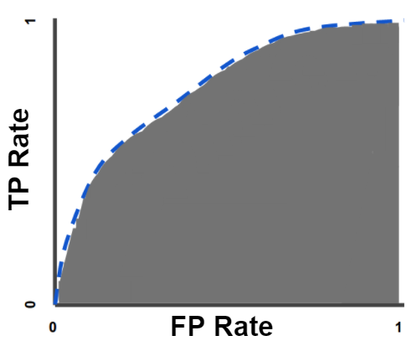
ROC Curve
AUC - Area Under the ROC Curve.
ROC can be quantified using AUC.
Random guess
https://developers.google.com/machine-learning/crash-course/classification/roc-and-auc
https://medium.com/acing-ai/what-is-auc-446a71810df9

Slide 18
Homework
Homework: Lab06
Lab06: Logistic Regression, Metrics
Bonus: Lab07 && Lab08
Lab07: Support Vector Machine, k-Nearest Neighbors
Lab08: Cross Validation, Ensemble

Slide 19
Reference
https://bookdown.org/ccwang/medical_statistics6/section-43.html
https://bookdown.org/ccwang/medical_statistics6/bernoulli.html
https://bookdown.org/ccwang/medical_statistics6/binomial.html
https://bookdown.org/ccwang/medical_statistics6/likelihood-definition.html
https://en.wikipedia.org/wiki/Sensitivity_and_specificity
https://commons.wikimedia.org/w/index.php?curid=109730045
https://developers.google.com/machine-learning/crash-course/classification/roc-and-auc
https://medium.com/acing-ai/what-is-auc-446a71810df9
https://github.com/dariyasydykova/open_projects/tree/master/ROC_animation

