Slide 1

Green Pace
Security Policy Presentation
Developer: Monticia Dunn

Slide 2

OVERVIEW: DEFENSE IN DEPTH
Defense-In-Depth is an important policy to follow in order to protect an organizations’ assets. A security policy will setup secure guidelines for the organization to follow to ensure that proper security measures are taken

Slide 3
THREATS MATRIX
Secure Coding standards come with varying threat levels that help measure the impact of those vulnerabilities.
Likely Risk that is more likely to occur | Priority Risk that requires more attention
Low priority Risk that doesn’t require as much attention | Unlikely Risk that is more unlikely to occur

Slide 4
10 PRINCIPLES
Validate Input Data
Heed Compiler Warnings
Architect and Design for Security Policies
Keep It Simple
Default Deny
Adhere to the Principle of Least Privilege
Sanitize Data Sent to Other Systems
Practice Defense In Depth
Use Effective Quality Assurance Techniques
Adopt a Secure Coding Standard

Slide 5
CODING STANDARDS
Include the appropriate type information in function declarators
Declare function parameters that are pointers to values not changed by the function as const
Guarantee that storage for strings has sufficient space for character data and the null terminator
Prevent SQL injection
Detect and handle memory allocation errors
Incorporate diagnostic tests using assertions
Handle all exceptions
Obey the one-definition rule
Close files when they are no longer needed
Do not rely on side effects in unevaluated operands

Slide 6
ENCRYPTION POLICIES
Encryption in rest - By guaranteeing that the data is encrypted when it is on disk, encryption at rest is intended to stop the attacker from obtaining the unencrypted data. A hacker who finds a hard disk containing encrypted data but not the encryption keys must remove the encryption in order to read the data.
Encryption at flight - Encryption of data in-flight is the process of securely encrypting data as it is being transferred in some way. It can be unencrypted as it’s at rest on drive arrays but for other methods of transit like with web browsers it’s important to always use secure protocols like encrypting emails before transmitting and utilizing digital signatures
Encryption in use - Encryption of data in-use is the process of protecting data while it is being used in memory by an application before it is sent to the CPU for processing. The encryption keys in this process are unique to each application, so someone with access to the RAM may parse the memory to locate that key

Slide 7
TRIPLE-A POLICIES
Authentication - Authentication is the process of verifying a user is who they claim to be
Authorization - Authorization is the process used by a server to grant rights or permissions for a user to access specific resources or functionality
Accounting - Accounting is the process of monitoring and recording user activity as they interact with the system.

Slide 8
Unit Testing
The coding vulnerability I chose to test is Exception handling, since that was one of the top 10 coding standards in our policy.
The main goal was to capture the errors in the code and display the appropriate errors to the user via exception handling

Slide 9
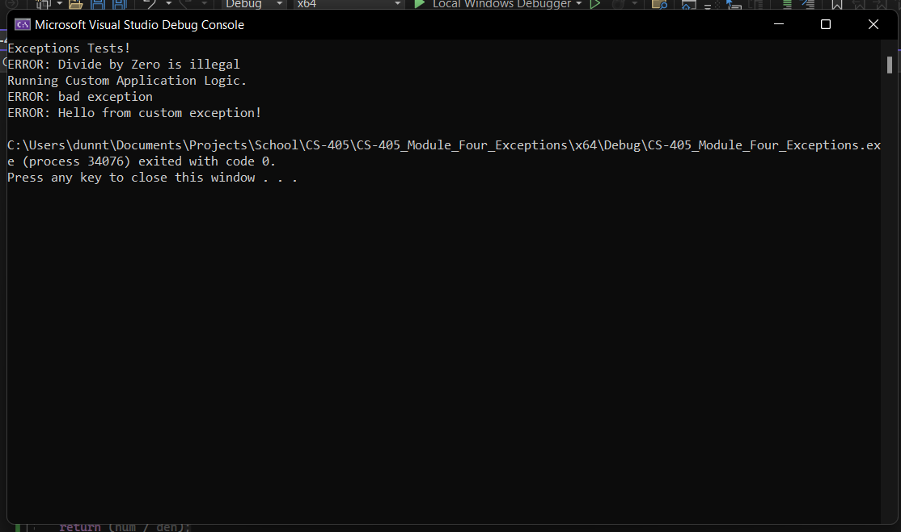

Slide 10

AUTOMATION SUMMARY

Slide 11
TOOLS
A DevSecOps pipeline is a CI/CD pipeline with integrated security practices and tooling using a full circle approach
Some external tools that could be used to aid the execution of this structure include:
JIRA
CPPCheck
Debuggers

Slide 12
RISKS AND BENEFITS
There are pros and cons for both acting now and waiting to apply this security policy.
Some of the risks include time and money expense and accumulated technical debt
Some of the benefits include higher security, more maintainability and less potential vulnerabilities arising as the code base expands
The best approach depends on the company, I think in our case an incremental rollout of security measures from the policy would work best and we could act now instead of waiting and indeterminate amount of time

Slide 13
RECOMMENDATIONS
Remain consistent with the Security Policy
Enforce the Security Policy sooner rather than later
Keep up with emerging threats in the cybersecurity space

Slide 14
CONCLUSIONS
All the standards from the security policy should be adopted to prevent future problems
Each standard is meant to address one of the 10 main Security Principles and more can be added later to expand the policy further.
These all are meant to help enforce the zero-trust and defense-in-depth policy as well

Slide 15
REFERENCES
Foster, S. (2021, January 22). DevSecOps pipeline overview: Devsecops simplified. Perforce Software. Retrieved April 16, 2023, from https://www.perforce.com/blog/kw/devsecops-pipeline-overview

