Slide 1

Xanadu
Quantum Chemistry Challenge: Team 13
Brett Widholm
Dan Johnson
Landon Holcomb
Solomon Ellis-Summers

Slide 2

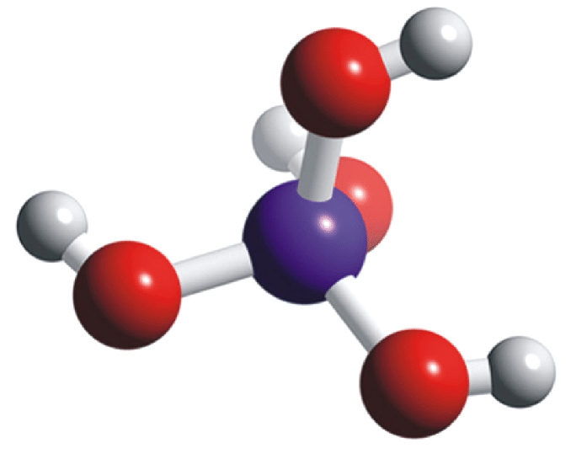



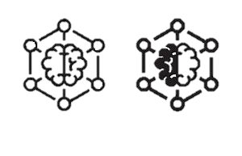
Quantum Frameworks
Molecular Data & Materials Science Integration
Silicon Energy Modeling
PES Scanning
Quantum Algorithms
Classical Computing Integration
Python
VQE (Variational Quantum Eigensolver)
Hybrid Quantum-Classical Workflow
VQD (Variational Quantum Deflation)
Classical ML for Optimization
PES (Potential Energy Surfaces)

Slide 3







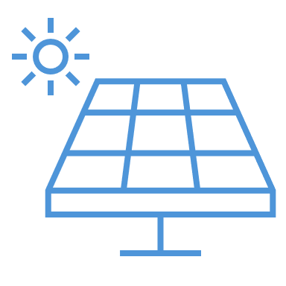










The Impact of Silicon Spectral Gap
Semiconductors
Solar Energy
Qubits
Enhancing Semiconductor Performance
Increased Energy Conversion Efficiency
Optimizing Qubit Stability
Reduced Power Consumption
Cost Reduction for Solar Installations
Increased Quantum Processing Power
Market Leadership in Advanced Materials
Competitive Edge in Renewable Energy Market
Competitive Advantage in Quantum Hardware
Faster Time-to-Market
Development of Next-Generation Solar Technologies
Cost-Effective Quantum Solutions
Applications in Power Electronics
Addressing Energy Storage Needs
Quantum Computing Applications

Slide 4





Ground State
Spectral Gap
VQE
First Excited
VQD
PES
Software
Process
Result

Slide 5
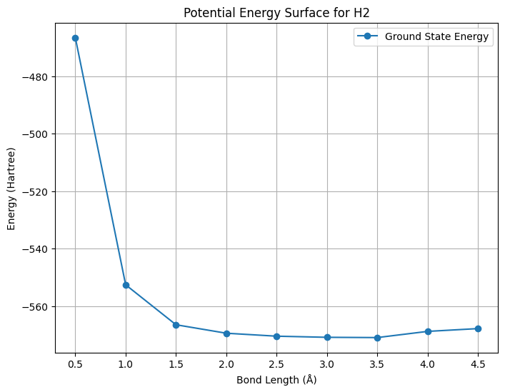
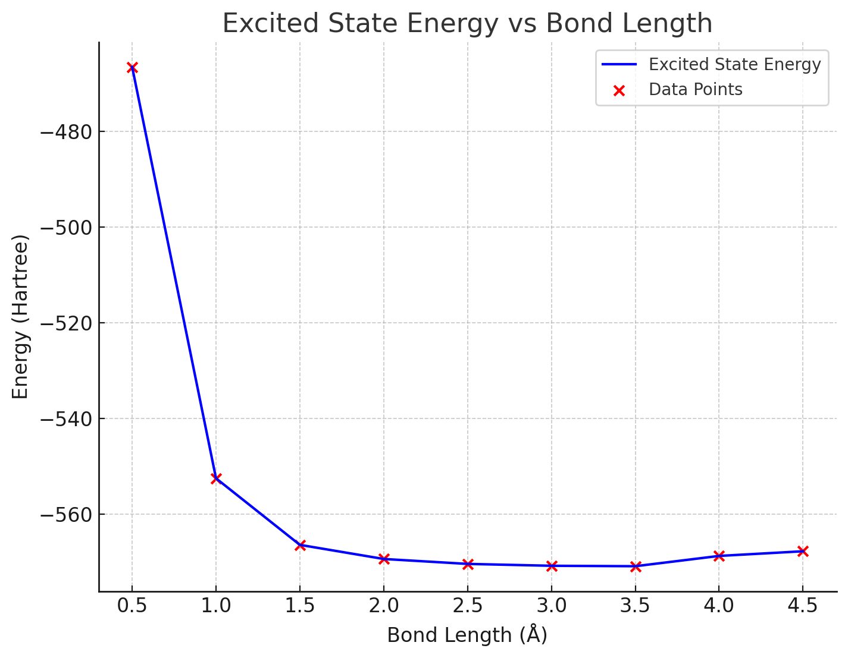
Graphs
Ground State
Excited State
Potential Energy Surface (PES) for SI2
Potential Energy Surface (PES) for SI2

Slide 6
Calculations Table
Bond Length | Ground State | Excited State | Difference
0.5 | -466.533 | -548.81021 | 82.27673
1 | -552.56 | -569.01765 | 16.46131
1.5 | -566.47 | -570.75221 | 4.284101
2 | -569.42 | -570.91462 | 1.496029
2.5 | -570.45 | -570.91349 | 0.464175
3 | -570.84 | -570.78856 | -0.05292
3.5 | -570.93 | -570.67973 | -0.2531
4 | -568.78 | -570.60632 | 1.825007
4.5 | -567.81 | -570.56347 | 2.757079
Spectral Gap = -0.01821 = (Minimum Ground State – Minimum Excited State)

Slide 7
Work Cited
Dixon, D. A.; Feller, D.; Peterson, K. A.; Gole, J. L. The Molecular Structure and Ionization Potential of Si₂: The Role of the Excited States in the Photoionization of Si₂. J. Phys. Chem. A 2000, 104 (11), 2326–2332. DOI: 10.1021/jp992078b.
Ren, S., Shou, C., Jin, S., Chen, G., Han, S., Chen, Z., Chen, X., Yang, S., Guo, Y., & Tu, C. (2021). Silicon quantum dot luminescent solar concentrators and downshifters with antireflection coatings for enhancing perovskite solar cell performance. ACS Photonics, 8(8), 2392-2399. https://doi.org/10.1021/acsphotonics.1c00550&#8203;:contentReference[oaicite:0]{index=0}

