Slide 1
Fixed Income Portfolio Management
Akash Tickoo

Slide 2
Project Overview
Objective: Compare and analyze USD and EUR fixed income portfolios.
Scope: Assess credit quality, sector exposure, maturity profile, and risk sensitivities (KRD).
Tools Used: Python (analysis & automation), Streamlit (interactive app), Power BI (dashboards), GitHub (collaboration).
Outcome: Actionable insights for stakeholders on portfolio structure, risks, and exposures.

Slide 3
Data Pipeline
Raw Data
Data Cleaning
Portfolio Analysis
Export Results
Dashboards
Streamlit
Power BI

Slide 4
Portfolio Analysis Outcomes
Portfolio Summary
USD Portfolio: ~$26.3B, Yield ~5.3%, Avg. Maturity ~12.9 yrs.
EUR Portfolio: ~$13.4B, Yield ~3.4%, Avg. Maturity ~6.0 yrs.
Credit Quality
USD: Dominated by AA+ (70%), exposure to BBB & NR.
EUR: AAA (23%), AA- (21%), NR (15%), BBB (14%).
Multiple rating agencies: S&P, Fitch, Moody’s, MSCI ESG.

Slide 5
Sector Exposure
USD: Mainly Treasury (59%), Industrial (20%), Financials (11%).
EUR: Treasury (55%), Non-Corporate (19%), Industrial (9%).
Duration & Maturity
Weighted Duration: USD ~6.0 yrs, EUR ~6.5 yrs.
Maturity Buckets:
USD: Heavy in 10–30y (43%).
EUR: Balanced across 0–10y (60%)
Top Holdings
USD: US Treasury Notes/Bonds, GNMA, UMBS.
EUR: Sovereigns – France, Germany, Spain, Italy.

Slide 6
Risk Profiles (KRD)
USD: Peak rate sensitivity at 10Y.
EUR: Spread across 5–15Y, less concentrated.
Geographic Exposure
USD: 93% US, small UK, Canada, Japan exposure.
EUR: Diversified – France (21%), Germany (19%), Italy (14%), Spain (10%).

Slide 7
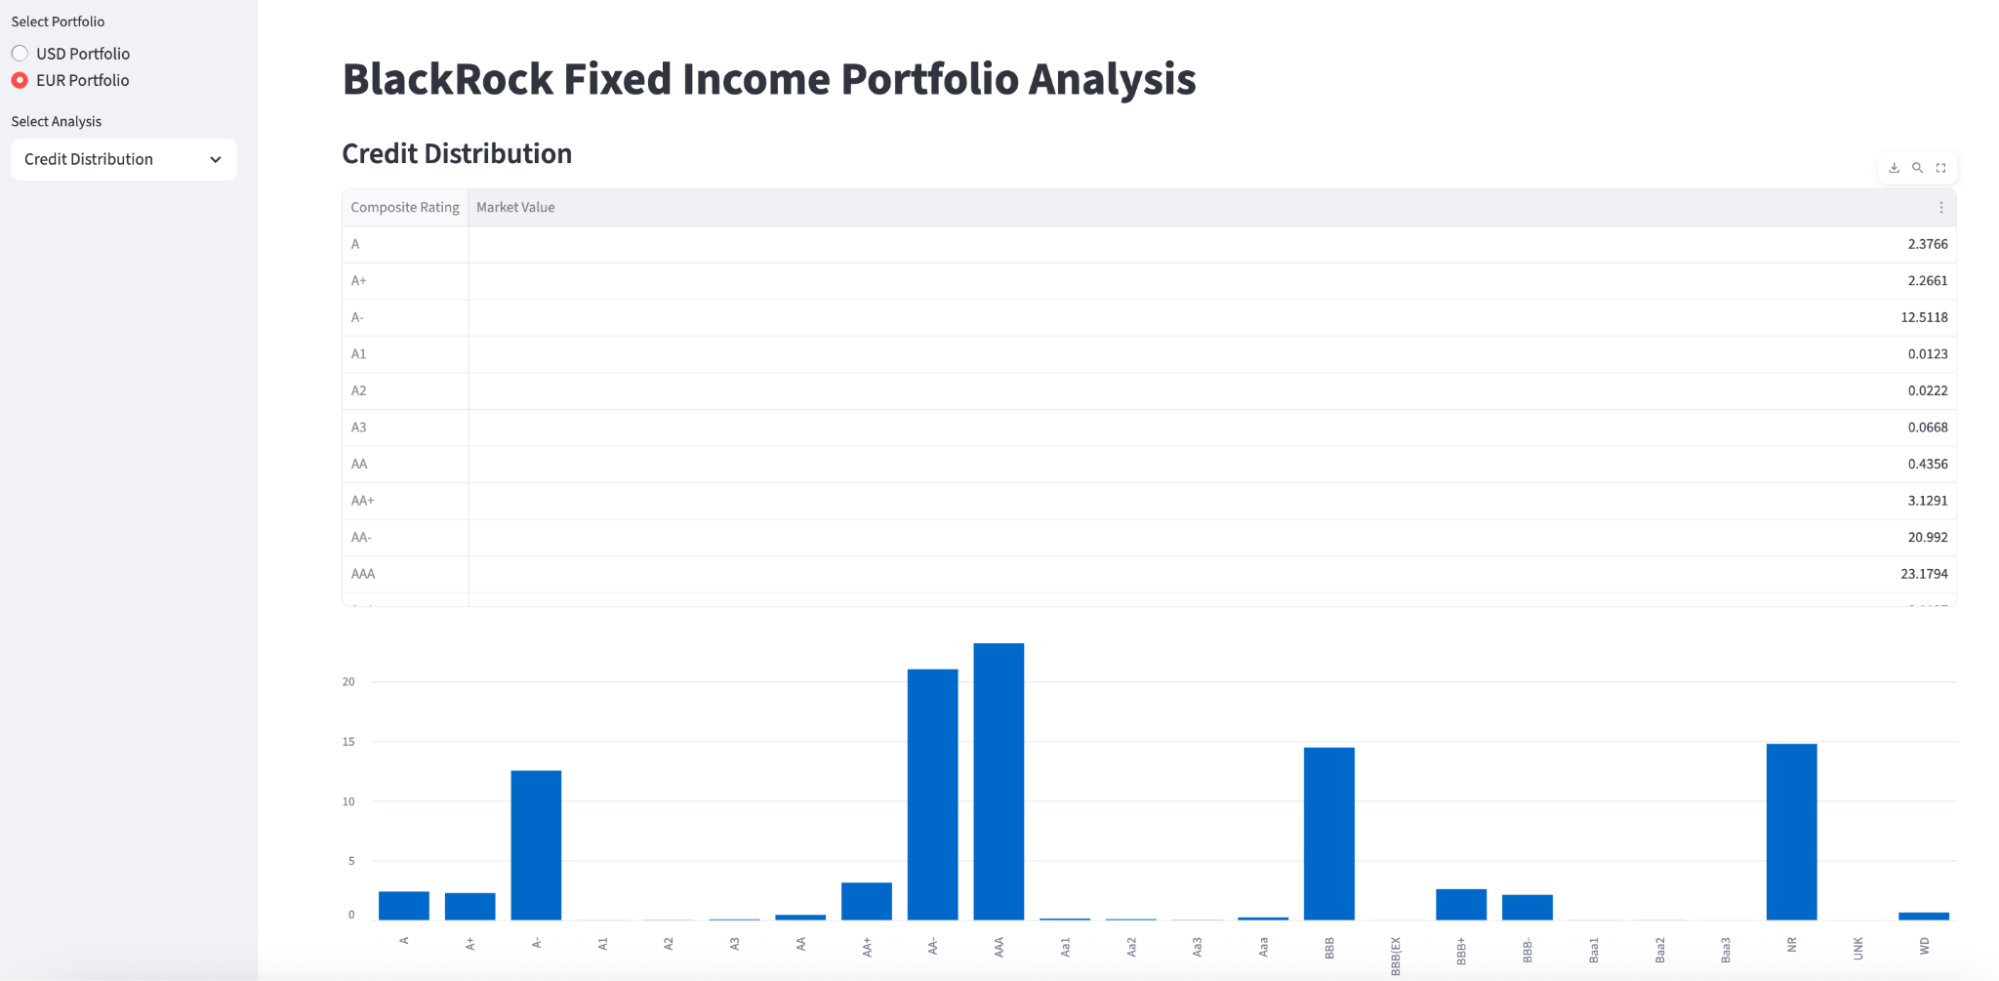
DashBoard - StreamLit

Slide 8
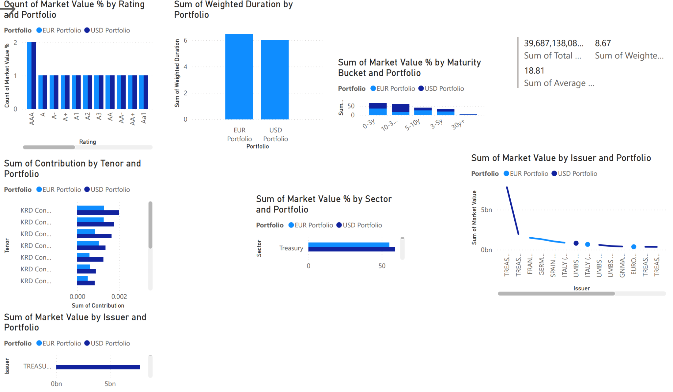
DashBoard PowerBI

Slide 9
Thank you

