Slide 1

2026
FIFTH ANNUAL · SEPTEMBER 14, 2026 · THE STATLER DALLAS
THE 10 PILLARS OF VISIONARY GREATNESS
Mark C. Winters, Visionary & Founder / Rocket Fuel University
@MarkCWinters
eosnorthtexas.com
#WeRunOnEOS2026
Notes:
Title slide. Replace the title, your name, and handle. Leave the logo, event line, and footer as they are.

Slide 2
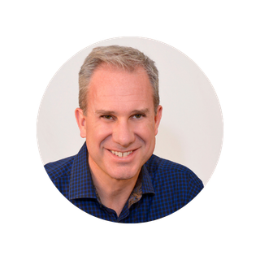



THE 10 PILLARS OF VISIONARY GREATNESS
How Driven Entrepreneurs Get What They Want Without Doing It All Themselves
Mark C. Winters
Rocket Fuel University®
Visionary / Founder

Slide 3
VISIONARY DNA - SUPERPOWERS
Founding entrepreneur
Lots of ideas
Big picture thinker
Good industry / target market pulse
Enjoys R&D
Enjoys big external relationships
Inspirer for the organization
Creative problem solver
Create and hold the company vision
Closes big deals
Good at connecting the dots
Reality distortion field

Slide 4
VISIONARY DNA - CHALLENGES
Inconsistency
Organizational “whiplash”
Dysfunctional teams
Create lack of clear direction
Reluctance to let go
Underdeveloped leaders and managers
“Genius” with 1,000 helpers
Eyes bigger than their stomach
Naturally resistant to following a process
Quickly and easily bored
No patience for the details
Create chaos
Often have some level of ADD
All foot on gas pedal – with no brake
Drive is too intense for most people

Slide 5
VISIONARY ROLE
See the future
Ideation
BIG external relationships
Solving interesting problems
Closing big deals

Slide 6
THE QUESTION:
HOW TO BECOME TRULY GREAT IN THIS ROLE?

Slide 7
A: THE 10 PILLARS… OF VISIONARY GREATNESS
(Because Visionaries LOVE Lists!)
PILLAR 1
KNOW THYSELF
PILLAR 6
THINK ABOUT WHAT YOU THINK ABOUT
PILLAR 2
MAINTAIN WARRIOR SHAPE
PILLAR 7
WATCH OUT FOR PITFALLS
PILLAR 3
SURROUND YOURSELF
PILLAR 8
HELP OTHERS STRETCH
PILLAR 4
COMMIT TO YOUR OPERATING SYSTEM
PILLAR 9
GO SLOW TO GO FAST
PILLAR 5
SUPPORT YOUR INTEGRATOR
PILLAR 10
DO NO HARM

Slide 8
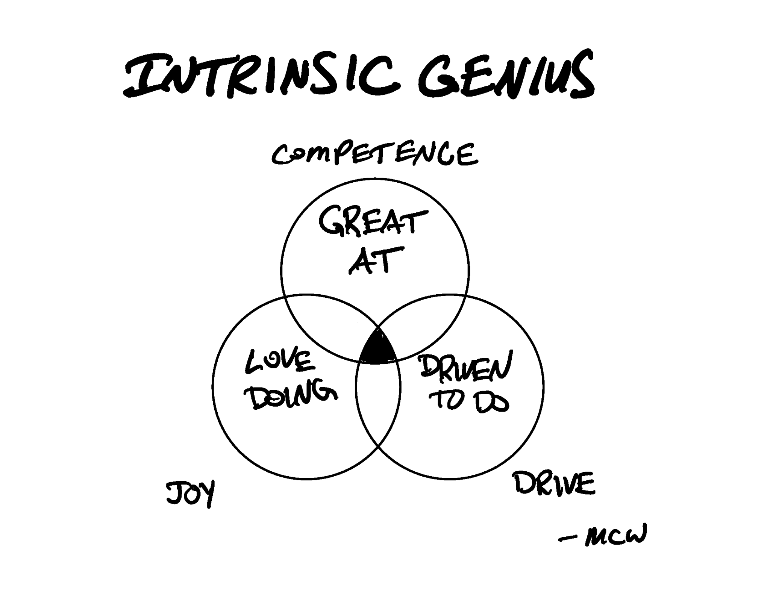
PILLAR 1: KNOW THYSELF
“To know thyself is the beginning of wisdom.”
- Socrates
Notes:
The inner work (Jonathan)
Profiling Tools
Intrinsic Genius
Statement: You can't integrate a Visionary you don't understand.
Tool: Intrinsic Genius. Run it on yourself first.
Provocation: Can you describe the VIS edge you were hired to complement?

Slide 9
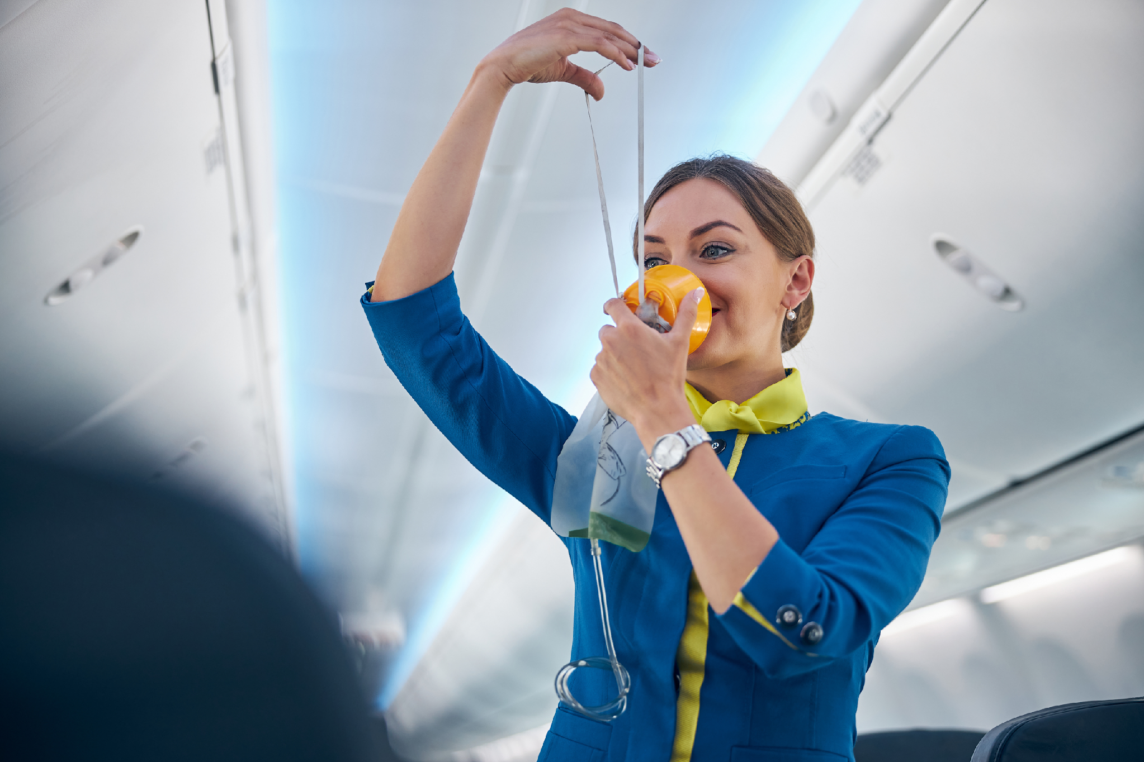
PILLAR 2: MAINTAIN WARRIOR SHAPE
“MASK YOURSELF BEFORE YOUR CHILDREN”
Notes:
The most important ability is availability
Present Self vs. Future Self
Mind, Body, Spirit — levers for each
Statement: A depleted Visionary makes expensive decisions.
Tool: Body/Mind/Spirit Levers
Provocation: When did you last tell your VIS: “I/we need you to take care of yourself”?

Slide 10
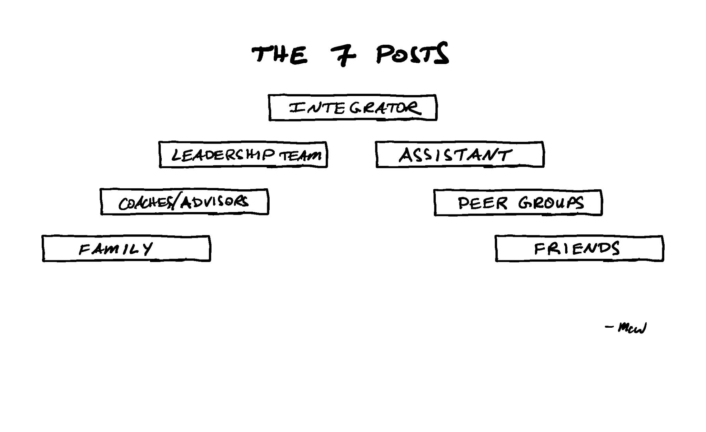
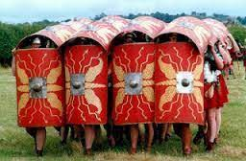
PILLAR 3: SURROUND YOURSELF
“SHIELD WALL”
Notes:
Shield Wall (Gino)
7 Special Posts / Relationships
Culture Formula
Statement: You're one post in their Shield Wall, and also accountable for another (LT).
Tool: Shield Wall gap analysis — done together.
Provocation: Which Special Post(s) is your Visionary missing? Helping fill it, or covering for it?

Slide 11
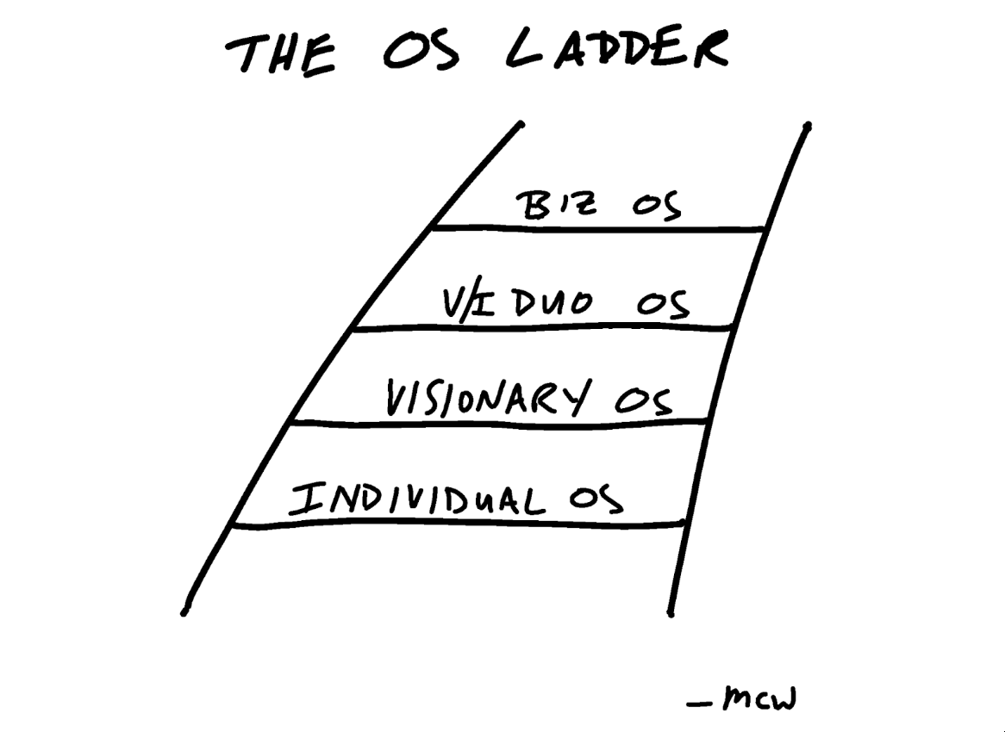
PILLAR 4: COMMIT TO YOUR OS
THE OS LADDER
Notes:
Structure Fuels Freedom
Choose one. Don't waffle. Commit to mastery.
OS Ladder — top down
XF / 9 Domains
Statement: Structure fuels freedom.
Tool: OS Ladder self-rating: both of you, then compare.
Provocation: What's the weakest rung on your Visionary's ladder?

Slide 12
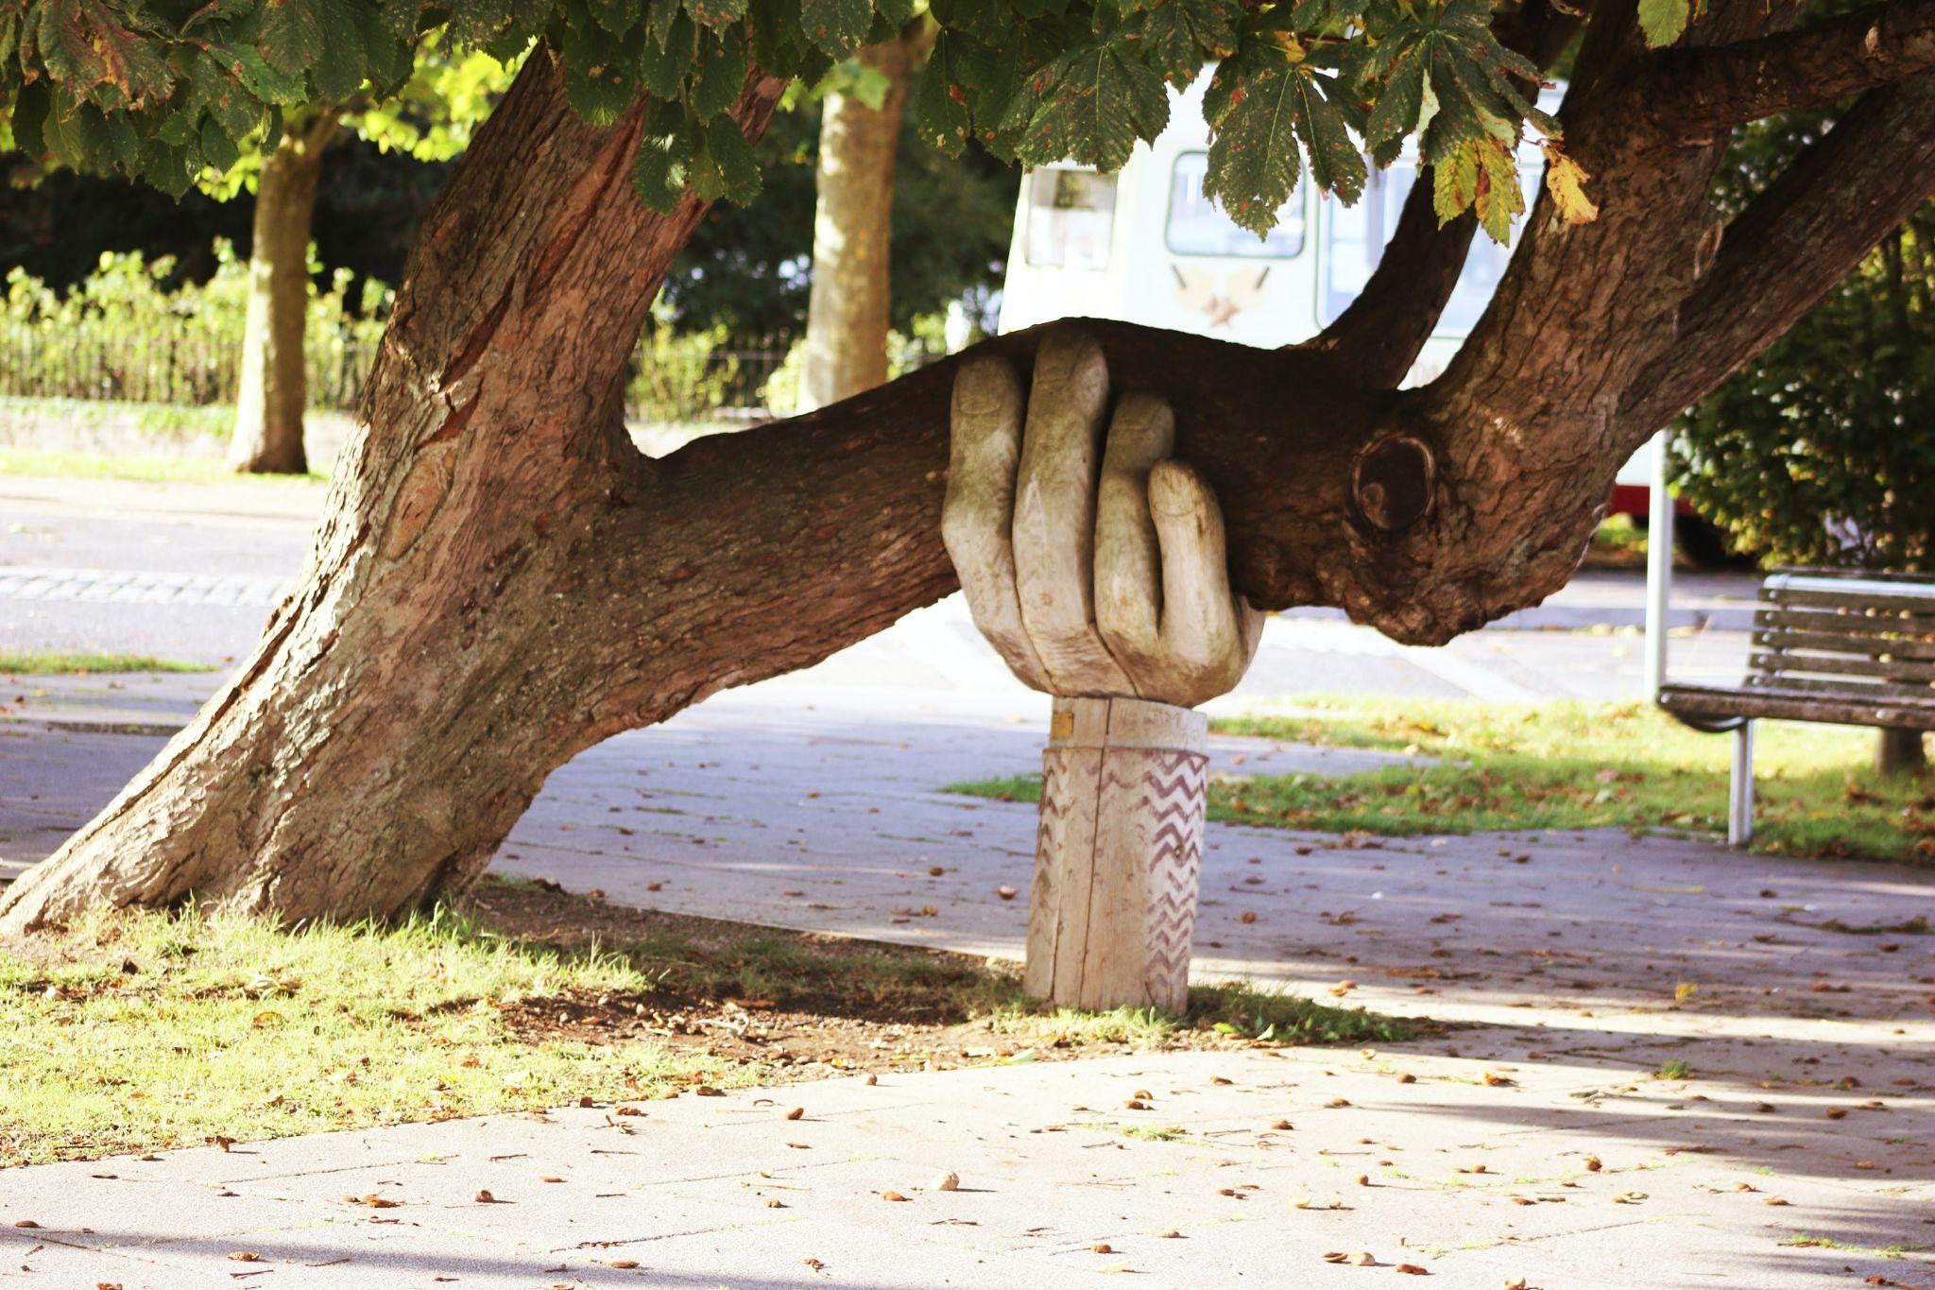
PILLAR 5: SUPPORT YOUR INTEGRATOR
Don’t make it harder for them than it already is…
Notes:
INT job is hard enough
VIS Commitments
RFPI (Open & Honest)
Statement: Make it easy for them to support you well.
Tool: RFPI.
Provocation: If you don't know how your VIS would answer, you don't know your VIS.

Slide 13
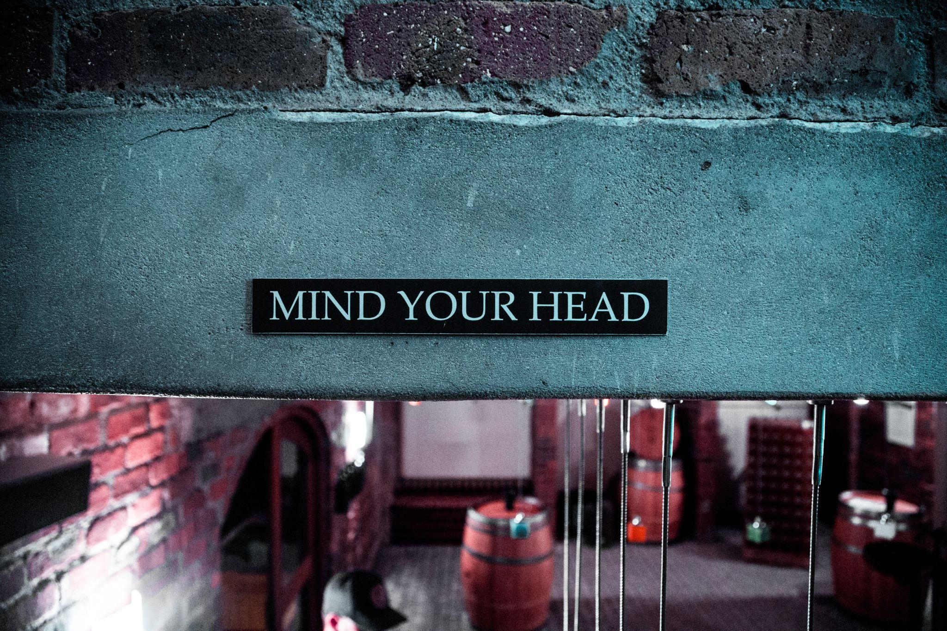
PILLAR 6: THINK ABOUT WHAT YOU THINK ABOUT
MINDSETS MATTER
Notes:
7 Mindsets
Intellectual Humility
Diamond of Creativity
Statement: What V thinks about impacts everything. Help them make their thinking visible.
Tool: 7 Mindsets.
Provocation: When did you last tell your V their thinking was doing damage?

Slide 14
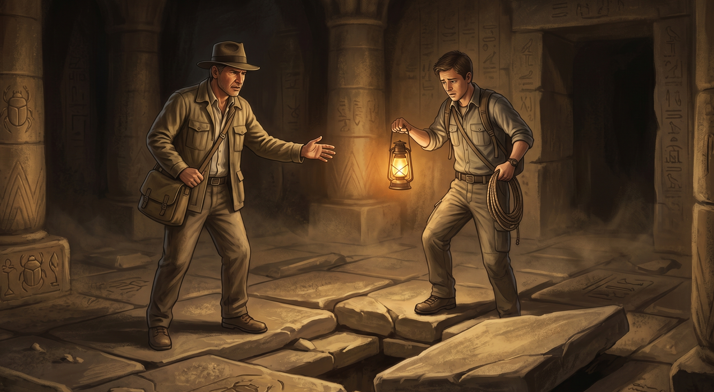
PILLAR 7: WATCH OUT FOR PITFALLS
“THE FLOOR - IT MOVES…
ASPS - VERY DANGEROUS…
YOU GO FIRST”
Notes:
Bad Behavior (tampering, end runs, Owner's Card)
Becoming the Bottleneck
Statement: Every Visionary pitfall has an Integrator accomplice.
Tool: Name the pitfalls. Make them visible.
Provocation: Name the last V pitfall you noticed and did not name.

Slide 15
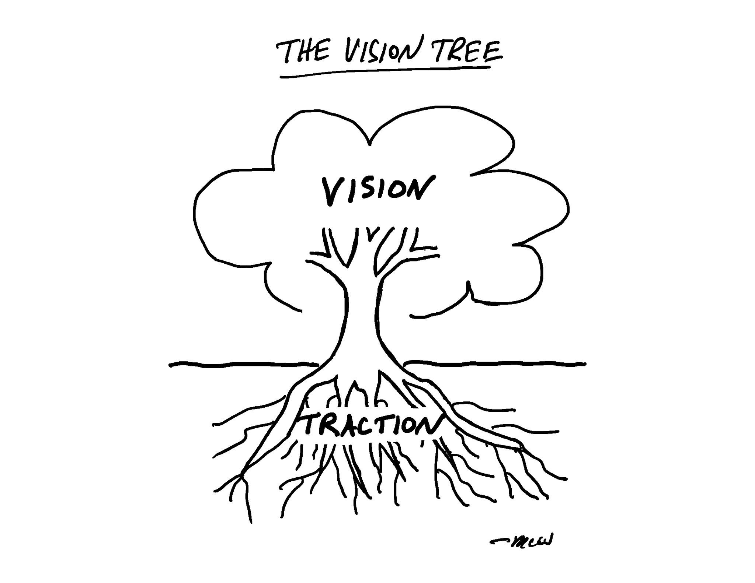
PILLAR 8: HELP OTHERS STRETCH
HEALTHY STRETCHING… WHERE THEY SHOULD
Notes:
Stretch the Vision. Predict the Traction. Must do both.
The Vision Tree
The Vision Expander
Statement: Healthy = Stretch the vision. Predict the traction.
Tool: Vision Expander.
Provocation: Which is harder: V predicting the Traction, or I stretching the Vision? Which is working better right now?

Slide 16
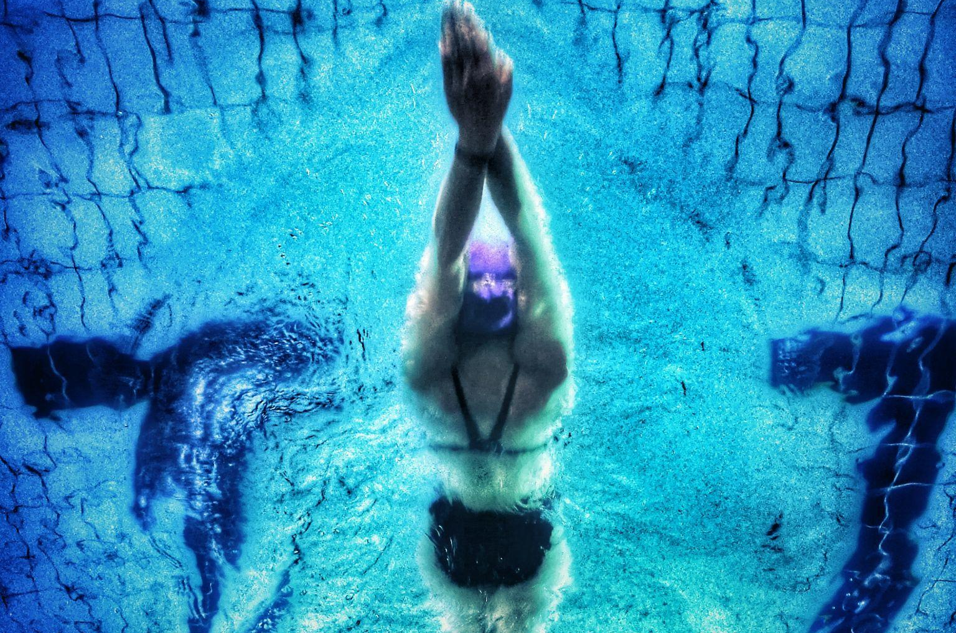
PILLAR 9: GO SLOW TO GO FAST
SLOW IS SMOOTH…
SMOOTH IS FAST
Notes:
Frenetic energy… Slow is Smooth, Smooth is Fast
Flow Follows Focus
Traffic Jam Theory
Statement: They're gonna create traffic jams. You must either clear it - or prevent it.
Tool: Traffic Jam model.
Provocation: How much time do you spend clearing traffic jams vs preventing them?

Slide 17
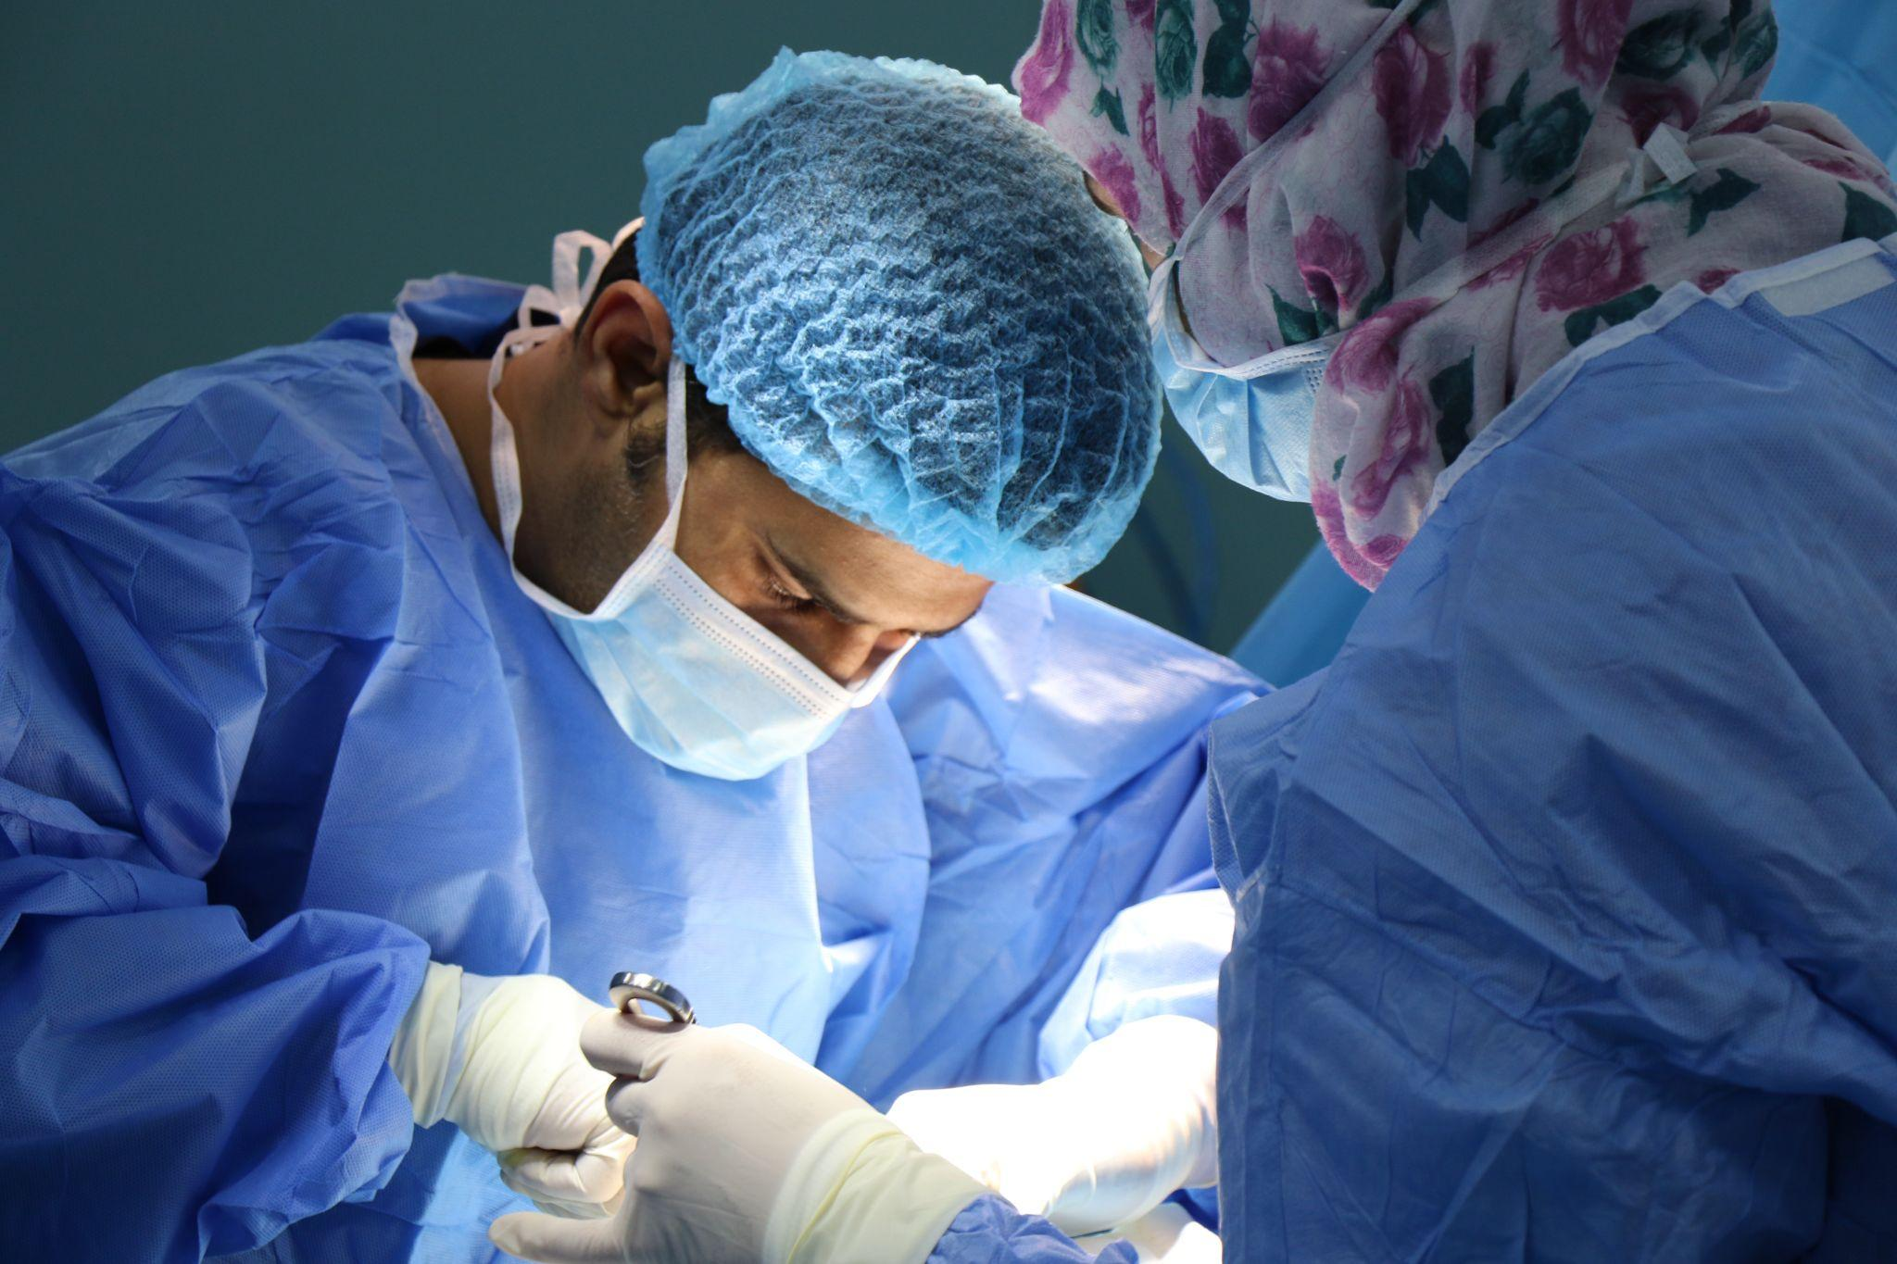
PILLAR 10: DO NO HARM
From the Latin:
“Primum Non Nocere”
THE HIPPOCRATIC OATH,
245 AD
(but not really)
Notes:
Jonathan's Big Truck
Vision Confusion
Special Exceptions
Thinking Out Loud
Statement: Protect them from screwing up the single largest investment in their portfolio.
Tool: Susan Scott's Decision Tree.
Provocation: How many leafy decisions are being treated like a much meatier part of the tree?

Slide 18
YOUR FUTURE
BIGGER & BRIGHTER

Slide 19
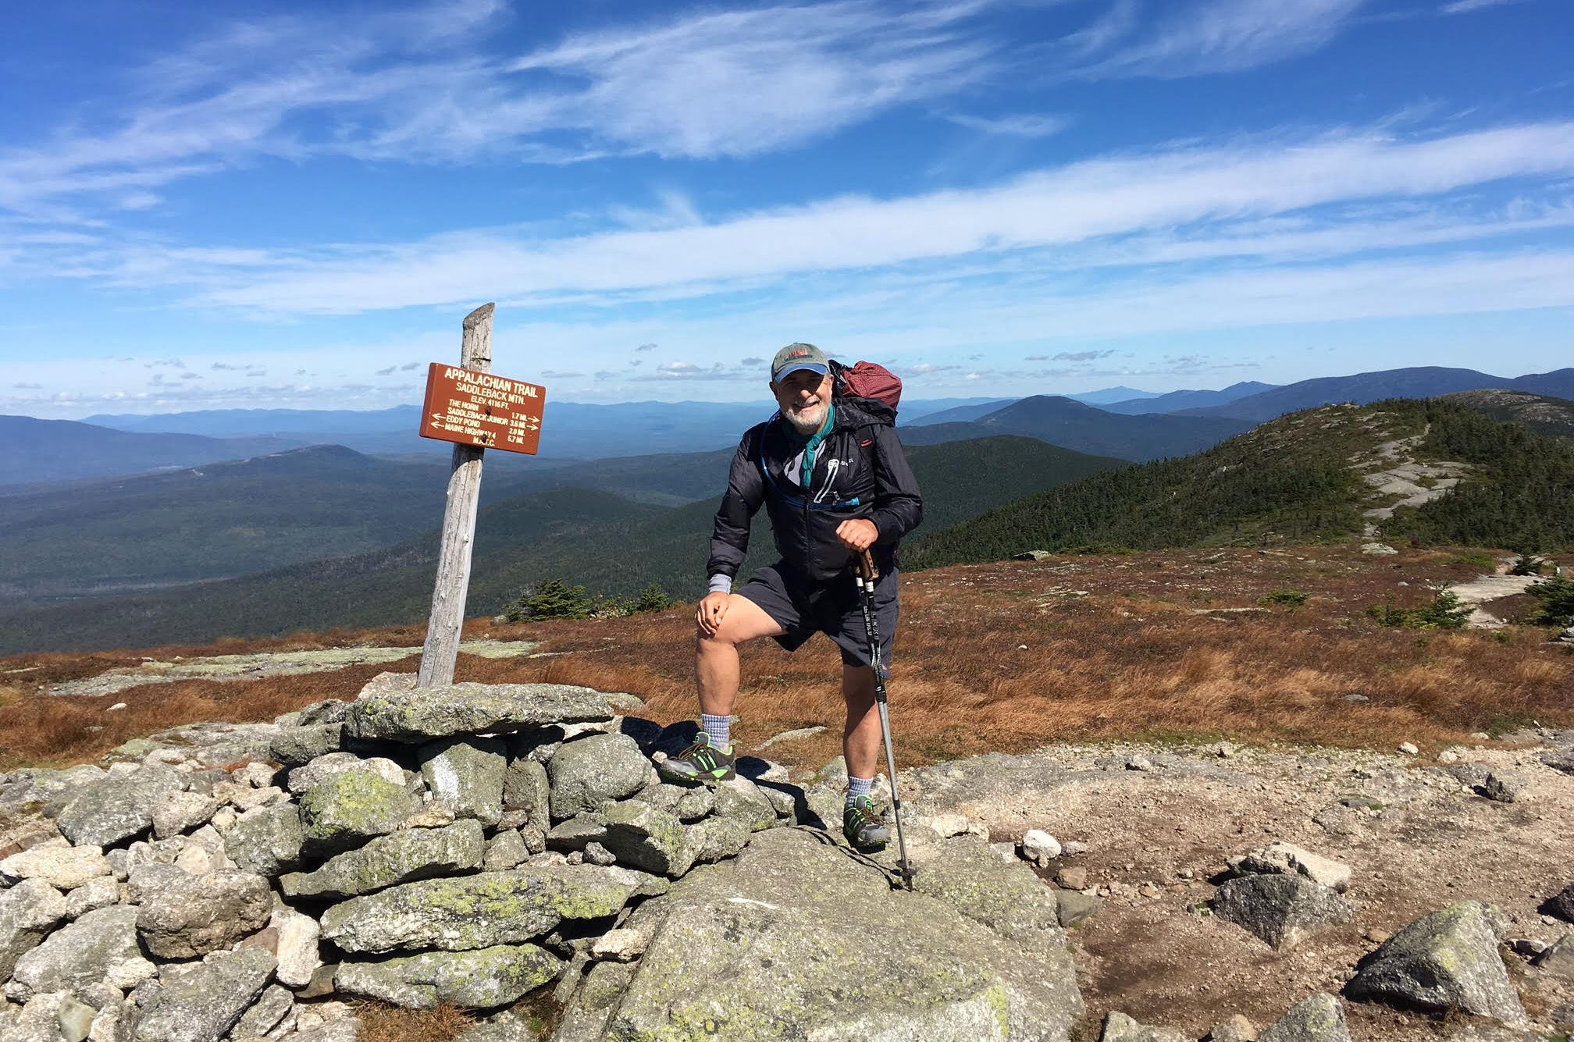
EXPONENTIAL FREEDOM
“Hello from the AT…
my Integrator has everything under control!”

Slide 20
NEXT STEPS
FOR YOU… AND YOUR INTEGRATOR

Slide 21
VISIONARY
INTEGRATOR
Read: VISIONARY (all about you)
VisionaryBook.com (more tools/resources)
Join Our Community: Visionary Book Owners Group (on LinkedIn)
Read VISIONARY (peek inside their brain)
Read ROCKET FUEL (5 Rules + 5 Tools)
All the Rest: https://academy.eosworldwide.com/c/visionaries-integrators (even more tools/resources)

Slide 22
NOW…
GO CHANGE THE WORLD!

Slide 23
Q&A
ASK ME ANYTHING

Slide 24






THANK YOU
mark@markcwinters.com
markcwinters.com
@markcwinters
MARK C. WINTERS
Rocket Fuel University
Visionary / Founder

Slide 25
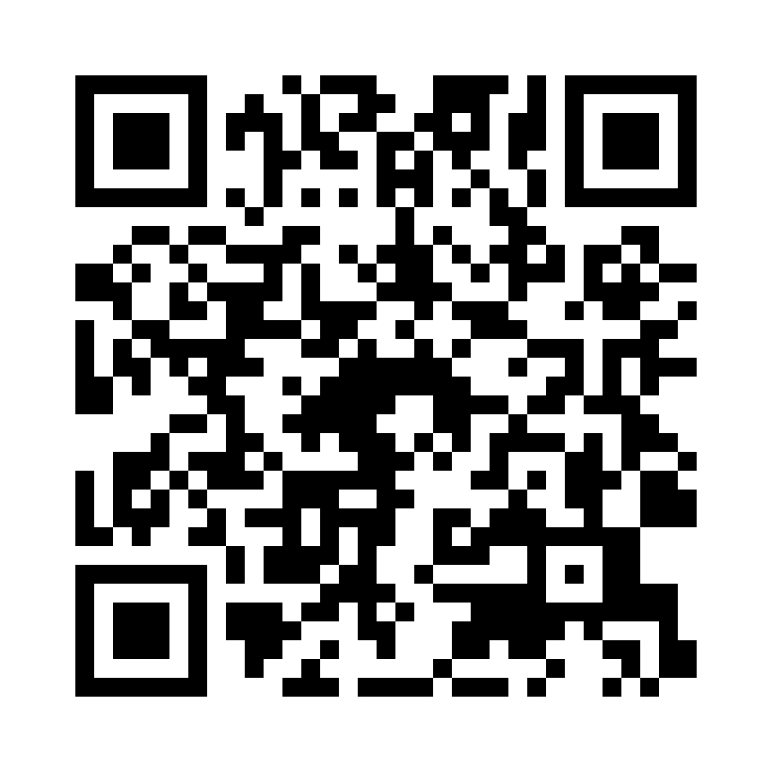
Session Survey
Scan the code to share quick feedback on this session.
Thank you for your feedback.
#WeRunOnEOS2026

