Slide 1

2026
FIFTH ANNUAL · SEPTEMBER 14, 2026 · THE STATLER DALLAS
Presentation Title of One to Three Lines
Speaker Name, Title / Organization
@Handle
eosnorthtexas.com
#WeRunOnEOS2026
Notes:
Title slide. Replace the title, your name, and handle. Leave the logo, event line, and footer as they are.

Slide 2

Session Agenda
01
Opening topic
One short line on what this segment covers
02
Main idea
The core teaching block of your session
03
Application
How the room puts it to work on Monday
04
Q&A
Leave five to ten minutes for questions
2026
#WeRunOnEOS2026
Notes:
Session agenda. Swap in your own segments — three to five rows works best. Delete rows you do not need.

Slide 3
2026
Section
Break
#WeRunOnEOS2026
Notes:
Section break. Replace the two lines with your section name — keep the flame/orange two-tone. Duplicate this slide for each section.

Slide 4
Full-Width Bullets
First key point in one short line
Second key point — parallel phrasing makes scanning easy
Second-level detail, used sparingly
Third key point that carries its own weight
Fourth key point — five bullets max per slide
2026
#WeRunOnEOS2026
Notes:
Full-width bullets. Five bullets max, one line each. Use the indented row for a rare second level.

Slide 5
Text + Photo
Short supporting point number one
Short supporting point number two
Second-level detail, used sparingly
Short supporting point number three
#WeRunOnEOS2026
Notes:
Text and photo. Drag a high-resolution photo (1 MB or larger) onto the right panel. Keep the text to three short points.

Slide 6
Big Graphic
2026
#WeRunOnEOS2026
Notes:
Big graphic. Drop in a diagram, chart, or screenshot — it will aspect-fit, never stretch. Arrange or crop as needed.

Slide 7
“
Replace with a short, punchy quote — one or two sentences that land the point you want the room to remember.
— Attribution Name,
Title / Company
#WeRunOnEOS2026
Notes:
Quote slide. One or two sentences at most. Update the attribution name and title.

Slide 8













Thank You to Our Sponsors
TITLE SPONSORS
BOOK SPONSORS
HAPPY HOUR SPONSOR
SWAG BAG SPONSORS
BOOTH SPONSORS
2026
#WeRunOnEOS2026
Notes:
Sponsor thank-you. Logos are current as of the 2026 site — keep this slide as-is and show it at the end of your session.

Slide 9
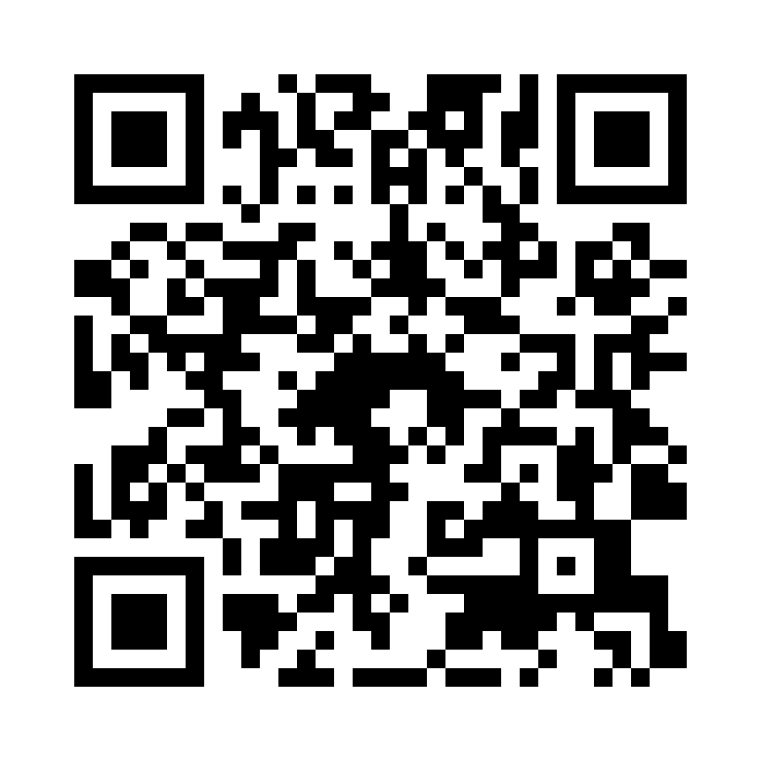
Session Survey
Scan the code to share quick feedback on this session.
Thank you for your feedback.
#WeRunOnEOS2026
Notes:
Session survey. Drop the survey QR code onto the white card. Leave this up while you take questions.

Slide 10
2026
Speaker
Guidelines
Four slides of house rules — delete them before you present.
#WeRunOnEOS2026
Notes:
Start of the guidelines section — for speakers, not for presenting. Delete slides 10-13 before you present.

Slide 11
Slides & Content
DO
AVOID
Build from the layouts in this file
New colors, fonts, or slide styles
Keep copy short, scannable, and big
Dense paragraphs and small type
Use one or two levels of bullets
Clip art or watermarked images
Duplicate slides to make more room
Moving the footer or the Texas mark
2026
#WeRunOnEOS2026
Notes:
House rules for slide content.

Slide 12
Fonts
League Spartan
This deck uses one family at three weights — free to install from fonts.google.com/specimen/League+Spartan
ExtraBold
Page titles & section breaks — 48 pt and up
Bold
Emphasis, numbers, and labels — 24–28 pt
Medium
Body copy — 22–26 pt, never smaller than 18 pt
2026
#WeRunOnEOS2026
Notes:
Type rules. League Spartan is the free Gotham-style family used across the deck.

Slide 13
Color Palette
Midnight Navy
Slate
EOS Orange
#142233 — backgrounds & titles
#303B4F — gradient partner
#FF7900 — primary accent
Flame
Cloud
Steel Gray
#F04E23 — accent pair
#E5E8EB — dividers & tiles
#A5AAAF — captions & footers
Navy and white backgrounds only. Orange is for accents — never body text.
2026
#WeRunOnEOS2026
Notes:
Color rules. Navy and white backgrounds only; orange is for accents.

Slide 14
2026
Thanks, y’all!
FIFTH ANNUAL · SEPTEMBER 14, 2026 · THE STATLER DALLAS
@Handle
eosnorthtexas.com
#WeRunOnEOS2026
Notes:
Closing slide. Swap in your handle so the room can find you.

