Slide 1

2026
FIFTH ANNUAL · SEPTEMBER 14, 2026 · THE STATLER DALLAS
Profit Power:
Stronger — or Just Bigger?
Mark Stanley
Teacher · Expert EOS Implementer™ · Co-Author of Data · Clarus Visionary · UNSTOPPABLE! Visionary
linkedin.com/in/markstanleyprofile
www.markstanley.com
eosnorthtexas.com
#WeRunOnEOS2026
Notes:
MOUNTAIN — before the story starts. Doors open / walk-in slide.
OPENING LINE (when the mic is live): "Show of hands — who grew revenue last year? Keep them up. Who got STRONGER last year? ... Different question. That's the next ninety minutes."
RUN-OF-SHOW (90 min, rehearse against a timer):
0:00–0:12 Story + promise (slides 1–7)
0:12–0:26 Five numbers + Exercise 1 (8–12)
0:26–0:38 Profit Power Ratio + Exercise 2 (13–18)
0:38–0:50 Power of X — board, page-2 setup, seven moves, the screen (19–30)
0:50–0:58 Price — excuses, Table A, discounts, Table B, quote (31–35)
0:58–1:03 First Move Monday (36–37)
1:03–1:07 Proof + now what (38–40)
1:07–1:10 The flag (41)
1:10–1:30 Survey up, Q&A, sponsors, thanks (42–44)
IF RUNNING LONG: cut 33–34 (discount excuses + Table B). Never cut the exercises or the flag.
Book signing is Sunday evening; the box with the flag is under the table from 9am.

Slide 2

Session Agenda
01
The Trap
Why revenue can grow while the business gets weaker
02
Five Numbers
The whole P&L — then your Profit Power Ratio™, live
03
The 7 Power Moves
Four that find hidden profit, three that release trapped cash
04
First Move Monday
Your number, your move — plus what's next and Q&A
2026
#WeRunOnEOS2026
Notes:
MOUNTAIN — the promise. 60 seconds, no more.
SAY: "By the end you will read your business in five numbers, know your Profit Power Ratio — stronger or just bigger, in one number — and leave with your first move for Monday morning."
TRANSITION: "But first, the sentence that almost took me down."
TIMING: 1 min.

Slide 3
“
We grew twenty percent last year.
No sentence feels better to say.
No number is easier to hide behind.
#WeRunOnEOS2026
Notes:
MOUNTAIN — BACKGROUND. The belief the room walked in with.
SAY: "They almost always mean revenue. Ego lives in that number — and danger: revenue can grow while the business gets weaker, and most scorecards cannot tell the difference."
ASK for a show of hands: "Who said some version of this sentence in the last year?" Let the hands go up. "Keep it up if you know — for a fact — whether your business got STRONGER last year, not just bigger." Watch them drop.
TRANSITION: "I get to say this next part because I paid full tuition. 2008."
TIMING: 2 min.

Slide 4

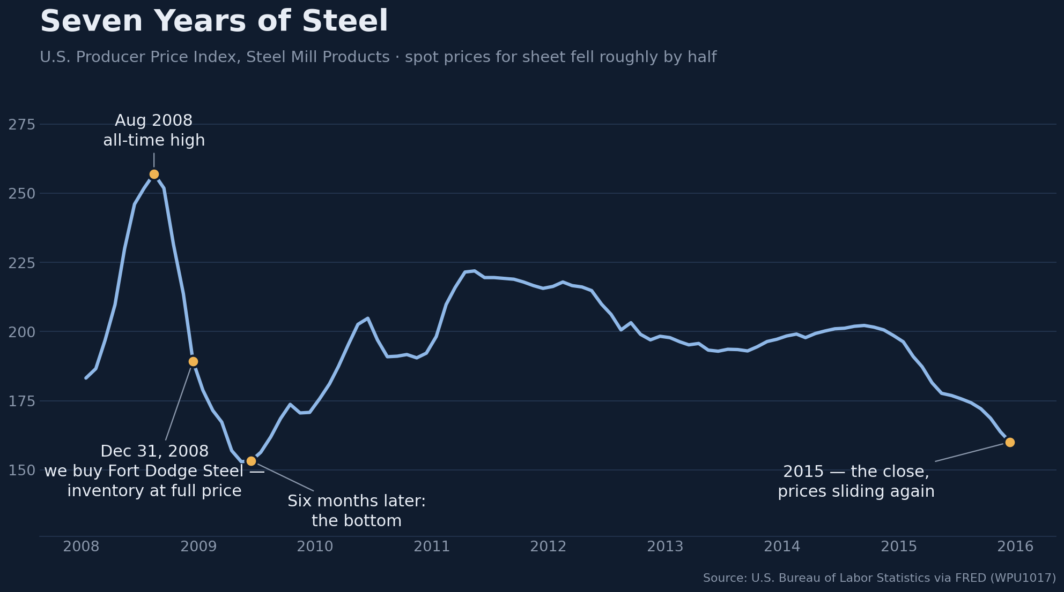
December 31, 2008 — Into the Great Recession
 | 2008 Financials | 2009 Forecast — 6 Months In
Revenue | $6M | $3.5M
Gross Margin | 30–32% | 20–22%
Gross Profit / week | ~$36K | ~$14K
The Nut | $25K / week | $25K / week
EBITDA | +$600K | ≈ −$550K
2026
#WeRunOnEOS2026
Notes:
MOUNTAIN — RISING ACTION begins. The steel story, part 1. (Walk the table top to bottom — left column is the business we bought, right column is six months later.)
SAY: "On the last day of 2008, three partners and I bought Fort Dodge Steel — founded 1899, it's stitched on the flag behind me. You'll see the real one later. The left column is what we bought: $6M in revenue, 30-some points of margin, $600K of EBITDA. We paid full price for the inventory — $1.2M. First piece of a roll-up. We thought we could take on the world. We even had a flag made — our Jolly Roger."
POINT AT CHART once (evidence, not the story): "Steel peaked in August 2008 and was already off the top when we closed. Six months later it found bottom."
THE RIGHT COLUMN, row by row: "Six months in — the Great Recession, the Lesser Depression. Revenue: $6M to $3.5M. Margins: low thirties to low twenties. And here's the row that no revenue number shows you: gross profit went from about $36K a week to about $14K a week — while the nut never moved. $25K a week. Every week. We were $11K in the hole before Monday's first truck rolled. EBITDA swung from +$600K to half a million in the red."
NOTE (for you): the math: 31% × $6M = $1.86M GP vs $1.3M nut = +$600K. 21% × $3.5M = $735K GP vs the same nut = ≈ −$550K. PPR 1.4 → 0.6 — don't name the ratio here; it pays off at winning/surviving/losing.
TIMING: 3.5 min.

Slide 5

The Friday Over Beers Was When I Knew
“Cheers - A record sales week!”
It sounded good. Something was off.
Not one more dollar of gross profit.
We had dropped margin to buy the revenue.
Trucks driving further. Everyone working harder.
“We pulled the cash levers as hard as we could.”
2026
#WeRunOnEOS2026
Notes:
MOUNTAIN — RISING ACTION, the turn. Steel story, part 2.
SAY: "Friday afternoon, end of a long week. We're having beers, and my head of sales raises his glass: 'Cheers — a record sales week!' The biggest of our entire run. It sounded good. And something was off. We had not made one more dollar of gross profit. A record week. The same gross profit. We had dropped margin to buy the revenue — trucks driving further, everyone working harder, for nothing extra."
SAY: "That Monday I locked out the bottom four price codes. Real tension with my head of sales — who was also my partner. That's when I knew. Our gross profit dollars were not covering our OPEX. Years later I'd have a name for it: a Profit Power Ratio below 1.0. In 2009 I could only feel it."
CASH LEVERS (last bullet): "So we fought with the levers we had. Payables out to 45 days. Receivables in at 30. Inventory turns from 6 to 18 — tripled. Pulled about as hard as they can be pulled. They kept us alive. They never made us well."
TIMING: 3 min.

Slide 6
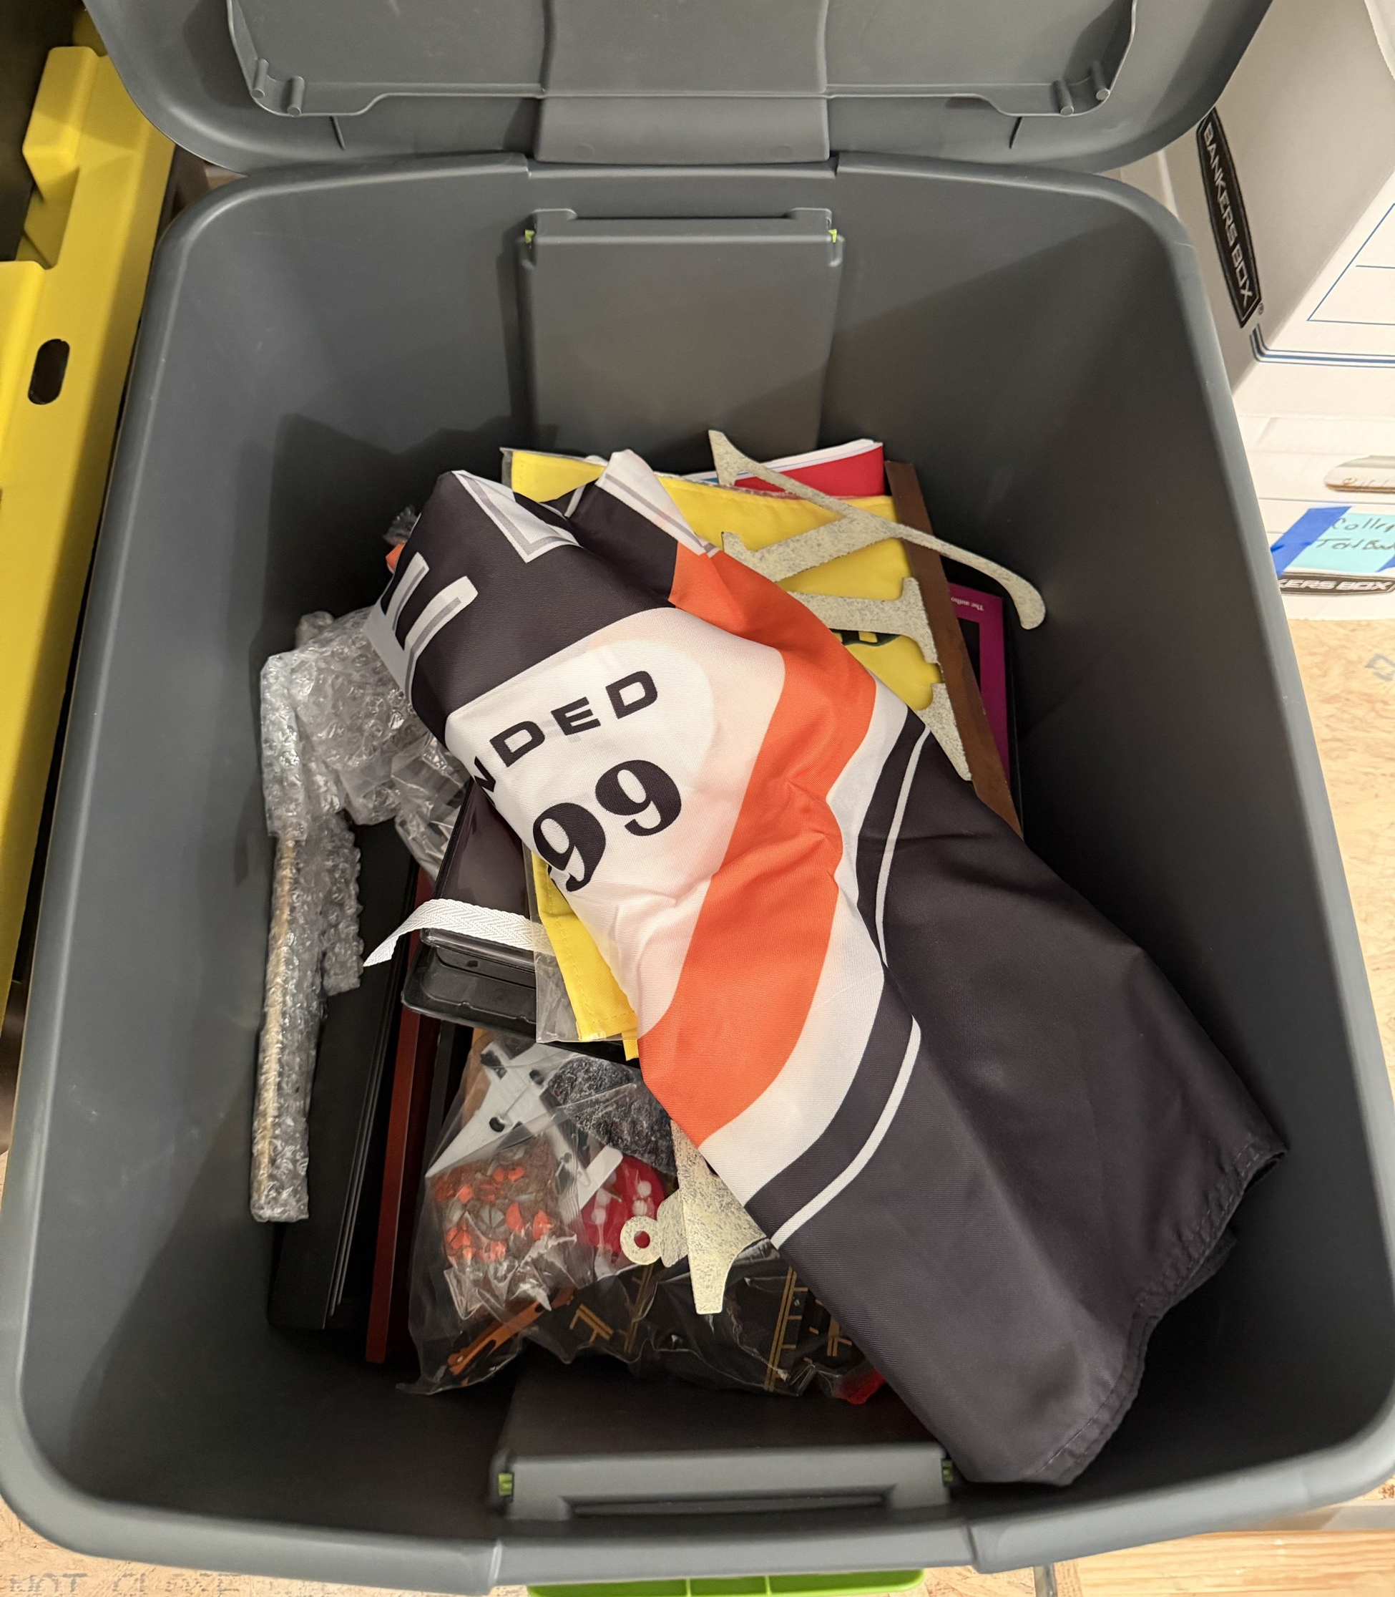
May 2015 — Folding the Flag
Founded 1899 — ended on our watch
Twelve people had to find new jobs
Promises Broken
My confidence shattered
The flag went into a box in my attic
The box — photographed August 29, 2026
“2,000+ days, untallied stress and $865,000+ later,
there were a few lessons learned and many to teach.”
#WeRunOnEOS2026
Notes:
MOUNTAIN — CLIMAX OF THE PAIN. The photo is the actual flag in the actual box — taken August 29, 2026, after eleven years in the attic. FOUNDED 1899 on the cloth. (The real box is backstage — it comes out at the end. Don't tip it.)
SAY: "In May 2015 we closed it — we got killed on the second downdraft, and there was nothing left to absorb it. A company that had carried that name since 1899 ended on our watch. Twelve people had to find new jobs. And my confidence — broken. The flag, our Jolly Roger, got folded into a box in my attic. It's still there. I photographed it two weeks ago."
READ THE LINE on the slide, slowly — this is the gut punch: "2,000 days and $865,000 later, there were a few lessons learned and many to teach."
BEAT. Then: "This session is the way out I wish I'd had. The scores that mattered were never on the wall. Today we put them on yours."
TRANSITION: "Everything we do for the next hour is the system I needed in 2009. It starts with five numbers."
TIMING: 3 min.

Slide 7

“
Feeling good about revenue is one of the most expensive habits a leadership team can develop.
— Clarus
The Profit Power Ratio · Book One, Clarus Leadership Series
#WeRunOnEOS2026
Notes:
MOUNTAIN — pivot from pain to tools.
SAY: "I put that lesson in a book. In the fable, a leadership team a lot like yours meets a guide named Clarus — and this is the first thing he has to teach them. It cost me a steel company to learn it."
TRANSITION: "So let's replace feeling good with knowing. Five numbers."
TIMING: 1 min.

Slide 8
2026
The Five
Number Income Statement™
#WeRunOnEOS2026
Notes:
MOUNTAIN — FALLING ACTION / the tools, part 1. Tool 1: the 5-Number Income Statement™.
SAY: "Forget the 47-line P&L. Five numbers tell the real story — and if the whole team can read them, the whole team can lead with them."
TIMING: 15 sec.

Slide 9
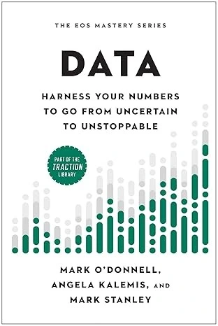
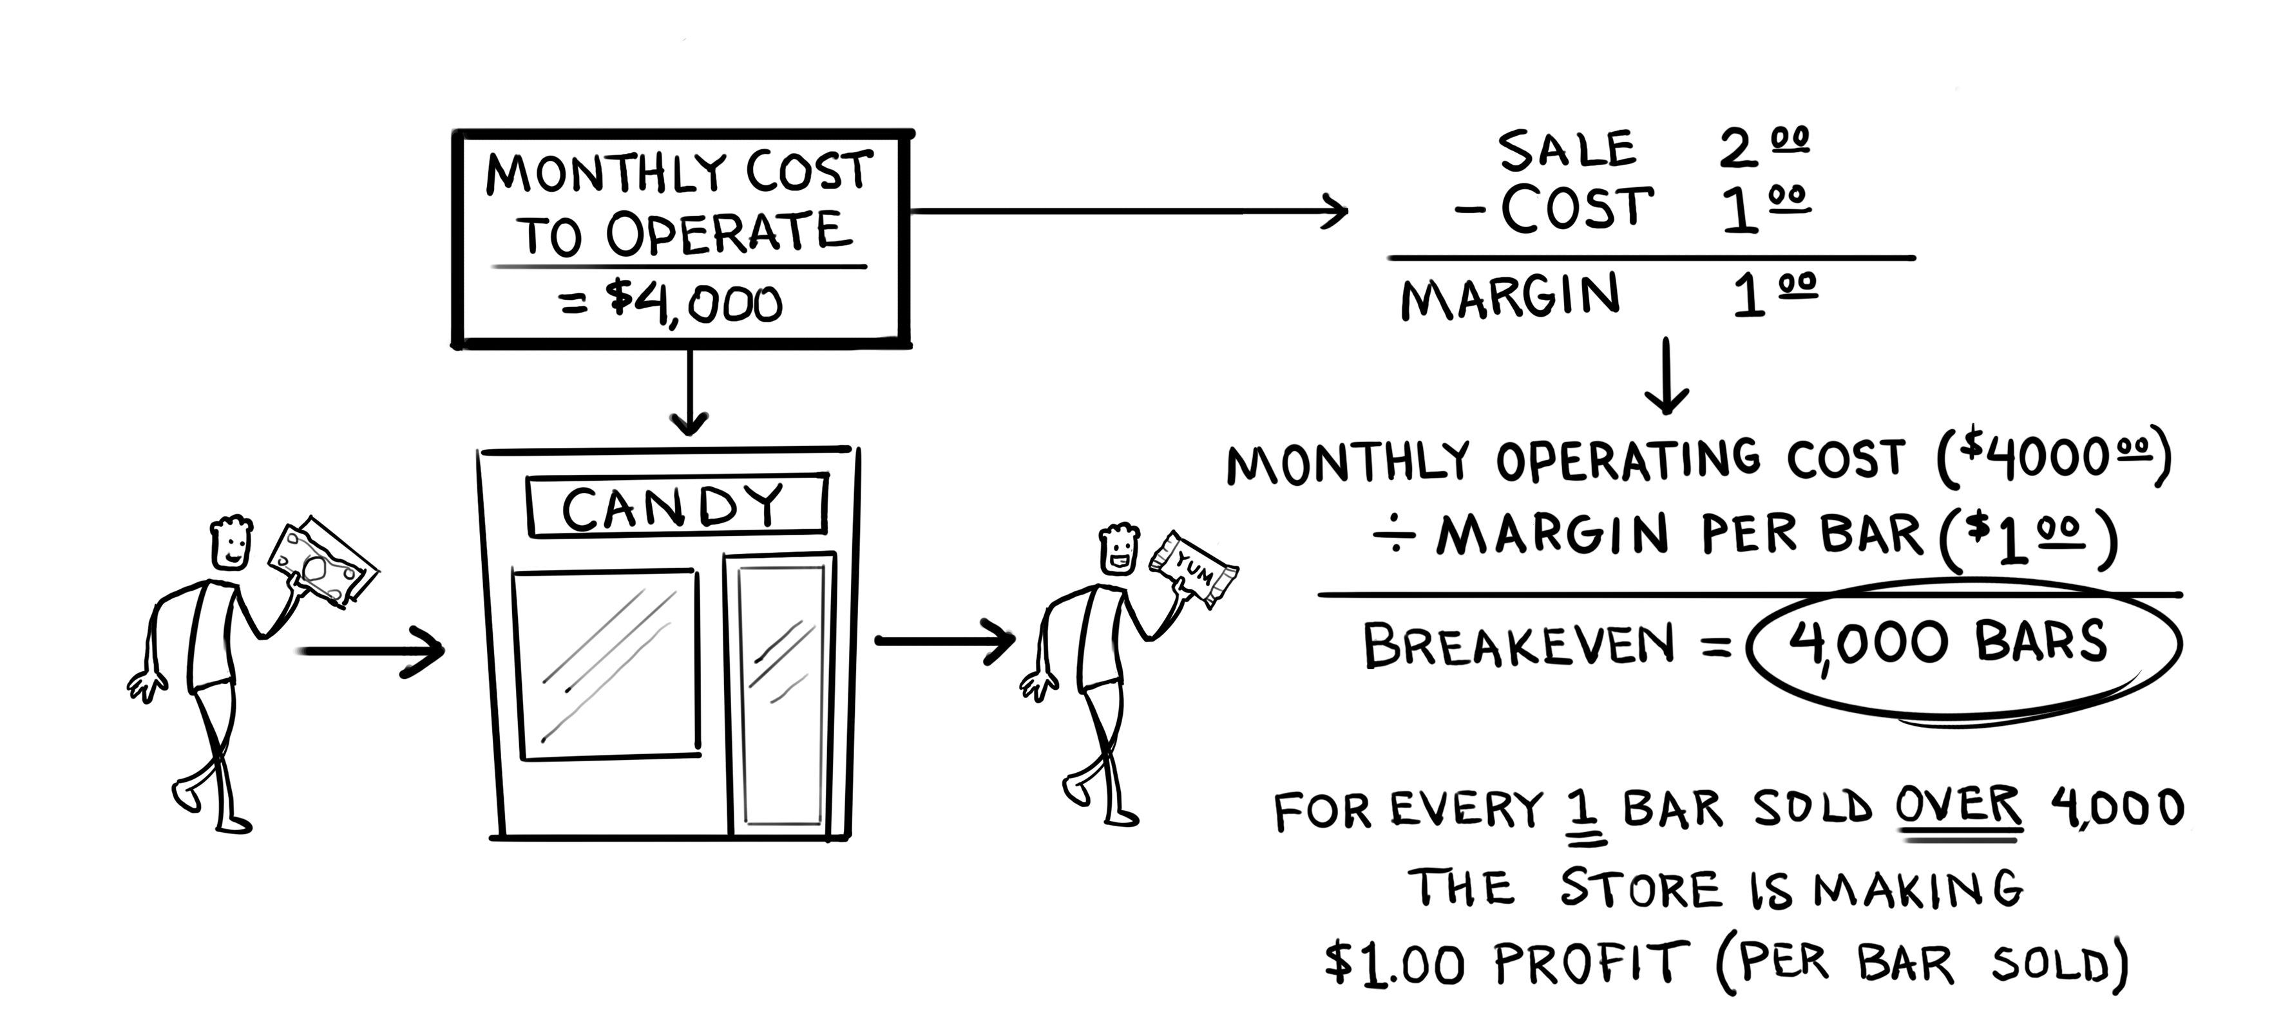
Let's Simplify: A Candy Store's Financials
BOOK
126
Yes, a candy store. Stay with me.
The most complex businesses get clearer when you reduce them to the candy-store model.
2026
#WeRunOnEOS2026
Notes:
TOOL 1 setup — the candy store.
OPENING LINE: "Yes, a candy store. Stay with me."
SAY: "Some of the most complex businesses in the world get clearer when you reduce them to the candy-store model. $4,000 a month to open the doors. A dollar of margin per bar. Breakeven: 4,000 bars. Every bar over 4,000 is a dollar of profit. It sells products, has costs, pays expenses, ends up with some profit — same as you."
COACHING CUE: if anyone resists "too simple" — that's the point. If you can't explain YOUR business in candy-store terms, you don't understand it well enough yet.
DATA BOOK ANCHOR: page 126.
TIMING: 2.5 min.

Slide 10
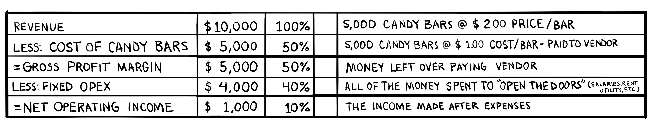
Introducing the 5-Number Income Statement™
BOOK
Forget complicated P&Ls — five numbers tell the real story of how money is made.
126
When everyone understands the 5 numbers, everyone can lead with them.
That's when clarity becomes a competitive edge.
2026
#WeRunOnEOS2026
Notes:
TOOL 1 — the five numbers, on the candy store.
OPENING LINE: "Forget the 47-line P&L. Five numbers tell the real story."
WALK THE HAND-DRAWN TABLE top to bottom: Revenue $10,000 — 5,000 bars at $2. Cost of the bars $5,000. Gross profit margin $5,000 — the money left after paying the vendor. Fixed OPEX $4,000 — everything it takes to open the doors. Net operating income $1,000.
PRINCIPLE: complexity is the enemy of alignment. Five numbers fits on a napkin; a napkin fits in every conversation. This isn't a finance tool — it's a leadership tool.
DATA BOOK ANCHOR: page 126.
TIMING: 2.5 min.

Slide 11
Your Five Number Story
You don't need perfect numbers. Just write down your best guess — this is where clarity begins.
# | What You’re Estimating | Why it Matters | Your Dollars | %
1 | Revenue | What your customer pays you
2 | Directly Variable Cost (DVC) | What it costs to fulfill the order
3 | Gross Profit $ | What’s left to run your business
4 | Operating Expense (OPEX) | What it costs to keep the lights on
5 | Net Operating Income | What you actually keep
$ 10,000
100
$ 5,000
50
$ 5,000
50
$ 4,000
40
$ 1,000
10
This isn't a finance test.
It's a snapshot of how your business creates (or loses) value.
2026
#WeRunOnEOS2026
Notes:
TOOL 1 — the example they copy. This is the same five-row story with example numbers — the room writes THEIR version on handout page 1 on the next slide.
WALK IT: "Revenue — what your customer pays you. DVC — what it costs to fulfill the order. Gross Profit — what's left to run the business. OPEX — what it costs to keep the lights on. Net Operating Income — what you actually keep."
SAY: "Estimating IS leadership. If you can't estimate yours within 20%, that's a finding too."
TIMING: 2 min.

Slide 12
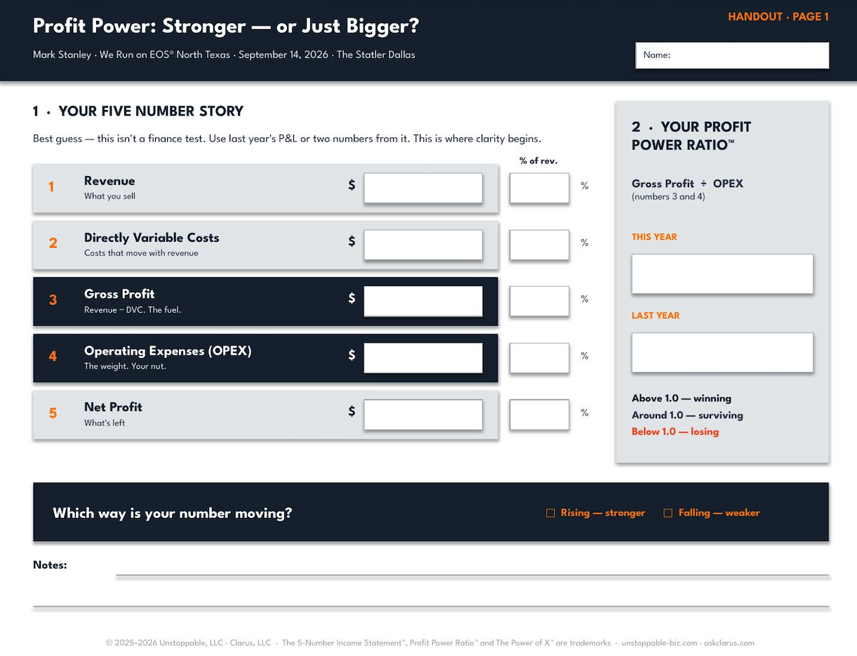
Handout · Pg 1
Your Five Number Income Statement™ — 3 Minutes
Handout, page 1
write your five numbers
Best guess. This isn't a finance test — it's a snapshot of how your business creates (or loses) value
Then compare gross margin with the person next to you
If you can't estimate within 20%, that's a finding too ;-)
2026
#WeRunOnEOS2026
Notes:
EXERCISE 1 — 3 minutes, handout page 1.
SAY: "Now plug yours in. Best guess. This isn't a finance test." Encourage phones out — last year's P&L or two numbers from it.
WORK THE ROOM. Encourage table chatter: "Compare your gross margin with the person next to you."
CALL TIME at 3 minutes: "Whatever you wrote — that's more clarity than most leadership teams operate with."
TRANSITION: "Two of your five numbers are about to become one."
TIMING: 4 min with debrief.

Slide 13
2026
The Profit Power Ratio™
#WeRunOnEOS2026
Notes:
MOUNTAIN — approaching the summit. Tool 2: the Profit Power Ratio™.
SAY: "Five numbers tell the story. One fraction bar tells the truth."
TIMING: 15 sec.

Slide 14

Understanding the Game
THE GAME
PROFIT POWER RATIO™
Grow Gross Profit faster than your OPEX.
Gross Profit ÷ OPEX
Candy Store: $5,000 GP ÷ $4,000 OPEX = 1.25
Gross Profit (GP) $
Money
OPEX$
< 1.0
Losing
1.0
Surviving
Breakeven
> 1.0
Winning
1.0 = breakeven —
gross profit exactly covers the nut
Time
Grow Gross Profit at a MUCH faster rate than OPEX.
If the ratio is the scorecard, this is the game.
2026
#WeRunOnEOS2026
Notes:
TOOL 2 — the game and the number, one frame.
SAY: "Business is a game. Gross Profit is the fuel — it moves you forward. OPEX is the drag — it always wants to creep up. The game is one sentence: grow gross profit at a MUCH faster rate than OPEX."
POINT RIGHT: "And there's one number that tells you if you're winning the game: the Profit Power Ratio. Gross Profit divided by OPEX. Candy store: $5,000 over $4,000 — 1.25. Every dollar of OPEX generated a dollar twenty-five of gross profit."
THE GAUGE: "Below 1.0 you're losing — that was Fort Dodge Steel, most weeks. At 1.0 you're working for the lights. Above 1.0 you're winning. And the direction matters more than the level."
TIMING: 3 min.

Slide 15
THE PROFIT POWER RATIO · WHAT STRENGTH LOOKS LIKE
Gross profit has to outrun OPEX.
Both lines can rise and the company still weaken. What matters is the gap between them — and whether it is widening.
How to read it
THE WIDENING GAP · 24 MONTHS
GROSS PROFIT
Both lines rising
Normal — growth costs money. OPEX should climb.
Gap widening
PPR climbing. Growth is buying strength.
OPEX
Lines converging
PPR falling. Bigger — and more fragile.
Lines crossed
Every month the gap widens, PPR rises — and each new dollar buys more strength.
PPR below 1.0. It costs more to run than it keeps.
The workshop version. This is the picture from UNSTOPPABLE — the same one leaders draw on a whiteboard when the penny drops.
The platform draws it from their own 23 months.
#WeRunOnEOS2026
Notes:
TOOL 2 — the picture. What "stronger" looks like on a chart. Do not read the right column; point at the lines.
SAY: "Two lines. Gross profit on top, OPEX underneath. Both are rising — and that's normal, growth costs money. The question is never whether OPEX went up. The question is the GAP. Is it widening or closing?"
POINT AT THE GAP: "Widening — you're getting stronger, every new dollar buys more strength. Closing — you're getting bigger and more fragile, and nobody in the building can feel it yet. Crossed — you're paying more to run the business than it keeps. That's Fort Dodge in 2009."
FORT DODGE BEAT: "Our lines crossed in six months. The flag was still on the wall."
TIMING: 1.5 min.

Slide 16
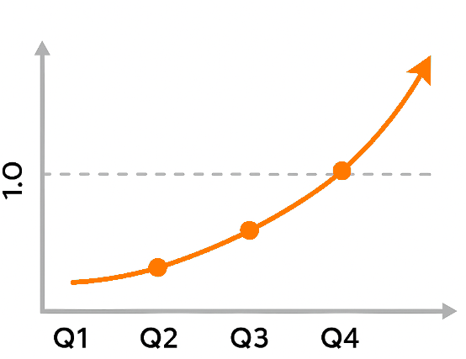


Profit Power Ratio™ = Profit Leverage
Three uses of the ratio
1- Track Progress.
Quarter-over-quarter gains = smart action compounding.
2- Decide on Spend.
Will the new OPEX grow GP faster than cost?
3- Align the Team.
One number. Total focus.
One number to rule them all.
Alignment isn't accidental — it's designed.
2026
#WeRunOnEOS2026
Notes:
TOOL 2 — what to DO with the number.
WALK THE THREE: "Track progress — when the ratio improves quarter over quarter, the team is making smart decisions and compounding them. Decide on spend — before approving any OPEX increase, ask: will this grow gross profit faster than it grows cost? Align the team — everyone rallies around a single score that says whether the business is winning, surviving, or losing."
TIMING: 2 min.

Slide 17
Handout · Pg 1
Your Profit Power Ratio™— 3 Minutes
Handout, page 1 —
Your Gross Profit ÷ your OPEX — this year and last
Handout, page 1 — calculate both
Assess:
Above 1.0 — winning.
Around 1.0 — surviving.
Below 1.0 — losing.
2026
#WeRunOnEOS2026
Notes:
EXERCISE 2 — 30 seconds of math, 3 minutes with the debrief. Handout page 1, section 2. THIS IS THE CLIMAX OF THE SESSION.
SAY: "Two of your five numbers. Gross profit divided by OPEX. This year — and last year. Thirty seconds."
CALL TIME: "Above one — you're winning. Around one — surviving. Below one — losing. Now the one that matters: which way is it MOVING?"
WORK THE ROOM: "Hands up if it went up. Hands up if it went down. Keep them up. Look around — that's the room." (Let the silence sit.)
LANDING LINE: "Some of you just found out you're bigger. Some of you just found out you're stronger. Revenue could never have told you which."
TRANSITION: "So what do you do about it? Seven moves. Every one of them already inside your business."
TIMING: 3 min.

Slide 18
CLARUS PLATFORM · THE PROFIT POWER RATIO
One gauge, one trend, every page.
What's on it
THE GAUGE
THE TREND · 24 MONTHS
Always visible
Header of every page — leader, dashboard, Atlas.
Reading and direction
The number, and whether it is climbing.
1.0
One click to the levers
0.5
2.0
Tap it and Power of X opens on the same numbers.
1.42
Twenty-four months of PPR, monthly — the same window Atlas already holds.
Color is meaning
above 1.0 · getting stronger
Green above 1.0, yellow near it, orange below.
The gauge and the trend are one component, fed by the same computed PPR — one number, on every page.
#WeRunOnEOS2026
Notes:
TOOL 2 — what the number looks like when it's on the wall. 45 seconds, no demo, no pitch.
SAY: "This is what the ratio looks like when it's live. Always visible — top of every page. The number, and whether it's climbing. Green above one, orange below. That's the whole point: a leadership team that can see the number every Monday doesn't need me to tell them whether they're getting stronger."
FORT DODGE BEAT (optional): "If this had been on my wall in 2009, I'd have known in February what I found out over beers in June."
BRIDGE: "Now — what moves it. Seven dials."
TIMING: 45 sec.

Slide 19
2026
The Power of X™
Learning The Seven Power Moves
#WeRunOnEOS2026
Notes:
MOUNTAIN — DESCENT / what to do about it. Tool 3: The Power of X.
SAY: "Seven moves. Four that find profit — price, volume, direct cost, overhead. Three that release cash — collect faster, hold cash longer, move inventory faster. Every one of them is already sitting inside your business. The question is which one has the most leverage for you."
TIMING: 15 sec.

Slide 20

“
You do not need any lever to move 10%. You need to know which lever, moved 1%, deliberately, and held, does the most good.
— Clarus
The Power of X · Book Two, Clarus Leadership Series
#WeRunOnEOS2026
Notes:
MOUNTAIN — pivot into the seven moves. Book Two.
SAY: "Book Two is where the levers live. In the fable, the team's instinct is to yank everything at once. Clarus stops them with this: you don't need any lever to move ten percent. You need to know which lever, moved one percent, deliberately, and held, does the most good — because one percent, compounded across seven levers and four quarters, is the whole game, played properly."
TRANSITION: "Seven levers. Let's learn them."
TIMING: 1 min.

Slide 21







CLARUS PLATFORM · THE POWER OF X
The Power of X™
Fundamentals at work — the seven moves that make you stronger, not just bigger
PROFIT POWER RATIO™ · 4 profit drivers
CASH CONVERSION · 3 cash levers
1
Increase Price
5
DSO — Collect Faster
2
Increase Volume
6
DPO — Hold Cash Longer
3
Reduce DVC
7
DIO — Move Inventory Faster
4
Reduce OPEX
THE FOUNDATION · Just 1% More · Cover Your Nut · below it, no dial is worth pulling
The Power of X™ is your margin and momentum engine.
Pick the move with the most leverage — run it hard. Then repeat.
2026
#WeRunOnEOS2026
Notes:
TOOL 3 — all seven moves, one frame.
LEFT COLUMN — the profit drivers: "Increase price — be bold, fix the leaks. Increase volume — mine the gold in the customers you already have. Reduce DVC — remove the waste. Reduce OPEX — get lean."
RIGHT COLUMN — the cash levers: "Collect faster. Hold cash longer. Move inventory faster. These three kept Fort Dodge alive for seven years — pulled about as hard as they can be pulled. They buy you time; the left column fixes the structure."
PRINCIPLE: "You don't need all seven. You need the ONE with the most leverage in your business right now."
TIMING: 3 min.

Slide 22
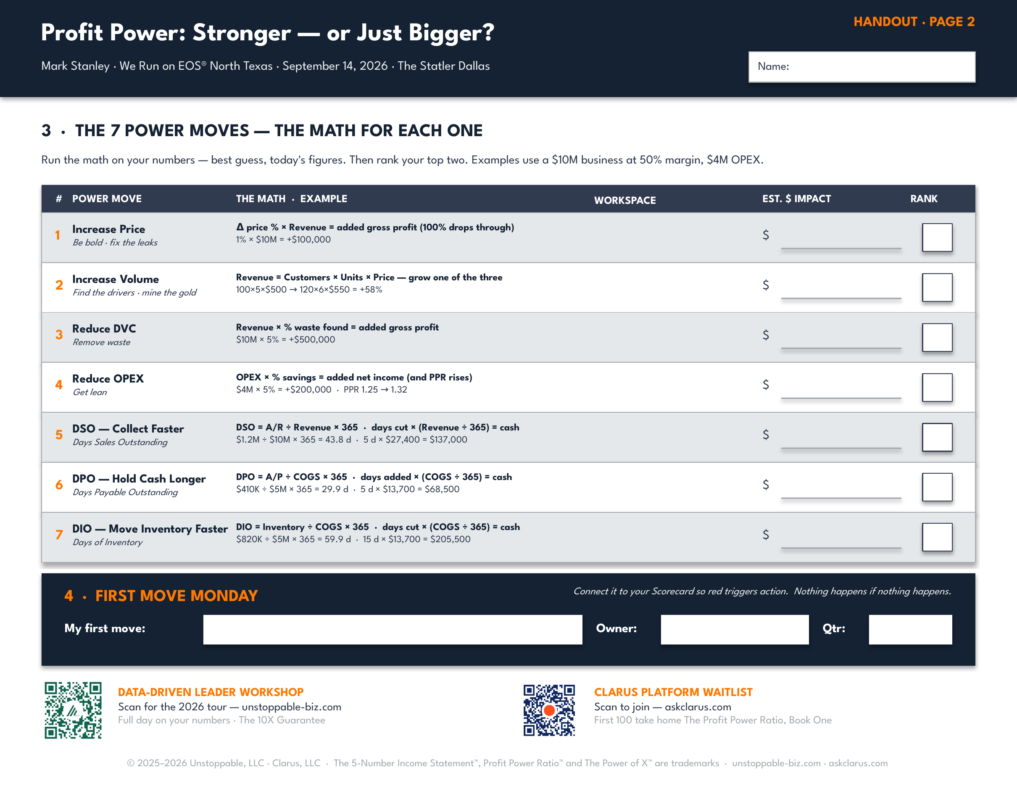
Handout · Pg 2
The 7 Power Moves — Handout, Page 2
Handout, page 2 — seven moves, the math for each one
We'll walk through all seven, one at a time
As we go: run the math on YOUR numbers — best guess
Write the $ in the box. We rank them at the end.
2026
#WeRunOnEOS2026
Notes:
SET UP PAGE 2 — 60 seconds. This is the working page for the next ten minutes.
SAY: "Turn to page 2. Seven rows, seven moves. Each one has the formula and a worked example on a ten-million-dollar business. I'm going to walk all seven — while I do, put a number in the box on the right. Your business, your best guess. We rank them at the end."
Do not explain the moves here — that is what the next seven slides are for. Pens out, then go.

Slide 23
1
Power Move 1 — Increase Price
Handout · Pg 2
Be bold · Fix the leaks
THE MOVE
THE MATH · $10M BUSINESS, 50% MARGIN
+1% price × $10M revenue
= +$100,000 gross profit — 100% drops through
Raise the price. Stop giving it away. Every dollar of price is a dollar of gross profit — no cost attached to it.
THREE PLAYS
1
Be bold
WHY IT MATTERS
Annual rate review. Tiered pricing. Sell outcomes, not hours.
The hardest gearing of all seven — and the only dial with no undo.
2
Fix the leaks
Kill the low-value discounts. Put an approval on every exception.
3
Prove the value
If you can prove it, you can price it.
One unit of courage buys three units of strength.
Deep dive coming — the excuses, the math, and the tables.
2026
#WeRunOnEOS2026
Notes:
POWER MOVE 1 overview — 45 seconds. "Price is first because it has the hardest gearing. One percent of price at your margin is nearly three percent of gross profit. And it is the only dial with no undo — so we will spend real time here in a minute." Do NOT do the excuses yet. Bridge: "Hold that thought — six more dials first."

Slide 24
2
Power Move 2 — Increase Volume
Handout · Pg 2
Find the drivers · Mine the gold
THE MOVE
THE MATH · THREE SMALL MOVES
100 × 5 × $500 = $250,000 today
120 × 6 × $550 = $396,000 → +58%
Revenue = Customers × Units × Price. You don't grow revenue — you grow one of the three things that produce it.
THREE PLAYS
1
Customers
WHY IT MATTERS
Win-back calls. Referrals. The list of people who bought once.
Small moves on three levers, multiplied, equal big revenue.
2
Units
Cross-sell and bundle — they buy the rest of it from someone.
3
Customer share first
Mine the base before you chase. New × new is a startup play.
The cheapest dollar to earn is the next one from a customer who already trusts you.
Customer share first. Market share second.
2026
#WeRunOnEOS2026
Notes:
POWER MOVE 2 — 45 seconds. "Nobody grows revenue. You grow customers, or units, or price. Twenty percent more customers, one more unit in the basket, fifty dollars of price — that is 58% more revenue, and nobody worked 58% harder." Then the gold: "Most of you have a CRM full of people who bought once. That is the cheapest dollar on the planet."

Slide 25
3
Power Move 3 — Reduce DVC
Handout · Pg 2
Remove waste
THE MOVE
THE MATH · $10M BUSINESS
$10M revenue × 5% waste
= +$500,000 gross profit — same customers, same price
Directly variable costs move with every sale — and waste hides inside them: overproduction, defects, waiting, motion, over-processing.
THREE PLAYS
1
Spot it. Name it.
WHY IT MATTERS
Eight kinds of waste. You can't fix what you haven't found.
Most companies can find 5% in waste, rework, and avoidable expense.
2
Cut the leaks
Low-margin SKUs. Returns. Re-bid the inputs and the freight.
3
Simplify
Fewer steps. Better tools. Do it once, right.
Waste steals margin — even if you don't see it.
Start with the big ones hiding in plain sight.
2026
#WeRunOnEOS2026
Notes:
POWER MOVE 3 — 40 seconds. "Every one of you has five percent sitting in rework, returns, waiting and overproduction. Five percent of ten million is half a million of gross profit — no new customer required." Fort Dodge beat if time: scrap steel is a real number on a real P&L.

Slide 26
4
Power Move 4 — Reduce OPEX
Handout · Pg 2
Get lean
THE MOVE
THE MATH · $4M OPEX
$4M OPEX × 5% savings
= +$200,000 net income · PPR 1.25 → 1.32
The nut. Roles, tools, layers, and recurring spend the business no longer needs — it creeps in a little every month.
THREE PLAYS
1
Expense creep
WHY IT MATTERS
Subscriptions, contracts, vendors — re-bid the top ten.
Every OPEX dollar cut is a net-income dollar — and it shrinks the bottom of the fraction.
2
Redundancy
Underused tools. Overlapping roles. Layers that add no speed.
3
Delegate & elevate
The right people in the right seats — then get out of the way.
OPEX is the weight you carry up the mountain.
Cut the invisible cost — and reinvest where it counts.
2026
#WeRunOnEOS2026
Notes:
POWER MOVE 4 — 40 seconds. "This is the one everybody reaches for first, and it is fourth on purpose. It works — five percent off a four-million nut is two hundred grand and the ratio moves. But you cannot cut your way to strong. Get lean, then go back to dials one, two and three."

Slide 27
5
Power Move 5 — DSO: Collect Faster
Handout · Pg 2
Days Sales Outstanding
THE MOVE
THE MATH · $10M BUSINESS
$1.2M A/R ÷ $10M × 365 = 43.8 days
Cut 5 days × $27,400/day = $137,000 released
How long your money sits in your customers' accounts. The sale is on the P&L — the cash isn't in the bank.
THREE PLAYS
1
Invoice fast
WHY IT MATTERS
Bill the day you ship. No 'invoice run' on Fridays.
Every day of DSO is cash trapped in A/R — and a line of credit you're paying for.
2
Terms tight
NET 45 → NET 30. Deposits. Progress billing.
3
Collect early
Friendly reminder at 7 days. Live call at 30. Escalate at 45.
The sale isn't real until the cash is in the bank.
Pick one play. Run it 60 days. Watch DSO drop.
2026
#WeRunOnEOS2026
Notes:
POWER MOVE 5 — 40 seconds. "Cash levers are measured in days, and days times daily spend equals dollars. Ten-million business, twenty-seven thousand a day. Five days faster is a hundred and thirty-seven grand you already earned." The cleanest cash on the planet.

Slide 28
6
Power Move 6 — DPO: Hold Cash Longer
Handout · Pg 2
Days Payable Outstanding
THE MOVE
THE MATH · $5M COGS
$410K A/P ÷ $5M × 365 = 29.9 days
Add 5 days × $13,700/day = $68,500 released
How long YOU hold cash before paying suppliers. Pay on time — not early. Paying early is donating working capital.
THREE PLAYS
1
Ask
WHY IT MATTERS
'What are your standard terms?' NET 30 → 45/60. Get it in writing.
Negotiated terms are interest-free float — if you earn the right to ask.
2
Earn
Pay on time, every time. Be the customer they want to keep.
3
Trade
Volume and multi-year commitments for terms. Scale is currency.
Pay smart — not fast.
Ask. Earn. Trade. Without burning a supplier relationship.
2026
#WeRunOnEOS2026
Notes:
POWER MOVE 6 — 35 seconds. "How many of you pay on day ten because the bookkeeper is tidy? That is your working capital sitting in somebody else's bank." Ask, earn, trade. Keep it short — this room knows the concept.

Slide 29
7
Power Move 7 — DIO: Move Inventory Faster
Handout · Pg 2
Days of Inventory
THE MOVE
THE MATH · $5M COGS
$820K inventory ÷ $5M × 365 = 59.9 days
Cut 15 days × $13,700/day = $205,500 released
How long inventory sits before it sells. Every dollar on the shelf is a dollar that is not in the bank.
THREE PLAYS
1
Turn faster
WHY IT MATTERS
ABC analysis. Push the A-items. Tighter forecasting.
Idle inventory is the most expensive working capital — it traps cash AND costs money to hold.
2
Clear the old
Bundle it, discount it, liquidate it — move on.
3
Buy smarter
Smaller, more frequent orders. Fewer SKUs. Vendor-managed where you can.
If it's not turning, it's burning.
Every birthday your inventory has costs another day of trapped cash.
2026
#WeRunOnEOS2026
Notes:
POWER MOVE 7 — 35 seconds. Fort Dodge beat: "I owned a steel yard. Inventory is where my cash went to die." Then the three plays. Bridge to the closer: "Seven dials. Here is what it looks like when they are all on one screen."

Slide 30

CLARUS PLATFORM · THE POWER OF X
Move a lever — watch the number react.
Seven levers on the five-number statement. Profit and cash react live.
askclarus.com / power-of-x
What's on it
FIVE-NUMBER STATEMENT
Seven levers
PPR LEVERS
now → with 1% price
Price
Revenue
30.0M
30.3M
Four profit levers (Price, Volume, DVC, OPEX) and three cash levers (DSO, DIO, DPO).
Volume
Gross Profit
17.4M
17.7M
DVC
Net
5.1M
5.4M
Profit and cash, side by side
PPR gauge and trend for profit — cash freed for the cash levers.
OPEX
PROFIT POWER RATIO™
1.58 → 1.61
CASH LEVERS
Highest leverage — ranked live
DSO
climbing toward target 1.80
Which lever moves net the most per 1% in YOUR business.
Highest leverage: PRICE · +$300k net per 1%
DIO
DPO
CASH FREED +$820k
Commit → Scorecard
Commit a scenario and it becomes the number the team runs on.
Cash cycle 37 days · DSO 42 + DIO 30 − DPO 35
Seven levers. One screen. The number reacts before you spend a dollar.
Rank the moves by what 1% buys in your business — then pull the one with the most leverage.
#WeRunOnEOS2026
Notes:
THE SCREEN — 60 seconds, no selling. This is what the Power of X looks like when it's live instead of on a whiteboard.
WALK IT: "Seven levers on the left — four move profit, three move cash. Slide one and the five-number statement reacts on the right. Price is the hot one here: one percent, three hundred grand to the bottom line."
THE POINT: "You don't need this screen to do the math — the handout works. What the screen does is RANK the levers for your business so the argument in the leadership meeting is over before it starts."
BRIDGE: "So let's do the deep dive on the lever with the most leverage — and the most excuses. Price."
TIMING: 1 min. Do not demo. Do not pitch.

Slide 31
Power Move 1 — Why We Struggle to Raise Prices
WHAT WE TELL OURSELVES
…
“What if we lose customers?”
“We don't want to sound greedy.”
“Competitors might undercut us.”
“We're not sure how to justify it.”
“We've always done it this way.”
…
…
It's time to be bold.
Staying safe may be costing you more than you think — if you can prove the value, push the price.
2026
#WeRunOnEOS2026
Notes:
POWER MOVE 1, part 1 — the excuses. (Bullets animate By Paragraph — read each one out loud, slowly.)
OPENING LINE: "Let me read these out loud. Tell me which one you've said this year."
Pause after the fifth. Watch the nods. Everyone has used one of these in the last 12 months.
THE REFRAME: "Every one of these is a STORY. The math doesn't care about your story. Staying safe may be costing you more than you think — inaction has a price too, and it shows up in your margin."
FORT DODGE BEAT: "I locked out the bottom four price codes on a Monday morning and it nearly cost me a partner. It was still the right move."
TIMING: 2.5 min.

Slide 32
Table A — Price Increase
Percentage drop in sales you can sustain and still keep the same gross profit dollars after a price increase.
P. 62
PRICE INCREASE ↓
GROSS MARGIN →
 | 10% | 15% | 20% | 25% | 30% | 35% | 40% | 45% | 50% | 55% | 60%
2% | 15.0% | 10.0% | 7.3% | 5.6% | 4.4% | 3.5% | 2.9% | 2.3% | 1.9% | 1.6% | 1.3%
3% | 20.8% | 14.2% | 10.4% | 8.0% | 6.4% | 5.1% | 4.2% | 3.4% | 2.8% | 2.3% | 1.9%
4% | 25.7% | 17.9% | 13.3% | 10.3% | 8.2% | 6.7% | 5.5% | 4.5% | 3.7% | 3.1% | 2.5%
5% | 30.0% | 21.3% | 16.0% | 12.5% | 10.0% | 8.1% | 6.7% | 5.5% | 4.5% | 3.8% | 3.1%
10% | 45.0% | 34.0% | 26.7% | 21.4% | 17.5% | 14.4% | 12.0% | 10.0% | 8.3% | 6.9% | 5.7%
15% | 54.0% | 42.5% | 34.3% | 28.1% | 23.3% | 19.5% | 16.4% | 13.8% | 11.5% | 9.6% | 8.0%
20% | 60.0% | 48.6% | 40.0% | 33.3% | 28.0% | 23.6% | 20.0% | 16.9% | 14.3% | 12.0% | 10.0%
25% | 64.3% | 53.1% | 44.4% | 37.5% | 31.8% | 27.1% | 23.1% | 19.6% | 16.7% | 14.1% | 11.8%
30% | 67.5% | 56.7% | 48.0% | 40.9% | 35.0% | 30.0% | 25.7% | 22.0% | 18.8% | 15.9% | 13.3%
WORKED EXAMPLE
$10M revenue
50% gross margin
+20% price
14.3%
of your volume you could lose — and still keep the same $5M of gross profit.
→ the orange cell. Most price increases lose far less than that.
Find your margin. Find your price move. That's your cushion.
High-margin businesses can absorb more volume loss — and even small increases at modest margins create real room.
2026
#WeRunOnEOS2026
Notes:
TABLE A — the one they photograph.
OPENING LINE: "This is Table A. Memorize where it lives — you'll use it the rest of your career."
READ IT LIKE A TAX TABLE: gross margin across the top, price increase down the side, the cell is your tolerance. Point at the orange cell: "50% margin, 20% price increase — you can lose 14.3% of your volume and keep every dollar of gross profit."
TWO TAKEAWAYS: high-margin businesses can absorb more volume loss than low-margin ones; even small price increases at modest margins create real cushion.
SAY: "This is the table your sales team should have laminated and taped to their monitor."
TIMING: 2.5 min.

Slide 33
Power Move 1 — Why We Resort to Discount
WHAT WE TELL OURSELVES
…
“They'll say no if we don't give a deal.”
“This client expects a discount.”
“We'll lose the sale if we don't budge.”
“Something is better than nothing.”
“It's just this once…”
…
…
Discounts feel like control — but often give it away.
What if pricing with confidence creates more trust?
2026
#WeRunOnEOS2026
Notes:
POWER MOVE 1, part 2 — fix the leaks. (Bullets animate By Paragraph.)
OPENING LINE: "Be honest. Which of these have you said this quarter?"
Read each excuse slowly. Let the room sit with it. Most heads will nod.
THE REFRAME: "Discounts feel like control. They feel proactive — like you're saving the deal. But every discount is a quiet vote that your value isn't enough. You're trading margin to buy certainty."
FLIP IT: "What if pricing with confidence actually builds trust? Customers read a firm price as a firm promise."
TIMING: 2 min.

Slide 34
Table B — Price Discount
Percentage increase in sales required to keep the same gross profit dollars after a price discount.
P. 64
PRICE DISCOUNT ↓
GROSS MARGIN →
 | 10% | 15% | 20% | 25% | 30% | 35% | 40% | 45% | 50% | 55% | 60%
2% | 22.5% | 13.1% | 8.9% | 6.5% | 5.0% | 3.9% | 3.2% | 2.6% | 2.1% | 1.7% | 1.4%
3% | 38.6% | 21.3% | 14.1% | 10.2% | 7.8% | 6.1% | 4.9% | 3.9% | 3.2% | 2.6% | 2.1%
4% | 60.0% | 30.9% | 20.0% | 14.3% | 10.8% | 8.4% | 6.7% | 5.4% | 4.3% | 3.5% | 2.9%
5% | 90.0% | 42.5% | 26.7% | 18.8% | 14.0% | 10.8% | 8.6% | 6.9% | 5.6% | 4.5% | 3.6%
10% | not possible | 170.0% | 80.0% | 50.0% | 35.0% | 26.0% | 20.0% | 15.7% | 12.5% | 10.0% | 8.0%
15% | not possible | not possible | 240.0% | 112.5% | 70.0% | 48.8% | 36.0% | 27.5% | 21.4% | 16.9% | 13.3%
20% | not possible | not possible | not possible | 300.0% | 140.0% | 86.7% | 60.0% | 44.0% | 33.3% | 25.7% | 20.0%
25% | not possible | not possible | not possible | not possible | 350.0% | 162.5% | 100.0% | 68.8% | 50.0% | 37.5% | 28.6%
30% | not possible | not possible | not possible | not possible | not possible | 390.0% | 180.0% | 110.0% | 75.0% | 54.0% | 40.0%
WORKED EXAMPLE
$10M revenue
50% gross margin
−20% price
33.3%
more sales you need just to keep the same gross profit — it collapses from $5M to $3.33M.
→ the orange cell. And below 20% margin, it isn't possible at all.
This table is the receipt.
Low-margin businesses get crushed first — at a 20% margin, a 5% discount needs 26.7% more volume just to stand still.
2026
#WeRunOnEOS2026
Notes:
TABLE B — the receipt.
OPENING LINE: "Find your row, find your column, read the cost."
Gross margin across the top, discount down the side, the cell is your multiplier. Point at the orange cell: "50% margin, 20% discount — you need 33.3% more sales just to make the same gross profit."
THEN THE RED: "See the cells that say 'not possible'? At a 10% margin, a 10% discount can't be sold back at ANY volume. You've given away the whole margin."
LOW-MARGIN WARNING: "At a 20% margin, even a 5% discount needs 26.7% more volume to stand still."
PRINCIPLE: "Every discount is a profit decision, not a sales decision. Treat it that way."
TIMING: 2.5 min.

Slide 35
“
1% of price, at your margin, is nearly 3% of Gross Profit — there is no other dial where one unit of courage buys three units of strength.
— Clarus
The Power of X · Book Two, Clarus Leadership Series
#WeRunOnEOS2026
Notes:
THE 1% PRINCIPLE — the small-move gospel.
SAY: "You do not need any lever to move 10%. You need to know which lever, moved 1%, deliberately, and held, does the most good — because 1%, compounded across seven levers and four quarters, is not a small number. It is the whole game, played properly."
WORK A LIVE EXAMPLE from the room if energy allows: someone's revenue, 1% of margin, straight to the bottom line.
TIMING: 2 min.

Slide 36
2026
First Move
Monday
#WeRunOnEOS2026
Notes:
MOUNTAIN — RESOLUTION. Nothing happens if nothing happens.
SAY: "Everything we've done today is worth exactly nothing on Tuesday unless one thing changes on Monday. Page 2, bottom section."
TIMING: 15 sec — straight into the exercise.

Slide 37
First Move Monday — 3 Minutes
Handout, page 2 — section 4
Circle the move with the most leverage — not the easiest
Name the owner. Name the quarter.
Write the move you'll make Monday morning
Put it on the Scorecard — so red triggers action
2026
#WeRunOnEOS2026
Notes:
FIRST MOVE MONDAY — 3 minutes, handout page 2, section 4. This is the payoff for the page.
OPENING LINE: "Look at your page 2. Somewhere in that column is a number bigger than the others. That's your move."
90 seconds of silence — circle it, owner, quarter, the Monday move. Do not talk over it.
THEN: "Turn to the person next to you. Tell them the move and the owner. Thirty seconds each."
CLOSE THE BEAT: "One move. One owner. One number. Monday. That is how data becomes dollars."
TIMING: 3 min + the pair share.

Slide 38
“
Gross profit, not revenue.
— Josh Storey, Owner, Storey Program Management
$250,000 in impact found · Data-Driven Leader Workshop, Charlotte
#WeRunOnEOS2026
Notes:
PROOF, in someone else's words.
SAY: "That's a business owner in Charlotte, at the end of a workshop day, summing up everything I just took 60 minutes to teach you — in four words. He found $250,000 on the way to writing it. Leaders in these rooms have found $160K, $410K, $770K — one CFO found over a million."
TRANSITION: "Which brings me to what's next — for those who want to go deeper."
TIMING: 1 min.

Slide 39


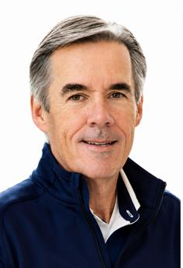
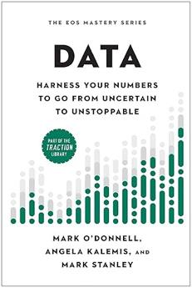


2026 WORKSHOPS
HOUSTON
9/10
BIRMINGHAM
9/15
KANSAS CITY
9/16
THE 2026 TOUR • ACROSS NORTH AMERICA
DATA-DRIVEN LEADER WORKSHOP
RALEIGH
9/17
ALLENTOWN
10/1
Harness Your Numbers To Go From Uncertain To UNSTOPPABLE!
TAMPA
10/6
BATON ROUGE
10/7
3 Takeaways:
1. Find More Profit & Cash — ½ day on this
2. A Scorecard You LOVE!
3. Measurables That Drive Performance
All the content we could not fit in the Data Book.
Impact Counter
Our own data through July 2026
COLUMBUS
10/15
SAN DIEGO
10/16
Workshops
14
Leaders
580
Impact
$300M
Per Leader
$500K+
DES MOINES
10/22
MINNEAPOLIS
10/23
TORONTO $795 USD
11/6
The impact reported by leaders at the workshops.
CALGARY $795 USD
11/25
COMING 2027
THE 10X GUARANTEE
If you don't find 10X your investment in impact — you don't pay.
Chicago • Atlanta • Cleveland
$995 per seat
SCAN TO REGISTER
Led by the Co-Authors of the Data Book and Expert EOS Implementers with over 2,200 session days.
WWW.UNSTOPPABLE-BIZ.COM
Mark Stanley
THE EOS MASTERY SERIES
Angela Kalemis
Notes:
NOW WHAT, beat 1 — the workshop tour. Light touch; the agreement allows a brief mention and there's a table at the back.
SAY: "Everything today came out of a full-day workshop — the Data-Driven Leader Workshop. Today was the ninety-minute version; the full day is your numbers, your scorecard, your first three moves, with Angela and me in the room. Fourteen cities this fall — the QR is on your handout, page 2, and on the table in the back."
DO NOT: read the city list, quote the price from stage, or say "sign up." Point at the QR and move on.
TIMING: 45 sec.

Slide 40











Keep Going — The Clarus Leadership Series
The four Clarity books are written, taught, and already in the platform.
The other eight are the runway — and each one unlocks the capability it teaches.
1
2
3
4
5
6
7
8
9
10
11
12
The Profit
Power Ratio
The Power
of X
The Core
Driver
The Signal
The Flow
The Alignment
The Demand
The Operation
The Behaviors
The Constraint
The Variation
The Waste
CLARITY
CONFIDENCE
CONTROL
books 1–4 · written, taught, in the platform
books 5–8 · being written
books 9–12 · the last third
TODAY
Every attendee takes home Data — the book behind today’s tools
FIRST 100
Join the Clarus platform waitlist — take The Profit Power Ratio, Book One, with you
askclarus.com
scan to join the waitlist
KEEP GOING
Books 1–4 are on Amazon — follow Cole's journey from uncertain to in control
2026
#WeRunOnEOS2026
Notes:
NOW WHAT, beat 2 — the books and the platform. Light touch; the agreement allows brief book references and this is a gift, not a pitch.
SAY: "Today came out of a book called Data, in the EOS Mastery Series — every one of you takes a copy home. What I learned folding that flag became a series of its own: the Clarus Leadership Series. One principle, one book, twelve of them — Book One is The Profit Power Ratio, Book Two is The Power of X. You just did both."
SAY: "The first four books are written, and they're what the Clarus platform ships — the platform only does what the books have already taught. If you want on the waitlist, the first hundred take Book One home today. And books one through four are on Amazon if you want to keep going with Cole's journey."
TIMING: 1.5 min.

Slide 41

One More Thing
The Fort Dodge Steel flag — out of the attic, out of the box
Founded 1899. Closed 2015. The scores that mattered were never on the wall.
This time, the scores that matter go on the wall.
Stronger — or just bigger?
Five numbers. One ratio. Seven moves. Now you know how to tell.
#WeRunOnEOS2026
Notes:
MOUNTAIN — RESOLUTION, the bookend. THE BOX COMES OUT ON STAGE.
DO: bring the box out. Open it. Take your time. "I told you this flag went into a box in my attic in 2015. I brought the box."
SAY: "FOUNDED 1899 — it's right there on the cloth. A hundred and sixteen years, and the scores that mattered were never on the wall. Now you know the five numbers, the one ratio, and the seven moves that put them there."
UNFURL IT — you, on stage, full width. Hold it up. Let the room look at it. No group photo, no calling people up — the flag is the picture. Phones will come out on their own.
LAST LINE, flag still up: "Stronger — or just bigger? Now you know how to tell."
TIMING: 3 min. Then the survey slide for Q&A.

Slide 42
Session Survey
Scan the code to share quick feedback on this session.
Thank you for your feedback.
#WeRunOnEOS2026
Notes:
Q&A — leave this up while you take questions (10–15 min).
NOTE: drop the session survey QR code onto the white card when the organizer sends it.
SAY: "While we do questions — scan the survey. It takes a minute and it genuinely shapes what I teach next time."

Slide 43













Thank You to Our Sponsors
TITLE SPONSORS
BOOK SPONSORS
HAPPY HOUR SPONSOR
SWAG BAG SPONSORS
BOOTH SPONSORS
2026
#WeRunOnEOS2026
Notes:
Kept exactly as the event template ships it — show at the end of the session per the organizer's house rules.
SAY: "These folks make the day free-flowing — thank them at their booths."

Slide 44
2026
Thanks, y’all!
FIFTH ANNUAL · SEPTEMBER 14, 2026 · THE STATLER DALLAS
linkedin.com/in/markstanleyprofile
eosnorthtexas.com
#WeRunOnEOS2026
Notes:
CLOSE.
SAY: "Know your number. Pick your move. Make it Monday. Thanks, y'all."
Then to the book-signing table / meet-and-greet as coordinated with the organizer.

Slide 45
2026
Appendix
The Power of X™ output
#WeRunOnEOS2026
Notes:
APPENDIX — not presented. The eight-page Power of X output from Clarus, for anyone who asks what the platform produces.

Slide 46
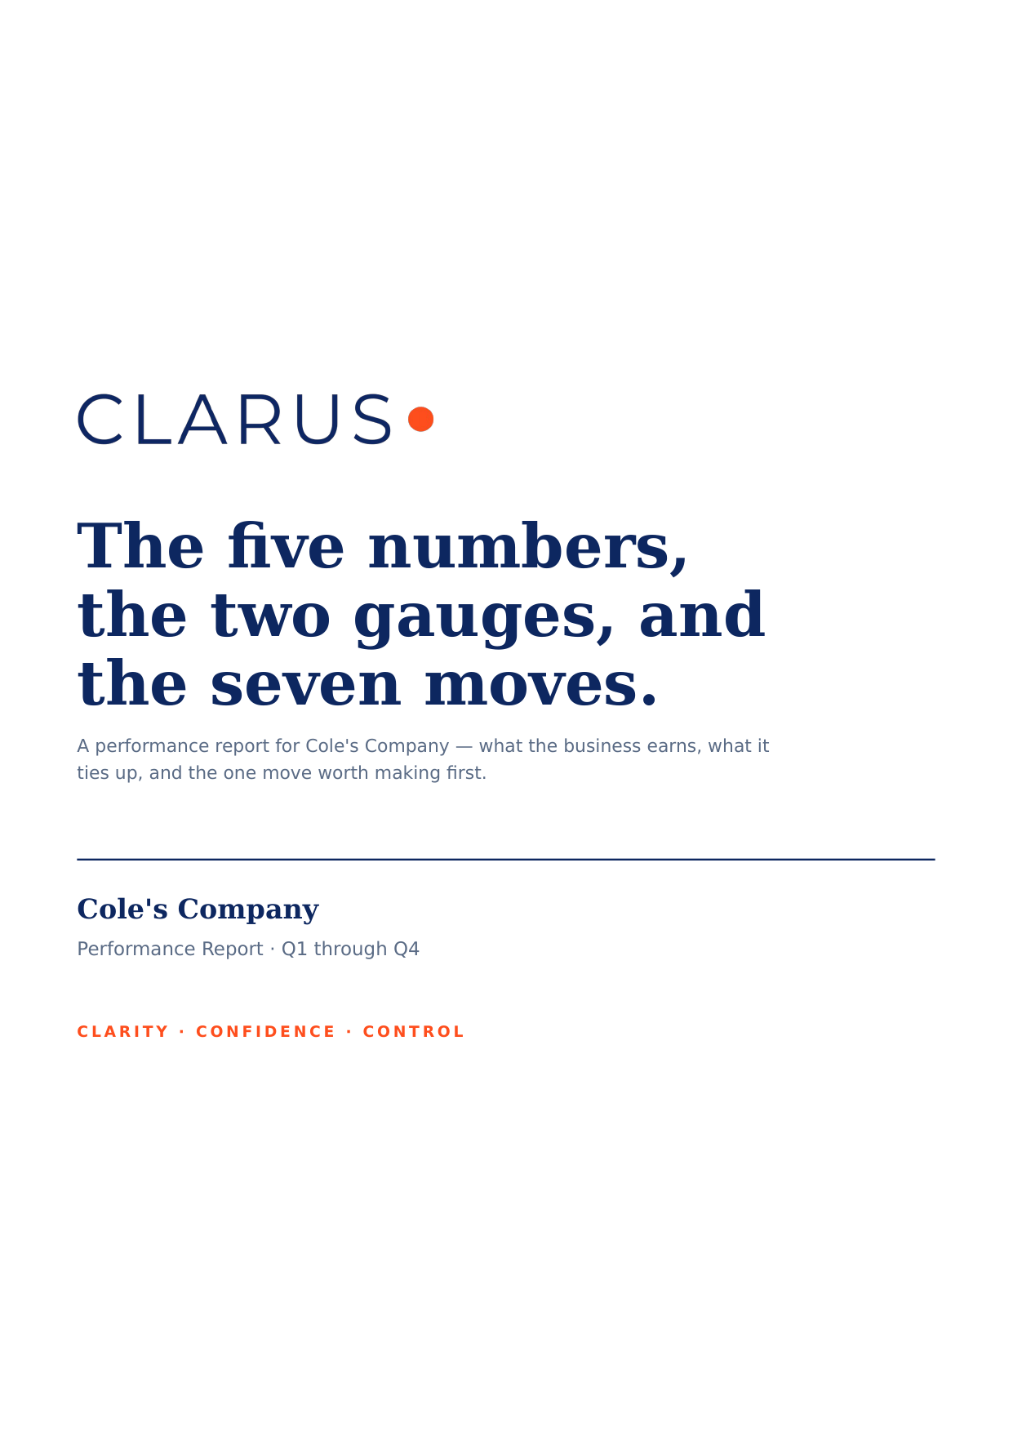
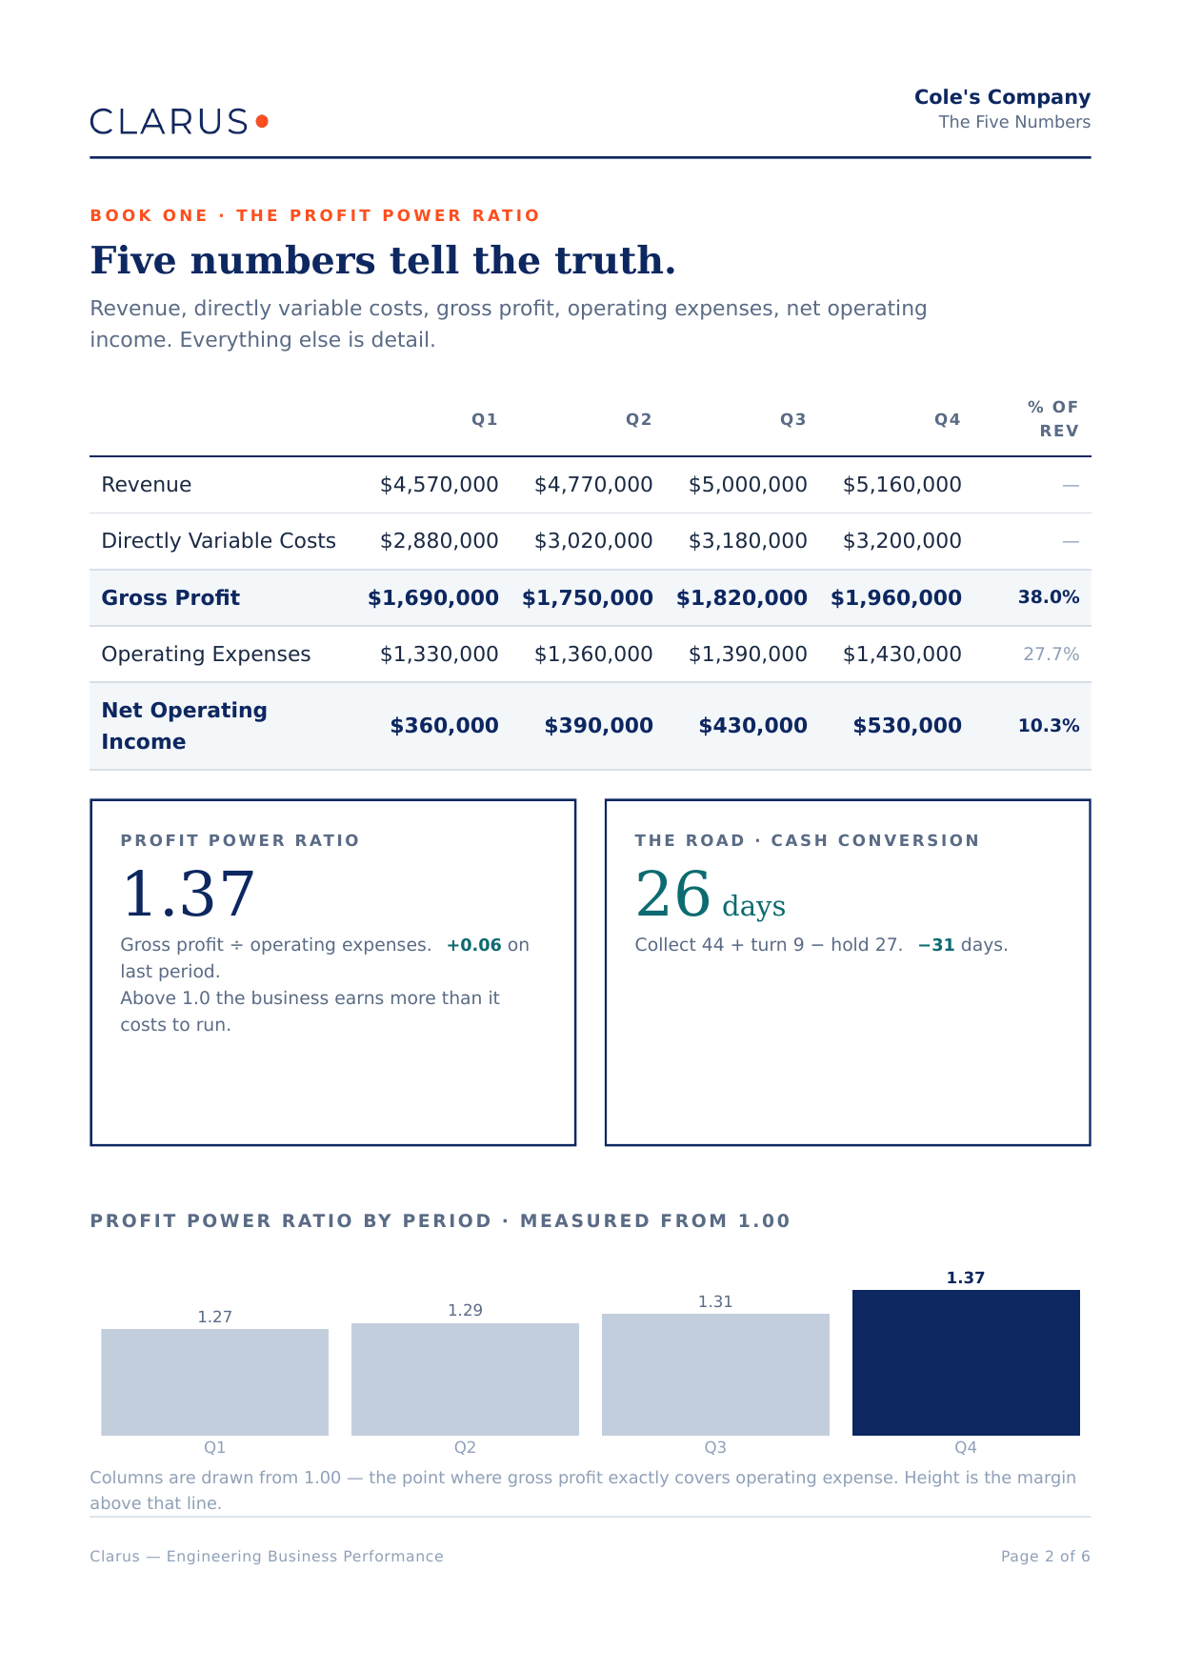
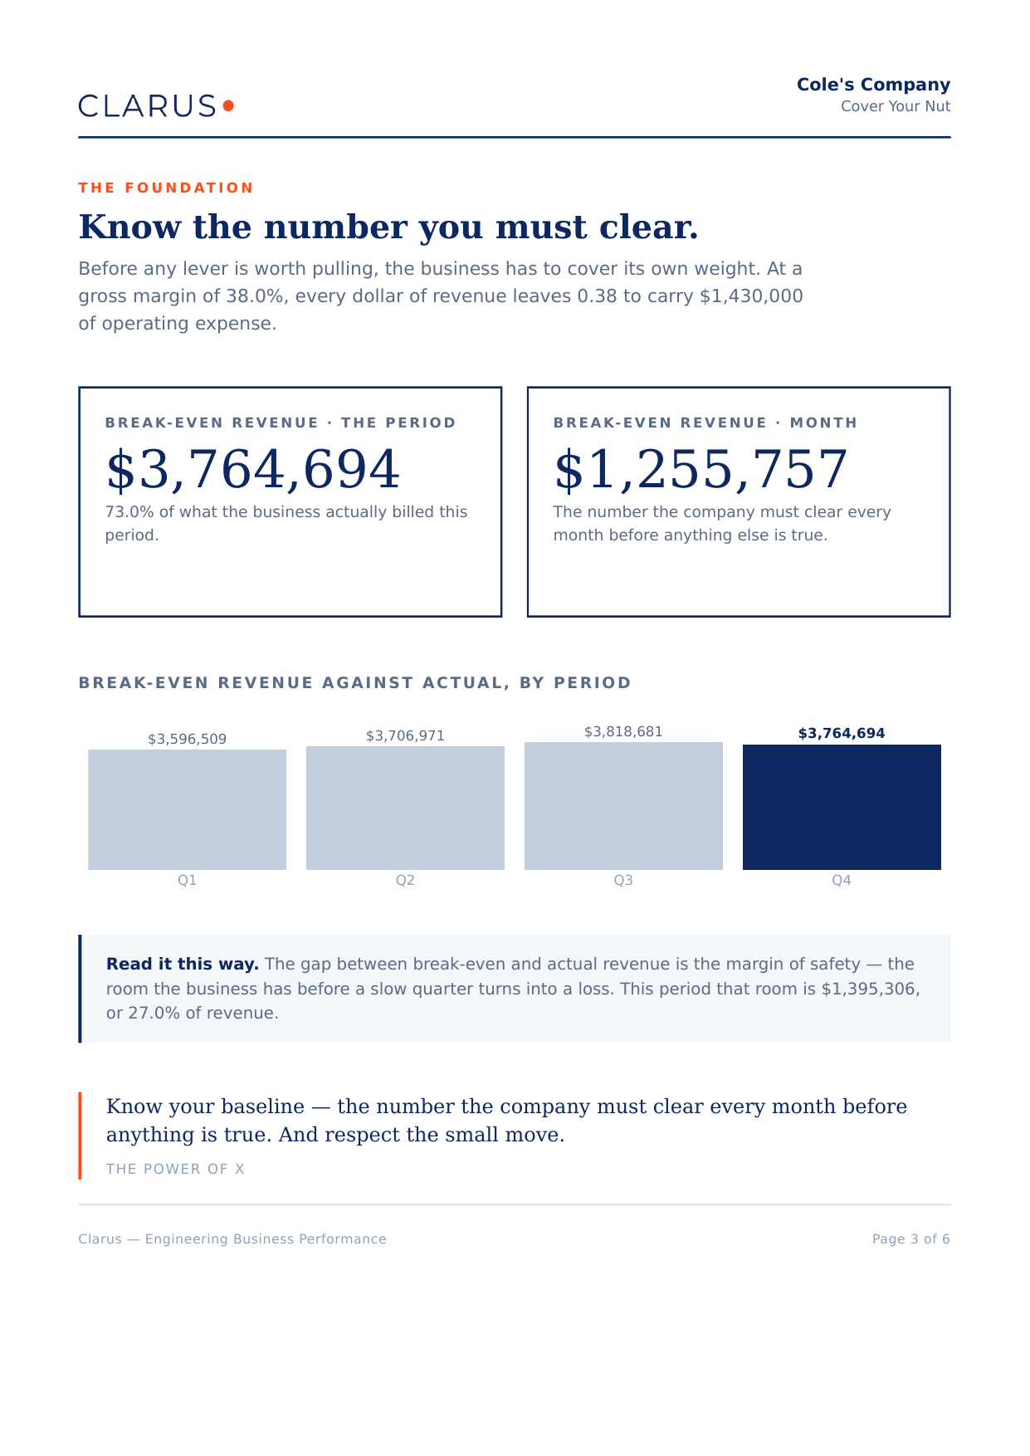
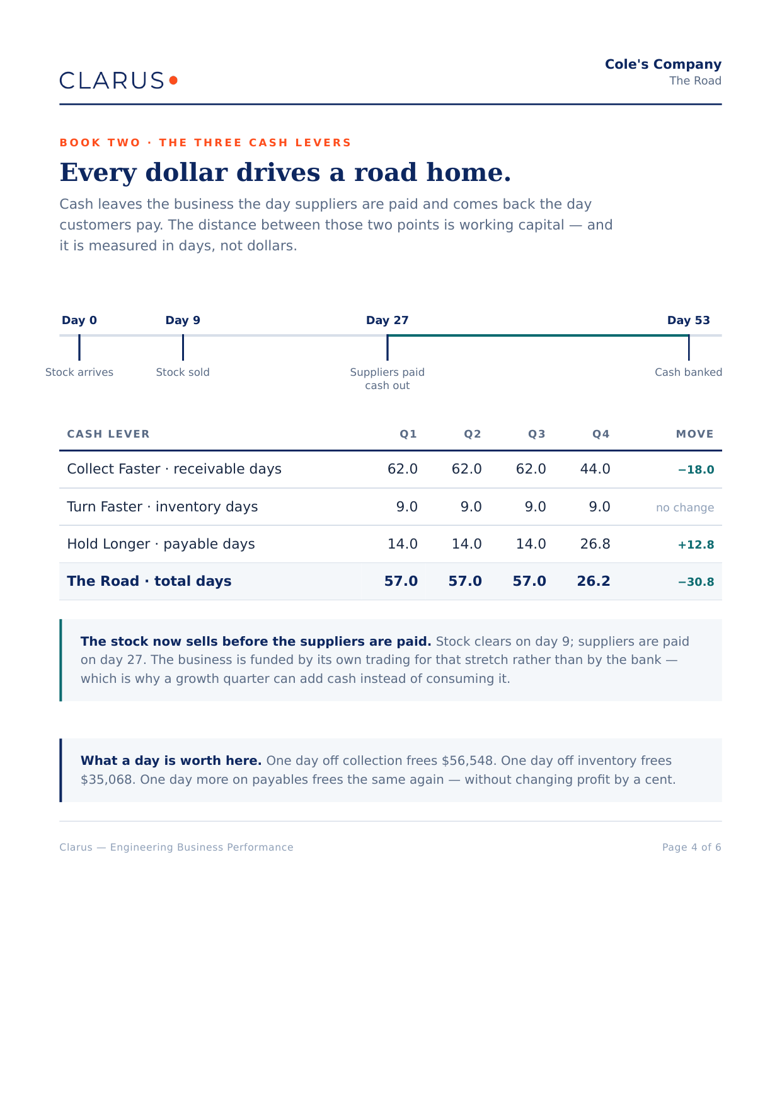
POWER OF X · THE OUTPUT, PAGES 1–4
First, what happened.
Four pages that describe the period — the five numbers, the floor beneath them, and the road the cash travels.
01
Cover
02
The Five Numbers
03
Cover Your Nut
04
The Road
the five numbers, two gauges,
seven moves
revenue to net operating
income, and the margin
the number to clear before
anything is true
work → cash in days —
stamina, drawn
Print, not export. US Letter, brand-typeset, page numbers and a method line — the artifact leaders mark up in the meeting. Generated on demand, for any period Atlas holds.
#WeRunOnEOS2026
Notes:
APPENDIX — not presented. Output pages 1–4 of the Power of X report the Clarus platform produces: cover, the five numbers, the nut, and the cash road. Here in case someone asks "what does the platform actually give you?" during Q&A — pull it up, don't walk it.

Slide 47
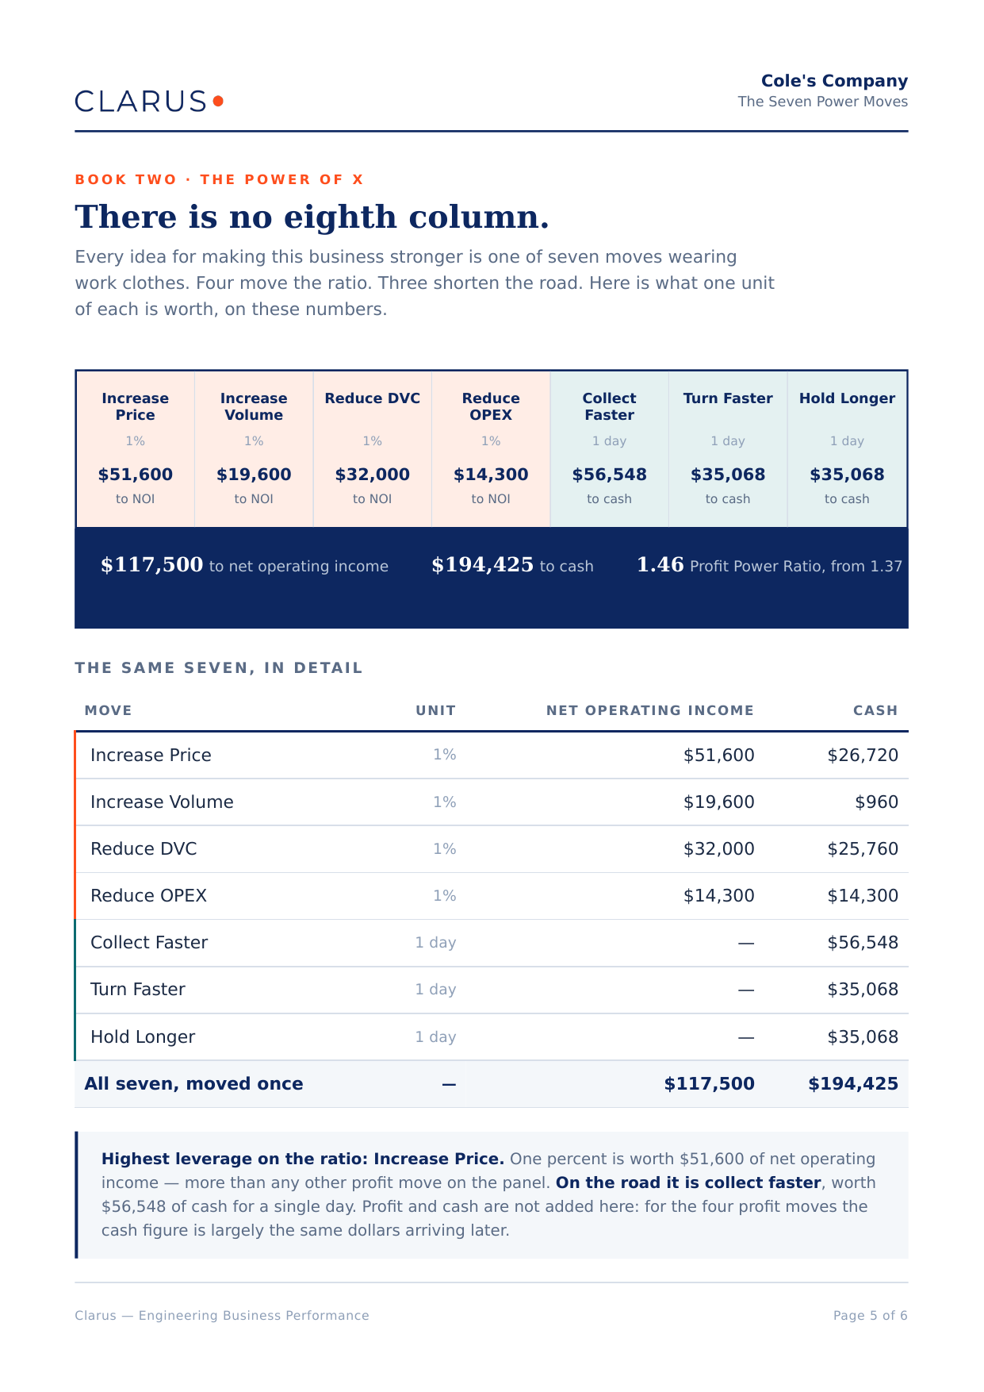
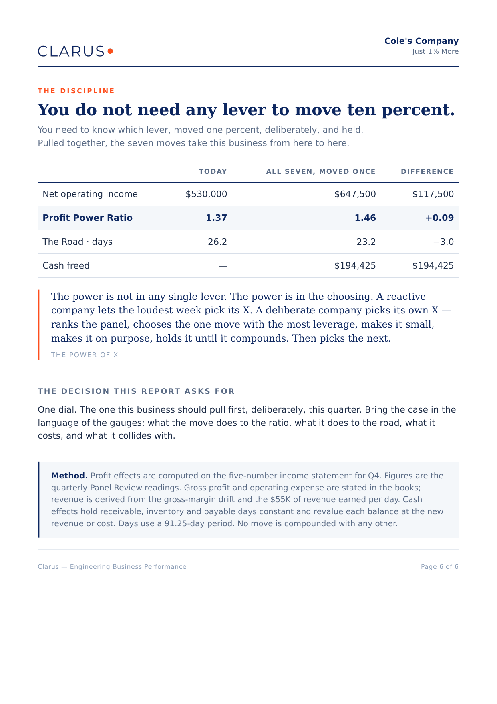
POWER OF X · THE OUTPUT, PAGES 5–8
Then, what we do about it.
Four pages that decide — the moves available, the small one that compounds, the year ahead, and what the team committed to.
BOOK TWO · THE YEAR AHEAD
THE RECORD · THIS PERIOD
The year, if you do this.
What we decided.
Core Driver · jobs per week
90
the move
Ramp two crews to a
tightened ICP
Lisa · wk 13
80
Rebuild the intake gate
Chad · wk 9
70
Hold price. Revisit at
re-lock
Cole · Q1
60
EXPECTED, AND GIVEN UP
now
+6 mo
+12 mo
Quality 94 → 97% · Core Driver 70 → 74/wk
PPR +0.03 · two segments deferred, −64K
the Line
after the move
hold
05
Seven Power Moves
06
Just 1% More
07
The Year Ahead
08
What We Decided
every lever, ranked by
what it releases
the small move, compounded
across seven levers
the committed move, run
twelve months against the Line
locked entries from the Record
— nothing typed twice
Pages 07 and 08 close the report on commitments rather than options.
#WeRunOnEOS2026
Notes:
APPENDIX — not presented. Output pages 5–8: the seven moves ranked, the 1% move, the year ahead, and what the team committed to. Same rule: reference only if asked.

