Slide 1

Customer
CELEBRATIONS
We Run on EOS North Texas 2026
Monday, September 14, 2026 · The Statler, Dallas

Slide 2
COMMUNITY WIN
AMI Construction, Inc.
Nashville Business Journal 2025 Fastest-Growing Companies, #10 in Middle Tennessee
Nashville. Also a National Top 50 Contractor in four categories (paving, striping, pavement repair, and sealcoating) through the Pavement Maintenance and Reconstruction Top Contractor program.
AMI Construction leadership team
Implementer: Duke Revard

Slide 3
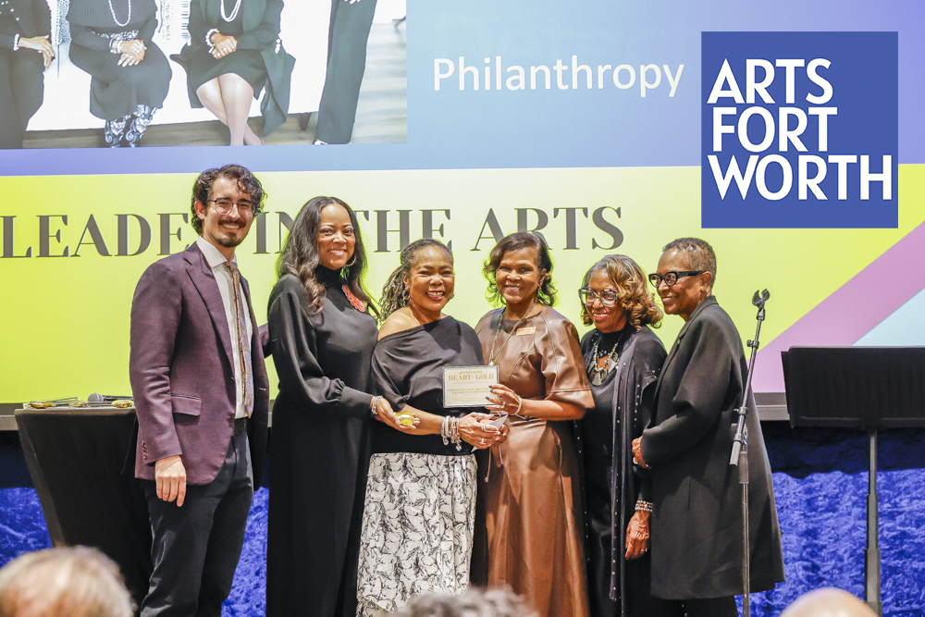
COMMUNITY WIN
Arts Fort Worth
Heart of Gold 2026 raised the Philanthropist Award for Tarrant County Pearls
Fort Worth nonprofit. Heart of Gold event on February 27, 2026 recognized the Tarrant County Pearls Chapter of The Links, Incorporated with the Philanthropist Award, presented by Executive Director Wesley Gentle.
Wesley Gentle, Executive Director
Implementer: Sandi Mitchell

Slide 4
COMMUNITY WIN
Artstillery
10 years and a 2026 Moody Fund for the Arts grant
Celebrating 10 years (June 27, 2026). The grant supports "Dichotomy of Compassion," the current immersive multimedia production. Now Dallas and Chicago.
Ilknur Nilufer Ozgur, Founder, Executive and Artistic Director
Implementer: Shane Spillers

Slide 5

COMMUNITY WIN
Austin Street Center
D CEO 2026 Nonprofit and Corporate Citizenship Finalist
Dallas. Record 640 housing placements in FY25 (up 25%). Record revenue in FY25, up 17% year-over-year and 36% over two years.
Daniel Roby, CEO
Implementer: Kevin Taylor

Slide 6
COMMUNITY WIN
B2 Design Co
Connect CRE 2025 Women in Real Estate, Texas honoree
Founder and CEO B. Allison Brooks, AIA (October 2025). Recently completed interiors for HALL Park Hotel and The Ludlow. Offices in Dallas, Chicago, Miami, and Chapel Hill.
B. Allison Brooks, Founder and CEO
Implementer: Shane Spillers

Slide 7
COMMUNITY WIN
BAT Security
Up 23% in gross revenue in the first 7 months on EOS
Waxahachie. Started Focus Day in January 2026 and posted Core Values throughout the office. Momentum has held all year.
Kyle Beller, President
Implementer: Kevin Taylor

Slide 8

COMMUNITY WIN
Beacon Hill Preparatory Institute
20 years serving North Texas students and families
Nonprofit celebrating its 20th Anniversary on July 6, 2026. Since 2006, Beacon Hill has delivered in-school, after-school, and summer literacy and math tutoring across North Texas.
Beacon Hill Preparatory Institute
Implementer: Sandi Mitchell

Slide 9
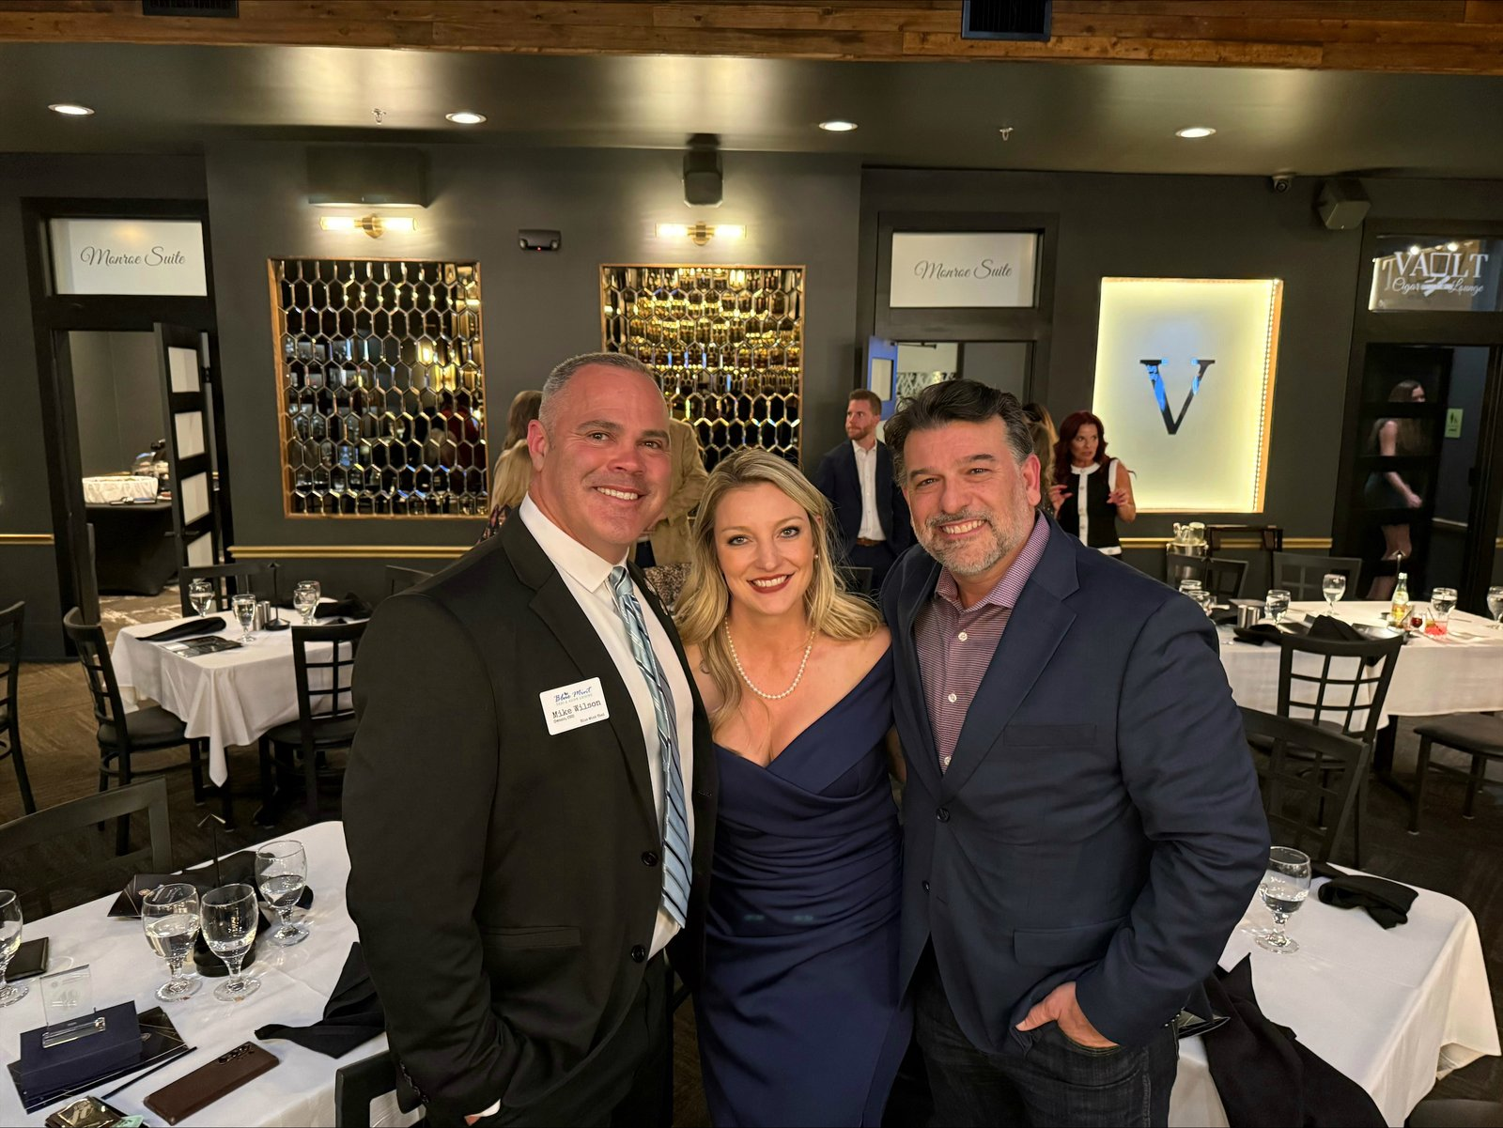
COMMUNITY WIN
Blue Mint Thai
Multi-year Best of DFW, ESGR honors, and a House Resolution
Midlothian. Best Asian Restaurant in South DFW five years running (2021–2026). ESGR Pro Patria, Patriot, and Above and Beyond awards (July 2026). House Resolution from Rep. Brian Harrison (August 2026).
Mike Wilson, CEO · Alisa Dodenhoff
Implementer: Kevin Taylor

Slide 10
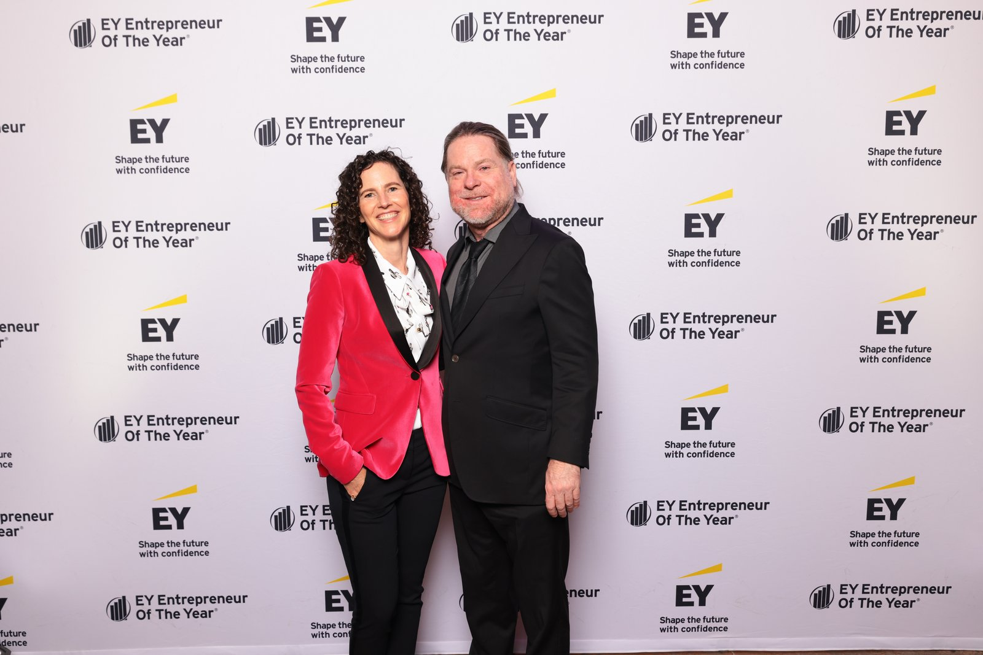
EY EOY 2026 · SOUTHWEST FINALIST
Brain Storm Shelter Restaurants
Southwest Finalist
Jason Boso — founder of Truck Yard, Twisted Root Burger Co., and more. Also a finalist in the Oklahoma City ULI Impact Awards.
Jason Boso, Founder
Implementer: Amanda Matthews

Slide 11

COMMUNITY WIN
C1M
2025 Vistage Top Performer, 4.96 speaker average
CEO John Arnott recognized as a 2025 Vistage Top Performer for his speaking work with Vistage member CEO peer groups.
John Arnott, CEO
Implementer: Amy Johannesen

Slide 12
HEADLINE WIN
Catco
Featured in the new Issues book, record calendar year, and patents pending
Featured in the newly released EOS Issues book. Trailing-12-month orders broke the record three times. Record Q4, record Q1, record first half, record calendar year, and three record calendar months. Revenue posted a record Q2, record first half, and four record calendar months. Two patents pending plus a third application in progress. Two new leadership team hires with one more in recruitment.
Travis Richards
Implementer: Jill Young

Slide 13
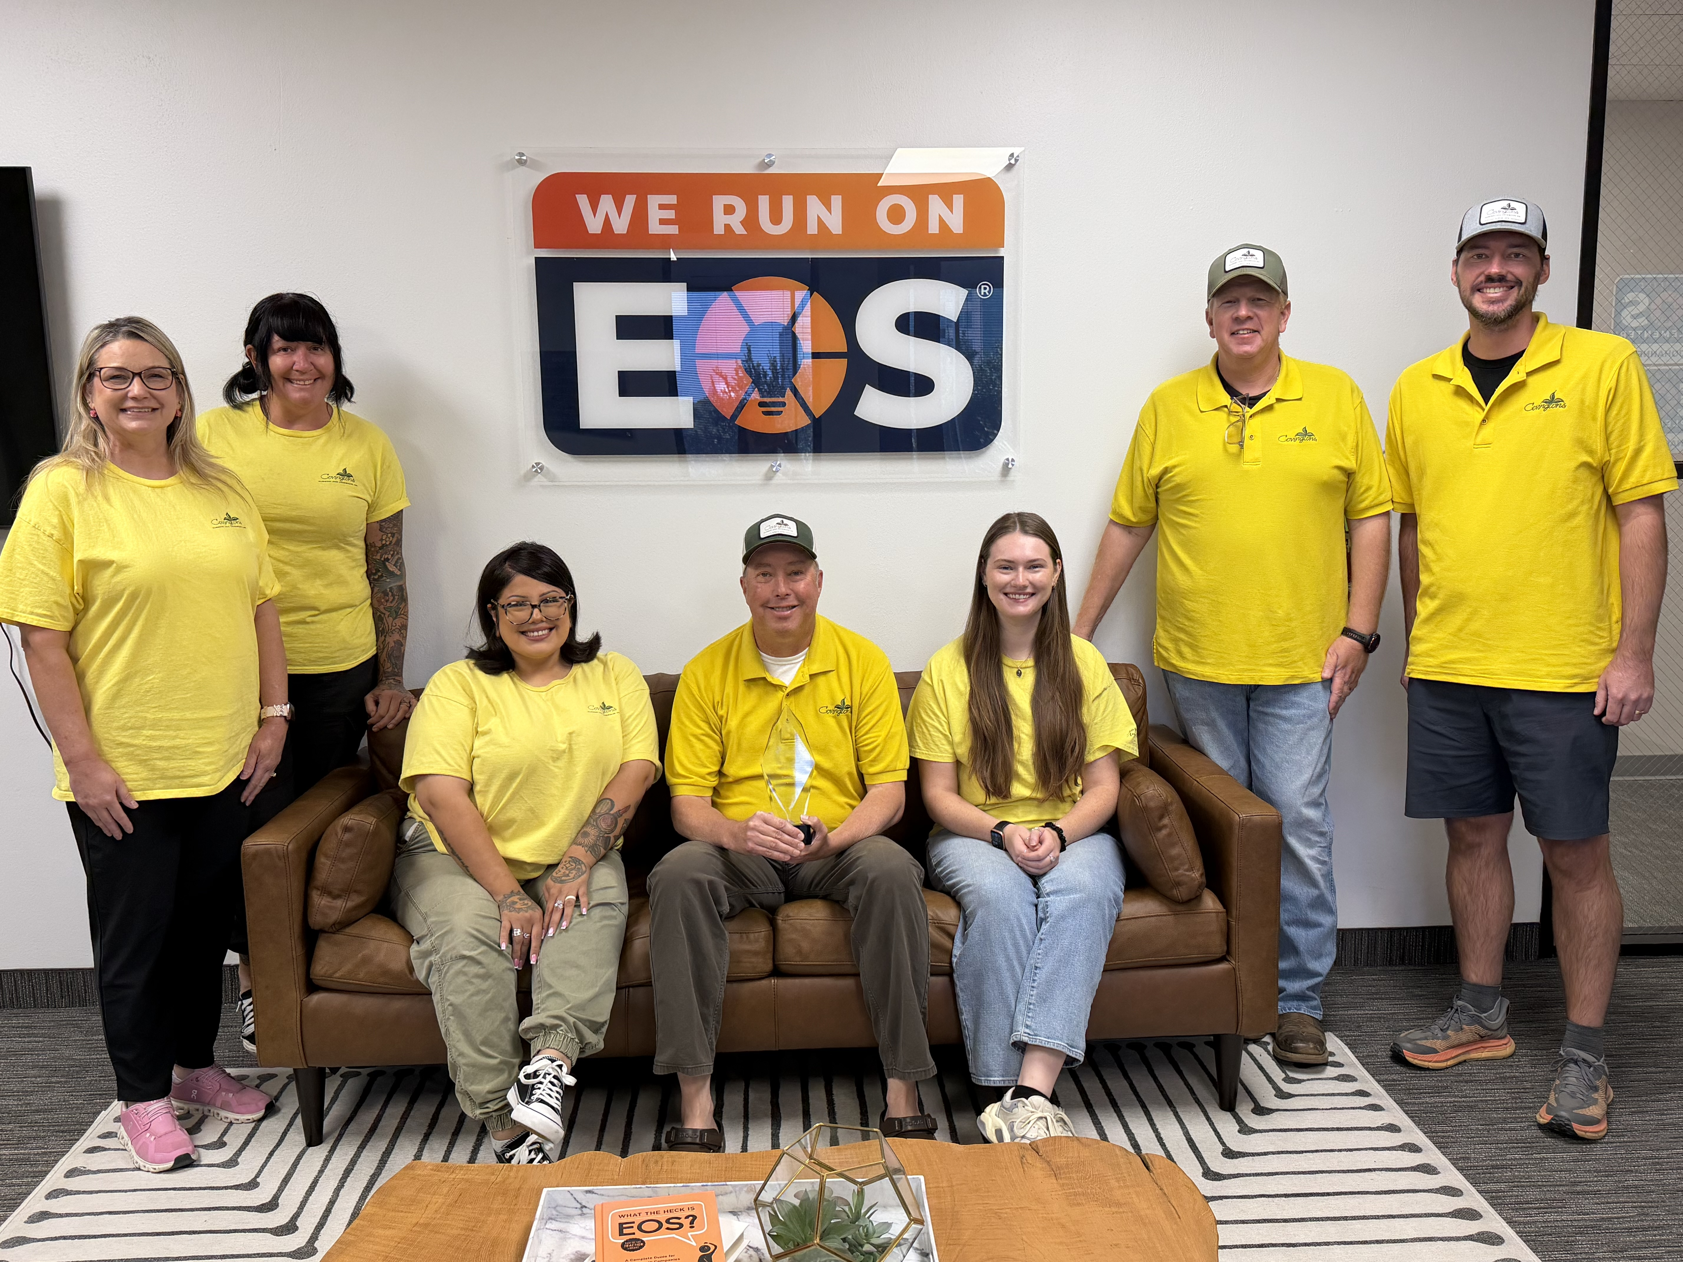
COMMUNITY WIN
Covington's Nursery
Rowlett Chamber of Commerce Small Business of the Year
Rowlett-based garden center and landscape design company. Recognized by the Rowlett Chamber of Commerce as Small Business of the Year.
Covington's Nursery team
Implementer: Amy Johannesen

Slide 14
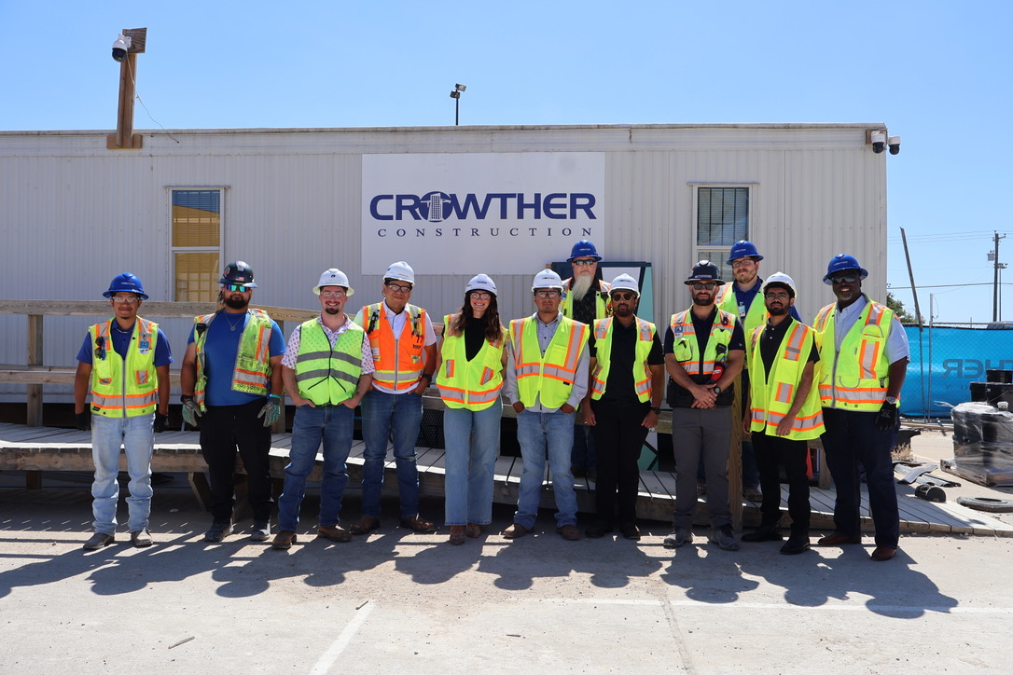
COMMUNITY WIN
The Crowther Group
Best Place to Work for Working Parents, three years running
Ranked No. 56 on the Dallas Business Journal Largest General Contractors list (June 2026). Third consecutive year partnering with UTA’s Senior Capstone program and expanding K-12 pipelines with Dallas ISD, Garland ISD, DeSoto ISD, and P-TECH. April Crowther Foundation extended its philanthropic reach to The Bahamas.
Thomas and Trish Crowther
Implementer: Sandi Mitchell

Slide 15
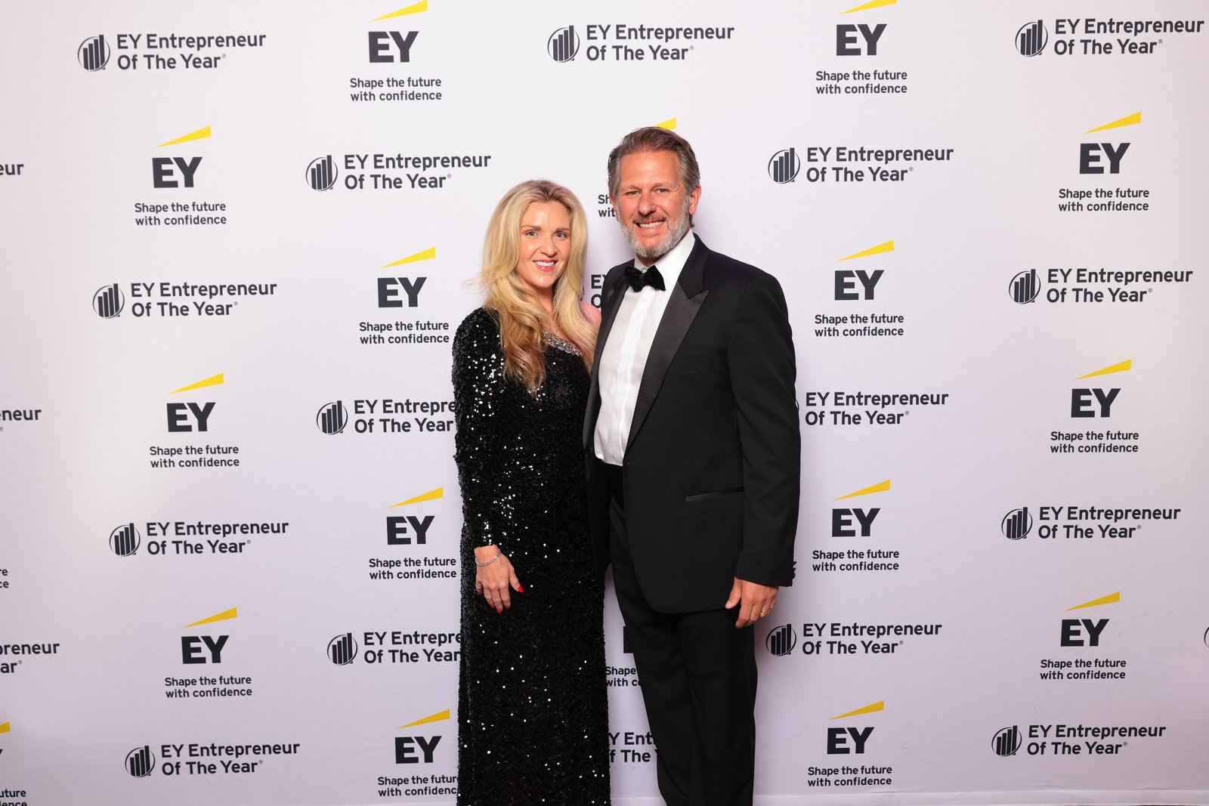
EY EOY 2026 · SOUTHWEST FINALIST
Excel Medical Staffing
Southwest Finalist
Founder and CEO Gabriel Griess, U.S. Air Force Academy graduate. Grapevine-based.
Gabriel Griess, Founder and CEO
Implementer: Justin Mink

Slide 16
EY EOY 2026 · HEARTLAND FINALIST
HorsePower Brands
Heartland Finalist
CEO Tony Hulbert. Nine home-service franchise brands, five of them on Entrepreneur magazine’s 2026 Franchise 500. Omaha-based.
Tony Hulbert, CEO
Implementer: Justin Mink

Slide 17
COMMUNITY WIN
Hotchkiss Insurance
Six consecutive years on Houston Business Journal Best Places to Work
Houston and Dallas. Houston Business Journal Best Places to Work 2018 through 2023 (#11 medium company in 2023). Insurance Journal Best Agency to Work For Gold, South Central, in 2015 and 2019. Dallas Morning News Top 100 Places to Work in 2018 (#17 small company).
Hotchkiss Insurance leadership team
Implementer: Duke Revard

Slide 18
COMMUNITY WIN
KPost Roofing & Waterproofing
Best-in-Class, ARMA 2026 Excellence in Asphalt Roofing
Commercial/Mixed Use category winner for the National Medal of Honor Museum in Arlington. Honored at the International Roofing Expo in Las Vegas, January 2026.
Steve Little, Keith Post, and Jayne Williams, Founders
Implementer: Shane Spillers

Slide 19
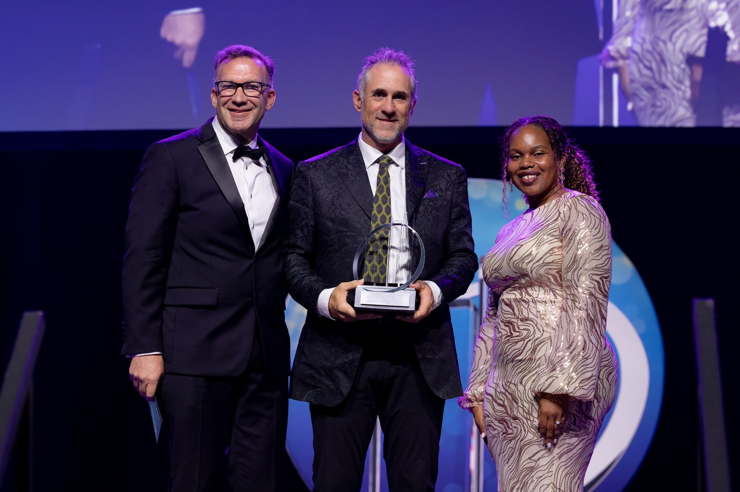
EY EOY 2026 · SOUTHWEST WINNER
Lime Media Group
Southwest Winner + 2026 Top Workplaces Culture Excellence
Founder and CEO Heath Hill. Rockwall-based. Top Workplaces Culture Excellence winner (July 2026).
Heath Hill, Founder and CEO
Implementer: Leonard Lynskey

Slide 20
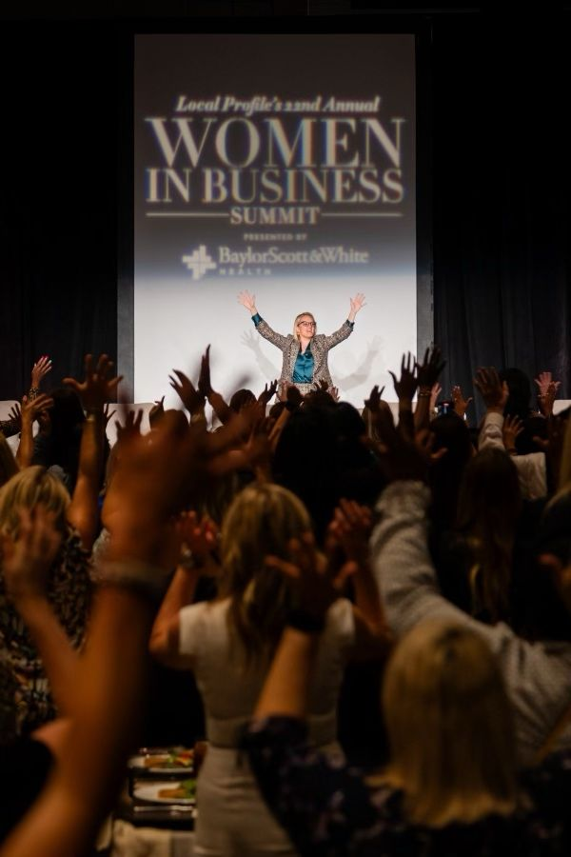
COMMUNITY WIN
Local Profile
25th Annual Women in Business Summit sold out two months early
Plano-based media company. The September 18 flagship summit sold out in two weeks, two months before the event. Presented by Baylor Scott and White Health.
Rebecca Silvestri, Publisher · Philip Silvestri
Implementer: Sandi Mitchell

Slide 21
HEADLINE WIN
Maverick Power
Signs $1.75 billion acquisition agreement with nVent
Announced Aug 24, 2026 with up to $550M more tied to 2027–2028 performance. Also No. 7 on the 2026 Inc. Regionals: Southwest list (627% growth), a 2026 Inc. 5000 honoree, and Tom Currier named a 2026 DFW Titan 100 honoree.
Tom Currier, President and CEO
Implementer: Shane Spillers

Slide 22
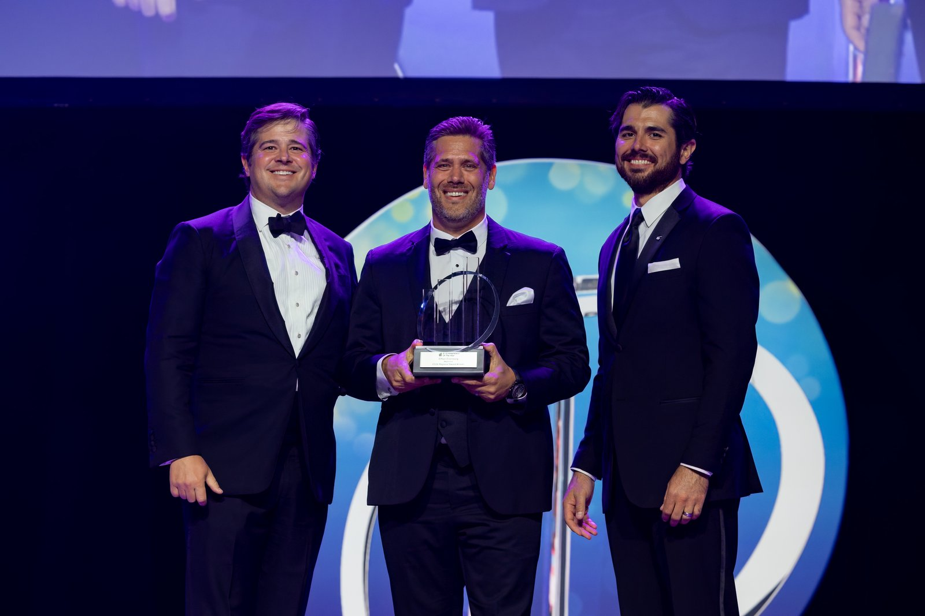
EY EOY 2026 · SOUTHWEST WINNER
Moonshot
Southwest Winner — advancing to National Awards
Founder and CEO Ethan Ellenberg. Denton-based. Advances to the EY National Awards in November 2026.
Ethan Ellenberg, Founder and CEO
Implementer: Ryan Wall

Slide 23
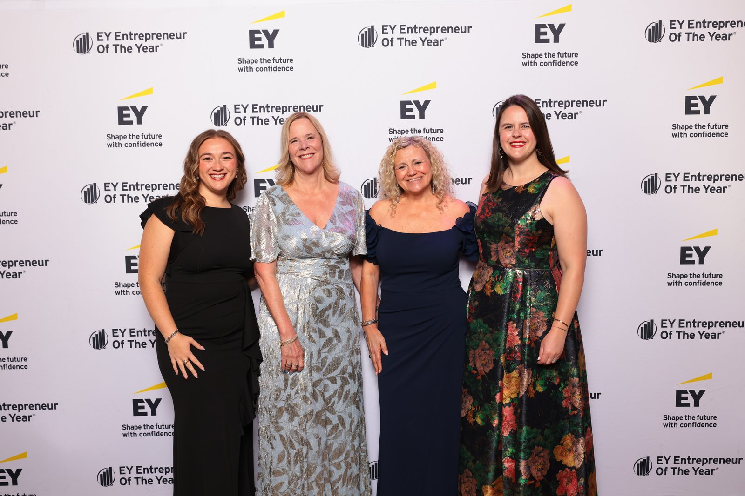
COMMUNITY WIN
Neighborhood Management, Inc.
EY Entrepreneur Of The Year 2026 Southwest Finalist
President Beverly Coghlan, PCAM — one of 44 finalists from 41 companies, announced April 21, 2026.
Beverly Coghlan, President
Implementer: Shane Spillers

Slide 24
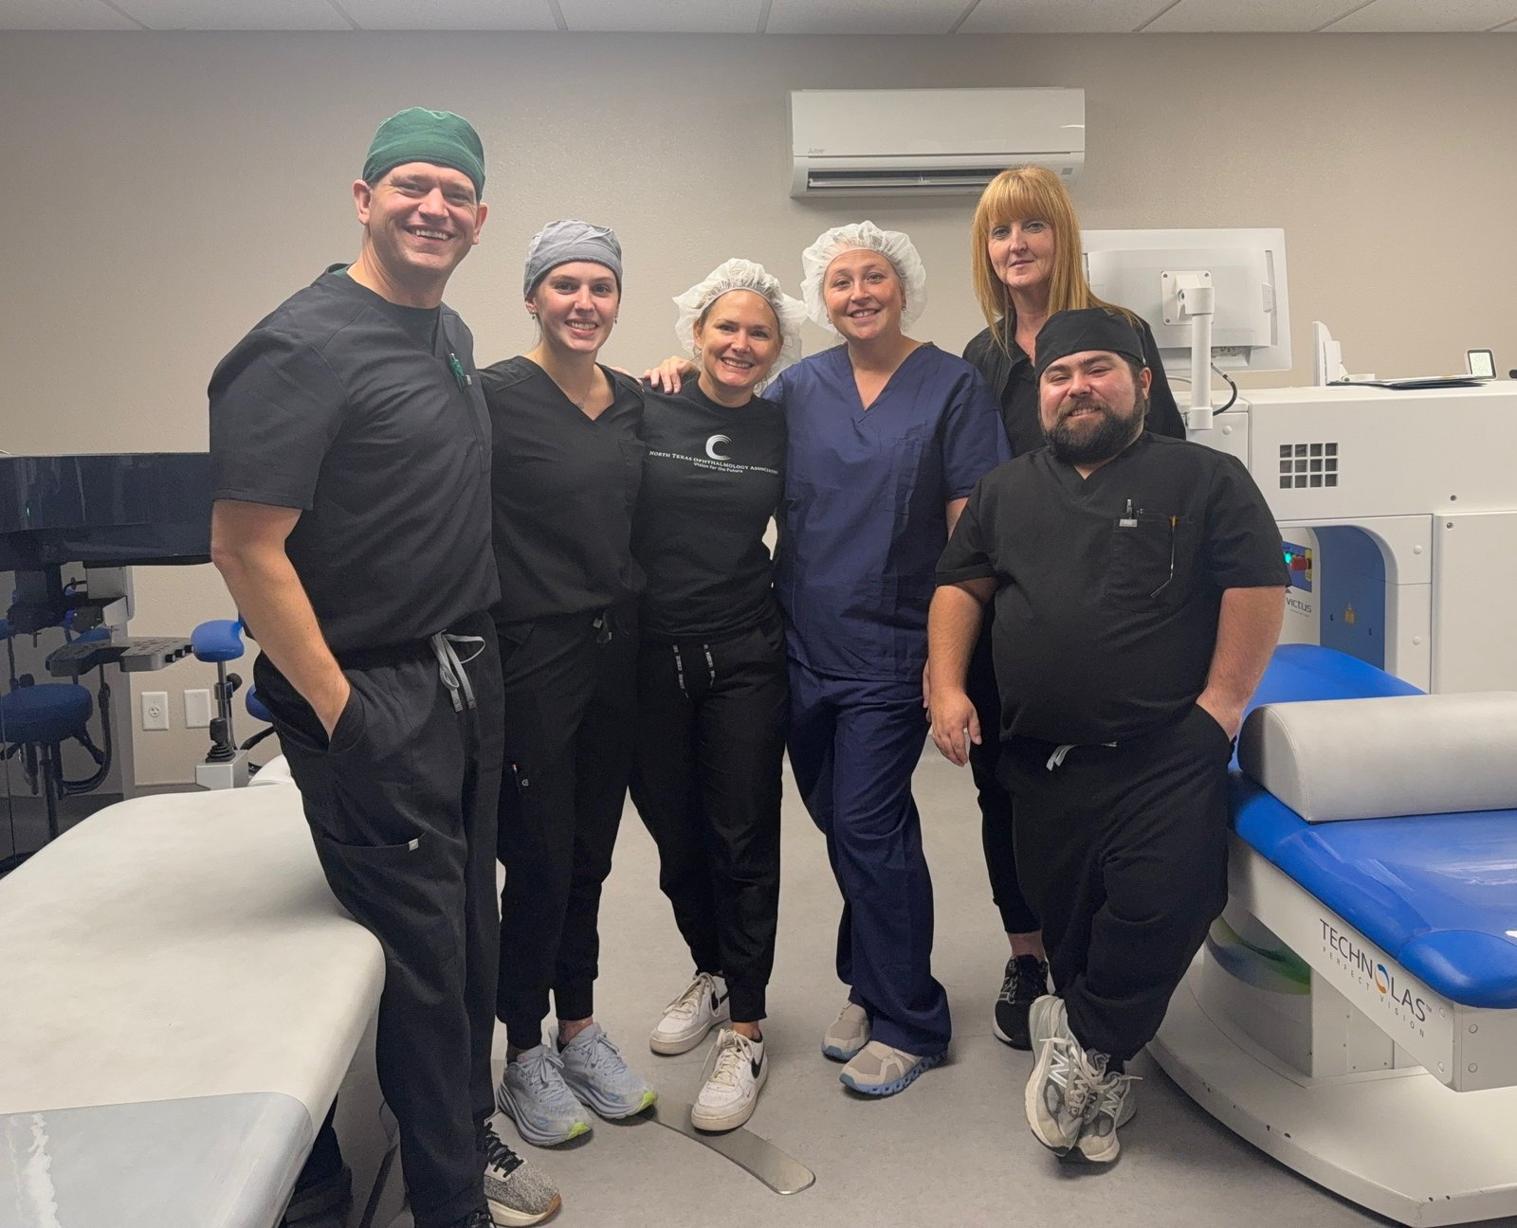
COMMUNITY WIN
North Texas Ophthalmology
Launched LASIK, opened a second location, turned a loss into profit
Wichita Falls. Launched LASIK as a new service line, opened a second location, and turned a $300K loss in 2025 into roughly $150K profit YTD 2026 while paying down debt.
Matt Griffiths, Director of Marketing and Technology
Implementer: Erin Thiem

Slide 25
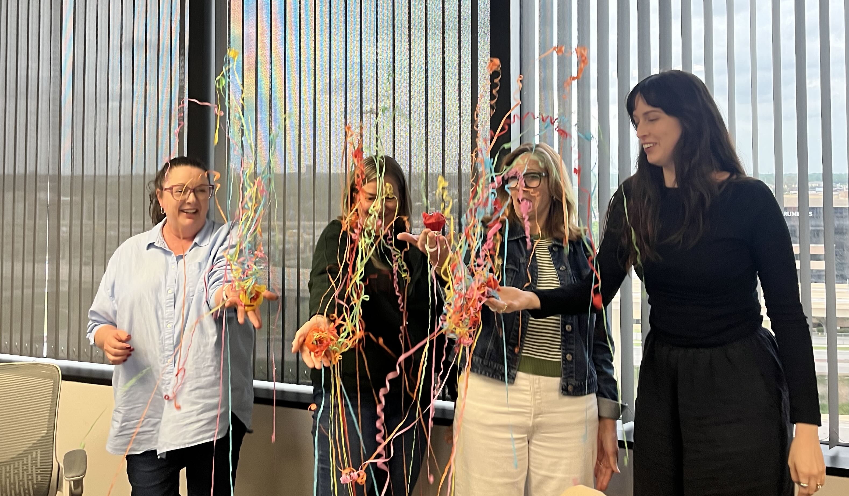
COMMUNITY WIN
Rose Marketing Solutions
EO Dallas Forum Moderator of the Year
Ruth Ann Rose named Forum Moderator of the Year by EO Dallas. Featured speaker at the Hinge Brokers Shift Early Childhood Conference.
Ruth Ann Rose, Founder
Implementer: Amanda Matthews

Slide 26
HEADLINE WIN
TEKConcierge
MSP Titan of the Southwest 2025 and DBJ Fast 50 back-to-back
Richardson-based managed IT provider. 2025 MSP Titan of the Southwest, Dallas Business Journal Fast 50 in both 2025 and 2026, Inc. Regionals: Southwest in 2025 (#104) and 2026 (#81), Inc. 5000 four years running (2023 through 2026), Channel Partners MSP 501 (2025), and FDI Insider Managed Intelligence Provider of the Year for Richardson (2026).
TEKConcierge leadership team
Implementer: Aaron Garcia

Slide 27
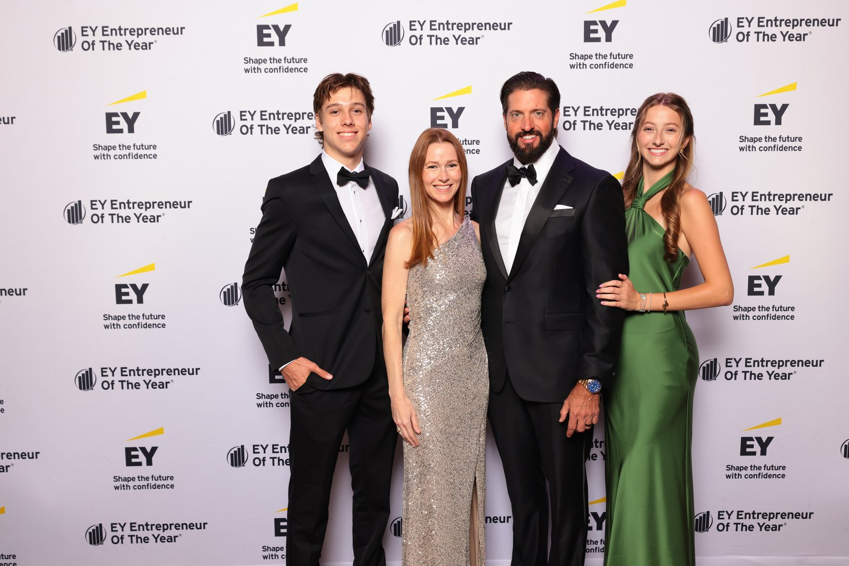
EY EOY 2026 · SOUTHWEST FINALIST
TruLabs
Southwest Finalists
Co-founders Brandon Pogue (CEO) and Jennifer Pogue (CMO). McKinney-based.
Brandon and Jennifer Pogue
Implementer: Amy Johannesen

Slide 28
Congratulations
to our North Texas EOS Community
We Run on EOS North Texas 2026
The Statler, Dallas · Monday, September 14, 2026

