Slide 1

Customer
CELEBRATIONS
We Run on EOS North Texas 2026
Monday, September 14, 2026 · The Statler, Dallas

Slide 2
HEADLINE WIN
Maverick Power
Signs $1.75 billion acquisition agreement with nVent
Announced Aug 24, 2026 with up to $550M more tied to 2027–2028 performance. Also No. 7 on the 2026 Inc. Regionals: Southwest list (627% growth), a 2026 Inc. 5000 honoree, and Tom Currier named a 2026 DFW Titan 100 honoree.
Tom Currier, President and CEO
Implementer: Shane Spillers

Slide 3
COMMUNITY WIN
KPost Roofing & Waterproofing
Best-in-Class, ARMA 2026 Excellence in Asphalt Roofing
Commercial/Mixed Use category winner for the National Medal of Honor Museum in Arlington. Honored at the International Roofing Expo in Las Vegas, January 2026.
Steve Little, Keith Post, and Jayne Williams, Founders
Implementer: Shane Spillers

Slide 4
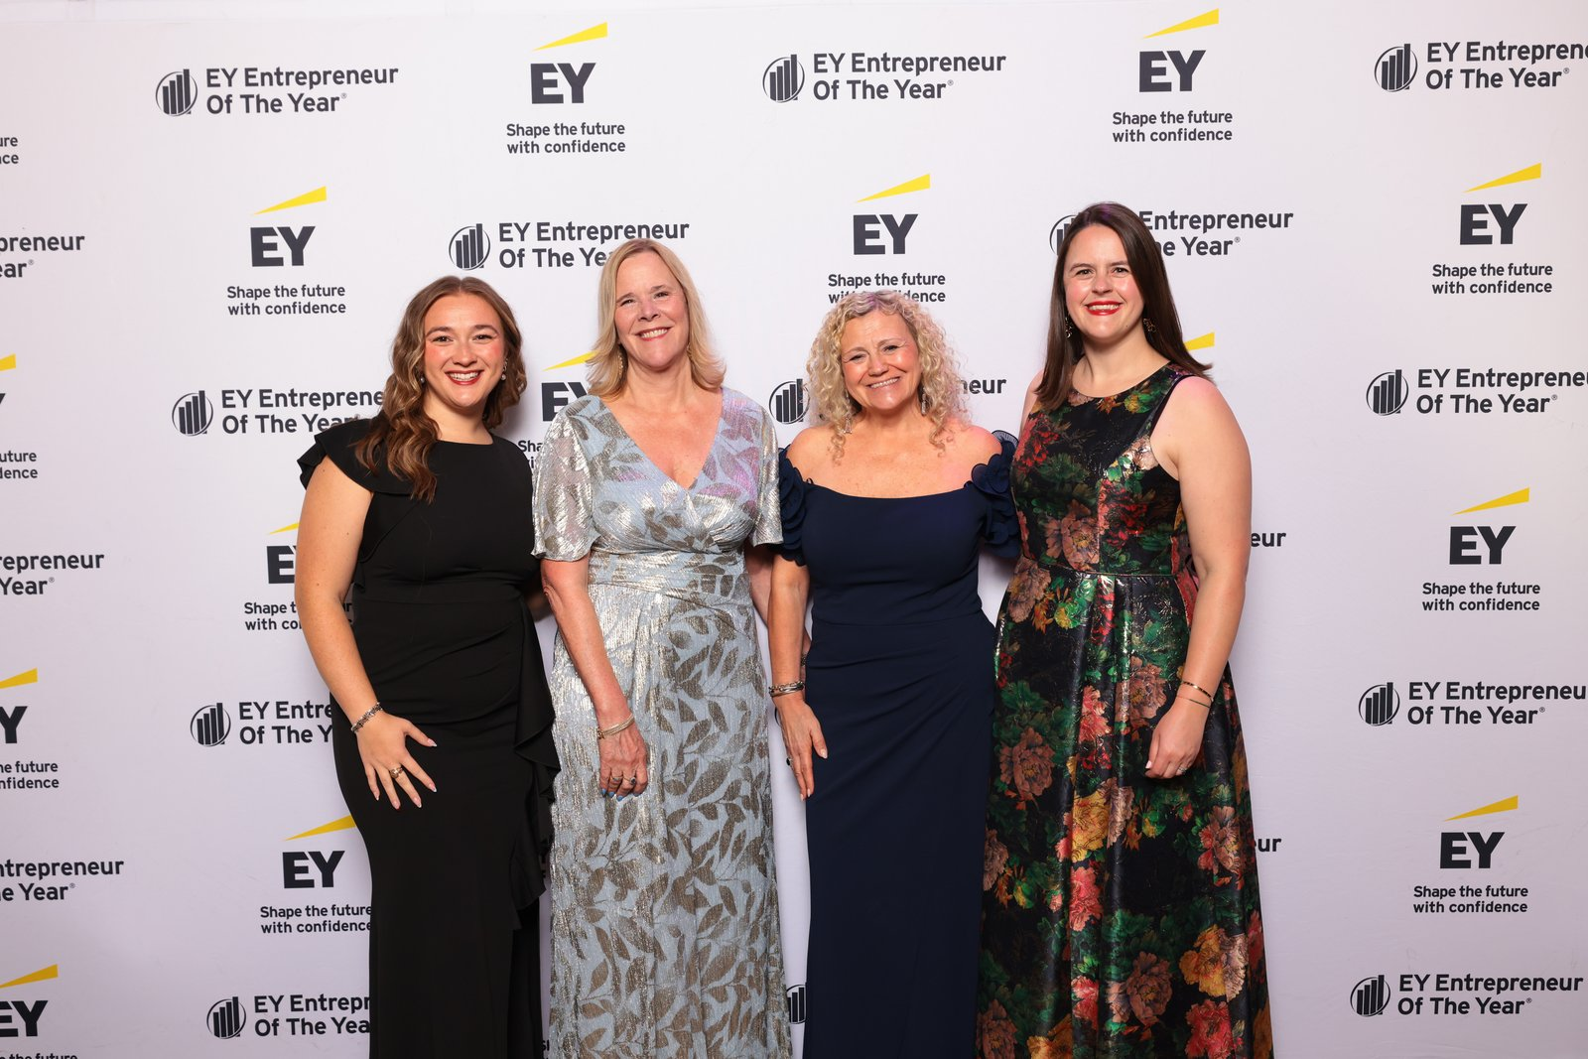
COMMUNITY WIN
Neighborhood Management, Inc.
EY Entrepreneur Of The Year 2026 Southwest Finalist
President Beverly Coghlan, PCAM — one of 44 finalists from 41 companies, announced April 21, 2026.
Beverly Coghlan, President
Implementer: Shane Spillers

Slide 5
COMMUNITY WIN
B2 Design Co
Connect CRE 2025 Women in Real Estate, Texas honoree
Founder and CEO B. Allison Brooks, AIA (October 2025). Recently completed interiors for HALL Park Hotel and The Ludlow. Offices in Dallas, Chicago, Miami, and Chapel Hill.
B. Allison Brooks, Founder and CEO
Implementer: Shane Spillers

Slide 6
COMMUNITY WIN
Artstillery
10 years and a 2026 Moody Fund for the Arts grant
Celebrating 10 years (June 27, 2026). The grant supports "Dichotomy of Compassion," the current immersive multimedia production. Now Dallas and Chicago.
Ilknur Nilufer Ozgur, Founder, Executive and Artistic Director
Implementer: Shane Spillers

Slide 7
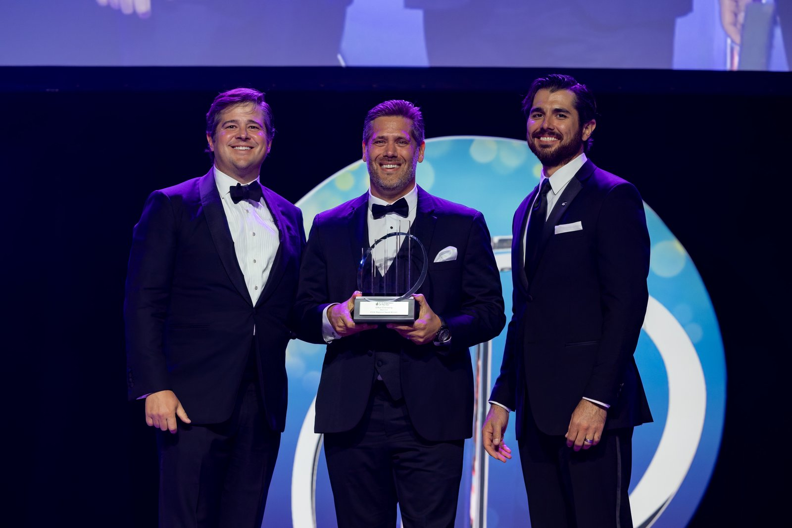
EY EOY 2026 · SOUTHWEST WINNER
Moonshot
Southwest Winner — advancing to National Awards
Founder and CEO Ethan Ellenberg. Denton-based. Advances to the EY National Awards in November 2026.
Ethan Ellenberg, Founder and CEO
Implementer: Ryan Wall

Slide 8
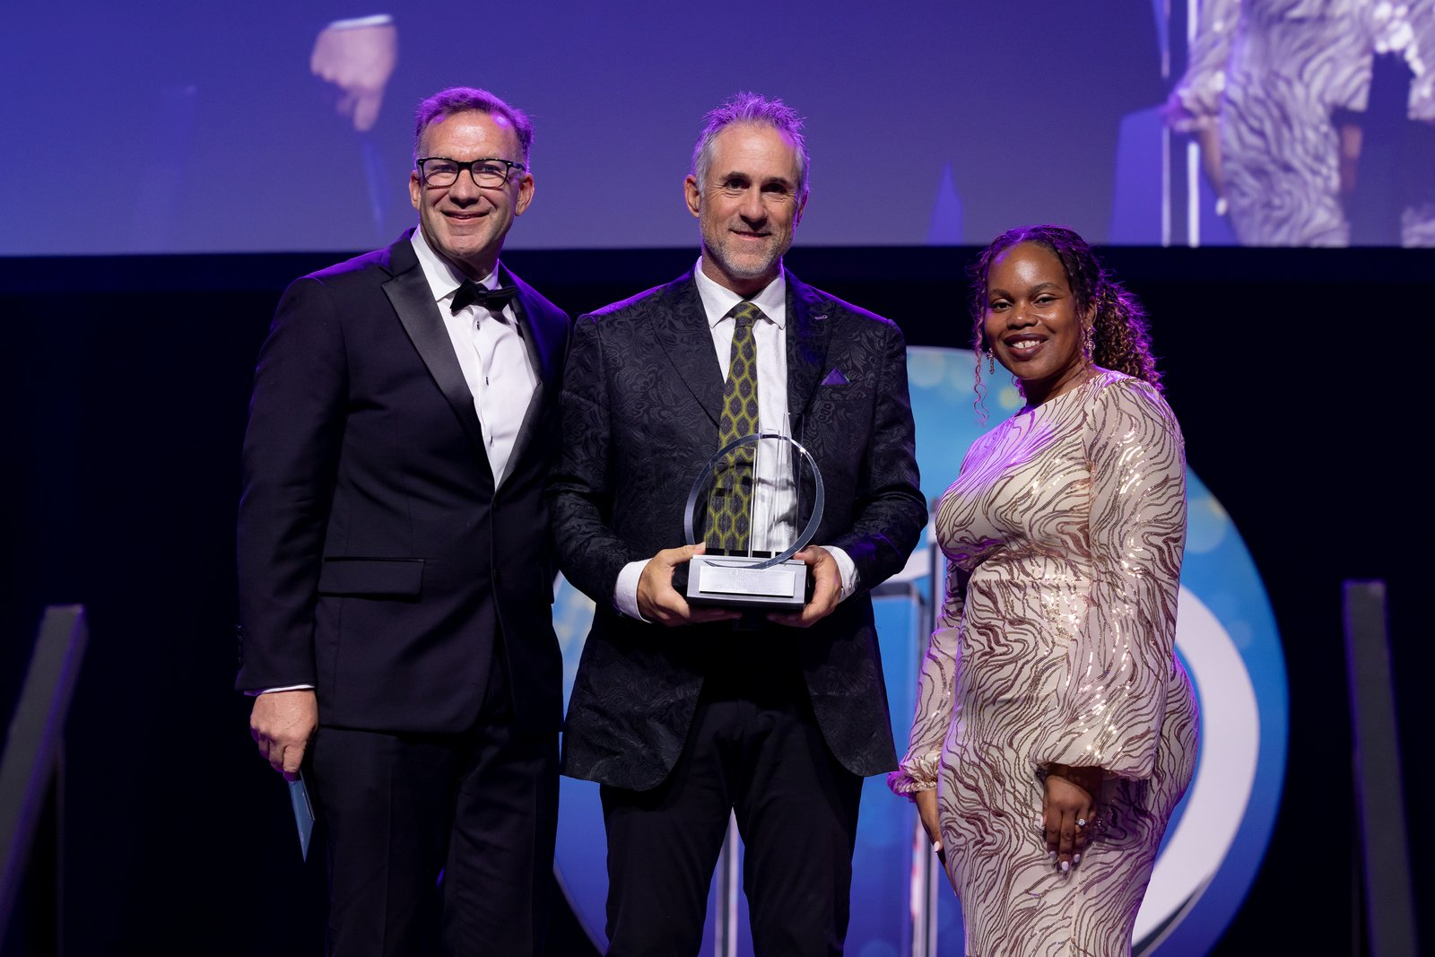
EY EOY 2026 · SOUTHWEST WINNER
Lime Media Group
Southwest Winner + 2026 Top Workplaces Culture Excellence
Founder and CEO Heath Hill. Rockwall-based. Top Workplaces Culture Excellence winner (July 2026).
Heath Hill, Founder and CEO
Implementer: Leonard

Slide 9
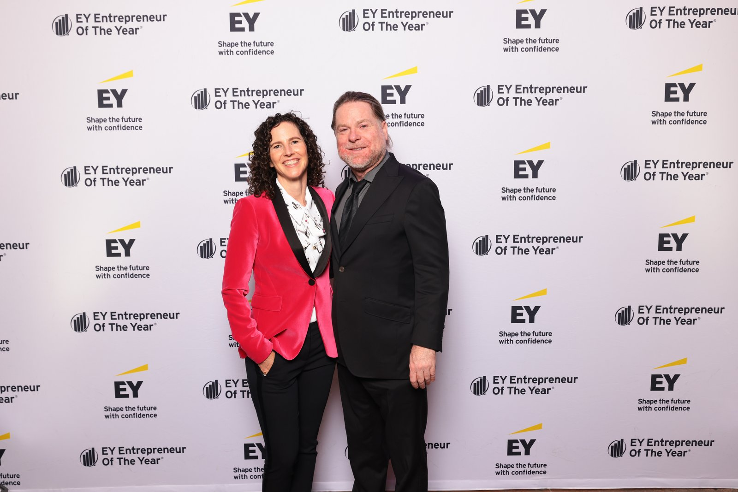
EY EOY 2026 · SOUTHWEST FINALIST
Brain Storm Shelter Restaurants
Southwest Finalist
Jason Boso — founder of Truck Yard, Twisted Root Burger Co., and more. Also a finalist in the Oklahoma City ULI Impact Awards.
Jason Boso, Founder
Implementer: Amanda Matthews

Slide 10
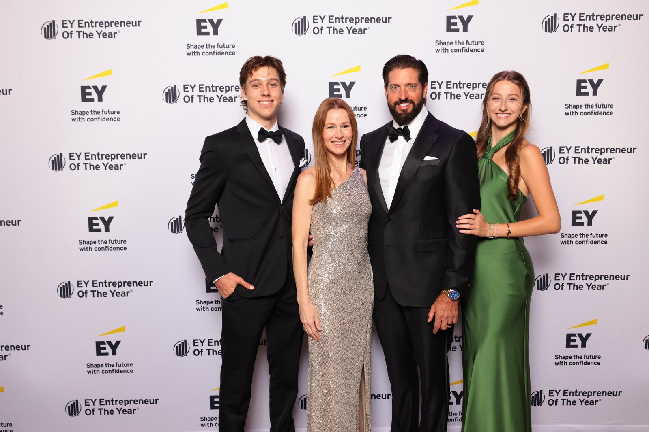
EY EOY 2026 · SOUTHWEST FINALIST
TruLabs
Southwest Finalists
Co-founders Brandon Pogue (CEO) and Jennifer Pogue (CMO). McKinney-based.
Brandon and Jennifer Pogue
Implementer: Amy Johannesen

Slide 11
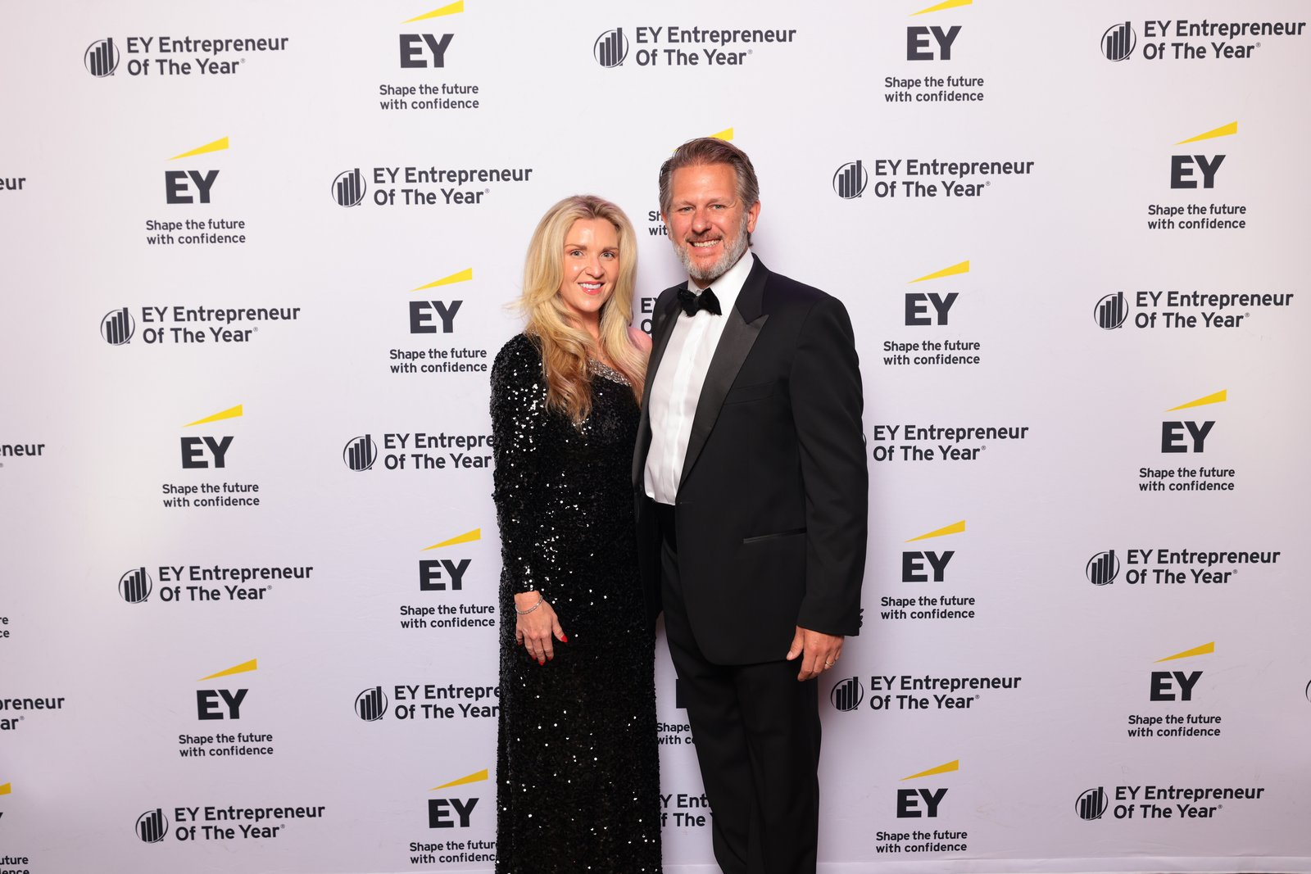
EY EOY 2026 · SOUTHWEST FINALIST
Excel Medical Staffing
Southwest Finalist
Founder and CEO Gabriel Griess, U.S. Air Force Academy graduate. Grapevine-based.
Gabriel Griess, Founder and CEO
Implementer: Justin Mink

Slide 12
EY EOY 2026 · HEARTLAND FINALIST
HorsePower Brands
Heartland Finalist
CEO Tony Hulbert. Nine home-service franchise brands, five of them on Entrepreneur magazine’s 2026 Franchise 500. Omaha-based.
Tony Hulbert, CEO
Implementer: Justin Mink

Slide 13
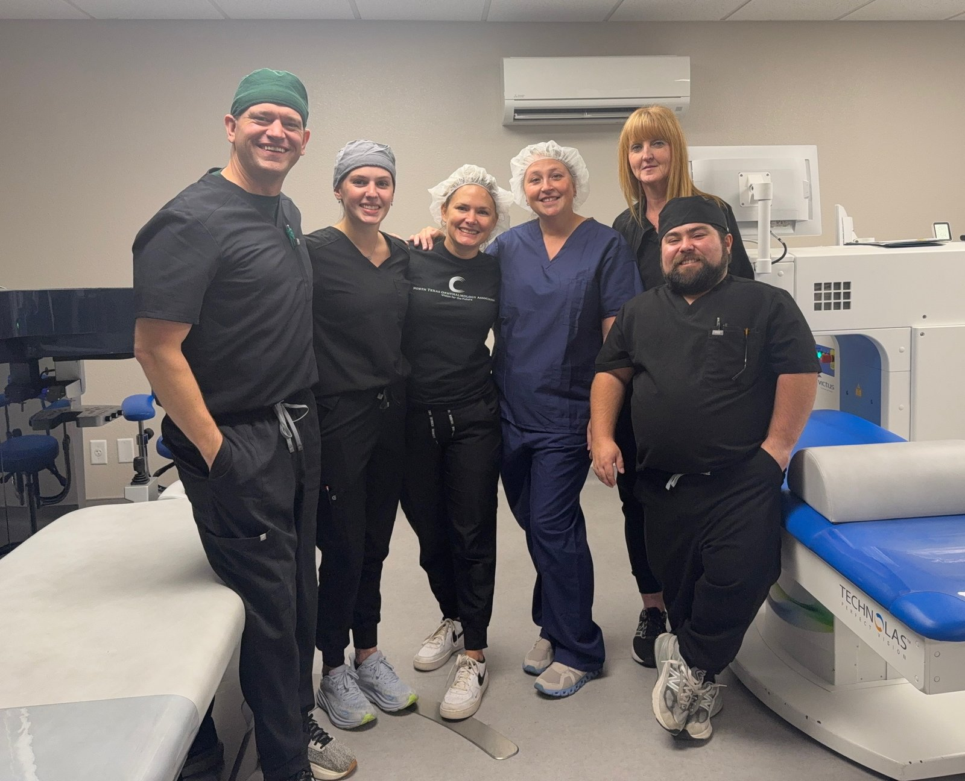
COMMUNITY WIN
North Texas Ophthalmology
Launched LASIK, opened a second location, turned a loss into profit
Wichita Falls. Launched LASIK as a new service line, opened a second location, and turned a $300K loss in 2025 into roughly $150K profit YTD 2026 while paying down debt.
Matt Griffiths, Director of Marketing and Technology
Implementer: Erin Thiem

Slide 14

COMMUNITY WIN
Austin Street Center
D CEO 2026 Nonprofit and Corporate Citizenship Finalist
Dallas. Record 640 housing placements in FY25 (up 25%). Record revenue in FY25, up 17% year-over-year and 36% over two years.
Daniel Roby, CEO
Implementer: Kevin Taylor

Slide 15
COMMUNITY WIN
BAT Security
Up 23% in gross revenue in the first 7 months on EOS
Waxahachie. Started Focus Day in January 2026 and posted Core Values throughout the office. Momentum has held all year.
Kyle Beller, President
Implementer: Kevin Taylor

Slide 16
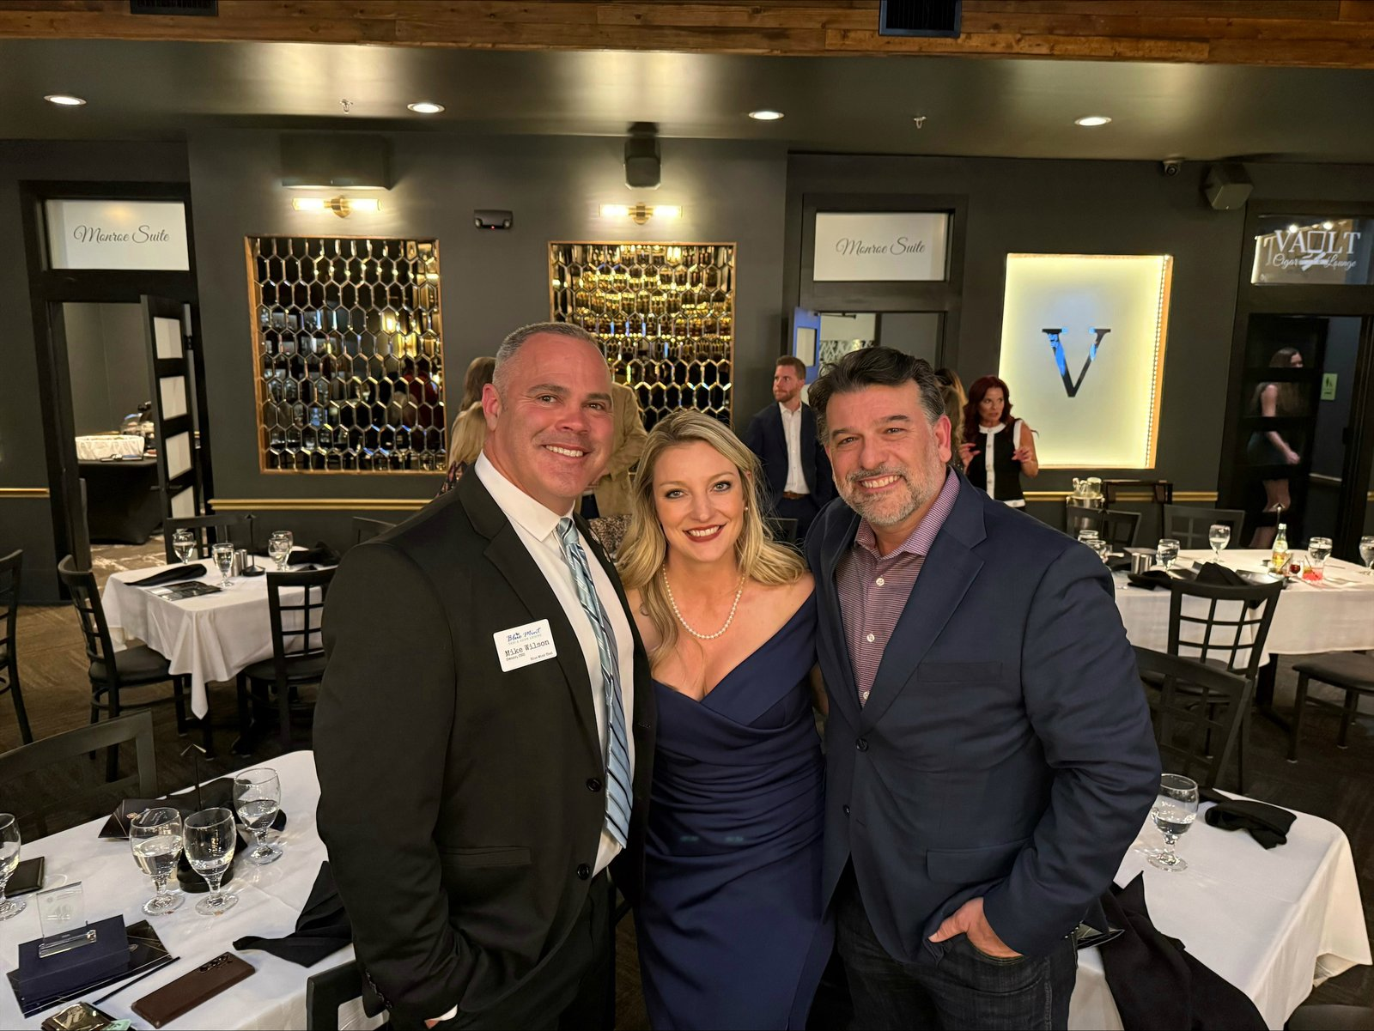
COMMUNITY WIN
Blue Mint Thai
Multi-year Best of DFW, ESGR honors, and a House Resolution
Midlothian. Best Asian Restaurant in South DFW five years running (2021–2026). ESGR Pro Patria, Patriot, and Above and Beyond awards (July 2026). House Resolution from Rep. Brian Harrison (August 2026).
Mike Wilson, CEO · Alisa Dodenhoff
Implementer: Kevin Taylor

Slide 17
COMMUNITY WIN
Rose Marketing Solutions
EO Dallas Forum Moderator of the Year
Ruth Ann Rose named Forum Moderator of the Year by EO Dallas. Featured speaker at the Hinge Brokers Shift Early Childhood Conference. On track for the highest revenue year in company history.
Ruth Ann Rose, Founder
Implementer: Amanda Matthews

Slide 18
Congratulations
to our North Texas EOS Community
We Run on EOS North Texas 2026
The Statler, Dallas · Monday, September 14, 2026

