Slide 1
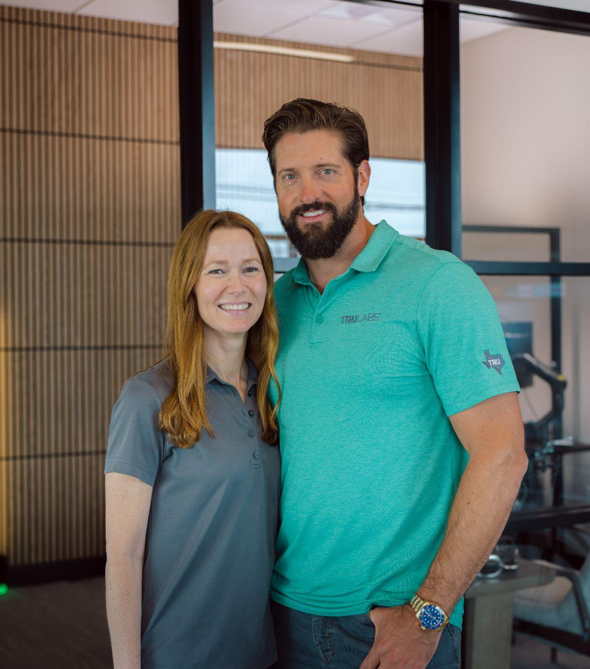

Only husband and wife team in the finals.
Previous Finalists & Winners Include
✦Amazon
✦Celsius
✦Chobani
✦Mary Ruth’s
✦Bloom
✦AG1
✦Body Armor
✦Honest Company
TRULABS | CONFIDENTIAL
‹#›

