Slide 1

2026
FIFTH ANNUAL · SEPTEMBER 14, 2026 · THE STATLER DALLAS
Six Keys to Getting What You Want from your Entrepreneurial Company
Ann Sheu, Certified EOS Implementer®
ann.sheu@EOSWorldwide.com
eosnorthtexas.com
#WeRunOnEOS2026
Notes:
Title slide. Replace the title, your name, and handle. Leave the logo, event line, and footer as they are.

Slide 2

Session Agenda
01
Get REAL
02
Keep it SIMPLE
03
Get RESULTS
04
Q&A
#WeRunOnEOS2026
Notes:
Session agenda. Swap in your own segments — three to five rows works best. Delete rows you do not need.

Slide 3
2026
Get
REAL
#WeRunOnEOS2026
Notes:
Section break. Replace the two lines with your section name — keep the flame/orange two-tone. Duplicate this slide for each section.

Slide 4

Get REAL
You
Me
Brief history
Discoveries
#WeRunOnEOS2026
Notes:
Text and photo. Drag a high-resolution photo (1 MB or larger) onto the right panel. Keep the text to three short points.

Slide 5





Frustrations
Control
Profit
People
Hitting the ceiling
Nothing’s working
#WeRunOnEOS2026

Slide 6
2026
Keep it
SIMPLE
#WeRunOnEOS2026
Notes:
Section break. Replace the two lines with your section name — keep the flame/orange two-tone. Duplicate this slide for each section.

Slide 7








The EOS Model®
2026
#WeRunOnEOS2026

Slide 8
“
Vision without traction is hallucination.
— GINO WICKMAN
#WeRunOnEOS2026
Notes:
Quote slide. One or two sentences at most. Update the attribution name and title.

Slide 9
100%
The EOS Model®
Goal 80%
0%
2026
#WeRunOnEOS2026

Slide 10
100%
The EOS Model®
Most
20%
0%
2026
#WeRunOnEOS2026

Slide 11


The EOS Model®
8 Questions
2026
#WeRunOnEOS2026

Slide 12
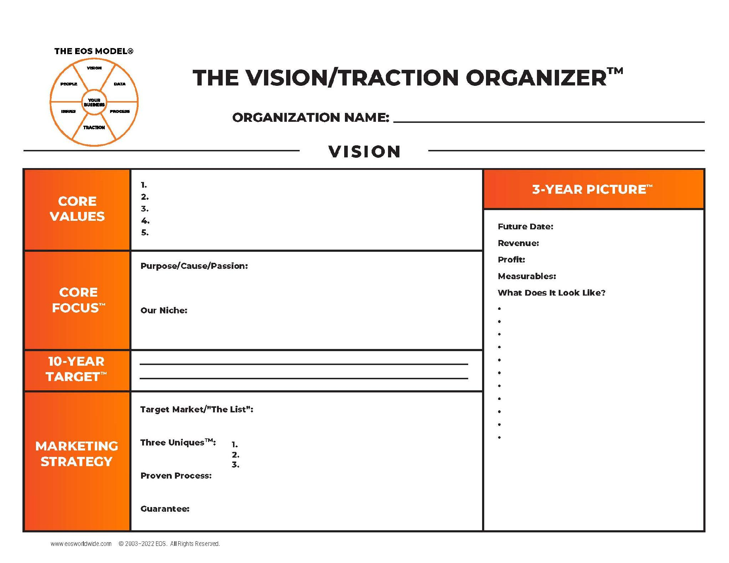
The Vision/Traction Organizer™
2026
#WeRunOnEOS2026
Notes:
Big graphic. Drop in a diagram, chart, or screenshot — it will aspect-fit, never stretch. Arrange or crop as needed.

Slide 13
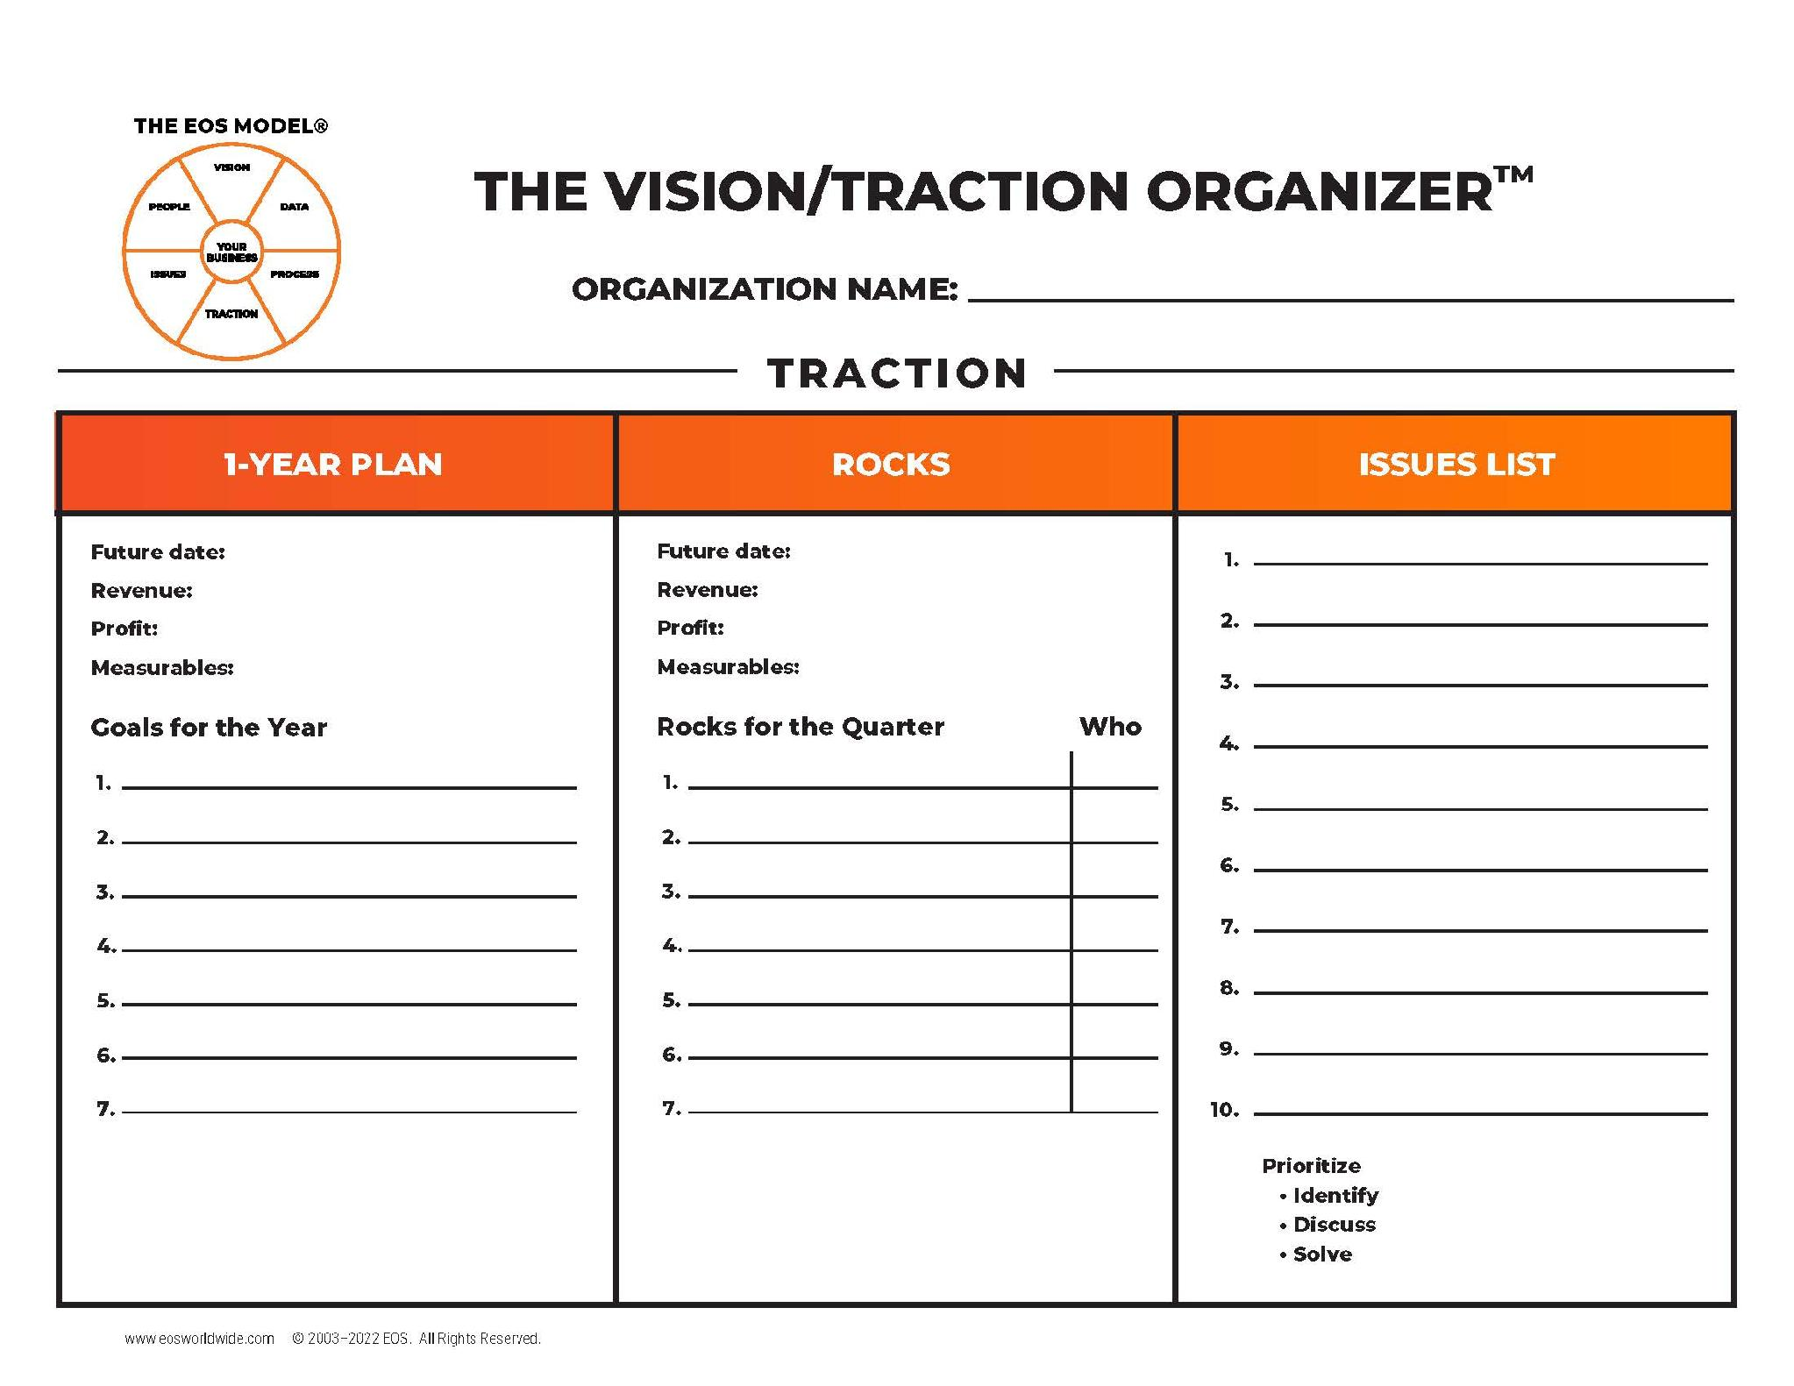
V/TO™
2026
#WeRunOnEOS2026
Notes:
Big graphic. Drop in a diagram, chart, or screenshot — it will aspect-fit, never stretch. Arrange or crop as needed.

Slide 14
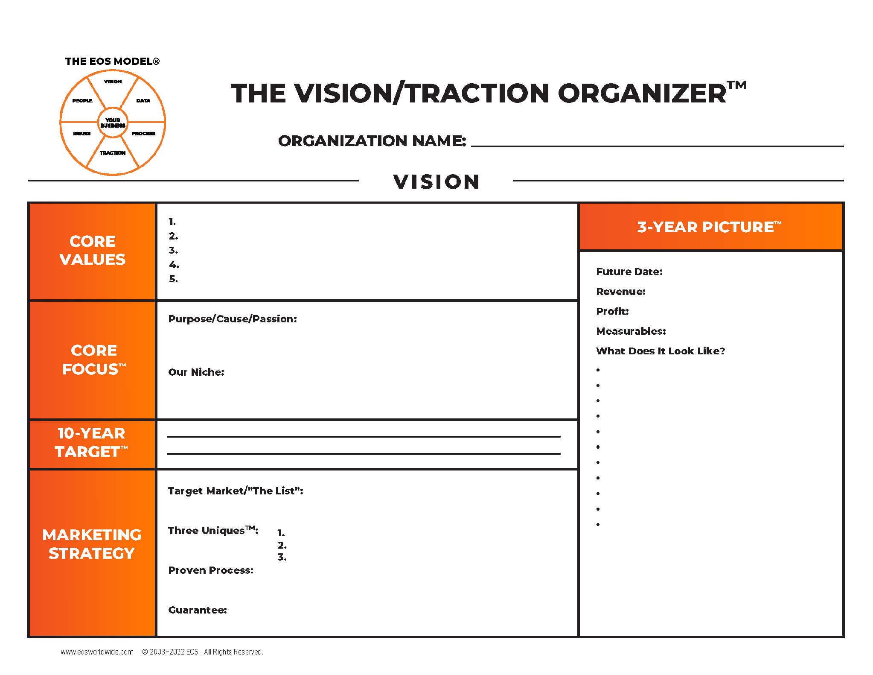
V/TO™
Discover
Define
Live and Breathe
2026
#WeRunOnEOS2026
Notes:
Big graphic. Drop in a diagram, chart, or screenshot — it will aspect-fit, never stretch. Arrange or crop as needed.

Slide 15
V/TO™
2026
#WeRunOnEOS2026
Notes:
Big graphic. Drop in a diagram, chart, or screenshot — it will aspect-fit, never stretch. Arrange or crop as needed.

Slide 16
V/TO™
What do you want from your business?
5-30 years out
#1 Goal
2026
#WeRunOnEOS2026
Notes:
Big graphic. Drop in a diagram, chart, or screenshot — it will aspect-fit, never stretch. Arrange or crop as needed.

Slide 17
V/TO™
2026
#WeRunOnEOS2026
Notes:
Big graphic. Drop in a diagram, chart, or screenshot — it will aspect-fit, never stretch. Arrange or crop as needed.

Slide 18
V/TO™
2026
#WeRunOnEOS2026
Notes:
Big graphic. Drop in a diagram, chart, or screenshot — it will aspect-fit, never stretch. Arrange or crop as needed.

Slide 19
V/TO™
2026
#WeRunOnEOS2026
Notes:
Big graphic. Drop in a diagram, chart, or screenshot — it will aspect-fit, never stretch. Arrange or crop as needed.

Slide 20
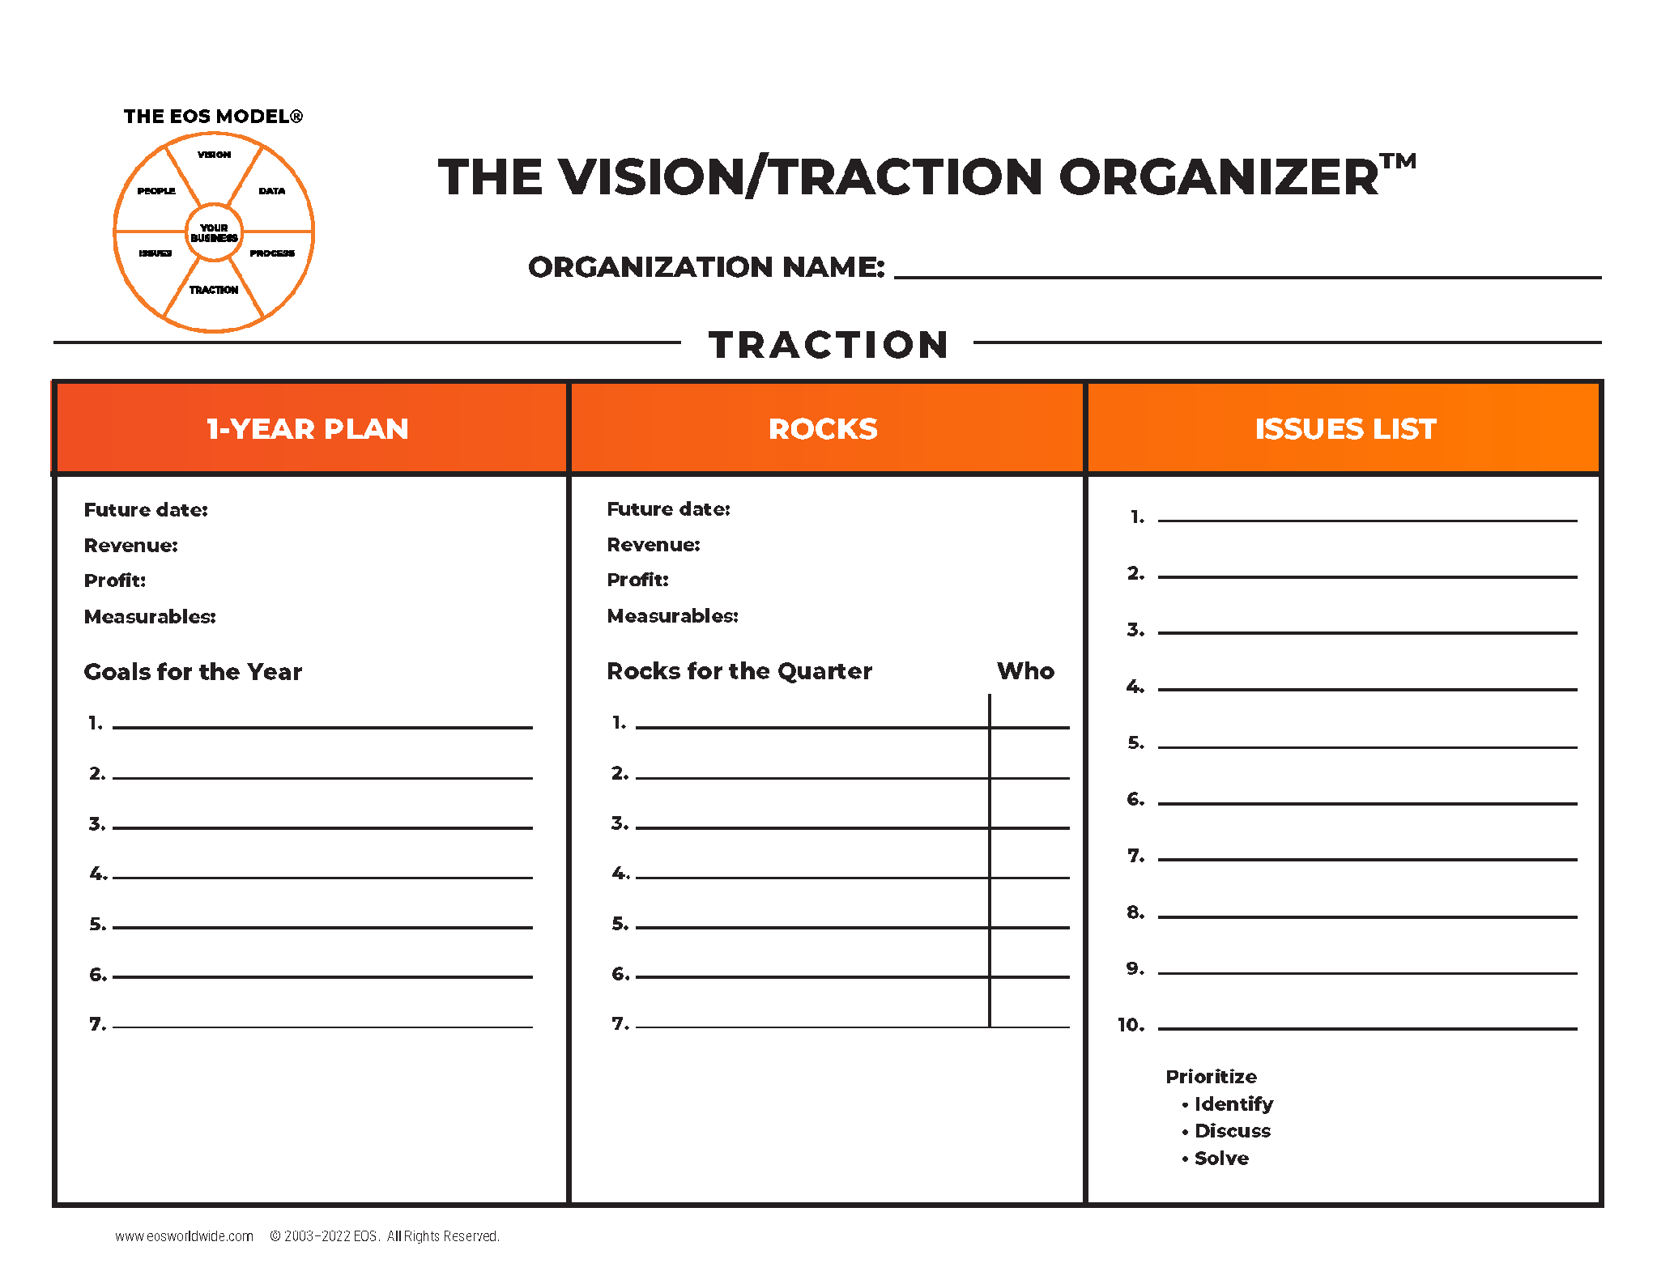
V/TO™
2026
#WeRunOnEOS2026
Notes:
Big graphic. Drop in a diagram, chart, or screenshot — it will aspect-fit, never stretch. Arrange or crop as needed.

Slide 21
V/TO™
2026
#WeRunOnEOS2026
Notes:
Big graphic. Drop in a diagram, chart, or screenshot — it will aspect-fit, never stretch. Arrange or crop as needed.

Slide 22
V/TO™
2026
#WeRunOnEOS2026
Notes:
Big graphic. Drop in a diagram, chart, or screenshot — it will aspect-fit, never stretch. Arrange or crop as needed.

Slide 23
The EOS Model®
100% Strong
8 Questions
Shared by All
2026
#WeRunOnEOS2026

Slide 24
The EOS Model®
Right People
2026
#WeRunOnEOS2026

Slide 25
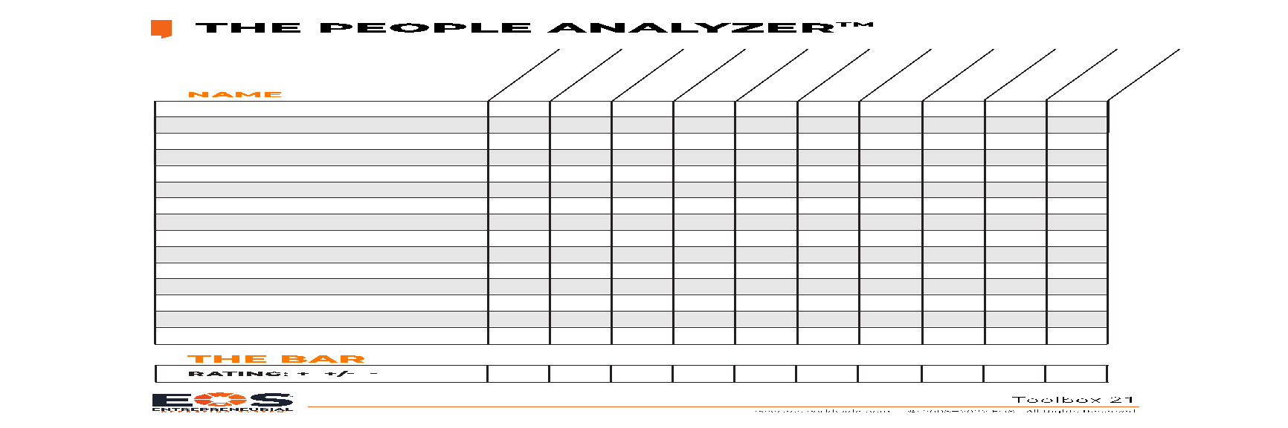

THE PEOPLE ANALYZER™
Humbly confident
Do the right thing
Grow or Die
Do what you say
Help First
NAME
Maria Rodriguez
+ + + + +
John Smith
- +/- - - +/-
George Wilson
+/- +/- + +/- +
THE BAR
Rating + +/- -
+
+/–
+
+/–
+
2026
#WeRunOnEOS2026

Slide 26
The EOS Model®
Right People
Right Seats
2026
#WeRunOnEOS2026

Slide 27
“
“Structure first, people second.”
— GINO WICKMAN
#WeRunOnEOS2026
Notes:
Quote slide. One or two sentences at most. Update the attribution name and title.

Slide 28
Accountability Chart™
VISIONARY
INTEGRATOR
MARKETING/SALES
OPERATIONS
FINANCE
2026
#WeRunOnEOS2026

Slide 29
Right Seats
Function
Name
Role
Role
Role
Role
Role
2026
#WeRunOnEOS2026

Slide 30
Right Seats
Marketing/Sales
Gets It
Wants It
Capacity to Do It
G
W
C
Name
LMA™
Marketing
Hit sales numbers
Sell
Account management
2026
#WeRunOnEOS2026

Slide 31
THE PEOPLE ANALYZER™
Humbly confident
Do the right thing
Help First
Do what you say
Grow or Die
GETS IT
WANTS IT
VALUE
CAPACTIY
VALUE
NAME
Maria Rodriguez
+ + + + +
Y
Y
Y
John Smith
- +/- - - +/-
Y
Y
N
George Wilson
+/- +/- + +/- +
N
Y
Y
THE BAR
Rating + +/- -
+
+/–
+
+/–
+
2026
#WeRunOnEOS2026
Notes:
Big graphic. Drop in a diagram, chart, or screenshot — it will aspect-fit, never stretch. Arrange or crop as needed.

Slide 32
Right Seats
Function
Name
Role
Role
Role
Role
Role
2026
#WeRunOnEOS2026

Slide 33
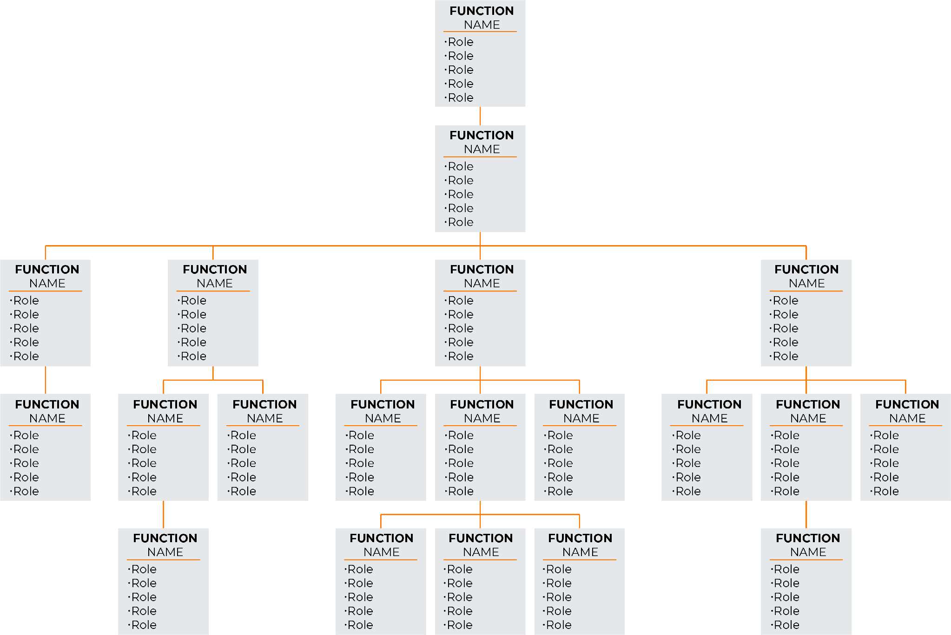
Right Seats
2026
#WeRunOnEOS2026

Slide 34
Two Kinds of People Issues
Right Person, Wrong Seat
Wrong Person, Right Seat
2026
#WeRunOnEOS2026
Notes:
Full-width bullets. Five bullets max, one line each. Use the indented row for a rare second level.

Slide 35
The EOS Model®
100% Strong
Right People
Right Seats
2026
#WeRunOnEOS2026

Slide 36
The EOS Model®
2026
#WeRunOnEOS2026

Slide 37
“
If we have data, let’s look at the data.
If all we have are opinions, let’s go with mine.
— JIM BARKSDALE,
former Netscape CEO
#WeRunOnEOS2026
Notes:
Quote slide. One or two sentences at most. Update the attribution name and title.

Slide 38
The EOS Model®
Scorecard
2026
#WeRunOnEOS2026

Slide 39
Right Seats
WHO
MEASURABLES
GOAL
30
-
Sep
7
-
Oct
14
-
Oct
21
-
Oct
28
-
Oct
4
-
Nov
11
-
Nov
18
-
Nov
25
-
Nov
2
-
Dec
9
-
Dec
16
-
Dec
23
-
Dec
Anne
Weekly Revenue
>=$84,500
$92,000
$85,238
$81,200
$80,934
$88,678
$88,200
$85,321
$80,282
$95,291
$100,281
$86,200
$78,290
$83,498
Anne
Cash Balance
>=$14,245
$16,230
$15,200
$12,289
$11,989
$14,980
$15,123
$14,989
$11,291
$17,281
$18,359
$15,289
$10,221
$11,189
Robert
Sales Calls
50
54
55
61
59
32
48
51
72
61
54
50
52
54
Robert
Sales Meetings
10
10
10
10
8
10
10
12
11
15
10
9
8
8
Robert
Proposal
5
5
5
6
5
6
5
6
4
5
8
6
5
5
Robert
Closed Business
2
2
3
6
3
2
3
5
3
2
1
2
8
4
David
Customer Satisfaction
>=80%
80%
80%
80%
80%
80%
80%
80%
80%
80%
80%
80%
80%
80%
Claire
Accounts Payable
<$8,000
$8,450
$9,234
$3,450
$5,500
$4,300
$8,900
$2,300
$5,409
$4,390
$9,032
$3,445
$2,300
$5,009
David
Errors
<=4
3
2
2
2
2
1
2
3
0
0
0
2
1
John
Utilization/Capacity
>75%
75%
76%
75%
75%
75%
75%
75%
82%
75%
75%
78%
75%
75%
2026
#WeRunOnEOS2026

Slide 40
Scorecard Measurables
Weekly Revenue
Cash Balance
Sales Calls
Sales Meetings
Proposals
Closed Business
Customer Rating
Accounts Receivable
Accounts Payable
Errors
Utilization Rates
Web Conversions
2026
#WeRunOnEOS2026
Notes:
Full-width bullets. Five bullets max, one line each. Use the indented row for a rare second level.

Slide 41
The EOS Model®
100% Strong
Scorecard
Measurables
2026
#WeRunOnEOS2026

Slide 42
The EOS Model®
2026
#WeRunOnEOS2026

Slide 43
The EOS Model®
Issues List
IDS™
2026
#WeRunOnEOS2026

Slide 44
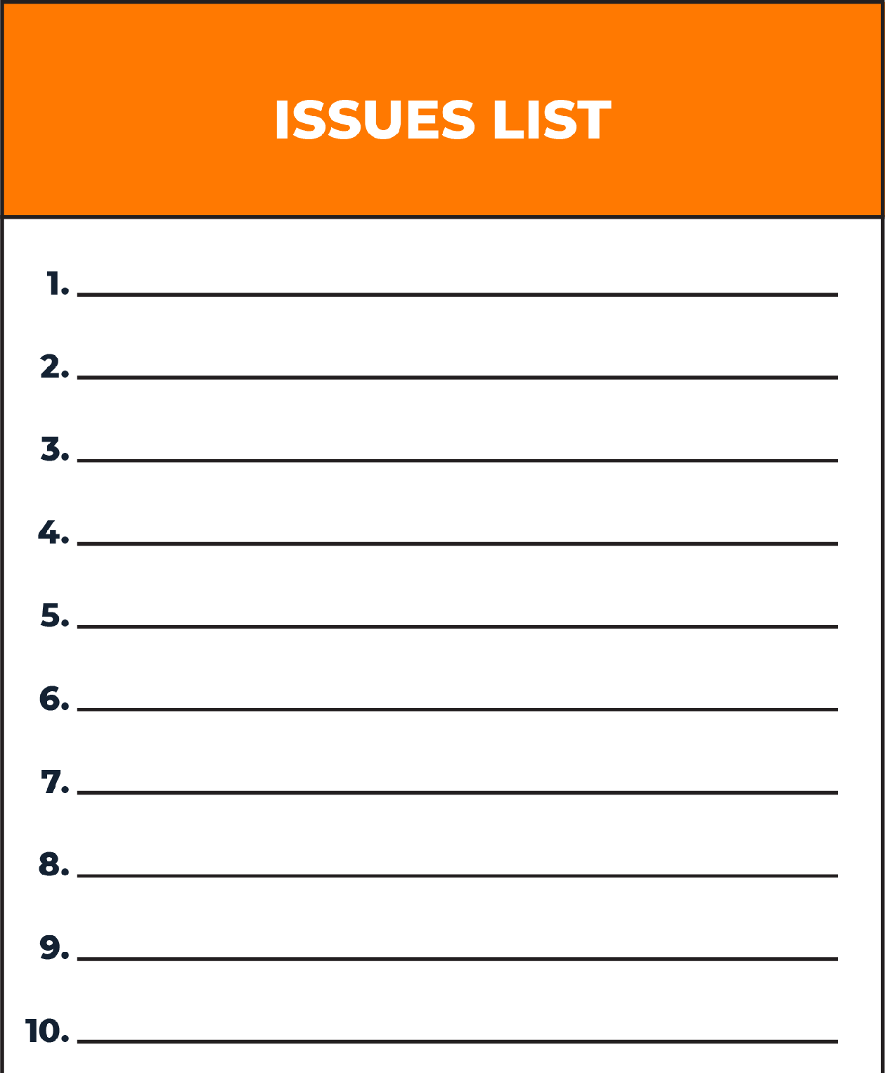
Issues Solving Track
• Identify
• Discuss
• Solve
• I
• D
• S
2
Website Rock off-track
Darren U. Right Person
1
Andi S. Right Seat
Sales off-track
3
Anodyne Merger
Utilization off-track
Western US expansion
2026
#WeRunOnEOS2026

Slide 45
The EOS Model®
100% Strong
Issues List
IDS
2026
#WeRunOnEOS2026

Slide 46
The EOS Model®
Documented
2026
#WeRunOnEOS2026

Slide 47

Handful of Core Processes
People
Marketing
Sales
Operations 1
Operations 2
Accounting
Customer Service
#WeRunOnEOS2026
Notes:
Text and photo. Drag a high-resolution photo (1 MB or larger) onto the right panel. Keep the text to three short points.

Slide 48
Document and Simplify
Table of Contents
People
Marketing
Sales
Operations
Operations
Accounting
Customer Service
2026
#WeRunOnEOS2026

Slide 49
Document
and Simplify
People Process
ID Need ____________
Define Seat ____________ ____________
Hiring ____________ ____________
On-Boarding/ ____________
Training ____________
LMA ____________ ____________
Termination ____________ ____________
Sales Process
New Lead ____________
Initial Call/ ____________
Qualify ____________
____________
Fit Meeting ____________
____________
Proposal ____________
____________
Win/Lose ____________
____________
2026
#WeRunOnEOS2026

Slide 50
“Your Company Way”
Table of Contents
People
Marketing
Sales
Operations
Operations
Accounting
Customer Service
People Process
ID Need ____________
Define Seat ____________
____________
Hiring ____________
____________
On-Boarding/ ____________
Training ____________
LMA ____________
____________
Termination ____________
____________
2026
#WeRunOnEOS2026

Slide 51
“
“Systemize the predictable
so you can humanize the exceptional.”
— ISADORE SHARP,
founder of Four Seasons Hotels
#WeRunOnEOS2026
Notes:
Quote slide. One or two sentences at most. Update the attribution name and title.

Slide 52
The EOS Model®
Documented
Followed by All
2026
#WeRunOnEOS2026

Slide 53


FBA Checklist
Train
Measure
LMA
Update
#WeRunOnEOS2026

Slide 54
The EOS Model®
100% Strong
Documented
Followed by All
2026
#WeRunOnEOS2026

Slide 55
The EOS Model®
Rocks
Meeting Pulse
2026
#WeRunOnEOS2026

Slide 56

Meeting Pulse™
90-Day World™
Meeting Pulse
Same Day
Same Time
Start on Time
End on Time
Same Agenda
#WeRunOnEOS2026
Notes:
Text and photo. Drag a high-resolution photo (1 MB or larger) onto the right panel. Keep the text to three short points.

Slide 57

Level 10 Meeting™
Good News 5 Minutes
Scorecard 5 Minutes
Rock Review 5 Minutes
Customer & Employee Headlines 5 Minutes
To Do List 5 Minutes
Reporting Only
Issues List/IDS 60 Minutes
Conclude 5 Minutes
2026
#WeRunOnEOS2026

Slide 58
The EOS Model®
100% Strong
Rocks
Meeting Pulse
2026
#WeRunOnEOS2026

Slide 59
The EOS Model®
2026
#WeRunOnEOS2026

Slide 60
2026
Get
RESULTS
#WeRunOnEOS2026
Notes:
Section break. Replace the two lines with your section name — keep the flame/orange two-tone. Duplicate this slide for each section.

Slide 61
The EOS Model®
2026
#WeRunOnEOS2026

Slide 62

EOS Foundational Tools™
V/TO
Accountability Chart
Rocks
Meeting Pulse
Scorecard
#WeRunOnEOS2026
Notes:
Text and photo. Drag a high-resolution photo (1 MB or larger) onto the right panel. Keep the text to three short points.

Slide 63
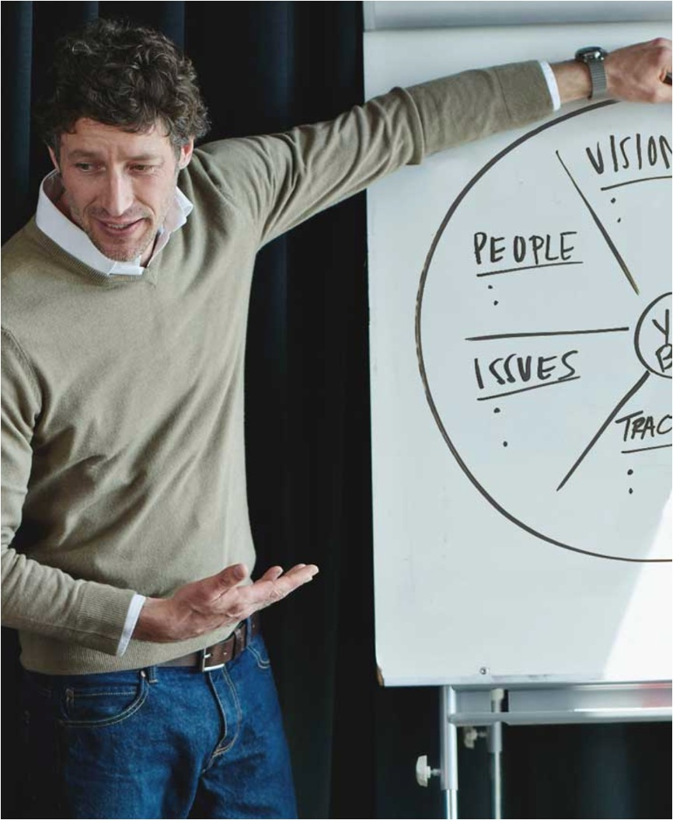
Resources
EOSWorldwide.com
Traction Library
Downloadable tools and videos
Base Camp
EOS Implementers
#WeRunOnEOS2026
Notes:
Text and photo. Drag a high-resolution photo (1 MB or larger) onto the right panel. Keep the text to three short points.

Slide 64

Final Thoughts
Choose — and Use — a System
Get What You Want – your #1 Goal
#WeRunOnEOS2026
Notes:
Text and photo. Drag a high-resolution photo (1 MB or larger) onto the right panel. Keep the text to three short points.

Slide 65
“
“I’ve never felt so alive and in control. I own the vision for my future and the ability to share it with others and get them on board.
Here's the best part—I'm 41 years old! I can only imagine what is possible.”
—– VISIONARY,
EOS Client in Minnesota
#WeRunOnEOS2026
Notes:
Quote slide. One or two sentences at most. Update the attribution name and title.

Slide 66
2026
Q&A
#WeRunOnEOS2026
Notes:
Section break. Replace the two lines with your section name — keep the flame/orange two-tone. Duplicate this slide for each section.

Slide 67
2026
Thanks, y’all!
FIFTH ANNUAL · SEPTEMBER 14, 2026 · THE STATLER DALLAS
ann.sheu@EOSWorldwide.com
eosnorthtexas.com
#WeRunOnEOS2026
Notes:
Closing slide. Swap in your handle so the room can find you.

Slide 68














Thank You to Our Sponsors
TITLE SPONSORS
BOOK SPONSORS
HAPPY HOUR SPONSOR
SWAG BAG SPONSORS
BOOTH SPONSORS
2026
#WeRunOnEOS2026
Notes:
Sponsor thank-you. Logos are current as of the 2026 site — keep this slide as-is and show it at the end of your session.

Slide 69

Session Survey
Scan the code to share quick feedback on this session.
Thank you for your feedback.
#WeRunOnEOS2026
Notes:
Session survey. Drop the survey QR code onto the white card. Leave this up while you take questions.

