Slide 1

2026
FIFTH ANNUAL · SEPTEMBER 14, 2026 · THE STATLER DALLAS
The Journey from Self-Implementing to Working with an EOS Implementer®
Brian Dosal, CEO + Integrator, Strety
linkedin.com/in/bdosal/
eosnorthtexas.com
#WeRunOnEOS2026

Slide 2

Session Agenda
01
Opening topic
Going from self-implementing to working with an implementer
02
Main idea
What we did well, what we missed, what changed
03
Application
Find your implementation blind spots and go after them
04
Q&A
Leave five to ten minutes for questions
2026
#WeRunOnEOS2026

Slide 3
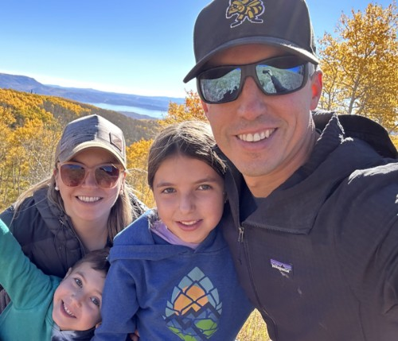
About Me
2nd Time SaaS Founder, sold co #1 in 2019 after 9 years. Ran on EOS from 2016
CEO, CoFounder, Product Guy, Integrator, Chief Whatever is Needed
Bootstrapped 2x — big DIY guy (self-implementer)
Live in Park City, UT. Originally from Miami, FL
#WeRunOnEOS2026

Slide 4
“
I’ve been documenting our real journey from self-implementing EOS to working with Lisa González as our Implementer. I’m sharing my biggest takeaways so far. This talk is candid, not prescriptive.
#WeRunOnEOS2026

Slide 5
About This Talk
What we did well
What we missed
What changed
2026
#WeRunOnEOS2026

Slide 6
2026
Level Setting on My
Experience with EOS®
What self-implementing EOS taught us before we ever had an Implementer
#WeRunOnEOS2026

Slide 7
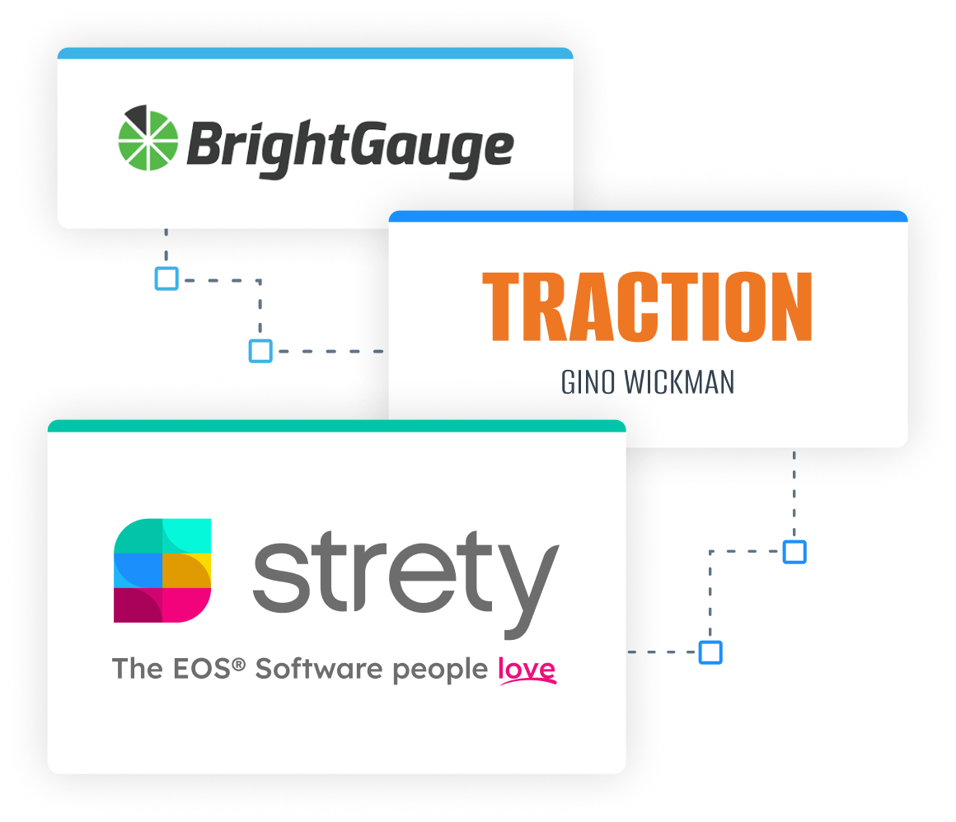
A Decade of Self-Implementation
Founded BrightGauge, an analytics software in 2010
Grew slowly... and then all of a sudden
Looked for a way to keep our growth calm
Got handed Traction at a conference in 2016
Built Strety v0 as an internal tool
Exited BrightGauge, semi-retired, back in the software business with Strety live in fall of 2023
Self-implementing through it all
#WeRunOnEOS2026

Slide 8
Our EOS Adoption at BrightGauge
Big on L10s
Started holding quarterlies and annuals ourselves
Sat in on a sister company implementation of EOS with EOS Implementer
Just focused on getting the right language together, rolling it out organically and the pieces that fit for me.
2026
#WeRunOnEOS2026

Slide 9
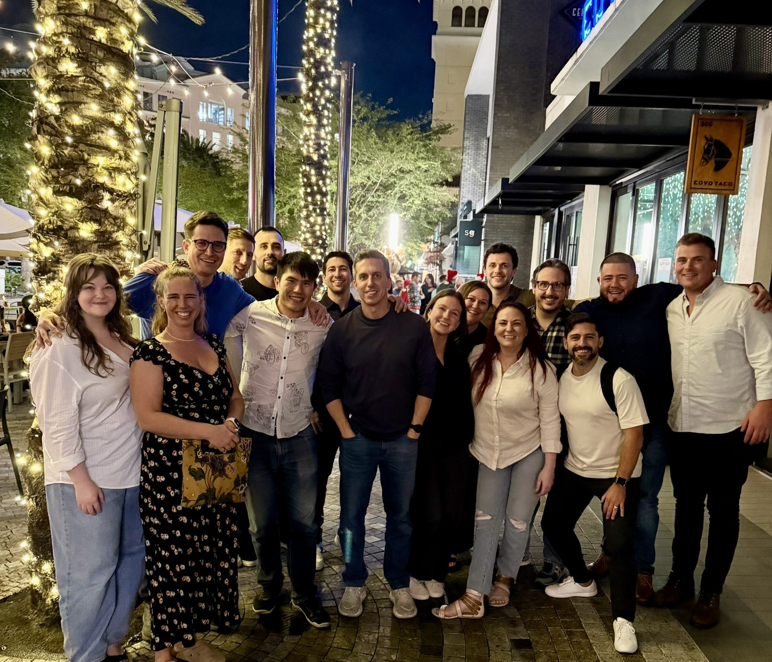
Strety, the Company
Started in 2023 and launched end of same year
Now 22 Full time folks, 10 of which from previous company
Started with 3, then to 8/9 in year, then to about 20 quickly
Didn’t feel the EOS pain until teams split up and I no longer could be in all L10s
#WeRunOnEOS2026

Slide 10
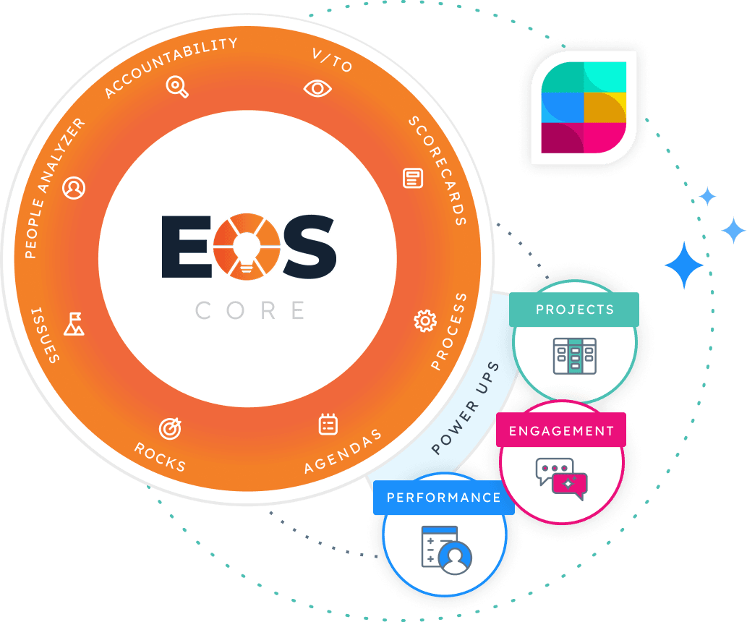
Strety, the product
EOS Software Platform
Power Ups are a major hit! Stopping SaaS sprawl.
Integrations, Integrations, Integrations
First licensee post exclusive license
Thousands of paying customers, about 200 per month, and many from other platforms
#WeRunOnEOS2026

Slide 11
2026
What We Got Right as
Self-Implementers
The wins worth celebrating from our EOS journey
#WeRunOnEOS2026

Slide 12
Core Values + Right People, Right Seats
Didn't treat core values as a vibe check — treated it as a non-negotiable
Hired slower than was comfortable
Moved people when seats weren't right
Chose short-term pain over long-term drag
A clean people foundation made self-implementation far more stable than it might have been.
2026
#WeRunOnEOS2026

Slide 13
“
“Almost right” always costs you later — usually when the stakes are higher and emotions are more tangled.
#WeRunOnEOS2026

Slide 14
My Favorite Tool: The Level 10 Meeting®
We respected the pulse: Same day. Same time. L10s were not optional.
Async prep in Strety helped protect IDS® time.
IDS was always honest — and productive
Comfortable saying “I think that’s on you”
Clear on who owns the outcome and who owns the decision
2026
#WeRunOnEOS2026

Slide 15
“
For self-implementers, I say implement the meetings first — that discipline sets the tone for how to run EOS.
#WeRunOnEOS2026

Slide 16
We Grew Calmly
The process works.
Self-implementing was transformational — not naive, not winging it
Helped scale BrightGauge and build Strety faster than we would have guessed
But there were blind spots we didn't know were blind spots…
2026
#WeRunOnEOS2026

Slide 17
We Were Stuck in The Startup Mindset Trap
“Long-range planning always felt a little fake to me.”
Things change constantly. Products evolve fast. Why debate what things might look like three years from now when something will change in six months?
So we defaulted to something vague and inspiring… and trusted we’d figure out the details.
Our V/TO was piecemeal… we always figured it was good enough.
Our Process Component® lived… almost entirely in our heads.
EOS Purity was too rigid for a fast-moving startup like us!
2026
#WeRunOnEOS2026

Slide 18
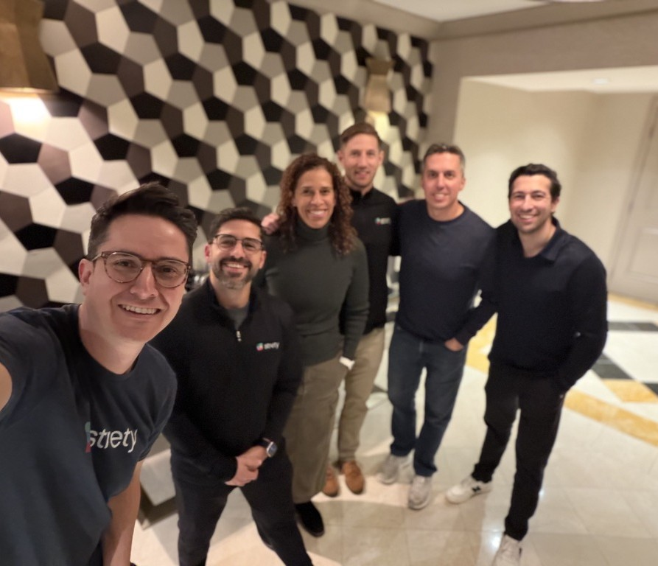
Why did we move to using an Implementer?
Our first Implementer-led session with Lisa González blew my mind in the best way. Here are the biggest a-has from the journey of transitioning to implementer-led.
We were constantly asked…
A local Implementer friend gave me unsolicited tips
Great Boss Workshop blew my mind
Met Lisa in Denver at a dinner and hit it off
I was always curious
#WeRunOnEOS2026

Slide 19
2026
What we learned quickly…
the aha moments
Our first Implementer-led session with Lisa González blew my mind in the best way. Here are the biggest a-has from the journey of transitioning to Implementer-led.
#WeRunOnEOS2026

Slide 20
“
No tech in the room is the only way.
A-HA #1
For a software CEO, this is literally mind-blowing.
#WeRunOnEOS2026

Slide 21
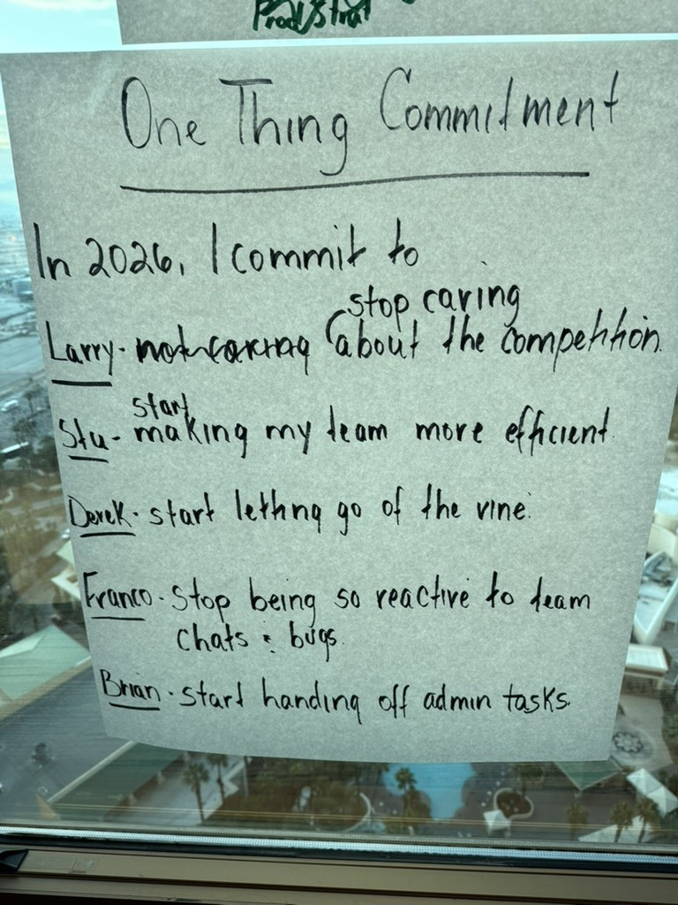
Sometimes the Best Tech is Post-Its
Markers and giant post-it notes filled up the walls
8 hours of focused work — not once did I feel tech was missing
Different city + same room all day = quality of conversation changed
Everything critical was captured and easy to pick up later in Strety
#WeRunOnEOS2026

Slide 22
“
Facilitation lifted the mental load.
A-HA #2
I could just be present. Listen, think, participate, engage.
#WeRunOnEOS2026

Slide 23
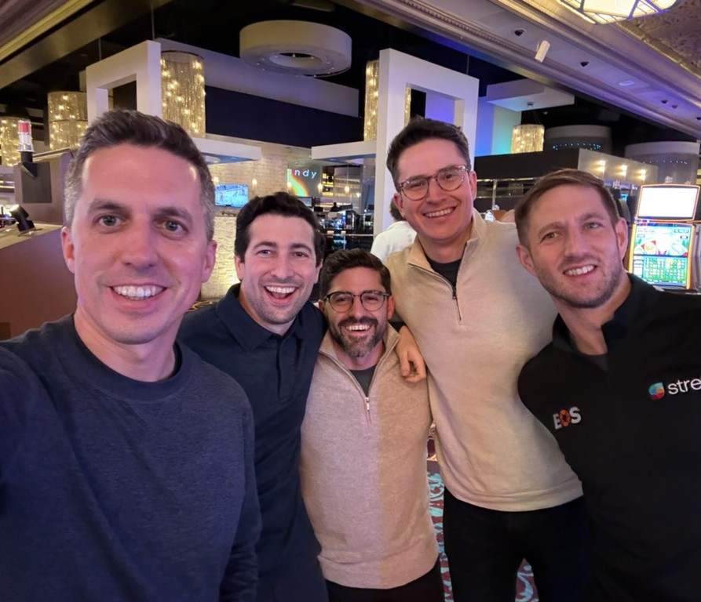
What Self-Facilitating Actually Costs You
Running the agenda + watching the clock + thinking about what’s next + refereeing participation
Skimping on parts you don’t feel are as relevant (count me guilty)
You don’t notice the mental load until someone takes it off your plate
More engagement, more focus, completely different energy in the room
Teachers, facilitators, coaches — not consultants
#WeRunOnEOS2026

Slide 24
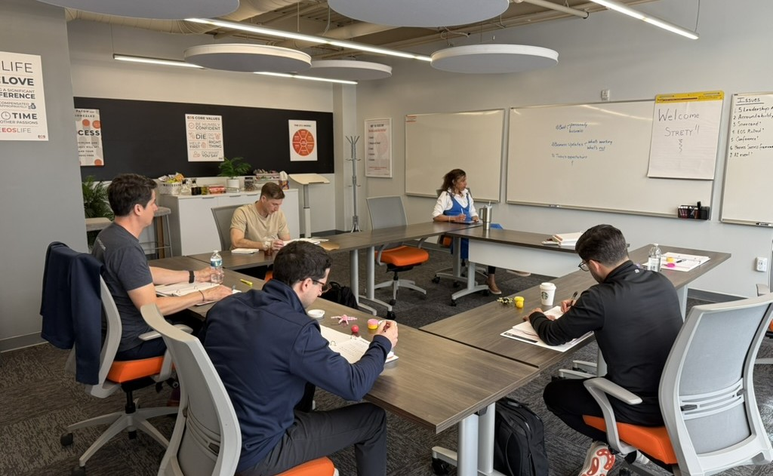
We levelled up Quarterlies
2026
#WeRunOnEOS2026

Slide 25
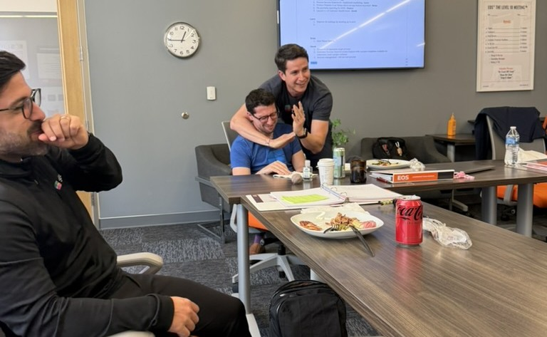
We can still be ourselves
2026
#WeRunOnEOS2026

Slide 26
“
More Tools to Use (and Use Better) in the EOS Toolbox™.
A-HA #3
An Implementer brought structure we didn't know we were missing.
#WeRunOnEOS2026

Slide 27
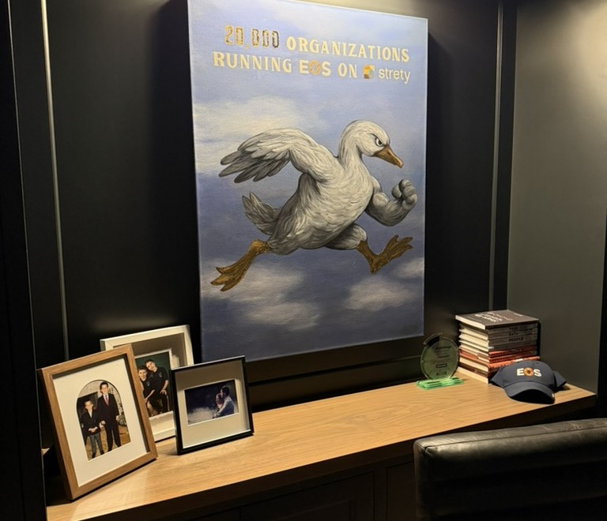
The V/TO™ Finally Clicked
“How will this company look so we all still love working here?”
The 3-Year Picture wasn’t constraining — it gave us a foundation of clarity that made shorter-term planning feel relevant.
1-Year Plan → grounded checkpoint. Rocks → conscious bets we chose as a team.
For the first time, these all felt truly grounded and connected, instead of a hodgepodge of Rocks *hoping* to add up to a true bigger picture.
#WeRunOnEOS2026

Slide 28
Process Became a Growth Multiplier
Delegation
You’re delegating a clearly defined way, not guessing
Automation
Steps laid out = automation candidates highlight themselves
Accountability
When the “how” is explicit, it stops being personal
Training
Focus on sub-processes and steps, not memorizing edge cases
2026
#WeRunOnEOS2026

Slide 29
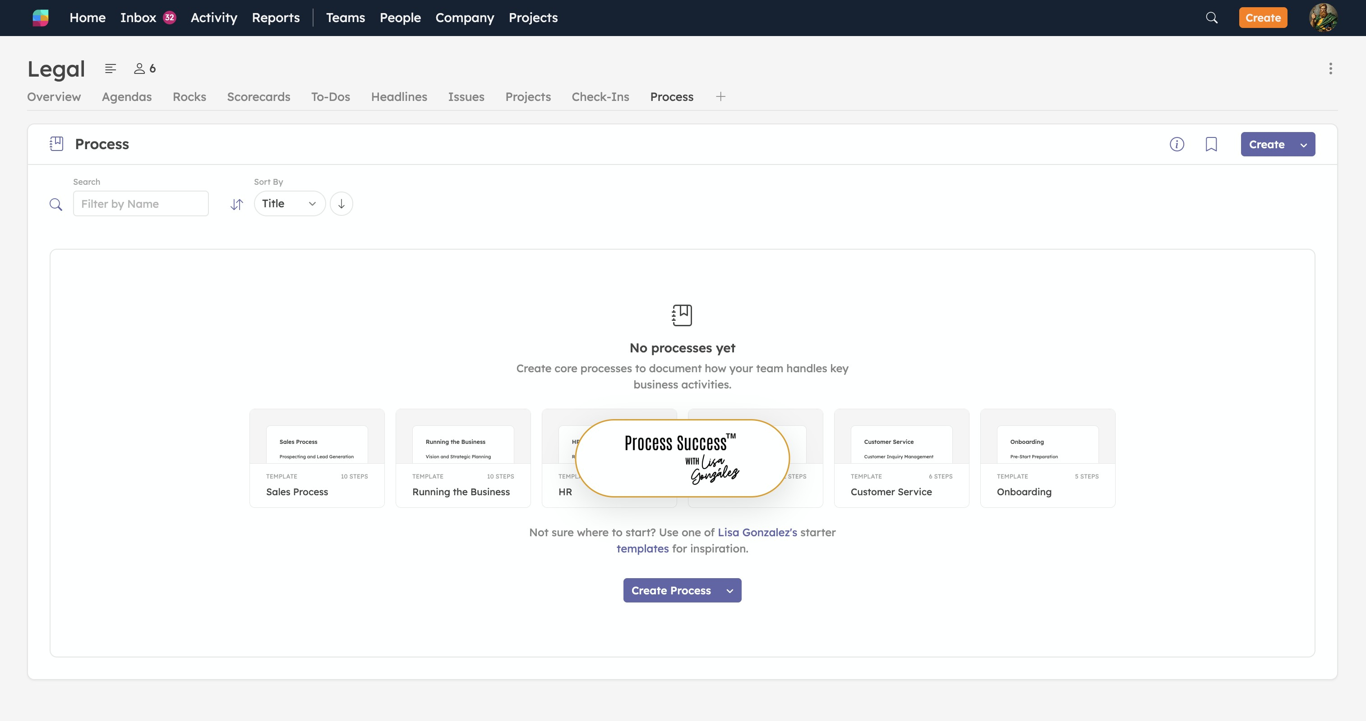
Process Became a Growth Multiplier (in the product, too!)
2026
#WeRunOnEOS2026

Slide 30
2026
What I Wish I Knew
Sooner
Here are the biggest things I missed as a self-implementer. Self-implementers, take note and learn from my mistakes!
#WeRunOnEOS2026

Slide 31
Stop Engineering Elegance
“Use it how you want to see it.”
I spent energy making Rocks, Measurables, and Goals perfectly clean.
I avoided overlap, sweated the details. Lisa normalized the gray areas.
Multiple ways to slice it — all valid.
Self-implementing taught me the mechanics. Being Implementer-led teaches there are multiple ways to slice it.
2026
#WeRunOnEOS2026

Slide 32
The Mental Hum of Self-Implementing
“Is this how it’s supposed to look?”
There’s a subtle mental hum.
You’re running the business but also refereeing the system.
You don’t notice the weight until someone lifts it.
#WeRunOnEOS2026

Slide 33
Everything Is an Issue
Just on a different time horizon
Write it down — free up mental space even if you won’t IDS it today
It’s not a crisis. It’s just an issue. IDS it when the timing is right.
Most stuck problems are People issues or Process issues
2026
#WeRunOnEOS2026

Slide 34
“
Idea? Problem? Challenge? Future Rock? Get it out of your head and drop it down onto the Issue list.
#WeRunOnEOS2026

Slide 35
EOS Purity is a Popular Concept — Because it Works
As a self-implementer (and a product builder), I thought EOS purity was overblown/unnecessary to get value from EOS
Talking through the places where we “flexed” with Lisa showed me differently
Purity gives you the discipline and structure that help you get the most out of EOS
2026
#WeRunOnEOS2026

Slide 36
“
Self-implementers should strive for EOS Purity more than anyone else. Without the guardrails, it’s too easy to make things harder than they need to be.
#WeRunOnEOS2026

Slide 37
Key Takeaways
Self-implementing isn't wrong — it's a stage (that can get you very far)
An Implementer lifts the mental load so you can participate
No tech in the room — then tech everywhere after
Stop engineering elegance — embrace the gray
The system works. Trust it and keep it pure if you can.
2026
#WeRunOnEOS2026

Slide 38
“
Questions?
#WeRunOnEOS2026

Slide 39
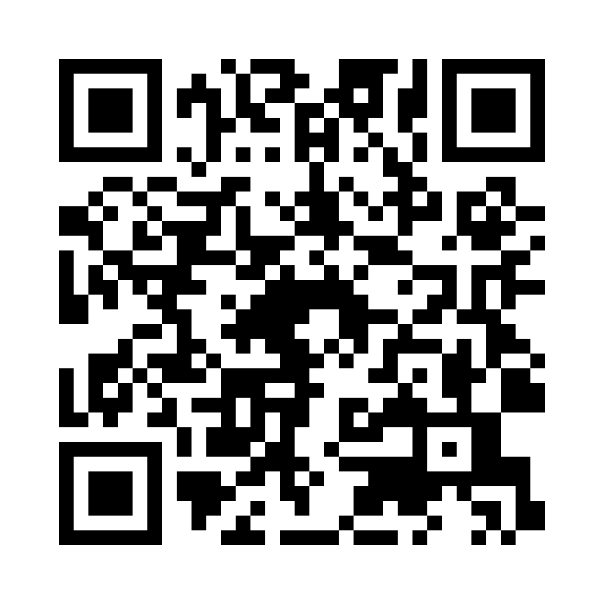
Session Survey
Scan the code to share quick feedback on this session.
Thank you for your feedback.
#WeRunOnEOS2026

Slide 40
2026
Thanks, y’all!
FIFTH ANNUAL · SEPTEMBER 14, 2026 · THE STATLER DALLAS
bdosal@strety.com
linkedin.com/in/bdosal
#WeRunOnEOS2026

