Slide 1
How (Not) to Fool Yourself with Data
Regina Nuzzo, Ph.D.
Gallaudet University
Science Journalist
Open & Reproducible Neuroscience Workshop
NIH
March 17, 2017
Regina.Nuzzo@Gallaudet.edu

Slide 2
Outline
Why this? Why now? Why here?
Which cognitive fallacies can trip you up during data analysis?
What de-biasing techniques can help?

Slide 3
Why this? A taxonomy of reproducibility
Empirical
Computational
Statistical
Stodden, IMS Bulletin (2013)

Slide 4
Why now?
“Our intuition when we start looking at 50 or hundreds of variables sucks.” –Keith Baggerly, statistician, UT MD Anderson Cancer Center
“I believe we are in the steroids era of social science.” –Andrew King, management researcher, Dartmouth College
“. . . If people seem to get remarkable results, then it raises the bar for everybody else to get equally remarkable results. Once people started routinely reporting brain-behavior correlations of 0.85, which is in actuality almost impossible, if you had a 0.4, then you were saying, ‘Gee, I’m not really doing this very well.’” –Hal Pashler, psychologist, UC San Diego
“Science is an ongoing race between our inventing ways to fool ourselves, and our inventing ways to avoid fooling ourselves.” –Saul Perlmutter, astrophycisist, UC Berkeley

Slide 5
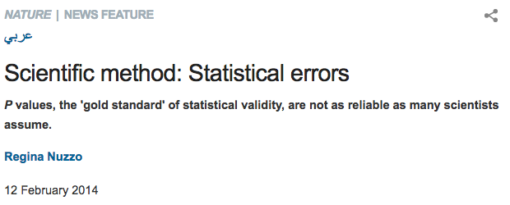

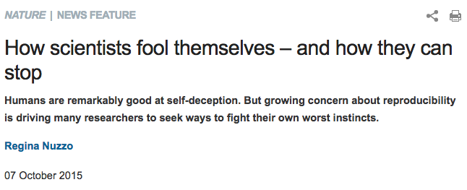

Slide 6
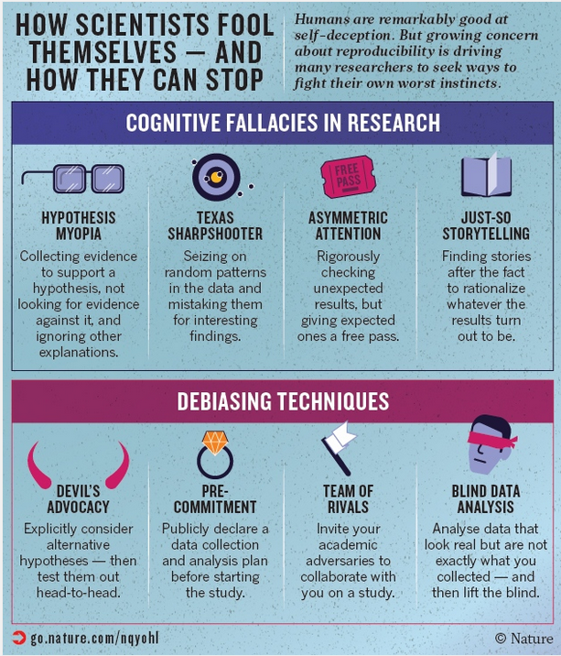

Slide 7
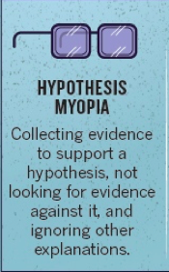
Problems

Slide 8

Overlooking many explanations
“If p, then q”
does not mean
“p is the only thing leading to q”
Fiedler, Klaus, in Social Psychology and Morality (2015)
Barletta The Nonproliferation Review (1998)
Notes:
In 1998 U.S. forensic analysts analyzed soil samples that CIA agents retrieved from around a pharmaceutical factory in Sudan and discovered traces of a chemical precursor to a deadly nerve gas EMPTA. The U.S. government, relying on this key piece of physical evidence, ordered a missile strike on the factory. One employee was killed and 11 wounded. “After they bombed the facility, the world scientific community looked at the evidence,” says forensic analysis manager Steve Velsko at Lawrence Livermore Berkeley Laboratory in California. “They realized that there were lots of alternative hypotheses that could have explained the presence of these chemicals. They could have been in the soil naturally due to fertilizer, and so on.” Yet it’s likely that when the evidence was presented to the decision makers in the government, there were no alternative hypotheses included, he says, and no expression of how the evidence supported or challenged various alternative hypotheses. Only later did officials acknowledge that their physical evidence wasn’t as solid as it had first appeared. “For policy makers, this was likely a case of confirmation bias,” Velsko says.

Slide 9
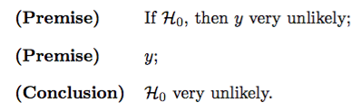
Not using likelihoods correctly
Sally Clark case, 1999:
Chance of 2 SIDS death: 1 in 297,000
But chance of 2 infanticides: 1 in 2.7 million
Wagenmakers, Eric‐Jan, et al. "The need for Bayesian hypothesis testing in psychological science." (2015)
Notes:
Makes sense when you think of hypothetical weight loss drug
But does it make sense when you think of Adam playing poker?
Courtrooms face a similar problem. In the famous Sally Clark case in Britain, a mother was found guilty in 1999 of murdering her two sons, based in part on statistical evidence that two children in the same family dying of Sudden Infant Death Syndrome (SIDS) would occur only 1 in 73 million families — a figure widely interpreted as fairly damning. Yet considering just one hypothesis leaves out an important part of the story. “The jury needs to weigh up two competing explanations for the babies’ deaths: SIDS or murder,” wrote statistician Peter Green on behalf of the Royal Statistical Society in 2002. “The fact that two deaths by SIDS is quite unlikely is, taken alone, of little value. Two deaths by murder may well be even more unlikely. What matters is the relative likelihood of the deaths under each explanation, not just how unlikely they are under one explanation.” Indeed, mathematician Ray Hill of University of Salford later estimated that a double SIDS death would occur in 1 out of 297,000 families, while two children murdered by parents would occur in 1 out of 2.7 million families — a likelihood ratio of 9 to 1 against murder. In 2003, the conviction against Clark was overturned based on new evidence, and the TKgovernmentagency went on to release other women who had been convicted of murdering their children on similar statistical grounds.

Slide 10
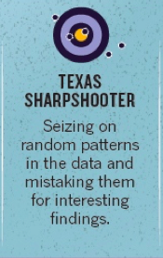

Slide 11
p-hacking
“Exploiting – perhaps unconsciously – researcher degrees of freedom until p < .05.”

Slide 12
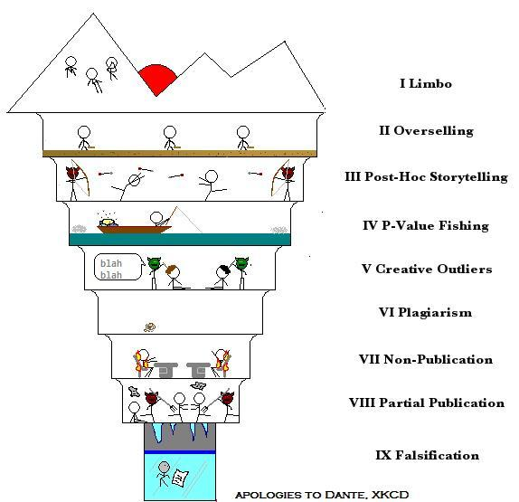
blogs.discovermagazine.com/neuroskeptic/2010/11/24/the-9-circles-of-scientific-hell/

Slide 13

p-hacking
http://shinyapps.org/apps/p-hacker/
Notes:
In May a journalist teamed up with a German documentary filmmaker to demonstrate how creative p-hacking during “one beer-fueled weekend” of data analysis, combined with lax standards in academic publishing, could be used to deceive the media and the public with findings about how eating chocolate leads to weight loss, better sleep, and lower cholesterol. Their method? They gathered 18 different measurements — weight, cholesterol, sleep quality, etc. — on 15 participants, which by their calculations gave them at least a 60 percent chance of finding at least one significant result. And then they cherry-picked only those findings to report.
These “p-hacking” practices during data are surprisingly common. A 2012 study of more than 2,000 U.S. psychologists found that half admitted to selectively reporting studies that “worked,” 58 percent have peeked at the results and then decided whether to collect more data, 43 percent have decided to toss out data only after checking its impact on the p-value, and 35 percent have reported unexpected findings as having been predicted from the start, a practice known as HARKing, or “hypothesizing after results are known.” But the researchers themselves didn’t blame themselves. Despite each of these practices being well known to increase the chances of false-positive findings, on average the participants rated each of them as being defensible.

Slide 14
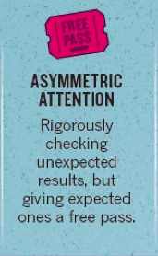

Slide 15

Only the errors you want
Herndon et al Cambridge Journal of Economics (2015)
Notes:
a famous 2010 paper by Harvard economists Carmen Reinhart and Ken Rogoff, who had analyzed post-World War II data from 20 countries and found that mean economic growth fell considerably when the size of a country’s debt rose above 90 per cent of its Gross Domestic Product — seeming to imply, essentially, that countries should tighten their belt and rein in debt or else risk choking their economy.
The paper’s results had made a big splash around the world, serving as the basis for testimony before the U.S. Senate Budget Committee, forming the evidence for U.S. Republican Senator Paul Ryan’s “Path to Prosperity” budget, and quoted by EU commissioner Olli Rehn in support of austerity strategies.

Slide 16
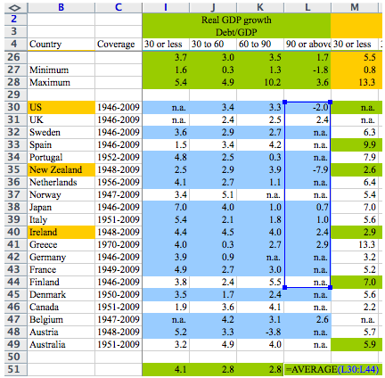
Only the errors you want
Herndon et al Cambridge Journal of Economics (2015)
Notes:
Herndon's work calculated that average growth dropped from 3.2 percent a much more moderate 2.2 per cent.
Even Albert Einstein has apparently fallen for this one. When he and Wander Johannes de Haas did their gyroscope experiments in 1915 to find the “g-factor,” a measure of the internal magnetic rotation of electrons in a material in a magnetic field, they expected from their theoretical models to find a g = 1. And indeed they reported a value of 1.02 +/-0.10. It wasn’t until six years later that de Haas revealed that the pair had actually done two experiments, with the other g-value coming out to be 1.45. But since the 1.02 value was so close to what their model predicted, de Haas said, he and Einstein convinced themselves that the larger value was due to experimental errors, and they just tossed it out. New research in the 1920s, however, revealed that their models were wrong, and in fact the true value of the g-factor was roughly 2 — closer to Einstein and de Haas’s “incorrect” value.
economist Richard Tol of the University of Sussex. Tol’s influential 2009 paper had found economic benefits from moderate climate change but was twice corrected in 2014 because of two overlooked estimates and two dropped minus signs, which Tol attributes to “gremlins interven[ing]”.
A 2004 study observed the discussions of researchers from three leading molecular biology laboratories as they worked through more than a hundred different lab experiments. In the cases where results didn’t align with expectations, 88 per cent of the time the scientists blamed the inconsistencies on how the experiments were conducted, not their own theories. Consistent results, on the other hand, were given little to no scrutiny, and the researchers proceeded apace.

Slide 17
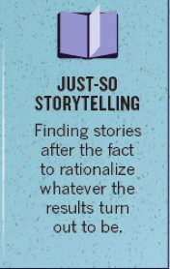

Slide 18
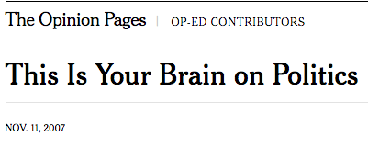
Finding a story – no matter what
Mitt Romney + amygdala activity =
“voter anxiety”? (Marco Iacoboni et al)
Or sexual excitement? (Martha Farah)
Farah Neuroethics & Law guest post at repository.upenn.edu/neuroethics_pubs/31

Slide 19
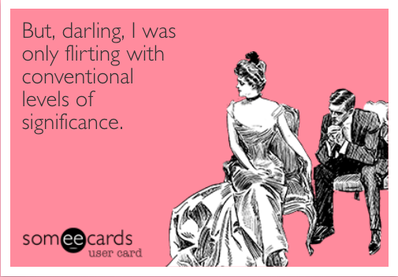
JARKing – Justifying After Results Are Known
https://mchankins.wordpress.com/2013/04/21/still-not-significant-2/

Slide 20

Fixes

Slide 21
Adversarial collaboration
Two voices
Disagree as little as possible
Not for the faint of heart

Slide 22
Become your own adversary
Do sanity checks – make sure things change when they’re supposed to
Do exploratory data analysis, especially plots
Consider dynamic reports like knitr
Baggerly & Coombes, “Forensic Bioinformatics” (in print)

Slide 23
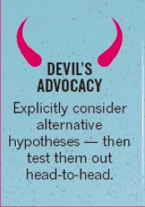

Slide 24
Competing hypotheses
Method of Multiple Working Hypotheses (Chamberlin 1890)
Strong Inference (Platt 1964)
Analysis of Competing Hypotheses (Richards Heuer, CIA, 1970s) http://competinghypotheses.org/

Slide 25
Competing hypotheses
Develop alternative hypotheses
Choose diagnosticity: an experimental test that will give different results depending on which hypothesis is true.
Consider Bayes Factors or Likelihood Ratio Tests
Whitney et al. Experimental Psychology (2012)
Notes:
A good test is one that has a high probability of some answer if the hypothesis is true and a low probability if it is false
For example, researchers at Aix-Marseille University in France and the University of Maryland discussed in their recent paper how they applied strong inference principles to studying how letter position is encoded by the brain during reading. Two competing theories — one in which the brain works with pairs of letters, and another with deals with comparisons of single letters — could both explain existing data very well. So the researchers worked to develop an experiment for which the two theories would have completely opposing predictions; the results showed the letter-pair theory to be a winner.

Slide 26
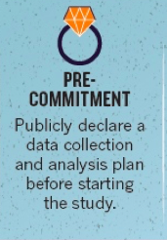

Slide 27
Sticking to your plan
Pre-registration
Registered reports
Two-stage analysis: exploratory, then confirmatory
Open everything on Open Science Framework
Dutilh et al Atten Percept Psychophys (2017, in print)

Slide 28
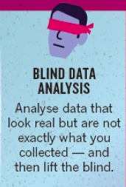

Slide 29
Getting out of your own way
Permute labels
Scramble some variables
Jitter data
MacCoun & Perlmutter Nature 2015

Slide 30
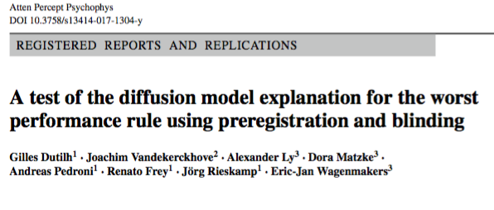
Doing it all: Dutilh et al
https://osf.io/qc5dh/
Dutilh et al Atten Percept Psychophys (2017, in print)

Slide 31
Doing it all: Dutilh et al
Studying Worst Performance Rule (Baumeister & Kellas, 1968)
4 specific tests with competing hypotheses, using Bayes Factors
“Registered Report”
Blinded data: one response variable randomly permuted
Code locked and posted on Open Science Framework
Code applied to unblinded data for confirmatory results
Exploratory analysis of real data
Two theoretical explanations for conflicting results
https://osf.io/qc5dh/
Dutilh et al Atten Percept Psychophys (2017, in print)

