Slide 1
120 YEARS OF OLYMPIC HISTORY
Athletes · Medals · Countries · Gender
Data Analysis Report | Power BI Dashboard Insights
269,731
135,571
39,835
Total Entries
Unique Athletes
Total Medals

Slide 2
🌍 COUNTRY PERFORMANCE
269,731
39,835
13,361
22,297
Total Entries
Total Medals
Gold Medals
London Entries (highest host)
🥇 USA Dominates Overall
The United States leads with 5,646 total medals and 18,604 athlete entries — the highest of any nation.
📍 London: Most Athletes Hosted
London recorded the highest cumulative entries across all hosted editions: 22,297 athletes from 209 countries.
🌍 Europe Leads Regionally
Europe contributed the largest share of entries, with Germany leading at ~15,787 athlete entries within the region.

Slide 3
🏆 ATHLETE PERFORMANCE
135,571
21%
25 yrs
175.6 cm
71.0 kg
Total Athletes
Medal Winners
Avg Age
Avg Height
Avg Weight
⚡ Athletics Dominates
Athletics recorded 38,624 entries and 3,969 medals — the highest across all sports in both categories.
🥇 Michael Phelps: GOAT
With 28 total medals (23 Gold), Michael Fred Phelps, II holds the all-time Olympic medal record.
📅 Peak Year: 1992 Barcelona
1992 saw the highest athlete count at 11,183, coinciding with peak combined Summer + Winter participation.
📊 Only 21% Win Medals
Out of 135,571 athletes, only 1 in 5 has won a medal — highlighting the need for stronger athlete pipelines.

Slide 4
⚥ GENDER PARTICIPATION
195,353
74,378
72%/28%
2016
Total Male Entries
Total Female Entries
Male / Female Split
Peak Female Year
📈 Steady Female Growth Since 1900
Female participation grew consistently from near-zero in 1896, with a marked acceleration post-1960 as more women's events were added.
⚠️ Still Below Parity
Despite progress, female entries (74,378) represent only ~28% of total entries (269,731), well below male participation (195,353).
🏃 Athletics: Top Sport for Both Genders
Athletics led participation for both males (26,958) and females (11,666), reinforcing its central role in the Games.
🌐 USA Leads Female Participation
The United States, Germany, Russia, Canada, and the UK recorded the highest female participation levels globally.

Slide 5
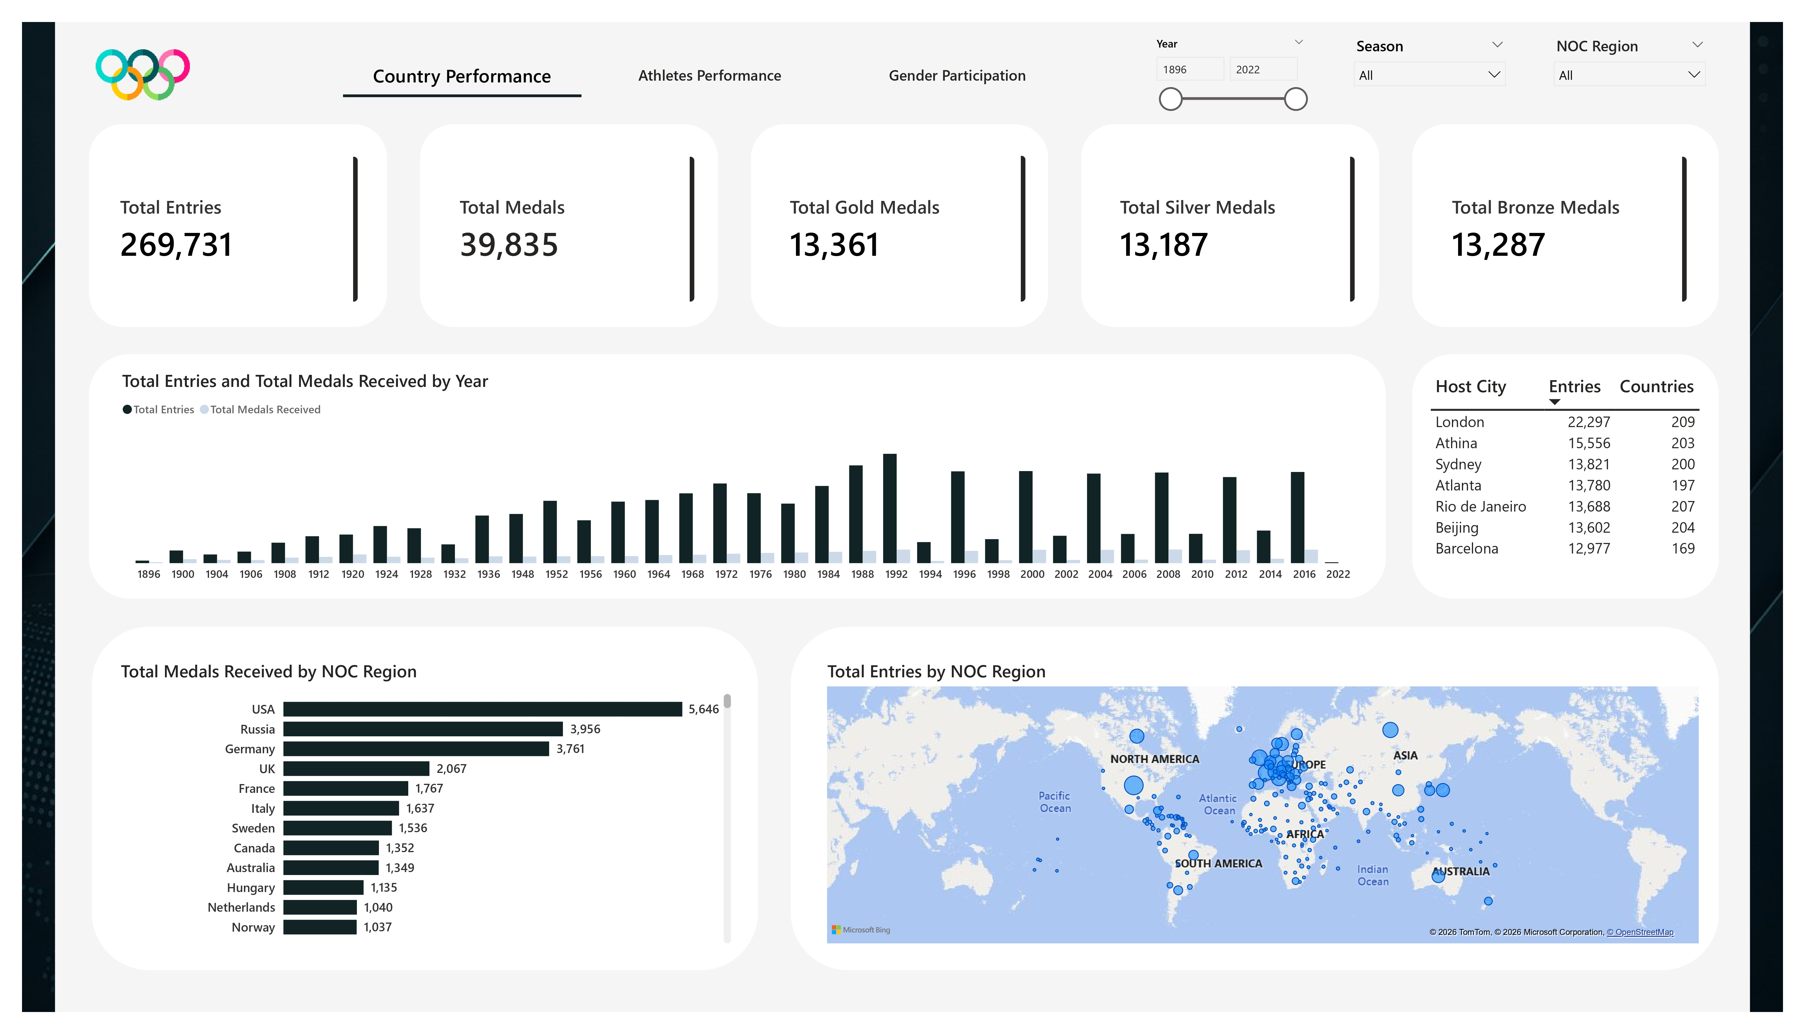
DASHBOARD: Country Performance

Slide 6
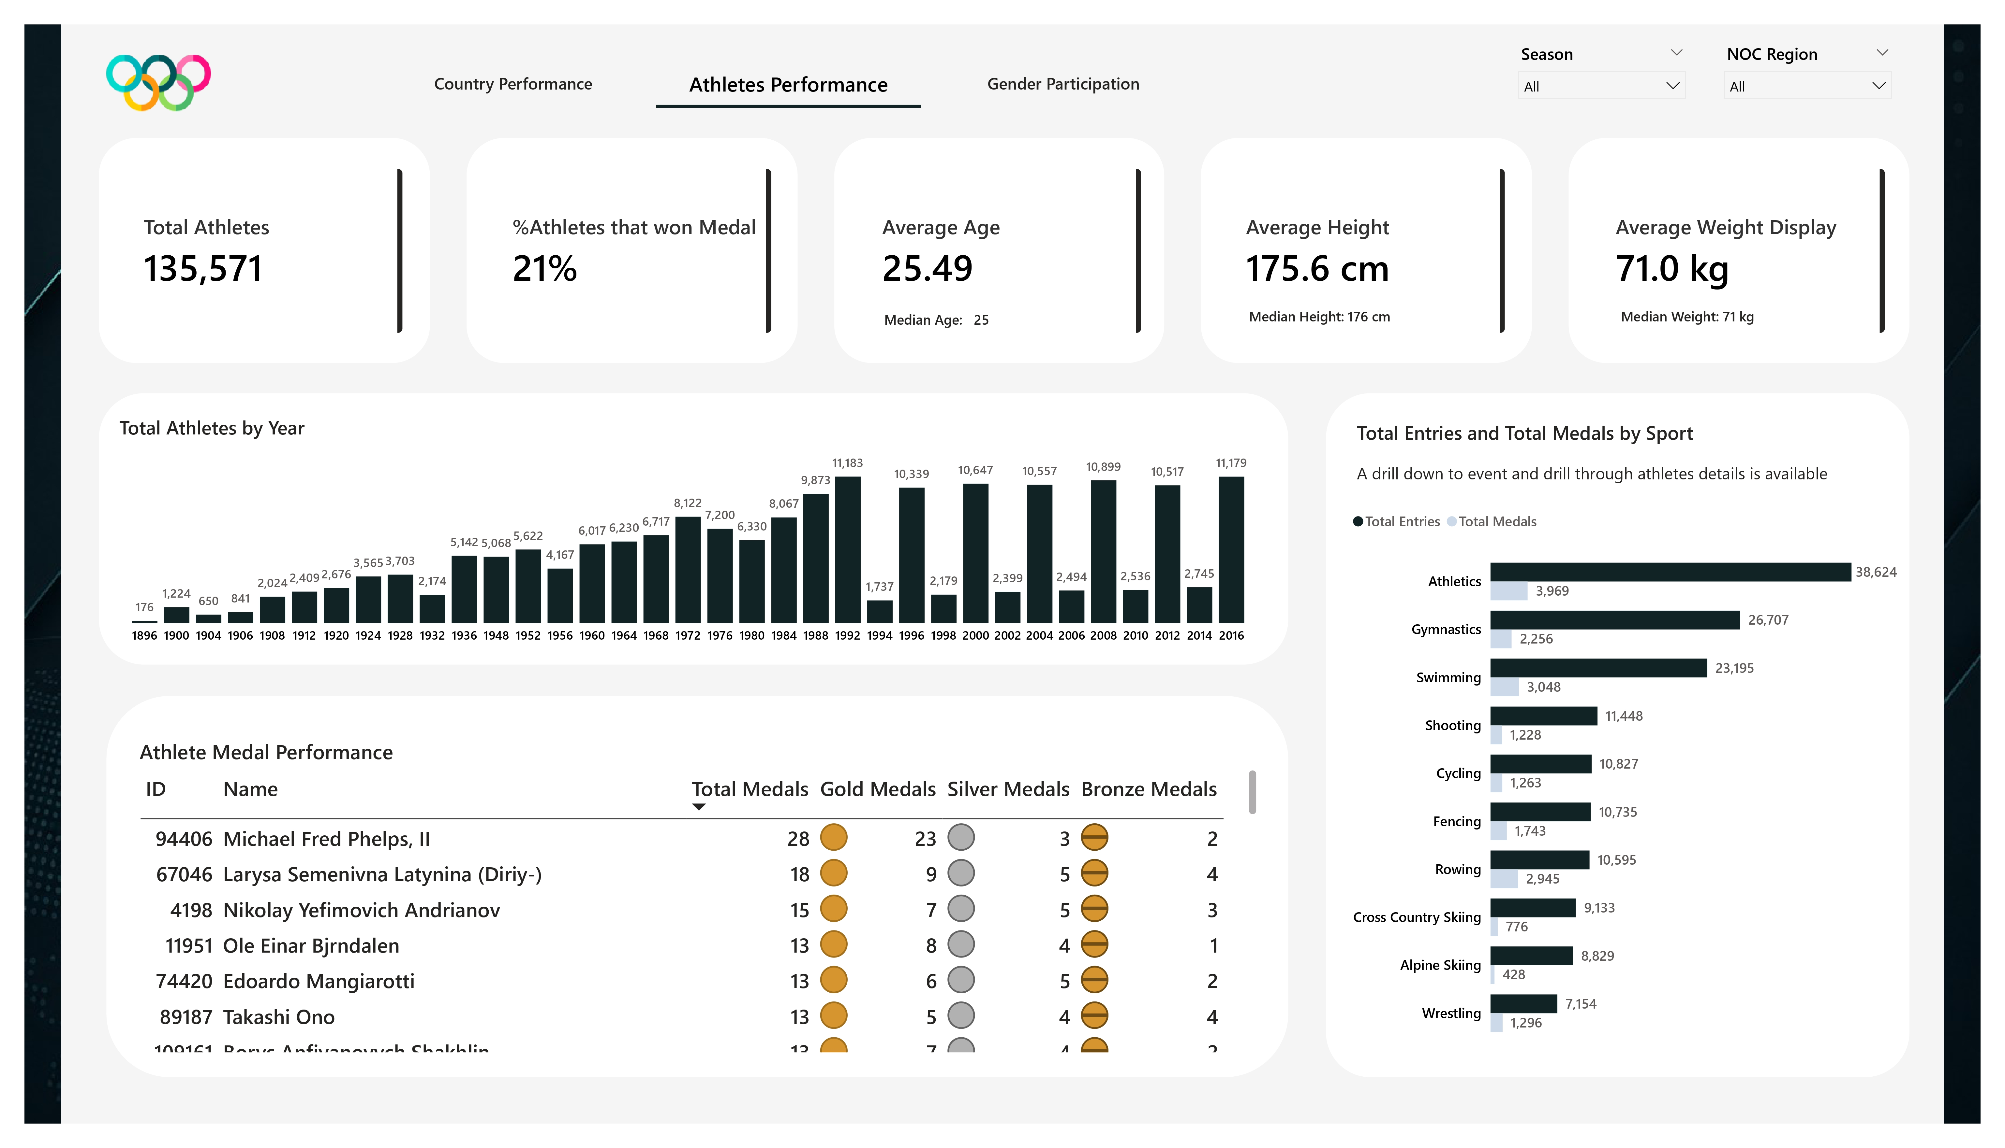
DASHBOARD: Athletes Performance

Slide 7
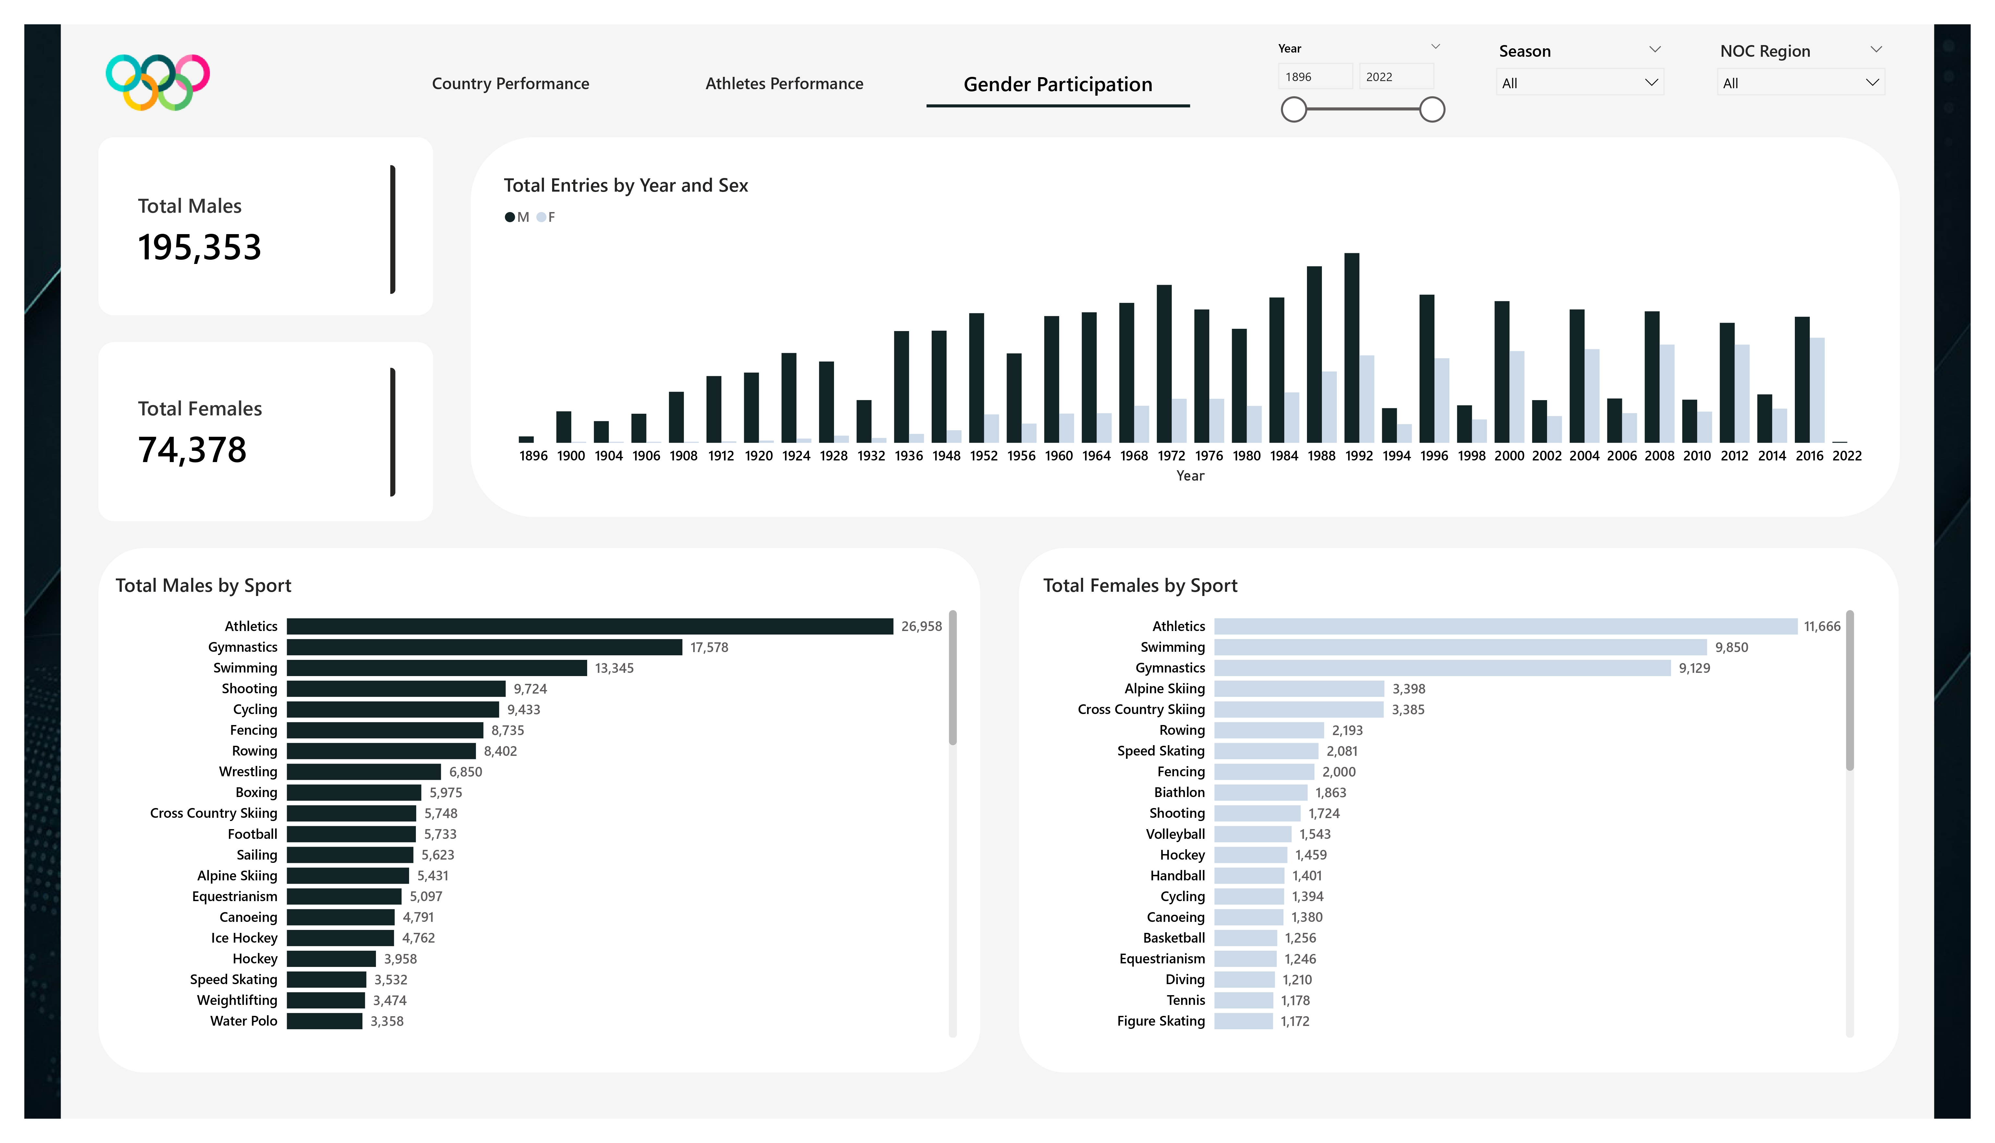
DASHBOARD: Gender Participation

Slide 8
💡 PROPOSED STRATEGIES
01
Strengthen Grassroots Sports Development
02
Increase Female Participation
Only 21% of 135,571 athletes won medals. Targeted investment in school sport programs and youth academies can build stronger athlete pipelines.
Female entries (74,378) represent just 28% of total entries. Awareness campaigns, scholarships, and equal access to training can close this gap.
Evidence: Athletes Performance Dashboard — %Athletes that won Medal: 21%
Evidence: Gender Participation Dashboard — Total Males: 195,353 vs Total Females: 74,378
03
Promote Low-Participation Sports
04
Encourage Broader International Participation
Athletics dominates while sports like Rugby, Polo, and Lacrosse lag far behind. Increased sponsorship and youth programs can broaden participation.
Medals and participation concentrate in USA and Europe. Nations like South Sudan, Nauru, and Brunei have minimal representation, especially in female events.
Evidence: Athletes Performance Dashboard — Entries by Sport showing Athletics at 38,624 vs others
Evidence: Country Performance Dashboard — Medal map and NOC Region breakdown

Slide 9
CONCLUSION
🥇
The USA is the undisputed Olympic leader — 5,646 medals & 18,604 entries across 120 years of competition.
🏃
Athletics is the backbone of the Games — highest entries (38,624) and medals (3,969) of any sport.
📈
Participation grew massively over time, peaking at 11,183 athletes in Barcelona 1992, before splitting into separate Summer/Winter schedules.
⚥
Gender inclusion has improved steadily, yet female athletes still represent only 28% of all entries — a gap that demands action.
🌍
Olympic success remains concentrated in a handful of nations; expanding grassroots and international support is key to a truly global Games.

