Slide 1
Can you plot Johnson Neyman for Continuous × Continuous?
Short Answer: Yes!
Personal usage only, and please do not distribute.
There is no guarantee for the accuracy of the content presented in the slides.

Slide 2
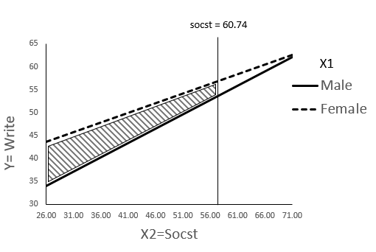
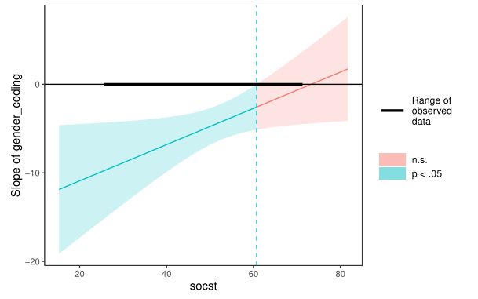

Johnson Neyman – Categorical × Continuous
Slope of Gender
X2=SOCST

Slide 3

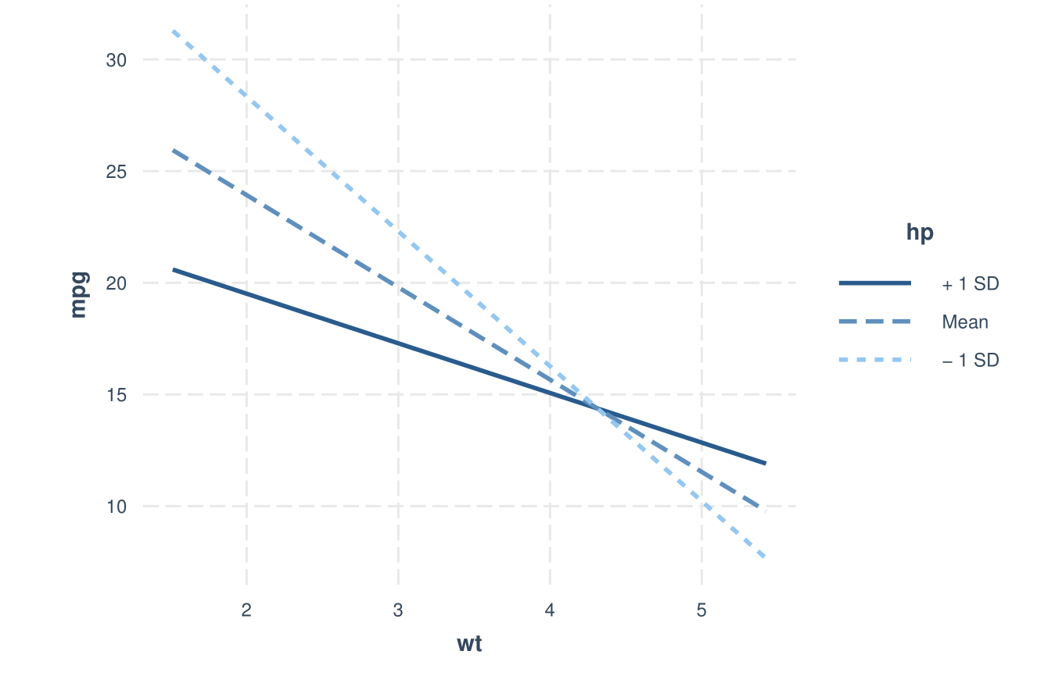
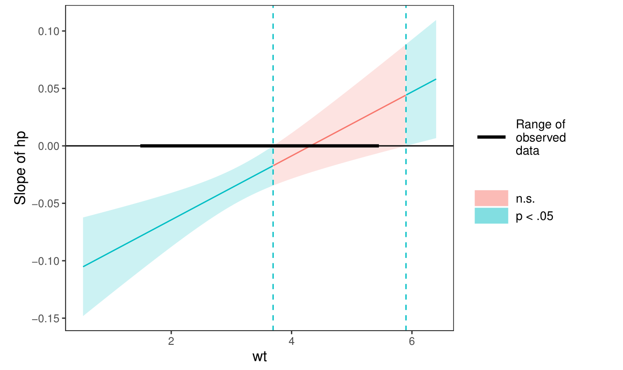

Johnson Neyman – Continuous × Continuous
You can use spotlight (+/- 1SD of hp) to plot the interaction effect.
This is not Johnson Neyman anymore.

