Slide 1
Dummy Coding & Contrast Coding in SPSS

Slide 2
Simple Linear Regression

Slide 3
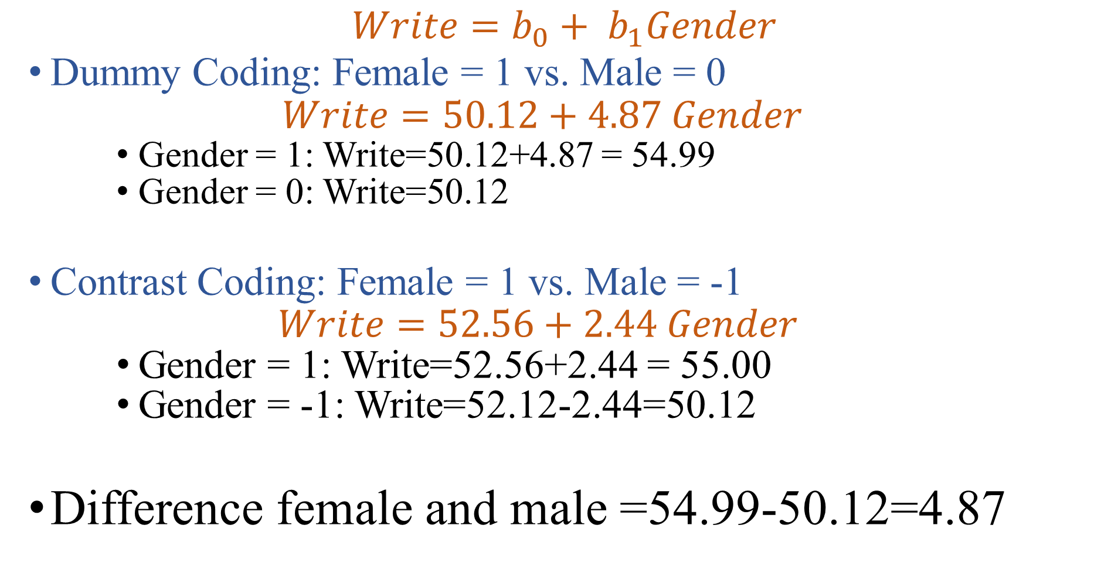
$$Write=b_{0}+ b_{1}Gender$$
Dummy Coding: Female = 1 vs. Male = 0
$$Write=50.12+4.87 Gender$$
Gender = 1: Write=50.12+4.87 = 54.99
Gender = 0: Write=50.12
Contrast Coding: Female = 1 vs. Male = -1
$$Write=52.56+2.44 Gender$$
Gender = 1: Write=52.56+2.44 = 55.00
Gender = -1: Write=52.12-2.44=50.12
Difference female and male =54.99-50.12=4.87

Slide 4
Multiple Linear Regression

Slide 5
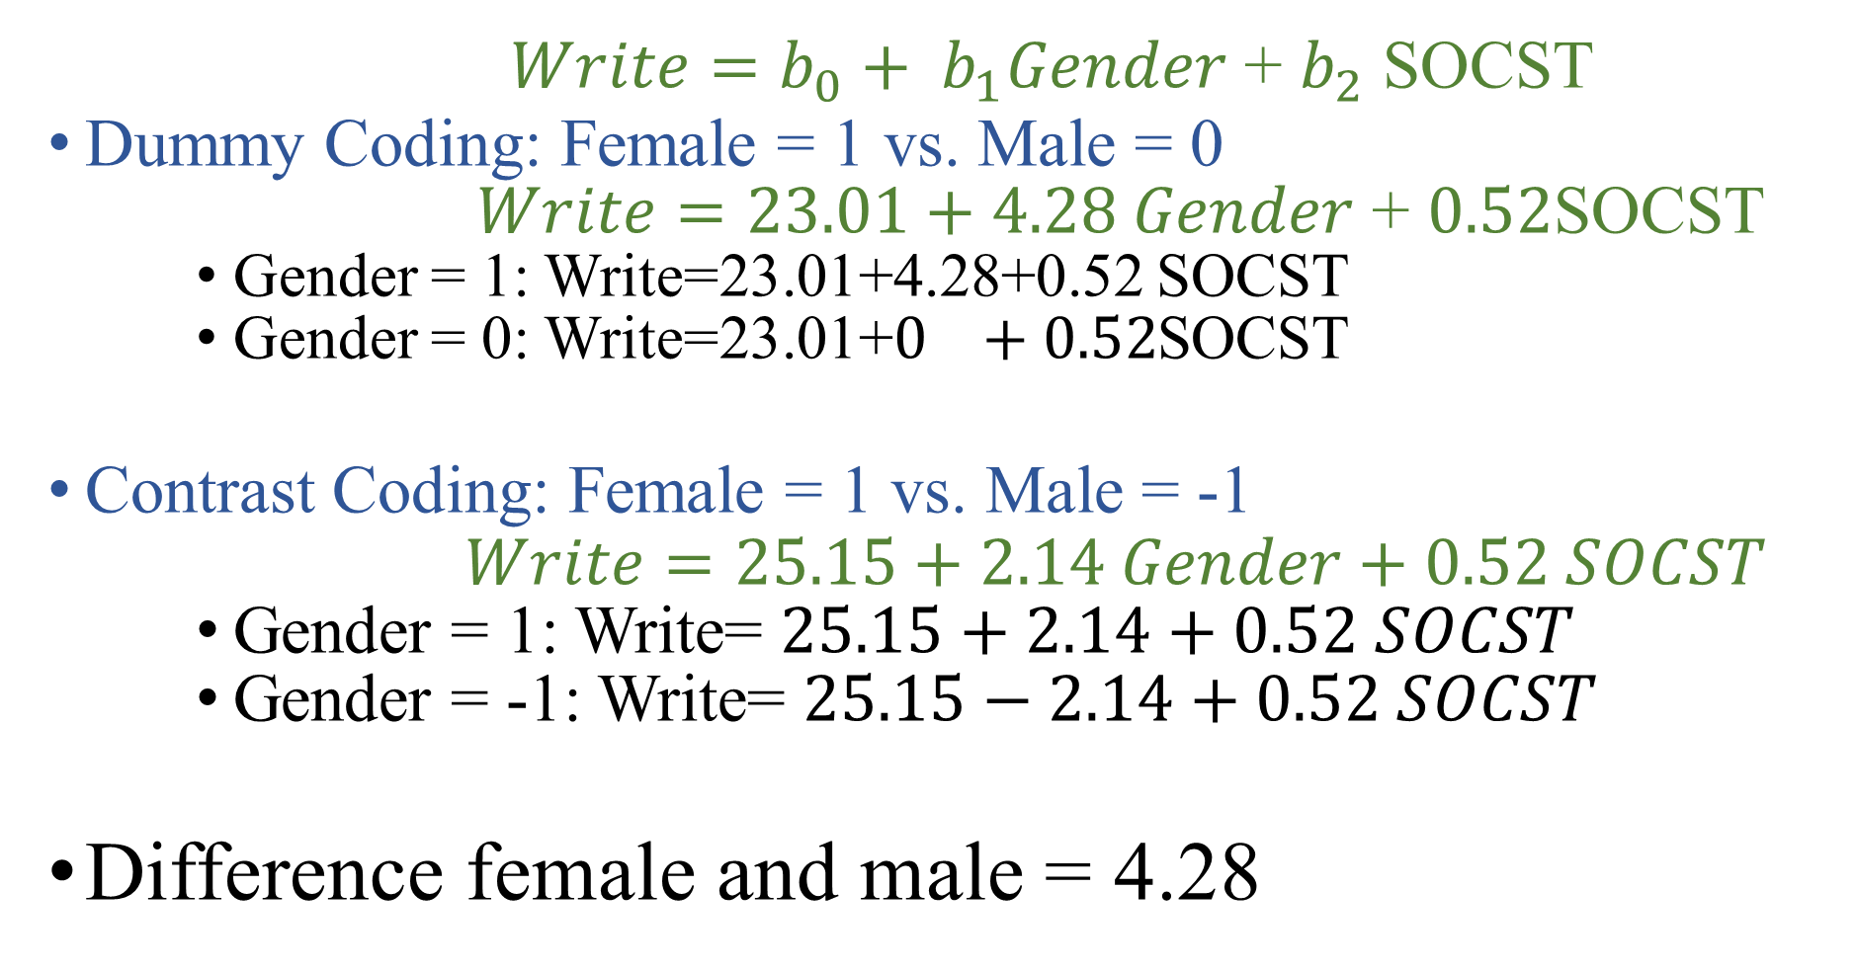
$Write=b_{0}+ b_{1}Gender$ + $b_{2}$ SOCST
Dummy Coding: Female = 1 vs. Male = 0
$Write=23.01+4.28 Gender$ + $0.52$SOCST
Gender = 1: Write=23.01+4.28+0.52 SOCST
Gender = 0: Write=23.01+$0 +0.52$SOCST
Contrast Coding: Female = 1 vs. Male = -1
$$Write=25.15+2.14 Gender+0.52 SOCST$$
Gender = 1: Write= $25.15+2.14+0.52 SOCST$
Gender = -1: Write= $25.15−2.14+0.52 SOCST$
Difference female and male = 4.28

