Slide 1
Spotlight Analysis in SPSS

Slide 2
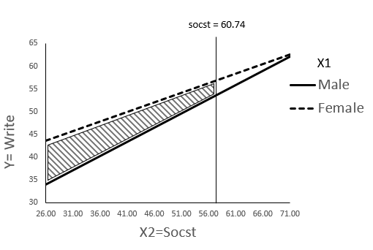
Spotlight Analysis vs. Johnson Neyman
Johnson Neyman (floodlight Analysis)
Spotlight Analysis (+1/-1 SD)

