Slide 1
Chapter 4 – Our first model
Artificial Intelligence

Slide 2
What are we doing?
Machine learning
Supervised learning
Reinforcement learning
Classification
Regression
Clustering
Dimensionality reduction
Unsupervised learning
Notes:
We have a dataset of student data (courses they started, grades, group they were in, previous education, shoe size, …)
Supervised learning, classification: given this data for a new student, will he or she pass?
Supervised learning, regression: given this data for a new student, what grade will he or she get?
Unsupervised learning, clustering: students with odd shoe sizes prefer AI? Students from Olen prefer networking?
Unsupervised learning, dimensionality reduction: average of grade in first year gives the same result

Slide 3
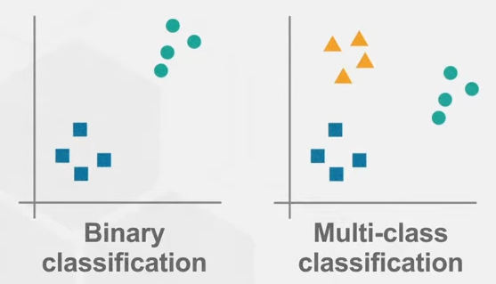
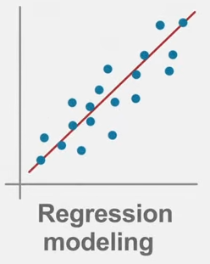
Supervised: Classification vs regression
Classification
  Output is class label (discrete)
  Looking for boundaries
  Evaluate using accuracy
  Binary: 2 labels, Multi-class: more than 2 labels
Regression
  Output is number (continuous)
  Looking for best fit line
  Evaluate using sum of squared error (r²)
Notes:
https://www.youtube.com/watch?v=G_0W912qmGc
https://www.youtube.com/watch?v=rHeaoaiBM6Y

Slide 4
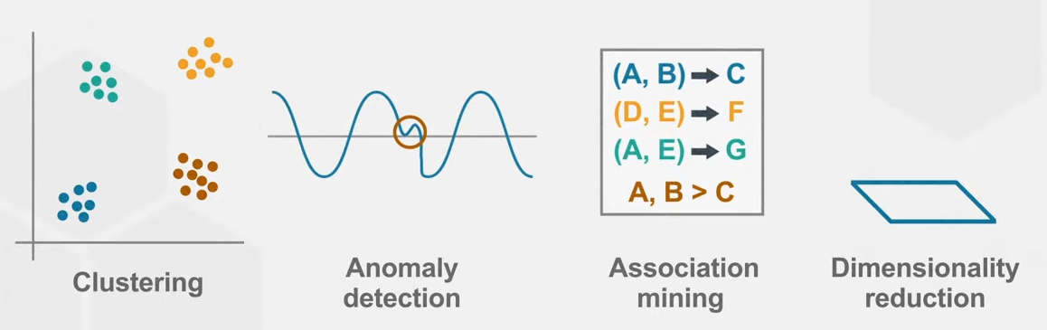
Unsupervised learning
Does not require a data scientist to prepare the data
Example: https://www.kaggle.com/code/ryati131457/titanic-unsupervised-kmeans
  Some preparation
  No guiding on which groups to make (you can’t ask the model who survived)
  But you get 5 groups of people that are at roughly the same location in some multidimensional space ^{(see next slide)}
Good to give insights in data beyond what regular statistics can do

Slide 5
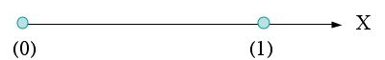
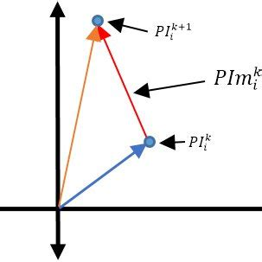

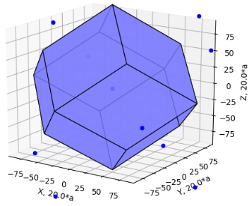


Multidimensional space
One dimensional:
Two dimensional:
Three dimensional:
More dimensional:
17 dimensions?
No problem.

Slide 6
Feature engineering
Feature: measurable input that can be used in a predictive model
  Price per ticket to predict survival of Titanic
Feature engineering: convert raw observations into features
  Name contains title (Mr., Mrs., Master., Lady., Sir., …)
  Extracting this will yield a very valuable feature
Remember that we are doing supervised learning, so we are responsible for providing the model with the data and labels

Slide 7
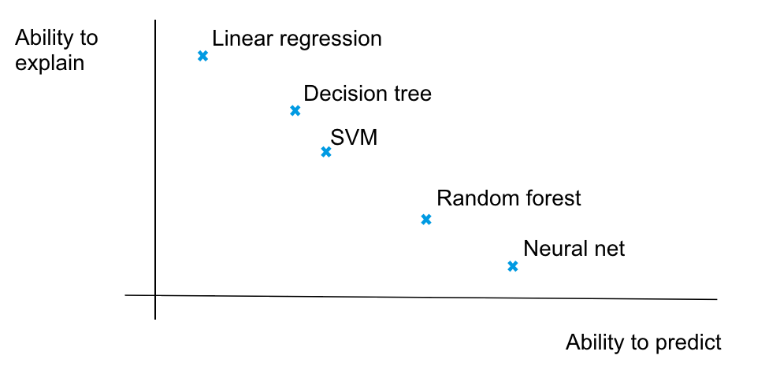
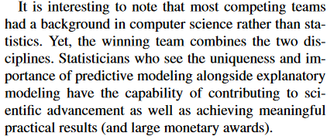
Creating models
We’ll be creating models that fit our data
In essence, any model can be used to predict and any model can be used to explain our data
But some models are better suited to the one or the other
Notes:
https://www.stat.berkeley.edu/~aldous/157/Papers/shmueli.pdf
https://medium.com/@nsorros/to-predict-or-to-explain-ddeb95ba9e25

Slide 8
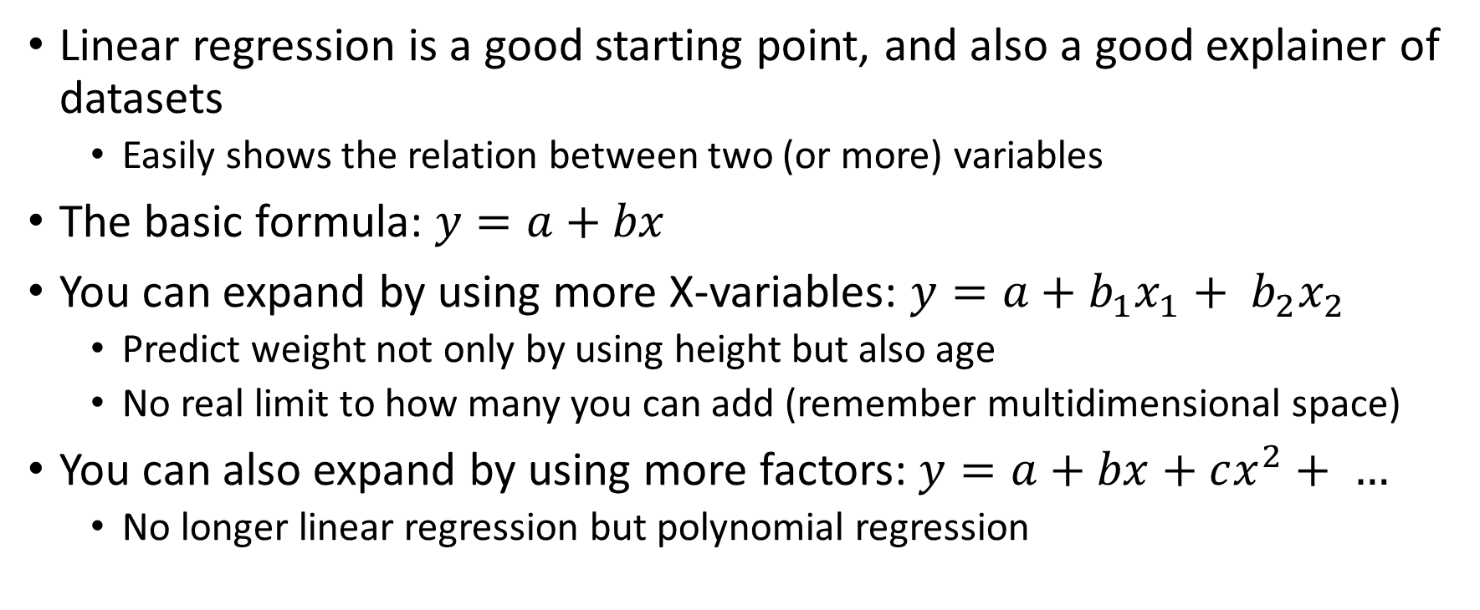
Linear regression
Linear regression is a good starting point, and also a good explainer of datasets
  Easily shows the relation between two (or more) variables
The basic formula: $y=a+bx$
You can expand by using more X-variables: $y=a+b_{1}x_{1}+ b_{2}x_{2}$
  Predict weight not only by using height but also age
  No real limit to how many you can add (remember multidimensional space)
You can also expand by using more factors: $y=a+bx+cx^{2}+ …$
  No longer linear regression but polynomial regression

Slide 9
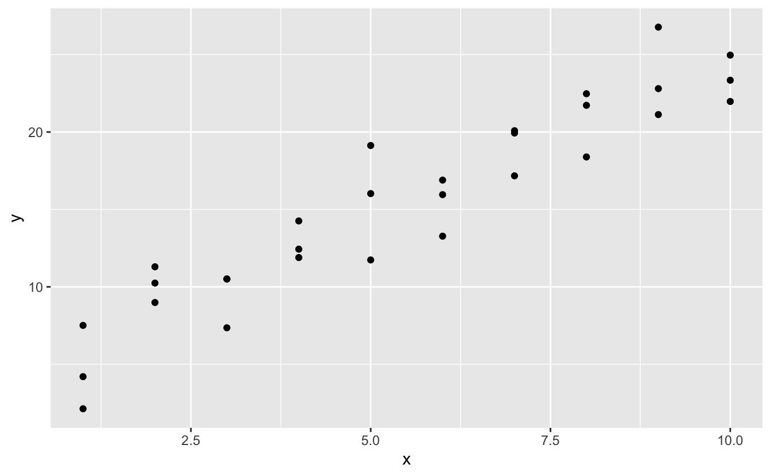
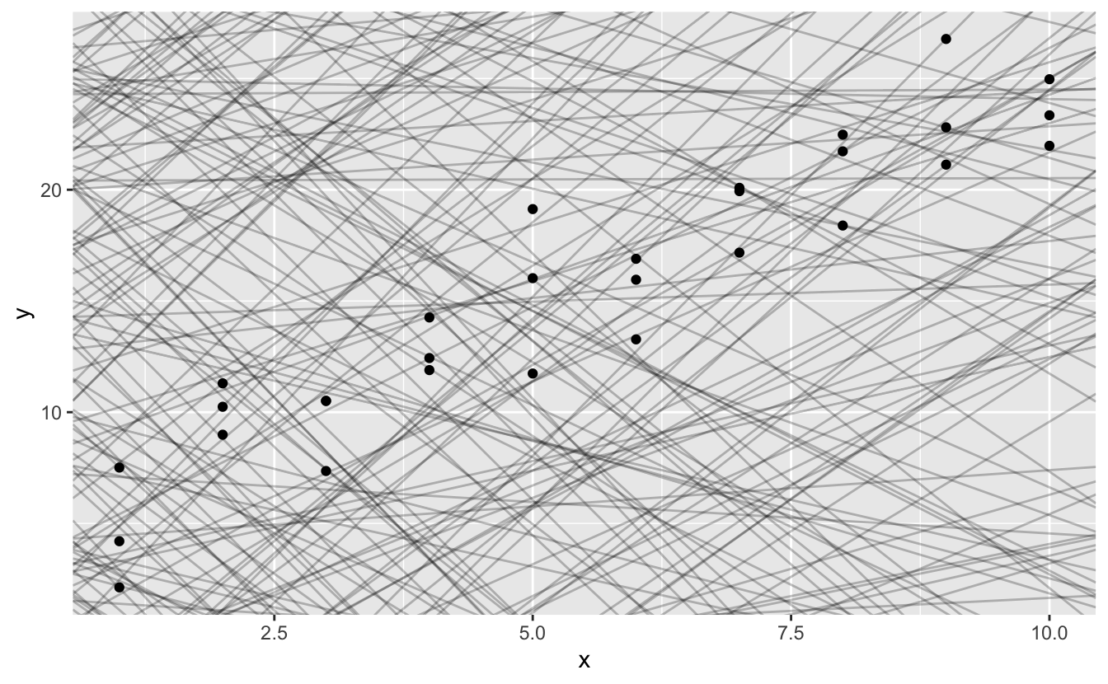
How does linear regression work?
Different (a, b) combinations

Slide 10
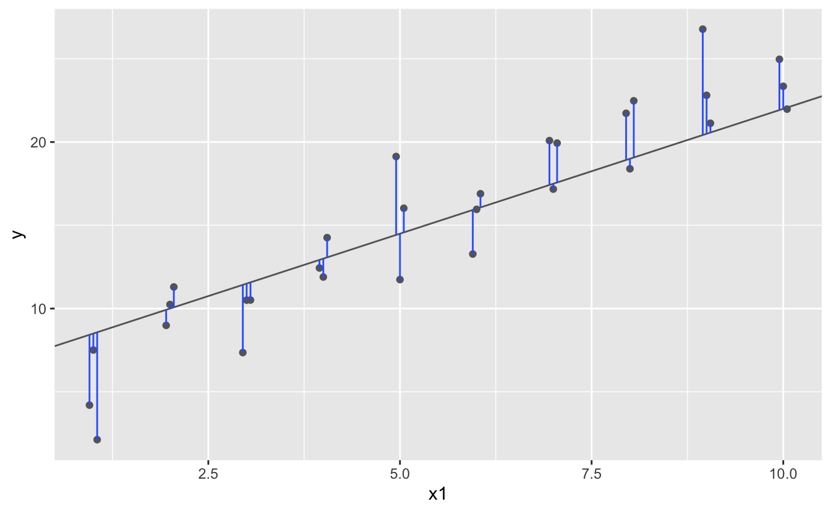
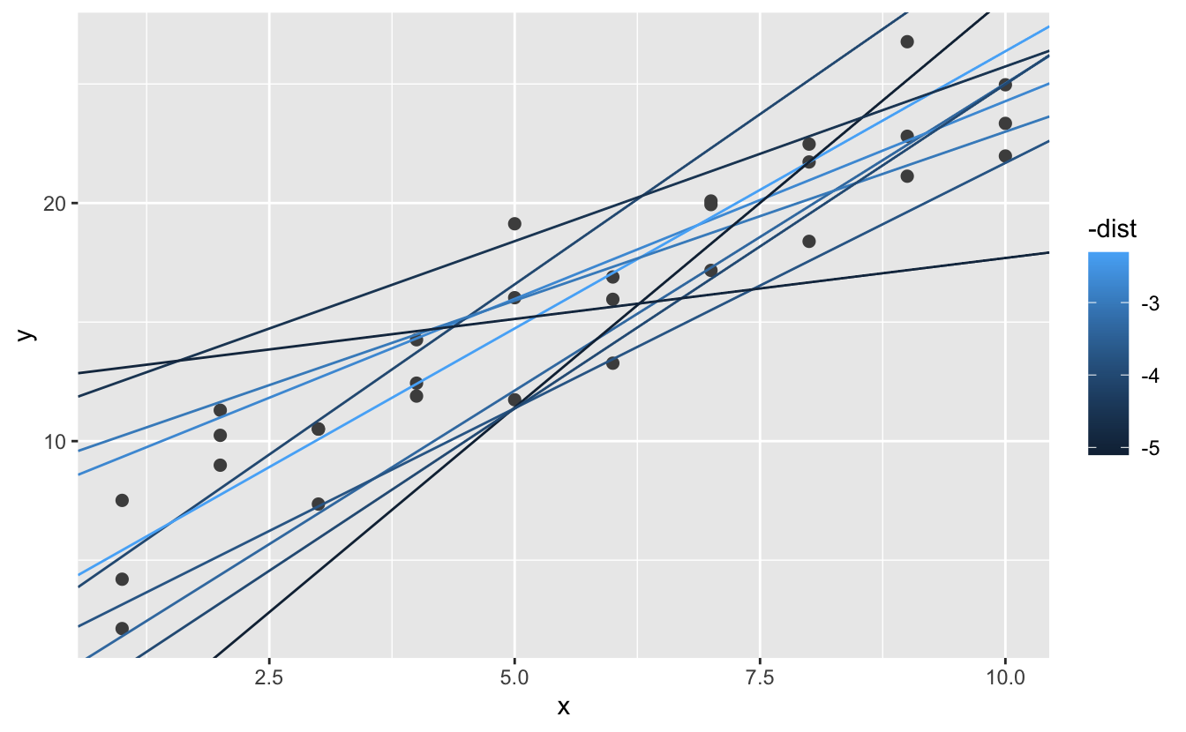

How does linear regression work?
Root-mean-square error

Slide 11
Root mean square?
Why do we use the RMSE to determine how good a model is?
There are other ways, but they have issues:
  Simply add the errors: some errors are positive, others are negative. This doesn’t add up well.
  Add the absolute value of the errors: Could work but we really want to penalize the big errors.
  MSE: Same as RMSE, but not the root. Is a good metric but isn’t in the same unit as the actual data (as it’s still squared). (See link in notes.)
  RMSE: Squaring gets rid of the sign and increases the big errors. Value can be compared to the actual data.
Notes:
https://www.statology.org/mse-vs-rmse/
https://towardsdatascience.com/what-does-rmse-really-mean-806b65f2e48e

Slide 12
Calculating the residuals
The residuals are the differences between the calculated values and the predicted values, the errors
Remember that we were always working with two variables
  If the residuals no longer show a pattern, that was the main defining correlation in the data
  If the residuals still show some kind of a pattern the model doesn’t fully define the data (and won’t be able to predict it)

Slide 13
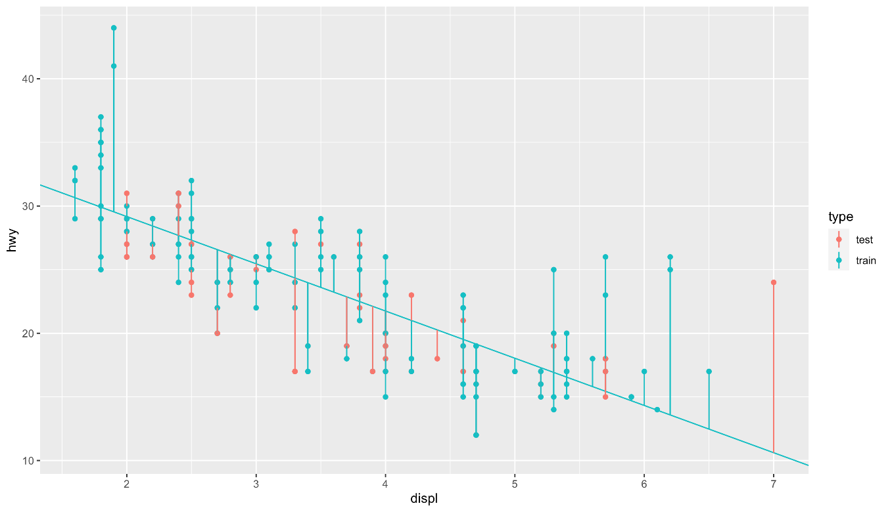
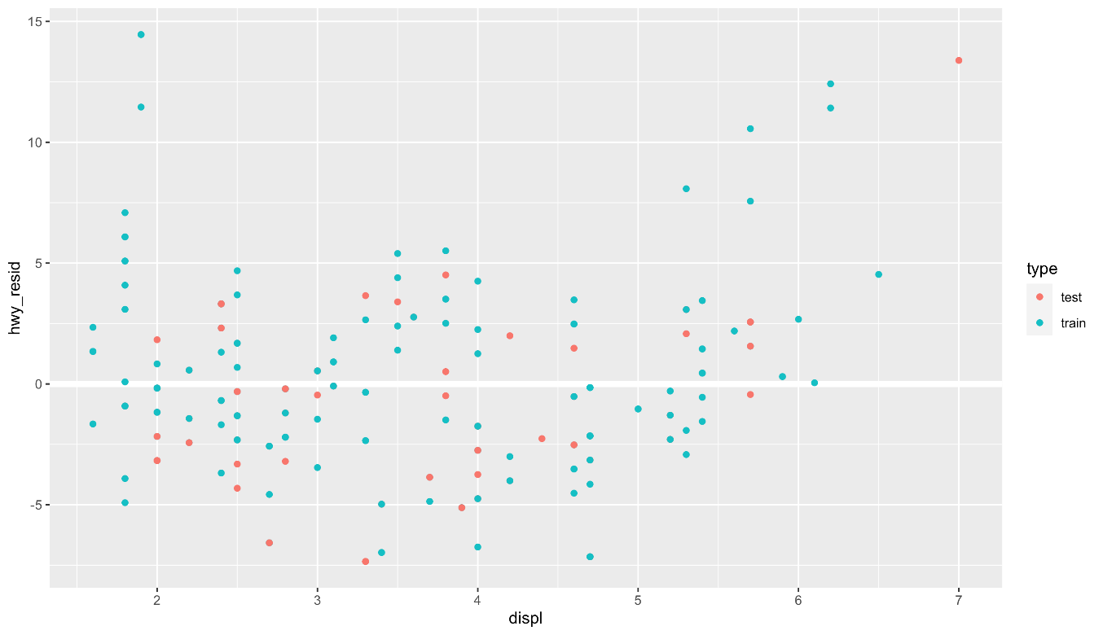
Calculating the residuals
hwy_{resid} = hwy_{actual} – hwy_{predicted}

Slide 14
Back to work!
First, explore “1 – linear regression”. It explains why the model we’ll be making next won’t be very good.
In “2 – the model” you’ll create a model that predicts the mpg of a car based on some parameters that you give.
Finally in “3 – the app” we’ll turn this into a streamlit app that can be used.
And why are we making a model which we know will be bad? Two reasons:
  https://www.youtube.com/watch?v=1rJ3Ga75OXE
  https://www.youtube.com/watch?v=-P11Bcpyw4g

