Slide 1

Machine learning - AWS
About this part of the course

Slide 2
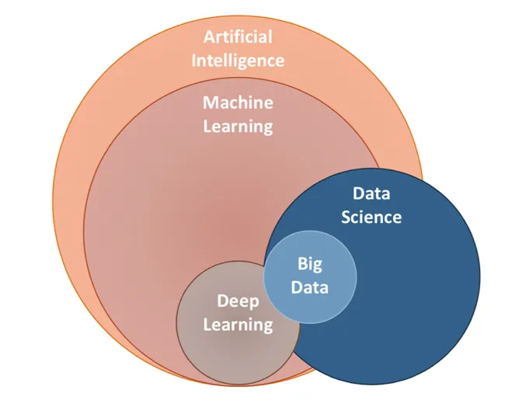
Course goals
Data science: course in 2ITF
AI: course in 2ITF
Machine learning: focus of this course
(AI on structured data, but we’ll be doing more than just that)
Deep learning and NLP: the rest of this course
Notes:
https://ai.plainenglish.io/data-science-vs-artificial-intelligence-vs-machine-learning-vs-deep-learning-50d3718d51e5

Slide 3

Cloud
The cloud is important
This course uses an AWS-academy course
You’ll do about half of that course, joined with slides on the ‘regular’ canvas course
When studying:
  Start from the Thomas More-slides
  Do the AWS-course as by the planning on the next slide
The goal of using AWS is to get to know Sagemaker and S3 buckets

Slide 4
Cloud
Do the chapters on AWS after the lessons in class (before the next lesson)
Make sure you get a passing grade on the end-of-chapter-test
  You can redo the test as often as you like
Planning:
  Week 1: chapter 1 and 2
  Week 2: chapter 3
  Week 4: chapter 4
The other chapters are optional
  The content is covered by the other teachers in this course

Slide 5
Course layout
6 half days:
  Data science recap, AWS basic, AWS sagemaker
  AWS and machine learning
  MLOps (sagemaker, pipelines, ML Flow), AutoML and PyCaret
  Time series and forecasting
  Unsupervised learning
  Project work
The project:
  Do AI and advanced data science on an elaborate dataset
  Do time series forecasting on another dataset (pass/fail and excelling)
  Model preparation and hosting

Slide 6
The exam
Project deadline: Monday 24-nov-2025, midnight
  Just after the Skil 3 project week. Don’t expect to have a lot of extra time during that week.
Friday after that: presentations (schedule TBD)
  Present findings, open questions on the method used and the course material
Grading:
  Project: 20% of final grade
    Retained in August!
  Other projects: 40% of final grade
  Closed book exam: 40% of final grade
    Of which 1/3 are machine learning-related questions

Slide 7
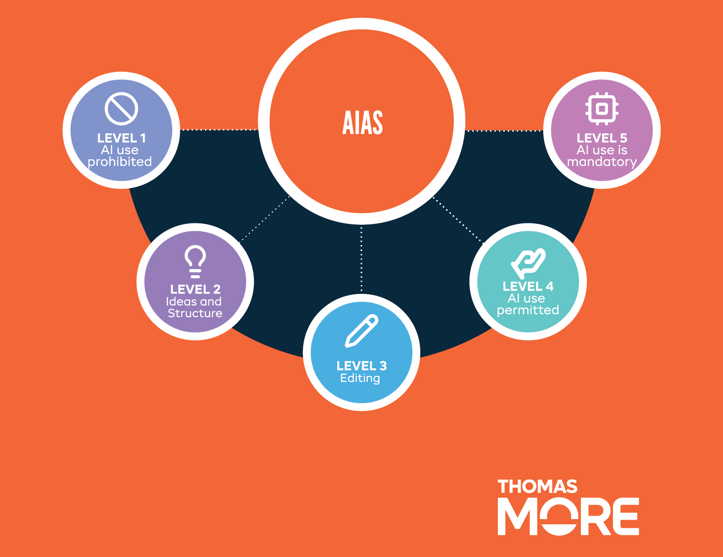

AI Assessment Scale – PE 60%

Slide 8
About the slides
The central guideline in this course
  Refers to AWS-course or other external
  Not numbered per class (week 1 is not necessarily ppt 1)
Not a good example for your final presentation
  Your final presentation: sell yourself (or your project) to a jury
  These presentations: course material, not selling anything
Don’t forget the notes, sometimes they contain more information or useful links
Notes:
I mean these notes down here.

Slide 9
About the slides
Powerpoint is supercalifragilisticexpialidocious, but it has its limits
Sometimes the slide will be a link
  To a jupyter notebook with explanations
  To a jupyter notebook with an exercise
  To a markdown-file with explanations
  To the module on AWS
  …
The slides are the guide between all the other course material,
but are not the only course material

Slide 10
What we’ll be doing
Modules on AWS
  Contain course material and exercises
  But the exercises are easy (just run the code, sometimes type some code)
Discussion topics
  Basis for oral part of examination
  Tries to get you to reflect on the course material (AWS and PPT)
  To be discussed in your project-team (Study group!)
Exercises
  To be done on Sagemaker or locally
  Individual, but may be discussed in your project team
  Not real “exercises,” more guidelines
  Can generally be done in under 10 minutes, but shouldn’t

Slide 11


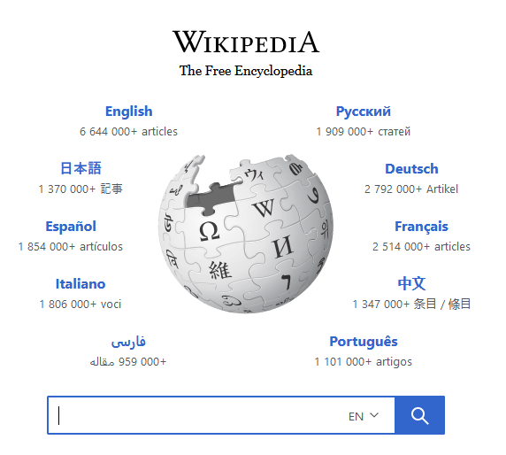
Notes:
Book was very thrilling, so much so I couldn’t sleep anymore. This was a problem.
I could look up the ending of the book Wikipedia. That would have helped me sleep, but I’d have to find a new book to read (preferably a boring one).
The moral of the story: I didn’t look up the ending (yet) and decided that all solutions to the exercises will be available from the very beginning of the course. You can simply read them and say ‘Yeah, I could have thought of that’ or not and actually learn something. Your call.
Update: In the end I did look up the ending, and I’m glad I did.

Slide 12
The project
Dataset 1: UK housing
  Housing prices in the England/Wales between 1995 and 2017
  Download from Kaggle
Dataset 2: UK Historic Electricity Demand Data
  Electricity demand in England/Wales between 2001 and 2025
  Download from Neso
Todo:
  Data science: Clean and explore
  Machine learning: Build models, compare them, build better models
  Deploy: Create an interface to use your model
Notes:
UK Housing: https://www.kaggle.com/datasets/hm-land-registry/uk-housing-prices-paid/data
UK Electricity demand: https://www.neso.energy/data-portal/historic-demand-data?page=0

Slide 13

Next up
Weapons of Math Destruction
AWS
  Login
  Find the correct course (Machine Learning Foundations, 3790)
  Finish module one (hello world of modules)
Group
  Make a group (in canvas)
  Create a github repo, invite me
  Do the first discussion topics
And the Lord spoke, saying, "First shalt thou take out the Holy Pin. Then shalt thou count to three, no more, no less. Three shall be the number thou shalt count, and the number of the counting shall be three. Four shalt thou not count, neither count thou two, excepting that thou then proceed to three. Five is right out.”
Notes:
The quote: https://en.wikiquote.org/wiki/Monty_Python_and_the_Holy_Grail

