Slide 1
Introduction to machine learning

Slide 2
Understand the data: data science
This course directly follows data science in 2itf
You’ll need all the skills you picked up there:
  Grabbing data
  Importing data
  Creating graphs
  Getting information on data
All using Python and Pandas

Slide 3
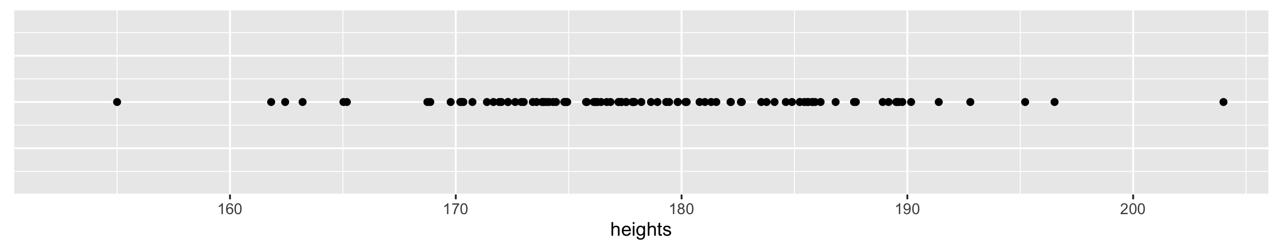
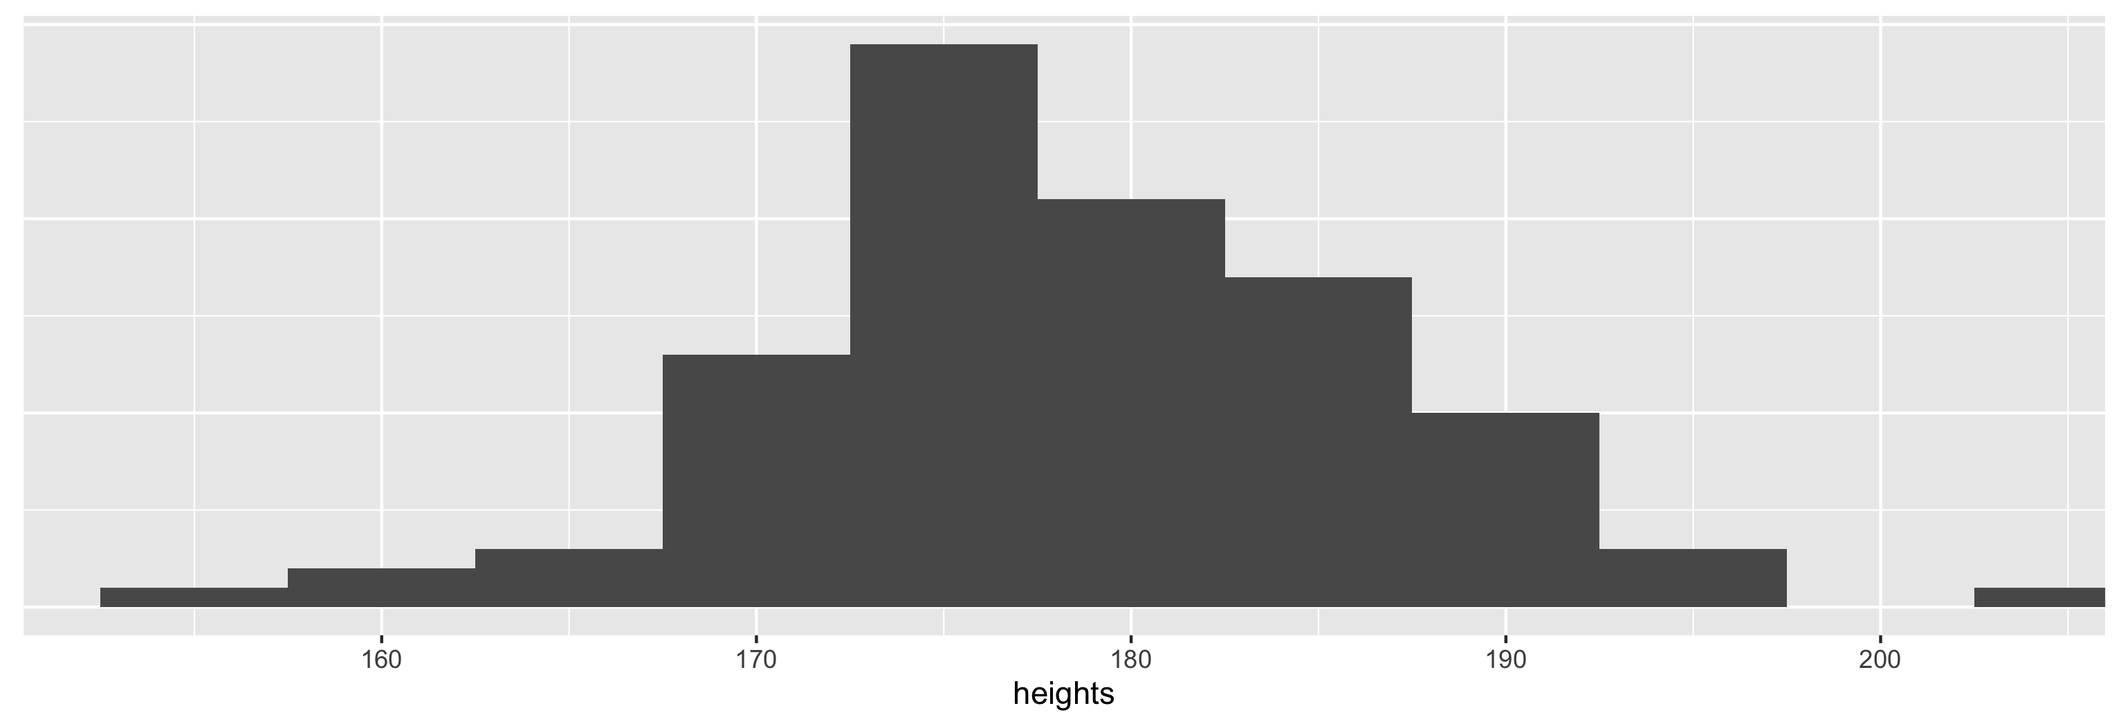
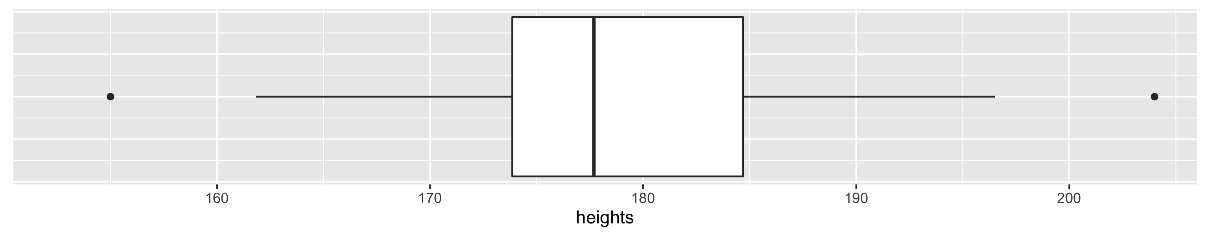
Recap: Histogram and boxplot
IQR
Inter-Quartile Range
min
smallest
non-outlier
p₂₅
p₅₀
p₇₅
biggest
non-outlier
max
boxplot does not show the mean!
1.5 * IQR
IQR
1.5 * IQR
OUTLIERS
x < p₂₅ – 1.5 * IQR
OUTLIERS
x > p₇₅ + 1.5 * IQR

Slide 4
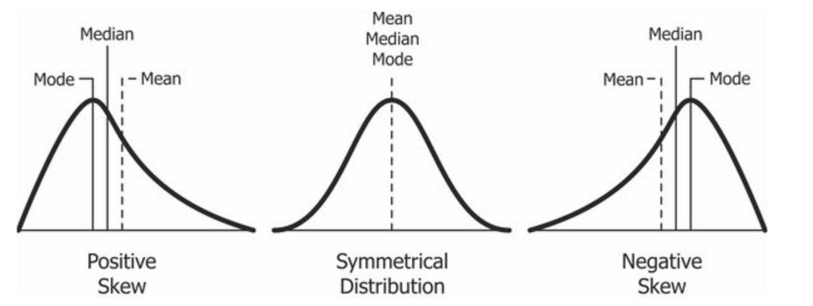

Recap: Mean and median
mean = average
median = “middle number”
mode = “most common value”

Slide 5
Recap: Exploratory data analysis
Variation
  How much do values of a same variable change across observations.
  “1-D spread” – single spread
Covariation
  How much do values of different variables change in a related way.
  “2-D spread” – related spread

Slide 6
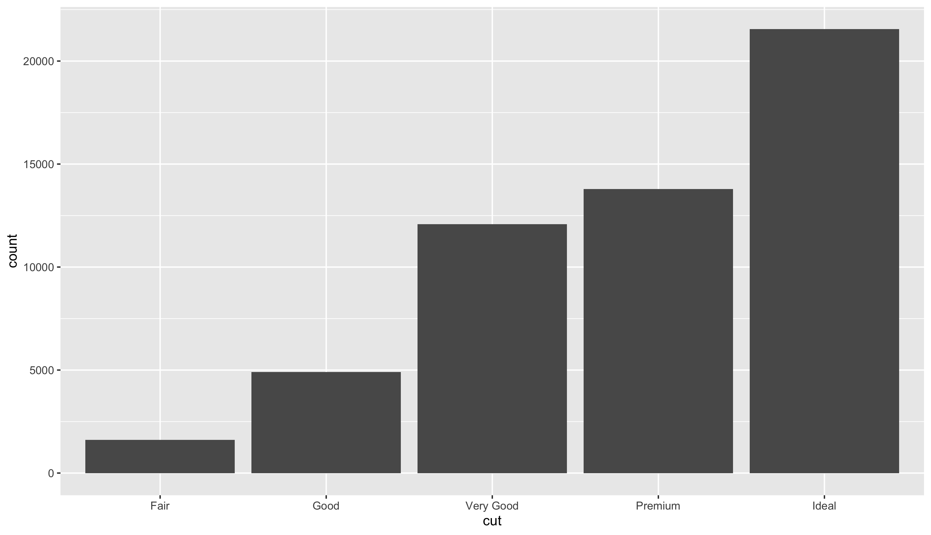
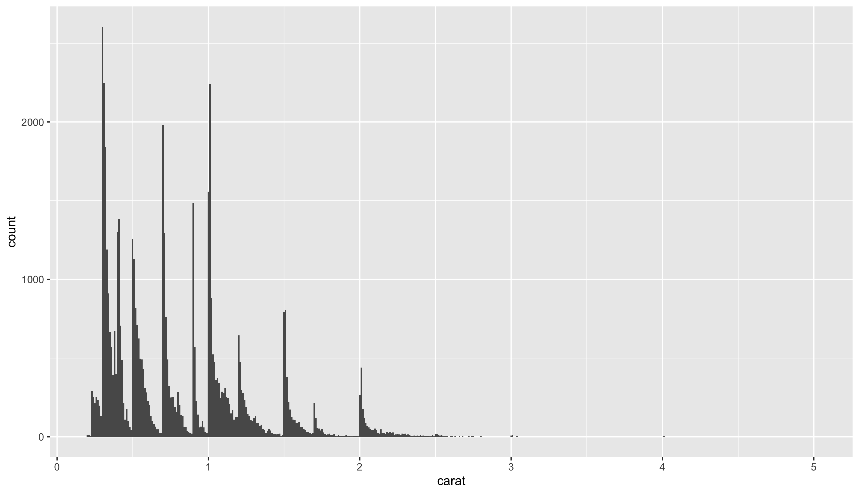
Recap: Exploring variation
Continuous variable
Categorical variable
Bar plot
Histogram
Notes:
What do you think when looking at the right graph? Outliers. The graph wouldn’t be so big if there weren’t any.

Slide 7
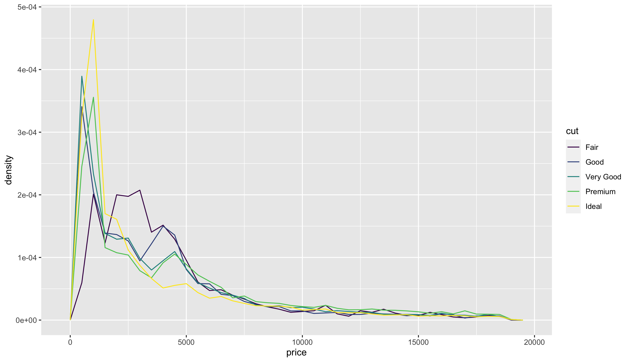
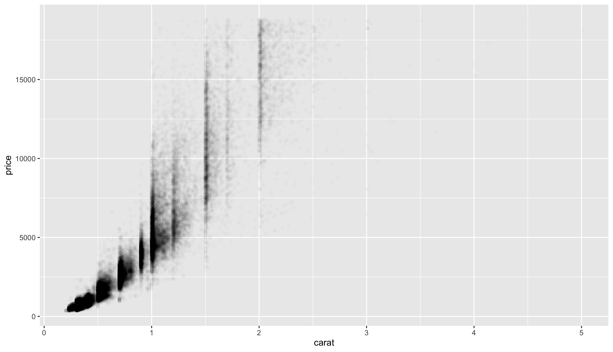
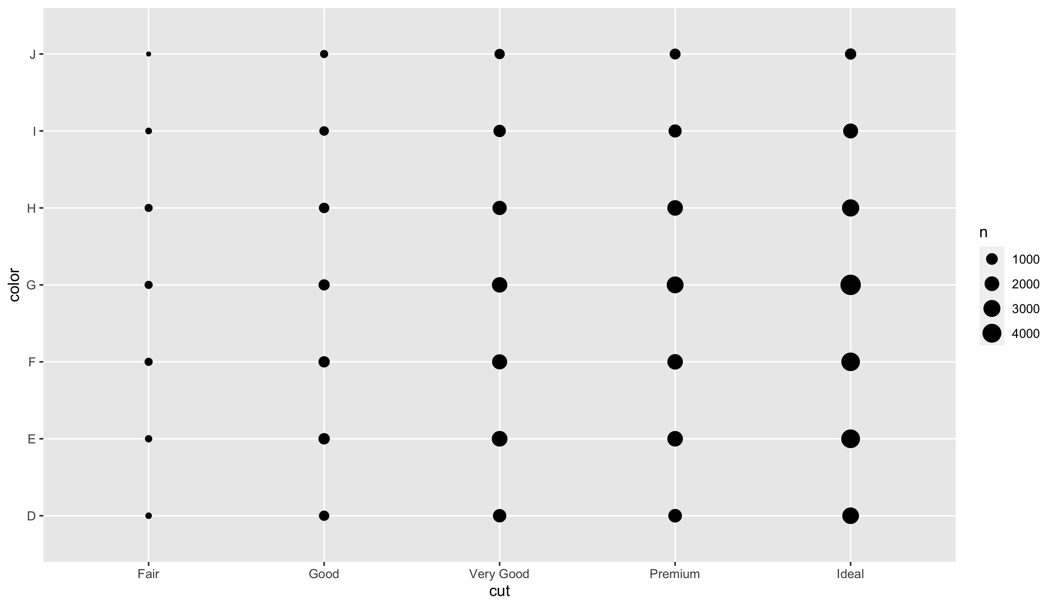
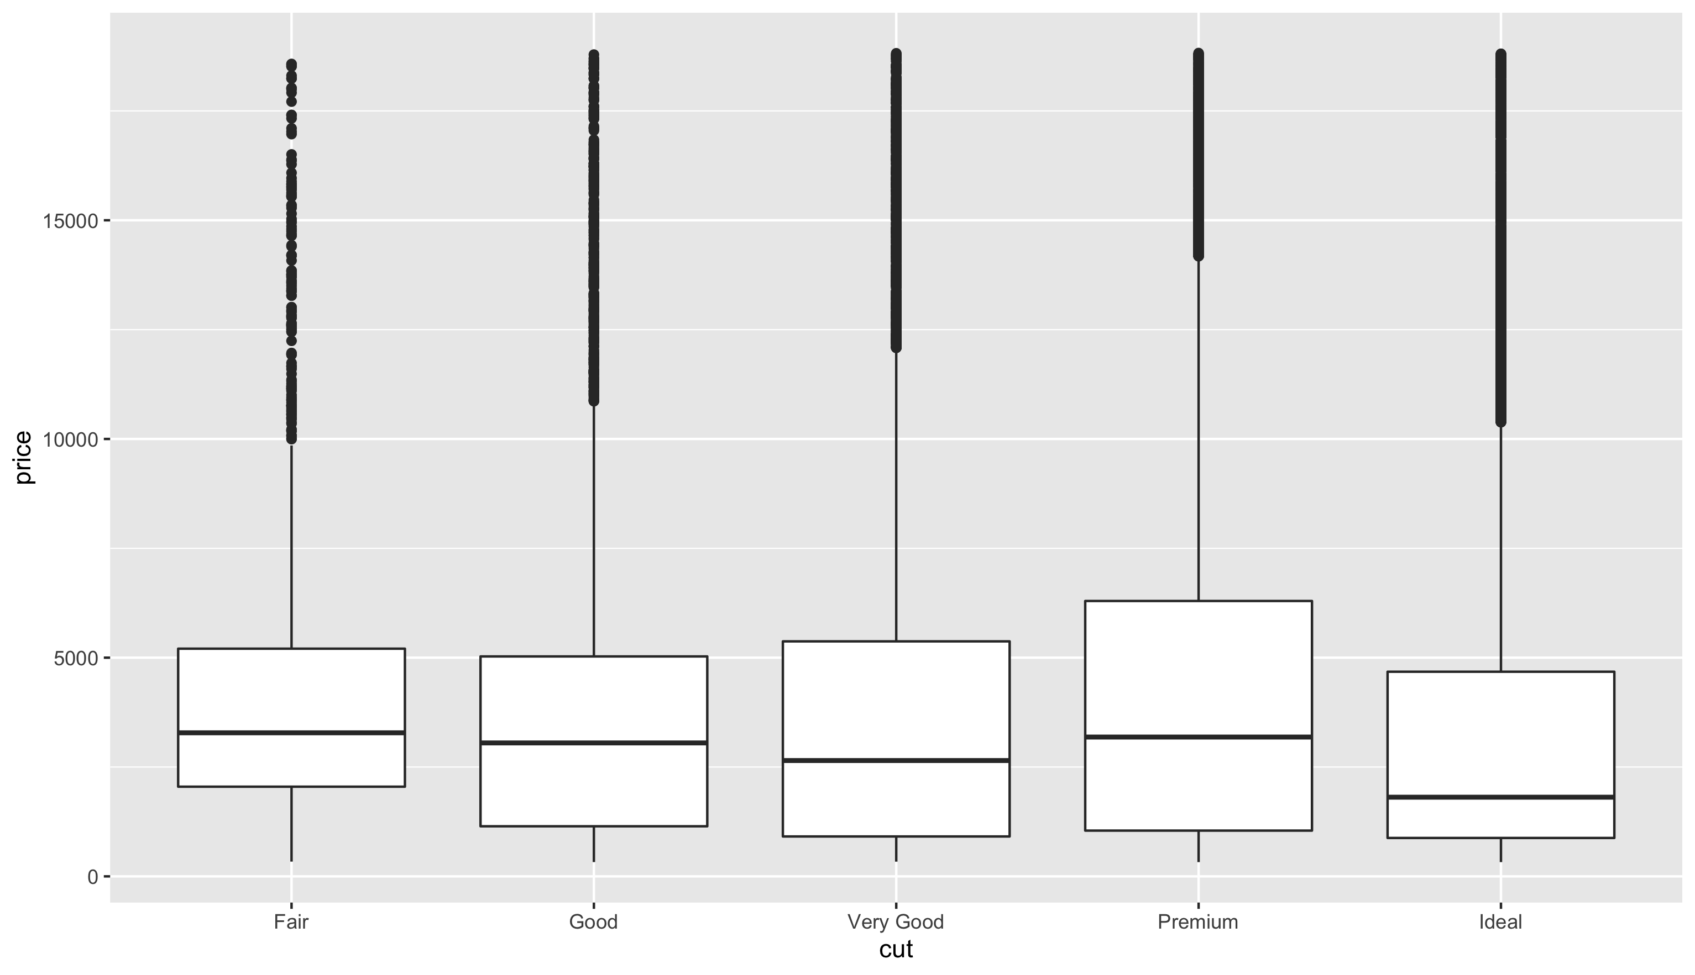
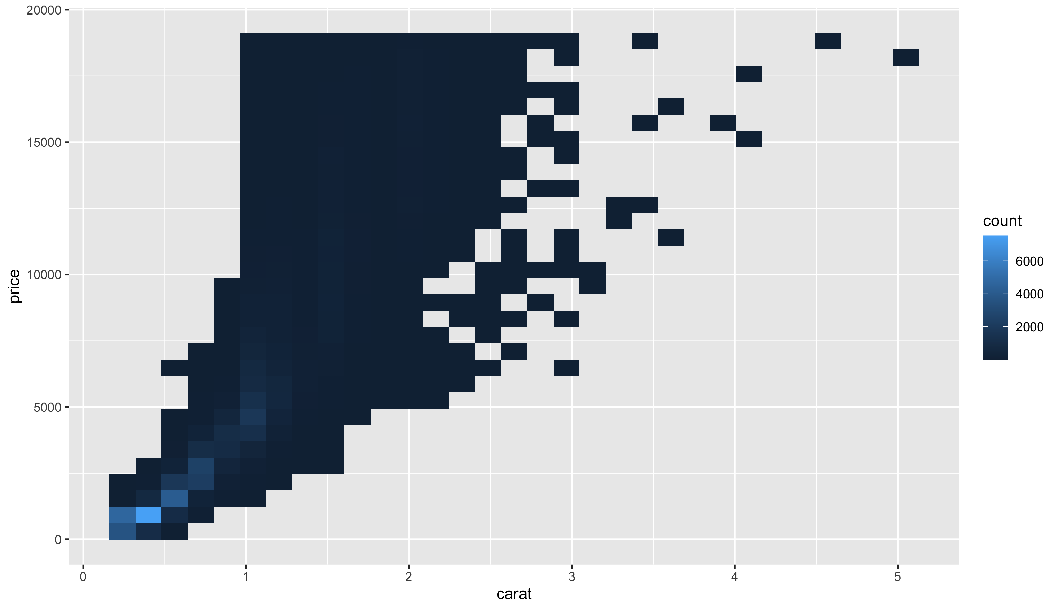
Recap: Exploring covariation
Categorical/Categorical
Continuous/Continuous
Categorical/Continuous
Frequency polygon
Grouped boxplot
Two-dimensional grid
Scatter plot
2D histogram

Slide 8
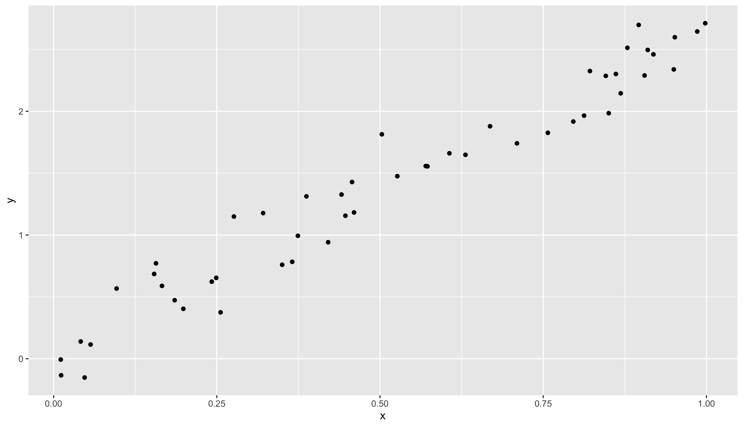
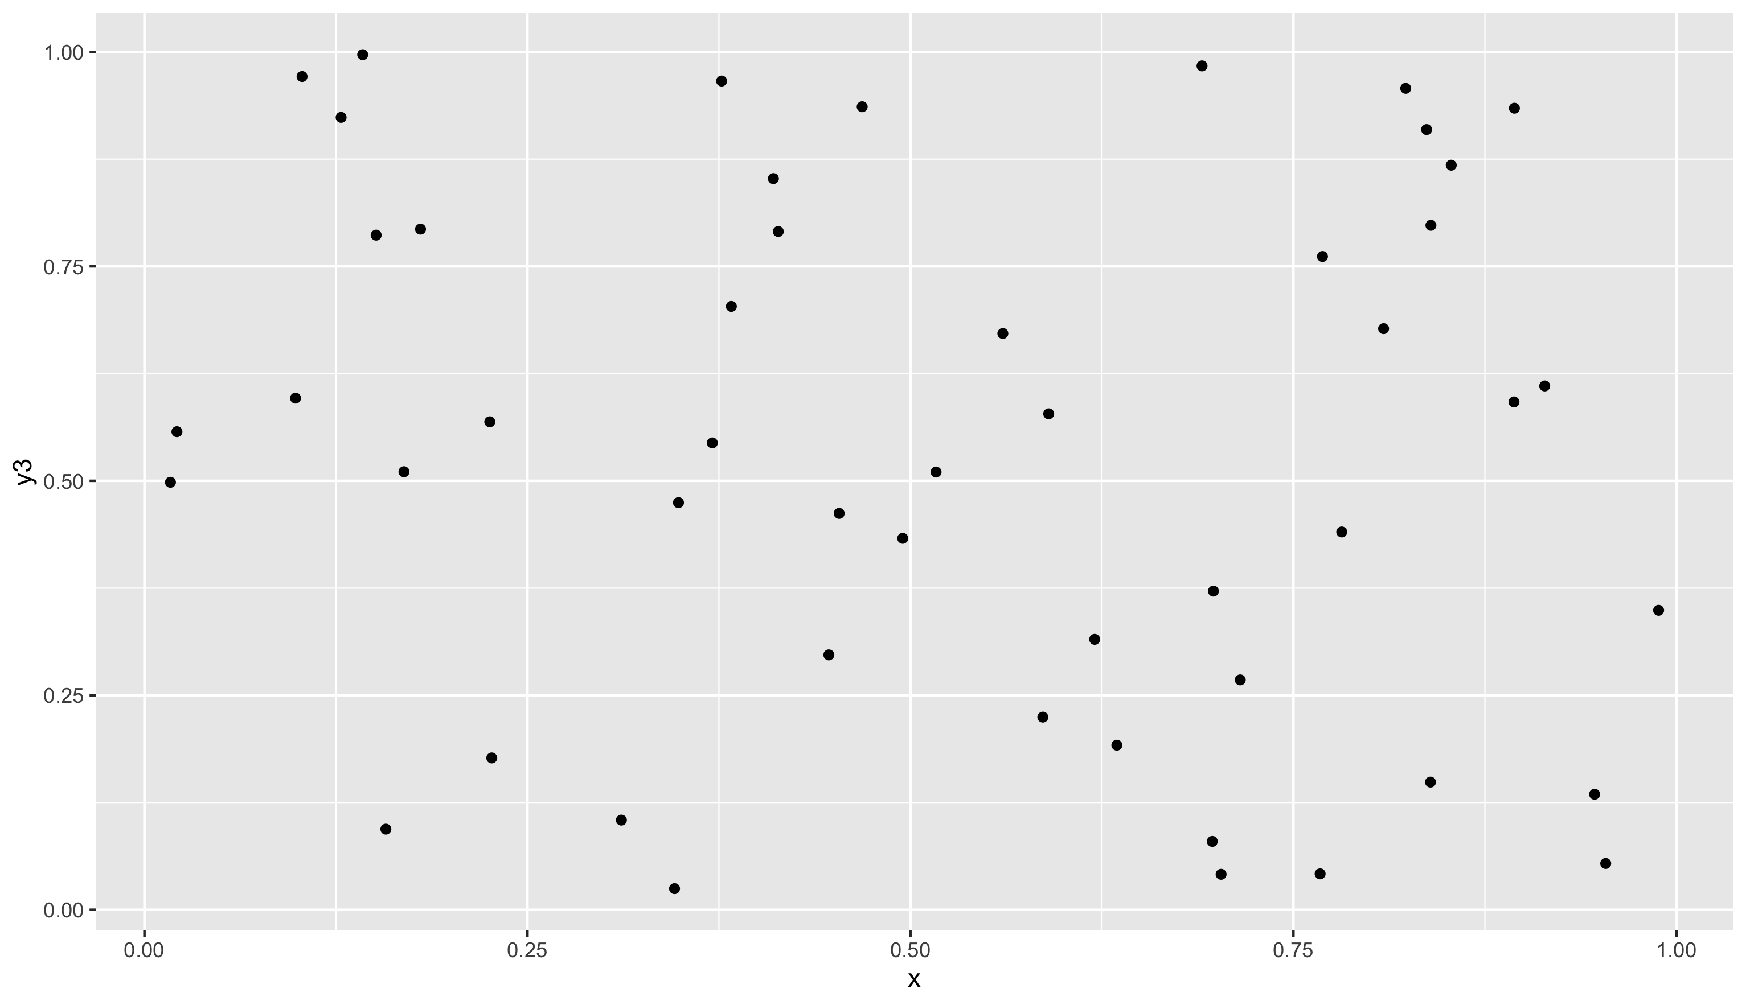
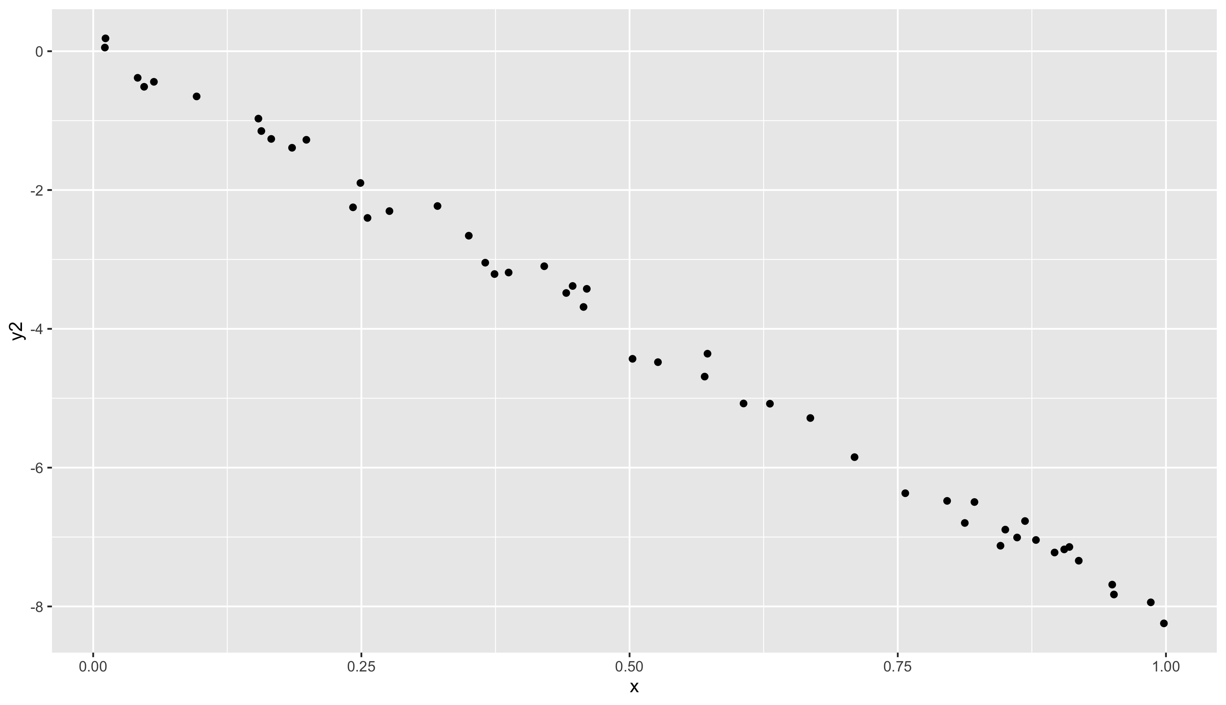
Recap: Covariance and correlation
Correlation ≈ 1
Strong positive relationship
Correlation ≈ 0
No relationship
Correlation ≈ -1
Strong negative relationship

Slide 9
Storytelling
Check out Hans Rosling:
Let my dataset change your mindset - link
The best stats you’ve ever seen – link
How not to be ignorant about the world - link

Slide 10
Recap: Virtual Environments
Every project you do goes in its own personal virtual environment
Never in the main environment unless it uses no libraries
When using git (which you are) only upload requirements.txt, not the venv-folder
In your project:
  One git repo, one requirements.txt (updated)
  One venv per student
Notes:
python -m venv venv
https://python.land/virtual-environments/virtualenv

