Slide 1
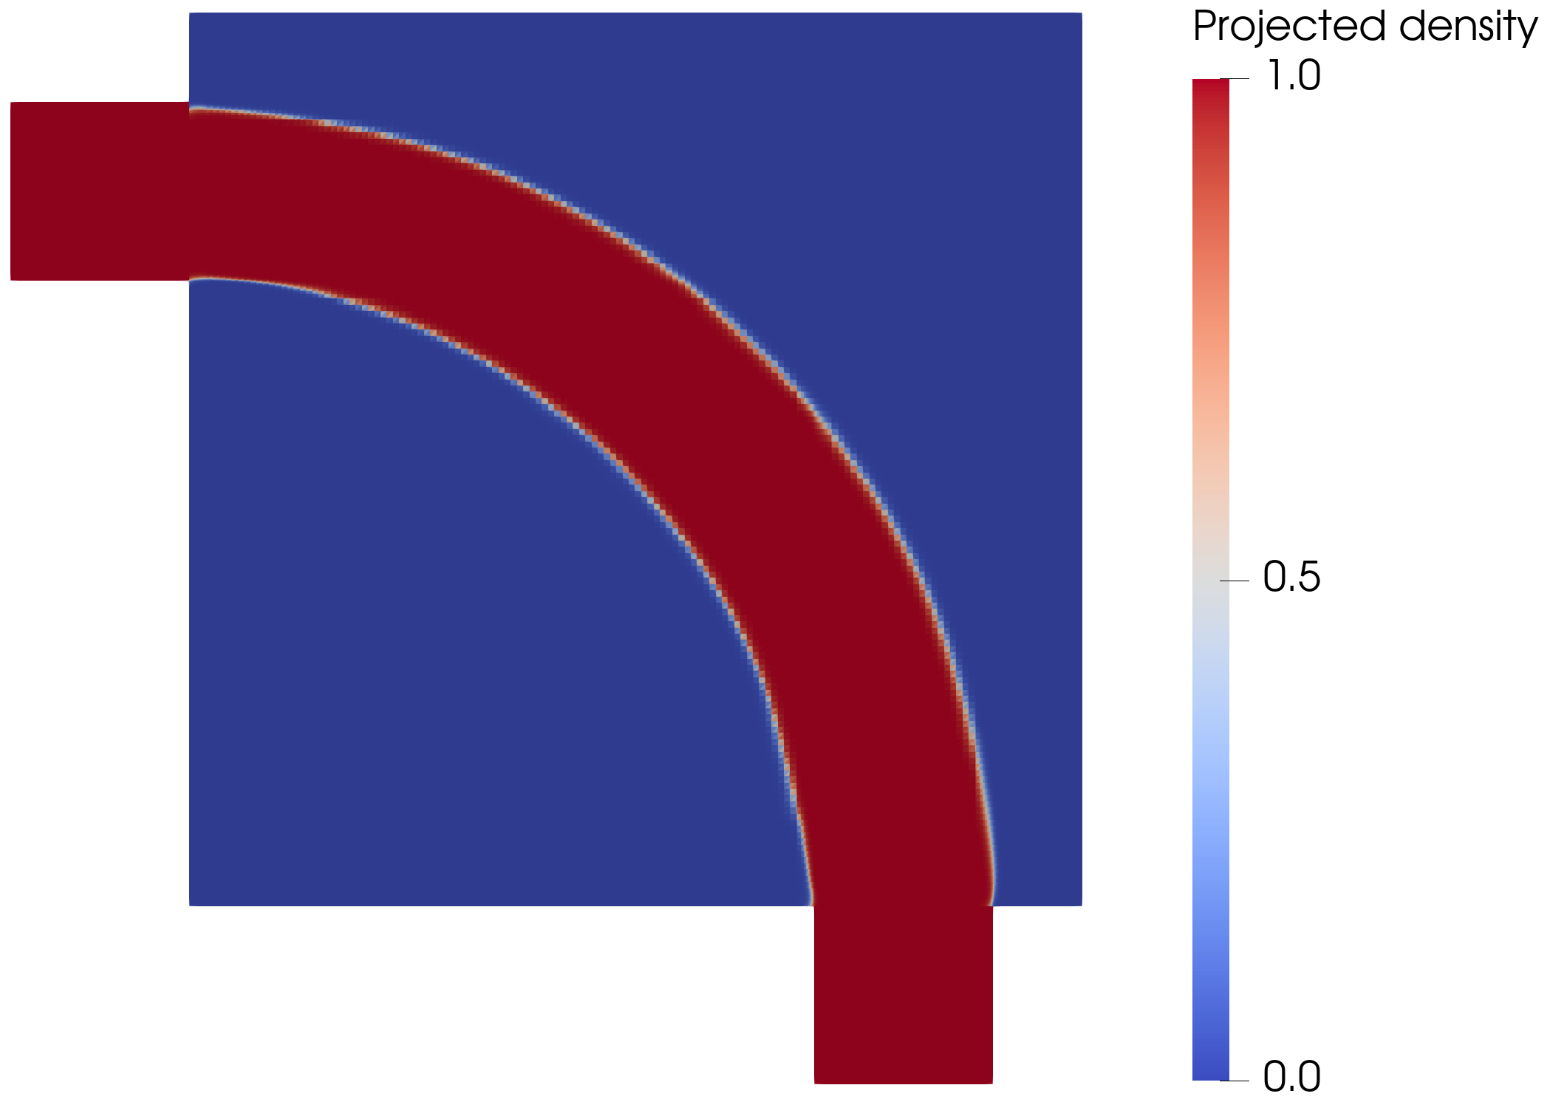
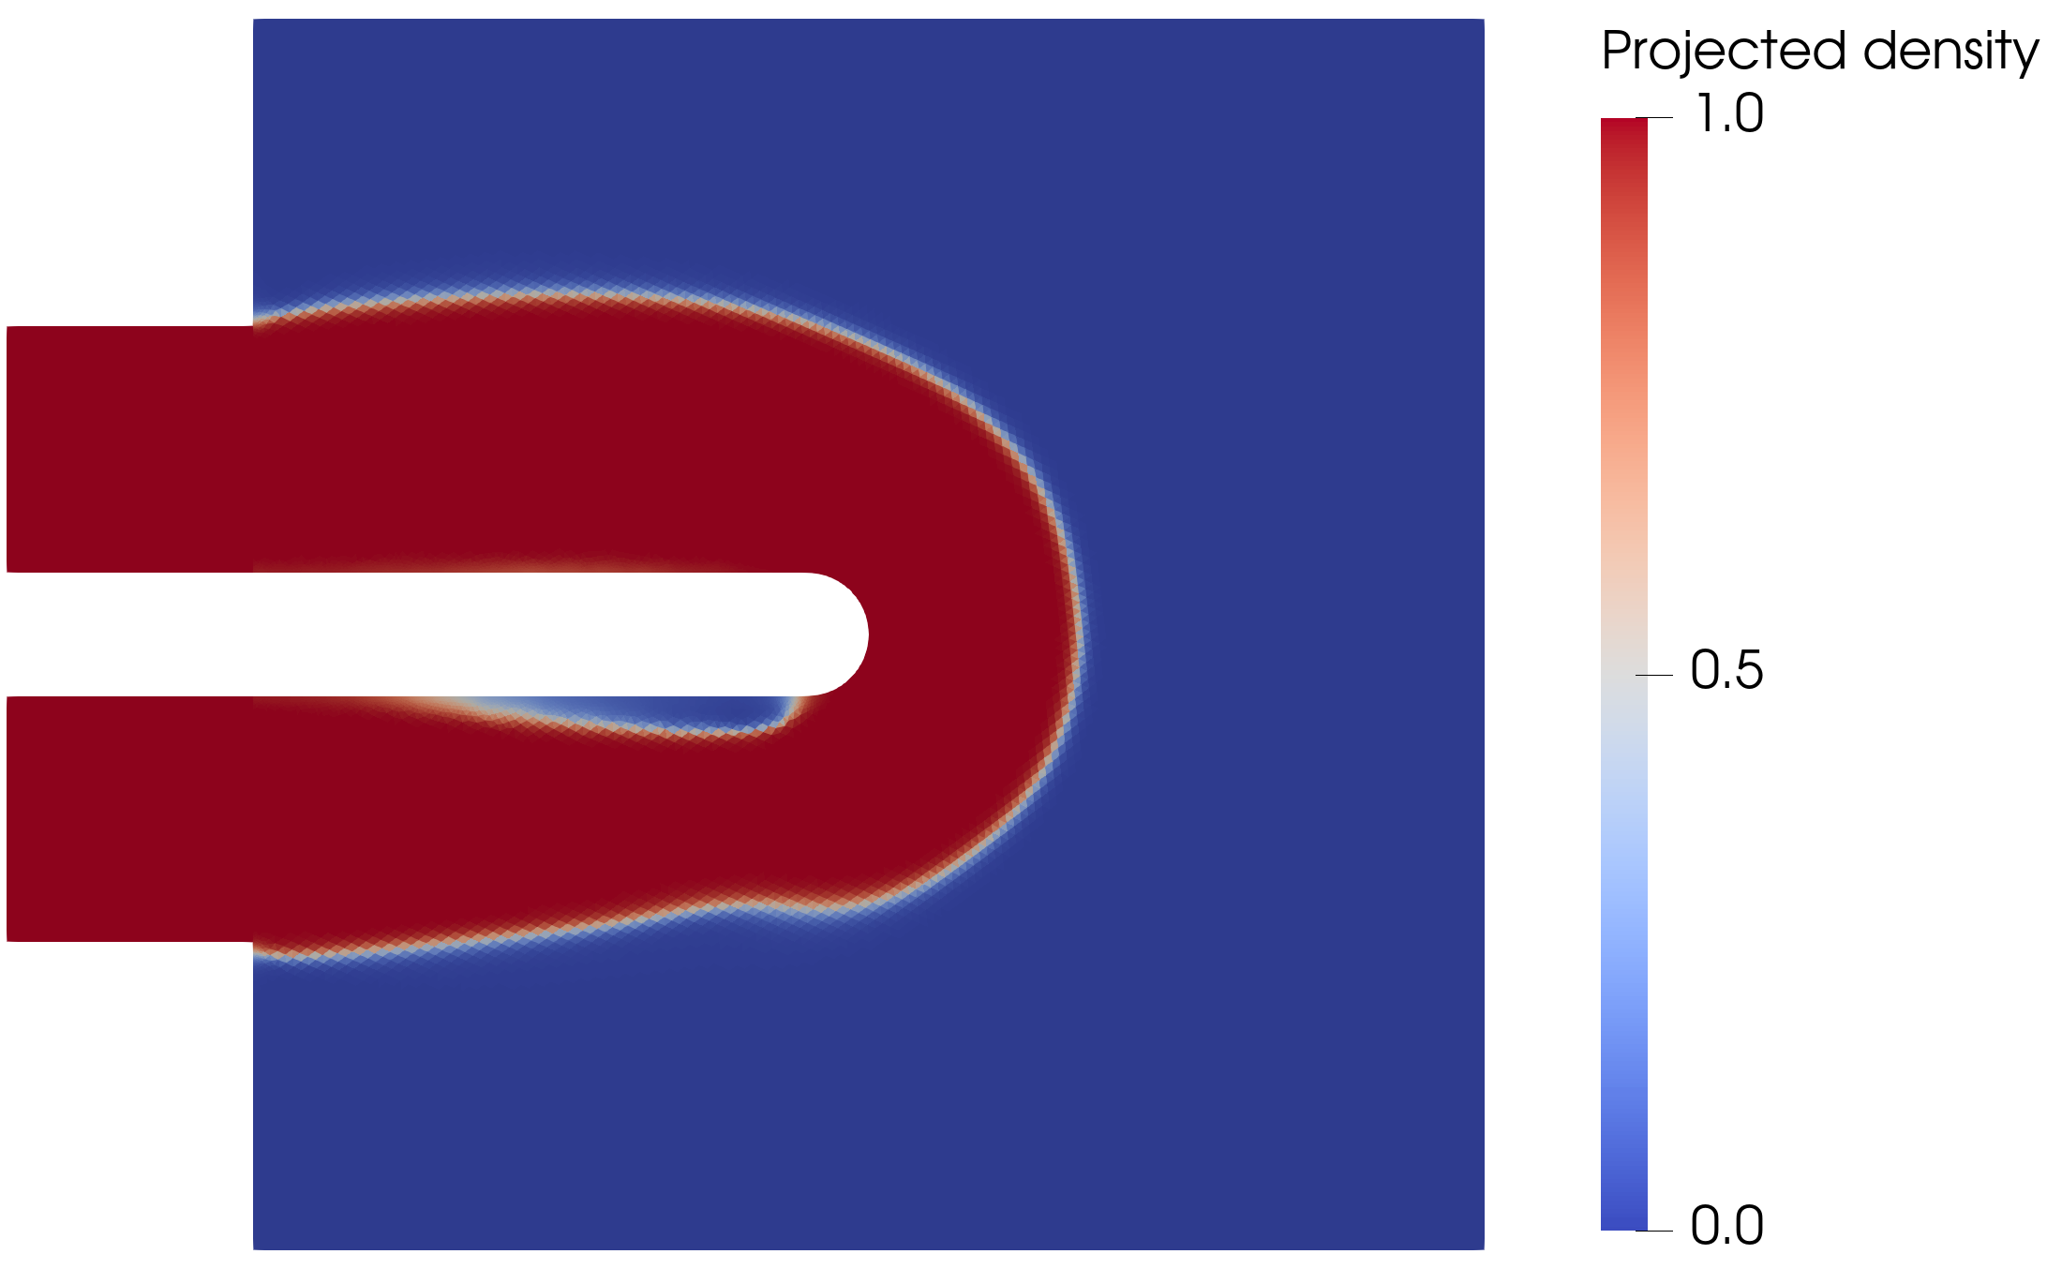
DEFENSE
Topology Optimization of Flow Configurations Operating in the Turbulent Regime
Tiebert Lefebure | Master of Science in Mechanical Engineering | KU Leuven
A turbulent topology-optimized density field is only useful after its sharp geometry survives independent CFD validation.
-72.0%
+48.3%
reversal
pipe-bend Delta p vs laminar
U-bend closure shift
diffuser ranking under SST
Notes:
Open with the central defense stance. This is not a claim that SA topology optimization solves every turbulent design problem. The thesis builds a turbulent TO workflow and then asks when the final designs remain credible after sharp-geometry validation.

Slide 2
ONE-SLIDE ANSWER
The result is conditional: robust in attached flow, fragile in separated flow.
Frozen-SA topology optimization can create useful low-loss turbulent candidates, but the final claim depends on the flow regime.
Pipe bend
U-bend
Diffuser
robust transfer
closure-sensitive
ranking reversal
SST raises pressure drop by only 4.5%; turbulent design lowers pressure drop by 72.0% vs laminar under SST.
Forced 180 degree return: SST raises pressure drop by 48.3% for the same turbulent geometry.
Under SA the turbulent design beats laminar; under SST it is 30.5% worse in pressure drop.
TurbulentTO master's thesis defense
02
Notes:
This is the thesis answer. The result is strongest because it is not overclaimed. Say: the framework works where the physics remain inside the model envelope, and it exposes uncertainty where they do not.

Slide 3
TALK MAP
The defense follows the evidence chain used in the thesis.
1. Model envelope
2. Forward solver
3. Optimization loop
4. Sharp validation
Where SA is a credible design closure
FEniCS-SA verified against Ansys
Density TO + frozen adjoint + MMA
Final geometries checked with SA and SST
TurbulentTO master's thesis defense
03
Notes:
This slide gives the committee a map. Emphasize that each later result is judged by the same standard: not only whether the optimizer makes a pretty topology, but whether the extracted geometry remains credible.

Slide 4
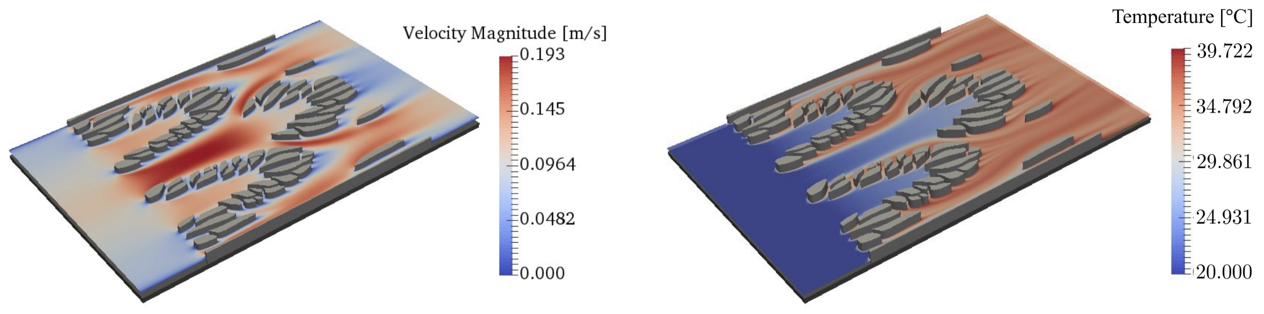
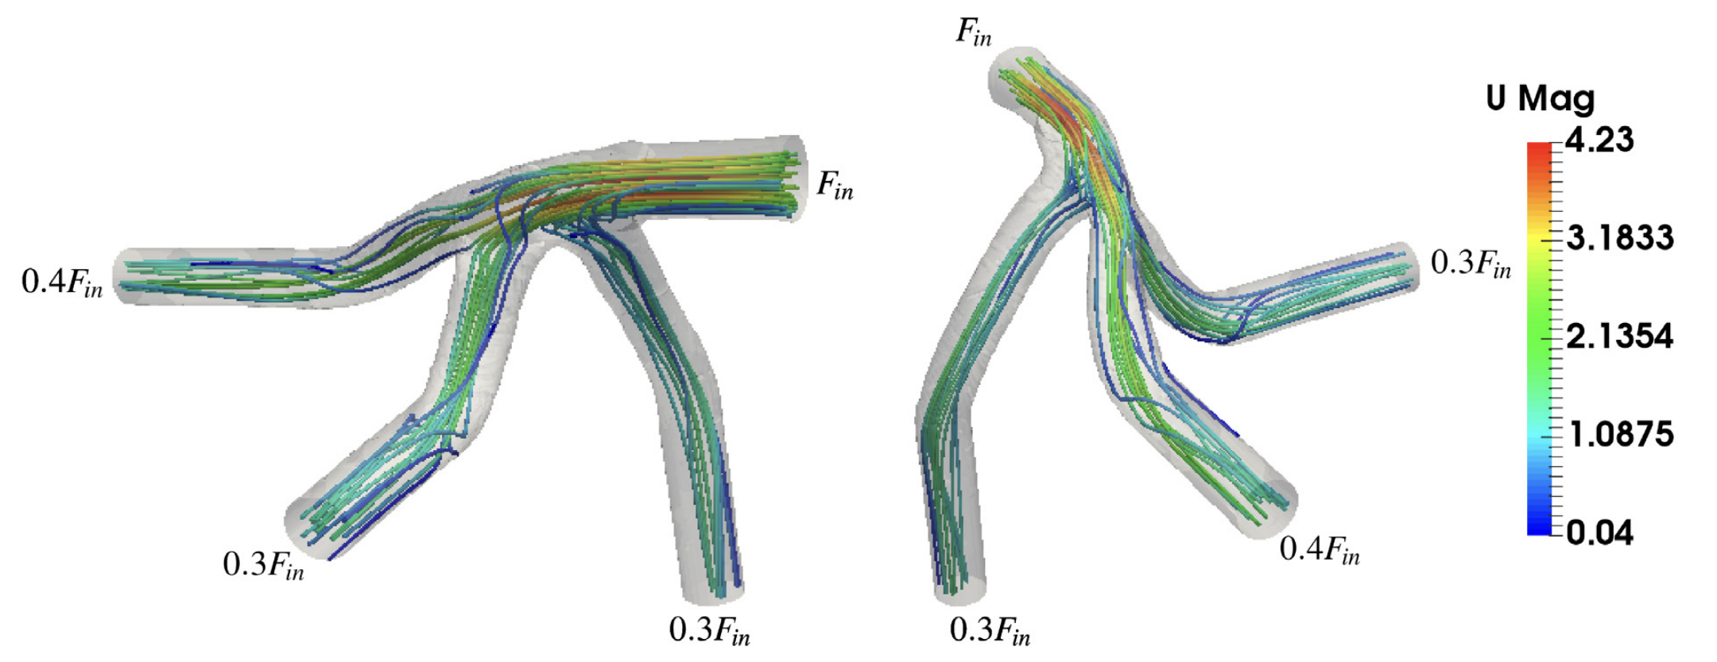
SCOPE
The thesis solves the hydraulic prerequisite, not the full thermal problem.
No energy equation and no conjugate heat transfer claim.
The target is low-loss turbulent internal routing: pressure drop, dissipation, and separated-flow sensitivity.
This narrower problem is already hard because turbulence, wall distance, topology penalization, extraction, and gradients all interact.
TurbulentTO master's thesis defense
04
Notes:
This prevents the obvious Q&A trap: why is there no heat transfer objective? The answer is that turbulent hydraulic routing is the prerequisite, and the thesis deliberately isolates it before adding CHT.

Slide 5
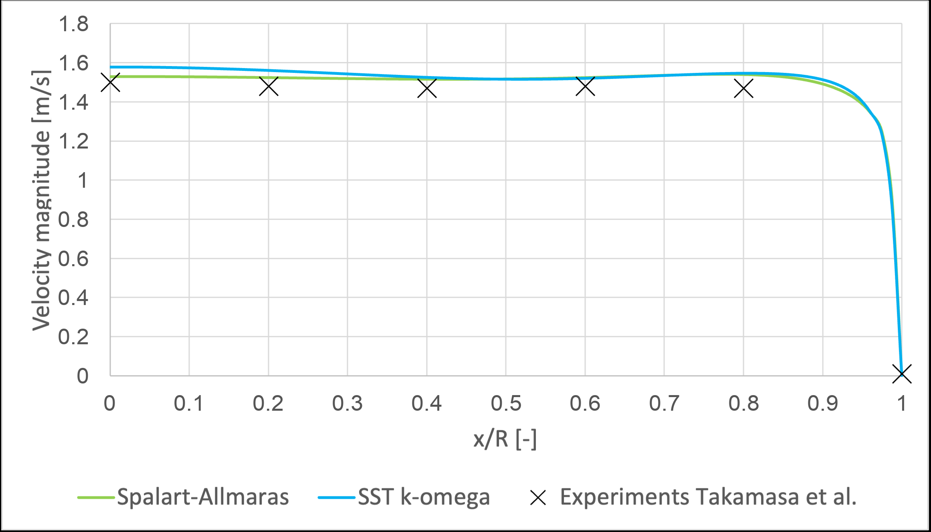
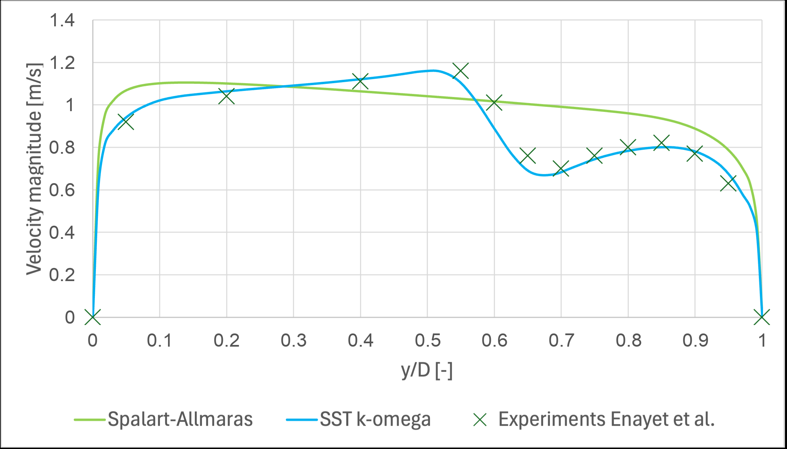
MODEL ENVELOPE
SA is a design closure, not closure-independent truth.
The model is practical for attached and mildly curved wall-bounded flow, but deterioration appears when curvature and separation dominate.
Moderate U-bend evidence: acceptable SA/SST agreement
Tighter bend evidence: visible closure deterioration
This boundary is the reason final designs are validated with an independent SST k-omega solve.
TurbulentTO master's thesis defense
05
Notes:
Keep this conceptual. SA is not being dismissed; it is being placed in the right role. It is usable as an optimization model where attached/mildly curved behavior dominates, but not as final truth for separated recovery.

Slide 6
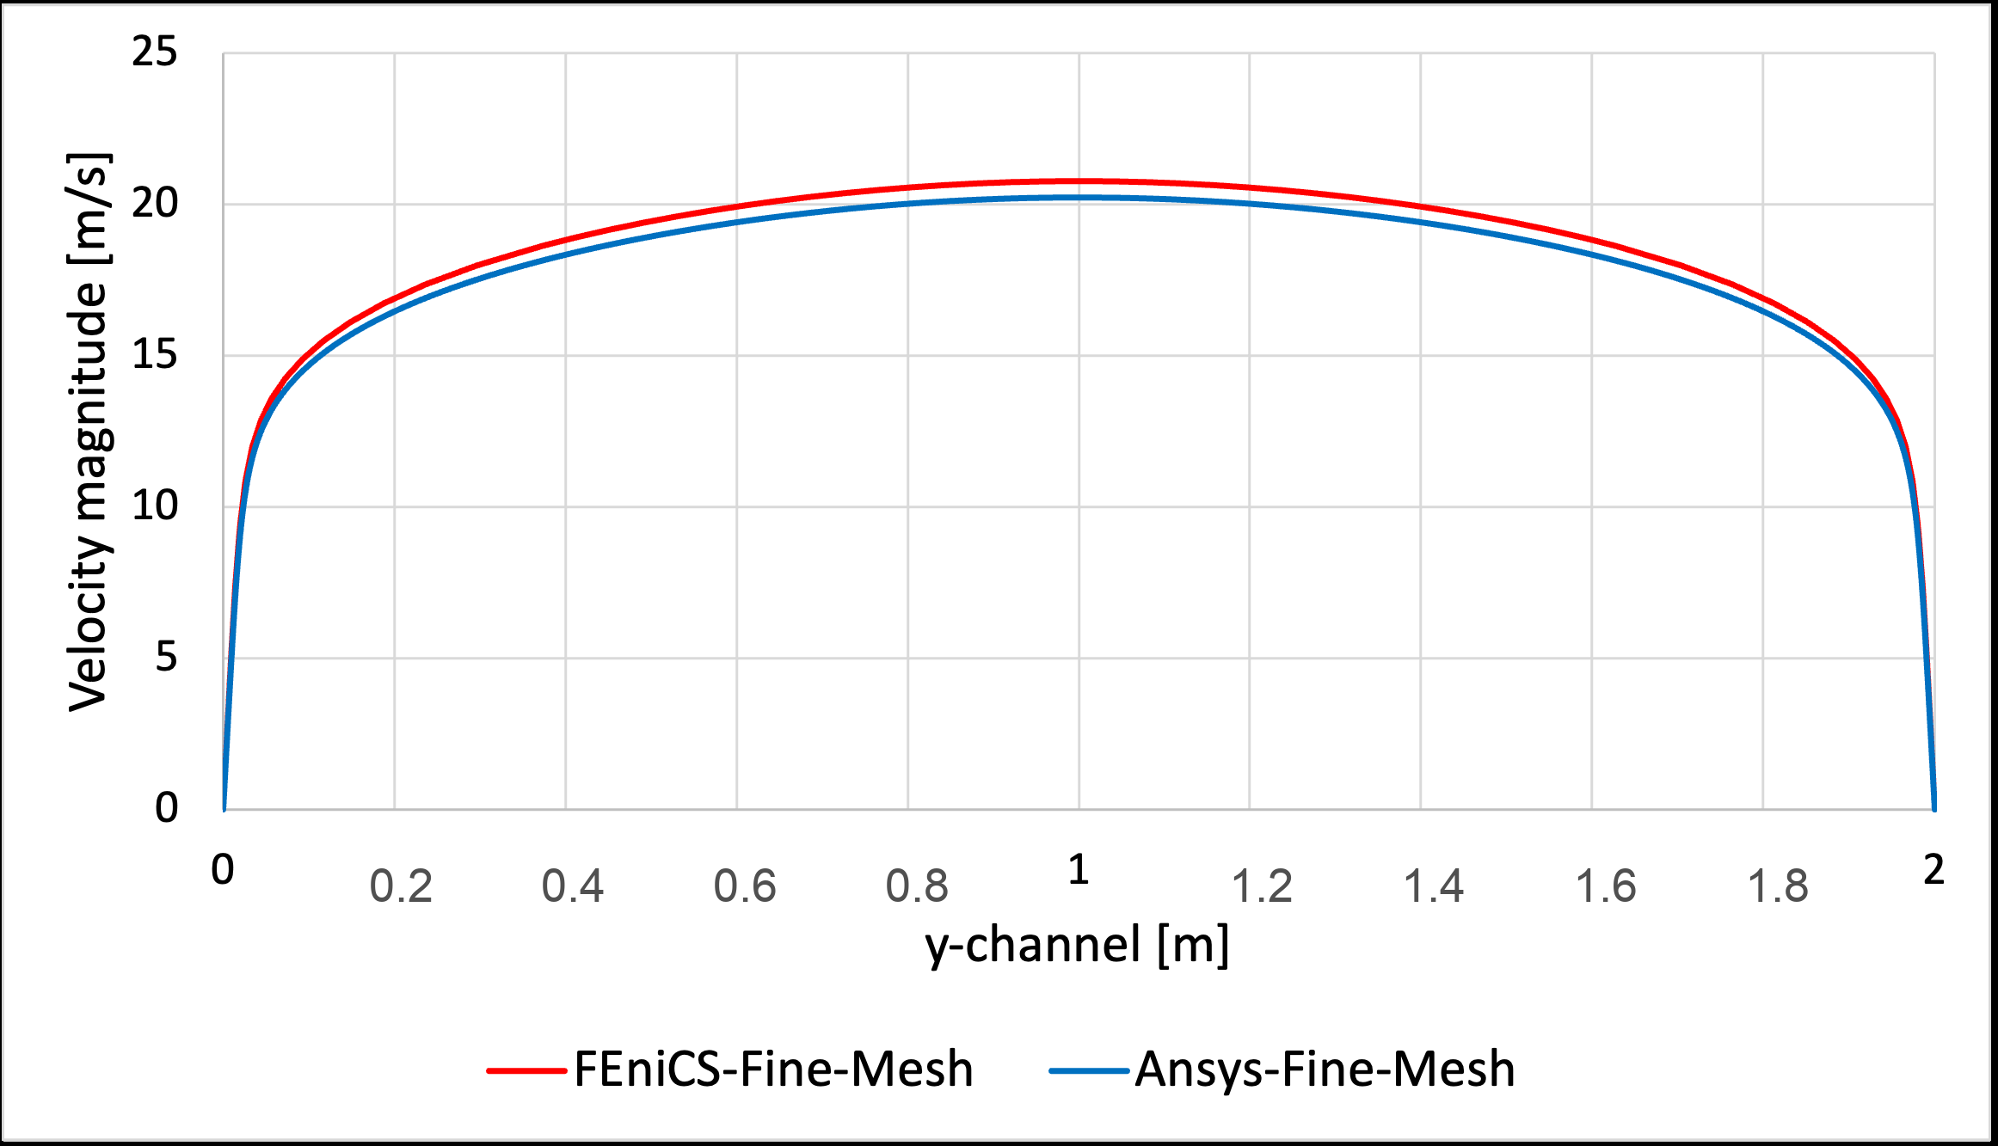
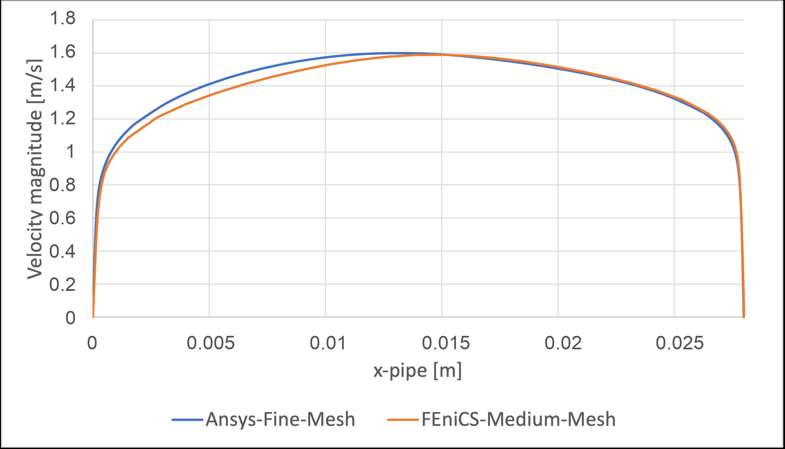
FORWARD SOLVER
The FEniCS-SA forward solver is verified before being optimized.
Periodic channel profile
2D U-bend exit profile
2.67%
2.79%
8.50%
channel bulk-velocity difference
U-bend pressure-drop difference
U-bend max profile discrepancy
TurbulentTO master's thesis defense
06
Notes:
The point is not perfect pointwise agreement. The point is that the forward solver reproduces the quantities needed by the optimizer: velocity-pressure coupling, SA transport, wall-distance treatment, and near-wall behavior.

Slide 7
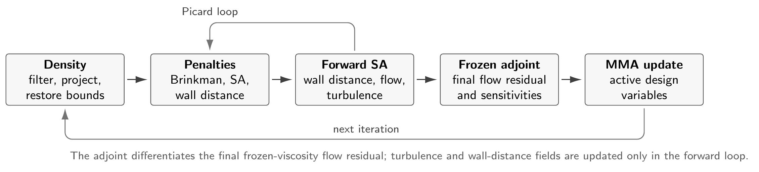
OPTIMIZATION METHOD
The optimizer changes density; the flow solver sees a penalized turbulent duct.
01
gamma -> filtered gamma -> projected gamma_bar
02
RANS-SA + Brinkman resistance + topology wall-distance penalty
03
MMA receives J, volume residual, and frozen-adjoint gradients
TurbulentTO master's thesis defense
07
Notes:
Explain the method at the right abstraction level. The mesh is fixed. Density controls where the flow is allowed. Brinkman penalization suppresses velocity in solid regions. SA and wall-distance penalties keep turbulence fields physically tied to the topology.

Slide 8
VALIDATION RULE
The claim is made only after diffuse-to-sharp transfer.
FEniCS diffuse density field
>
Extracted sharp wall geometry
>
Ansys-SA validation
>
Ansys SST k-omega stress test
The optimizer is judged by the exported geometry, not by the diffuse objective alone.
Phi_D
Delta p
SA vs SST
physical dissipation
static pressure drop
closure sensitivity
TurbulentTO master's thesis defense
08
Notes:
This is the rule that makes the results defensible. A density field can look plausible and still fail after extraction or after a closure change.

Slide 9
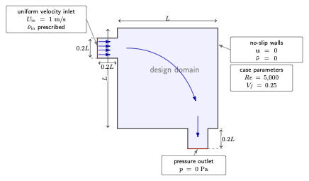
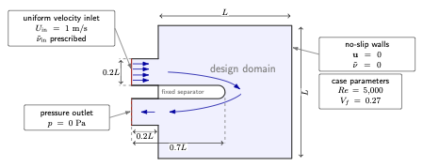
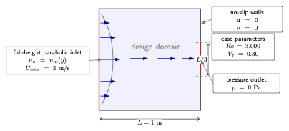
BENCHMARKS
Three geometries test three levels of turbulence-model risk.
Pipe bend
U-bend
Diffuser
attached / moderate curvature
forced 180 degree return
adverse pressure gradient
TurbulentTO master's thesis defense
09
Notes:
This is the transition into results. The three cases are not just three examples; they deliberately move from more defensible to more closure-sensitive physics.

Slide 10
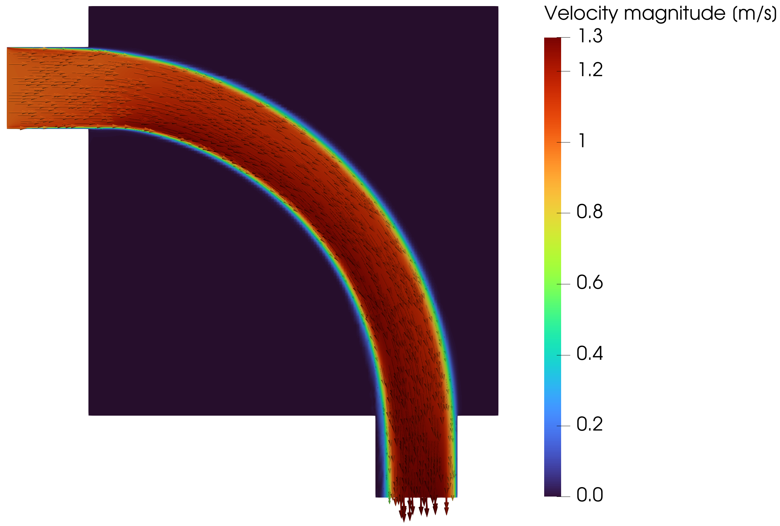
PIPE BEND
Pipe bend: the optimized route bypasses the sharpest corner.
At Re = 5000 and Vf = 0.25, the 70-iteration endpoint already forms the expected smooth routing strategy.
Projected density
FEniCS-SA velocity
Jp = 0.2130 Pa | endpoint is promising, not claimed as converged
TurbulentTO master's thesis defense
10
Notes:
Do not oversell convergence. The result is a provisional topology endpoint. The reason it matters is that the extracted shape survives validation.

Slide 11
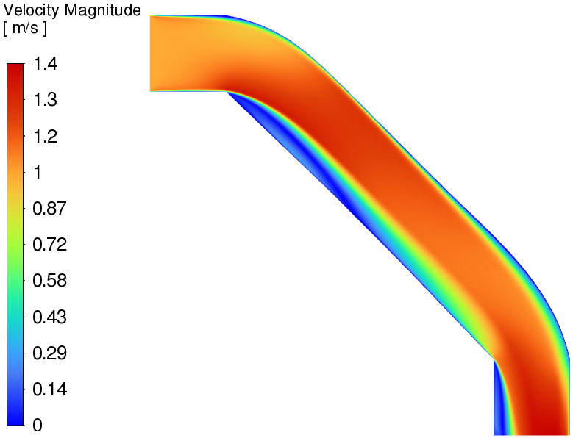
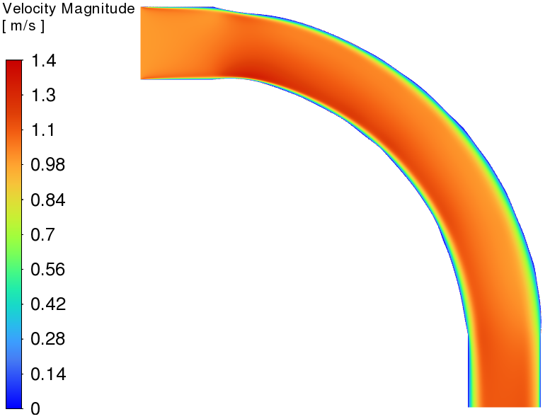
PIPE BEND VALIDATION
Under SST validation, the turbulent pipe bend crushes the laminar surrogate.
Laminar-optimized design, run at Re = 5000
Turbulent-optimized design, run at Re = 5000
-72.0%
-47.0%
pressure drop
viscous dissipation
TurbulentTO master's thesis defense
11
Notes:
This is the strongest slide in the talk. The comparison is fair because both extracted geometries are evaluated with the same SST k-omega model at the target turbulent operating condition.

Slide 12
PIPE BEND ROBUSTNESS
The pipe-bend geometry is not narrowly tuned to SA.
Replacing Ansys-SA by SST k-omega changes the extracted-geometry losses only modestly.
Pressure drop, lower is better
+4.5%
FEniCS diffuse SA
0.2130 Pa
pressure-drop shift, SA -> SST
+8.5%
Ansys sharp SA
0.1457 Pa
dissipation shift, SA -> SST
Ansys sharp SST
0.1522 Pa
5.92e-5
max coordinate FD discrepancy
TurbulentTO master's thesis defense
12
Notes:
This slide separates two issues: optimization convergence and validation robustness. The FEniCS endpoint can still be provisional, while the exported geometry can be robust under independent validation.

Slide 13
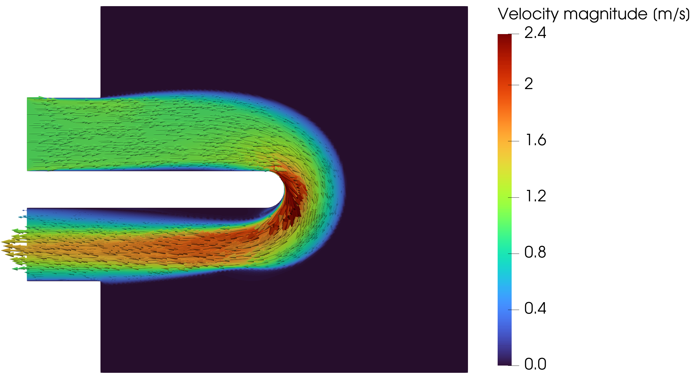
U-BEND
U-bend: the forced return makes the same method much harder.
The geometry forces a 180 degree return around a fixed separator, so recirculation and closure response become part of the design.
Projected density
FEniCS-SA velocity
Jp = 0.8250 Pa | Bayat k-epsilon reference scale = 0.8327 Pa | current run still evolving
TurbulentTO master's thesis defense
13
Notes:
Frame this as promising but not settled. If the current running case improves, this slide can be updated with the new endpoint.

Slide 14
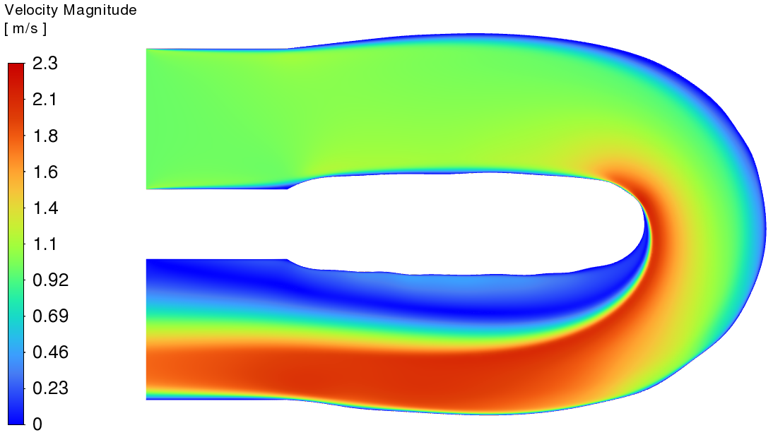
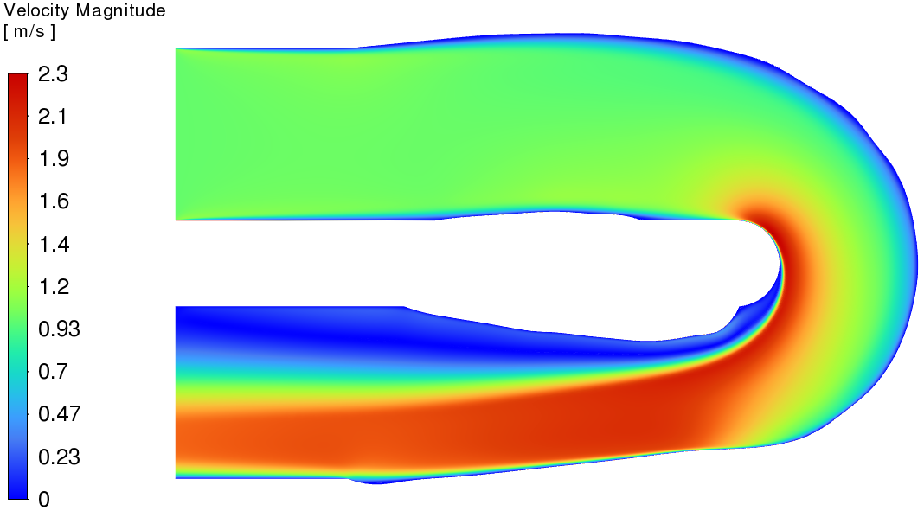
U-BEND VALIDATION
U-bend validation is positive under SA, but weak under SST.
Laminar design under SST
Turbulent design under SST
SA validation: turbulent design lowers Phi_D by 31.0% and Delta p by 16.3% vs laminar.
SST validation: turbulent design lowers Phi_D by only 5.0% but raises Delta p by 4.1%.
For the same turbulent geometry, SST raises Delta p by 48.3% relative to Ansys-SA.
TurbulentTO master's thesis defense
14
Notes:
This is where the narrative becomes cautious. The U-bend is not a failure, but it is not closure-independent. The separator-driven return flow makes local recirculation central to the answer.

Slide 15
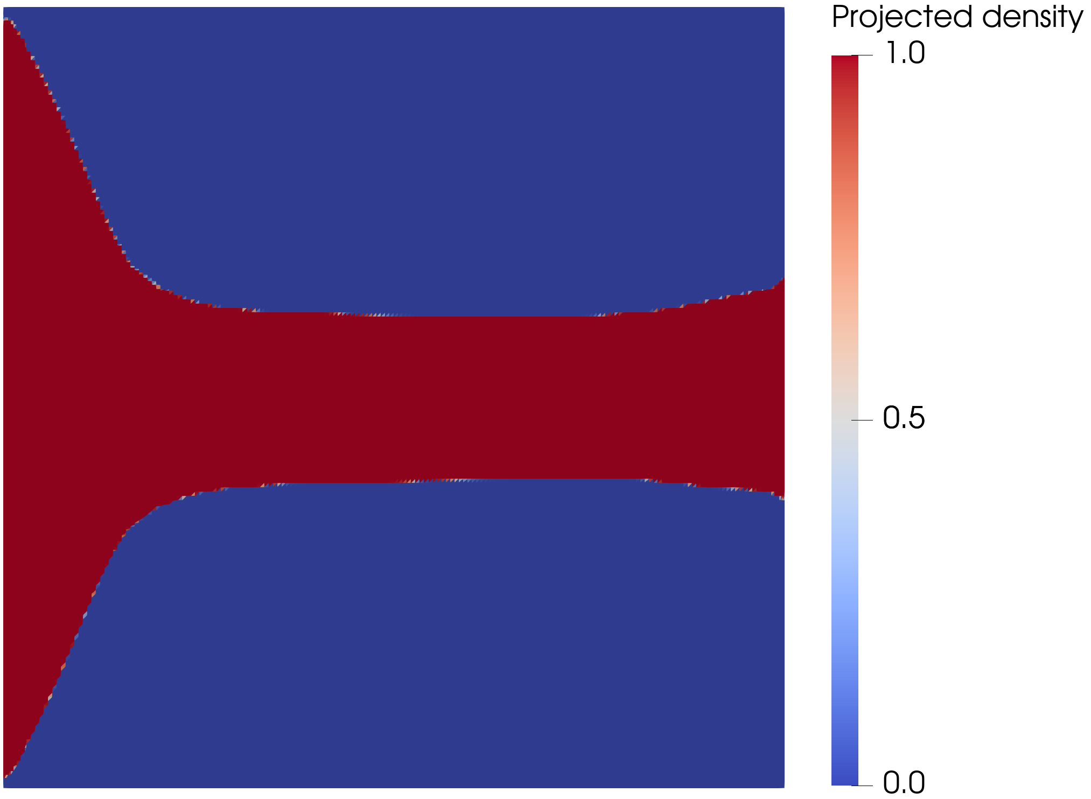
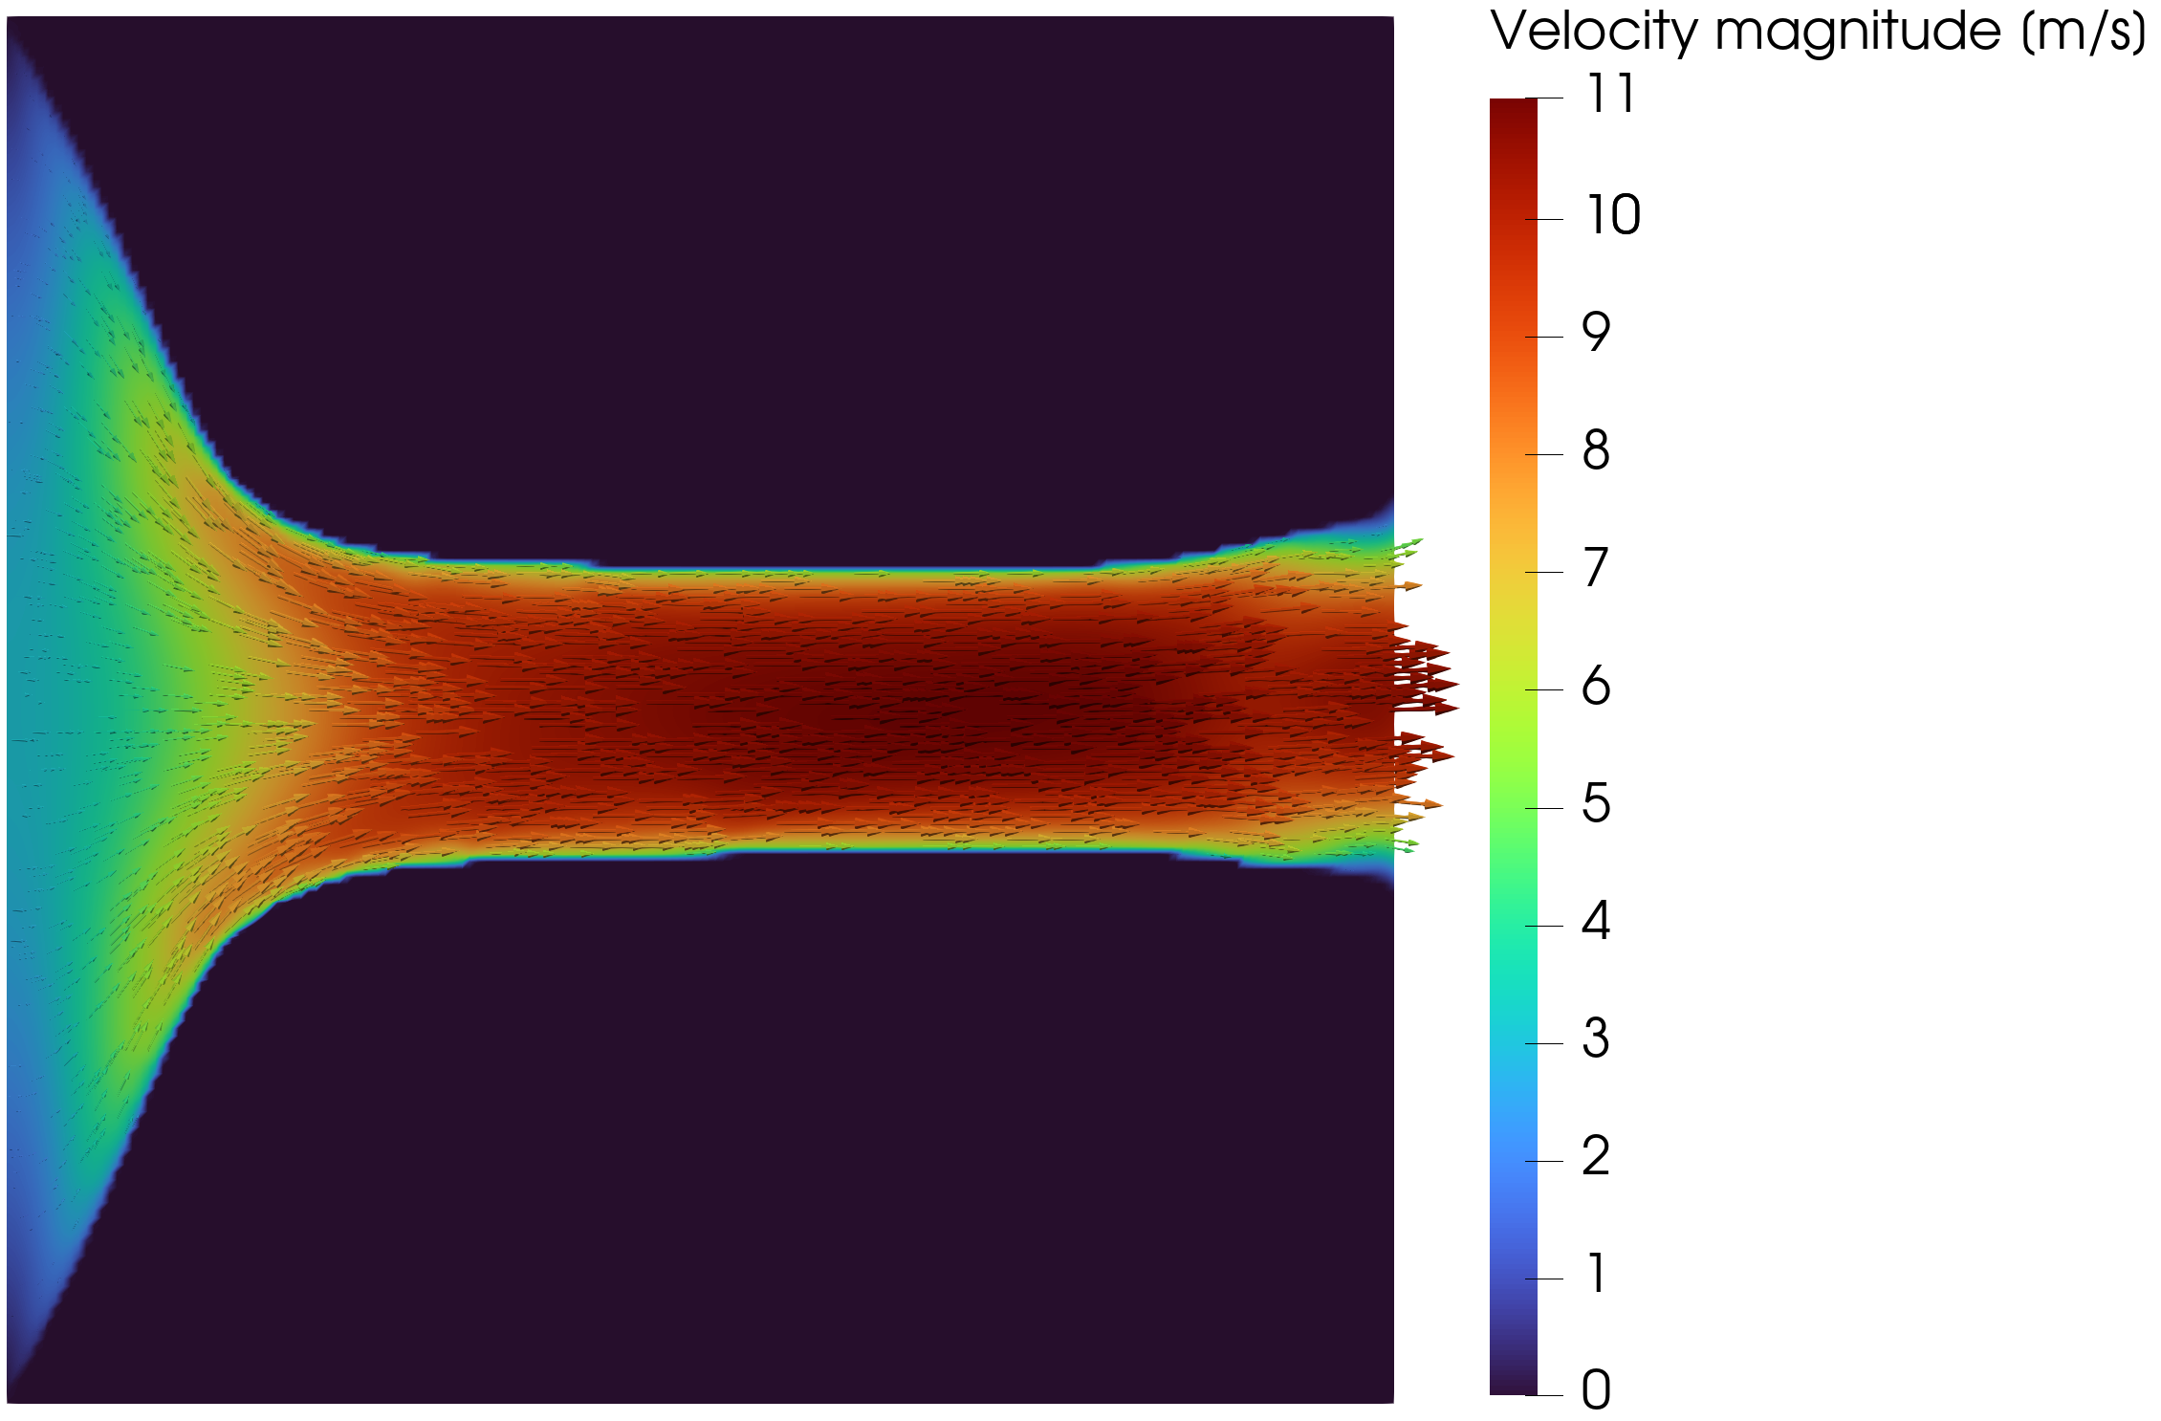
DIFFUSER
Diffuser: outlet treatment and adverse pressure gradients dominate the result.
The pressure-outlet variant removes a prescribed outlet velocity profile, but the final ranking remains closure-sensitive.
Pressure-outlet topology
FEniCS-SA velocity
Pressure-outlet objective: JD = 2.7664e5 W/m | 11.2% lower than velocity-outlet comparison point
TurbulentTO master's thesis defense
15
Notes:
Keep this short. The diffuser is not the headline success case. It is valuable because it shows how boundary treatment and separation sensitivity can decide the final ranking.

Slide 16
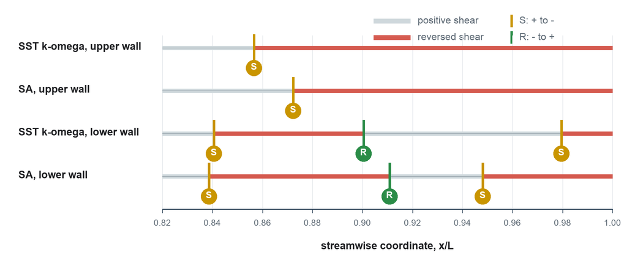
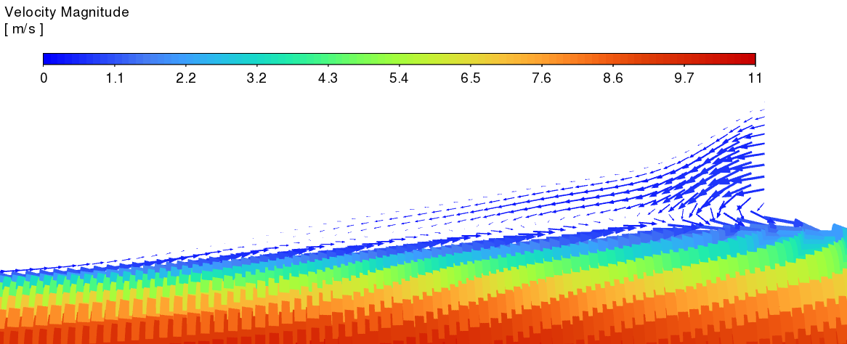
DIFFUSER VALIDATION
The diffuser ranking reverses when validation closure changes.
Model
Dissipation
Pressure drop
Decision
Ansys-SA
11.9% lower Phi_D
17.4% lower Delta p
turbulent wins
SST k-omega
13.7% higher Phi_D
30.5% higher Delta p
turbulent loses
Wall-shear sign diagnostic
SST vector close-up
TurbulentTO master's thesis defense
16
Notes:
This is the cautionary result. The scalar ranking reversal is more important than any single contour plot. It shows that model-form uncertainty can change the engineering decision.

Slide 17
SYNTHESIS
The cases define a credibility envelope.
Case
Dominant physics
Defensible claim
Pipe bend
attached / moderate curvature
robust turbulent-design advantage
U-bend
forced return / local recirculation
promising, but closure-sensitive
Diffuser
adverse pressure gradient / separation
validation closure can reverse ranking
The contribution is not a universal turbulent optimizer. It is a workflow for knowing when a turbulent optimized design is credible.
TurbulentTO master's thesis defense
17
Notes:
This is the main synthesis slide. It turns mixed results into a coherent thesis: the method is useful, and the validation envelope is the real engineering product.

Slide 18
LIMITATIONS
What is verified, and what is deliberately not claimed.
Verified inside this thesis
Not claimed
Wall-resolved FEniCS-SA forward solver against Ansys
Fully coupled turbulence adjoint
Frozen-adjoint derivative path where sensitivity checks were run
Closure-independent truth in separated flow
Sharp-geometry validation workflow for three benchmark cases
3D secondary-flow physics or CHT performance
TurbulentTO master's thesis defense
18
Notes:
This slide is designed for committee trust. State what the work proves and what it does not prove. That makes the positive pipe-bend result more credible.

Slide 19
FINAL COMPUTE
Use remaining compute to strengthen the U-bend, not to chase every case.
Priority
Run
Why
Presentation value
1
Continue U-bend Jp
highest upside; current run is evolving nicely
could sharpen the hardest Bayat case
2
Rerun U-bend sensitivity at final endpoint
same endpoint and continuation settings must be checked
defends the forced-return result in Q&A
3
Pipe polish only if stabilized quickly
result is already validated; oscillation can weaken the story
optional convergence evidence
Pipe oscillation fix: hold beta/q, add objective-acceptance backtracking, tighten final-state solves, then resume continuation.
TurbulentTO master's thesis defense
19
Notes:
Give a firm recommendation. If compute is scarce, U-bend matters most. Pipe bend is already scientifically defensible by validation, so do not replace it with a newer but noisy endpoint.

Slide 20
CLOSE
Main conclusion
Frozen-SA topology optimization is valuable when it produces candidates, not final answers.
The final engineering decision comes from sharp-geometry validation and closure sensitivity. In attached or moderately curved flow, the method can produce strong turbulent designs; in separated flow, the validation envelope becomes the result.
Notes:
Close with this exact distinction: candidate generator versus final answer. Then invite questions around the evidence chain.

Slide 21
BACKUP
All final validation metrics in one place.
Case
Evaluation
Phi_D
Delta p
Readout
Pipe
Ansys-SA sharp
0.0153
0.1457
baseline validation
Pipe
Ansys SST sharp
0.0166
0.1522
+8.5% / +4.5%
Pipe
laminar -> turbulent SST
0.0313 -> 0.0166
0.5444 -> 0.1522
-47.0% / -72.0%
U-bend
SA laminar -> turbulent
0.1137 -> 0.0785
0.9646 -> 0.8071
-31.0% / -16.3%
U-bend
SST laminar -> turbulent
0.1069 -> 0.1016
1.1496 -> 1.1973
-5.0% / +4.1%
Diffuser
SA laminar -> turbulent
1.3495e5 -> 1.1885e5
1.3979e5 -> 1.1541e5
-11.9% / -17.4%
Diffuser
SST laminar -> turbulent
1.1289e4 -> 1.2834e4
3.8332e4 -> 5.0006e4
+13.7% / +30.5%
TurbulentTO master's thesis defense
21
Notes:
Backup for quantitative questions. Do not put this in the main flow unless asked.

Slide 22
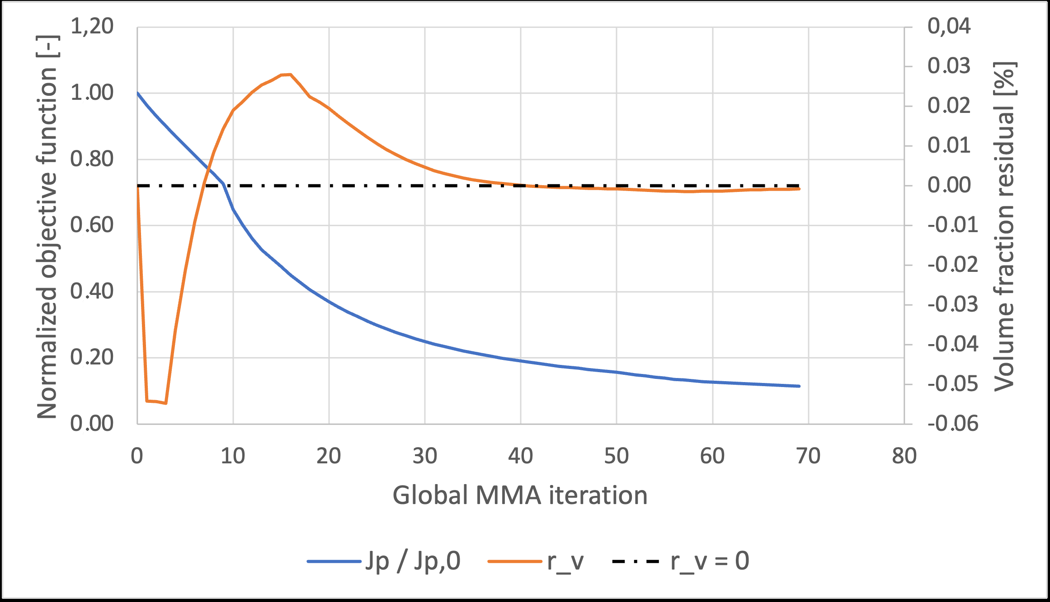
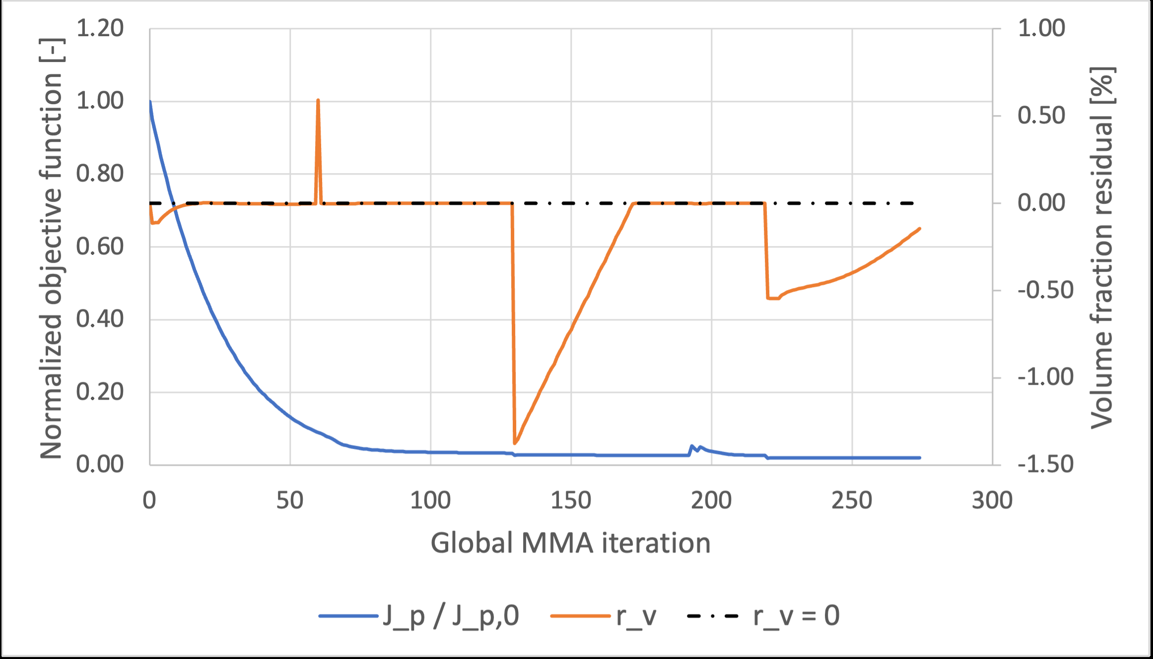
BACKUP
Sensitivity evidence verifies the derivative used by MMA.
Pipe-bend coordinate finite differences: maximum relative discrepancy 5.92e-5.
Pipe-bend directional Taylor test: approximately second-order behavior.
These checks verify the frozen derivative, not a fully coupled turbulence derivative.
Rerun U-bend sensitivity only on the final endpoint you plan to present.
Pipe convergence
U-bend convergence
TurbulentTO master's thesis defense
22
Notes:
Use this if asked whether the optimizer gradient is trustworthy. Be precise: it is trustworthy for the frozen problem it solves.

Slide 23
BACKUP
Pipe-bend oscillations: reduce step acceptance, not only move size.
Jp reacts strongly to small throat/radius changes in the curved path.
Frozen gradients omit how the next design recomputes SA, eddy viscosity, and wall distance.
Hold beta/q, require tighter final-state solves, reject objective-increasing trial steps, then continue only after monotonic behavior returns.
Projection/RAMP sharpening turns late density updates into more discrete geometry changes.
Lower move limits can help, but stage holding plus objective-acceptance backtracking is more targeted.
TurbulentTO master's thesis defense
23
Notes:
This answers the oscillation question directly. Mention that lowering move limits further is reasonable locally, but if every move is tiny the optimizer may only crawl without solving the acceptance problem.

Slide 24
BACKUP
Forward-solver verification numbers.
Benchmark
Metric
Value
Meaning
Periodic channel
Bulk velocity
2.67% difference
core wall-bounded behavior
Periodic channel
Velocity profile
E_inf 2.66%, E_L2 2.64%
profile agreement
2D U-bend
Pressure drop
2.79% difference
curved-flow agreement
2D U-bend
Bend-exit profile
E_inf 8.50%, E_L2 2.75%
local discrepancy remains visible
TurbulentTO master's thesis defense
24
Notes:
Backup for implementation questions. Separate forward-solver verification from turbulence-model validation.

Slide 25
BACKUP
Future work follows from the limitations.
Benchmark completion
Adjoint hierarchy
3D extension
CHT
polished pipe/U-bend continuation and endpoint sensitivity
frozen SA -> selected SA sensitivities -> stronger closures
secondary flows, Dean vortices, realistic extraction
turbulent heat flux and thermal objectives
TurbulentTO master's thesis defense
25
Notes:
Use this only if asked how the project continues. Keep it connected to limitations, not as a generic future-work list.

