Slide 1
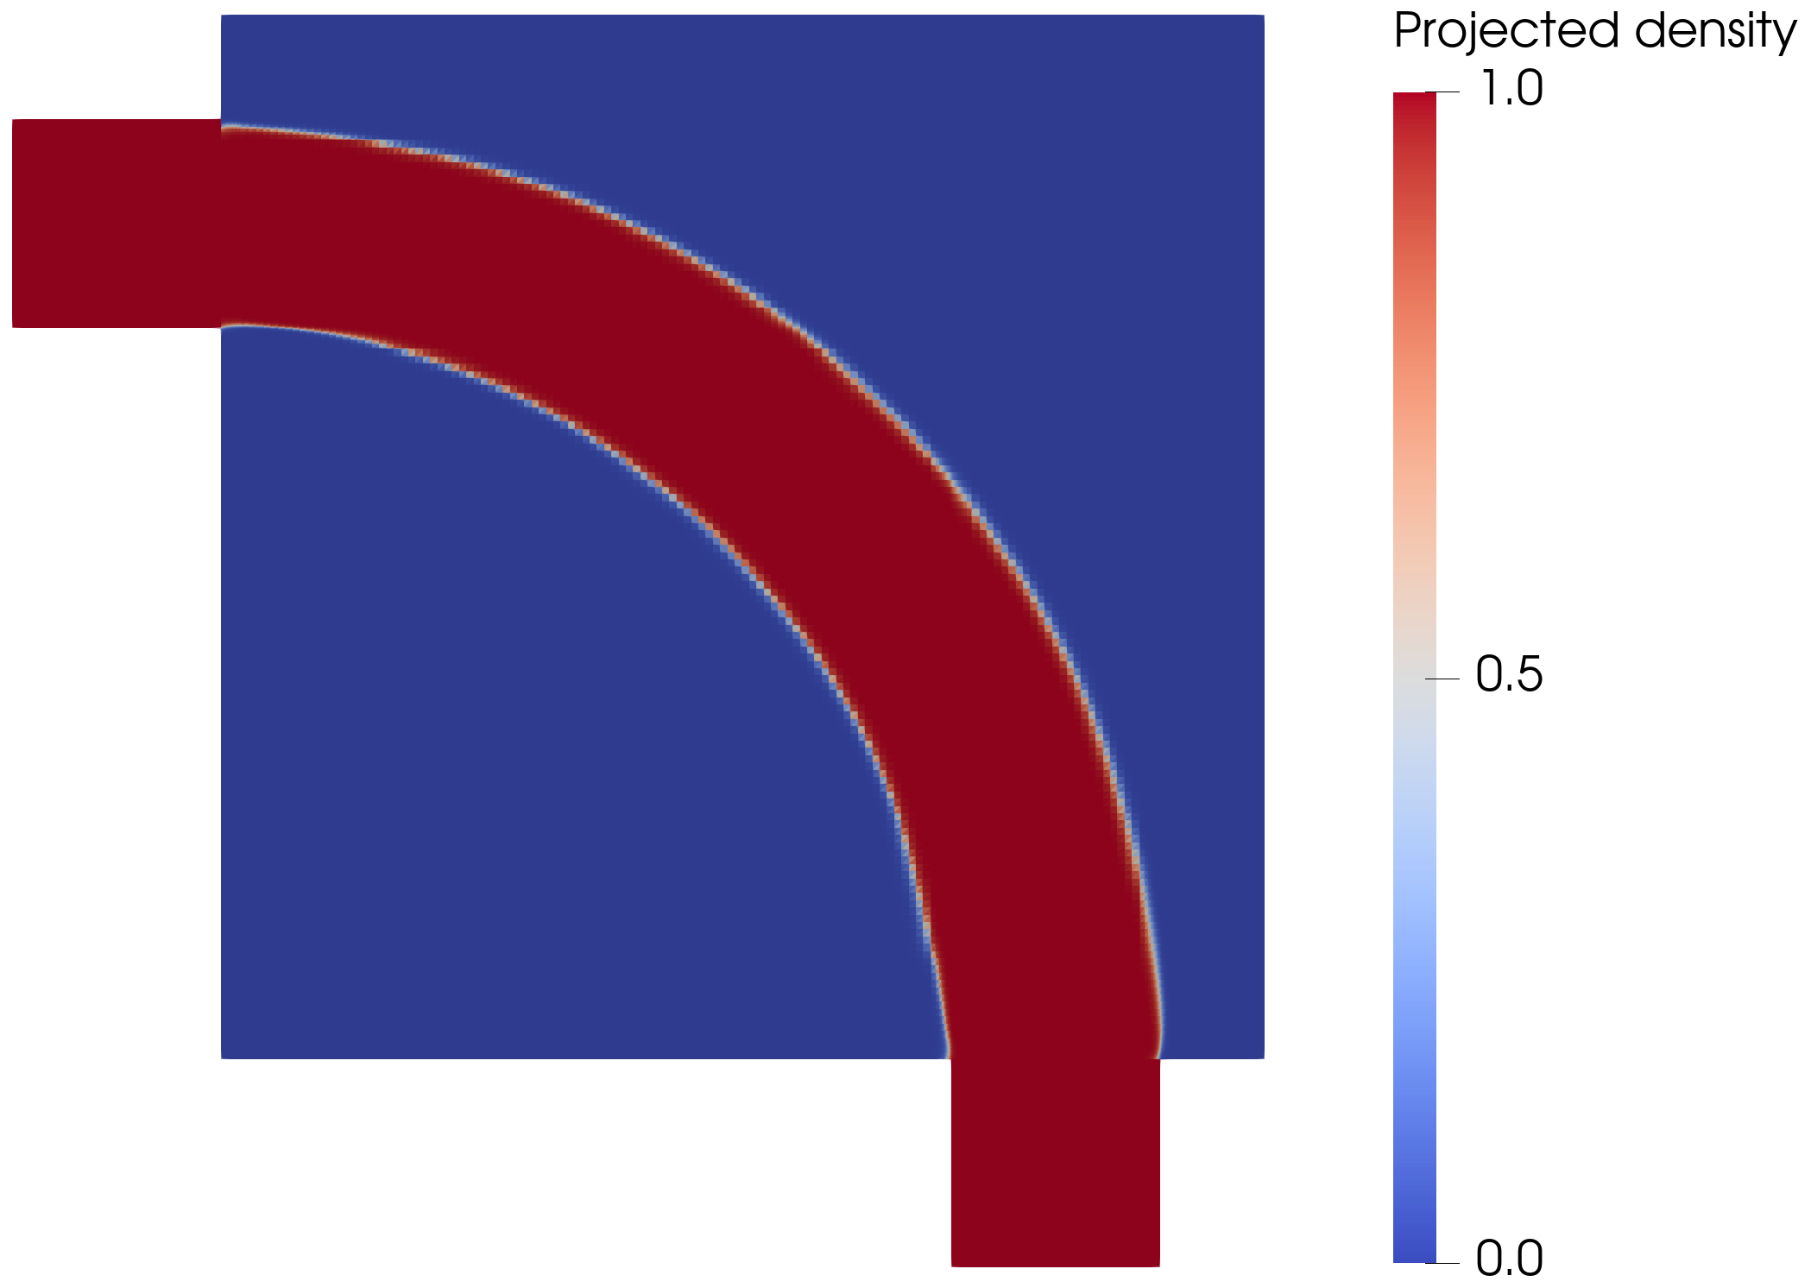
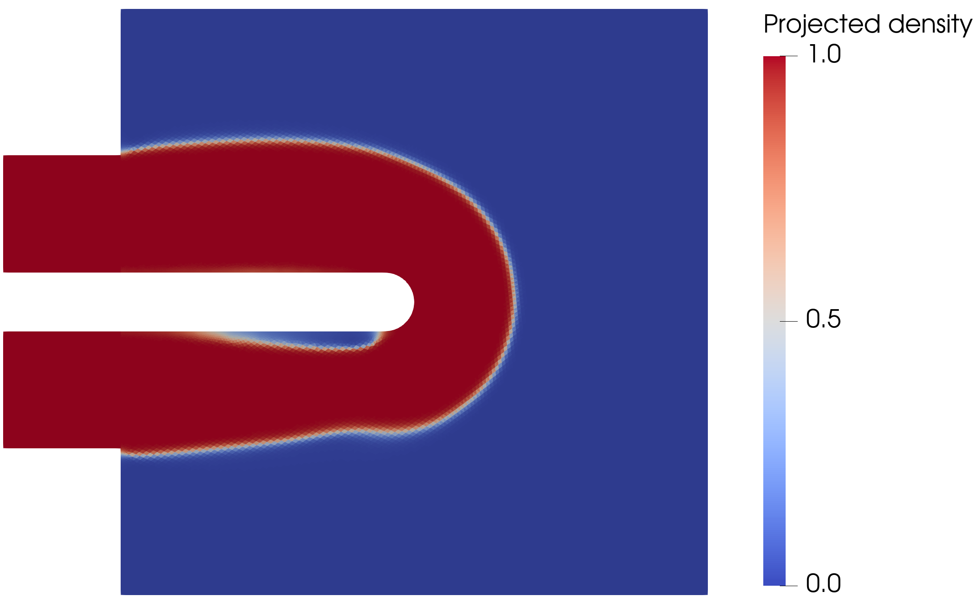
MASTER'S THESIS DEFENSE
Topology Optimization of Flow Configurations Operating in the Turbulent Regime
Tiebert Lefebure | KU Leuven | Mechanical Engineering
A turbulent topology-optimized density field is only useful after its sharp geometry survives independent CFD validation.
-72.0%
+48.3%
reversal
pipe-bend Delta p vs laminar
U-bend closure shift
diffuser ranking under SST
Notes:
Start with the balanced thesis claim. The deck is about building a workflow and proving when the output remains credible, not claiming a universal turbulent optimizer.

Slide 2
CORE CLAIM
The method works inside a credibility envelope.
Frozen-SA topology optimization produces useful turbulent design candidates when the flow remains attached or moderately curved. In separated flows, closure sensitivity becomes the result.
-72.0%
+48.3%
+30.5%
pipe-bend pressure drop vs laminar under SST
U-bend pressure-drop shift from SA to SST
diffuser pressure-drop reversal under SST
02
Notes:
This replaces the old executive-summary card slide. Speak it slowly: robust in attached flow, fragile in separated flow.

Slide 3
EVIDENCE CHAIN
Every result is judged through the same sequence.
01
02
03
04
Model envelope
Forward solver
Optimization
Sharp validation
Where is SA credible?
Does FEniCS reproduce Ansys?
Can MMA use frozen gradients?
Does the exported geometry survive?
03
Notes:
Use this as the talk map. It makes the defense feel rigorous rather than like a list of benchmark cases.

Slide 4
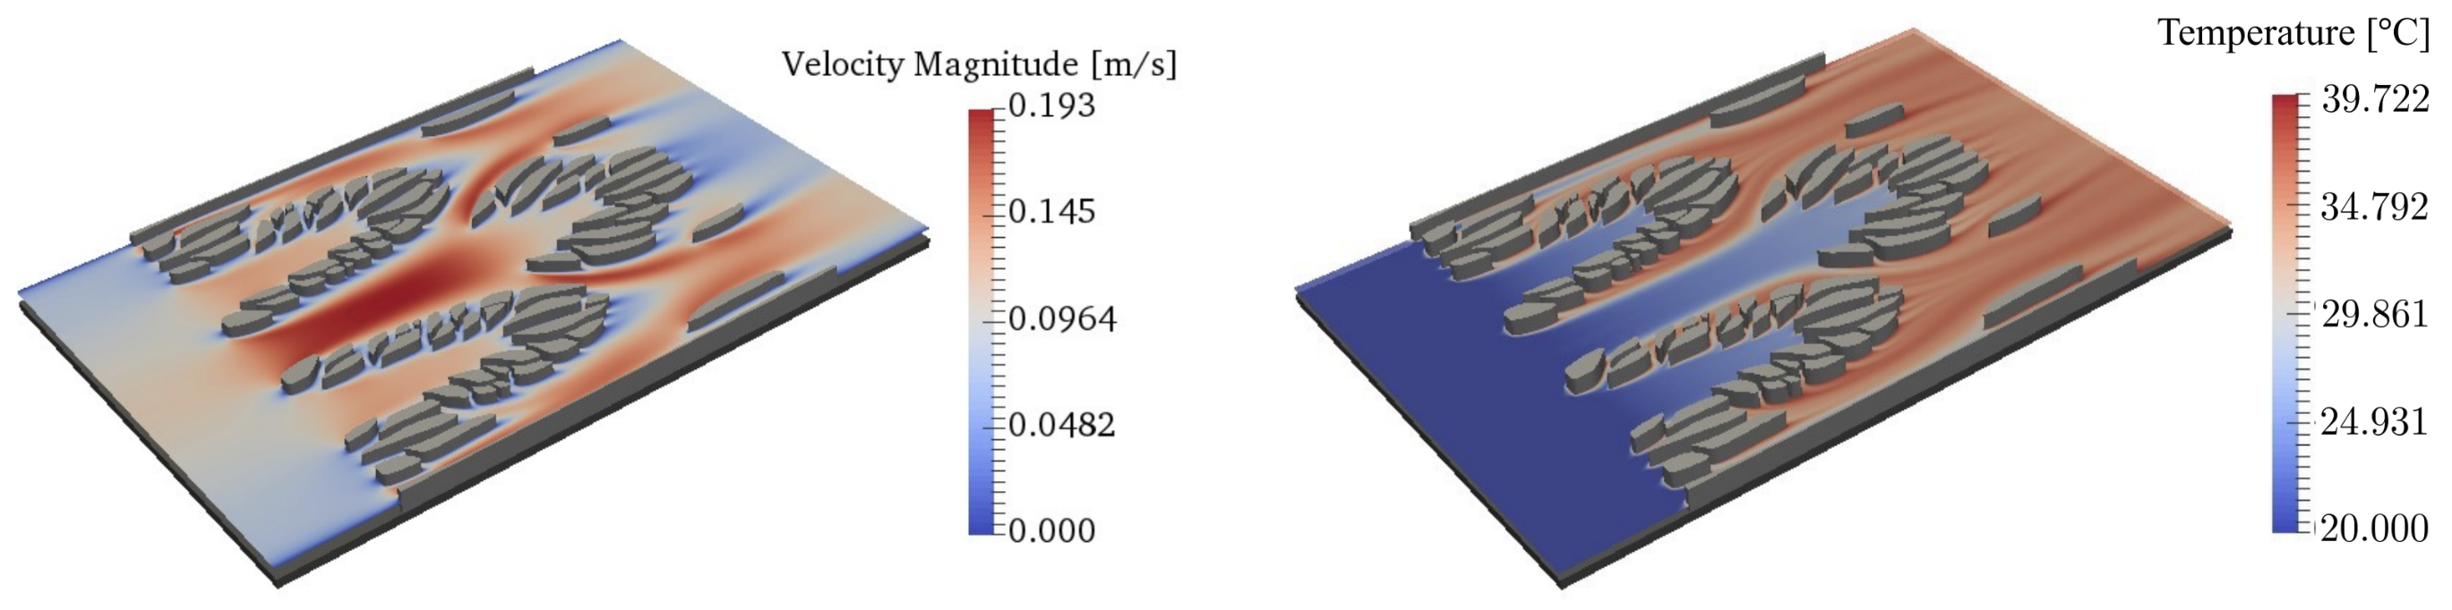
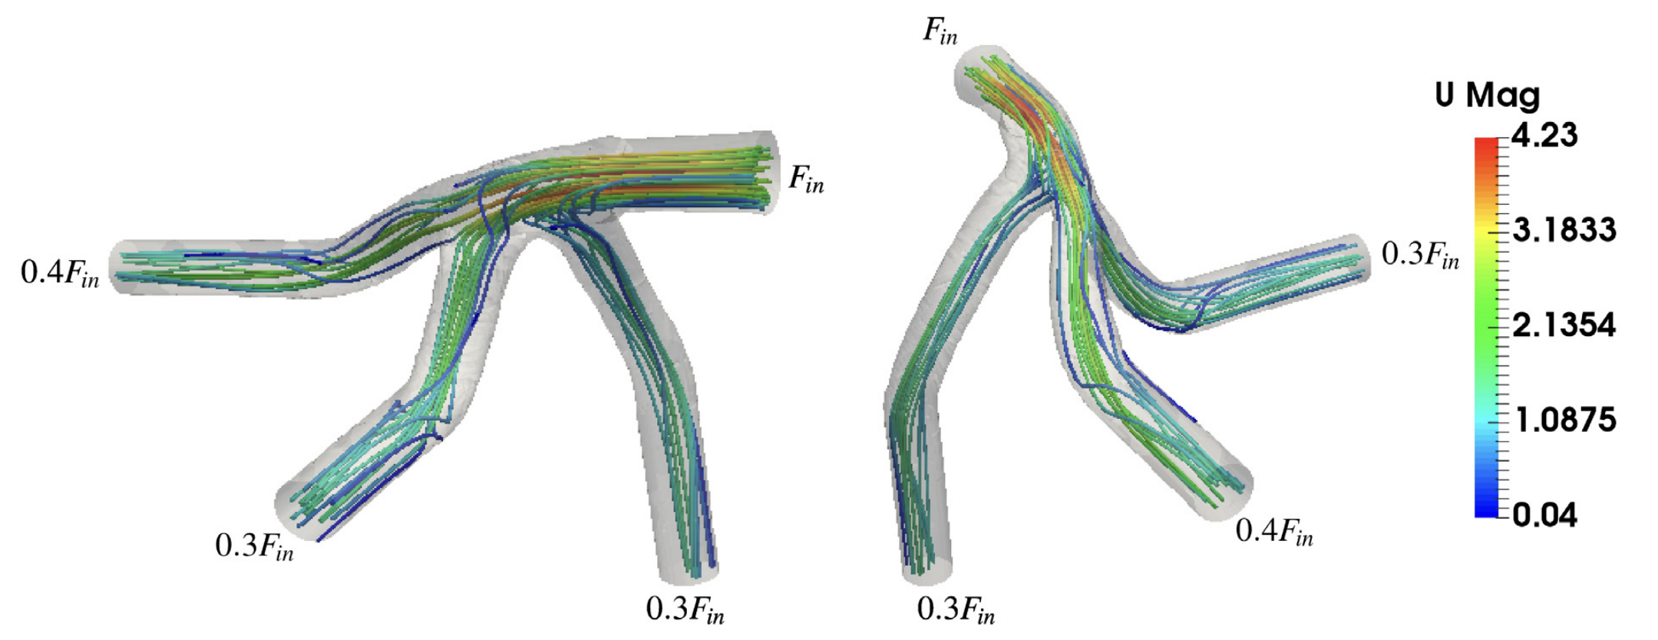
SCOPE
This thesis solves the hydraulic prerequisite, not the full thermal problem.
No energy equation and no conjugate heat transfer claim.
Target: low-loss turbulent internal routing with pressure drop and dissipation as hydraulic readouts.
The isolated problem is already hard: turbulence, wall distance, Brinkman penalization, geometry extraction, and gradients interact.
04
Notes:
This handles the heat-transfer question early. The thesis is deliberately hydraulic because turbulent CHT would add another layer before the fluid framework is trusted.

Slide 5
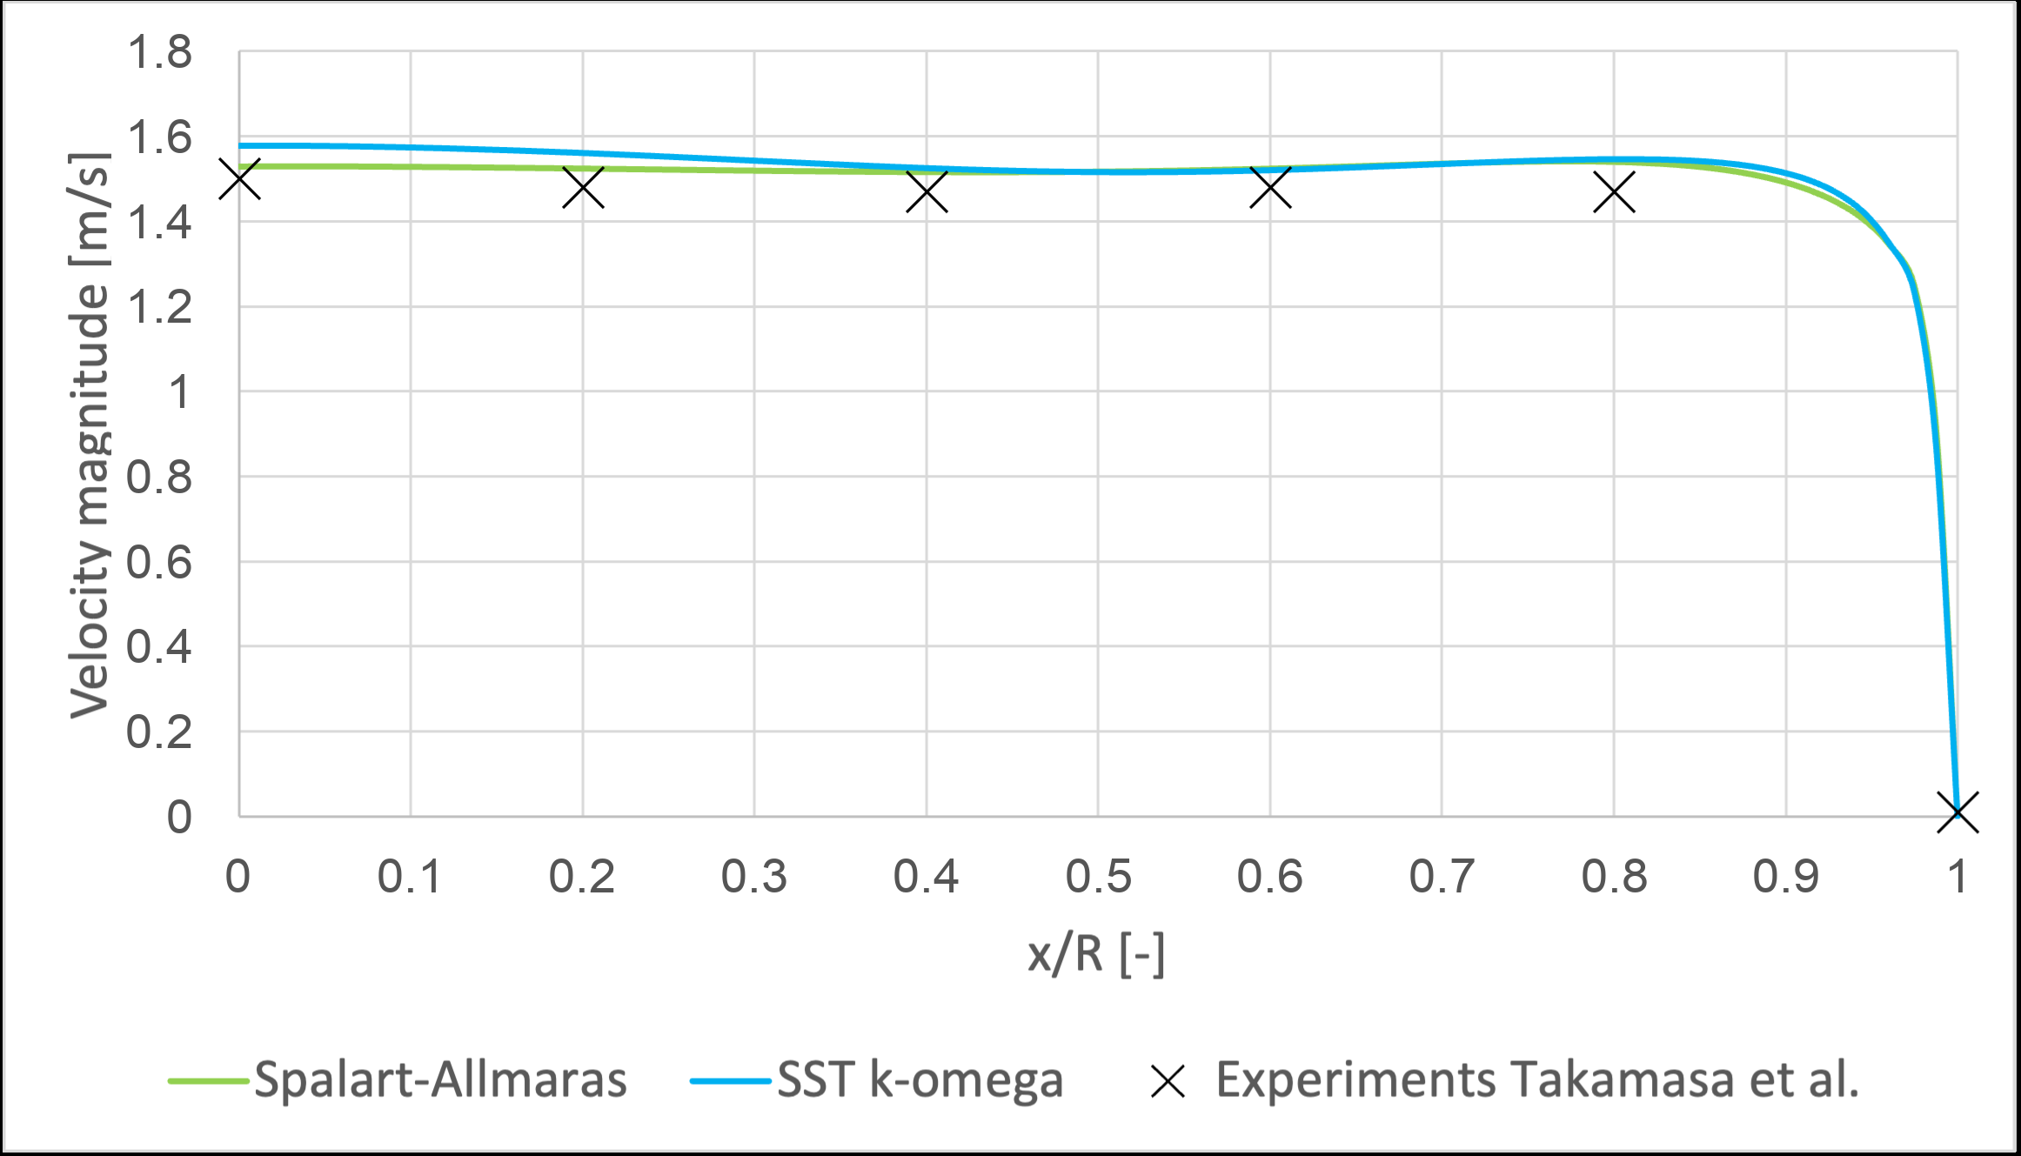
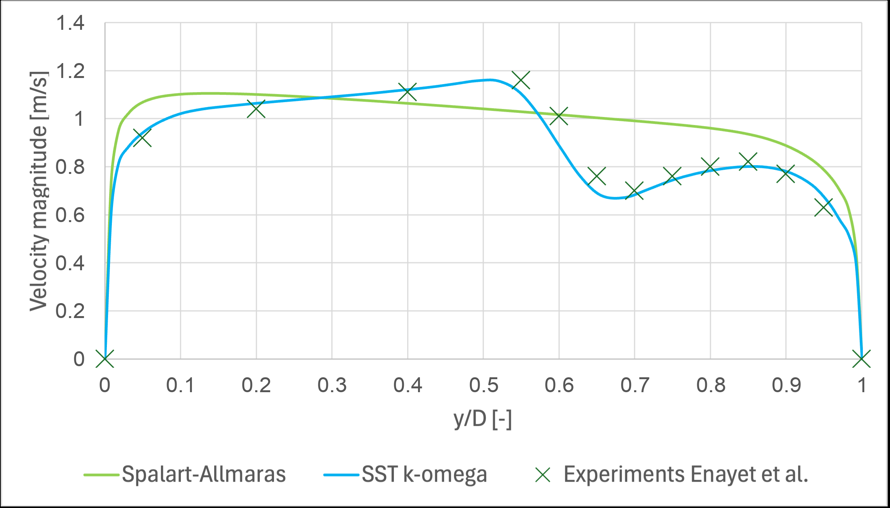
MODEL ENVELOPE
SA is a practical design closure, not final truth.
The Ansys comparisons define where the one-equation model remains useful and where curvature/separation make it risky.
Moderate U-bend: acceptable comparison
Tighter bend: visible closure deterioration
Therefore, sharp geometries are validated again with SST k-omega.
05
Notes:
Do not apologize for using SA. The point is that SA is a design model with a known envelope.

Slide 6
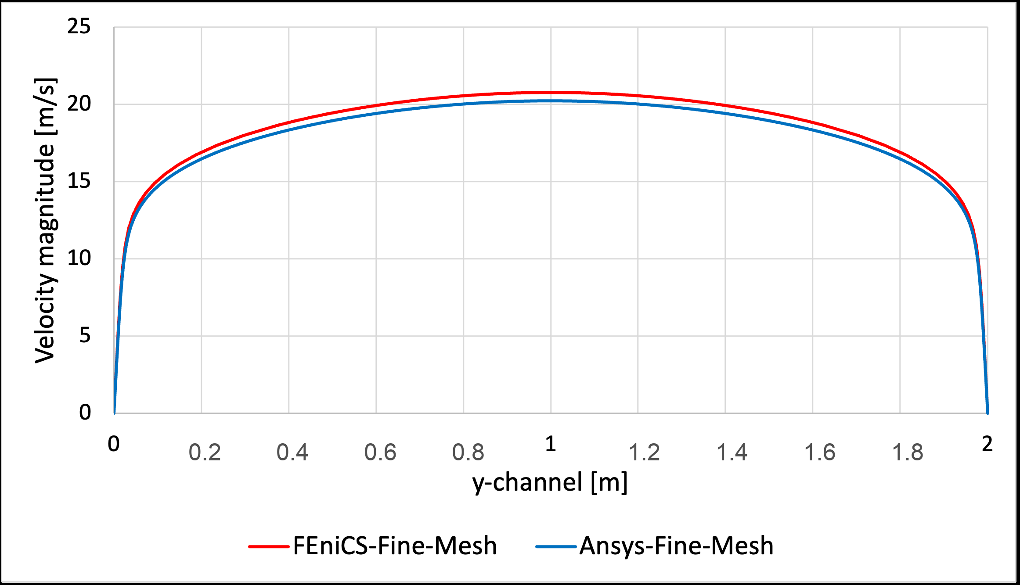
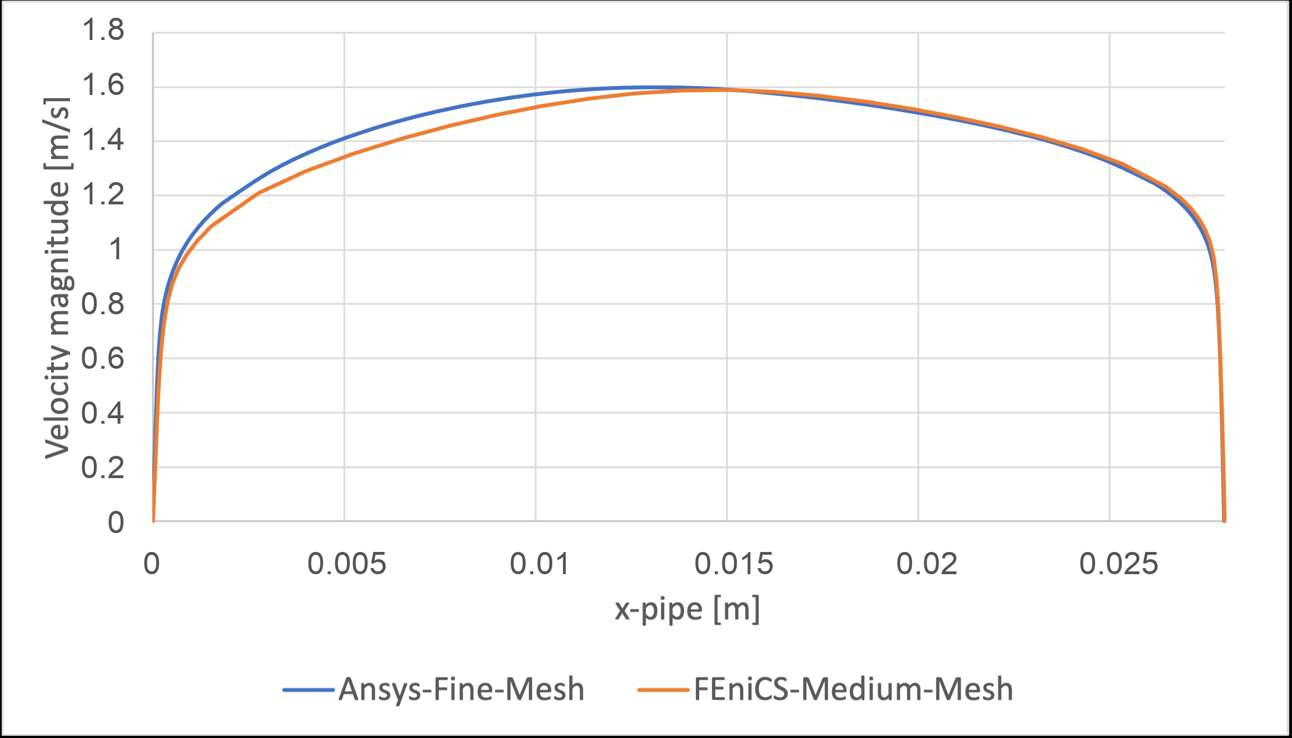
FORWARD SOLVER
The FEniCS-SA solver is verified before entering the optimizer.
Periodic channel profile
2D U-bend exit profile
2.67%
2.79%
8.50%
channel bulk velocity difference
U-bend pressure-drop difference
U-bend maximum profile discrepancy
06
Notes:
Separate implementation verification from model-form validation. These numbers justify using the FEniCS solver in the optimizer.

Slide 7
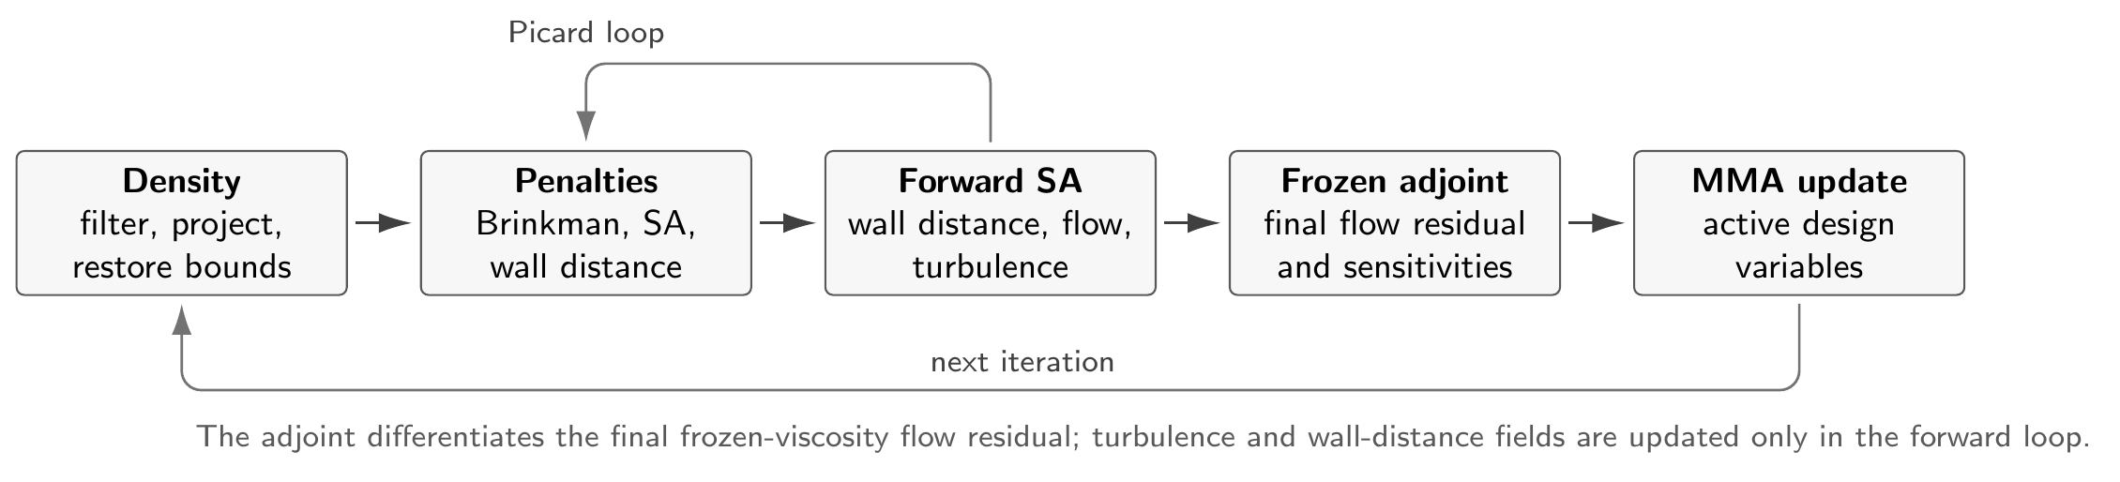
METHOD
The design variable is density; the flow model is turbulent RANS-SA with topology penalties.
01
gamma -> filtered density -> projected bounded density
02
Brinkman resistance suppresses velocity in solid regions
03
Topology-aware SA and wall-distance penalties follow the evolving walls
04
MMA updates active DG0 design cells using frozen-adjoint gradients
07
Notes:
Keep this high-level. Avoid deriving equations unless asked; the slide exists so the committee sees the moving parts.

Slide 8
VALIDATION RULE
The optimizer is judged by the exported sharp geometry.
01
02
03
04
Diffuse FEniCS density
Sharp wall extraction
Ansys-SA validation
SST k-omega stress test
Phi_D
Delta p
SA vs SST
physical dissipation
static pressure drop
closure sensitivity
08
Notes:
This is the core methodological rule. It prevents overclaiming based on a diffuse objective value.

Slide 9
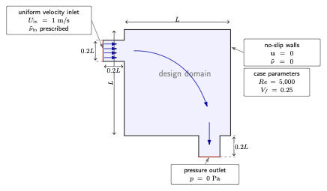
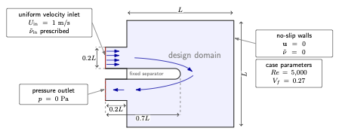
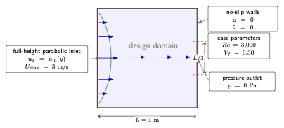
BENCHMARKS
The three cases deliberately move from low to high model risk.
Pipe bend
U-bend
Diffuser
attached / moderate curvature
forced 180 degree return
adverse pressure gradient
09
Notes:
The cases are not just examples. They are a credibility-envelope experiment.

Slide 10
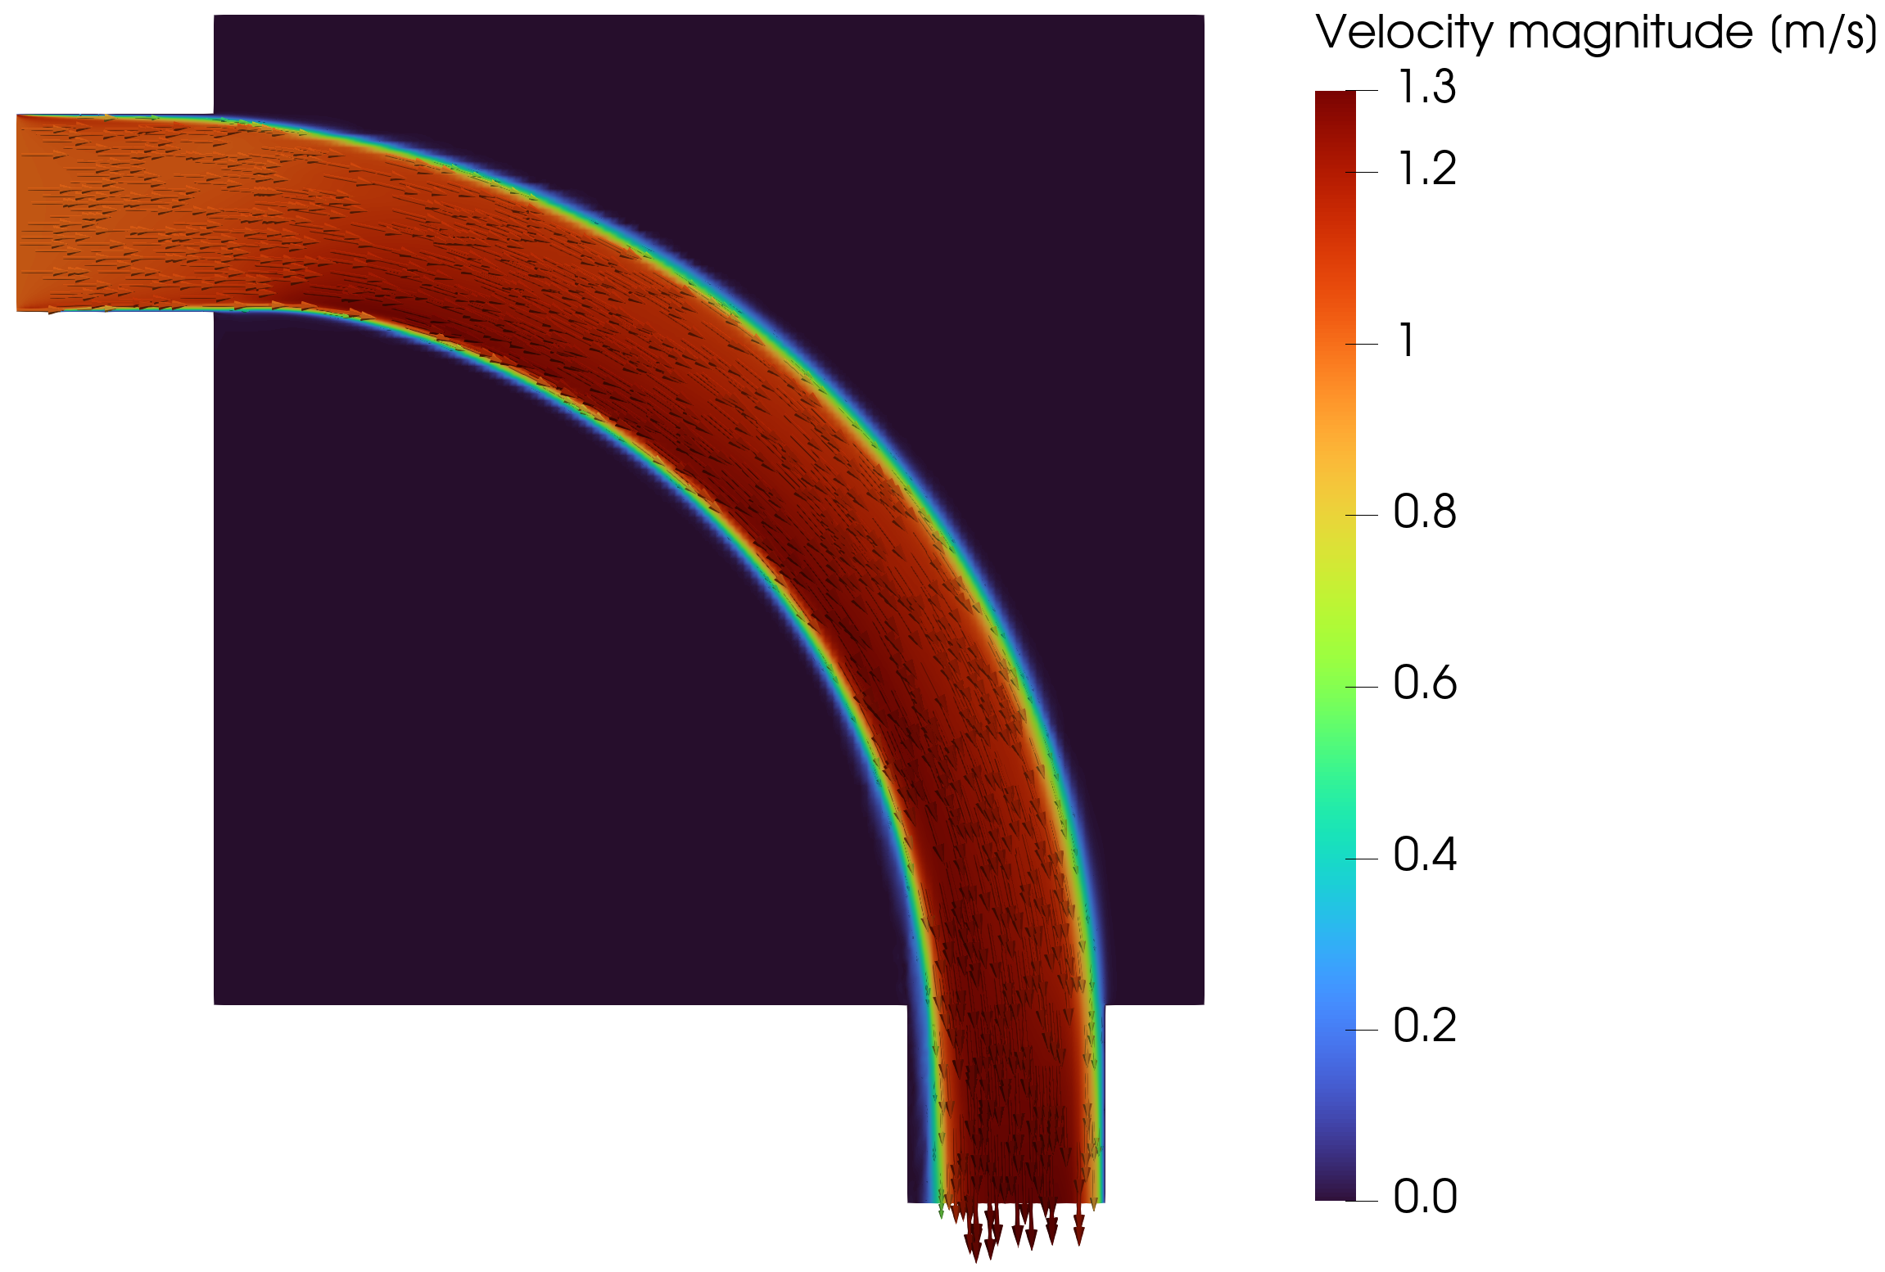
PIPE BEND
Pipe bend: the optimized duct avoids the sharpest corner.
At Re = 5000 and Vf = 0.25, even the 70-iteration endpoint forms the expected smooth turbulent routing strategy.
Projected density
FEniCS-SA velocity
Jp = 0.2130 Pa | endpoint is promising, not claimed as converged
10
Notes:
This slide should be visual. The claim is about routing, not convergence.

Slide 11
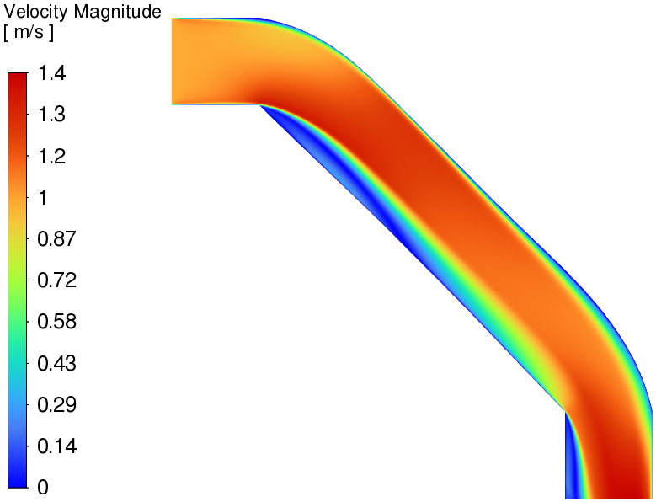
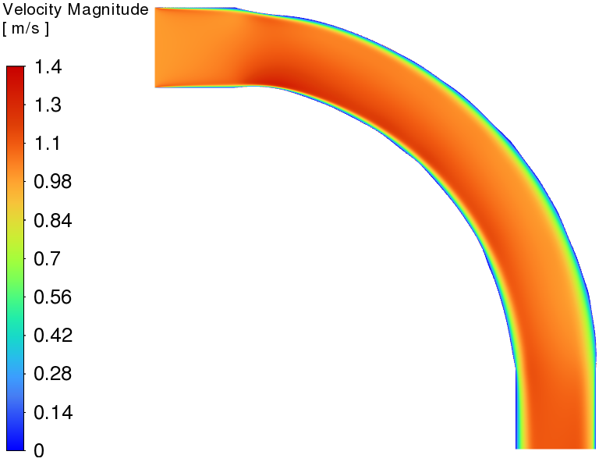
PIPE BEND VALIDATION
Under identical SST validation, the turbulent design decisively beats the laminar surrogate.
Laminar-optimized design run at Re = 5000
Turbulent-optimized design run at Re = 5000
-72.0%
-47.0%
pressure drop
viscous dissipation
11
Notes:
This is the strongest evidence slide. The comparison is fair because both geometries are evaluated at the same turbulent operating condition with SST.

Slide 12
PIPE BEND ROBUSTNESS
The extracted pipe bend is not narrowly tuned to SA.
The SST stress test increases losses only modestly relative to Ansys-SA.
Pressure drop, lower is better
4.5%
FEniCS diffuse SA
0.2130 Pa
Delta p shift, SA to SST
8.5%
Ansys sharp SA
0.1457 Pa
Phi_D shift, SA to SST
Ansys sharp SST
0.1522 Pa
5.92e-5
max coordinate FD discrepancy
12
Notes:
Stress that robustness is about the exported geometry. The optimization endpoint itself remains provisional.

Slide 13
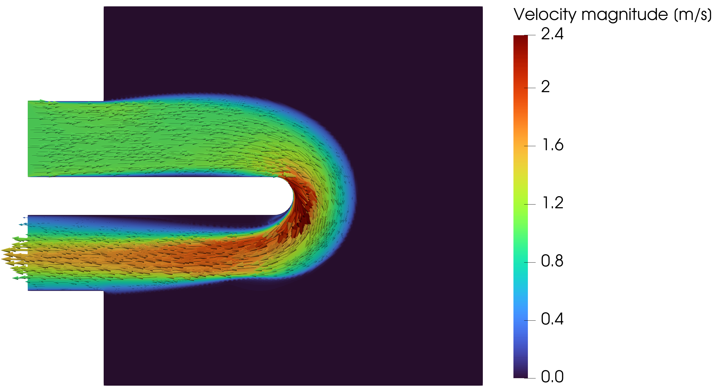
U-BEND
U-bend: the forced return makes the same workflow harder.
The fixed separator forces recirculation-sensitive 180 degree return flow, so closure response becomes part of the design.
Projected density
FEniCS-SA velocity
Jp = 0.8250 Pa | Bayat k-epsilon reference scale = 0.8327 Pa | current run still evolving
13
Notes:
Present as promising, not final. This is exactly the case worth continuing.

Slide 14
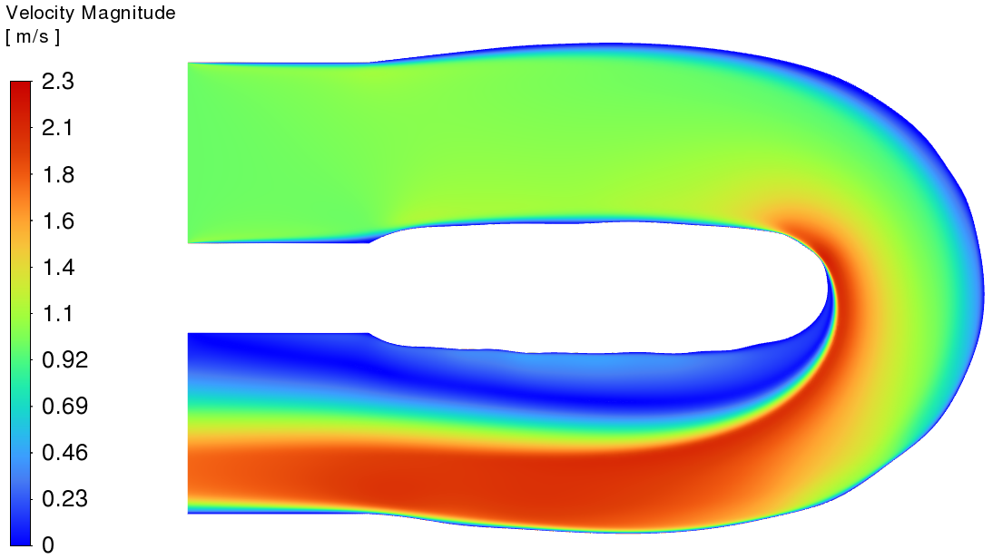
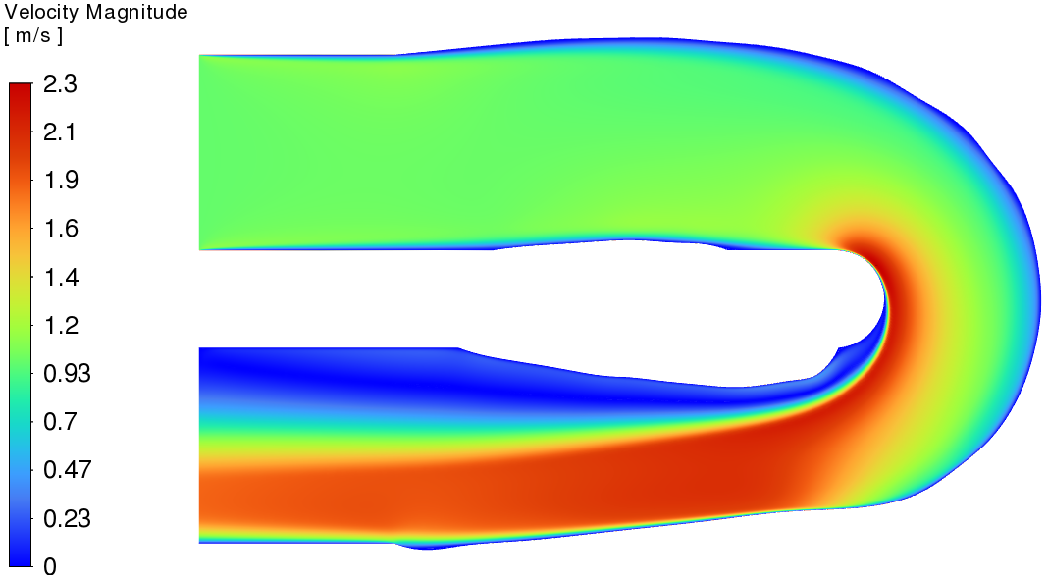
U-BEND VALIDATION
U-bend validation is positive under SA, but weak under SST.
Laminar design under SST
Turbulent design under SST
Under SA: turbulent design lowers Phi_D by 31.0% and Delta p by 16.3% versus laminar.
Under SST: turbulent design lowers Phi_D by only 5.0% but raises Delta p by 4.1%.
For the same turbulent geometry, SST raises Delta p by 48.3% relative to Ansys-SA.
14
Notes:
This is a nuanced result, not a failure slide. The U-bend shows why a forced return flow needs extra validation.

Slide 15
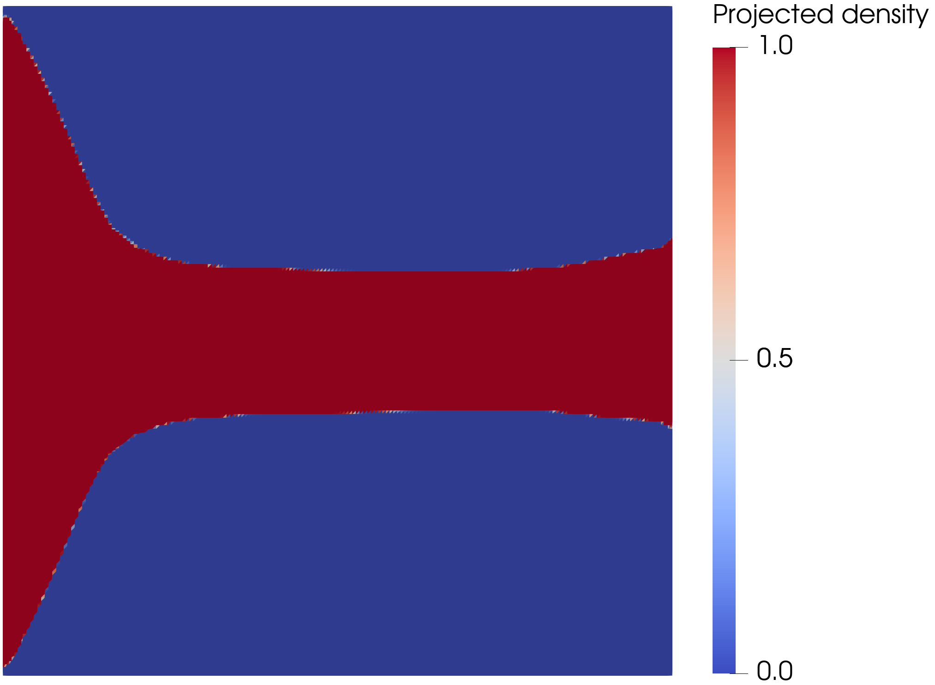
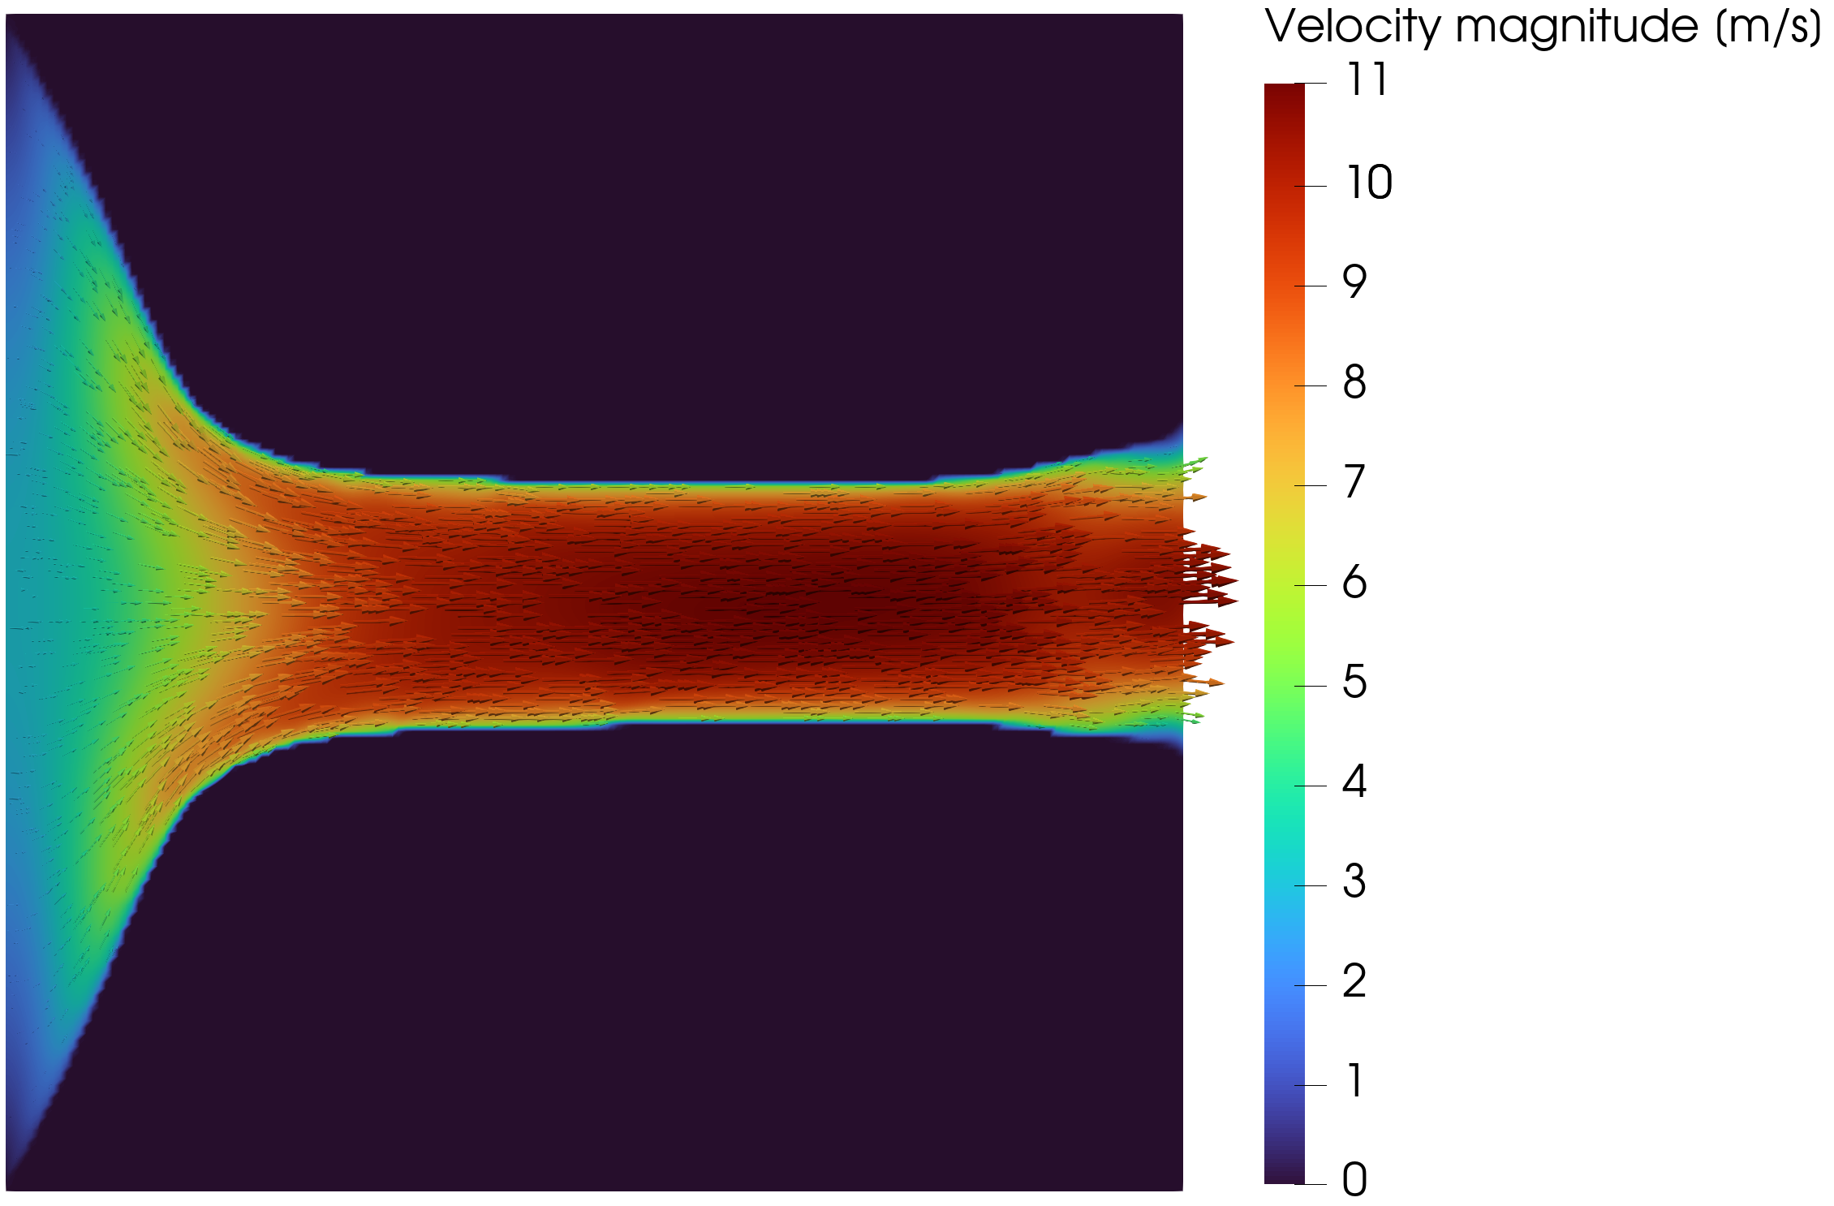
DIFFUSER
Diffuser: outlet treatment and adverse pressure gradients dominate the result.
The pressure-outlet variant is less forced than the velocity-outlet setup, but the final performance ranking remains closure-sensitive.
Pressure-outlet topology
FEniCS-SA velocity
JD = 2.7664e5 W/m | 11.2% below the velocity-outlet comparison point
15
Notes:
Do not make the diffuser a success case. Its role is to demonstrate sensitivity to boundary condition and closure.

Slide 16
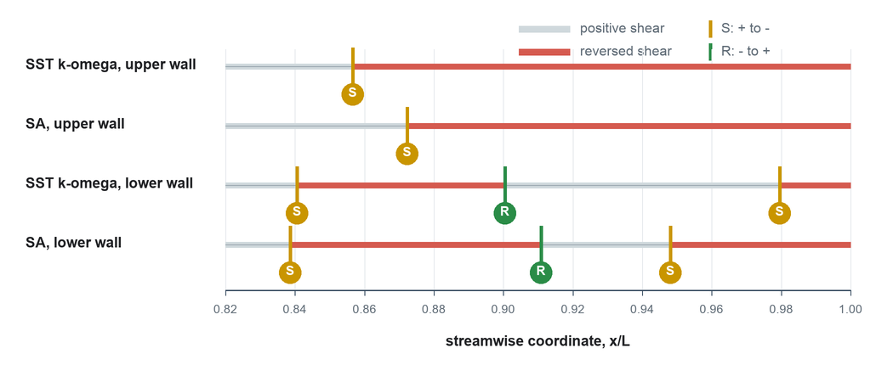
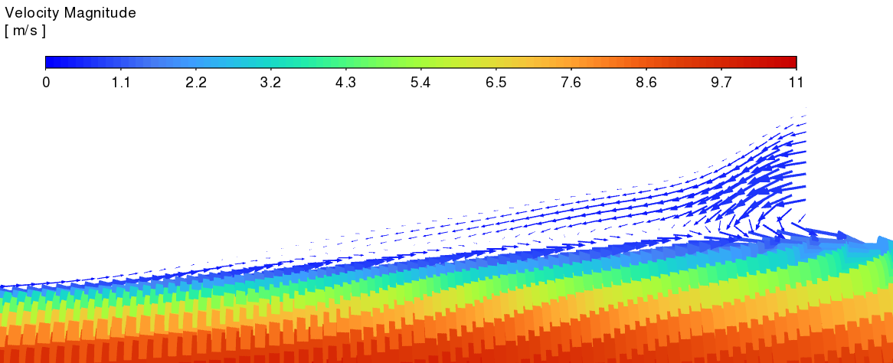
DIFFUSER VALIDATION
The diffuser ranking reverses when the validation closure changes.
Model
Dissipation
Pressure drop
Decision
Ansys-SA
11.9% lower Phi_D
17.4% lower Delta p
turbulent wins
SST k-omega
13.7% higher Phi_D
30.5% higher Delta p
turbulent loses
Wall-shear sign diagnostic
SST vector close-up
16
Notes:
The scalar ranking reversal is the key evidence. The diagnostics show why adverse-pressure-gradient flow is sensitive.

Slide 17
SYNTHESIS
The cases define a credibility envelope.
Case
Dominant physics
Defensible claim
Pipe bend
attached / moderate curvature
robust turbulent-design advantage
U-bend
forced return / local recirculation
promising, but closure-sensitive
Diffuser
adverse pressure gradient / separation
validation closure can reverse ranking
The contribution is a validation-aware turbulent TO workflow, not a universal optimizer.
17
Notes:
This is the slide that turns the mixed results into the thesis conclusion.

Slide 18
LIMITATIONS
What is verified, and what is deliberately not claimed.
Verified here
Not claimed
FEniCS-SA forward solver against Ansys
Fully coupled turbulence adjoint
Frozen-adjoint derivative path where checked
Closure-independent truth in separated flow
Sharp-geometry validation workflow for three cases
3D secondary-flow physics or CHT performance
18
Notes:
This slide is for credibility. Be explicit about limits.

Slide 19
FINAL COMPUTE
Use remaining compute to strengthen the U-bend.
#
Run
Why
Presentation value
1
Continue U-bend Jp
highest upside; current run is evolving nicely
could sharpen the hardest Bayat case
2
Rerun U-bend sensitivity at final endpoint
same endpoint and continuation settings
defends the forced-return result in Q&A
3
Pipe polish only if stabilized quickly
already validated; oscillation can weaken story
optional convergence evidence
Pipe oscillation fix: hold beta/q, add objective-acceptance backtracking, tighten final-state solves, then resume continuation.
19
Notes:
This is the practical recommendation. Do not chase the diffuser before the defense.

Slide 20
CLOSE
Frozen-SA topology optimization is valuable when it produces candidates, not final answers.
The final engineering decision comes from sharp-geometry validation and closure sensitivity. In attached or moderately curved flow, the method can produce strong turbulent designs; in separated flow, the validation envelope becomes the result.
Notes:
End with the candidate-versus-final-answer distinction.

Slide 21
BACKUP
Final validation metrics.
Case
Evaluation
Phi_D
Delta p
Readout
Pipe
Ansys-SA sharp
0.0153
0.1457
baseline validation
Pipe
Ansys SST sharp
0.0166
0.1522
+8.5% / +4.5%
Pipe
laminar -> turbulent SST
0.0313 -> 0.0166
0.5444 -> 0.1522
-47.0% / -72.0%
U-bend
SA laminar -> turbulent
0.1137 -> 0.0785
0.9646 -> 0.8071
-31.0% / -16.3%
U-bend
SST laminar -> turbulent
0.1069 -> 0.1016
1.1496 -> 1.1973
-5.0% / +4.1%
Diffuser
SA laminar -> turbulent
1.3495e5 -> 1.1885e5
1.3979e5 -> 1.1541e5
-11.9% / -17.4%
Diffuser
SST laminar -> turbulent
1.1289e4 -> 1.2834e4
3.8332e4 -> 5.0006e4
+13.7% / +30.5%
21
Notes:
Backup only. Use for exact Q&A numbers.

Slide 22
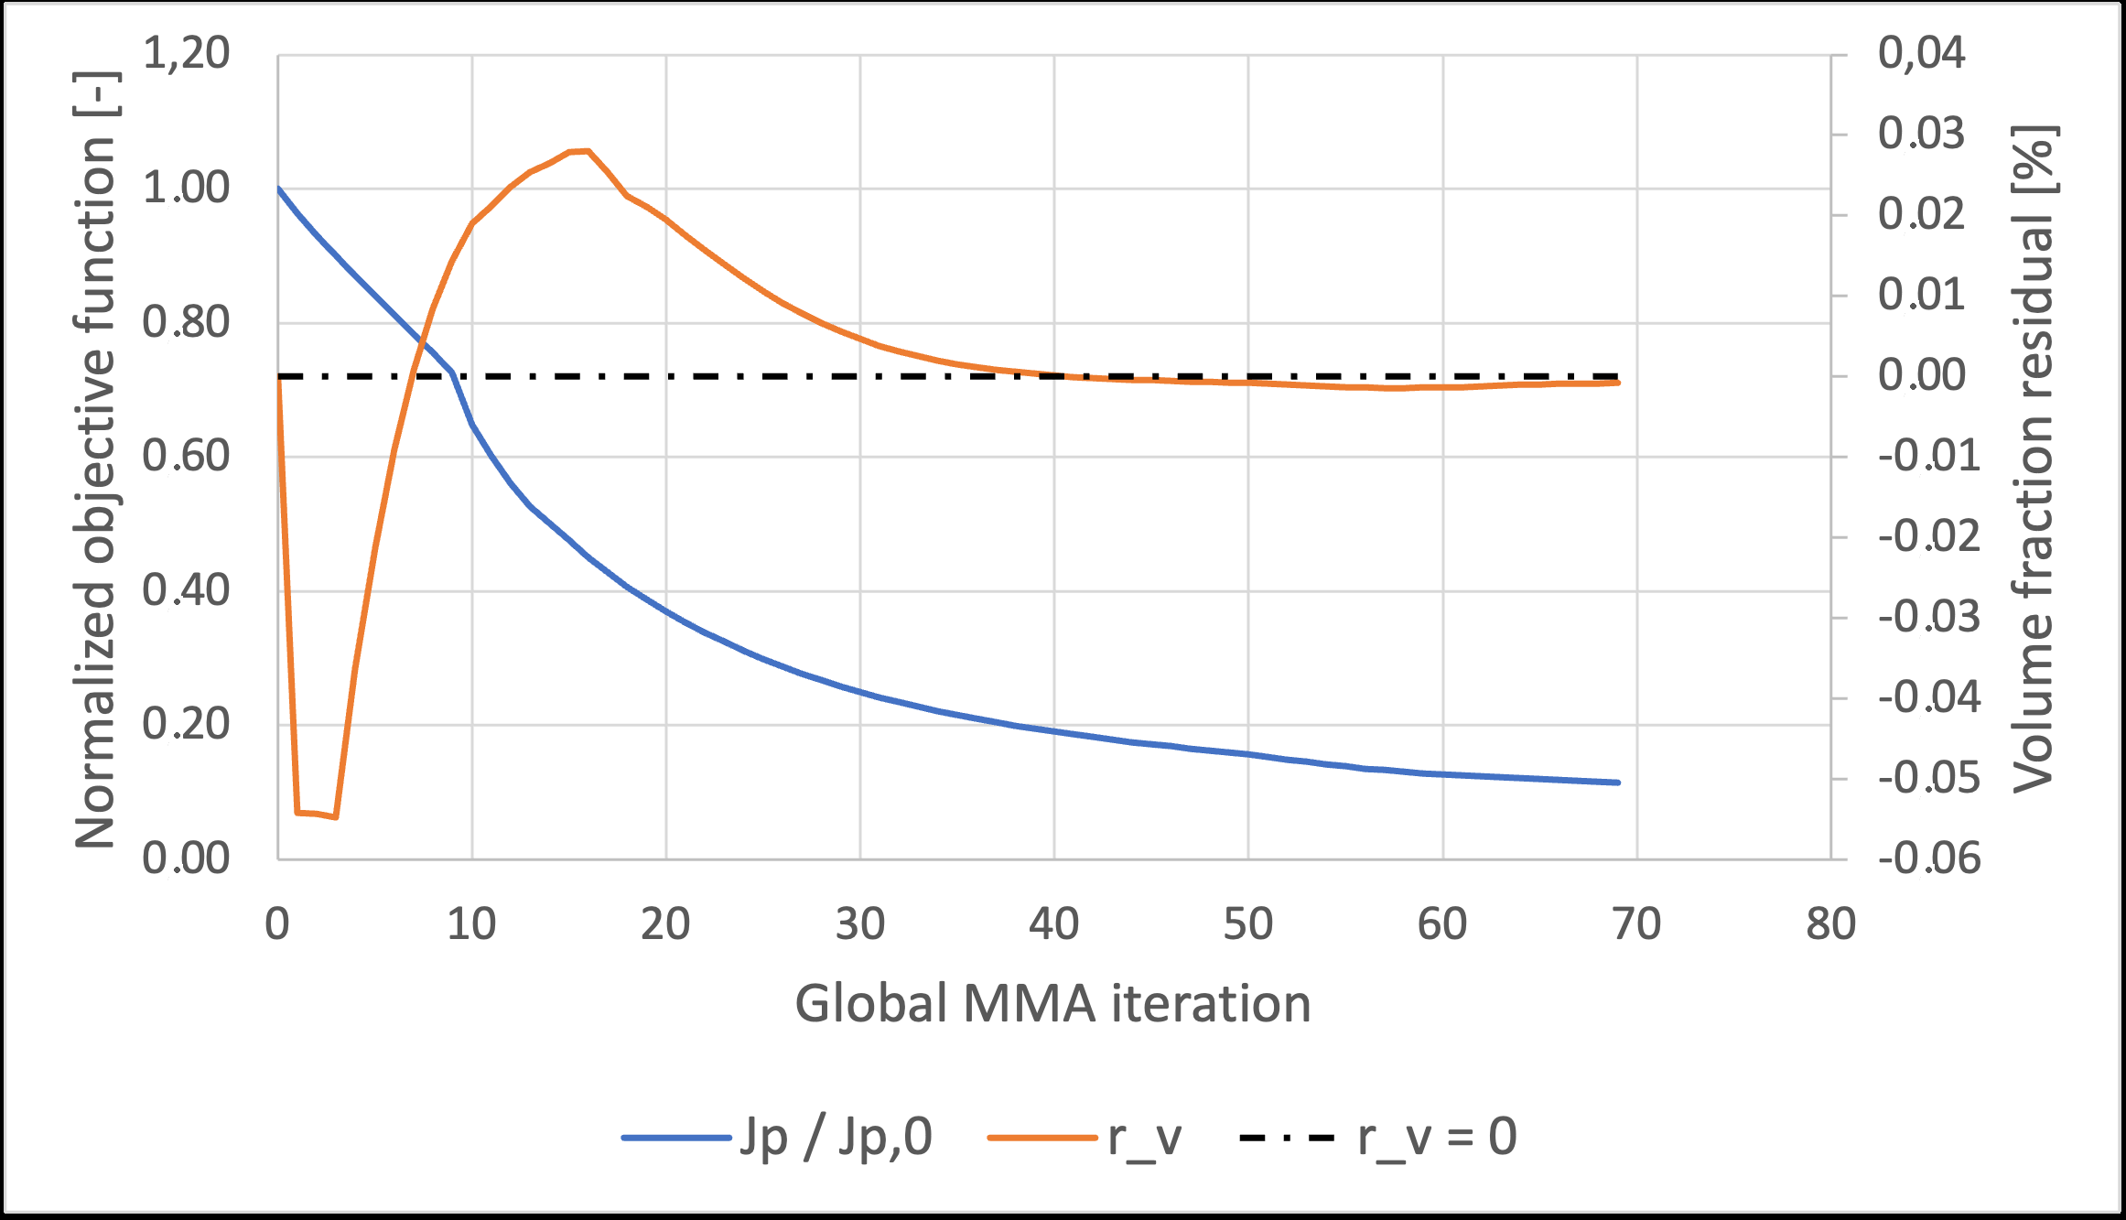
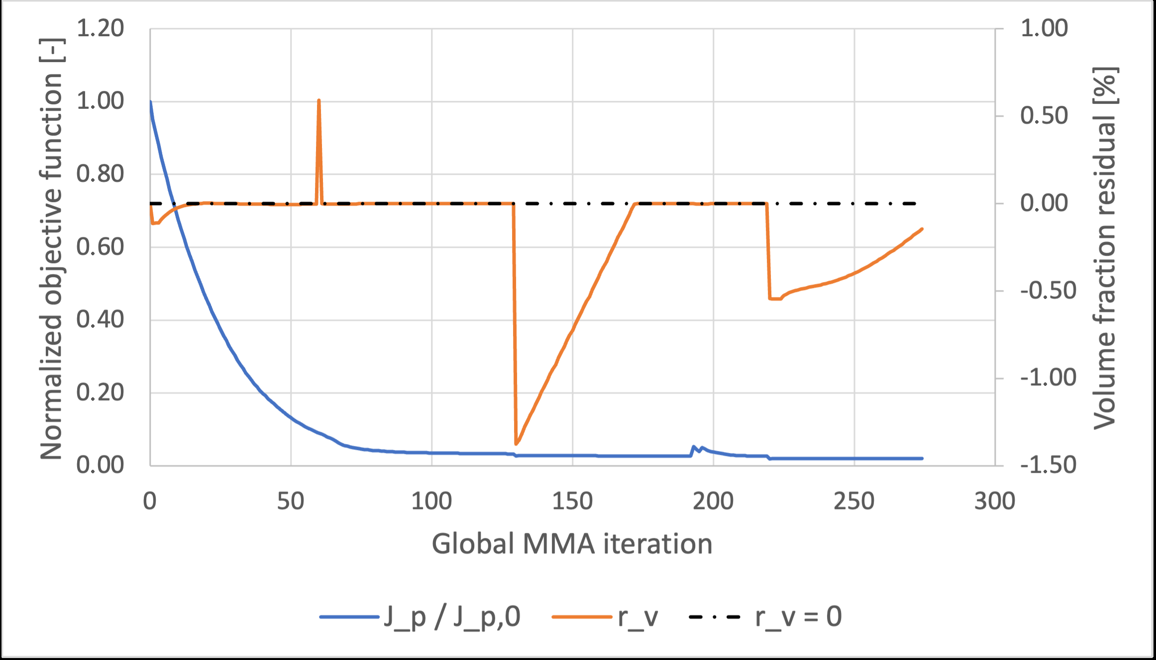
BACKUP
Sensitivity evidence verifies the derivative used by MMA.
Pipe-bend coordinate finite differences: maximum relative discrepancy 5.92e-5.
Pipe-bend directional Taylor test: approximately second-order behavior.
These checks verify the frozen derivative, not a fully coupled turbulence derivative.
Rerun U-bend sensitivity only on the final endpoint you plan to present.
Pipe convergence
U-bend convergence
22
Notes:
This answers gradient questions precisely.

Slide 23
BACKUP
Pipe-bend oscillations: reduce accepted step aggressiveness.
Jp reacts sharply to small throat/radius changes in the curved path.
Frozen gradients omit how the next design recomputes SA, eddy viscosity, and wall distance.
Hold beta/q; require tighter final solves; reject objective-increasing trial steps.
Projection/RAMP sharpening turns late density updates into more discrete geometry changes.
Lower move limits help locally, but acceptance/backtracking is more targeted.
23
Notes:
Use if asked directly about oscillations.

Slide 24
BACKUP
Forward-solver verification numbers.
Benchmark
Metric
Value
Meaning
Periodic channel
Bulk velocity
2.67% difference
core wall-bounded behavior
Periodic channel
Velocity profile
E_inf 2.66%, E_L2 2.64%
profile agreement
2D U-bend
Pressure drop
2.79% difference
curved-flow agreement
2D U-bend
Bend-exit profile
E_inf 8.50%, E_L2 2.75%
local discrepancy remains visible
24
Notes:
Backup for solver questions.

Slide 25
BACKUP
Future work follows directly from the limitations.
01
02
03
04
Benchmark completion
Adjoint hierarchy
3D extension
CHT
polished continuation and endpoint sensitivity
frozen SA -> selected SA sensitivities -> stronger closures
secondary flows, Dean vortices, realistic extraction
turbulent heat flux and thermal objectives
25
Notes:
Use if asked what comes next.

