Slide 1
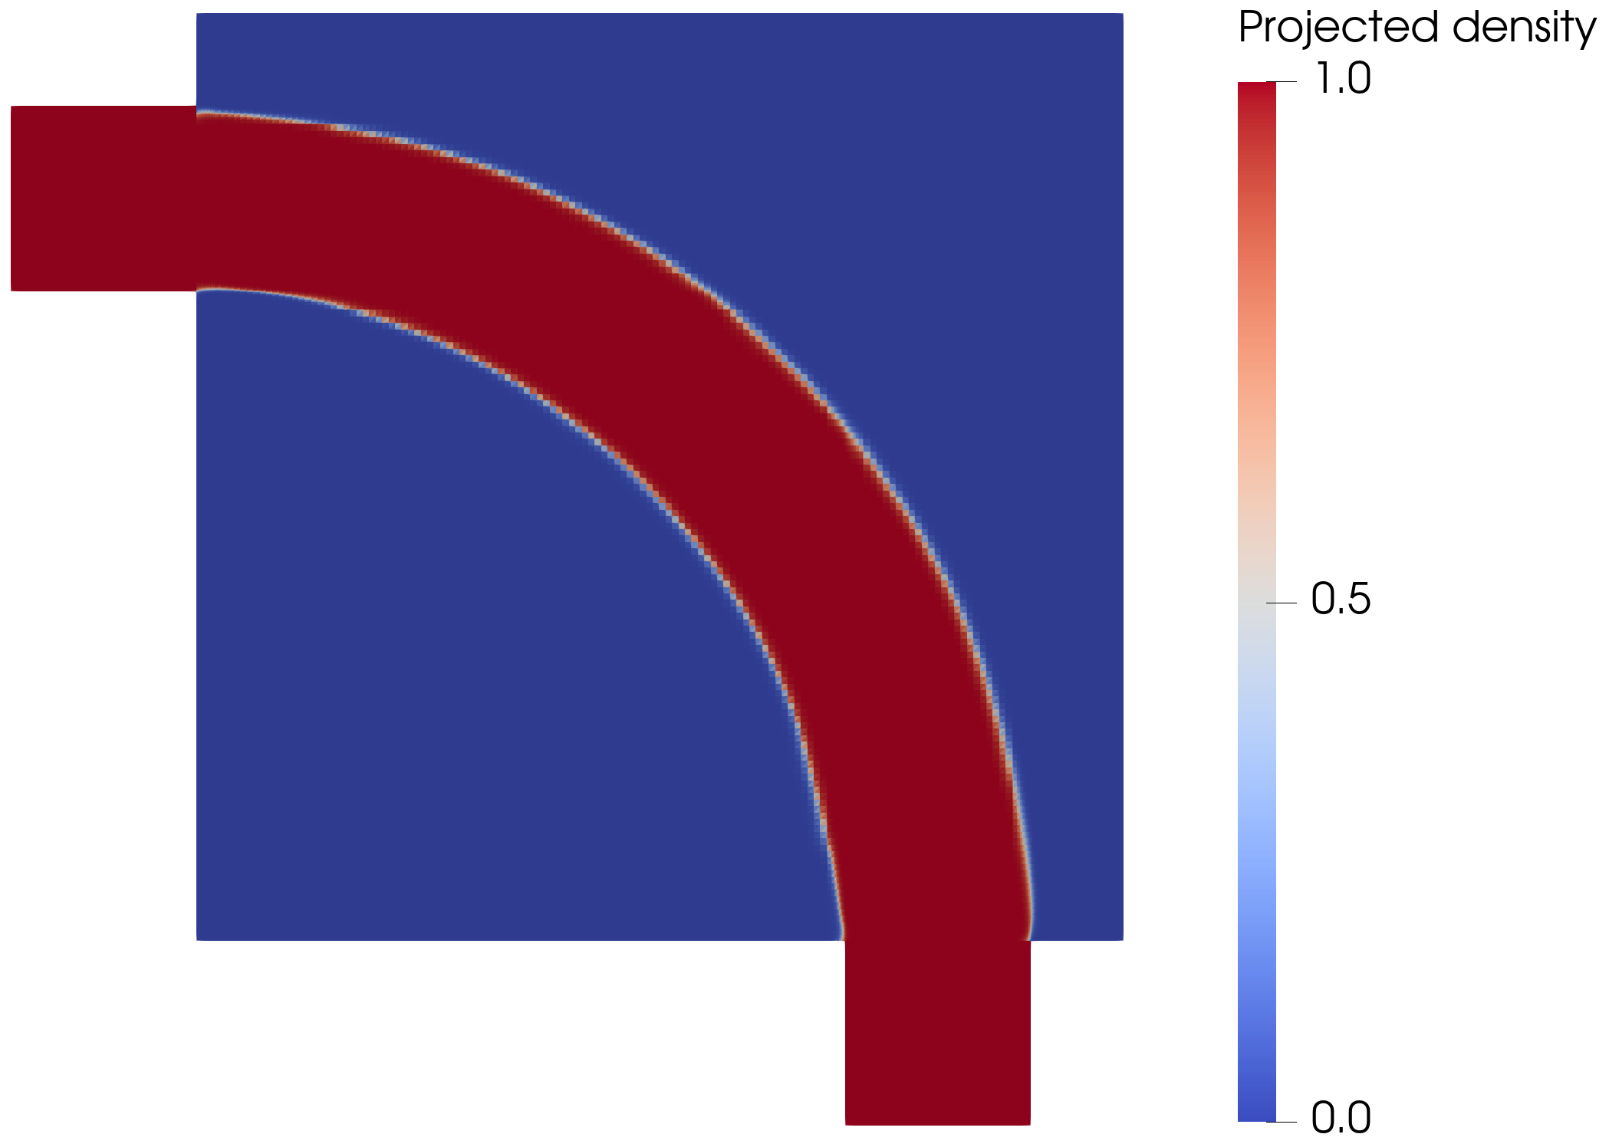
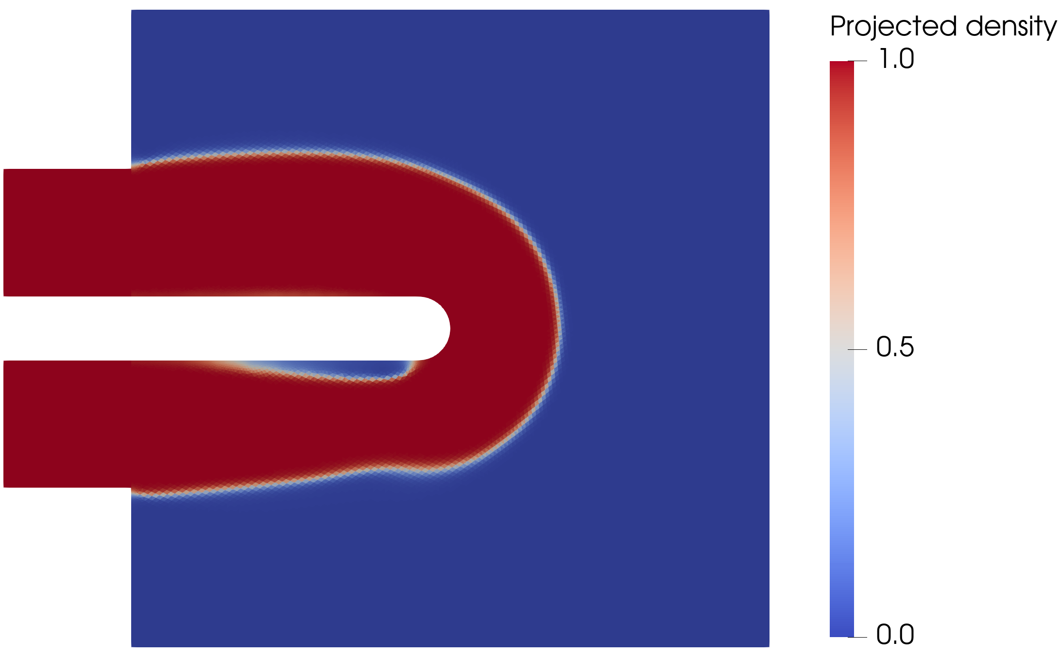
DEFENSE
Turbulent topology optimization works when the flow physics stay inside the model envelope.
A 30-minute defense deck for a FEniCS / Spalart-Allmaras density-based topology optimization framework.
Flow-only hydraulic scope
Frozen-SA adjoint
Sharp-geometry Ansys validation
72.0%
48.3%
30.5%
lower pipe-bend pressure drop vs laminar design
U-bend pressure-drop closure shift
diffuser SST ranking reversal
Notes:
Open by stating the balanced thesis: the framework is useful and verified, but not a universal turbulent design oracle. Say that the presentation will distinguish the attached-flow success case from the separation-sensitive cases.

Slide 2
THESIS CLAIM
The real contribution is the validation envelope, not just another optimized shape.
The framework combines wall-resolved SA, Brinkman topology penalization, filtering/projection, MMA, and a frozen-turbulence adjoint.
The decisive question is whether extracted sharp geometries remain credible under independent Ansys-SA and SST k-omega validation.
Final answer: pipe bend is robust; U-bend and diffuser are closure-sensitive and should be presented as cautionary evidence.
Yes
Conditional
No
forward FEniCS-SA solver verified against Ansys
optimized turbulent designs transfer
SA is not closure-independent truth in separated flow
TurbulentTO master's thesis defense
02
Notes:
Use this as a one-slide executive summary. It frames the work as rigorous engineering judgment rather than overclaiming.

Slide 3
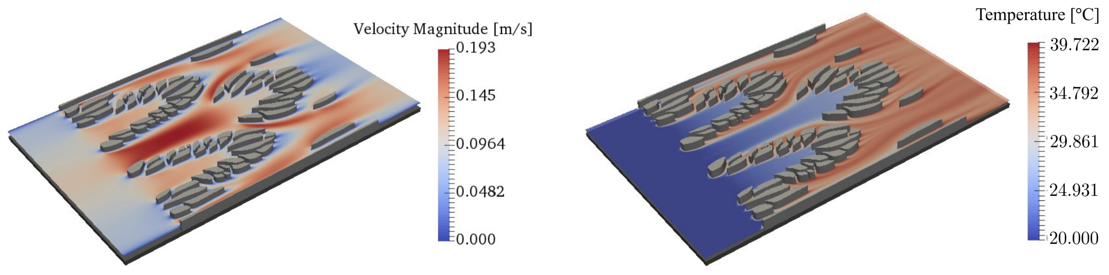
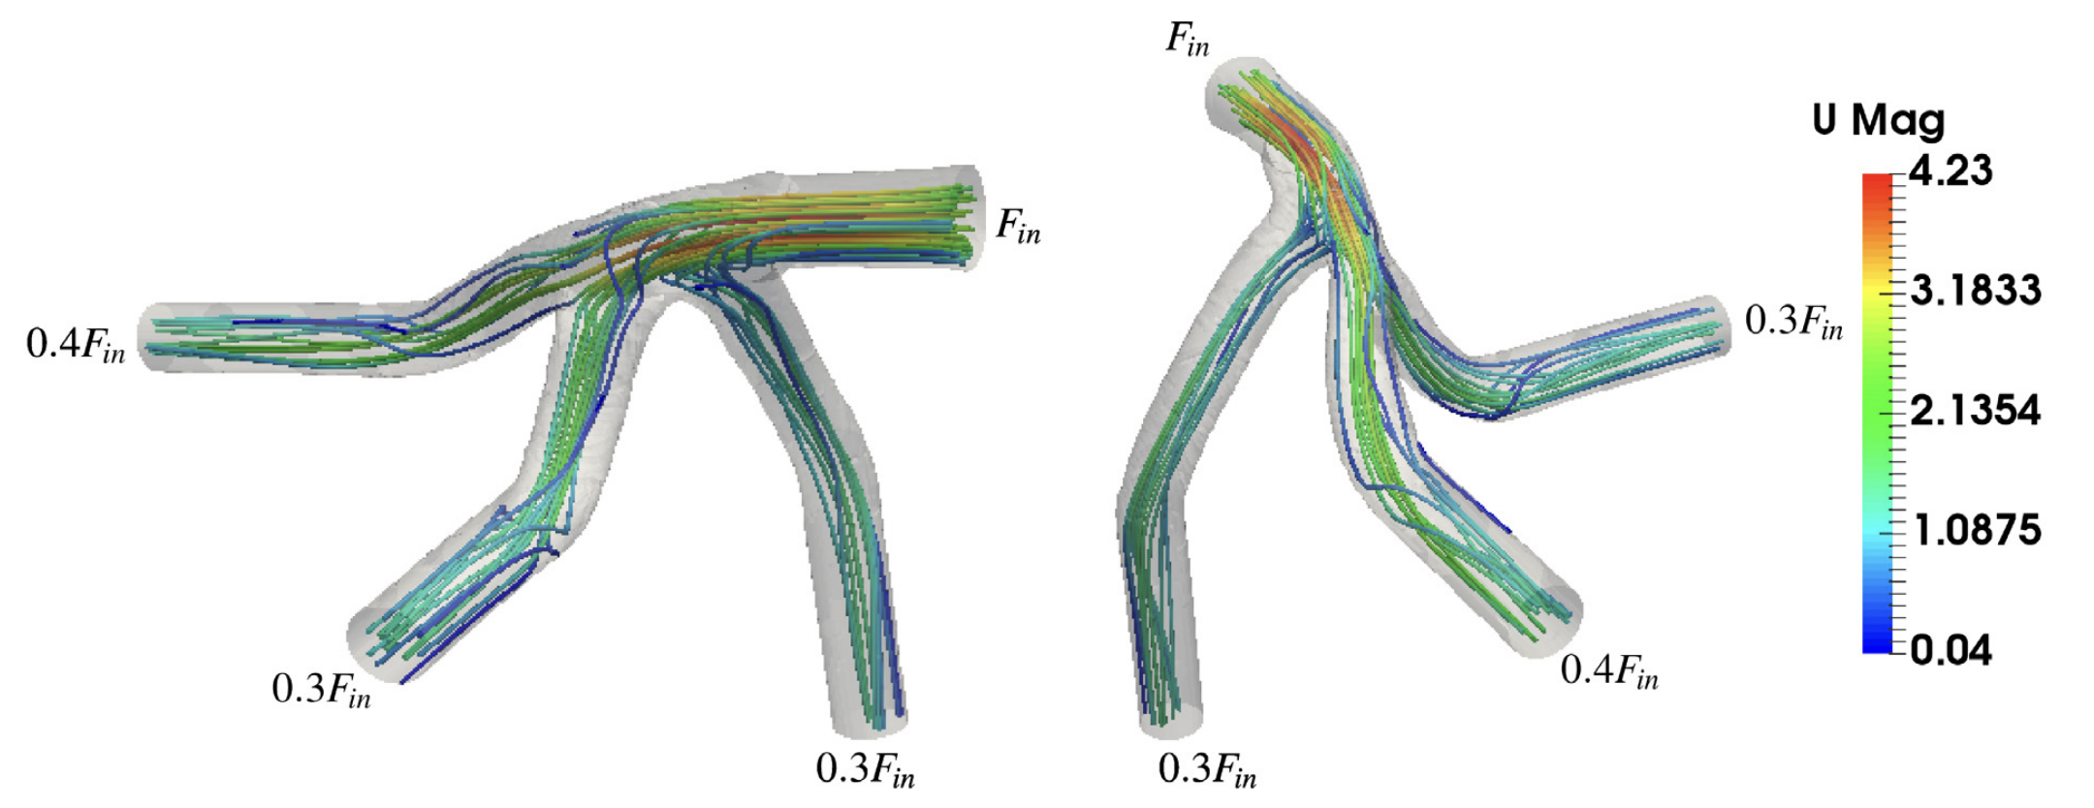
MOTIVATION
Before optimizing heat transfer, the turbulent hydraulic routing problem has to be trusted.
Thermal-management hardware needs compact internal paths with low pressure drop and controlled separation.
This thesis deliberately removes the energy equation: no CHT, no temperature objective, no thermal resistance claim.
The narrower scope isolates pressure loss, dissipation, turbulence closure behavior, and topology sensitivity.
Scope reduction is a feature: it makes the turbulent flow solver, adjoint, and validation chain inspectable.
TurbulentTO master's thesis defense
03
Notes:
Make clear why the thesis says flow-only. This prevents a Q&A trap about missing heat transfer.

Slide 4
PROOF CHAIN
The thesis is structured as a sequence of checks, not a single optimization run.
01
02
03
04
Model envelope
Forward solver
Optimizer
Validation
Where is SA defensible?
Does FEniCS reproduce Ansys-SA?
Can MMA use frozen gradients stably?
Does the extracted sharp geometry survive SA/SST?
TurbulentTO master's thesis defense
04
Notes:
This is the organizing slide for the talk. Spend about a minute and tell the audience the same evidence chain will be used case by case.

Slide 5
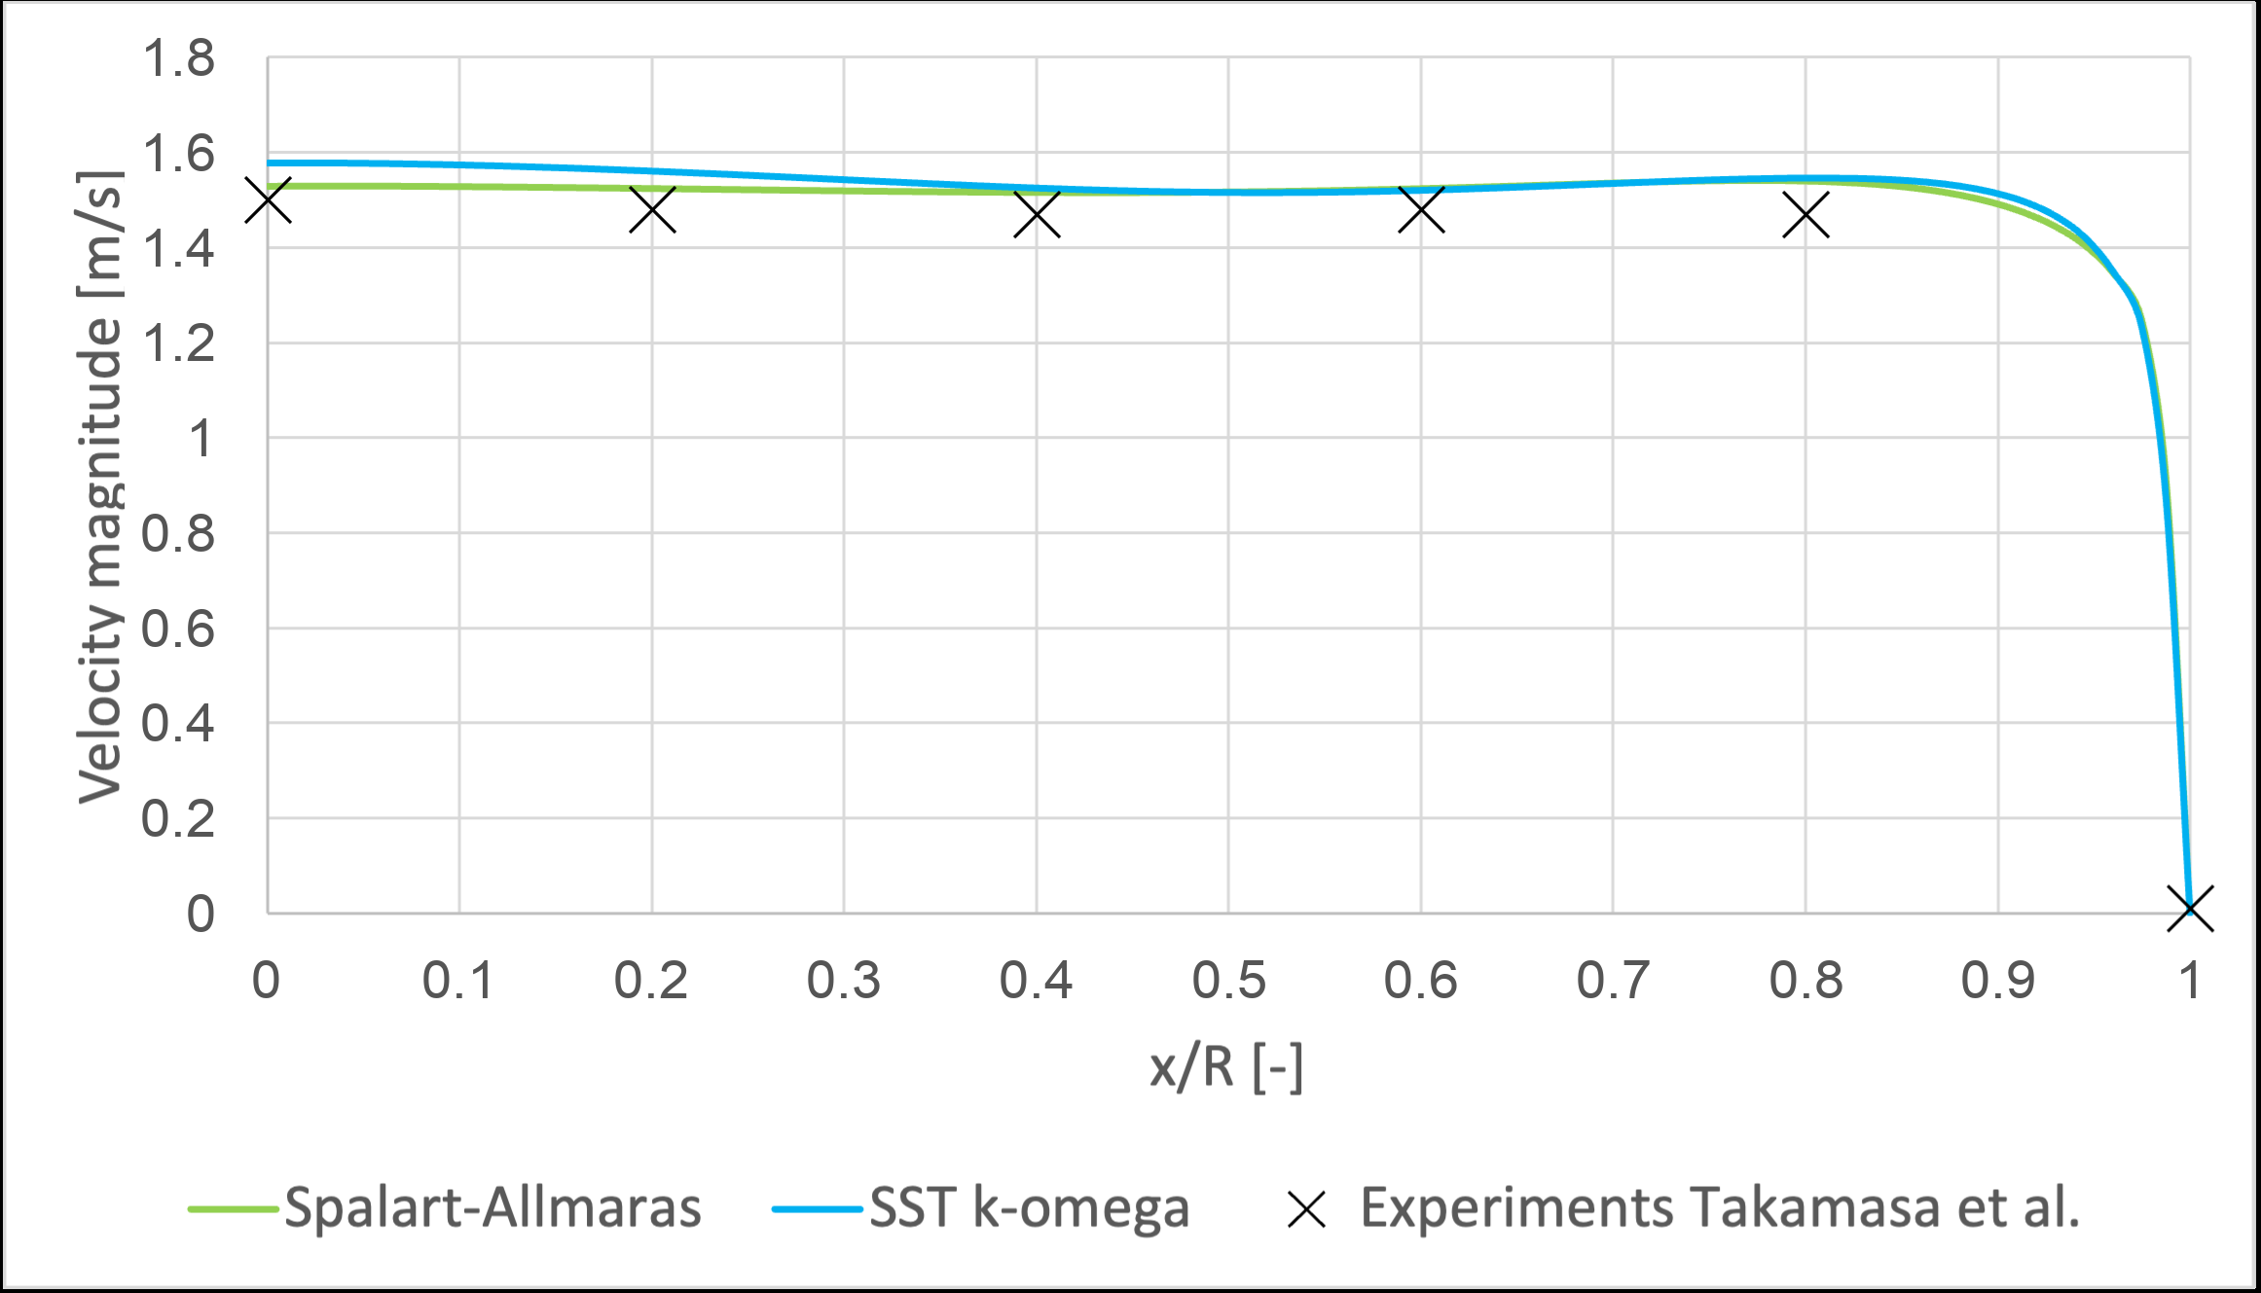
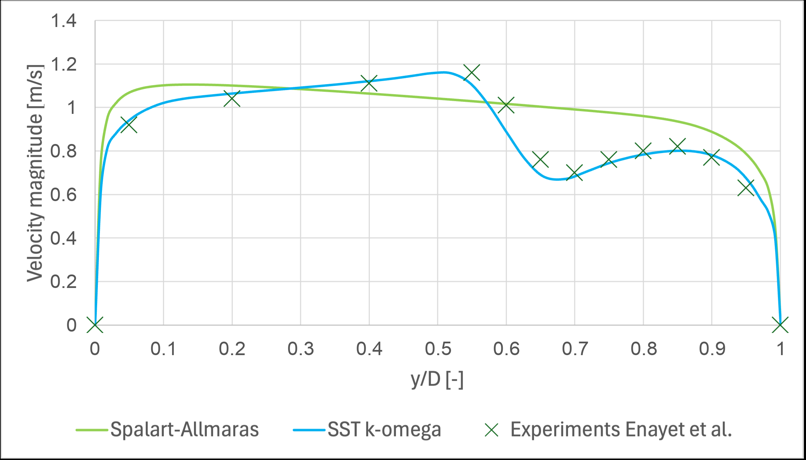
MODEL ENVELOPE
SA is credible for attached wall-bounded flow, but it degrades when curvature and separation dominate.
A one-equation scalar eddy-viscosity closure cannot represent all curvature-driven anisotropy and separated recovery.
The selected Ansys comparisons make the boundary concrete: moderate U-bend behavior remains plausible, tighter bend / separated recovery becomes more model-dependent.
This limitation becomes part of the interpretation of the topology optimization results.
Key defense sentence: SA is a design model inside an envelope, not experimental truth.
TurbulentTO master's thesis defense
05
Notes:
Mention Dean number only as a rough scale, not as a hard universal threshold. The audience should remember the model-form limitation before seeing the U-bend and diffuser.

Slide 6
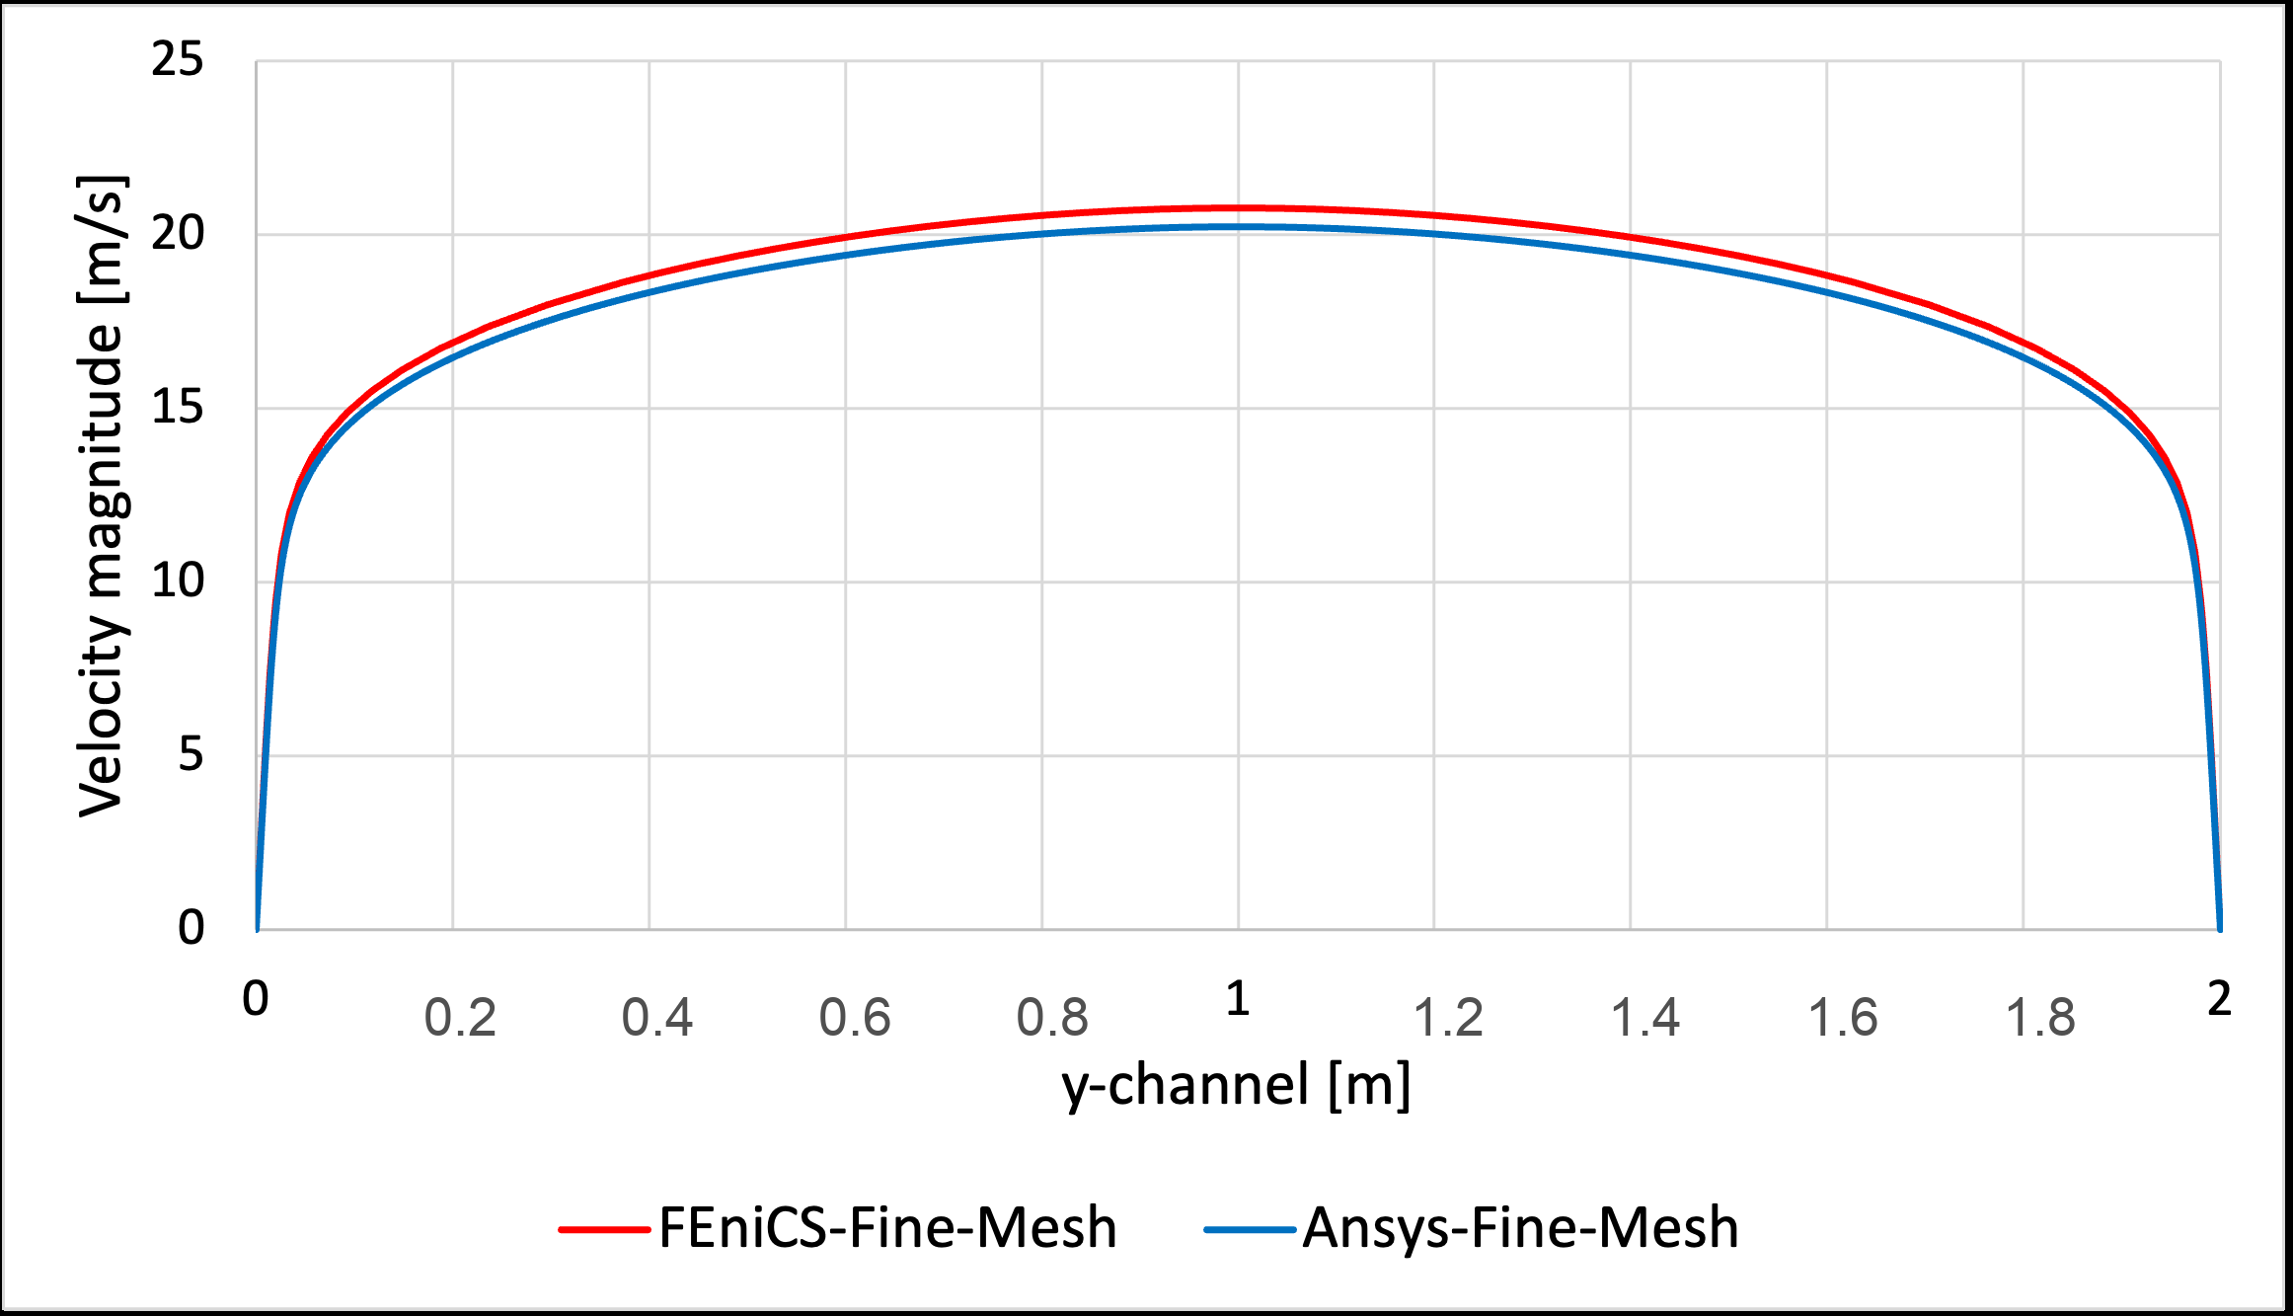
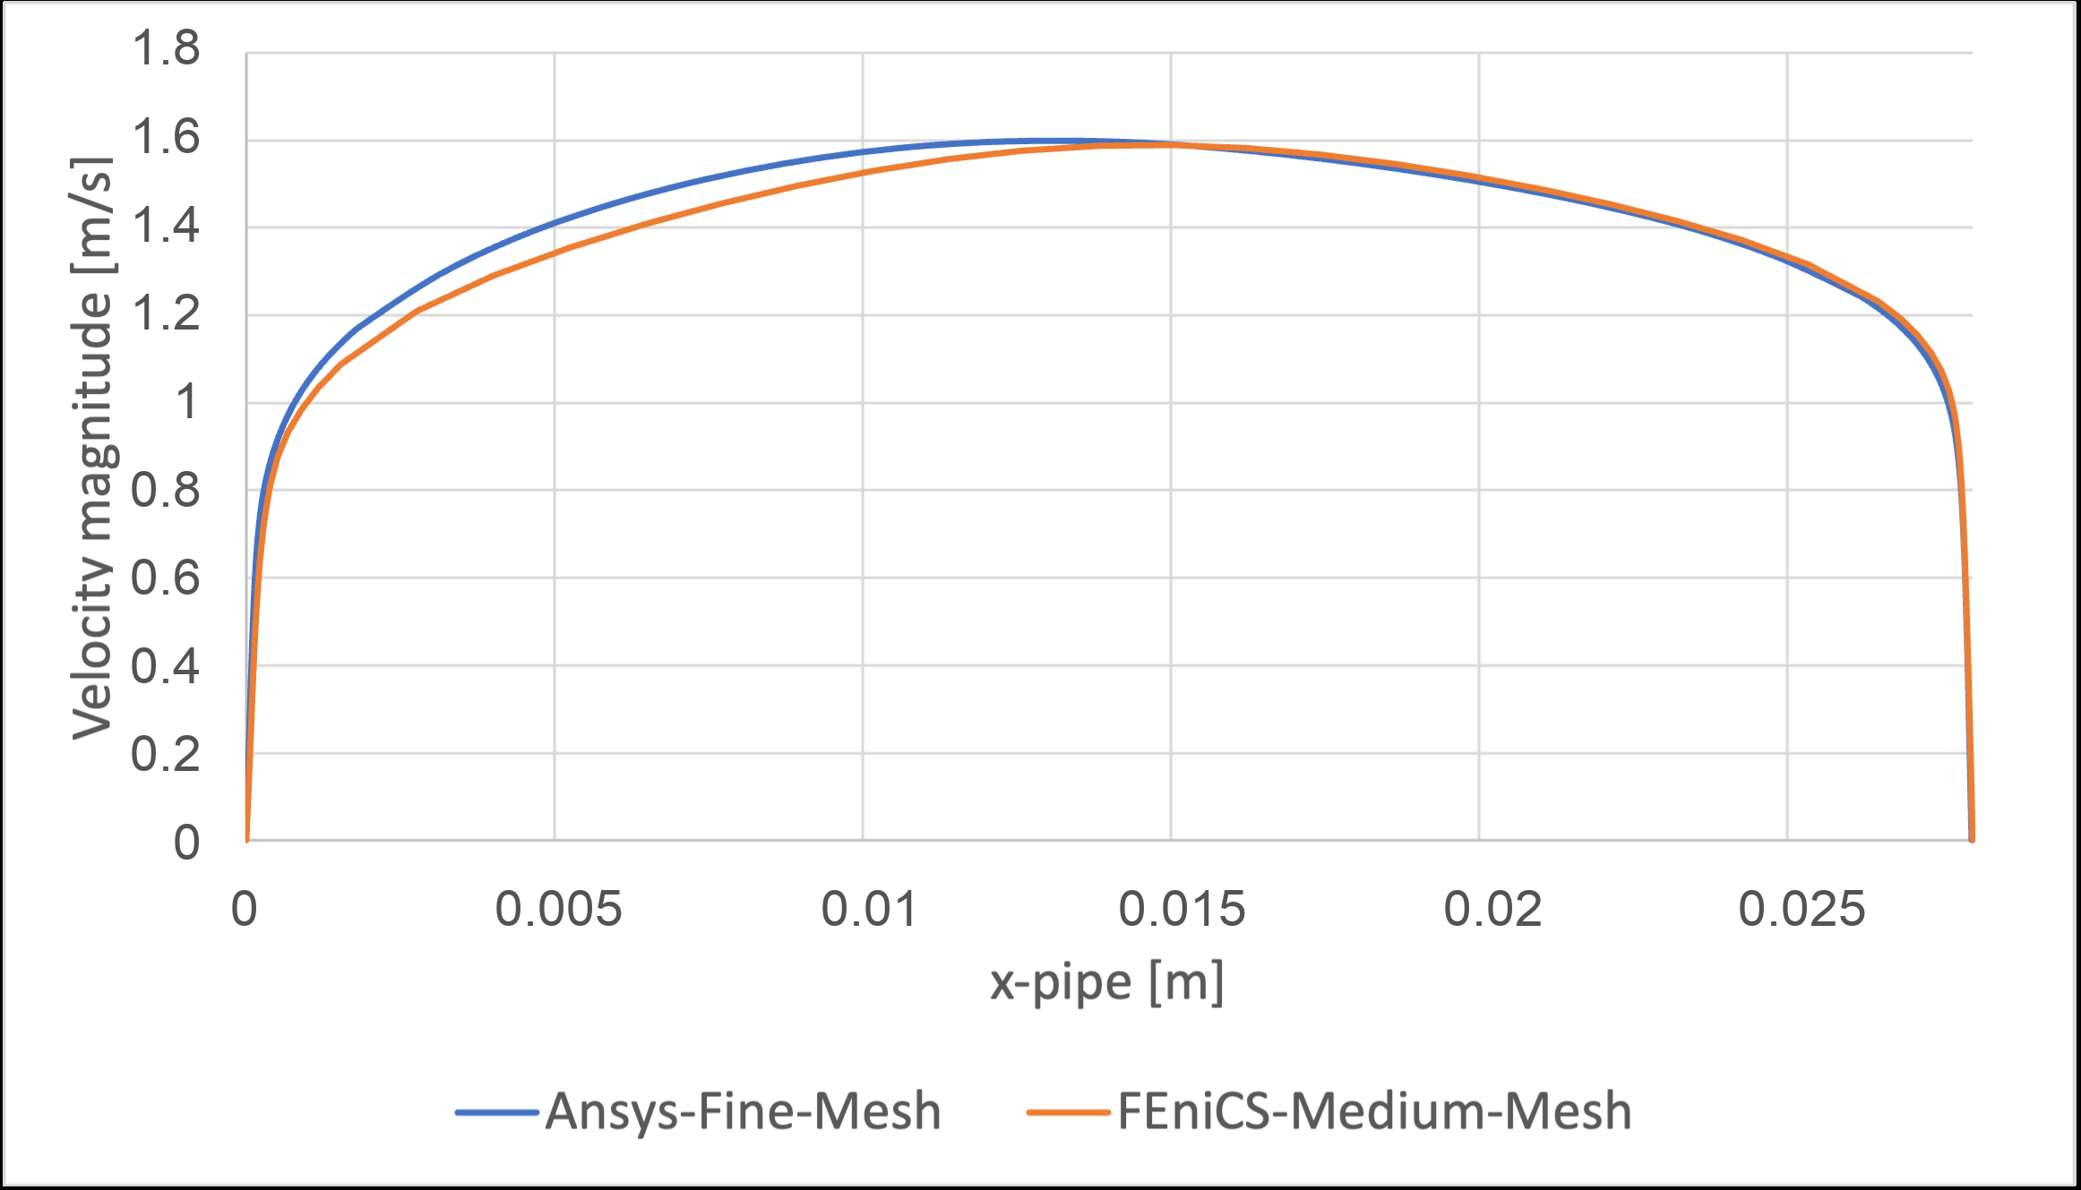
FORWARD SOLVER
The custom FEniCS-SA solver reproduces the Ansys reference at the level needed by the optimizer.
2.67%
2.79%
8.50%
channel bulk-velocity difference
U-bend pressure-drop difference
U-bend max profile error
TurbulentTO master's thesis defense
06
Notes:
These are the thesis Chapter 4 verification numbers. Emphasize that solver verification does not erase the model limitations.

Slide 7
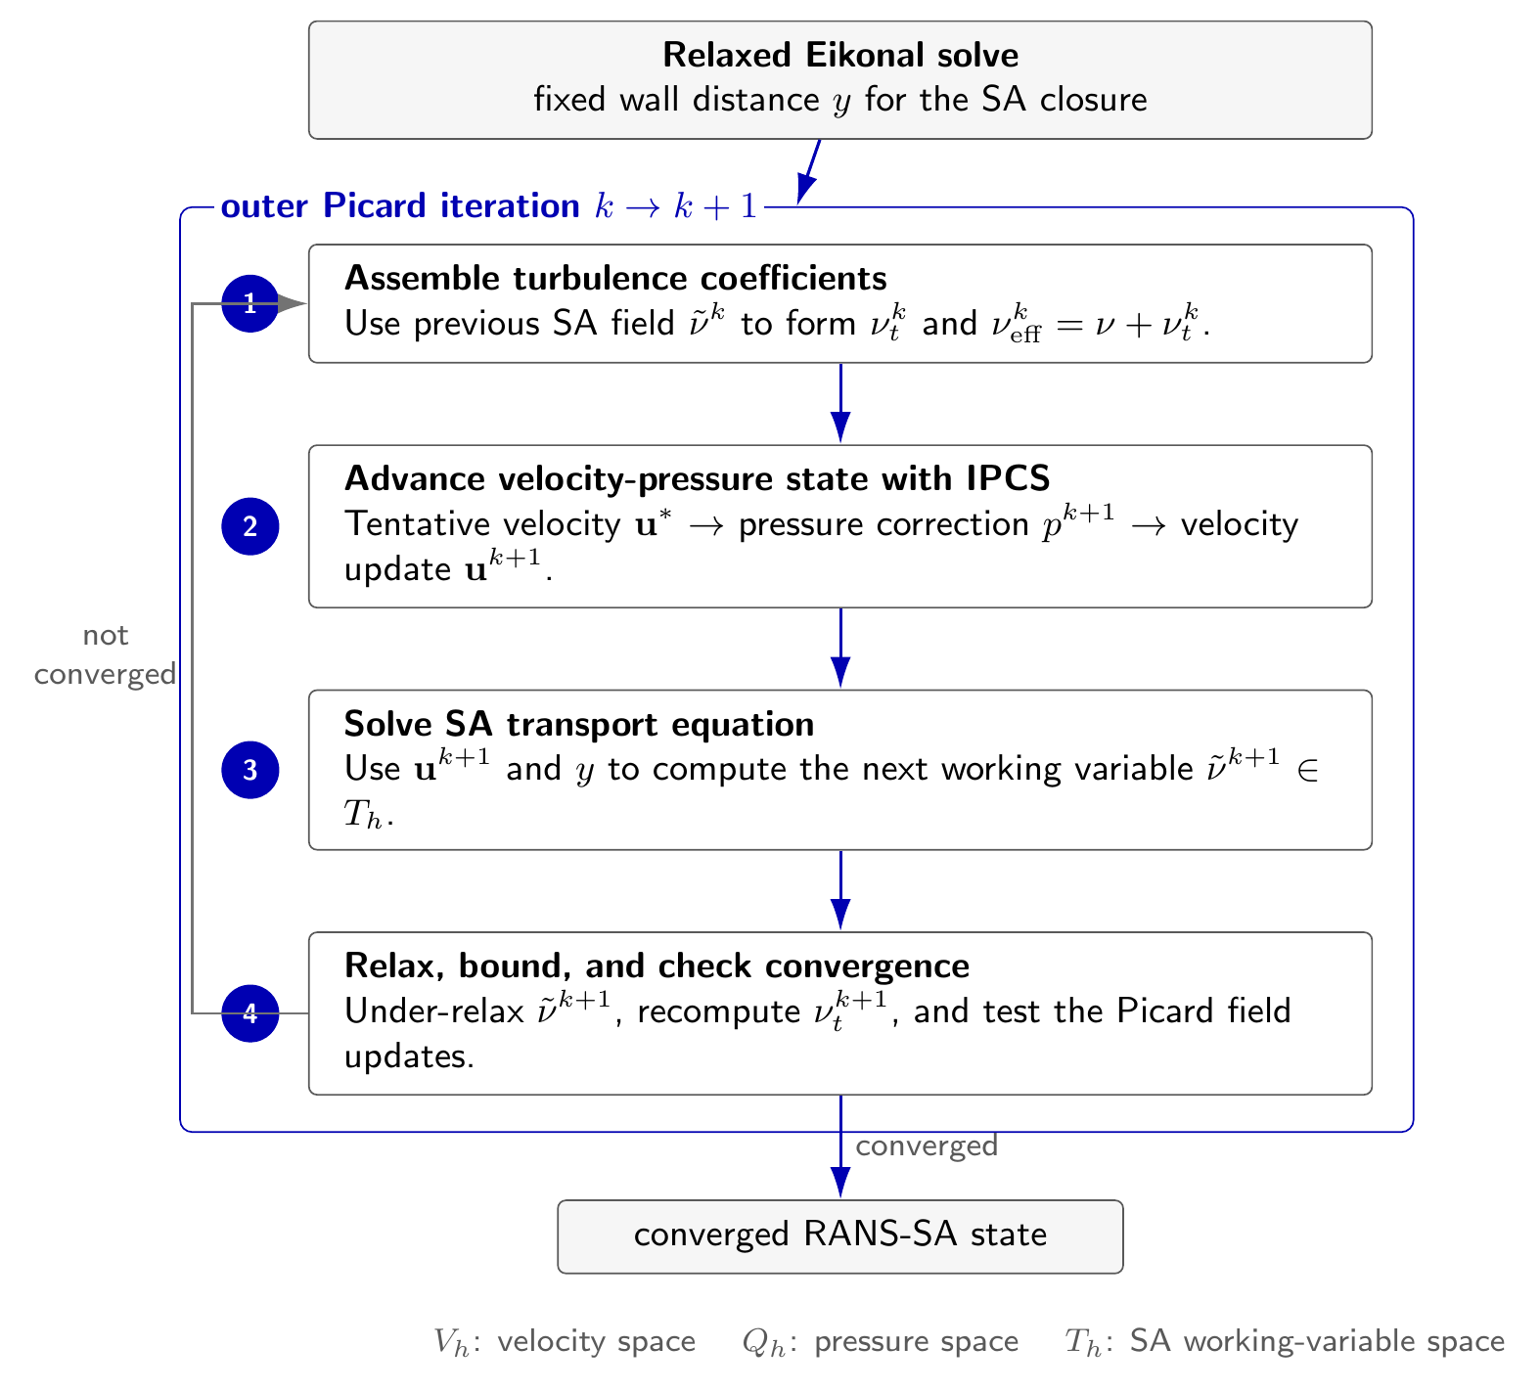
SOLVER COUPLING
The forward state is obtained through a nested flow-turbulence fixed point.
Flow: IPCS pseudo-time stepping and SNES final residual, depending on case settings.
Turbulence: SA transport updated in an outer Picard loop with wall-resolved boundary conditions.
Wall distance: relaxed reciprocal-wall-distance field, later penalized by topology-created solids.
The optimizer can only be as defensible as this forward state; loose final solves look like design noise.
TurbulentTO master's thesis defense
07
Notes:
Use this to explain why convergence quality matters later for pipe-bend oscillations.

Slide 8
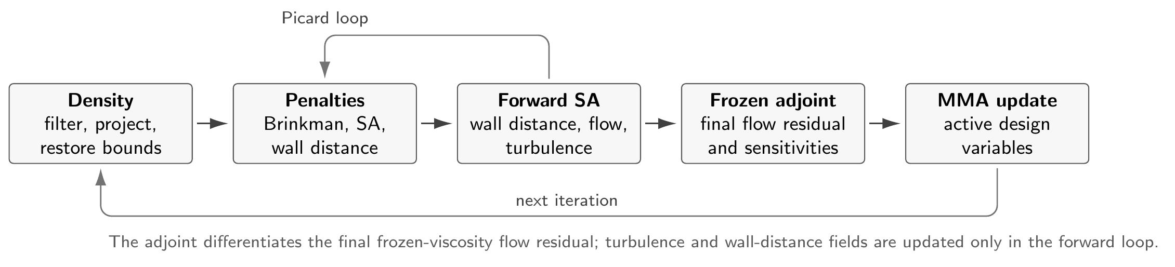
OPTIMIZATION LOOP
The topology loop adds Brinkman penalization, filtering, projection, MMA, and topology-dependent SA penalties.
rho
MMA
beta / q
DG0 design variable
gradient-based update
projection and RAMP continuation
TurbulentTO master's thesis defense
08
Notes:
Explain the order: density, filter, projection, penalized flow/turbulence, objective/adjoint, MMA update. Do not over-explain every equation.

Slide 9
FROZEN ADJOINT
The adjoint is internally consistent, but it intentionally freezes turbulence and wall-distance sensitivities.
density rho
forward solve: u, p, SA, G
freeze nu_tilde, nu_t, G
adjoint for u, p only
Gradient is consistent with the frozen model, not with a fully coupled turbulence derivative.
TurbulentTO master's thesis defense
09
Notes:
This is an important limitation slide. It also explains why oscillations can appear when the design step changes the turbulence field more than the frozen gradient predicts.

Slide 10
BENCHMARK PORTFOLIO
Three cases separate success from closure sensitivity.
Case
Re / Vf
Objective
What it tests
Pipe bend
5000 / 0.25
Jp
Attached, moderately curved transfer case
U-bend
5000 / 0.27
Jp
Forced 180-degree return around separator
Diffuser
3000 / 0.30
JD
Adverse pressure gradient and outlet treatment
TurbulentTO master's thesis defense
10
Notes:
Keep this concise. It sets up why different cases give different conclusions.

Slide 11
VALIDATION RULE
Validate the extracted sharp geometry, not only the diffuse objective.
Ansys-SA validation
Diffuse FEniCS density
Sharp-wall extraction
Ansys SST k-omega stress test
Claim is made only after this transfer step.
Phi_D
Delta p
SA vs SST
integrated viscous dissipation
static pressure drop
closure stress test
TurbulentTO master's thesis defense
11
Notes:
This slide defines the standard that all result slides must meet. Mention diffuse-to-sharp transfer as a limitation.

Slide 12
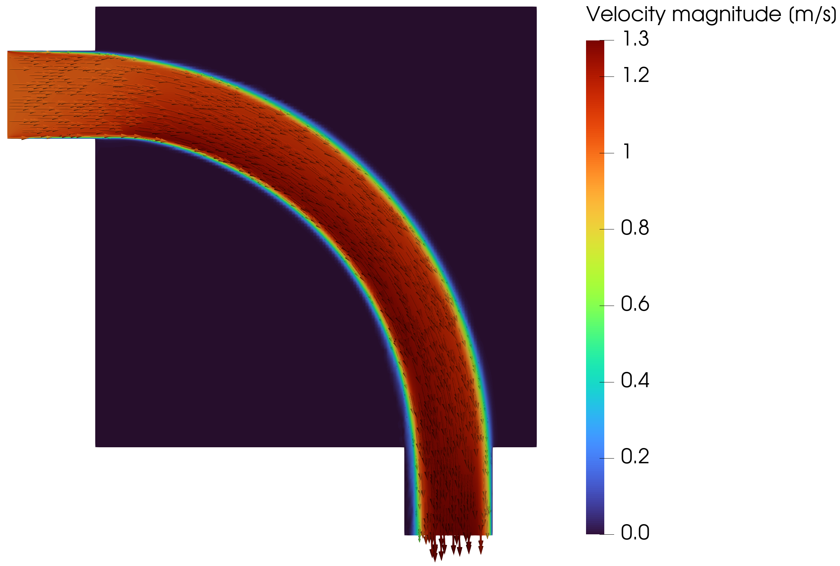
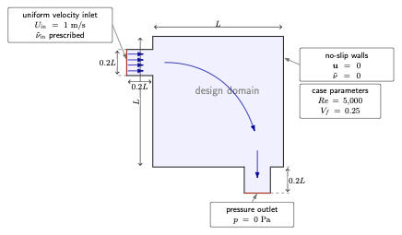
PIPE BEND
Pipe bend is the clean success case.
Jp = 0.2130 Pa
Vf = 0.25
Re = 5000
70-iteration FEniCS endpoint
target fluid volume fraction
Bayat/Alexandersen operating point
TurbulentTO master's thesis defense
12
Notes:
Be careful: call it a provisional endpoint, not a converged optimum. The robustness comes from validation, not from convergence.

Slide 13
PIPE VALIDATION
Pipe bend survives the SA-to-SST closure swap.
Pressure drop, lower is better
FEniCS diffuse SA
0.2130 Pa
SST validation changes pressure drop by +4.5% and dissipation by +8.5%, far below the U-bend and diffuser closure shifts.
Ansys sharp SA
0.1457 Pa
Ansys sharp SST
0.1522 Pa
+4.5%
+8.5%
0.1522 Pa
Delta p shift from Ansys-SA to SST
Phi_D shift from Ansys-SA to SST
SST sharp pressure drop
TurbulentTO master's thesis defense
13
Notes:
This is the strongest result. The closure swap gives small shifts relative to U-bend/diffuser.

Slide 14
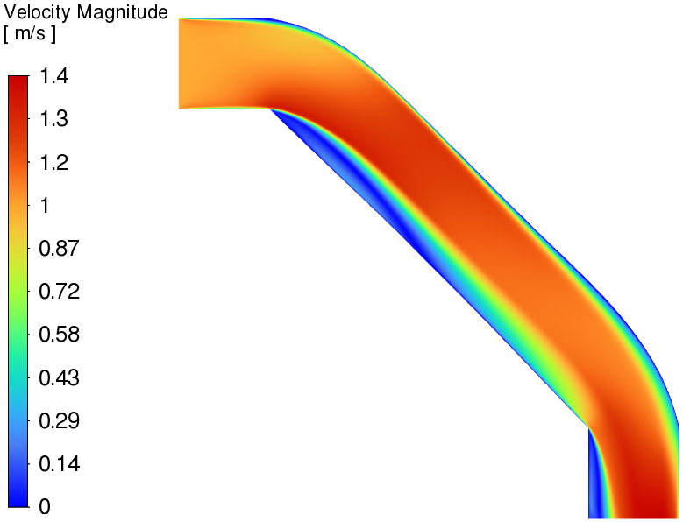
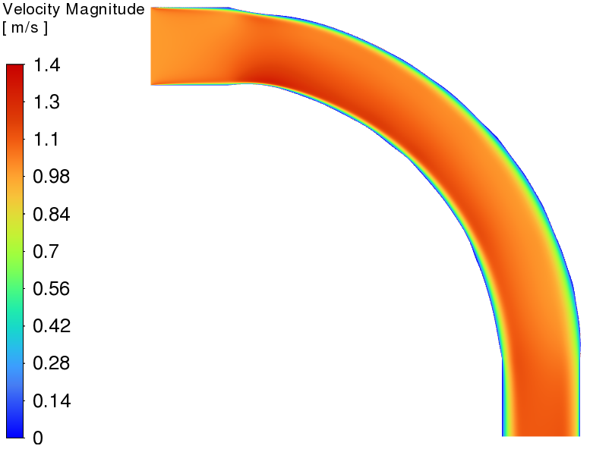
PIPE VS LAMINAR
Under identical turbulent validation, the turbulent pipe-bend design decisively beats the laminar surrogate.
Laminar topology creates a shorter, sharper turn that performs poorly at Re = 5000.
-72.0%
-47.0%
pressure drop vs laminar design
viscous dissipation vs laminar design
TurbulentTO master's thesis defense
14
Notes:
This is likely the slide the committee will remember. State the comparison is under identical SST k-omega operating conditions.

Slide 15
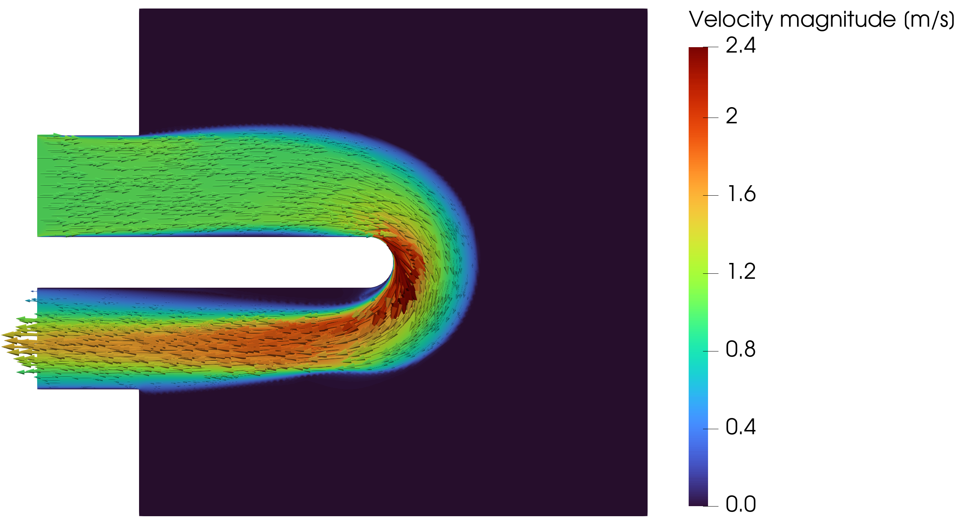
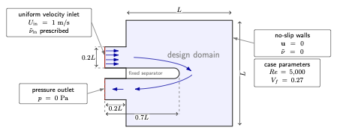
U-BEND
U-bend is plausible, but the forced return is sensitive.
Jp = 0.8250 Pa
0.8327 Pa
running
reported 275-iteration endpoint
Bayat k-epsilon reference scale
current Jp case still evolving
TurbulentTO master's thesis defense
15
Notes:
Mention the user's current run only as an ongoing opportunity, not as a final result unless it finishes before the defense.

Slide 16
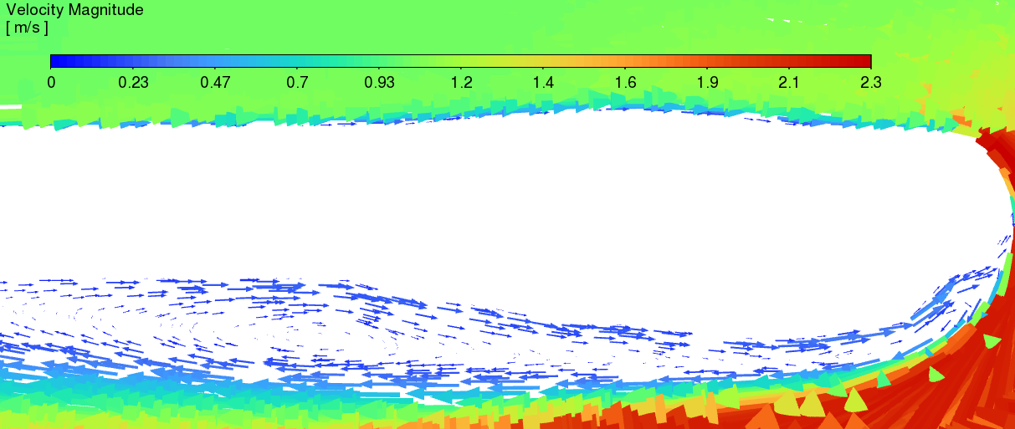
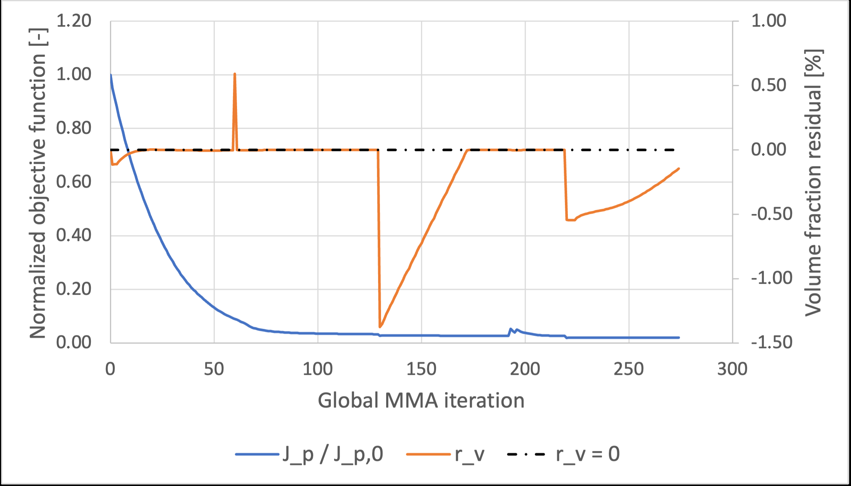
U-BEND VALIDATION
SST exposes the cost of U-bend separation sensitivity.
Evaluation
Phi_D
Delta p
Readout
Turbulent Ansys-SA
0.0785
0.8071
closure-family check
Turbulent Ansys SST
0.1016
1.1973
+29.4% / +48.3%
Laminar SST baseline
0.1069
1.1496
near tie under SST
Defense wording: useful turbulent candidate, not closure-independent performance proof.
TurbulentTO master's thesis defense
16
Notes:
The current evolving run is worth continuing because the reported U-bend is not final and this case is presentation-relevant.

Slide 17
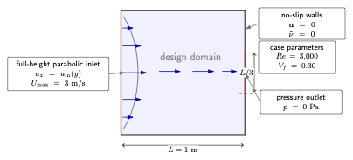
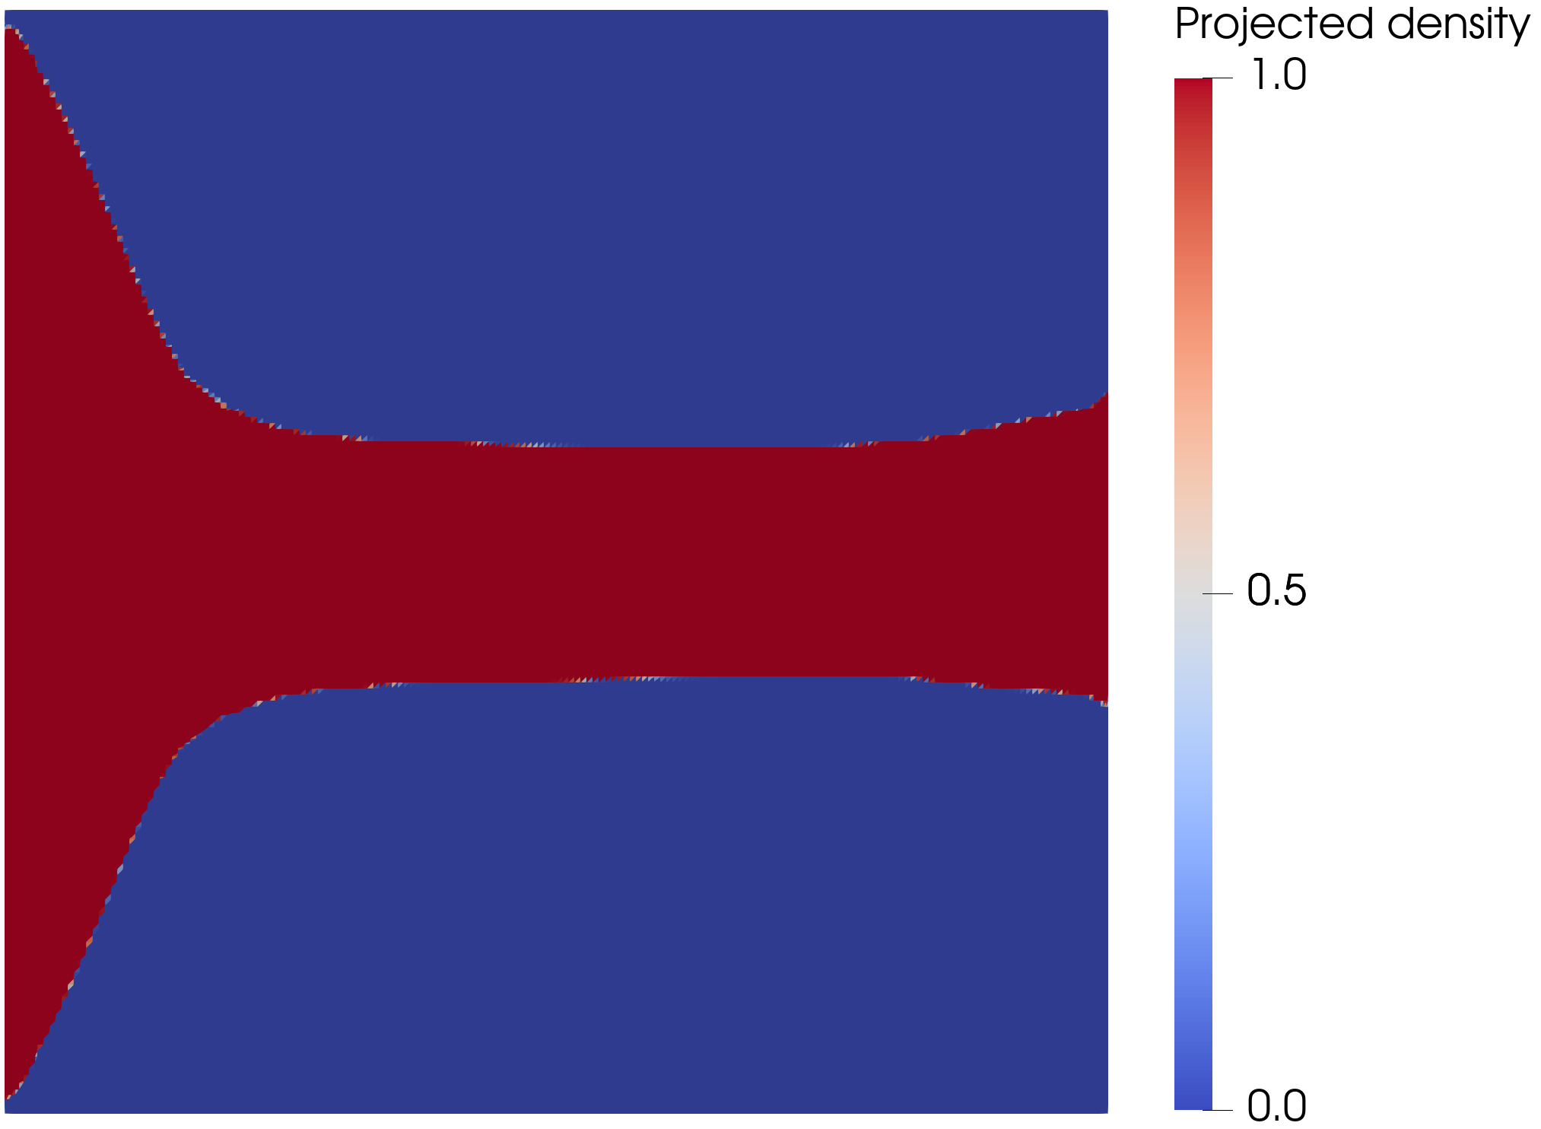
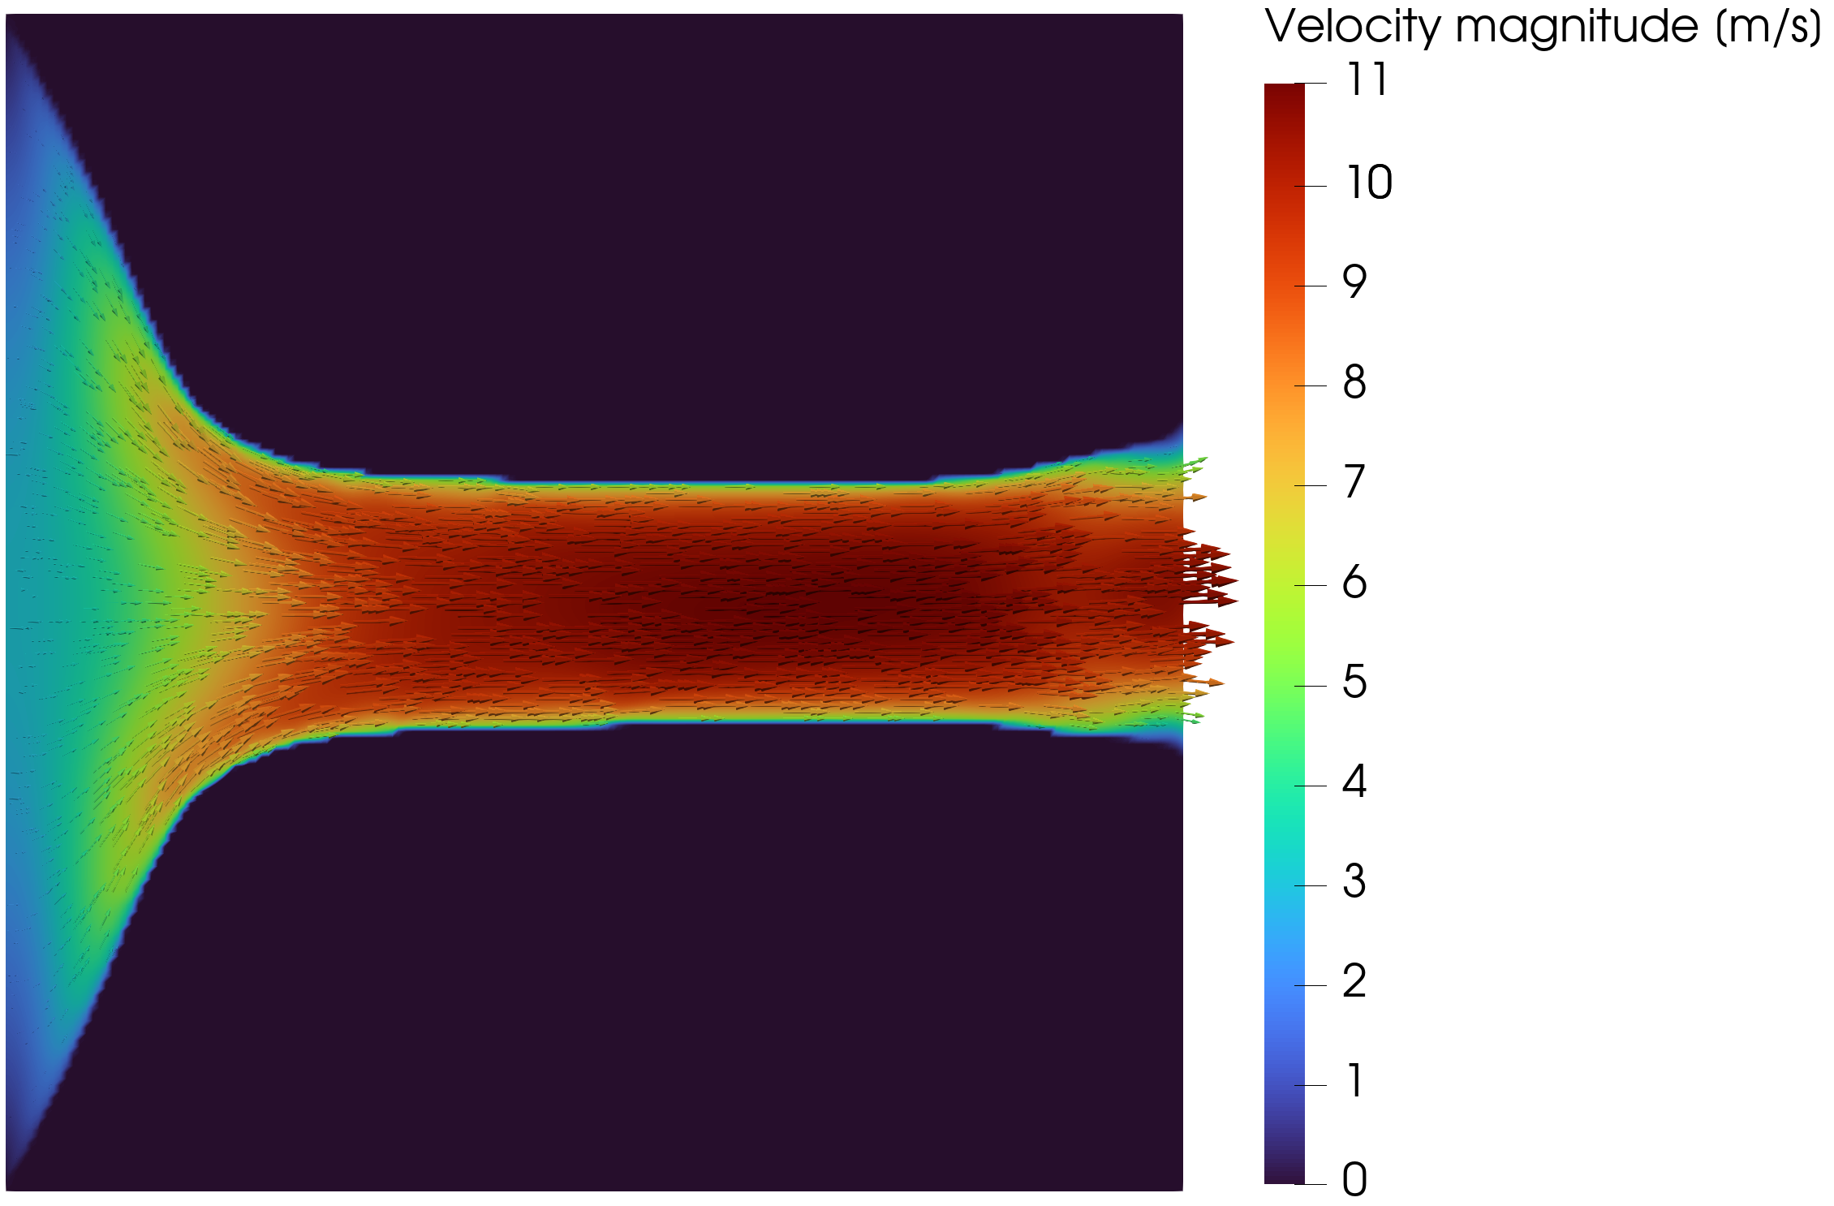
DIFFUSER
Boundary treatment steers the diffuser topology.
-11.2%
Re = 3000
Vf = 0.30
JD after switching from velocity outlet to pressure outlet
Yoon diffuser operating point
fluid fraction
TurbulentTO master's thesis defense
17
Notes:
Do not sell this as pressure outlet better in a universal sense; it is a different boundary-value problem.

Slide 18
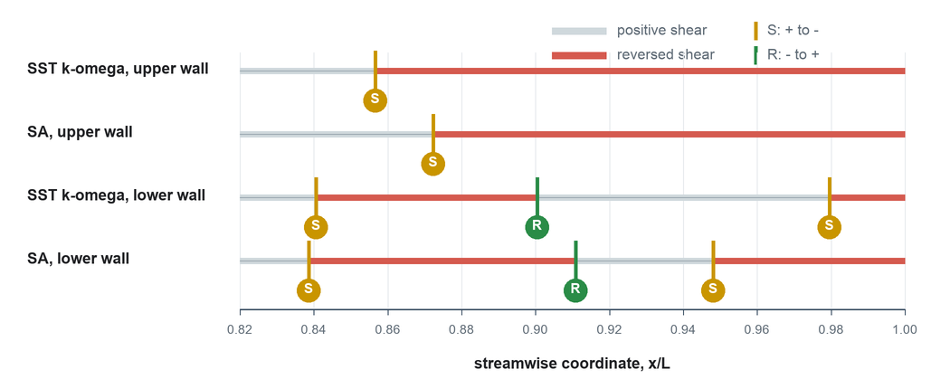
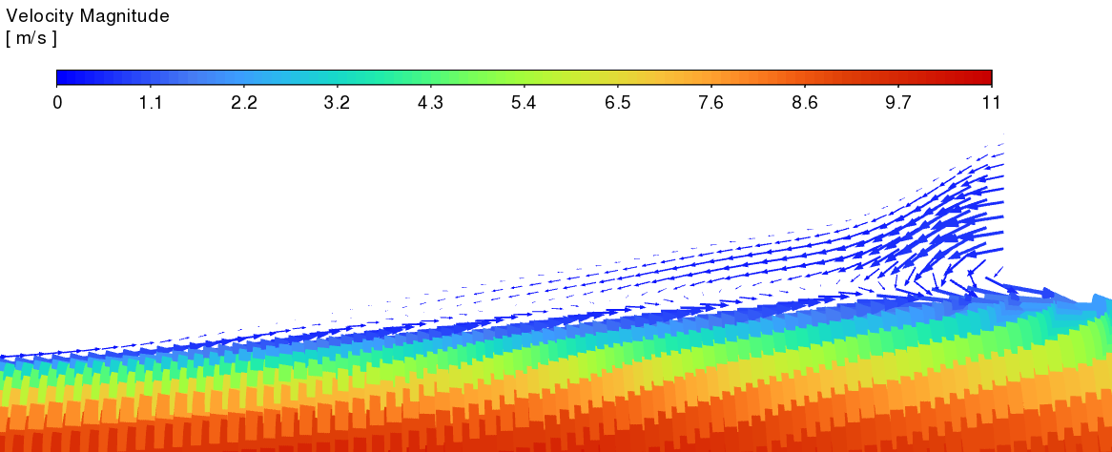
DIFFUSER VALIDATION
The diffuser reverses ranking under SST validation.
Design / model
Phi_D
Delta p_s
Relative to laminar
Laminar, Ansys-SA
1.3495e5
1.3979e5
baseline
Turbulent, Ansys-SA
1.1885e5
1.1541e5
-11.9% / -17.4%
Laminar, SST
1.1289e4
3.8332e4
baseline
Turbulent, SST
1.2834e4
5.0006e4
+13.7% / +30.5%
Do not overclaim: this is model-form uncertainty in an adverse-pressure-gradient flow.
TurbulentTO master's thesis defense
18
Notes:
This is the cautionary result. The exact magnitudes differ strongly because SA and SST model different separated/recovering behavior.

Slide 19
CROSS-CASE LESSON
The same optimizer gives different levels of credibility depending on flow regime.
Case
Dominant physics
Defensible presentation claim
Pipe bend
attached / moderate curvature
robust turbulent-design advantage
U-bend
forced return / local recirculation
promising but closure-sensitive
Diffuser
adverse pressure gradient / separation
boundary and closure sensitivity
The key result is not that turbulent TO always wins. It wins clearly when the optimized flow stays in the closure's practical range.
TurbulentTO master's thesis defense
19
Notes:
This is a synthesis slide. It turns apparent mixed results into a coherent scientific conclusion.

Slide 20
OVERALL CONCLUSION
Frozen-SA topology optimization is useful as an early turbulent design tool, provided validation is mandatory.
Credible: attached or moderately curved internal flows where SA and SST give consistent sharp-geometry rankings.
Risky: forced separation, adverse pressure gradients, and geometries where the optimizer exploits one closure's recovery behavior.
Mandatory: sharp-wall validation after extraction, preferably with at least one independent turbulence closure.
Build
Verify
Validate
open FEniCS turbulent TO framework
forward SA implementation
final sharp geometries
TurbulentTO master's thesis defense
20
Notes:
This should sound balanced. It is stronger to say where the method works than to claim it solves all turbulent TO.

Slide 21
WHAT TO RUN NEXT
Use remaining compute to strengthen the U-bend and support the pipe-bend result, not to chase every case.
Priority
Run
Why
Presentation value
1
Continue U-bend Jp
currently evolving nicely; reported 275-iteration state is provisional
could convert cautionary case into stronger endpoint
2
U-bend sensitivity after endpoint
same Jp derivative path as pipe bend, but forced return is the hard case
defends the run if asked about gradients
3
Pipe-bend polish only
result already validates well; oscillation risks diminishing returns
use as robustness support, not headline
4
Diffuser no extra priority
closure reversal is already the scientific point
unlikely to become closure-independent quickly
TurbulentTO master's thesis defense
21
Notes:
This directly answers the user's question. If compute is limited, U-bend is the best marginal investment.

Slide 22
PIPE OSCILLATIONS
Pipe-bend oscillations are a symptom of an over-reactive coupled design/flow update near a sensitive topology.
The pressure objective is global but reacts sharply to small throat/radius changes in the curved path.
Lower move limits help, but they are not the whole answer.
Frozen gradients ignore how the next design step recomputes SA, eddy viscosity, and wall distance.
Better: hold beta/q, add objective-acceptance step damping, require tighter final-state convergence, and only resume continuation after monotonic behavior returns.
Projection/RAMP continuation makes cell-level changes more discrete; a narrow path can flip between two near-equivalent layouts.
Loose or accepted final solves can turn nonlinear residual noise into apparent objective noise.
TurbulentTO master's thesis defense
22
Notes:
Mention that the current smooth continuation already has move limits down to 0.0015. The next step is controlled stage holding and candidate-step acceptance, not just making all moves tiny.

Slide 23
STABILIZATION PLAYBOOK
To remove oscillations, treat the MMA update like a nonlinear trust-region step.
Hold the current beta and q stage until the objective is monotone over a short window.
Recommended presentation stance: the 70-iteration pipe bend is already defensible by validation; further polishing is optional.
Reduce move only locally in oscillatory stages, for example 0.0015 -> 0.0010 or 0.00075, not across the whole campaign.
Enable or implement design-step backtracking for objective increase, not only for broken forward solves.
Tighten the final flow solve when judging objective values; avoid accepted-residual states as optimization evidence.
If oscillation persists, temporarily lower beta or increase filter radius before continuing projection sharpening.
TurbulentTO master's thesis defense
23
Notes:
This slide answers how to reduce oscillations. It is technical but useful in Q&A.

Slide 24
U-BEND SENSITIVITY
Rerun U-bend sensitivity, but only after the current Jp run reaches the endpoint you will actually present.
A sensitivity check before the final endpoint proves the wrong design state.
The U-bend is the harder Jp case because topology, recirculation, and closure response all interact around the separator.
The sensitivity check should use the exact continuation stage, beta, q, penalty settings, and final-solve tolerances of the presented endpoint.
Do
Do
Avoid
directional Taylor check on final endpoint
coordinate finite differences on selected active cells
rerunning sensitivity on an obsolete intermediate
TurbulentTO master's thesis defense
24
Notes:
This gives a clear answer: yes, but sequence matters. Current evolving run first, sensitivity second.

Slide 25
FUTURE WORK
The next research steps are model hierarchy, 3D geometry, and heat-transfer coupling.
01
02
03
04
Adjoint hierarchy
3D turbulent TO
CHT extension
Validation
frozen SA -> selected SA sensitivities -> stronger closures
secondary flow, Dean vortices, realistic extraction
turbulent heat flux, thermal objectives, conjugate boundaries
independent CFD first, experiments eventually
TurbulentTO master's thesis defense
25
Notes:
Use this as the final forward-looking slide before closing.

Slide 26
CLOSE
The method is valuable because it produces candidates and exposes when not to trust them.
Pipe bend: strong, defensible turbulent topology result.
U-bend: worth extending; likely the best remaining compute investment.
Diffuser: scientifically useful as a closure-sensitivity warning.
Main defense message: optimization plus independent validation is the design workflow.
30 min
15 min
1 sentence
presentation
Q&A with backup evidence
SA works conditionally
TurbulentTO master's thesis defense
26
Notes:
Close cleanly and invite questions. Do not introduce new details here.

Slide 27
BACKUP
All case metrics in one place for Q&A.
Case
Evaluation
Phi_D
Delta p
Readout
Pipe
Ansys-SA sharp
0.0153
0.1457
baseline validation
Pipe
Ansys SST sharp
0.0166
0.1522
+8.5% / +4.5%
Pipe
Laminar vs turbulent SST
0.0313 -> 0.0166
0.5444 -> 0.1522
-47.0% / -72.0%
U-bend
Ansys-SA sharp
0.0785
0.8071
SA-family improvement
U-bend
Ansys SST sharp
0.1016
1.1973
closure-sensitive
Diffuser
Ansys-SA turbulent
1.1885e5
1.1541e5
beats laminar under SA
Diffuser
Ansys SST turbulent
1.2834e4
5.0006e4
worse than laminar under SST
TurbulentTO master's thesis defense
27
Notes:
Backup table for metric questions.

Slide 28
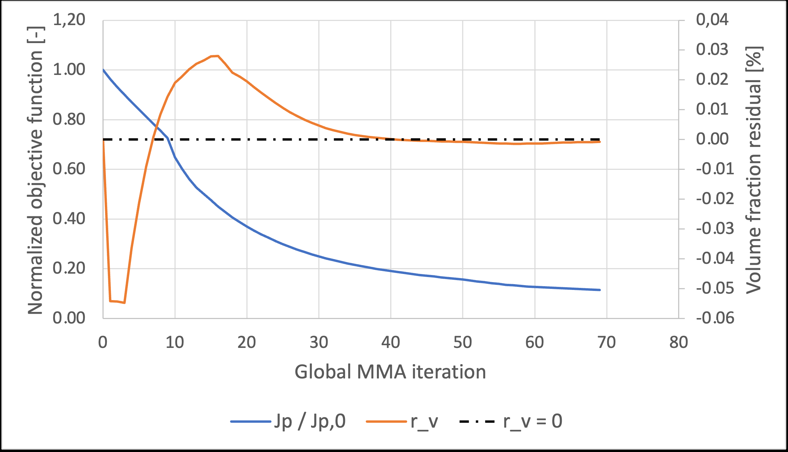
BACKUP
Sensitivity evidence supports the frozen derivative where it was run.
Pipe-bend coordinate finite differences: maximum relative discrepancy 5.92e-5.
Pipe-bend directional Taylor test: approximately second-order behavior.
Diffuser pressure-outlet sensitivity checks verify the frozen JD derivative path.
U-bend Jp sensitivity should be rerun on the final active endpoint.
TurbulentTO master's thesis defense
28
Notes:
Use if asked whether the gradients are trustworthy. Be precise: they verify the frozen derivative, not fully coupled turbulence sensitivity.

Slide 29
BACKUP
Forward solver verification numbers are good enough for the optimizer, but not a model-form validation.
Verification case
Primary metric
Value
Meaning
Periodic channel
bulk velocity difference
2.67%
FEniCS-SA reproduces channel-level behavior
Periodic channel
profile errors
E_inf 2.66%, E_L2 2.64%
near-wall and core profile agreement
2D U-bend
pressure-drop difference
2.79%
curved-flow solver agreement
2D U-bend
bend-exit profile
E_inf 8.50%, E_L2 2.75%
local max error remains visible
TurbulentTO master's thesis defense
29
Notes:
Use to defend the implementation layer separately from the turbulence-model layer.

Slide 30
BACKUP
If the pipe-bend polish is still oscillatory, stop when validation is already stronger than convergence.
The reported pipe bend is scientifically defensible because the extracted geometry survives sharp-wall SA/SST validation and strongly beats the laminar baseline.
Presentation hierarchy: validation robustness > prettier convergence history.
A noisy late-stage objective trace can weaken the presentation if framed as final convergence.
If a polish run does not settle quickly after stage holding and step damping, present it as exploratory and keep the validated 70-iteration geometry as the clean result.
Do not replace a defensible result with a newer but noisy endpoint.
TurbulentTO master's thesis defense
30
Notes:
This is the practical decision rule for final days before the presentation.

