Slide 1

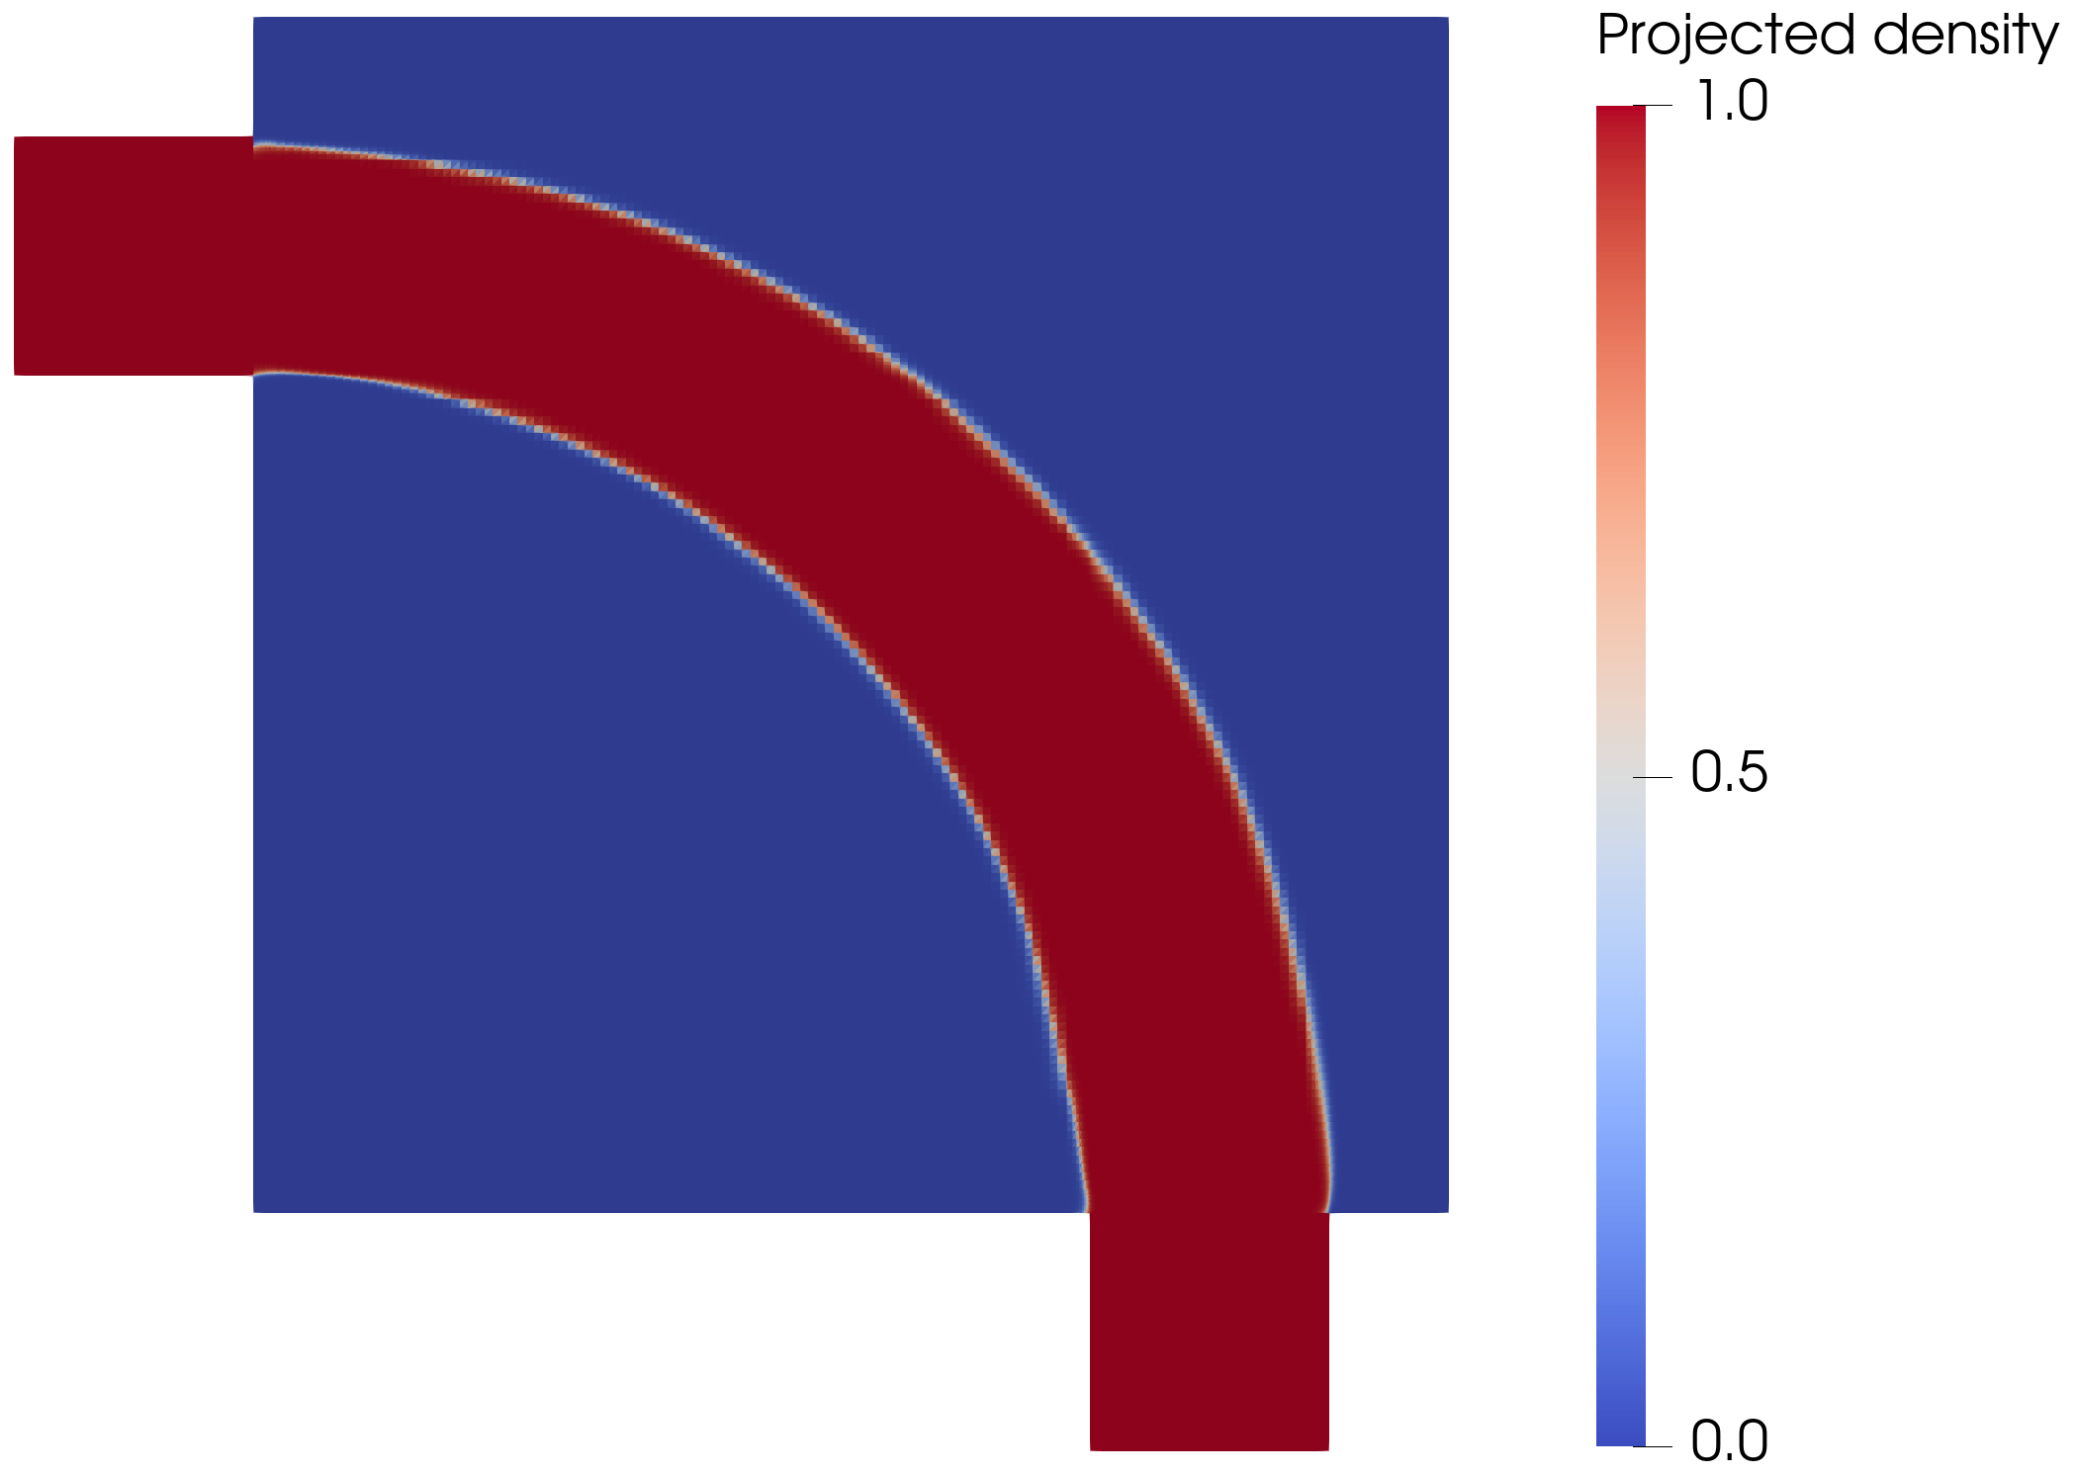
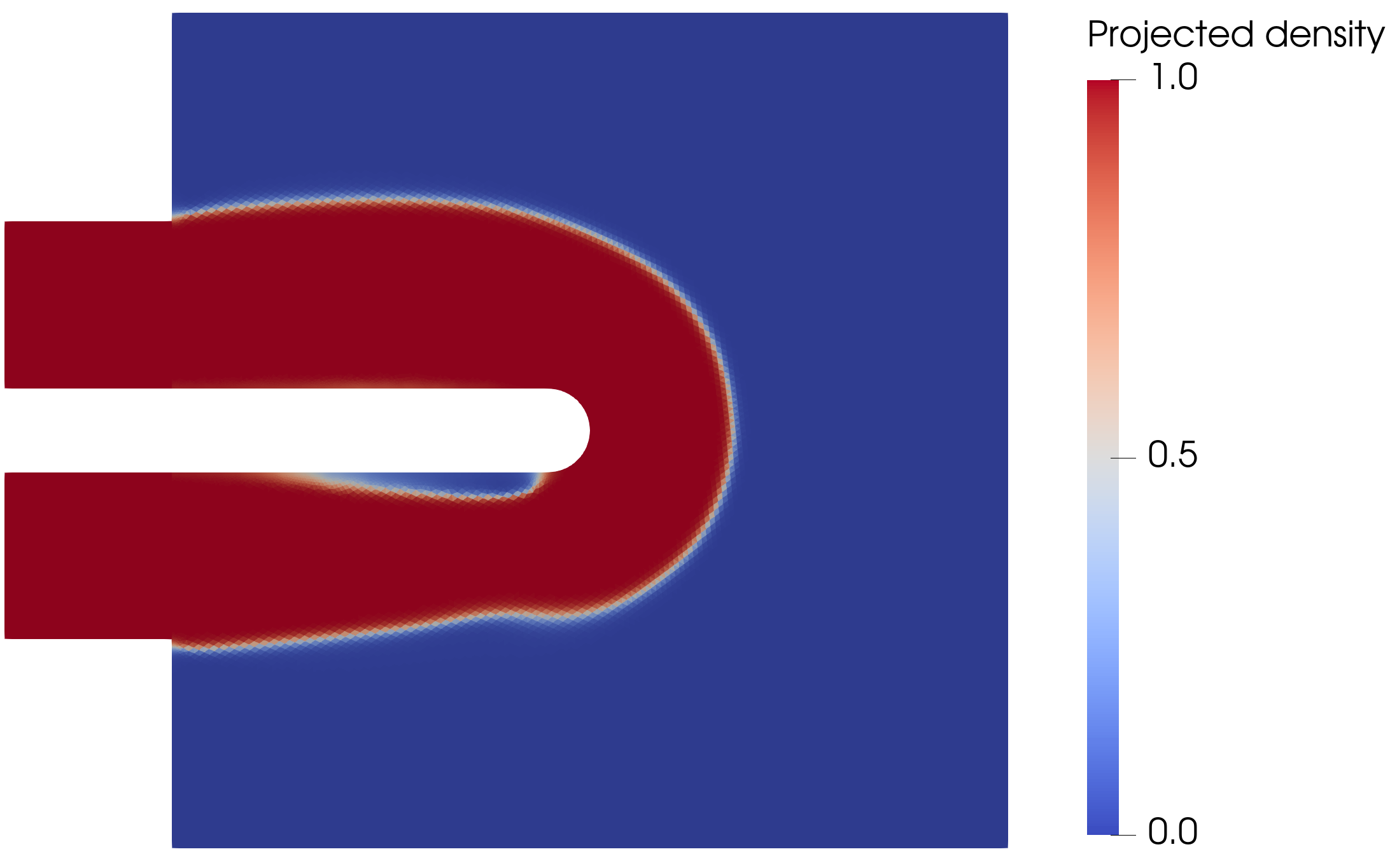
Topology Optimization of Flow Configurations Operating in the Turbulent Regime
Pipe bend
Tiebert Lefebure | Master's thesis defense | KU Leuven Mechanical Engineering
The optimizer is useful only when the extracted turbulent design survives independent CFD validation.
U-bend
-72.0%
+48.3%
reversal
pipe-bend Delta p vs laminar
U-bend SST pressure shift
diffuser ranking under SST
Notes:
Open with the defense stance. This is not a claim that the optimizer outputs final truth. The claim is that it can generate candidates, and that credibility is established only after sharp-geometry validation.

Slide 2
TurbulentTO
The result of the thesis is a validated design workflow, not just optimized shapes.
CLAIM
Frozen-SA topology optimization can create useful turbulent internal-flow candidates when the closure model, forward solver, gradient path, and exported geometry are all stress-tested.
Model envelope
Solver verification
Sharp validation
SA must be credible for the local flow physics.
FEniCS-SA must reproduce trusted reference cases.
Diffuse densities must survive Ansys-SA and SST checks.
Design candidates become defensible only after the validation chain closes.
02
Notes:
This slide reframes the thesis away from benchmark screenshots. The core contribution is the evidence chain and the conservative interpretation of where it works.

Slide 3
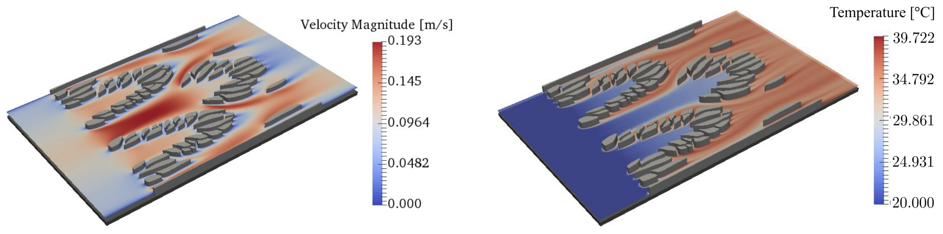
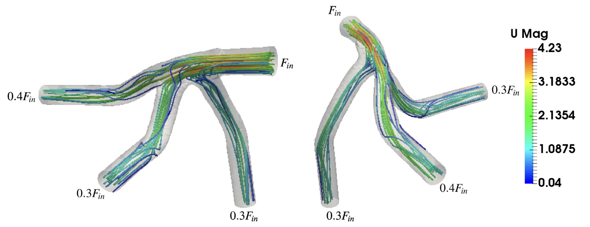
TurbulentTO
The thesis isolates the hydraulic turbulent-flow problem before adding heat transfer.
SCOPE
No energy equation and no conjugate heat transfer claim.
Target: low-loss turbulent internal routing using pressure drop and dissipation as hydraulic readouts.
The isolated flow problem already couples turbulence, wall distance, Brinkman penalization, evolving geometry, and frozen gradients.
Thermal motivation
Flow routing context
03
Notes:
Answer the heat-transfer question before it is asked. The thesis deliberately solves the turbulent hydraulic prerequisite; CHT would be a later layer.

Slide 4
TurbulentTO
Every case is judged by the same evidence chain.
ROADMAP
1
2
3
4
Model envelope
Forward solver
Optimization
Sharp validation
Where is SA credible enough to design?
Does FEniCS-SA reproduce reference flows?
Can MMA use the frozen gradient path?
Does the exported geometry survive Ansys/SST?
The same sequence is used for pipe bend, U-bend, and diffuser.
04
Notes:
Use this as the talk map. The same chain appears again in the synthesis, so the jury sees that the mixed results are deliberate evidence rather than scattered outcomes.

Slide 5
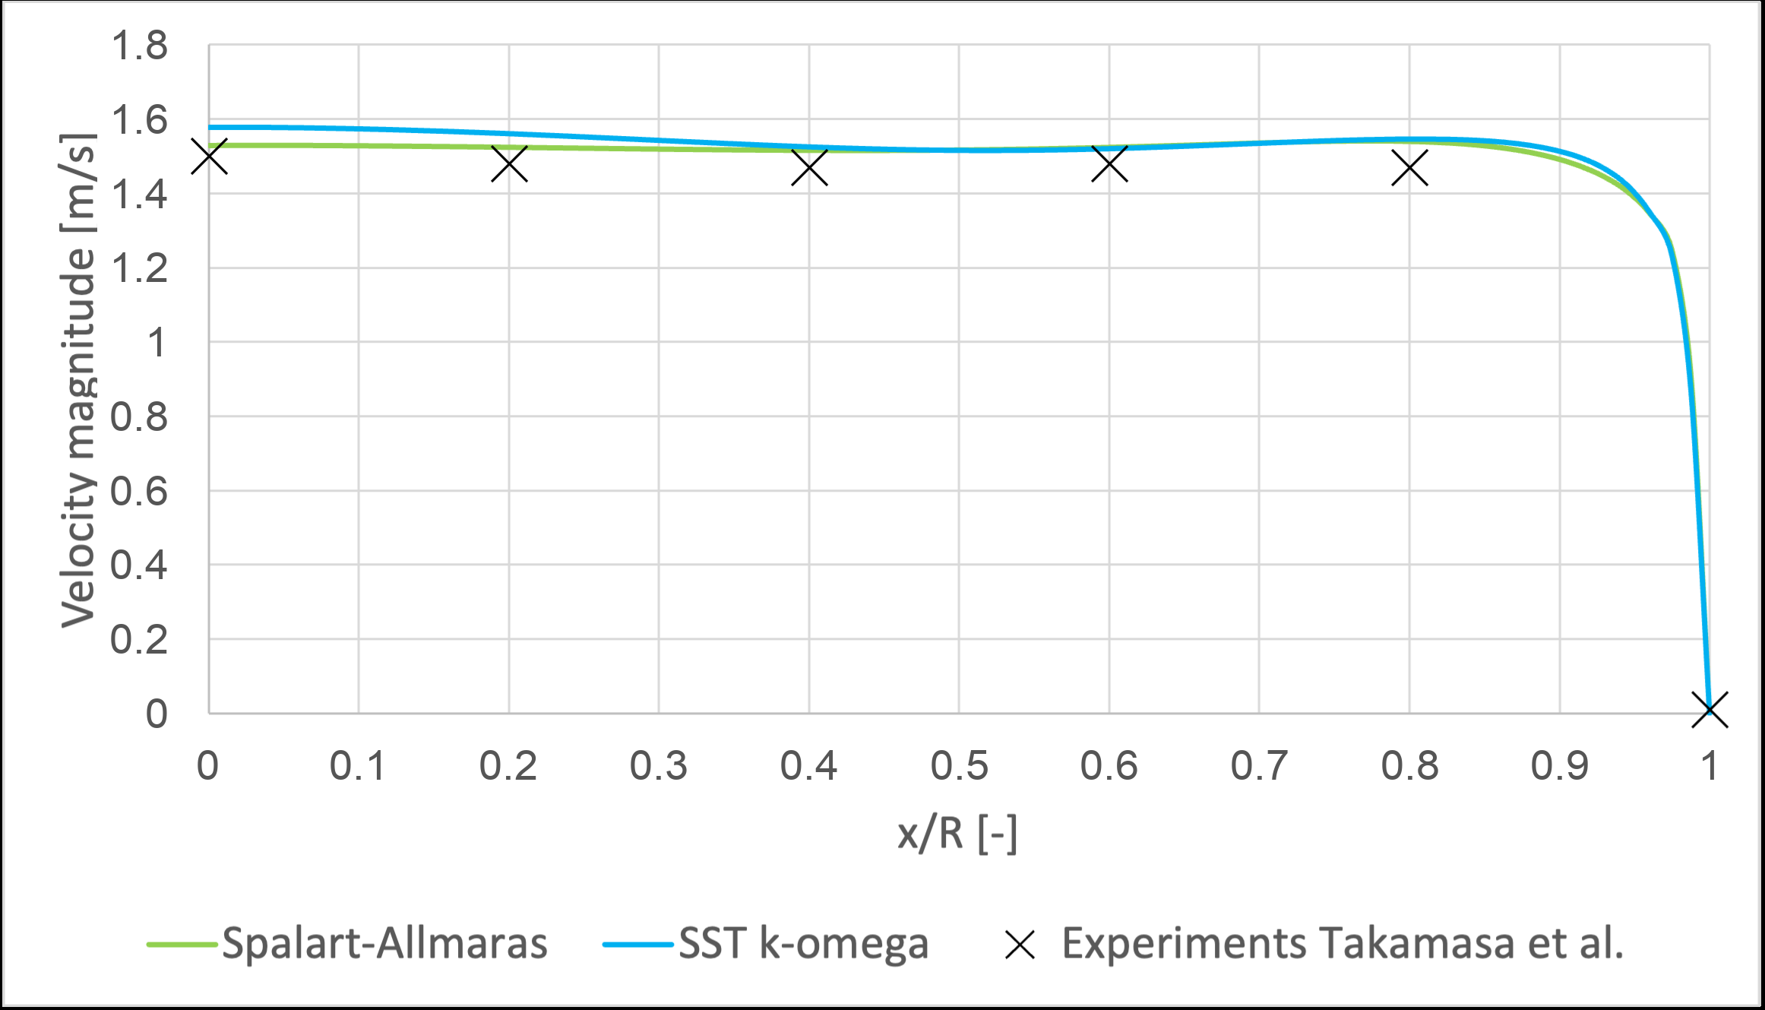
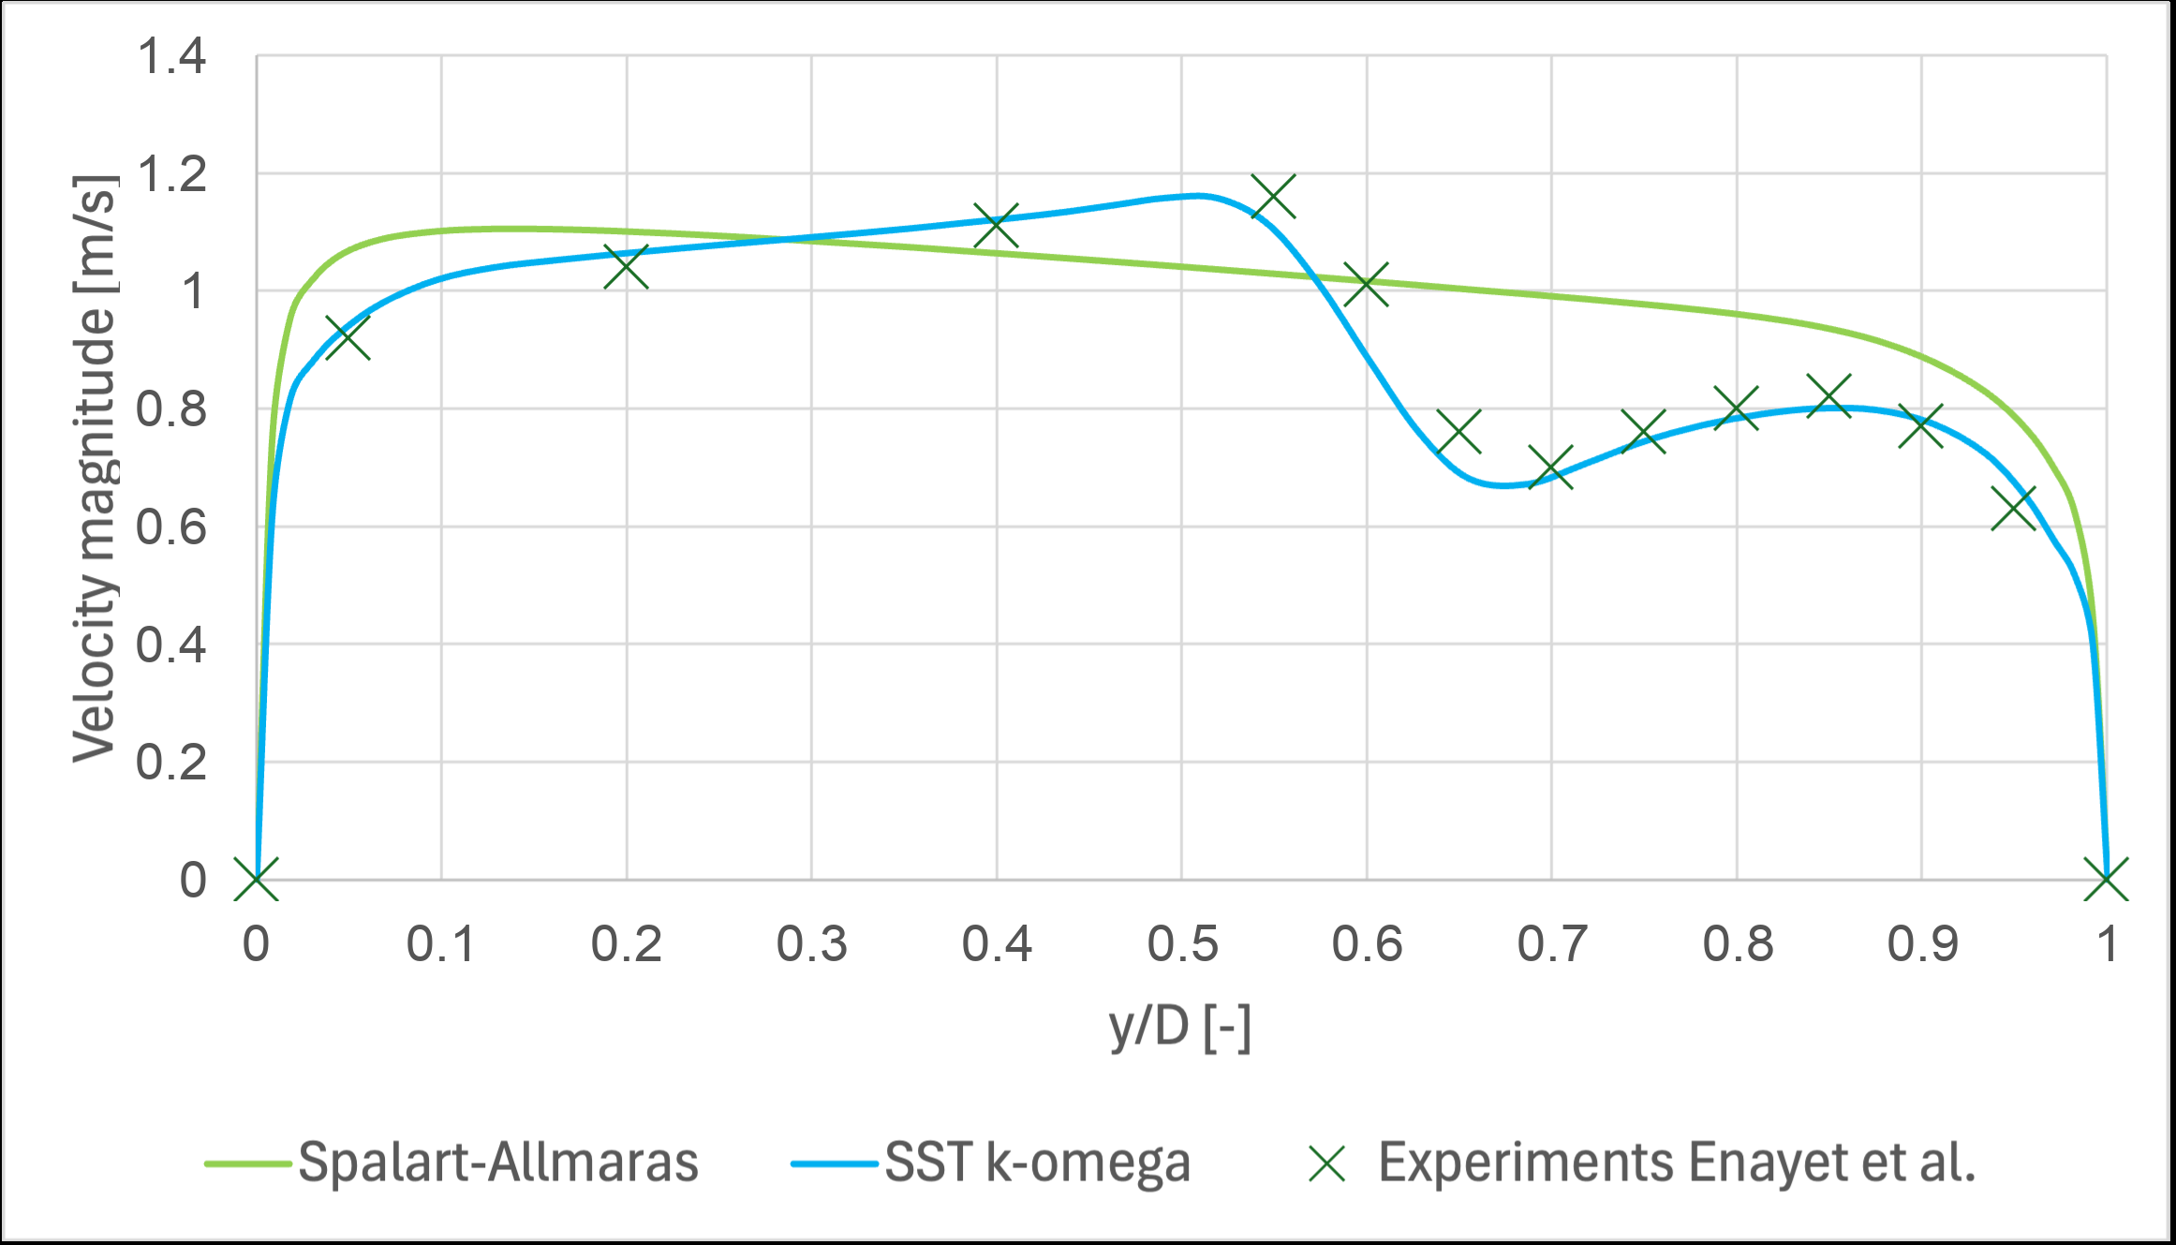
TurbulentTO
SA is a design closure with a visible operating envelope.
MODEL ENVELOPE
The Ansys comparisons define where the one-equation model remains useful and where curvature or separation becomes risky.
Moderate curved flow: close enough for design
Tighter curvature: closure deterioration is visible
Therefore, every extracted topology is validated again with SST k-omega.
05
Notes:
Do not apologize for SA. It is chosen because it is practical inside the optimizer. The validation step is what keeps the interpretation honest.

Slide 6
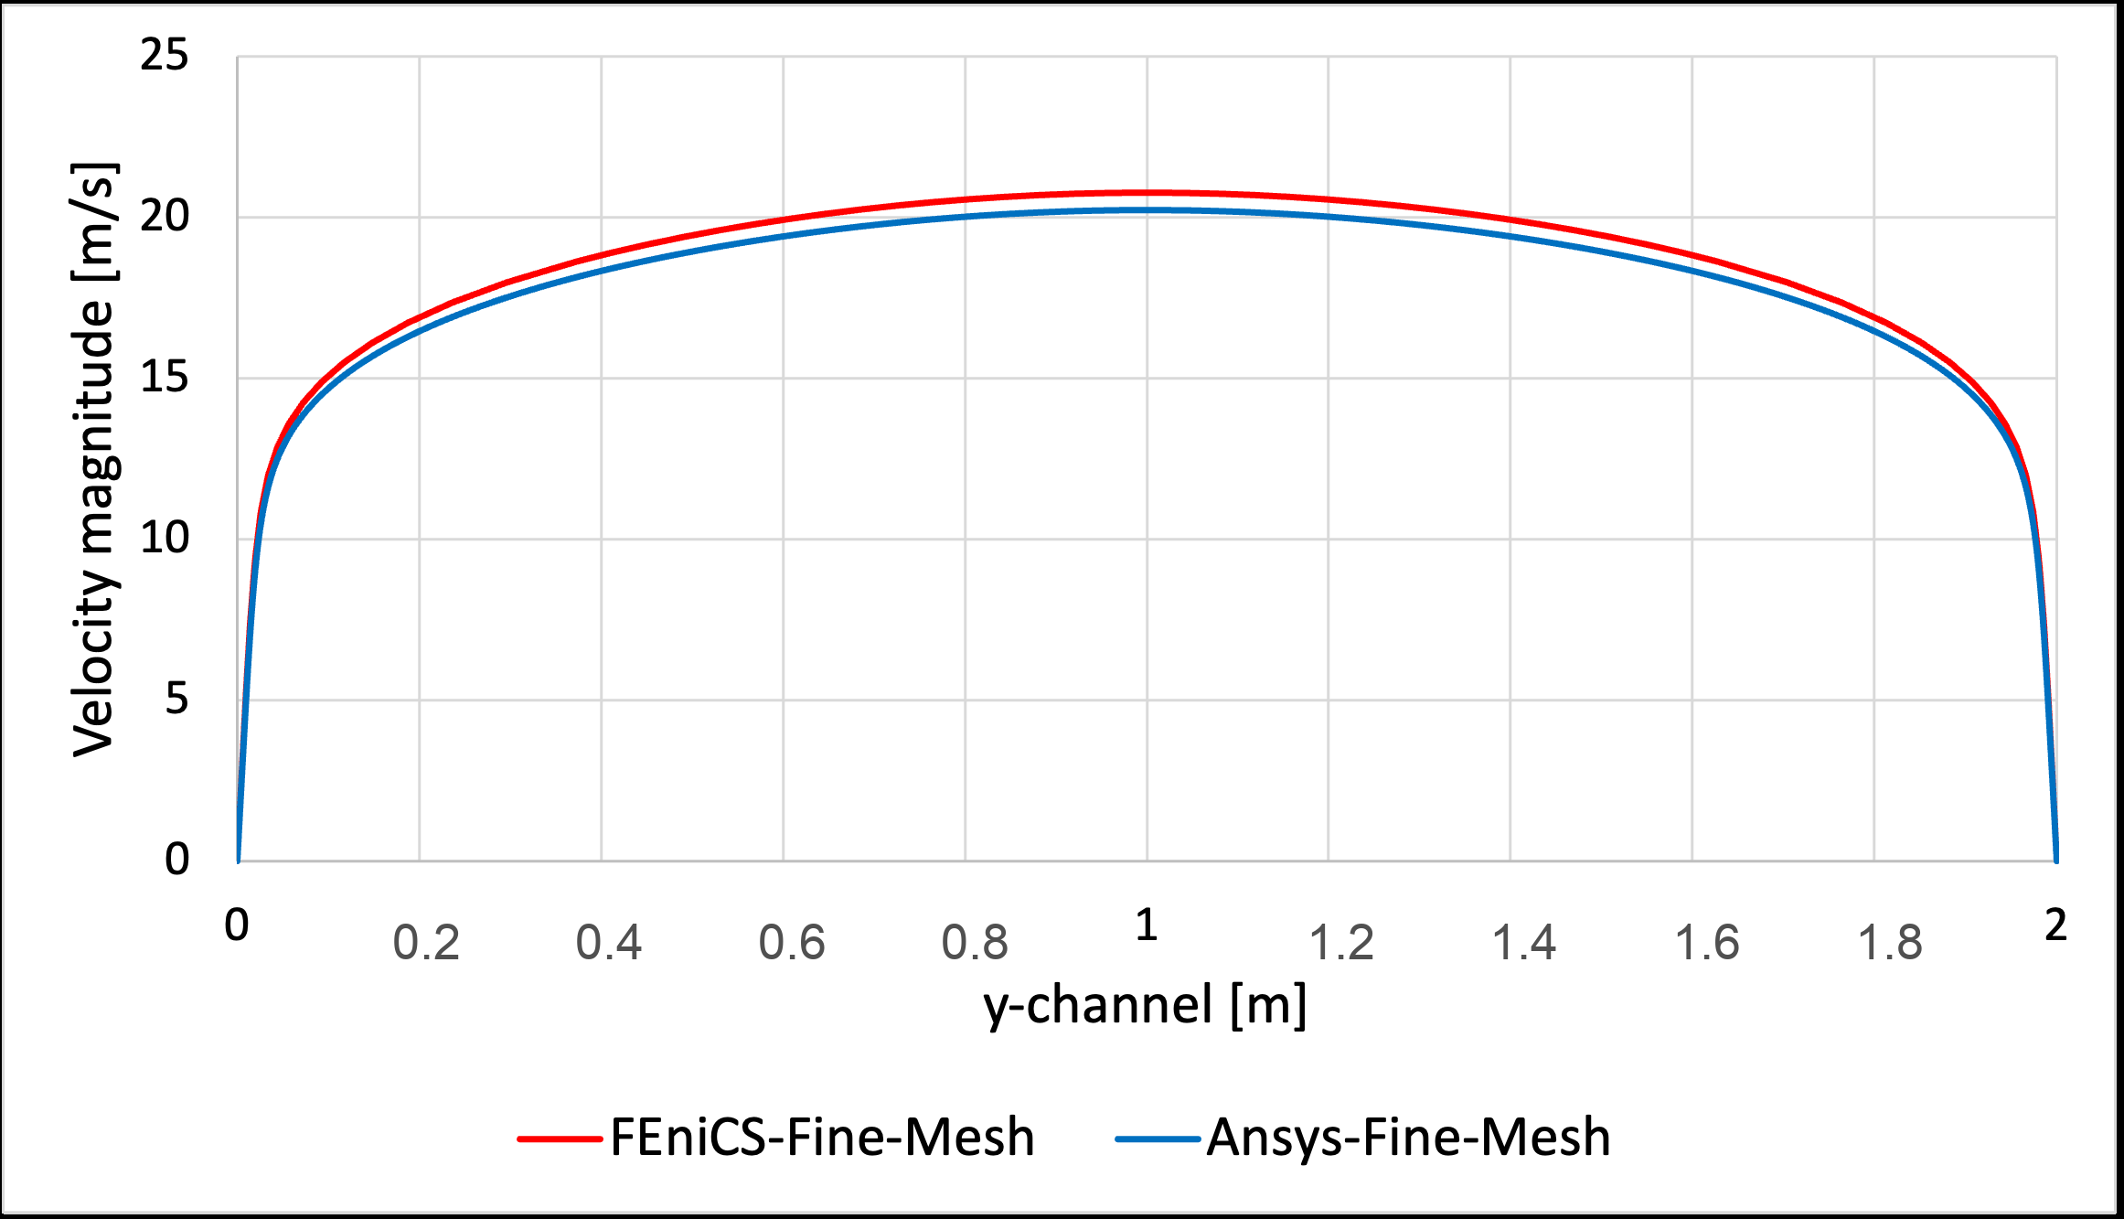
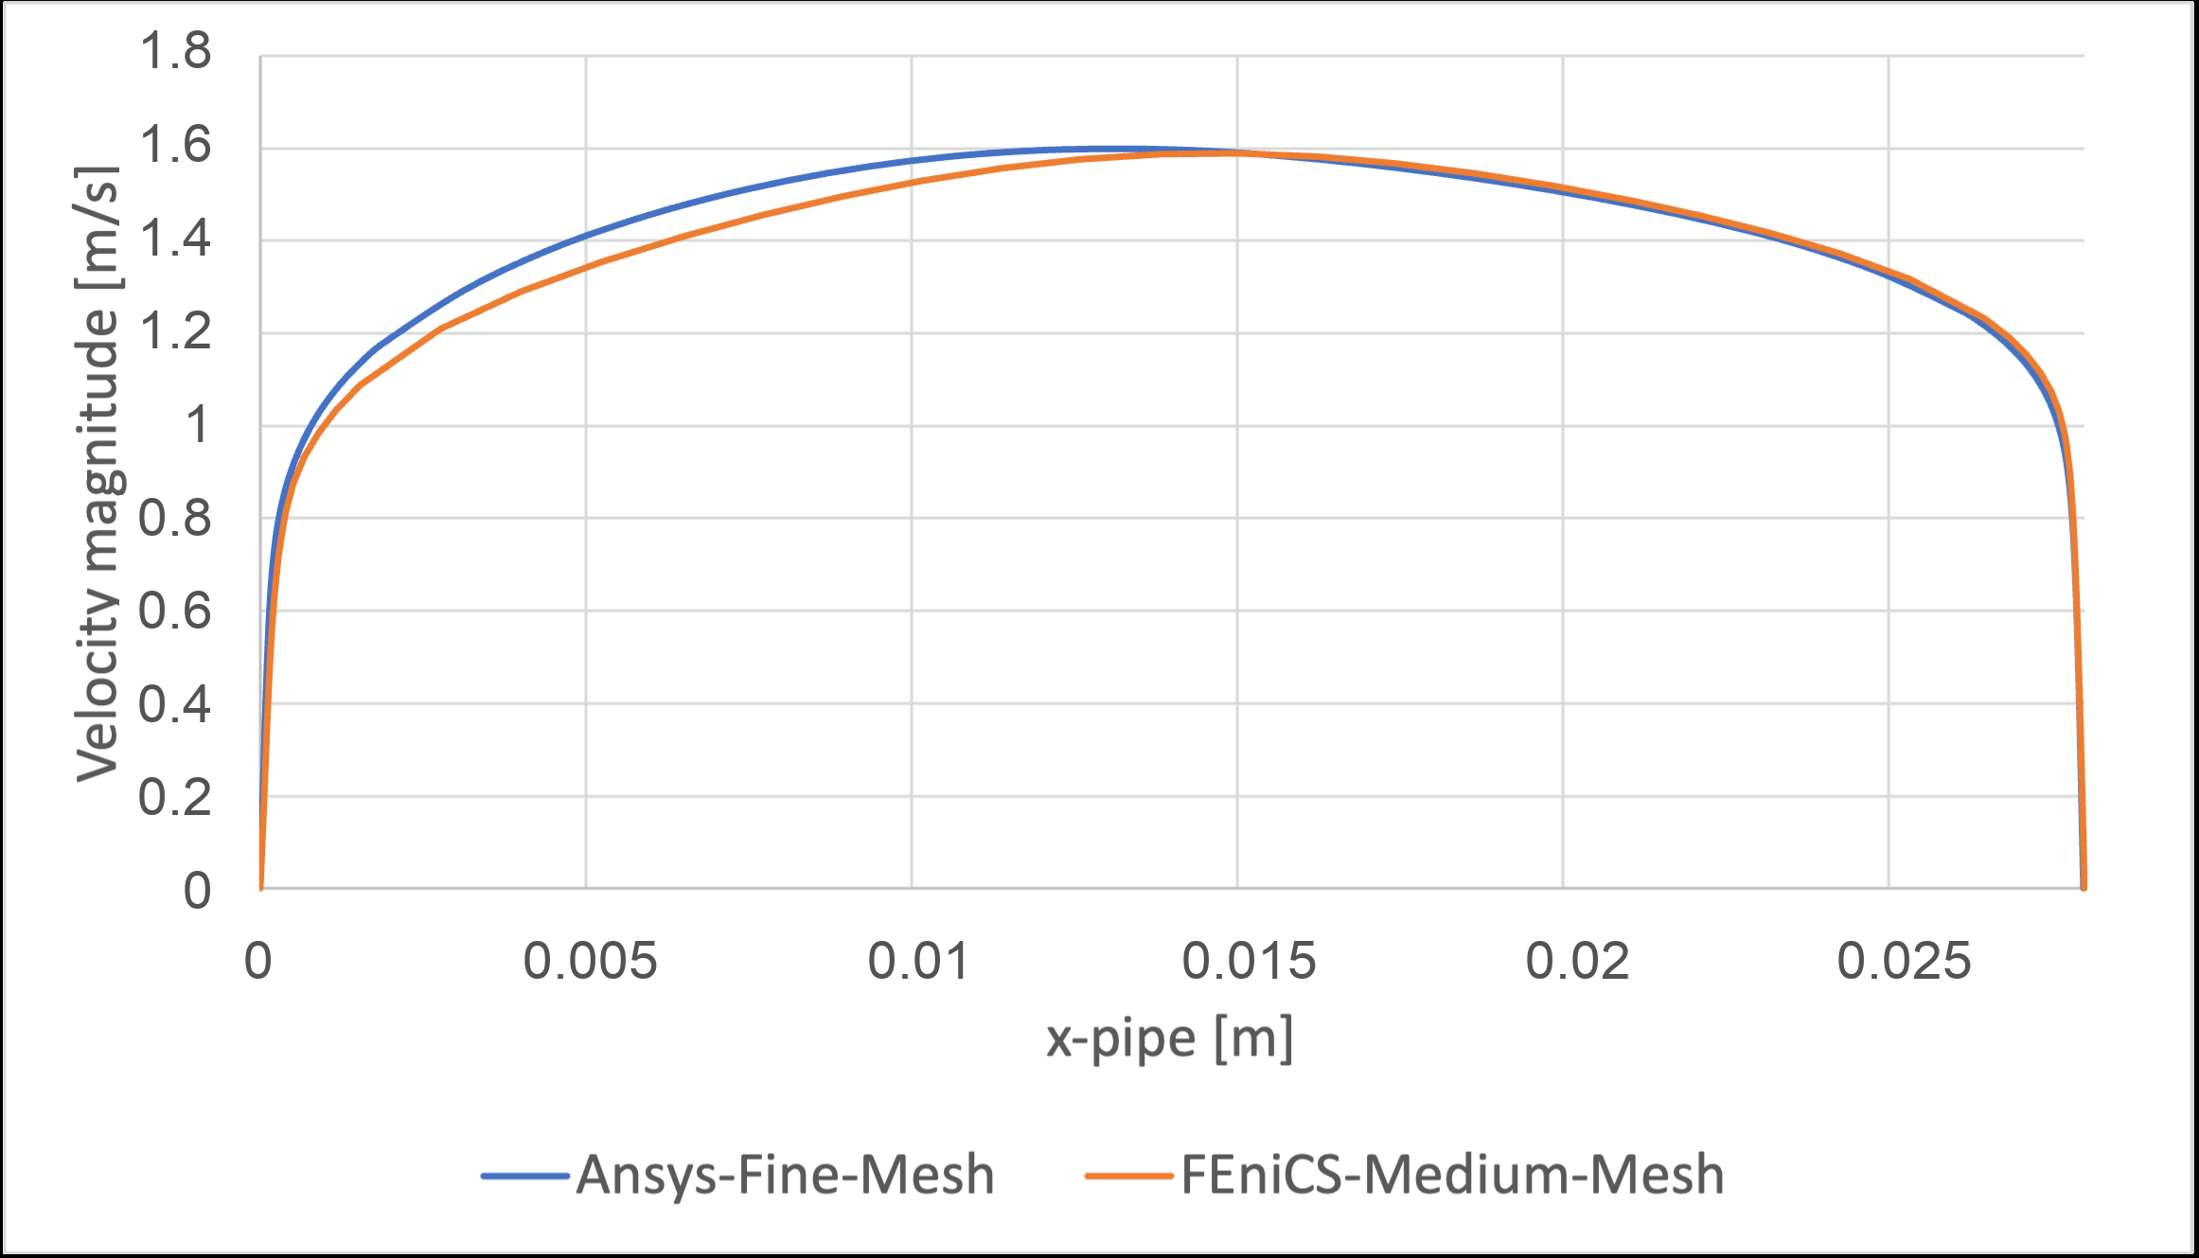
TurbulentTO
The FEniCS-SA solver is verified before it enters the optimizer.
FORWARD SOLVER
Implementation error is separated from model-form error using canonical wall-bounded and curved-flow checks.
Periodic channel: 2.67% bulk velocity difference
2D U-bend: 2.79% pressure-drop difference
The solver is accurate enough for optimization experiments, with local profile discrepancies kept visible.
06
Notes:
Emphasize that this is solver verification, not proof that SA is perfect physics. The later closure validation handles that.

Slide 7
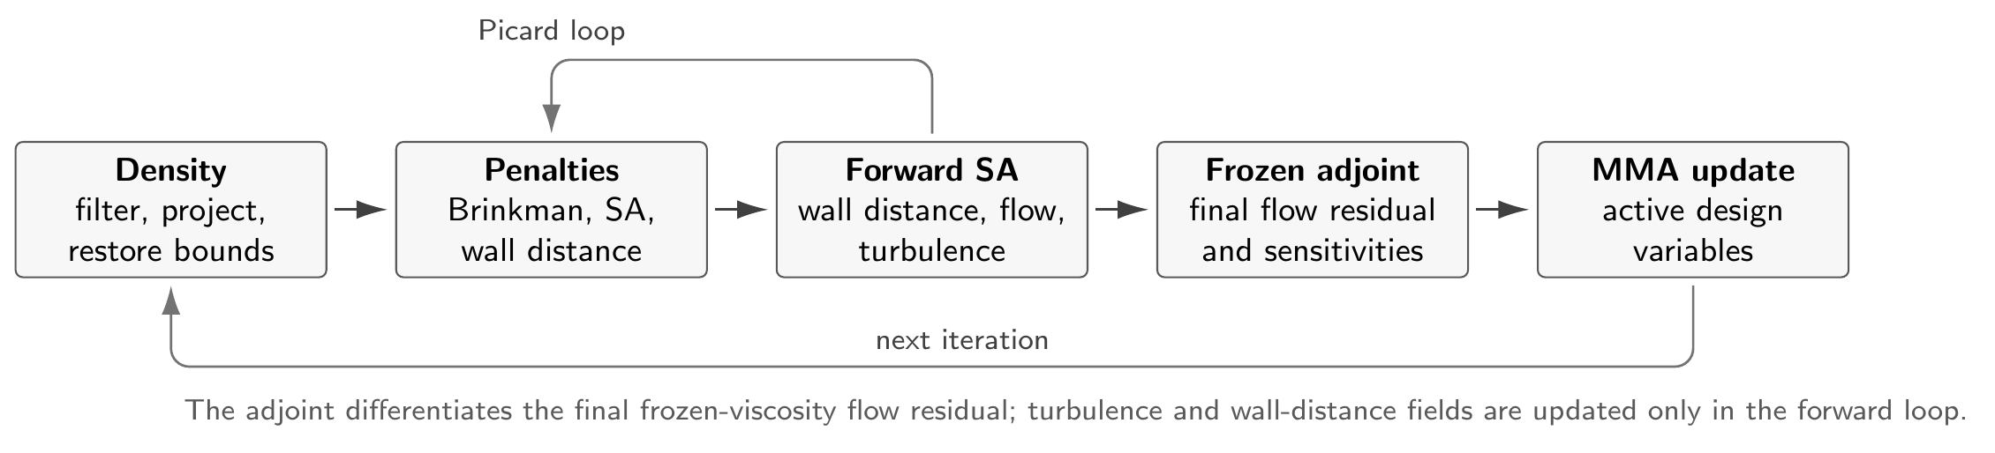
TurbulentTO
Density, topology penalization, and frozen adjoints form the optimization loop.
METHOD
01
Density chain
gamma -> filtered density -> projected bounded density
02
Flow penalization
Brinkman resistance suppresses velocity in solid-like regions
03
Turbulence terms
SA source terms and wall-distance penalties track evolving walls
04
Optimization
MMA updates active DG0 design cells from frozen-adjoint gradients
Turbulent topology optimization workflow
07
Notes:
Keep the equations out of the main path unless asked. The slide exists to show the moving parts and why fully coupled turbulence sensitivities are not claimed.

Slide 8
TurbulentTO
The optimized density field is not the final product; the extracted wall is.
VALIDATION RULE
Diffuse FEniCS density
1
Optimization objective and MMA history
Phi_D
viscous dissipation
Sharp wall extraction
2
Convert projected density to CAD-like geometry
Delta p
Ansys-SA validation
pressure drop
3
Same closure, independent solver
SA vs SST
SST stress test
closure sensitivity
4
Independent closure for robustness
08
Notes:
This is the methodological rule that prevents overclaiming. If the sharp wall fails, the diffuse objective is not enough.

Slide 9
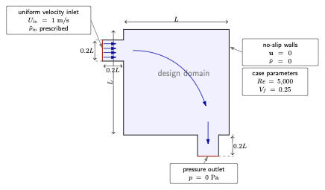
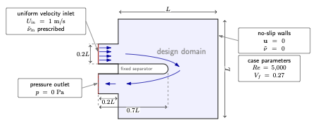
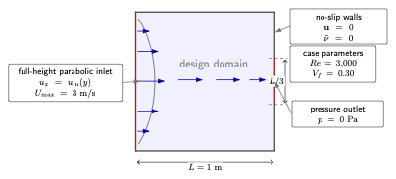
TurbulentTO
The three cases deliberately move from low to high model risk.
CASES
Pipe bend
U-bend
Diffuser
attached / moderate curvature
forced 180 degree return
adverse pressure gradient
strongest success
promising but closure-sensitive
cautionary result
09
Notes:
The cases are not just examples. They are an experiment in where the workflow remains credible.

Slide 10
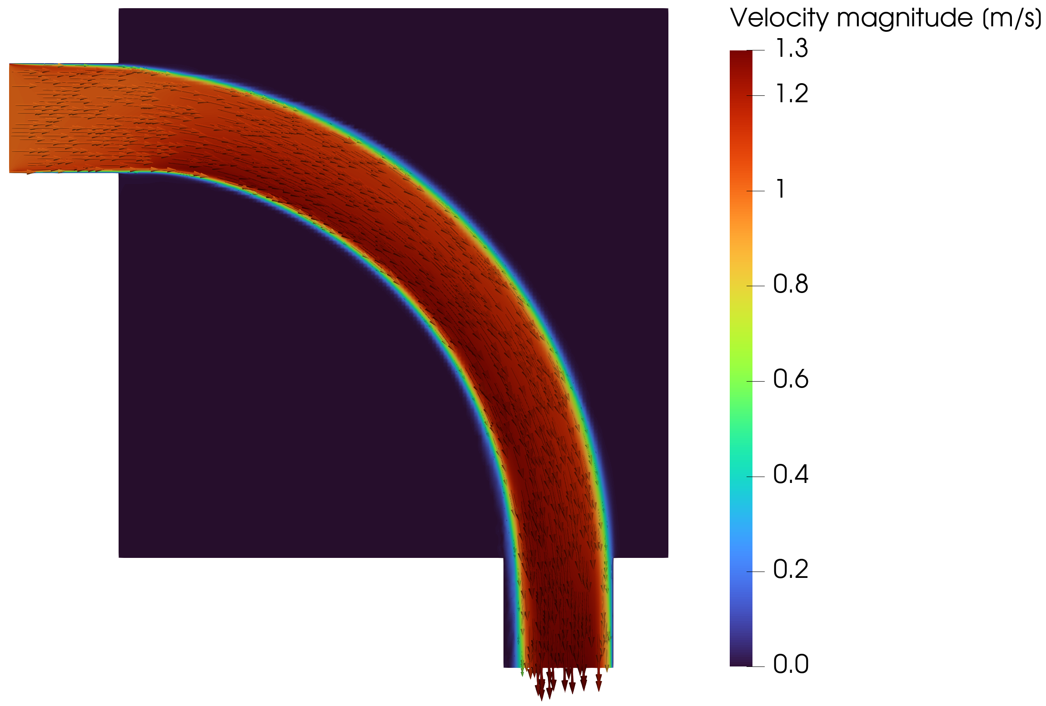
TurbulentTO
The optimized pipe bend avoids the sharpest corner and forms a smooth turbulent route.
PIPE BEND
At Re = 5000 and Vf = 0.25, the 70-iteration endpoint already shows the expected routing strategy.
Projected density
FEniCS-SA velocity
Jp = 0.2130 Pa | endpoint is promising, not claimed as fully converged
10
Notes:
This is a visual slide. The claim is the duct routing and validation potential, not perfect convergence.

Slide 11
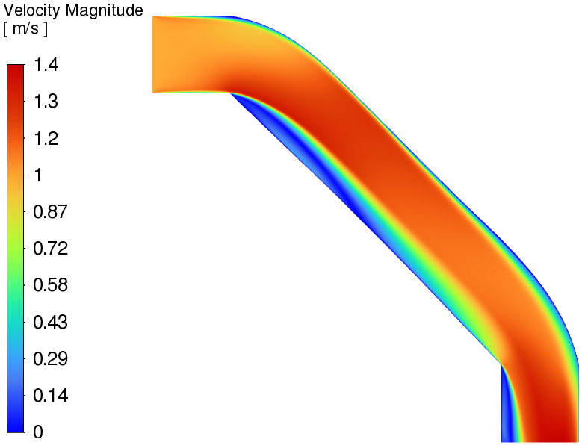
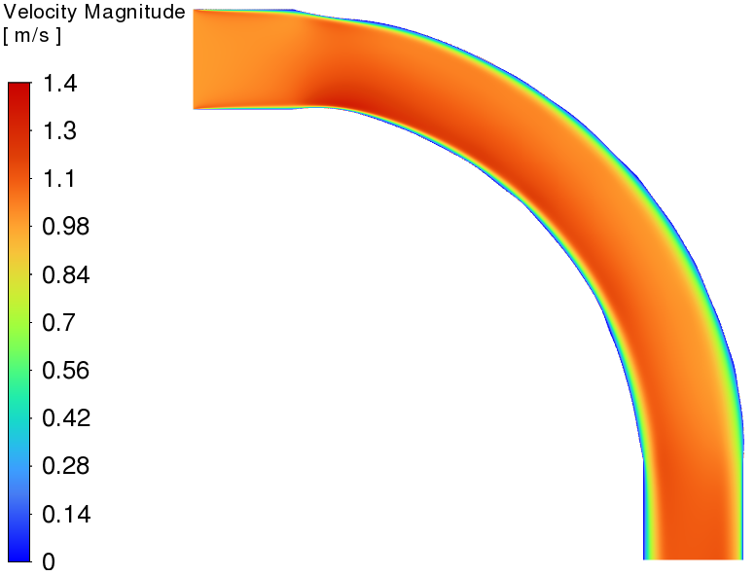
TurbulentTO
Under identical SST validation, the turbulent pipe bend decisively beats the laminar surrogate.
PIPE BEND VALIDATION
Laminar-optimized design at Re = 5000
Turbulent-optimized design at Re = 5000
-72.0%
-47.0%
pressure drop
viscous dissipation
11
Notes:
This is the strongest evidence. Both geometries are evaluated under the same turbulent operating condition and SST model.

Slide 12
TurbulentTO
The extracted pipe bend is not narrowly tuned to the SA model.
PIPE BEND
The SST stress test increases losses only modestly relative to Ansys-SA, while the turbulent design still dominates the laminar baseline.
Pressure drop, lower is better
4.5%
FEniCS diffuse SA
0.2130 Pa
Delta p shift from SA to SST
8.5%
Ansys sharp SA
0.1457 Pa
Phi_D shift from SA to SST
5.92e-5
Ansys sharp SST
0.1522 Pa
max coordinate FD discrepancy
12
Notes:
The pipe bend is the most defensible case. The oscillation concern belongs to convergence polish, not to the validation conclusion already obtained.

Slide 13
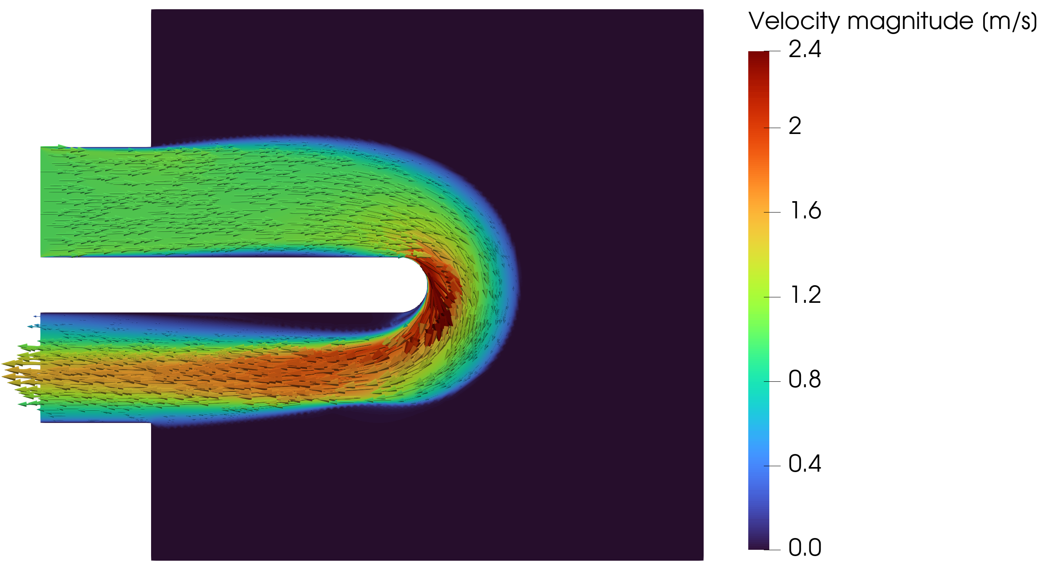
TurbulentTO
The U-bend is harder because the fixed separator forces recirculation-sensitive return flow.
U-BEND
The case remains promising, but closure response becomes part of the result.
Projected density
FEniCS-SA velocity
Jp = 0.8250 Pa | Bayat k-epsilon reference scale = 0.8327 Pa | current run still evolving
13
Notes:
Present this as the high-upside case worth continuing. Do not claim final convergence while the run is still evolving.

Slide 14
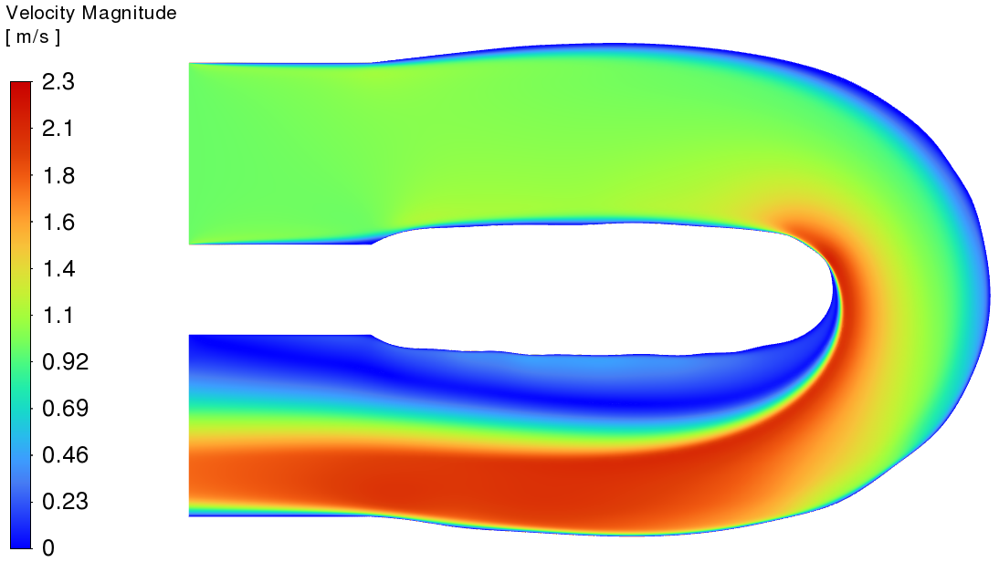
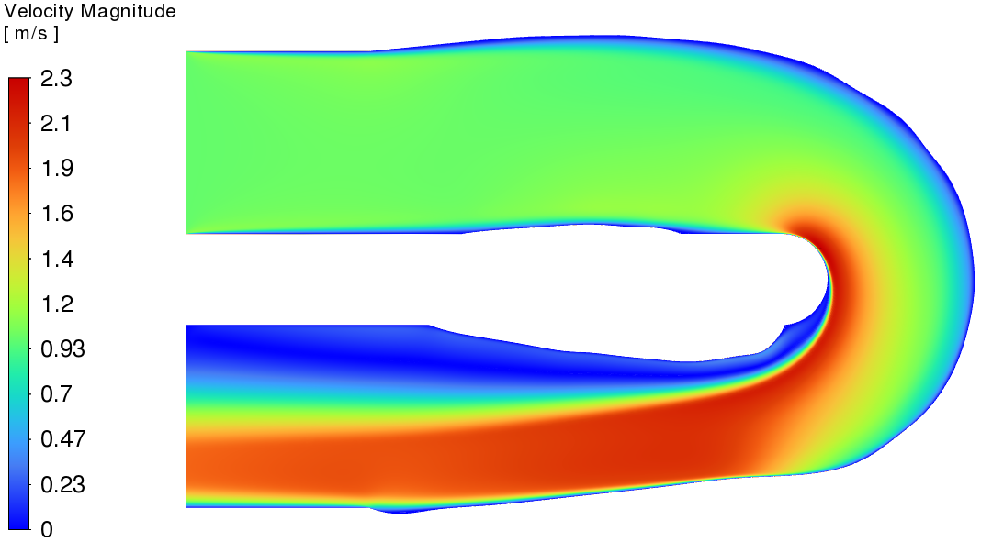
TurbulentTO
The U-bend improves under SA, but the SST validation is weak.
U-BEND VALIDATION
Laminar design under SST
Turbulent design under SST
Under SA: turbulent design lowers Phi_D by 31.0% and Delta p by 16.3% versus laminar.
Under SST: turbulent design lowers Phi_D by only 5.0% but raises Delta p by 4.1%.
For the same turbulent geometry, SST raises Delta p by 48.3% relative to Ansys-SA.
14
Notes:
This is the nuanced result. Say that the workflow produces a candidate, but the validation envelope is not as clean as the pipe bend.

Slide 15
TurbulentTO
The best remaining compute should strengthen the U-bend, not chase the diffuser.
REMAINING COMPUTE
#
Run
Why
Presentation value
1
Continue U-bend Jp
highest upside; current run is evolving nicely
could sharpen the hardest Bayat-style case
2
Rerun U-bend sensitivity
same final endpoint and continuation settings
defends the forced-return result in Q&A
3
Pipe polish only if stable
already validated; oscillation can weaken story
optional convergence evidence
Pipe oscillations: hold beta/q, tighten final-state solves, add objective-acceptance backtracking, then resume continuation.
15
Notes:
This answers the user's compute question directly. The U-bend has the best presentation upside. The diffuser is more likely to consume time without strengthening the main claim.

Slide 16
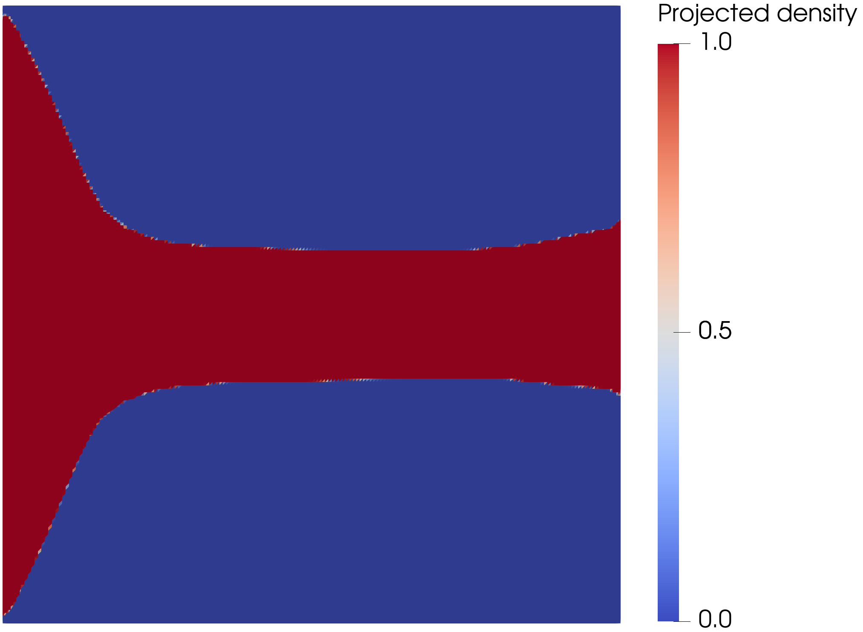
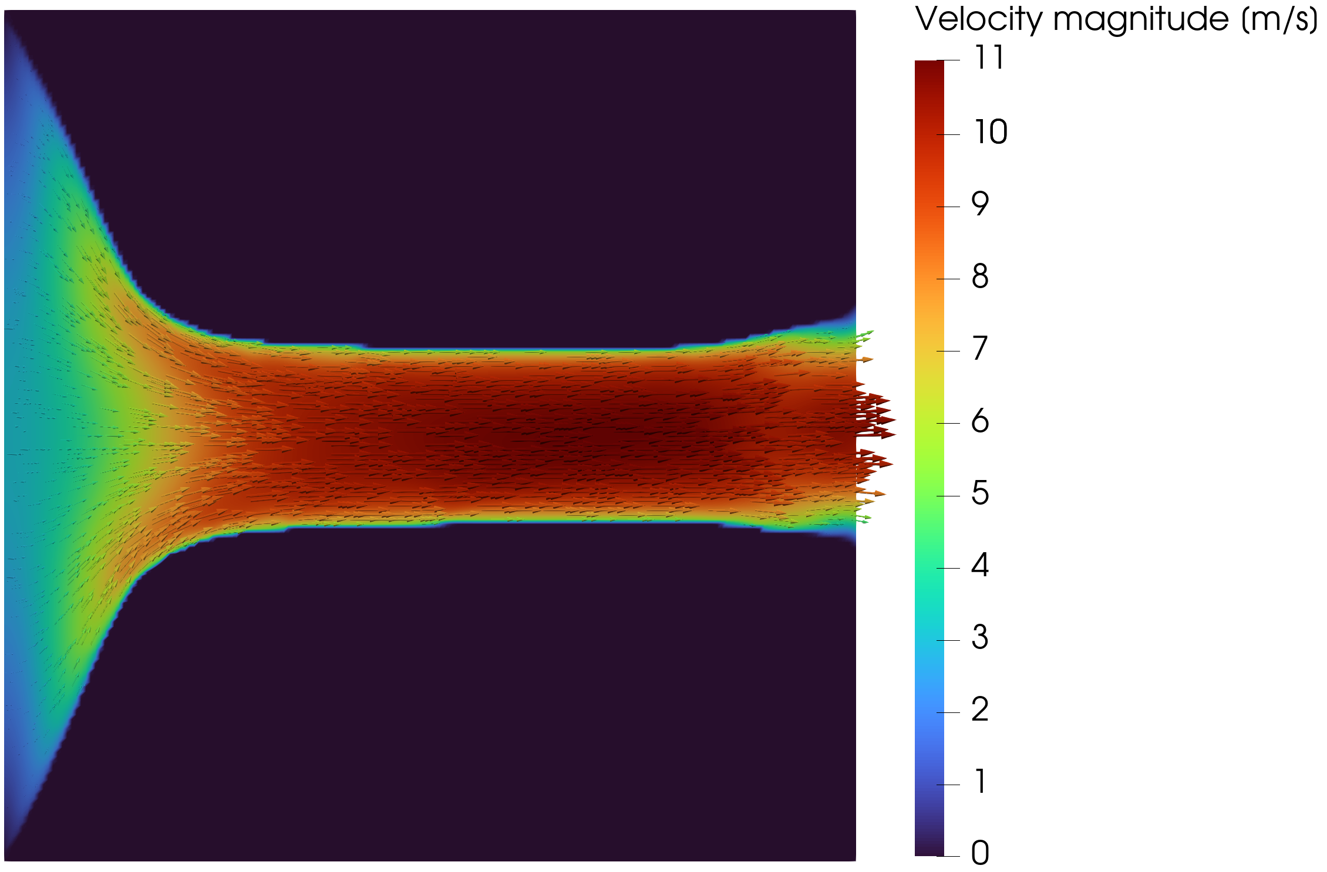
TurbulentTO
The diffuser shows that outlet treatment and adverse pressure gradients dominate the validation result.
DIFFUSER
The pressure-outlet variant is less forced than the velocity-outlet setup, but the performance ranking remains closure-sensitive.
Pressure-outlet topology
FEniCS-SA velocity
JD = 2.7664e5 W/m | 11.2% below the velocity-outlet comparison point
16
Notes:
Do not sell this as a success case. Its value is showing where the validation envelope becomes the result.

Slide 17
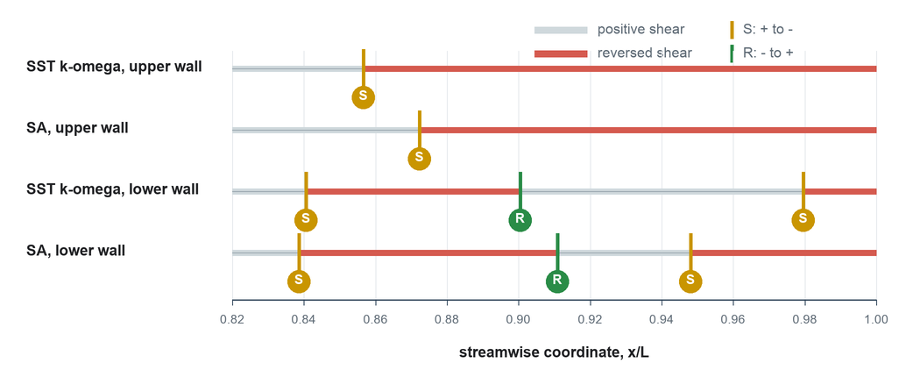
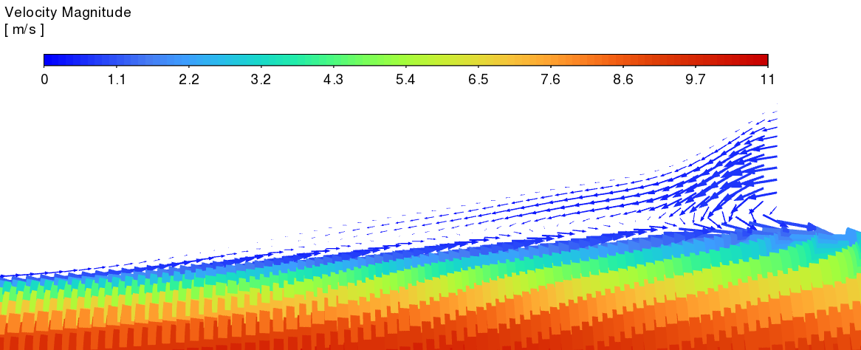
TurbulentTO
The diffuser ranking reverses when the validation closure changes.
DIFFUSER VALIDATION
Model
Dissipation
Pressure drop
Decision
Ansys-SA
11.9% lower Phi_D
17.4% lower Delta p
turbulent wins
SST k-omega
13.7% higher Phi_D
30.5% higher Delta p
turbulent loses
Wall-shear sign diagnostic
SST vector close-up
17
Notes:
Use the table as the claim and the diagnostics as the physical reason. This is the cautionary case.

Slide 18
TurbulentTO
The three cases define the credibility envelope of the workflow.
SYNTHESIS
Case
Dominant physics
Defensible claim
Strength
Pipe bend
attached / moderate curvature
robust turbulent-design advantage
strong
U-bend
forced return / local recirculation
promising, but closure-sensitive
medium
Diffuser
adverse pressure gradient / separation
validation closure can reverse ranking
weak
The contribution is a validation-aware turbulent TO workflow, not a universal turbulent optimizer.
18
Notes:
This is the synthesis slide. It turns mixed numerical results into a clear scientific conclusion.

Slide 19
TurbulentTO
The defense is strongest when the limitations are explicit.
LIMITATIONS
Verified here
Not claimed
FEniCS-SA forward solver against Ansys references
Fully coupled turbulence adjoint
Frozen-adjoint derivative path where checked
Closure-independent truth in separated flow
Sharp-geometry validation workflow for three cases
3D secondary-flow physics or CHT performance
19
Notes:
This slide is for credibility. It keeps the Q&A anchored to what the thesis actually proves.

Slide 20
CLOSE
Frozen-SA topology optimization is valuable when it produces candidates, not final answers.
Final engineering decisions come from sharp-geometry validation and closure sensitivity. In attached or moderately curved flow, the method can produce strong turbulent designs; in separated flow, the validation envelope becomes the result.
Notes:
End with the candidate-versus-final-answer distinction. This is the sentence the jury should remember.

Slide 21
TurbulentTO
Exact validation metrics.
BACKUP
Case
Evaluation
Phi_D
Delta p
Readout
Pipe
Ansys-SA sharp
0.0153
0.1457
baseline validation
Pipe
Ansys SST sharp
0.0166
0.1522
+8.5% / +4.5%
Pipe
laminar -> turbulent SST
0.0313 -> 0.0166
0.5444 -> 0.1522
-47.0% / -72.0%
U-bend
SA laminar -> turbulent
0.1137 -> 0.0785
0.9646 -> 0.8071
-31.0% / -16.3%
U-bend
SST laminar -> turbulent
0.1069 -> 0.1016
1.1496 -> 1.1973
-5.0% / +4.1%
Diffuser
SA laminar -> turbulent
1.3495e5 -> 1.1885e5
1.3979e5 -> 1.1541e5
-11.9% / -17.4%
Diffuser
SST laminar -> turbulent
1.1289e4 -> 1.2834e4
3.8332e4 -> 5.0006e4
+13.7% / +30.5%
21
Notes:
Backup for exact values during Q&A.

Slide 22
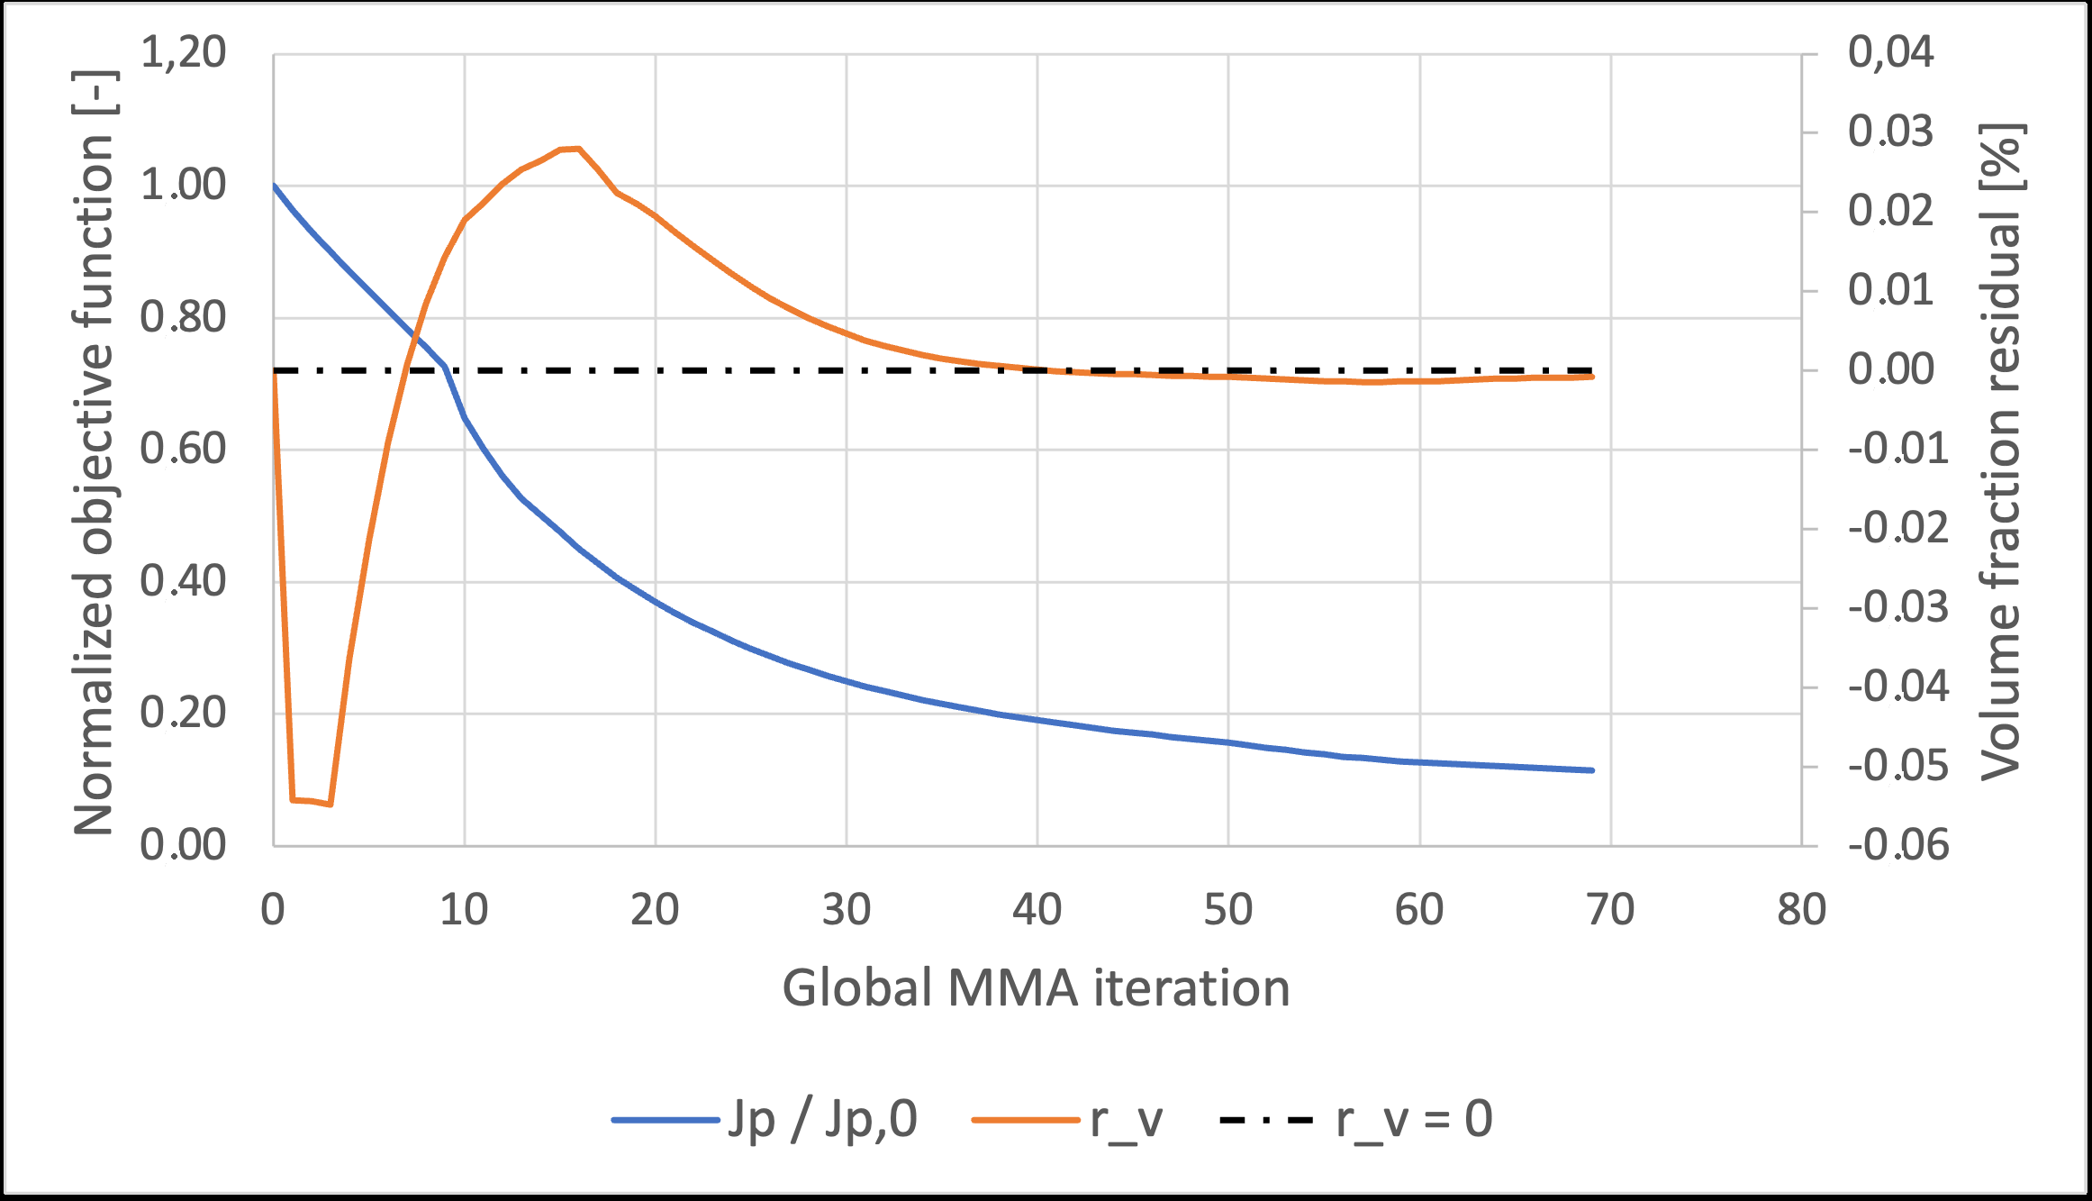
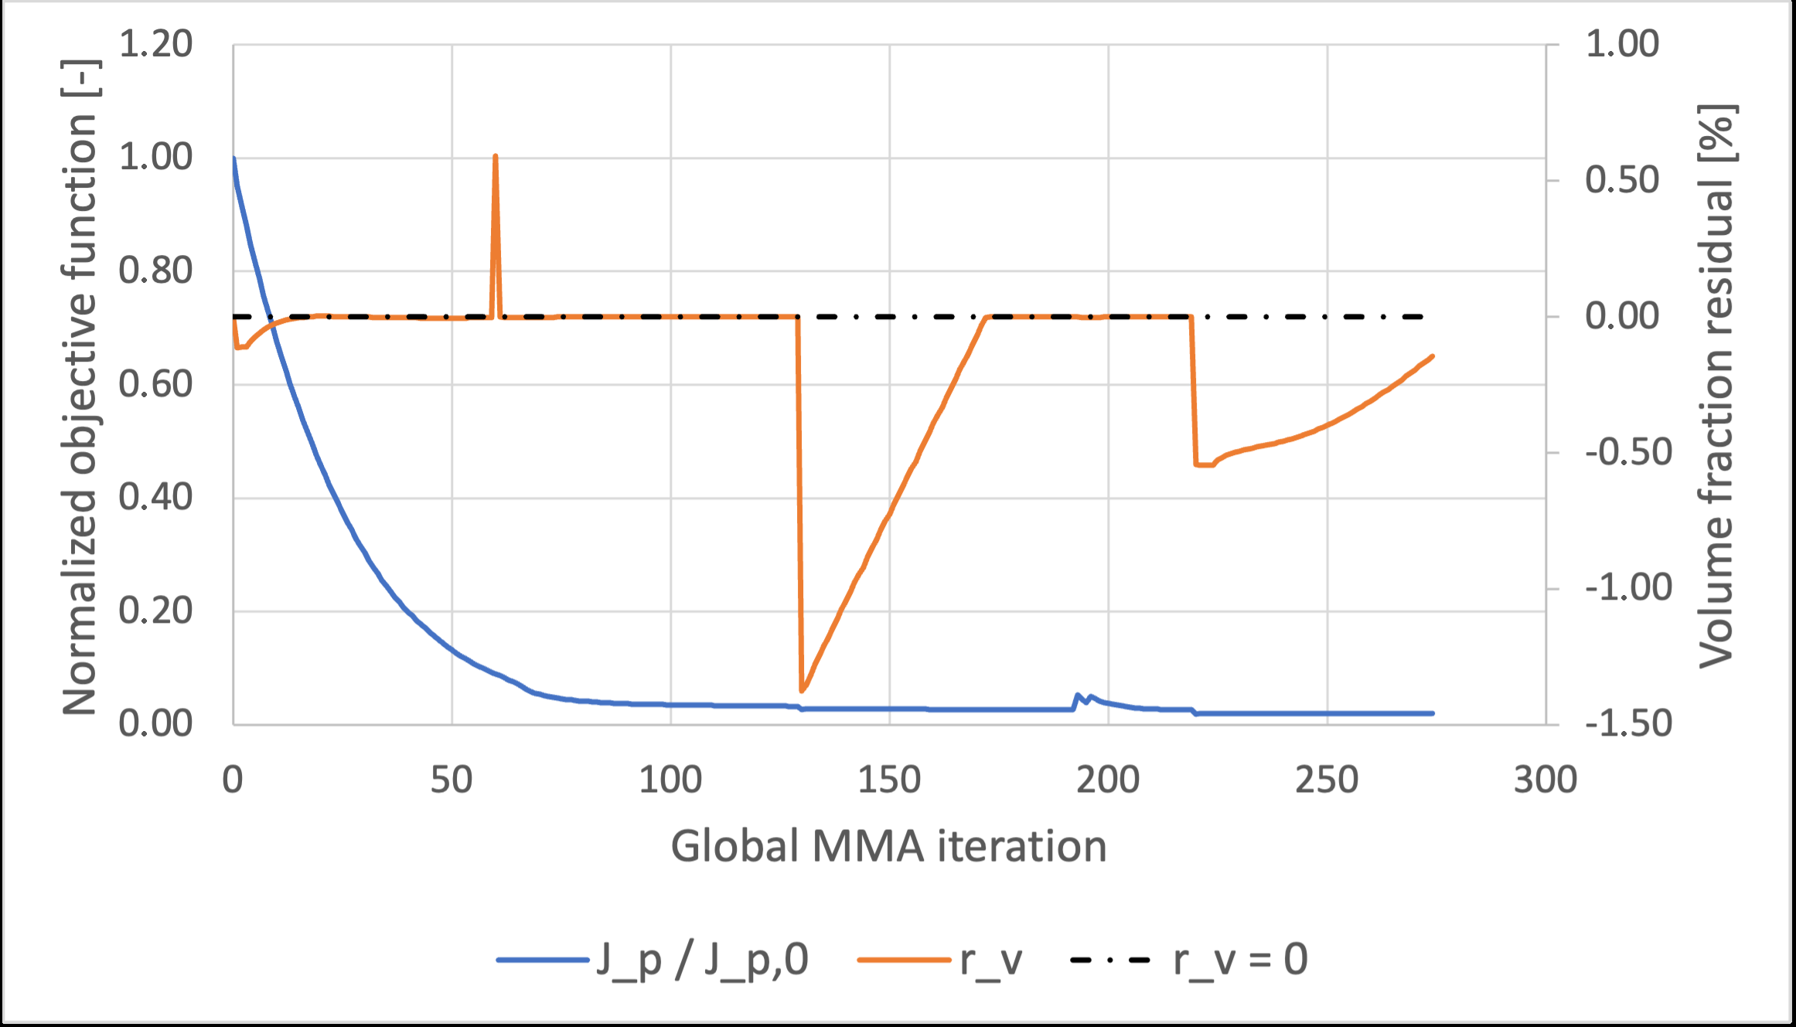
TurbulentTO
Sensitivity evidence verifies the derivative path used by MMA.
BACKUP
Pipe-bend coordinate finite differences: maximum relative discrepancy 5.92e-5.
Pipe-bend directional Taylor test shows approximately second-order behavior.
These checks verify the frozen derivative path, not a fully coupled turbulence derivative.
Pipe convergence
Rerun U-bend sensitivity only at the final endpoint you plan to present.
U-bend convergence
22
Notes:
Use this if the committee asks how trustworthy the gradient is.

Slide 23
TurbulentTO
Pipe-bend oscillations come from late-stage geometry sensitivity, not just the move limit.
BACKUP
Jp reacts sharply to small throat and radius changes in the curved route.
Frozen gradients omit how the next design recomputes SA, eddy viscosity, and wall distance.
For the presentation, do not over-invest in the pipe run unless the objective stabilizes quickly.
Projection/RAMP sharpening turns late density updates into more discrete wall changes.
Lower move limits can help, but objective-acceptance backtracking is more targeted.
23
Notes:
This answers the oscillation question. Lower move limits are not wrong, but acceptance/backtracking and tighter final solves are a better explanation and fix.

Slide 24
TurbulentTO
Forward-solver verification numbers.
BACKUP
Benchmark
Metric
Value
Meaning
Periodic channel
Bulk velocity
2.67% difference
core wall-bounded behavior
Periodic channel
Velocity profile
E_inf 2.66%, E_L2 2.64%
profile agreement
2D U-bend
Pressure drop
2.79% difference
curved-flow agreement
2D U-bend
Bend-exit profile
E_inf 8.50%, E_L2 2.75%
local discrepancy remains visible
24
Notes:
Backup for solver verification questions.

Slide 25
TurbulentTO
Q&A stance: answer directly, then add the boundary.
BACKUP
Q1
Is this industrially ready?
Research/design-candidate generator; final CFD and experiments remain mandatory.
Q2
Why SA?
One-equation, wall-resolved, practical for evolving topology; closure sensitivity is validated explicitly.
Q3
Why not DNS/LES?
Not practical inside thousands of evolving-topology iterations; RANS is the engineering compromise.
Q4
Main thesis contribution?
The validated evidence chain: model envelope, FEniCS solver, frozen gradients, sharp validation.
25
Notes:
This is based on the Q&A PDF. Keep answers short and do not overclaim.

