Slide 1





Analysis of Financial Statements
An analysis of the composition and growth of cash flow
GVHD: Nguyễn Chí Kiên

Slide 2




Members
Lê Thanh Phúc
NGUYỄN TIẾN DŨNG

Slide 3

Financial Statements
Property situation
Capital size
Source of asset information
It is the firm’s expected future performance that determines whether you should lend money to a firm or invest in it.

Slide 4

Financial Statements
Balance Sheet
Provides a snapshot of a firm’s financial position
Income Statement
Contains information on the profitability of the firm
Cash flow Statement
Provides detail about a firm's cashflow

Slide 5
Balance Sheet
ASSETS = LIABILITIES + EQUITY
ASSETS
Legal aspect: The asset section of a financial statement reflects the value of all assets owned by the entity at the time of reporting.
Economic aspect: The asset section also provides information about the composition of the entity's assets, which can be used to assess the entity's financial strength and performance.
Arranged in descending order of liquidity

Slide 6
Balance sheet
ASSETS = LIABILITIES + EQUITY
LIABILITIES AND EQUITY
Legal aspect: The source of funds section details the origin of the enterprise's assets, clarifies the amount of legal debt owed, and defines the limit of owners' responsibility for those debts.
Economic aspect: The source of funds section unveils the composition and scale of capital sources funding the enterprise's operations and investments. This information enables an evaluation of the enterprise's financial independence and its capacity to navigate financial risks.
Arranged according to the urgency of repayment requirements.

Slide 7
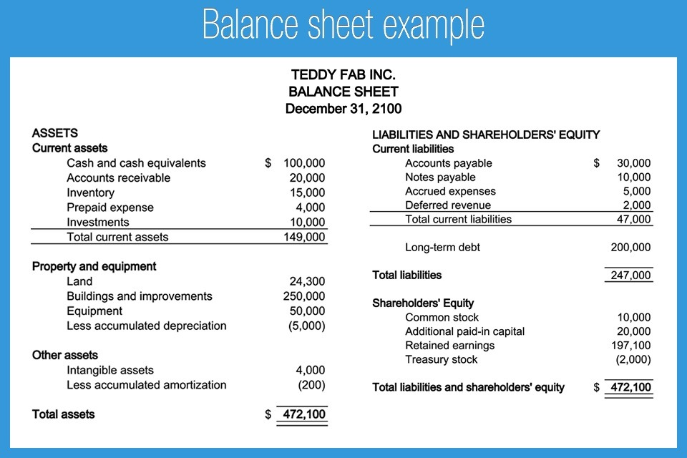
Balance sheet

Slide 8
Accuracy and Completeness
Quality Balance Sheet
Consistency
Fair valuation
Liquidity and Solvency
Transparency

Slide 9
INCOME STATEMENT
NET INCOME = REVENUE - EXPENSES
Revenue: the total amount of money earned from the sale of goods and services.
Expenses: The costs associated with generating revenue, including operating expenses, interest and taxes.
Net income (profit and loss): Calculated by subtracting total expense from total revenue. Positive net income indicates a profit, while negative net income indicates a loss

Slide 10
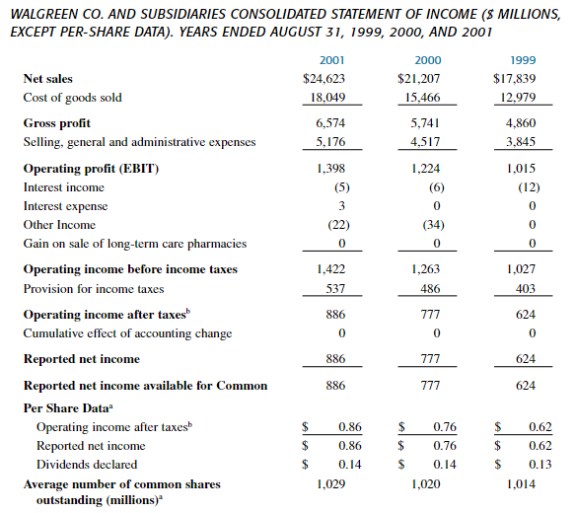
INCOME STATEMENT

Slide 11
Accuracy and Reliability
Quality Income Statement
Consistency
Non-recurring items
Earnings Quality
Comprehensive
Transparency

Slide 12
CASH FLOW STATEMENT
Operating activities: arising from the main revenue-generating activities of the enterprise and other activities except investing activities and financing activities.
Investing activities : arising from procurement, construction, liquidation, and sale of long-term assets and cash equivalents.
Financing activities : arising from activities that create changes in the scale and structure of the enterprise's equity and debt capital.

Slide 13
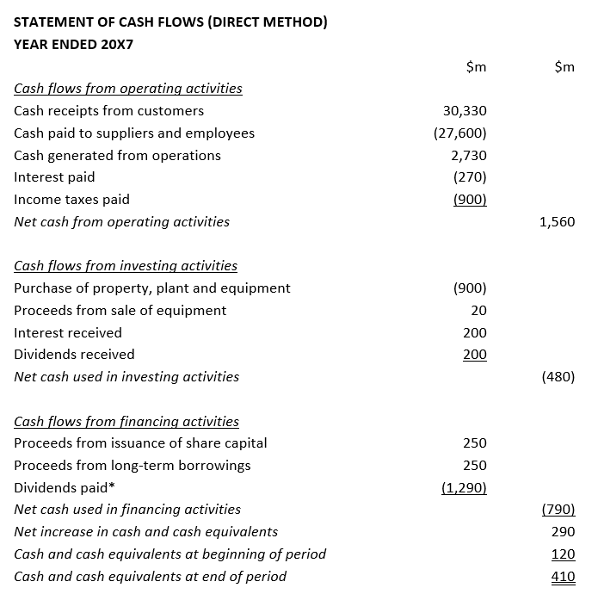
CASH FLOW STATEMENT

Slide 14
Example 1: An investor is considering investing in a company. They need to assess the company's financial condition and determine if the company is a good investment.
Example 2: A bank is considering lending money to a business. They need to assess the business's ability to repay the loan and determine if the business is eligible to receive the loan.
Financial ratios
Relationships: ratios are intended to provide meaningful relationships between individual values in the financial statements
Selective and categorizing: limit your examination to the most relevant ratios and categorize them into groups that will provide information on important economic characteristics of the firm

Slide 15
Financial ratios
Common size statement
financial statements that express each line item as a percentage of a base figure
Internal liquidity (solvency)
Indicate the ability of the firm to meet future short-term financial obligations
Operating performance
indicate how well the management is operating the business
Risk analysis
is the process of assessing and identifying potential risks or uncertainties that may impact the achievement of objectives or the success of a project, investment, or business operation
Growth analysis
the process of evaluating and assessing the growth prospects and performance of a company or investment

Slide 16
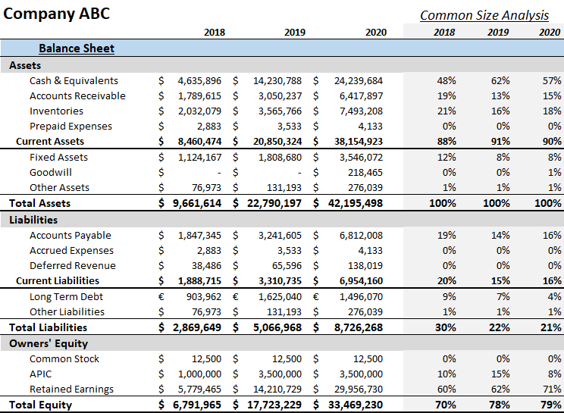
Common size statement

Slide 17
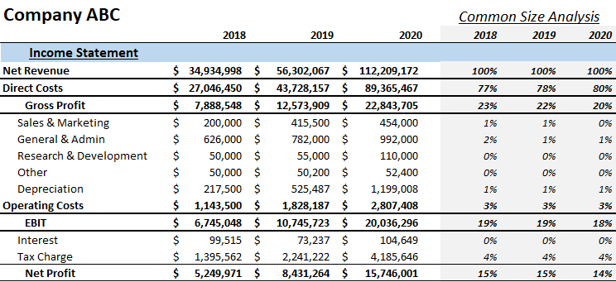
Common size statement

Slide 18


Internal liquidity
a) Current ratios: is a financial metric that measures a firm’s ability to cover its short - term obligations with its short-term assets.
b) Quick ratios: is a financial metric that measures a company's ability to meet its short - term obligations with its most liquid assets.

Slide 19

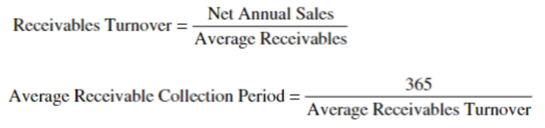
Internal liquidity
c) Cash ratios: is a financial metric that measures a company's ability to cover its short-
term liabilities with its most liquid assets.
d) Receivables Turnover: is an indicator of how many times, on average, a company collects its accounts receivable during a specific period, usually a year.

Slide 20


Internal liquidity
e) Inventory turnover: indicates the number of times a company sells and replaces its inventory during a specific period, typically a year.
f) Cash convertion cycle: It represents the number of days it takes for a company to sell inventory, collect receivables, and pay its accounts payable.

Slide 21
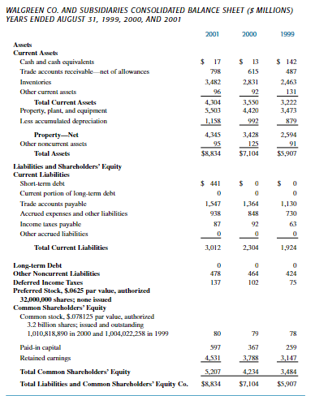

Slide 23
Operating performance
Operating efficiency
examine how the management uses its assets and capital
Operating profitability
analyze the profits as a percentage of sales and as a percentage of assets and capital employed.
1) The rate of profit on sales (profit margin)
2) The percentage return on capital employed

Slide 24



Operating efficiency
a) Total access turnover: is a financial ratio that measures a company's efficiency in using its total assets to generate revenue.
b) Net fixed access turnover: is a financial ratio that measures a company's efficiency in generating sales from its net fixed assets
c) Equity turnover: is a financial ratio that measures a company's ability to generate sales from its equity (shareholders' equity).

Slide 25



Operating profitability
1) The rate of profit on sales (profit margin)
a) Gross profit margin: is a financial metric that expresses the percentage of revenue that exceeds the cost of goods sold (COGS).
b) Operating profit margin: is a financial metric that measures the profitability of a company's core operating activities.
c) Net profit margin: is a financial metric that measures the percentage of profit a company earns from its total revenue after deducting all expenses, including taxes and interest.

Slide 26

Operating profitability
2) The percentage return on capital employed
a) Return on total capital: is a financial metric that measures a company's profitability in relation to its total capital, which includes both debt and equity.
b) Return on total capital including leases: provides a more comprehensive view of a company's return on all forms of capital, including the impact of lease financing.
- Multiple of Forthcoming Minimum Leases Payments
- Discounted Value of Future Minimum Leases Payments at the Cost of Long Term Debt
- Handling Lump Sum “Later” Payments

Slide 29
Operating profitability
2) The percentage return on capital employed
c) Implied interest for leased assets: is the interest rate that, when applied to the future lease payments, results in a present value equal to the initial carrying amount (cost) of the leased asset.
- Implied Interest in ROTC Calculation for Leased Assets
Two estimation techniques are mentioned: a rule-of-thumb approach and an interest rate applied to the discounted value of minimum lease payments.
+ Rule–of–thumb approach
You are considering buying a used truck. You know that the lease cost of a similar truck is about $500 per month.
+ Interest rate applied to the discounted value of minimum lease payments
You are considering buying a piece of manufacturing equipment with a 3-year lease, with monthly payments of $2,000. You plan to use the equipment for 5 years and sell it for $5,000. You want to calculate the purchase price based on a 10% discount rate.

Slide 30
Operating profitability
2) The percentage return on capital employed
c) Implied interest for leased assets
- Implied Depreciation on Leased Assets
Two common approaches are:
+ Using the Lease Term: Estimate implied depreciation by considering the typical term of the lease or the weighted average term.
++ Typical term of lease
Assume you lease a computer with a typical lease term of 3 years. The computer cost $1,000 new.
++ Weighted average term
You have three leases for the same type of machine: Lease 1: 2 years remaining, $500 monthly payment; Lease 2: 1 year remaining, $600 monthly payment; Lease 3: 3 years remaining, $400 monthly payment. Cost $1000.

Slide 31

Operating profitability
2) The percentage return on capital employed
- Percentage of Net Fixed Assets
Example 1: The total assets of a shoe manufacturing company are $10 million. The company's net fixed assets are $6 million (including factory, machinery, and equipment).
Example 2: The total assets of a software company are $5 million. The company's net fixed assets are $0.5 million (primarily computers and office equipment).
d) Return on owner’s equity

Slide 32
Risk Analysis
Business risk
is the uncertainty of income arising from the variability of a firm's industry, which, in turn, is influenced by fluctuations in sales and production costs.
Financial risk
refers to the potential for adverse financial outcomes or losses that a business may face due to its financial structure, decisions, or market conditions.
1) Proportion of Debt (balance sheet) ratios
2) Earning flow ratios
3) Cash flow ratios
Liquidity risk
refers to the potential for an individual or entity to encounter difficulties in buying or selling financial instruments in the market without causing a significant impact on their prices

Slide 33
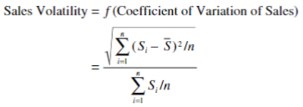

Business Risk
a) Sale variability: Sales variability, a key factor influencing earnings variability, is primarily determined by a firm's industry and is often beyond the control of management.
b) Operating leverage: refers to the impact of fixed production costs on the variability of a firm's operating earnings relative to changes in sales. In a scenario without fixed production costs, operating profits would directly vary with sales, and the operating profit margin would remain constant

Slide 34



Financial Risk
1) Proportion of debt (balance sheet) ratios:
a) Debt to Equity Ratios: This ratio measures the proportion of a company's financing that comes from debt compared to equity.
b) Long-Term Debt/Total Capital Ratios: This ratio focuses on long-term debt and assesses the proportion of long-term debt relative to the total capitalization of the company (long-term debt plus equity)
c) Total Debt Ratios: The debt ratio expresses the percentage of a company's assets that are financed by debt.

Slide 35
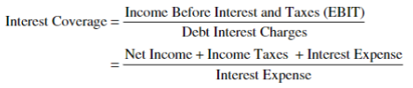
Financial Risk
2) Earning Flow Ratios
d) Interest Coverage: indicates a company's ability to cover its interest obligations.

Slide 36

Financial Risk
3) Cash Flow Ratios
a) Cash Flow Coverage Ratios: This ratio measures the company's ability to cover its interest payments with its operating income.
b) Cash Flow/Long-Term Debt Ratios: is a financial metric that assesses a company's ability to cover its long-term debt obligations using its cash flow.
c) Cash Flow/Total Debt Ratios: is a financial metric that assesses a company's ability to cover its total debt obligations using its cash flow.

Slide 37
Liquidity Risk
a) External Liquidity Defined: refers to a company's ability to meet its short-term financial obligations by accessing external sources of funds.
b) Determinants of Market Liquidity: refers to the ease with which an asset can be bought or sold in the market without causing a significant impact on its price
1) Bid-Ask Spread
2) Trading Volume
3) Market Depth
4) Price Impact
5) Volatility
6) Information Availability
7) Market Maker
8) Regulatory Environment
9) Transaction Costs
10) Macroeconomic Conditions
11) Assets-Specific Factors

Slide 38
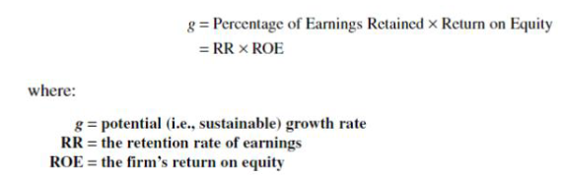
Growth Analysis
Is the process of evaluating and assessing the growth prospects and performance of a company or investment.

Slide 39
Dupont System
is a financial analysis framework that breaks down the Return on Equity (ROE) into its components to provide a more detailed understanding of a company's profitability
a) Net Profit Margin: measures the percentage of profit a company earns from its total revenue after accounting for all expenses.
b) Asset Turnover: measures how efficiently a company uses its assets to generate sales.
c) Financial Leverage: measures the extent to which a company uses debt to finance its operations.

Slide 40


