Slide 1
FINAL PROJECT

Slide 2
Contents
Project Topic
Project Analysis
Recommendation

Slide 3
Project Topic
Advanture Works is an international bicycle manufacturing company. Company offer high-quality bike parts and accessories for everyone from men to women and much more at a reasonable price.
They provide 460 Products, categorized in 4 groups: Accessories, Bikes, Clothing, Components.
Final Project: Management expects that the goods ordered will be sufficient for sales, on time, and at optimal import prices

Slide 4
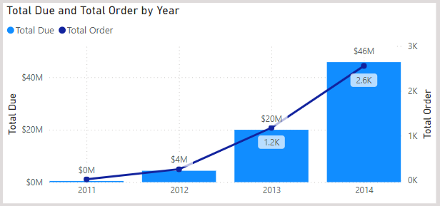
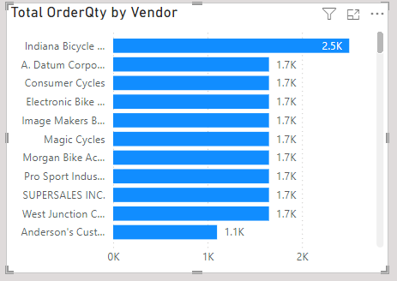
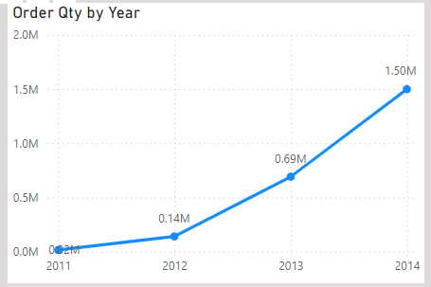
Project Analysis
Overview on Purchasing
The number of orders increases gradually each year
In 2014, the number of orders reached 2.6K along with the number of products purchased was 1.5M, double that of 2013.
Indiana Bicycle Center is the vendor with the largest quantity, up to 2.5K quantity ordered
There are up to 32 suppliers achieving quantity ordered
of over 1K

Slide 5
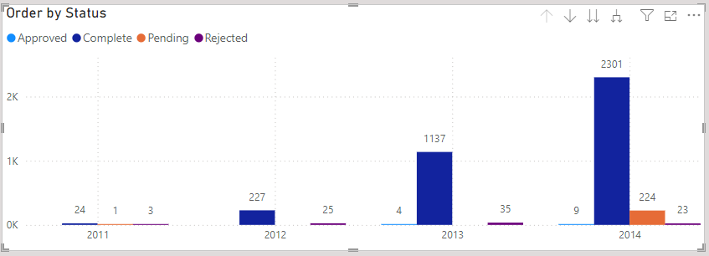
Project Analysis
Overview on Purchasing
With a rejection rate of 2.14%, it shows that the possibility of the order being completed is very good.
With goods that are in pending status, we need to consider the reason why? may be waiting for inspection or being shipped

Slide 6
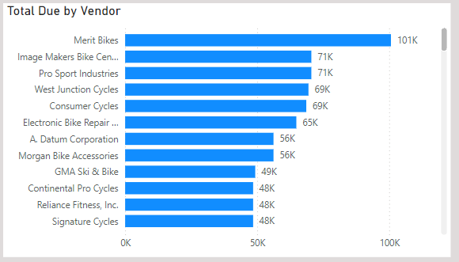
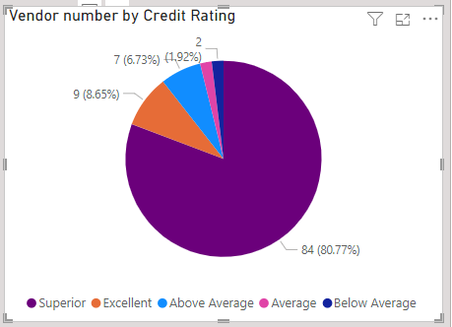
Project Analysis
Vendor Analysis
There are 104 Vendors: 102 Vendors have Credit Rating from average or higher
There are 2 vendor that are below average: Merit Bikes and Victory Bikes
(1) Merit Bikes is the Vendor with the highest revenue with the number of products sold being 1100 with the highest price ($82.83) compared to other products, and the number of rejected products is 55 products.
(2) Victory Bikes has a sales volume of only 6 and a delivery lead time of 19 (Average Lead Time is 19.45)
=> For vendors with Credit rating below average, there needs to be specific evaluation criteria to see the problems that vendors encounter that lead to low reputation levels

Slide 7
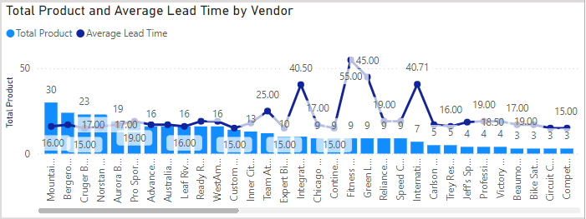
Project Analysis
Vendor Analysis
Average Lead time is 19.45
There are only 4 vendors with Lead times greater than average: Fitness Association (55), Green Lake Bike Company (45), Interational Trek Center (40.71), Integrate Sport Products (40.50)

Slide 8
Recommendation
For vendors with Credit rating below average, there needs to be specific evaluation criteria to see the problems that vendors encounter that lead to low reputation levels => find solutions to improve reputation levels. => increase efficiency in business
(1) About products: Improve product quality => reduce the number of returned goods
(2) Regarding delivery time: Arrange delivery time in accordance with schedule, for vendors with large delivery time => need to have solutions to optimize delivery time to meet or exceed production schedule => increase high productivity

Slide 9
Thank for watching

