Slide 1
Booking haircut online
A mobile application that help everybody can find and booking haircut around their home and help a small salon can manage their customer.

Slide 2
System component
App mobile : flutter
Api sever BE : nodejs express
Web Fe : angular
Cloud service : AWS
Database : mySQL

Slide 3
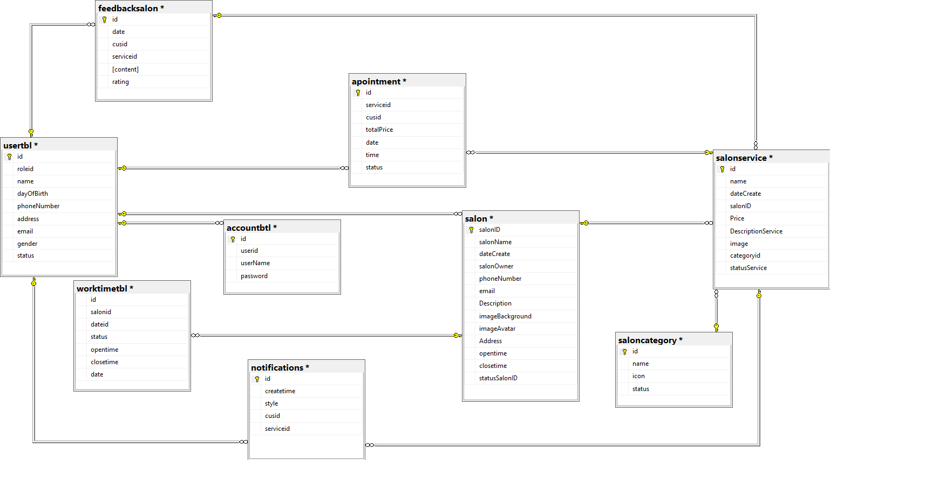
Database

Slide 4
App mobile
Flutter
MVC
1.Model
2.Service
3.Screan
Component : signin, signup, search service , booking, cancel booking, notification

Slide 5
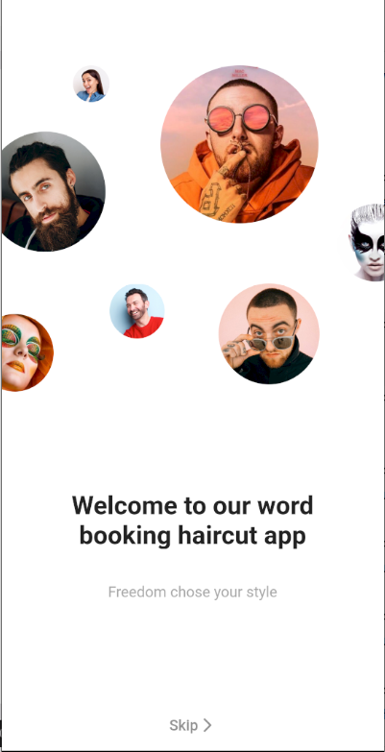
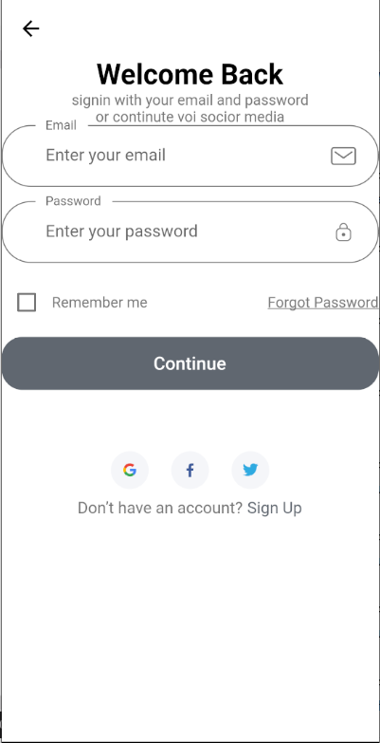
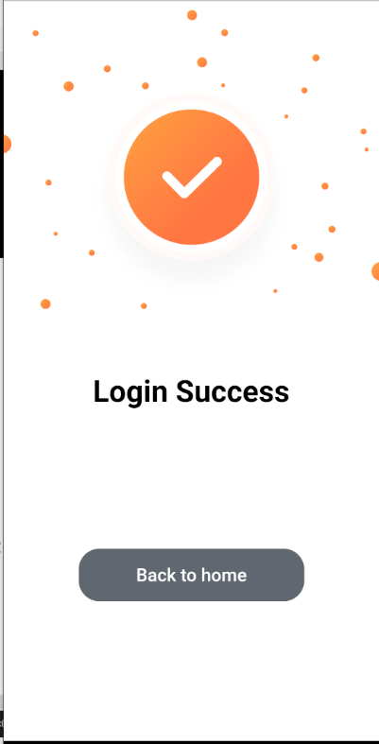
App mobile

Slide 6
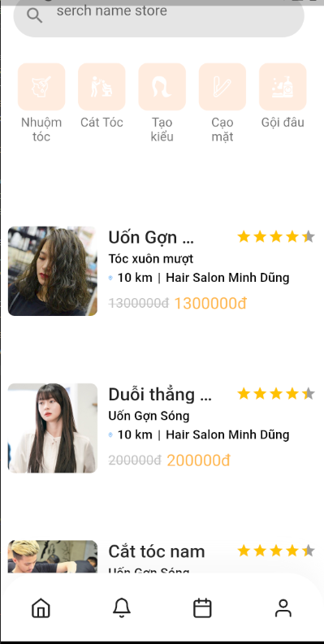
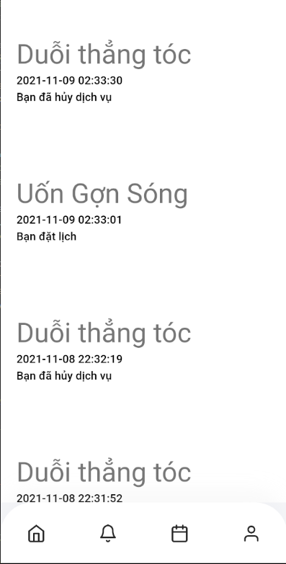
App mobile

Slide 7
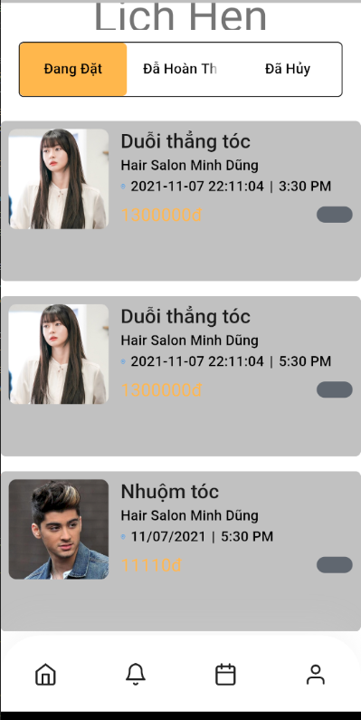
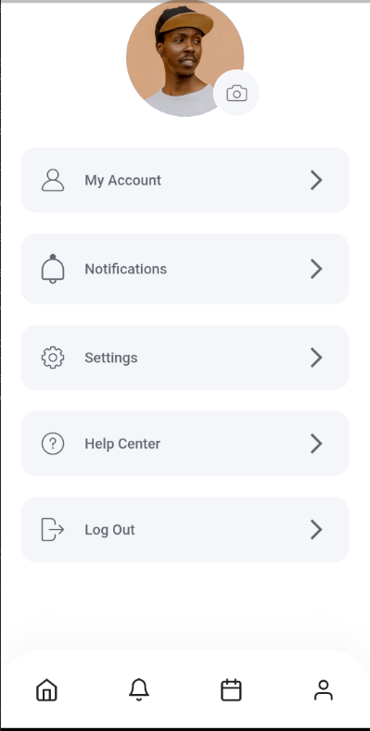
App mobile

Slide 8
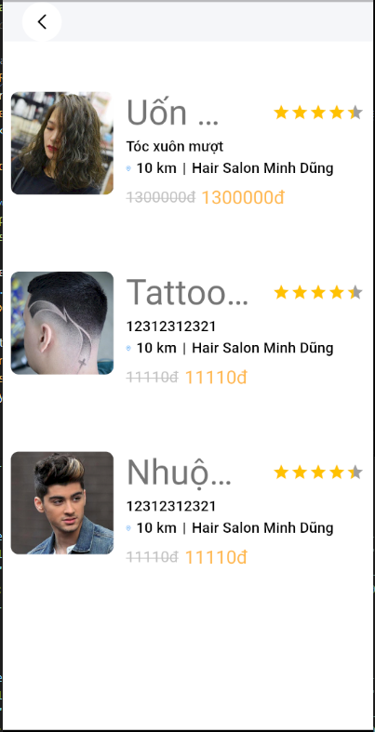
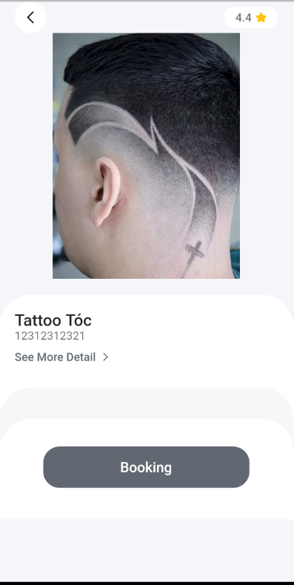
App mobile

Slide 9
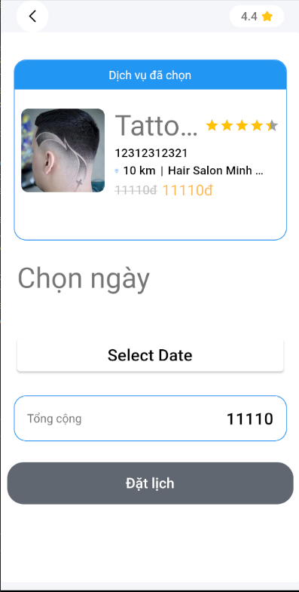
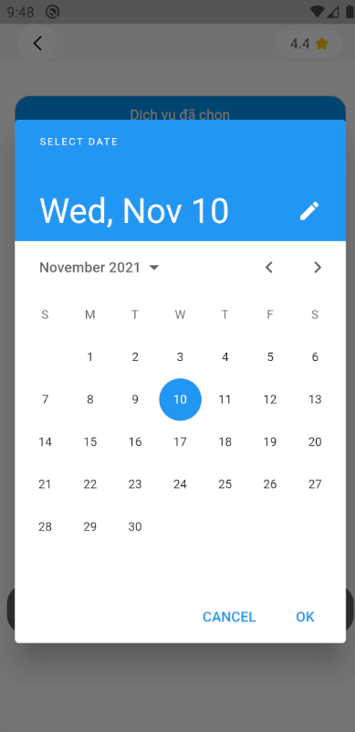
App mobile

Slide 10
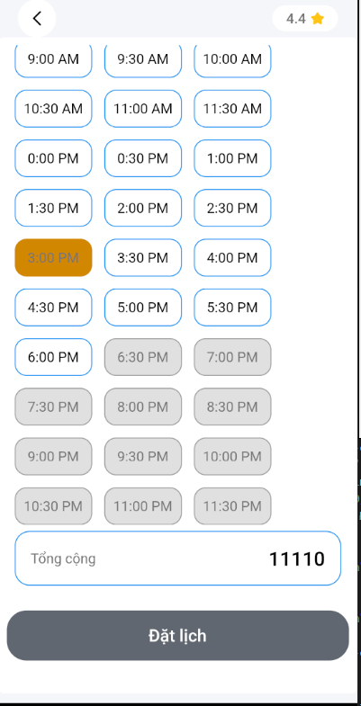
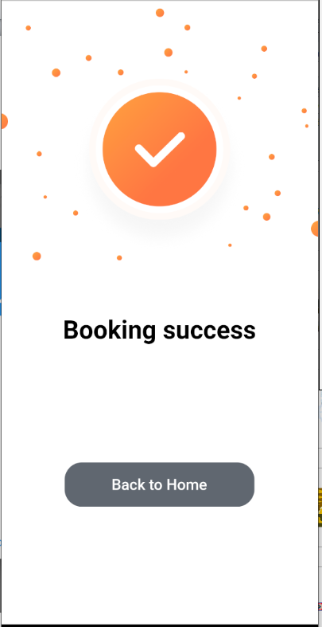
App mobile

Slide 11
Web
Angular
MVC
1.Model
2.Service
3.Screan
Component : signin, view schedule,
cancelbooking, manage profile,
manage service

Slide 12
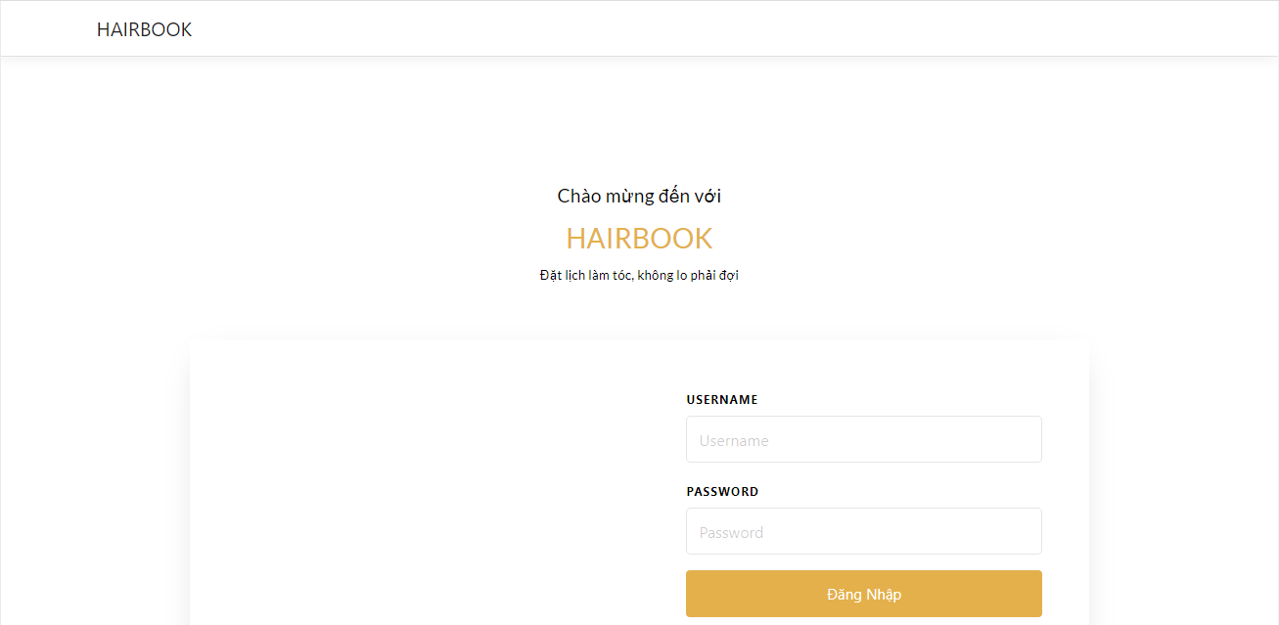
Web

Slide 13
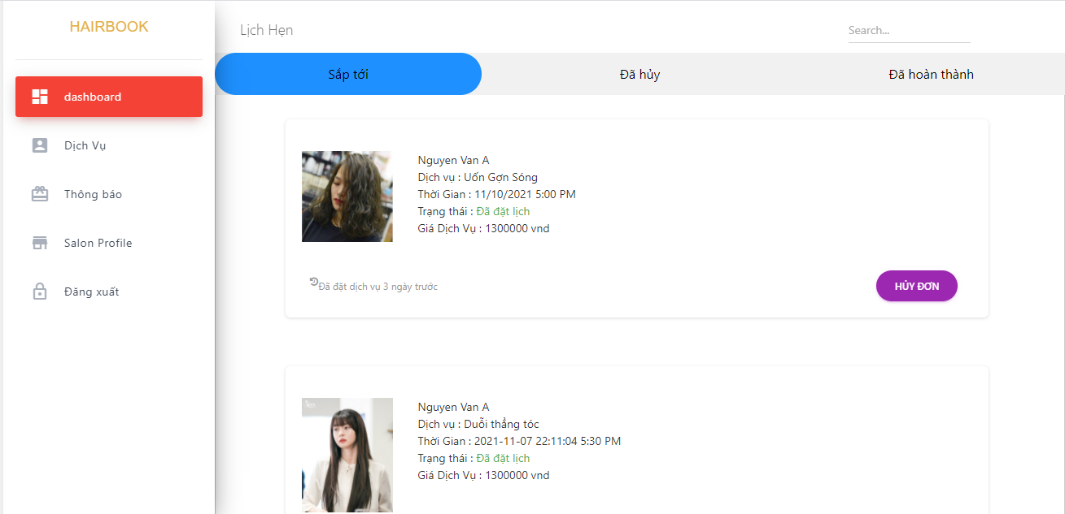
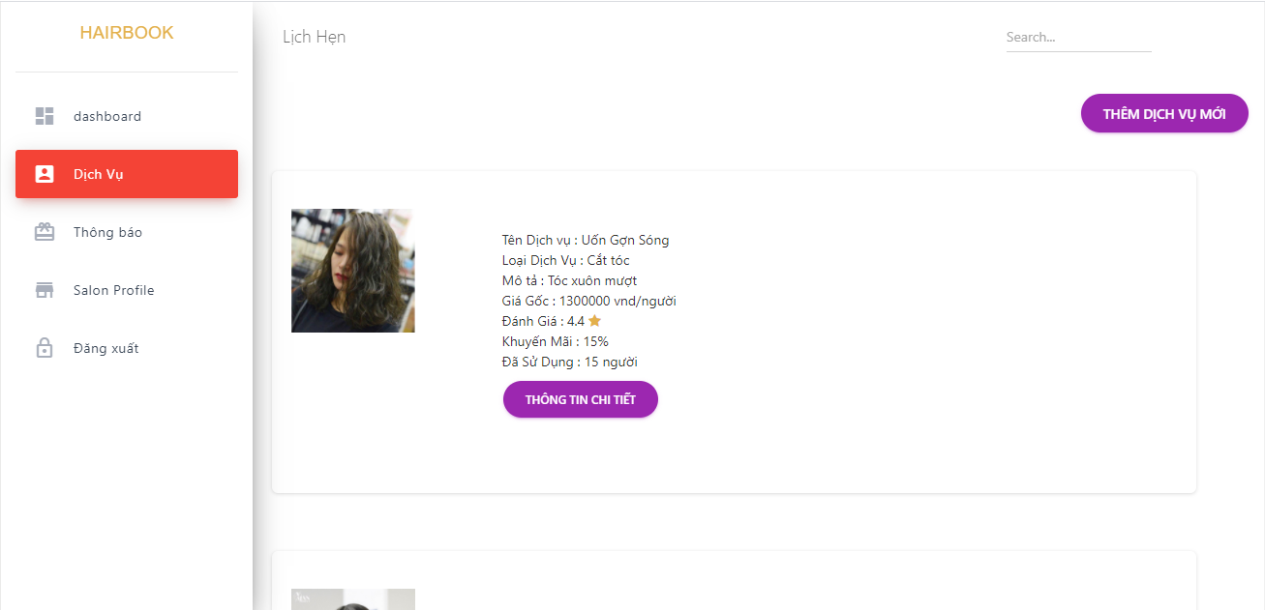
Web

Slide 14
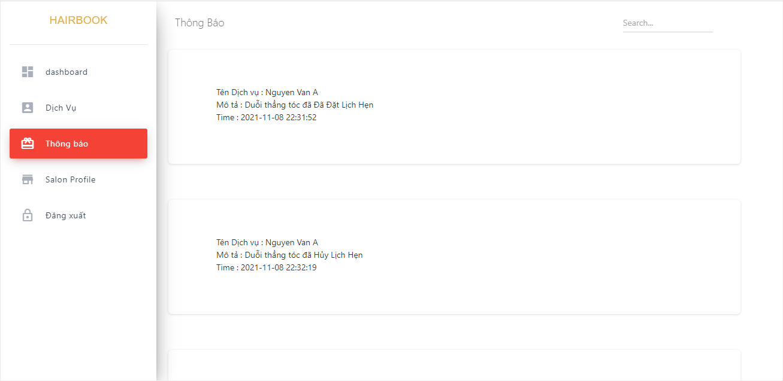
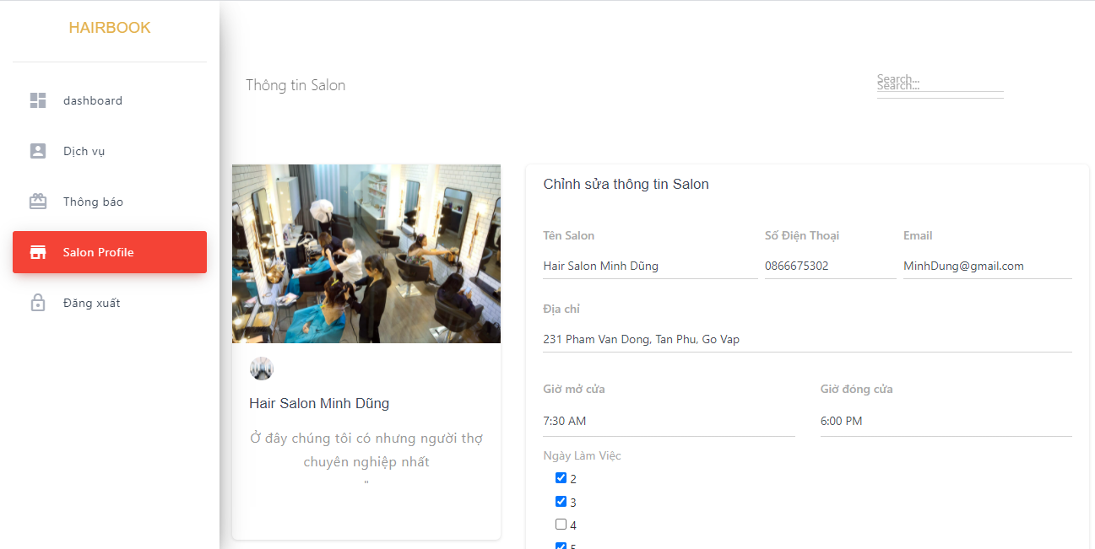
Web

Slide 15
Cloud service
AWS
Sever : EC2
DB : mySQL

Slide 16
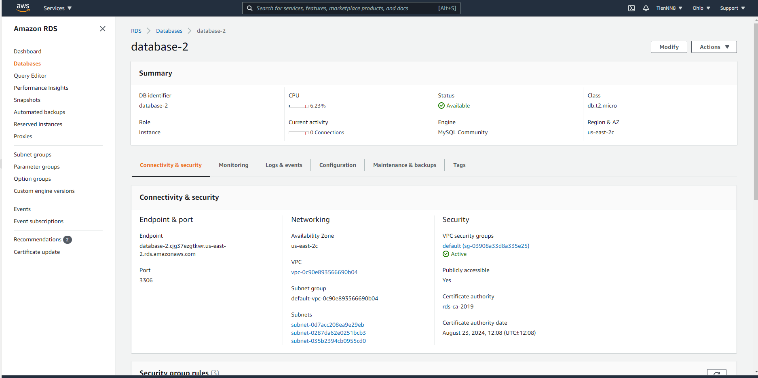
Cloud service

Slide 17

Cloud service

Slide 18
Thanks for listening

