Slide 1
Demo Assignment 1 PRICING
Pham Thuy Tien Le

Slide 2
Demo Assignment 1 - Pricing
+ Using Python
+ Create the function calculatePrice1 first, then calculatePrice3 and calculatePrice4
+ Function calculatePrice2 uses calculatePrice3 and calculatePrice4 as inner functions
Pham Thuy Tien Le

Slide 3
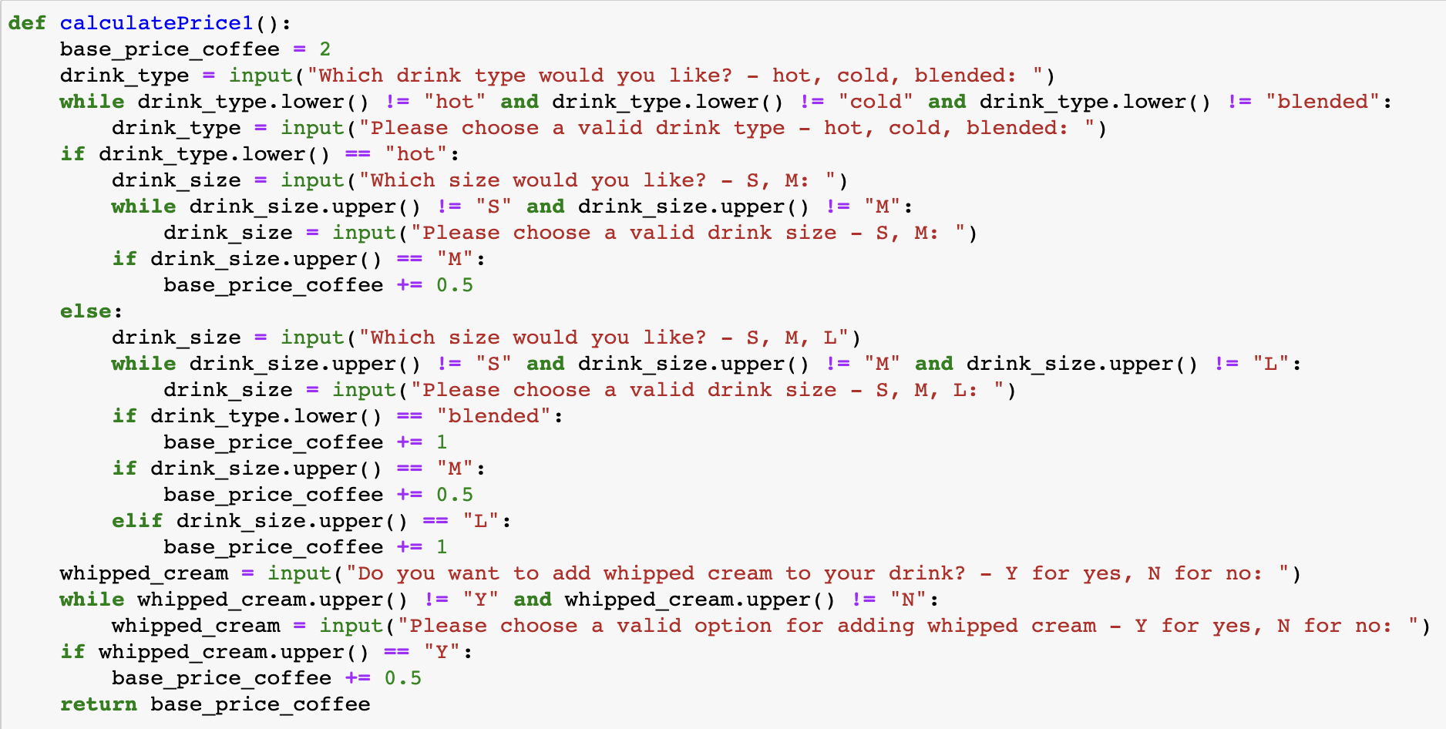
Demo Assignment 1 – Pricing - calculatePrice1
Set the base price of drink to 2
Pham Thuy Tien Le

Slide 4
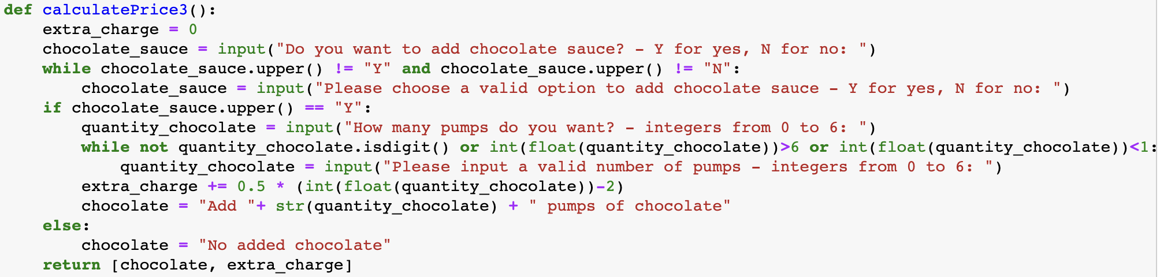
Demo Assignment 1 – Pricing – calculatePrice3
Pham Thuy Tien Le

Slide 5
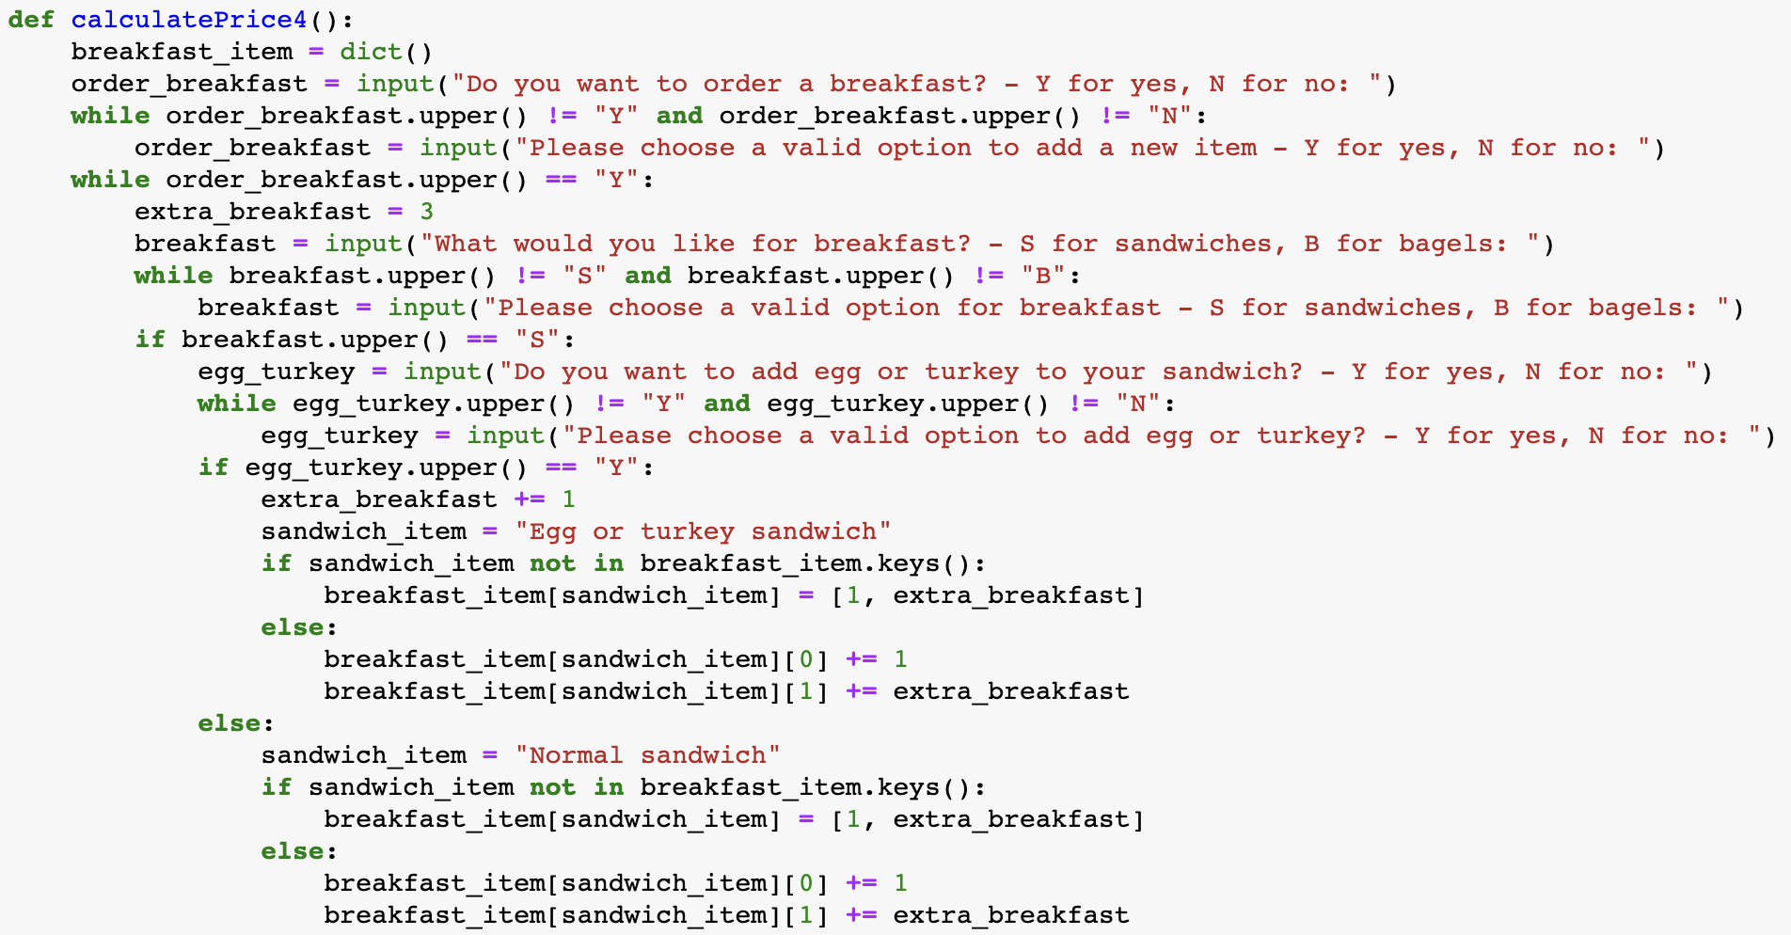
Demo Assignment 1 – Pricing – calculatePrice4
Set the base price of breakfast item to 2
Pham Thuy Tien Le

Slide 6
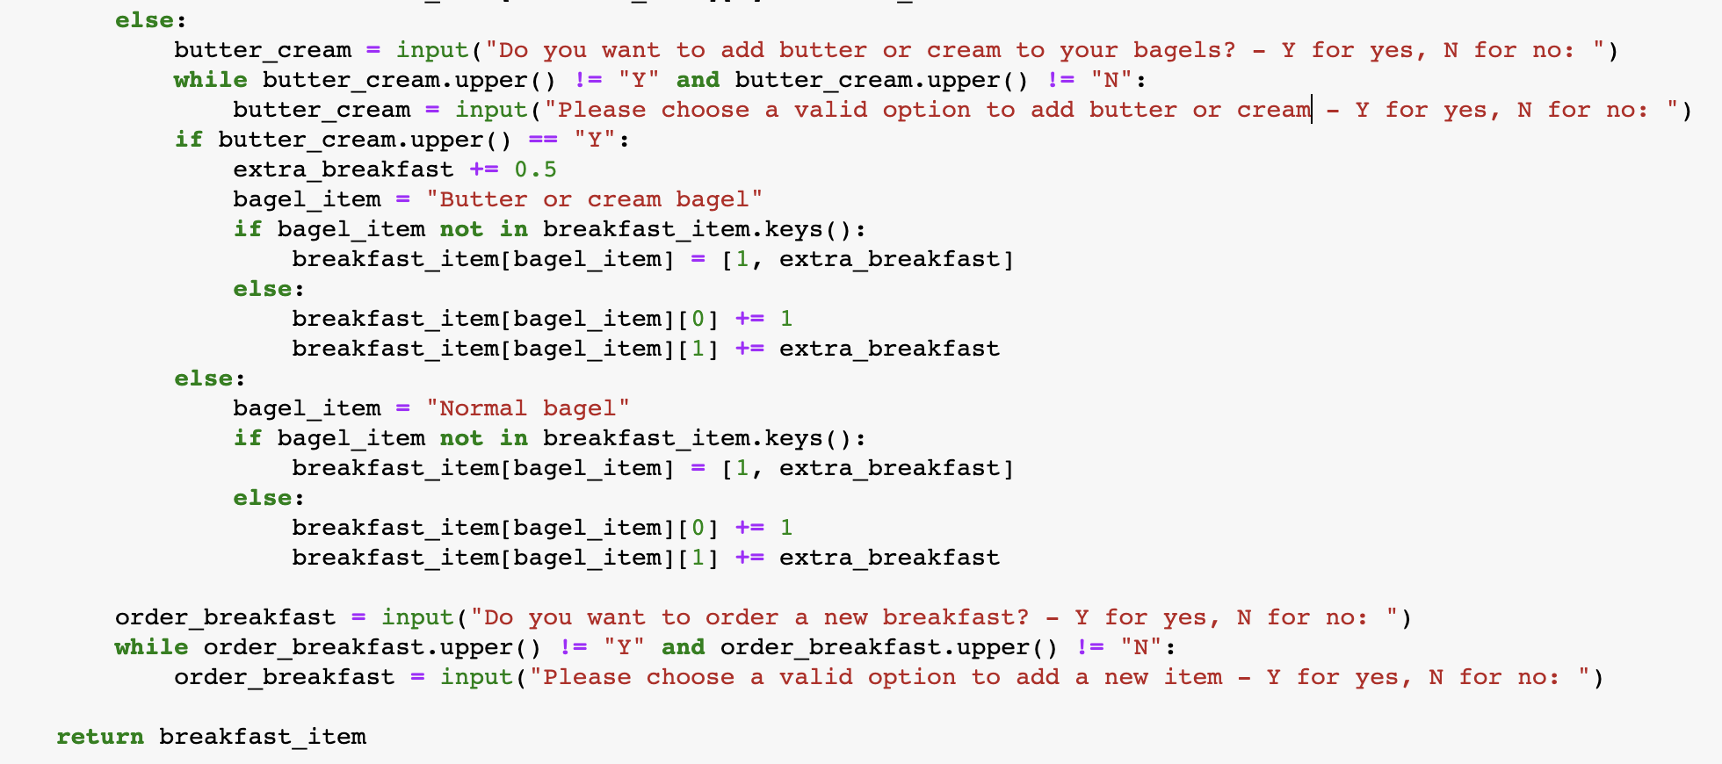
Demo Assignment 1 – Pricing – calculatePrice4 (cont)
Pham Thuy Tien Le

Slide 7
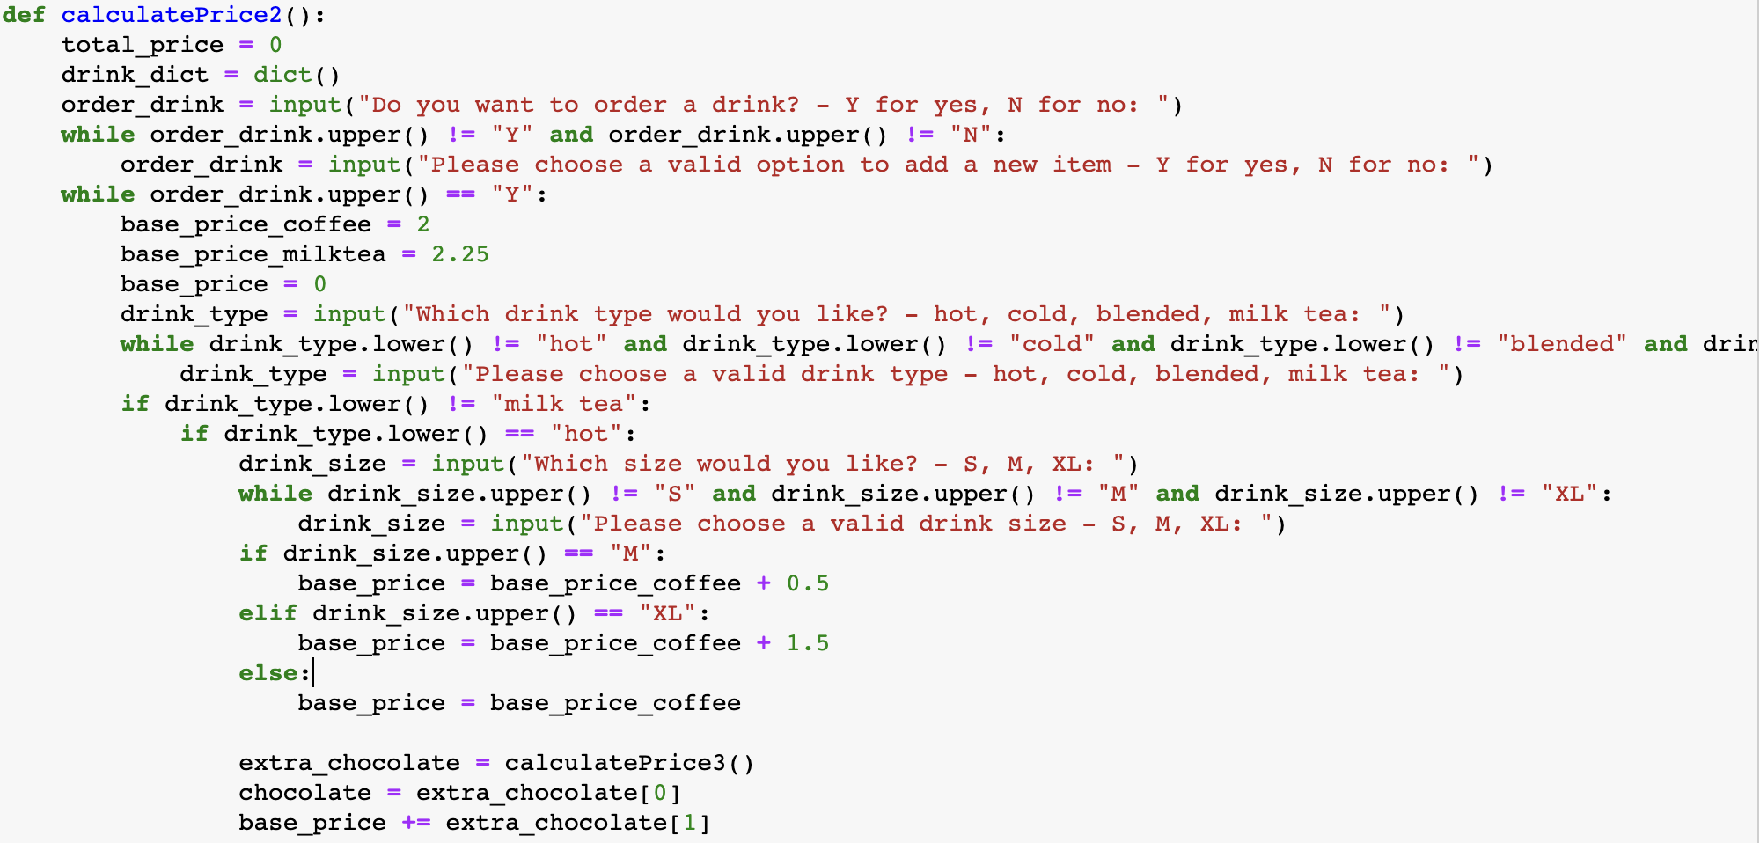
Demo Assignment 1 – Pricing – calculatePrice2
Set the base price of milk tea to 2.25
Pham Thuy Tien Le

Slide 8
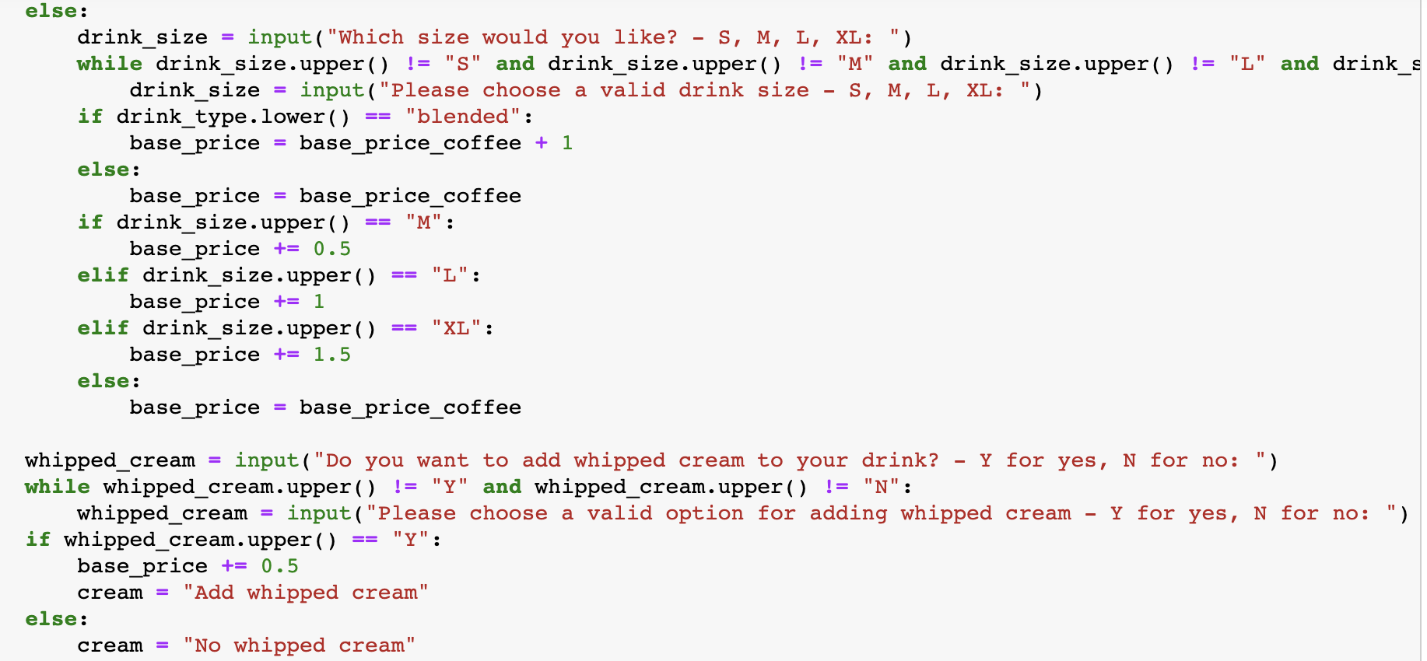
Demo Assignment 1 – Pricing – calculatePrice2(cont)
Pham Thuy Tien Le

Slide 9
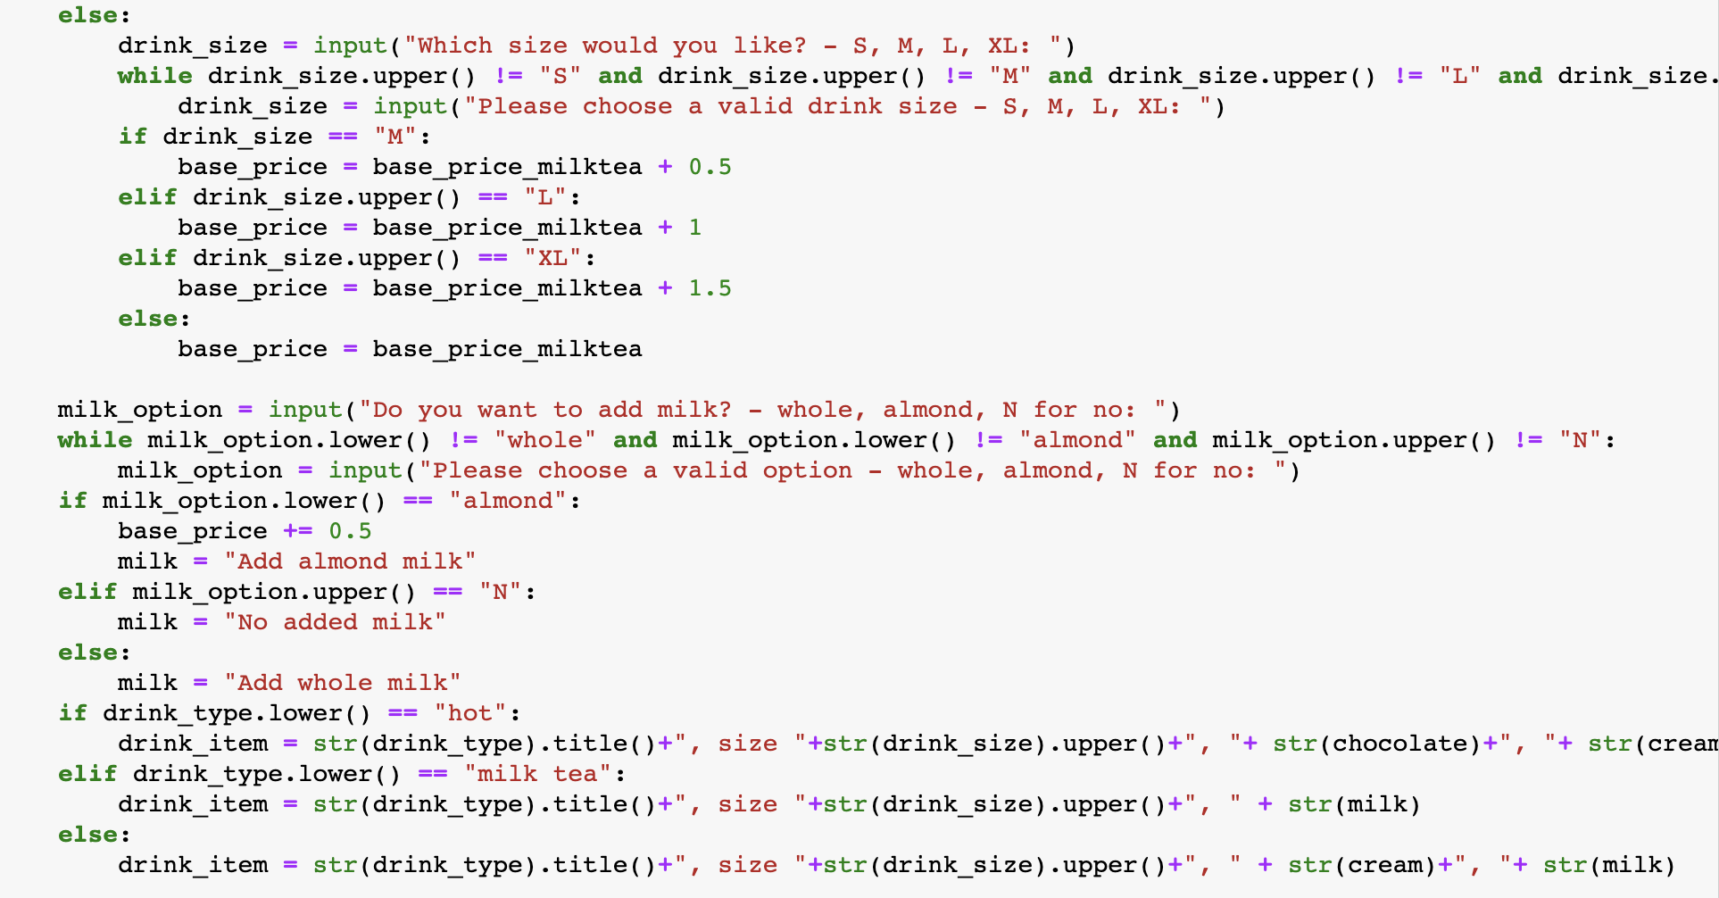
Demo Assignment 1 – Pricing – calculatePrice2 (cont)
Pham Thuy Tien Le

Slide 10
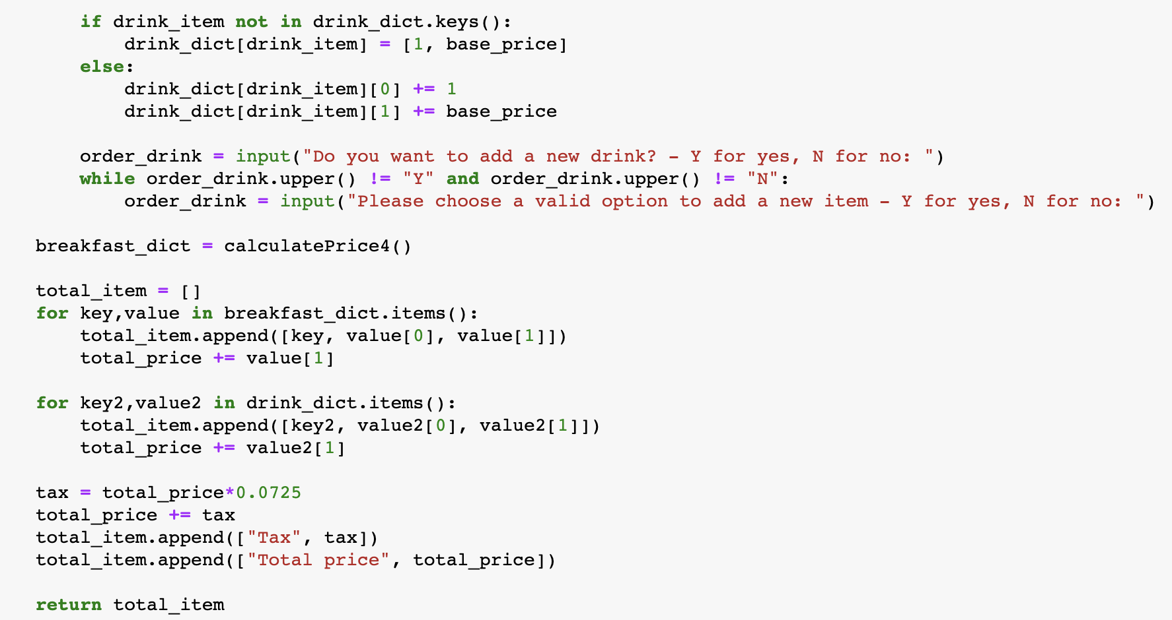
Demo Assignment 1 – Pricing – calculatePrice2 (cont)
Pham Thuy Tien Le

Slide 11
Thank you for listening!
Pham Thuy Tien Le

